Slide 1
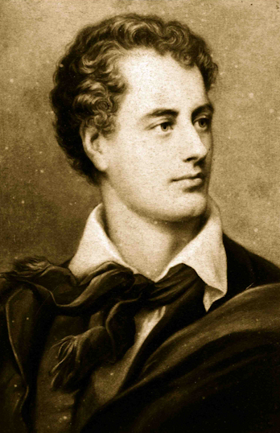
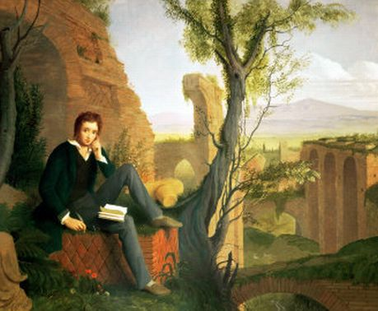
Percy Shelley
Presented by
Allison
Eric
Grace
Victor
&
Kristen
&
Lord Byron

Slide 2
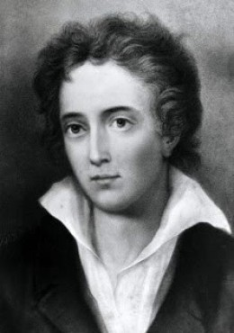
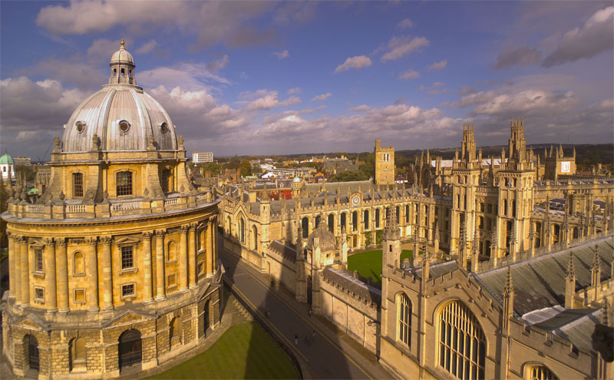
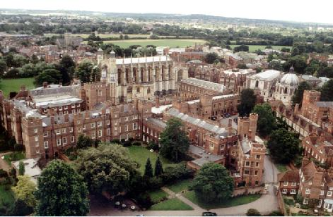
Birth to College
Shelley was born in 1792
Growing up he was bullied mercilessly
He dedicated his life to a war against injustice and oppression
He was sent to Eton and Oxford
In 1810 he co-wrote with Thomas Jefferson Hogg “The Necessity of Atheism”

Slide 3
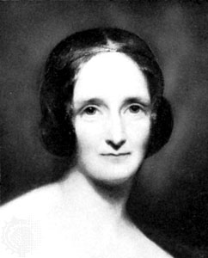

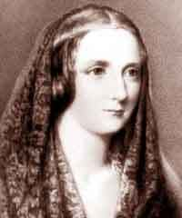
Harriet & Mary
Shelley went to London and met Harriet Westbrook, eloping when he was 18 and she was 16
1812 Shelley, Harriet, and Harriet’s sister Eliza traveled to Dublin
In 1813 he printed “Queen Mab”
Spring of 1814 Shelley fell in love with Mary Wellstonecroft Godwin
A depressed Harriet drowned herself and unborn baby in 1816

Slide 4
Italy
The Shelleys moved to Italy in the spring of 1818
The Shelleys’ two young children, Clara and William, died within 9 months of each other in 1818 and 1819
Near despair and almost completely lacking an audience Shelley wrote his greatest works

Slide 5
Last Years
Shelley tastes change
Shelley moved to Pisa in 1820, where he came the closest to finding contentment
A group gathered in Pisa, including Lord Byron, and Edward and Jane Williams
On July 8, 1822 Shelley and Edward Williams were drowned while sailing

Slide 6
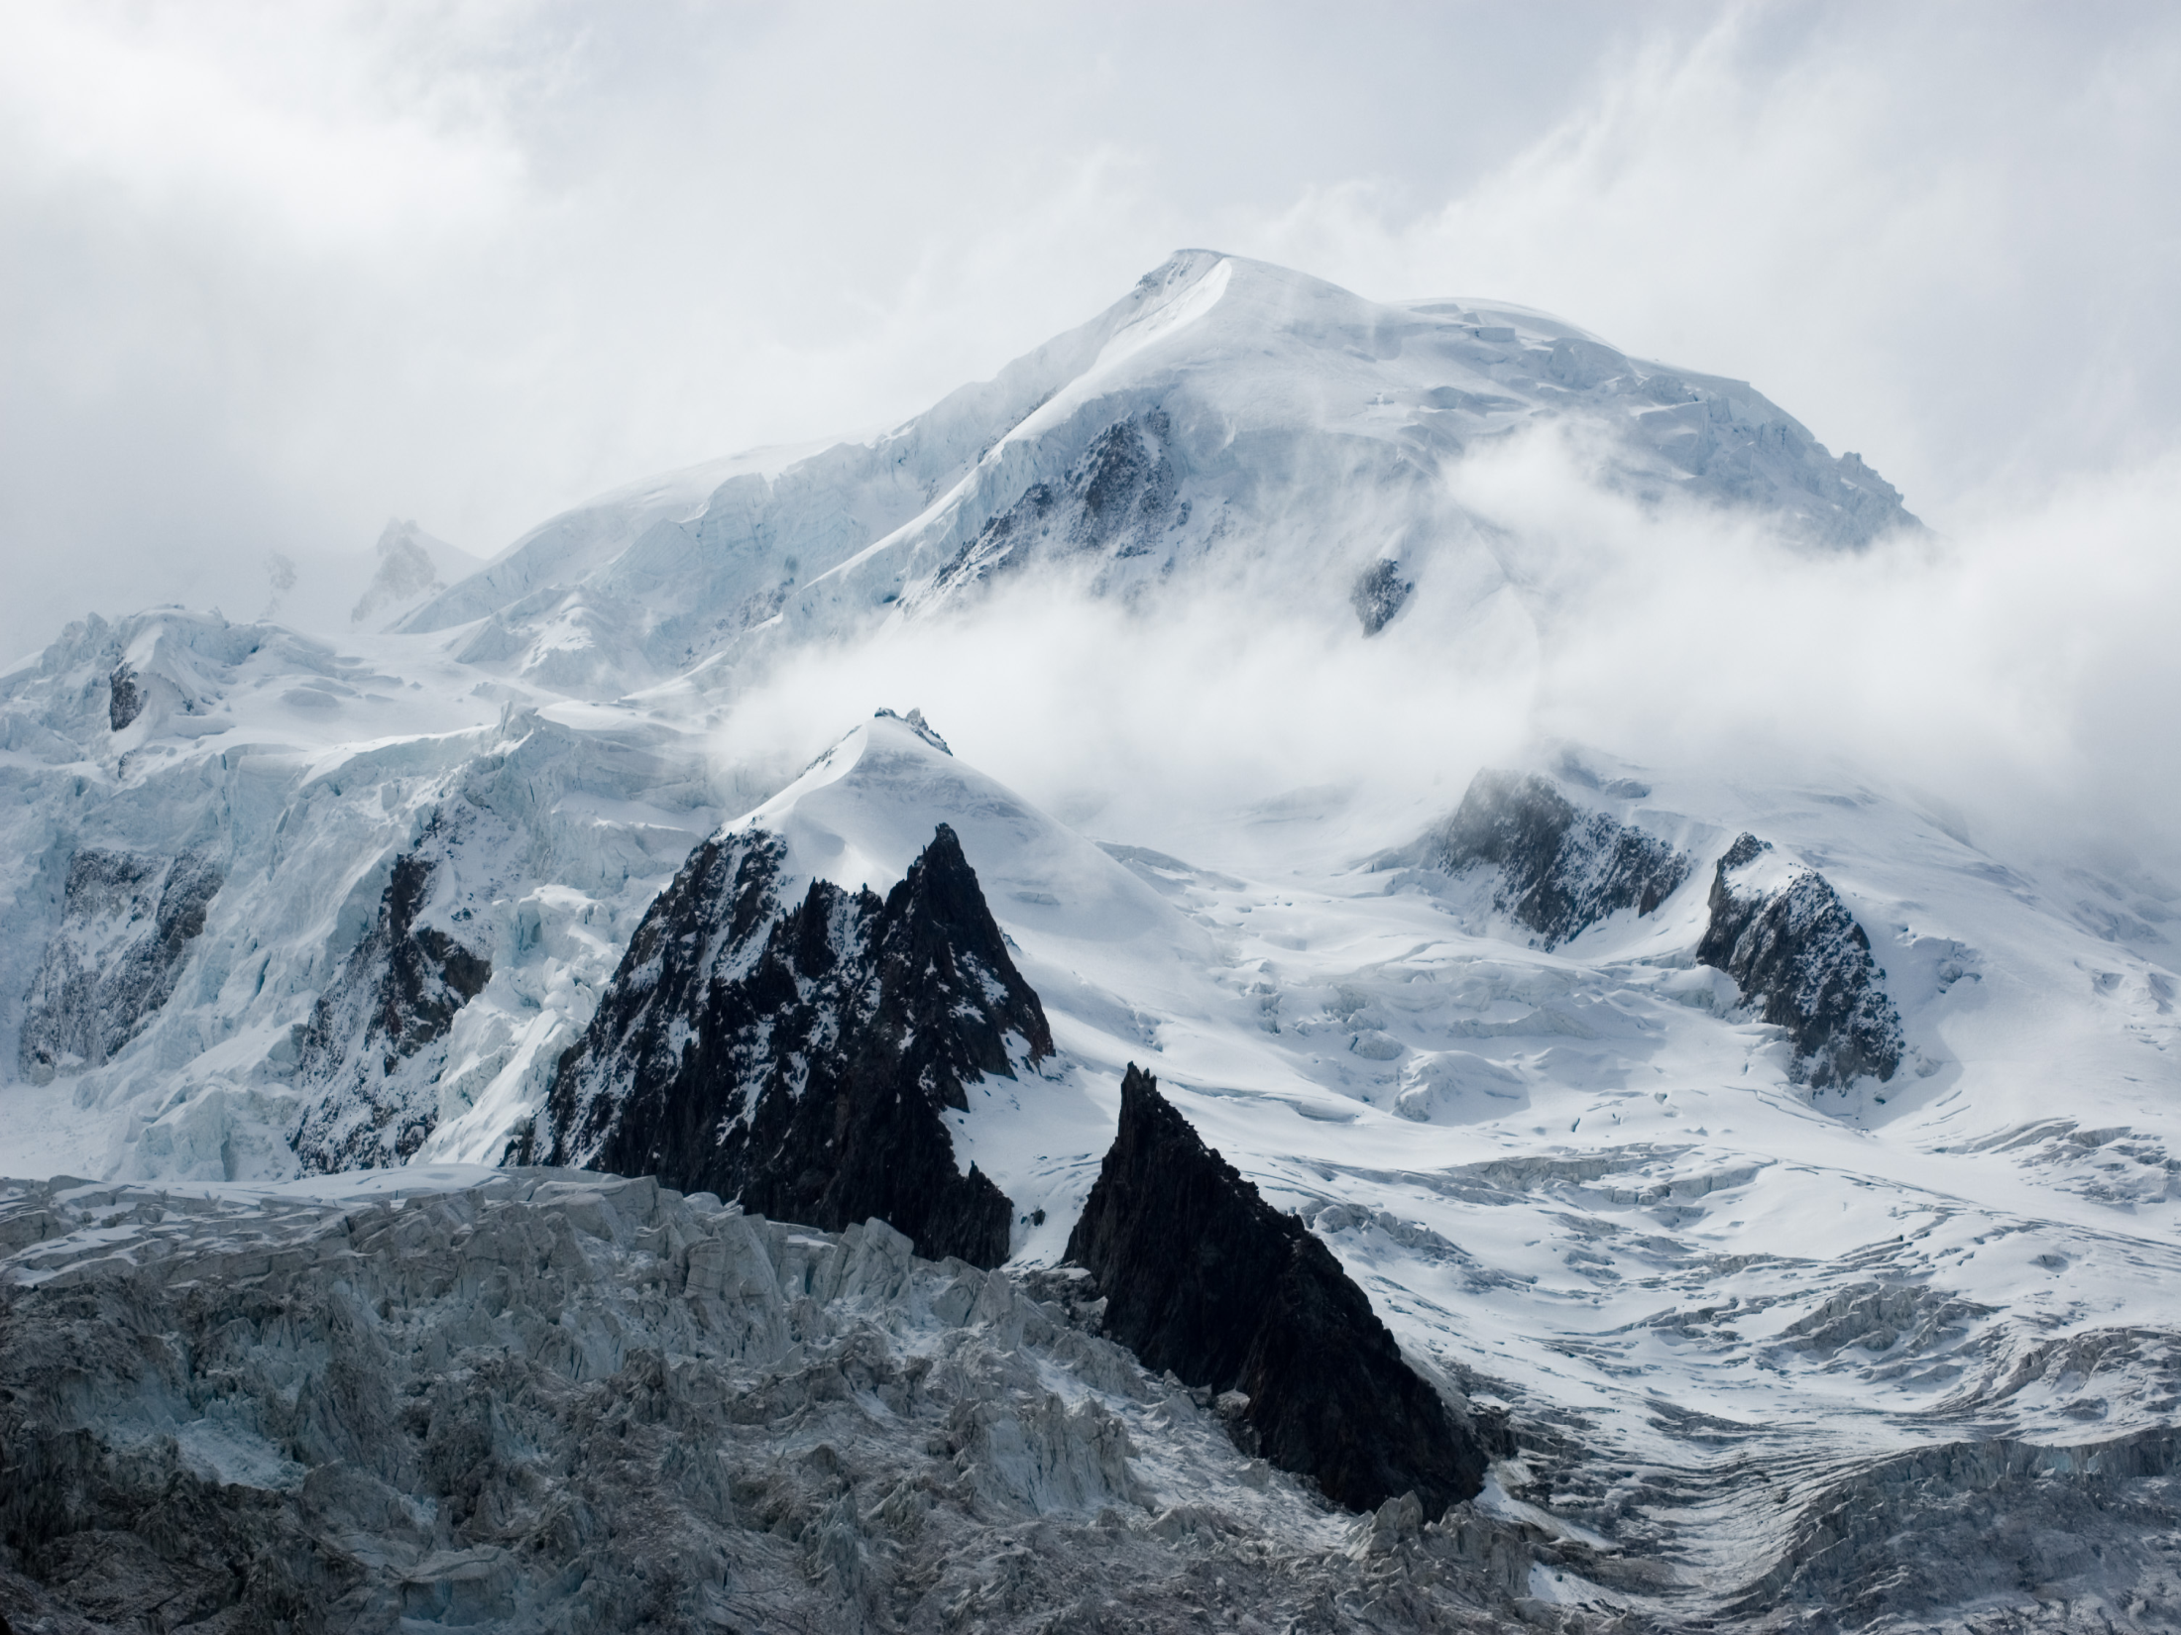
“Mont Blanc”
Composed between July 22 and August 29 in 1816
First published in 1817
Visiting Chamonix Valley near Geneva with Mary Godwin and Claire Clairmont.
"composed under the immediate impression of the deep and powerful feelings excited by the objects which it attempts to describe; and, as an undisciplined overflowing of the soul, rests its claim to approbation on an attempt to imitate the untamable wilderness and inaccessible solemnity from which those feeling sprang"

Slide 7
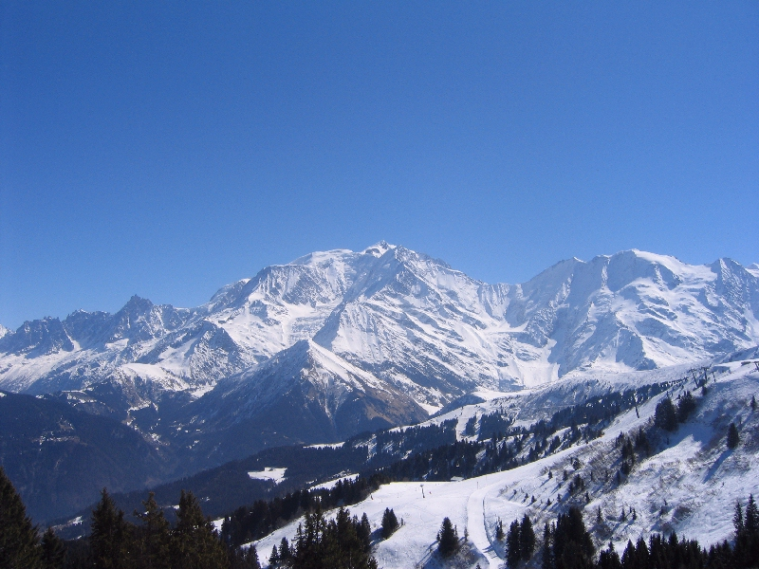
“Mont Blanc”
Stanza 1
Establishing the vastness of the universe by acknowledging the size of the mountain
River is a metaphor representing the human mind’s ability to understand anything over time

Slide 8
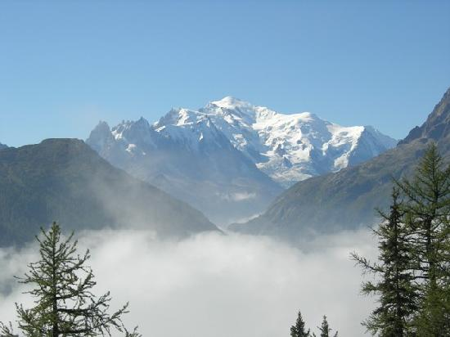
“Mont Blanc”
Stanza 3
Further description of Mont Blanc -- words like ice, rock, frozen floods, unfathomable deeps
Strong sense of isolation – eternity is cold and distant
Stanza 4
Intricate creation
Man is only a small part
The river has the power to destroy everything, including man’s creations
This river can thus represent both life and death

Slide 9
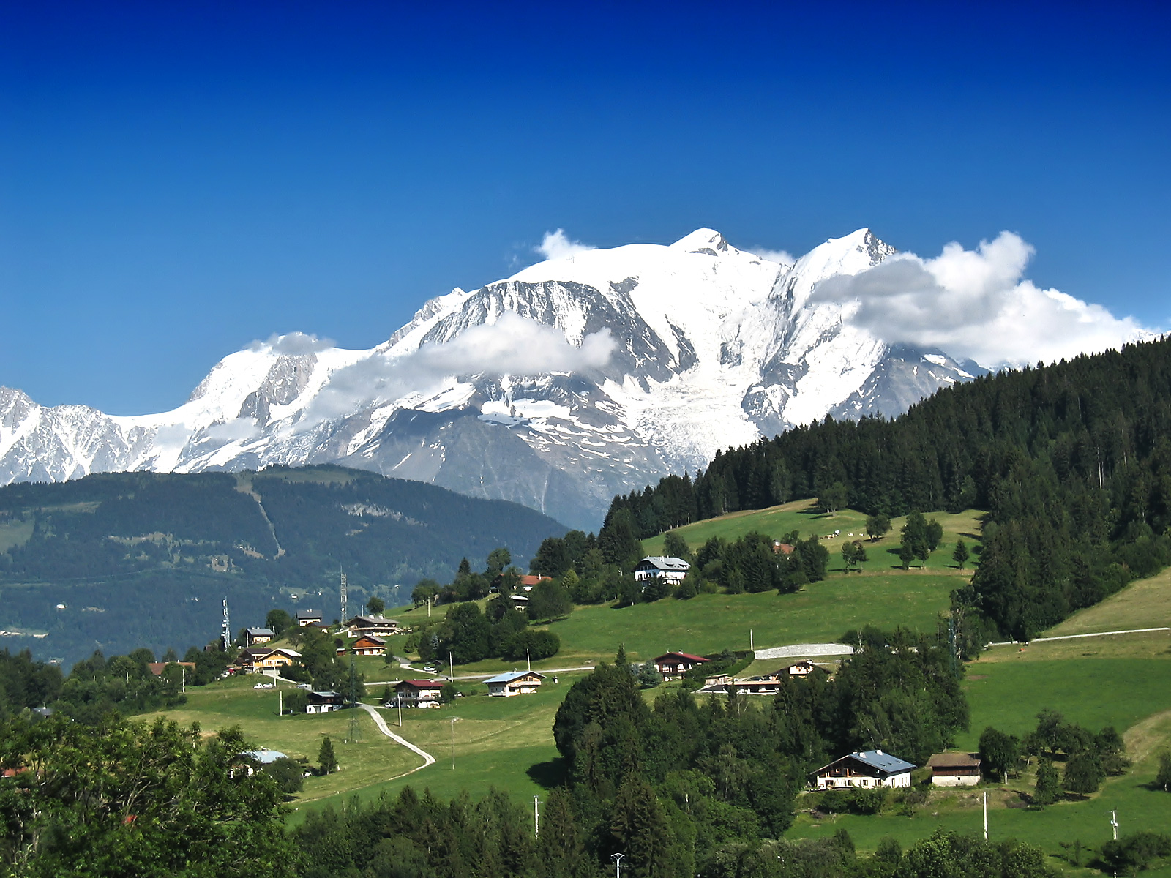
“Mont Blanc”
Stanza 5
The mountain is big and, like nature itself, cannot be fathomed all at once
However, nature is irrelevant without the human mind to perceive it

Slide 10
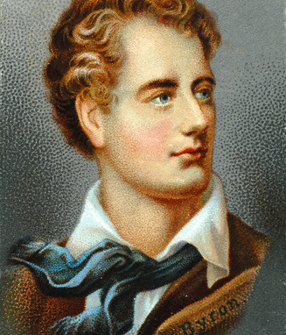
George Gordon, Lord Byron
(1788-1824)
“The greatest and most English artist; he is so great and so English that from him alone
we shall learn more truths of his country and of his age than from all the rest together.”
-Born in Dover, England on 22 January 1788
-Descended from colorful, violent aristocratic families; great-uncle was the fifth Baron Byron, a.k.a. the “Wicked Lord”
-His father, Captain John “Mad Jack” Byron died deep in debt when little Byron was 3 y/o.
--Raised by his mother, Catherine Gordon, heiress of Gight in Scotland; she was ill-educated but loved her son, unconditionally.
-At age 10, with the death of his great uncle, he inherited the title of the sixth Lord Byron.

Slide 11
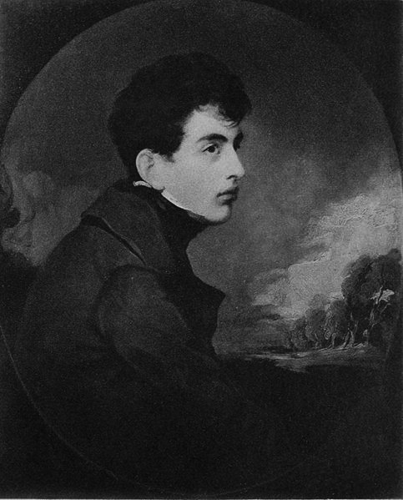
LORD BYRON THE SIXTH
-To suit his new status, was sent to Trinity College, Cambridge
-Had a deformed foot which he was rather embarrassed about; made him avid for athletic prowess—
-Played cricket and trained himself to be an expert boxer, fencer, swimmer and horseman.
-Tried his hand at lyric verse, some published in 1807 in Hours of Idleness; so harshly critiqued that Byron wrote in reply in his first important poem, English Bards and Scotch Reviewers, a vigorous satire ridiculing contemporaries, Wordsworth & Coleridge.

Slide 12
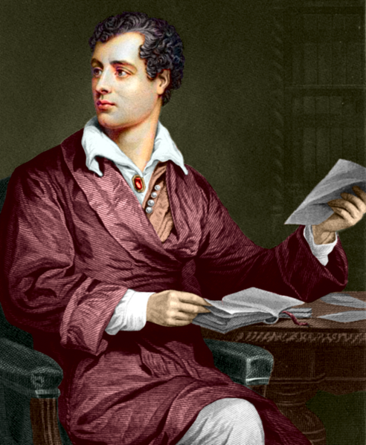
* LORD BYRON *
-After attaining an M.A., went on a tour through Portugal and Spain, to Greece—in the classic locale for Greek love, he encountered a culture that accepted sexual relationships b/t older aristocratic men and beautiful boys…
-Incorporated materials for many of his important poems, including Don Juan
-First literary product was Childe Harold; published first two cantos in 1812 and soon after returning to England, “awoke one morning and found himself famous.”

Slide 13
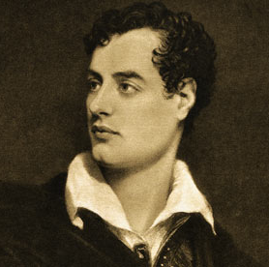
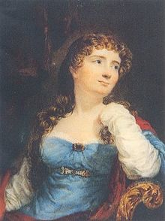
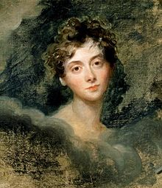
Coleridge wrote of Byron’s beauty: “So beautiful a countenance…his eyes the open portals of the sun—things of light, and for light.”
Augusta Ada .
FML.
Byron’s “Bizarre Love Triangle”
Annabella Milbanke
-unworldly; intellectual
Lady Caroline Lamb
-flamboyant; eccentric

Slide 14
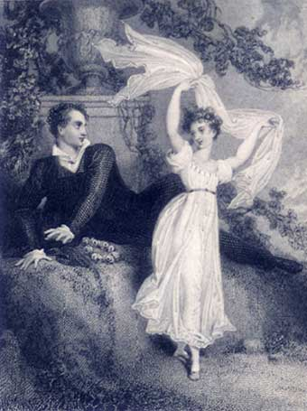
Byron & half-sister, Augusta Leigh
FML.

Slide 15
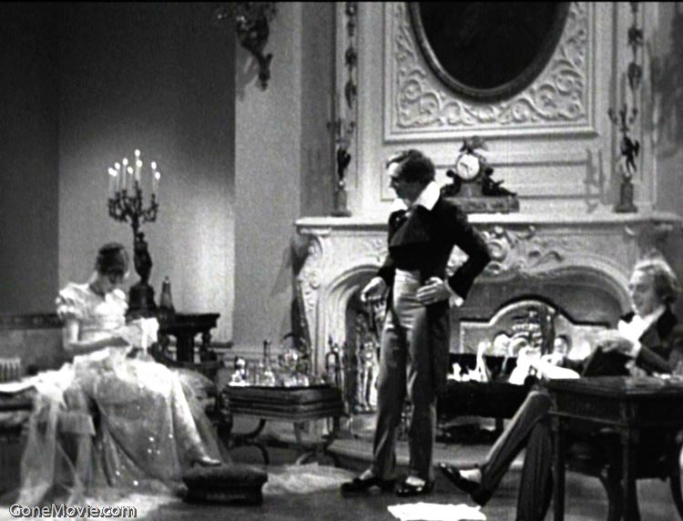
-Affair with half-sister and rumors of earlier homosexual liaisons led to Byron being ostracized by his friends and he left England forever in April 1816.
-In Geneva he lived with Percy & Mary Shelly, along with Mary’s stepsister, Claire Clairmont.
-In 1817 Byron est. in Venice, and began a debauchery of liaisons with 200+ women; it was also a period of great literary creativity.
-finished tragedy Manfred
-wrote 4th canto of Childe Harold
-began composition of DON JUAN: objected by almost all his friends, save the idealist Shelly, who deemed it better than anything he could ever write, himself—“that every word of it is pregnant with immortality.”

Slide 16
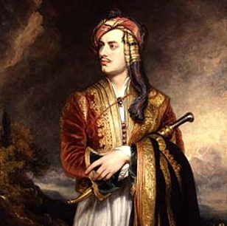
-Left the literary realm for good to help fight in the Greek war for independence from the Ottoman Empire
-Lived a Spartan existence; worn out, incubated many and died just after his 36th birthday.
-To this very day Byron is revered by the Greeks as a national hero.

Slide 17
BBC Documentary
“The Romantics”
Eternity (2005)
http://www.youtube.com/watch?v=V3lBUvbLYMU

Slide 18
“She Walks in Beauty”
Is composed of three stanzas with each stanza having six lines
About a beautiful cousin by marriage named Anne Wilmot
Her looks inspired him to write this poem
Poem shows feeling and intuition of speaker
Light and dark imagery
Comments on her purity and innocence

Slide 19
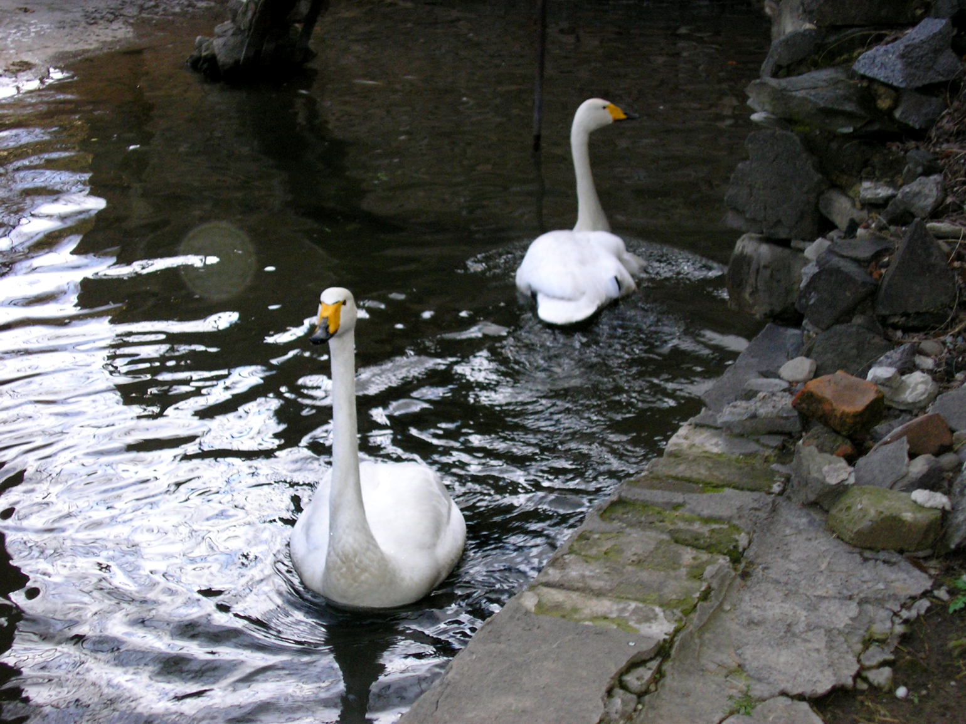

“When We Two Parted”
First person
About love which turns to hate (way more hate than love)
Will make you sad
Expresses feelings of love (Romanticism)
Cold element during beginning of poem

Slide 20
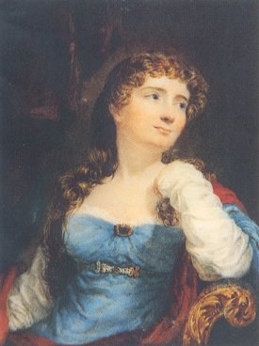
Byron’s “Don Juan”
Byron narrates the peom
Unlike other epics, which he mocks, it start at the beginning instead of ‘in medias reis’.
He starts off with parents
Donna Inez- is a reflection on his own wife and their relationship.

Slide 21

“Don Juan”
Don Jose- passionate father.
  “The apple does not fall far from the tree”
Don Juan- young well educated in every thing except the ‘facts of life’.
Donna Inez- young wife of Don Alfonso loveless marriage based on society.
Don Alfonso- 50 year old husband who has little to no persona.

Slide 22
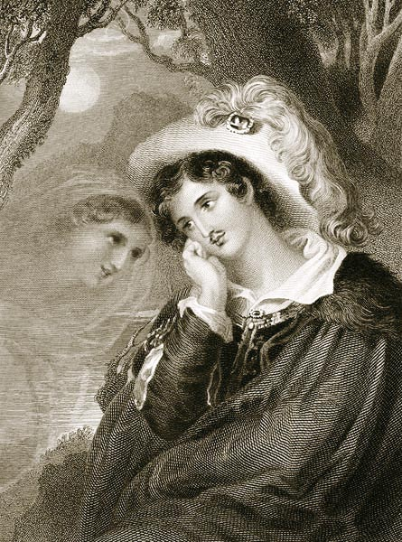
“Don Juan”
Don Juan does not realize what is going on because of his lack of sexual education.
Donna Julia realizes but denies her longings (for a while).
Nineteenth-century engraving illustrating Byron’s Don Juan, Canto I, Stanza 92.

Slide 23
“Don Juan”
Insinuation that Don Alfonzo and Donna Inez had an affair when they where younger and the affair of Donna Julia and Don Juan.
Young people marry based on society and not on feelings because that is what they have been taught .
Don Juan is a fictional character that has gained international fame . He is a symbol of libertinism.

