Slide 1

Compare/Contrast Essay
We Compare and Contrast in our everyday lives all the time.

Slide 2
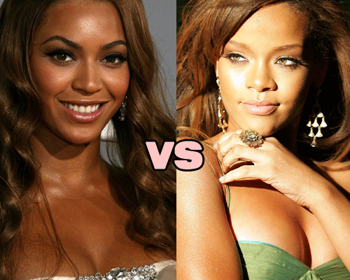
Everyday Choices
280 or 101?
Sweet or Salty?
Walmart or Target?
McDonald’s or Burger King?
Beyonce or Rihanna?
Morning person or Night person?
Mac or PC

Slide 3

Amercian Space, Chinese Place (459)

Slide 4

Compare
Shows similarities
Choose Subjects that are very different, so there are insightful points of similarity that are not obvious.
Ex. Coke vs. Donald Trump
Ex. Not Coke vs. Pepsi

Slide 5
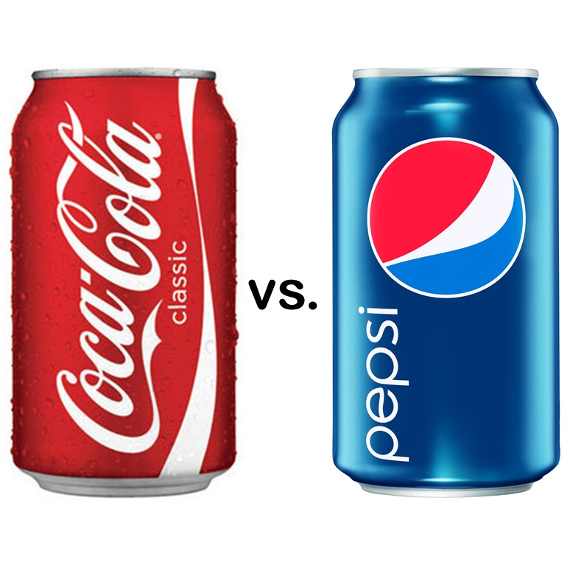
Contrast
Shows differences
Choose Subjects that are closely related, so the differences are not obvious.
  Ex. Coke vs. Pepsi
  Ex. Not Coke vs. Donald Trump

Slide 6
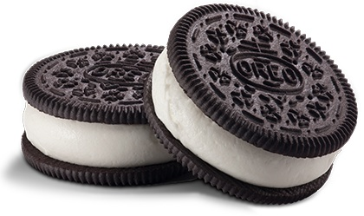

Your Turn!
Contrast Differences of 2 cookies
Compare Similarities of a cookie and a pencil

Slide 7
Limited Topics and Purpose
1. Choose a topic in your group that you have some personal experience or knowledge about.
2. Limit the topic
3. Decide if you will compare (show similarities) or contrast (show differences)
4. State what your purpose is : Inform or Persuade. Why is it important for the reader to read?
2 Celebrities, 2 Athletes, 2 Foods, 2 Dating Sites, 2 Games, 2 Cars, 2 De Anza Courses, 2 Teachers

Slide 8
Thesis
Every thesis should have your
1. Limited Topic
2. Purpose (inform or persuade)
3. Parts (how you will compare/contrast)

Slide 9

Example Thesis
Cats are better than dogs because of their cost, convenience, and cuddliness.
Your turn: Make a thesis from your topics in last activity.

Slide 10
Organize
Subject by Subject (block Method)
  This breaks the paper in two supporting body paragraphs
  Example: Paragraph 1. Cats : Cost, Convenience, Cuddle
  Paragraph 2. Dogs: Cost, Convenience, Cuddle
  Point by Point
  This breaks the paper by number of paragraphs for each point.
  Example: Paragraph 1. Cost: Cats. Vs. dogs
  Paragraph 2. Convenience: Cats. Vs. dogs
  Paragraph 3. Cuddliness: cats. Vs. dogs

Slide 11
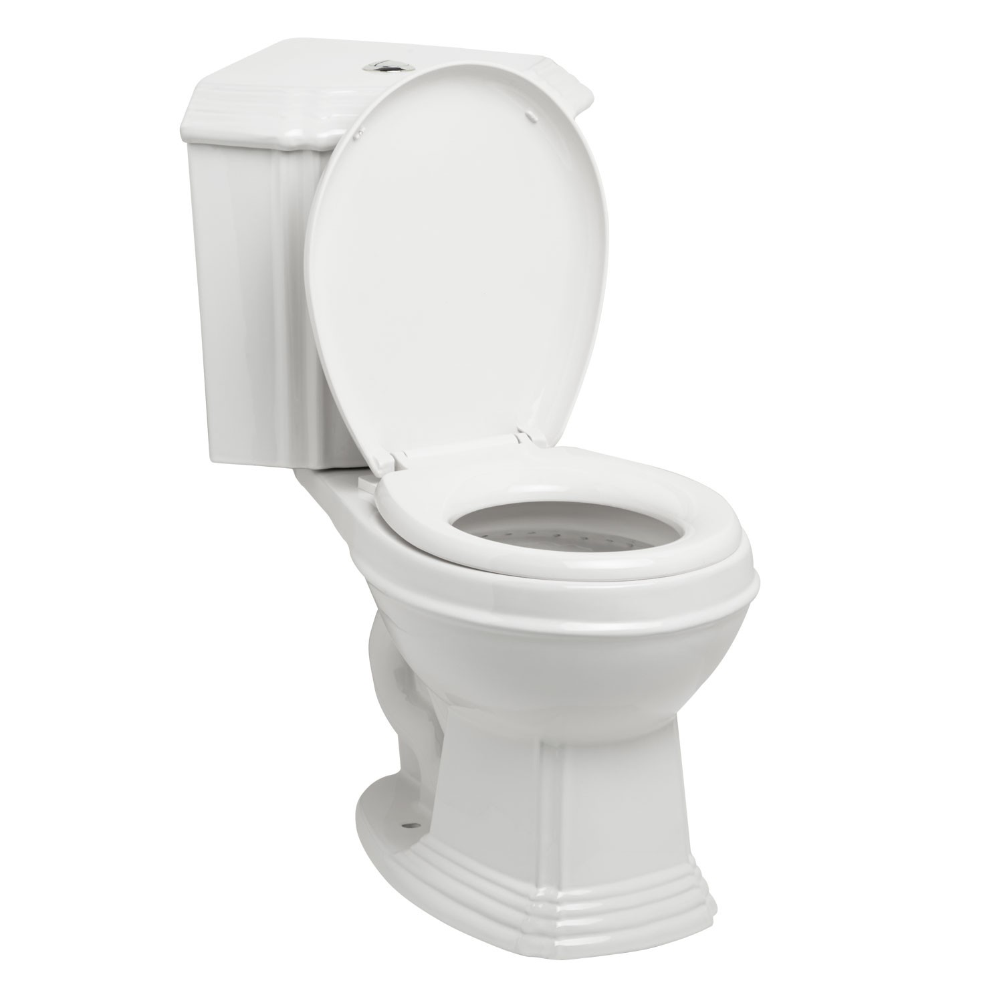
Sample Essay
Critically read “It’s Potty Time!”
1. Is this essay a compare or contrast essay?
2. Is the purpose to inform or persuade?
3. Locate the thesis and decide if it has all the elements (limited topic, purpose, parts)
4. Is it point by point or subject by subject?

