Slide 1
DESCRIPTION
Each week, we will learn one kind of essay otherwise known as “Rhetorical Strategy”

Slide 2
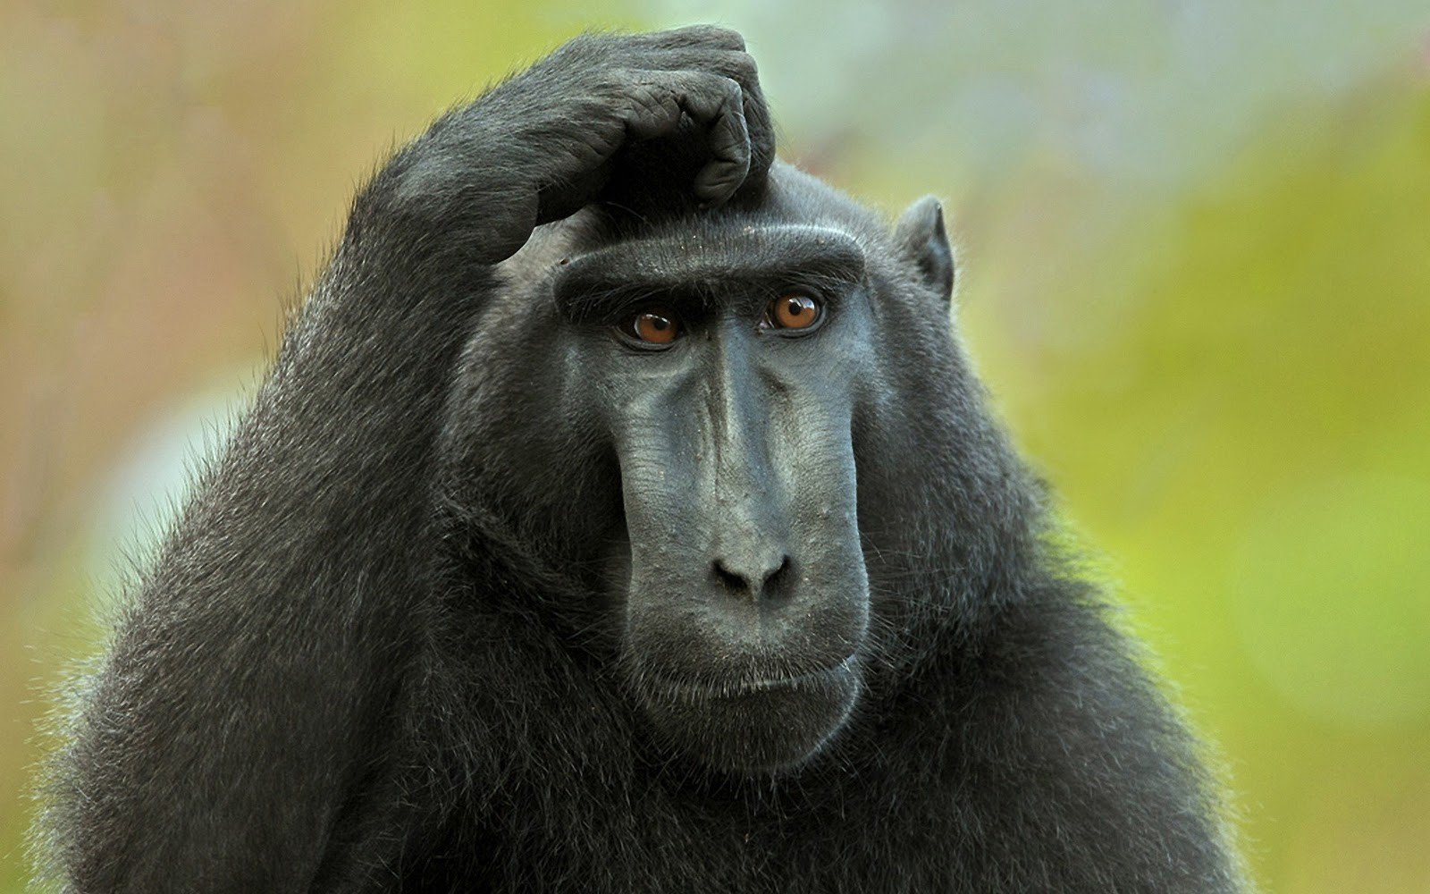
Why Important?
Think of practical applications for describing a person, place, or thing.
When would we need it for work, at home, in the car, at school, with friends or family?

Slide 3
“Unforgettable Miss Bessie” by Carl T. Rowan
Some of the best descriptive essays create a clear picture in the readers mind.
In groups, draw a picture of Miss Bessie. What does she look like? What is she wearing? What is she doing?

Slide 4
Language of Description
SPECIFIC is TERRIFIC!!!!
1. Avoid using Vague Words:
example: Thing, Stuff
2. Use Specific verses General:
Dog = Chihahua
House= Shack
Walk = Stroll
Talk = Whisper

Slide 5
Denotation vs. Connotation
Denotation is the dictionary definition of the word. It is an objective, neutral meaning.
example: House
Connotation is a subjective definition of the word. It has feelings, emotions and judgments atttached
Examle: Home

Slide 6
Let’s Play!
Neutral Positive Negative
Thin
Big
Smell
Old
Toilet
Died

Slide 7
Practice
Turn to page 265 in the Sundance Writer and compare the 2 paragraphs in the “Writing Activity”

Slide 8
Use All Your Senses
We often only describe with Sight, but in order to make the reader feel like he/she is really experiencing the description, also use sound, taste, touch, and smell.

Slide 9
Let’s Practice
Virtual Vacation
Close your eyes.
I’ll describe a place using only smell, sound, taste, and touch (no sight), and you tell me where we are.
Your turn:
Describe a place and don’t use any sight. We will try to guess.

Slide 10
Be a Great Observer
A great writer notices things that no one else does.
Practice! Go outside and describe a tree. Feel it, smell it, notice the details.

Slide 11
Describe with Action and Dialogue Show! Don’t Tell!
One of the biggest mistakes in description is to just tell what a person, place, or thing is like with just adjectives.
A better way to describe to make the reader experience the person, place, or thing is to show through speaking and moving.
Practice: We are going to describe our friend Bob. Each group will get an adjective that describes Bob, but you can not say it. You must show through what he does and says.

