Slide 1
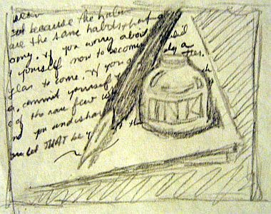
Example Essay
Illustrates and demonstrates

Slide 2
What is an Example Essay?
Helps illustrate a point to prove
Ex. San Francisco is a multi-cultural city
China town, North Beach, the Mission
Ex. Tom Hanks can play many and varied roles
Forest Gump, Big, Cast Away
Ex. I have dated many losers.
Matt, Tom, and Bob

Slide 3

When will we use in Life?
In what ways might giving examples be good in our everyday experience – work, family, friends, etc?

Slide 4
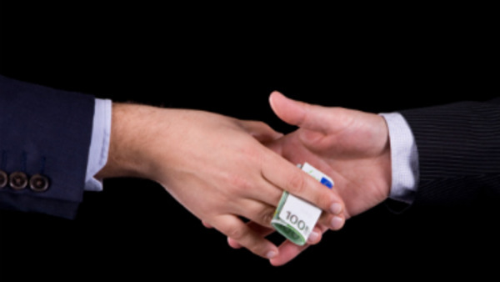
“Mexicans Deserve More than La Mordida” by Jose Rodriguez

Slide 5

Purpose: Inform
1. Inform: Examples can help clarify abstract or complex ideas
ex. Students should not use slang in their essays. Bitchin’, Dude, Gnarly, Mean Mug, Totes McGotes

Slide 6

Purpose: Persuade
2. Persuade: Convince reader to accept argument
ex. McDonald’s is and economical and healthy choice for students.
dollar menu, salads, kids meals

Slide 7

Audience
Remember to think about who your audience is when choosing examples.
Activity: Divide class into 3 groups. Each group is going to argue why one should go to Disneyland using examples. But each group will have a different audience. We’ll try to guess the audience.

Slide 8
Extended and Enumerated
1. Extended: Gives one long example (like “La Mordida”)
good: Lots of great detail and drama
bad: May not persuade the reader with just one.
2. Enumerated: Uses many examples
good: Persuades more easily.
bad: Too brief to fully explain, can sound like laundry list

Slide 9

Practice
Page 361 in the Sundance Writer, choose 1 sentence and give one long extended example to prove and 1 sentence to give many smaller examples to prove.

Slide 10
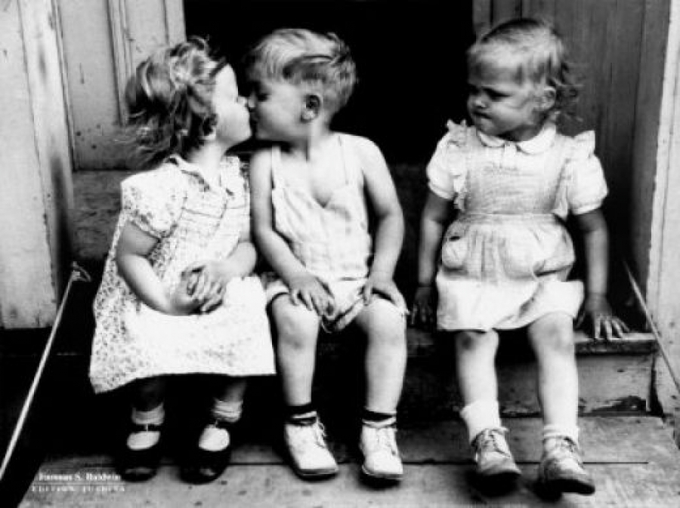
Hypothetical vs. Factual
1) Hypothetical: Fictitious, used for objectivity or future events with no real situations yet.
ex. Never date your friend’s ex.
Friend could feel betrayed
You could get jealous if they are together
Awkward comparisons

Slide 11
Factual
Factual: Based on a real incident with personal stories
Ex: Never get involved with a friend’s ex.
My friend Jane started dating her best friend, Nancy’s, ex-boyfriend, George, only 3 weeks after they had broken up, and Nancy was really angry. She yelled at Jane for 2 hours, then wrote her nasty e-mails and texts, and told the George all the bad things about Jane. Then whenever Jane would see the George and Nancy together, she worried about his infidelity. And George would often talk about Nancy when they are on dates. In the end, George and Jane broke up and Nancy and Jane are no longer friends.

Slide 12
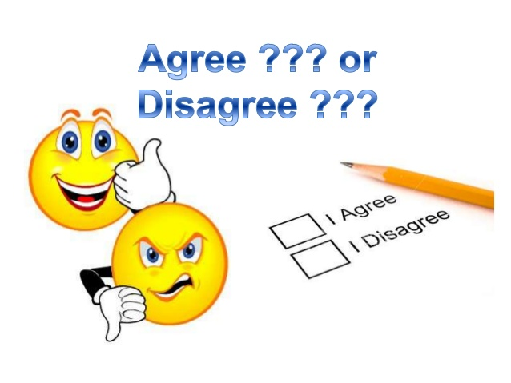
Practice
Agree/Disagree Game
I’ll give a thesis statement then everyone must go to the side of the room that shows if he/she agrees, disagrees, or has not decided.
Once you have choses your position, give examples to support your stance.

Slide 13

Dogs are better than Cats

Slide 14

TV is a mind wasting activity

Slide 15

Trump should not be president

Slide 16
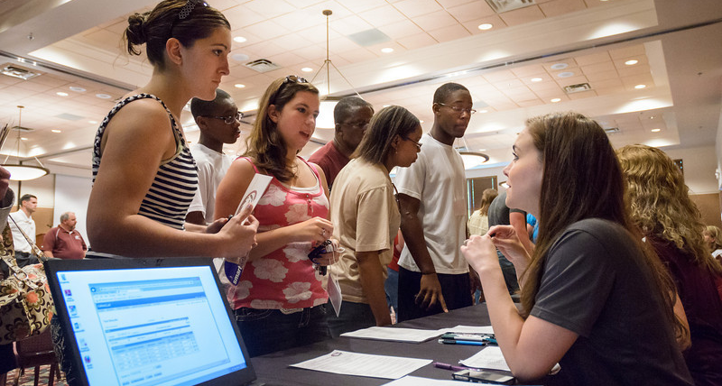
De Anza has a fair registration process.

