Slide 1
The gothic novel
Barb MacRae, Clarissa White, Haerim Kim, Helene Hong and Steven Chrabaszcz

Slide 2
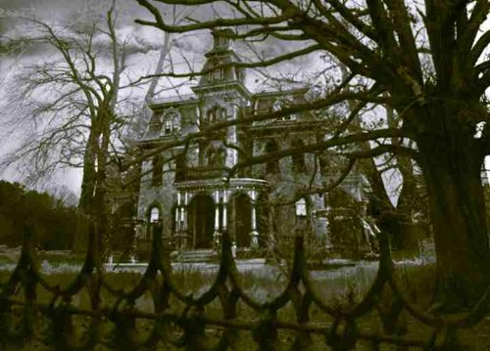
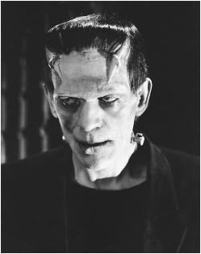
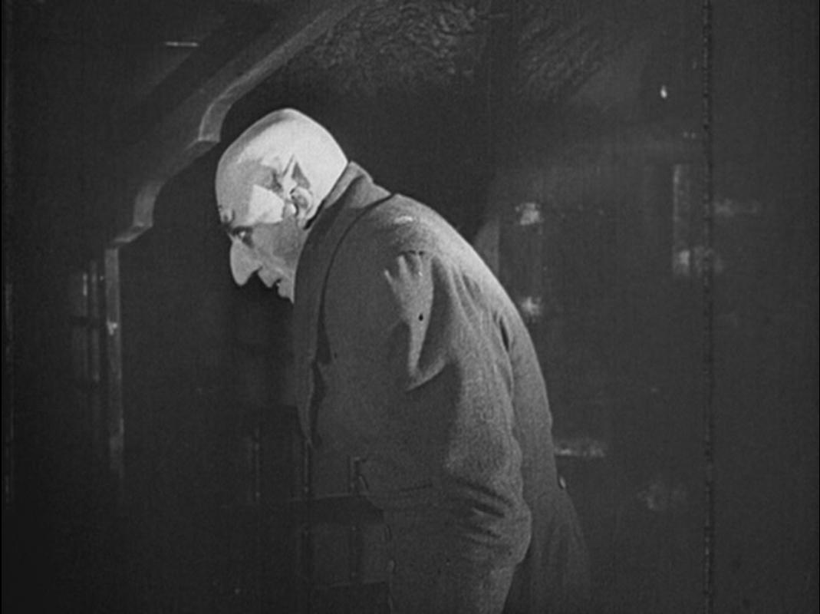
Overview of gothic

Slide 3
The beginning...
Gothic Novel, European Romantic, pseudo medieval fiction having a prevailing atmosphere of mystery and terror flourished in late eighteenth century
Horace Walpole, English author 1764 novel The Castle of Otranto.
Authors set their stories in the medieval period, and made plentiful use of ghosts, mysterious disappearances, and other sensational and supernatural occurrences.
Principal aim, evoke chilling terror by exploiting mystery, cruelty, and a variety of horrors.
The term "gothic" has also been extended to denote a type of fiction which lacks the medieval setting but develops a brooding atmosphere of gloom or terror
Common themes in gothic works are often elements of the dark side of human nature.

Slide 4
Characterization and plot
The protagonist, usually isolated, Voluntarily or Involuntarily.
The villain, the epitome of evil, either by his (usually a man) own fall from grace, or by some implicit malevolence.
The Wanderer, found in many Gothic tales, the epitome of isolation. Usually a form of divine punishment.
The plot itself mirrors the ruined world in its dealings with a protagonist's fall from grace as he/she succumbs to temptation from a villain.

Slide 5
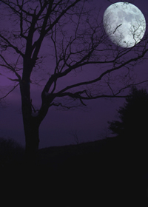
Gothic Elements
Setting in Gothic literature
Gothic novels are often set in old castles, haunted houses, dark woods and other creepy locations. Gothic castles often are run-down, have dungeons or basements, hidden passages, winding staircases or crypts

Slide 6
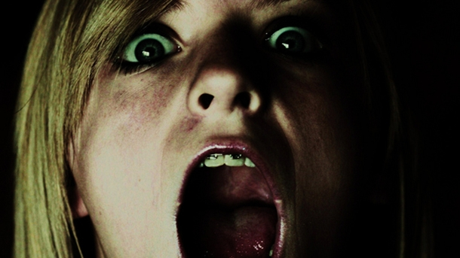
Horror and fear
Horror and fear are crucial to the Gothic novel and are always used as an underlying theme or atmospheric device. The horror in Gothic literature is subtle, playing on the reader's imagination to create fear.

Slide 7
Madness
Due to supernatural occurrences, the protagonist is driven mad from fear and overwrought emotion. Their descent into madness is often a slow process. The fear of madness, in not only the protagonist but the reader, is also used to create a sense of horror.
Atmosphere of mystery and suspense
Supernatural/Superstition
Confinement
Justice and Injustice

Slide 8
romance
Gothic literature also makes use of romance as a secondary plot point. This may involve a beautiful, high-spirited woman who lives in a creepy old castle. She may be bound by a curse, she may live with creepy servants or an evil, domineering husband. It is up to the protagonist to come to her rescue, creating romantic drama.

Slide 9
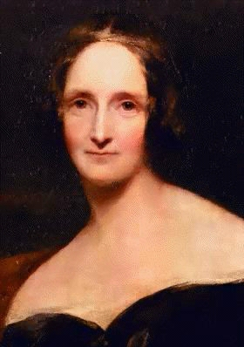
Mary wollstonecraft shelley
Born: Mary Wollstonecraft Godwin on August 30, 1797
Parents: William Godwin – radical philosopher and leading reformer and Mary Wollstonecraft – early feminist
Mom died 10 days after Mary’s birth – childbred fever
Four years later, Dad remarries to a widow, Mary Jane Clairmont, who had kids, too. (Jane and Charles)
Slightly rough childhood and home environment – 1812-1814: Sent to live with a family, the Baxter’s, in Dundee, Scotland

Slide 10
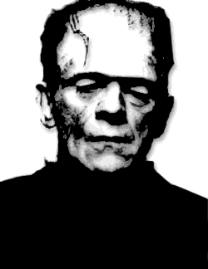
Mary wollstonecraft shelley cont.
1814: First encounter with Percy Bysshe Shelley at her father’s house in London– he was a friend of Godwin’s and 21 y/o; Mary was 16
1815: They eloped before her 17th birthday; Mary was pregnant with her first child.
Mary was pregnant 4 times throughout her life; her last son, Percy Florence, was the only one to grow old and live a life
1816: Percy and Mary legalizes their union/marriage (right after Shelley’s abandoned wife, Harriet, drowns herself); Mary gave birth to her next child, William
During this time, June 1816, Mary Shelley comes up with the idea of Frankenstein, or The Modern Prometheus, at Lord Byron’s place in Switzerland.

Slide 11
Mary wollstonecraft shelley cont.
1817: Mary Shelley’s third child, Clara is born; dies less than a year later
1818: Mary Shelley publishes Frankenstein anonymously; immediate sensation
1819: William, her son, dies from malaria, at the age of 3
Few months later, in November 1819, Percy Florence, her fourth child, is born
July 8, 1822: Percy Shelley drowns – a very hard time for Mary (financial issues)
Happy marriage? Affairs? Children?

Slide 12
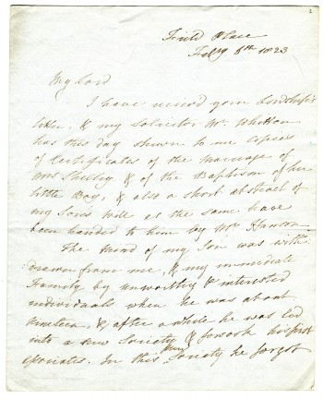
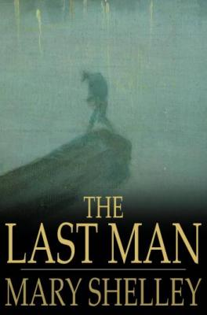
Mary wollstonecraft shelley cont.
Always sought acceptance by society, but never compromised her own ideals, and never re-married
1844: Sir Timothy Shelley dies; Mary’s financial situation becomes better
August 1823: Mary returns to England and looks to support her son, father, and herself by her literary output
Prolific time in her life: She wrote 6 novels, revised Frankenstein, authored 2 dramas, wrote multiple short stories, poems, and semi-fictional essays, translated and adapted several foreign works; published travel works, biographies, articles, and reviews; and edited Percy Shelley’s poetical and prose works.

Slide 13
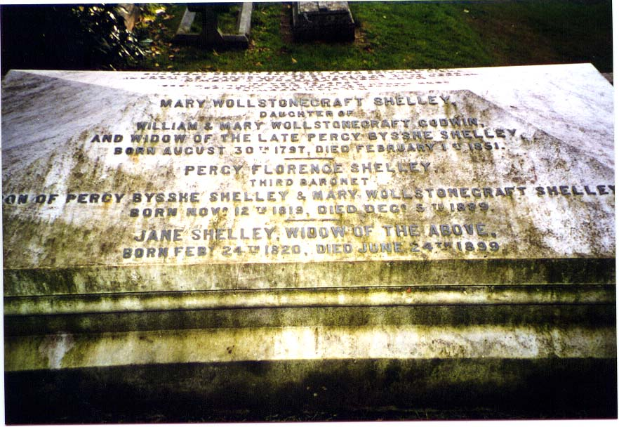
Died: February 1, 1851 – age 53; Buried at Bournemouth, Dorset, England
Now: Still known for Frankenstein and as the founding mother of science fiction; recognized as one of the first modern professional literary critics.

Slide 14
Rebels against Reason: The Gothic Era
Romantic and specifically Gothic Literature rose as a response to the Age of Enlightenment.
In the Enlightenment: Rise of experimental science, quest for an empirical model of how the universe worked.
Response to Revolutions in America, France and in science and technology.

Slide 15
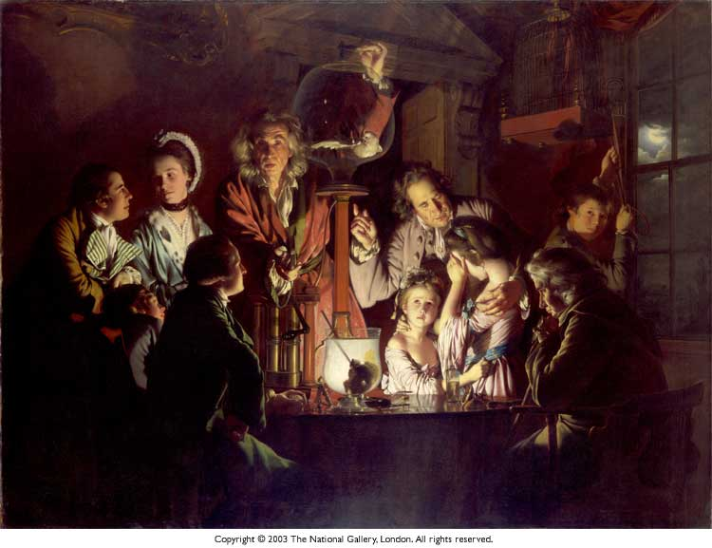
The Age of Enlightenment
Depended upon reason in explaining the mysteries of the universe.
Led to many scientific innovations in astronomy, industry and medicine.
The world was a conflict between the rational and the irrational.
Focused on Greek and Roman thinkers as their models.

Slide 16
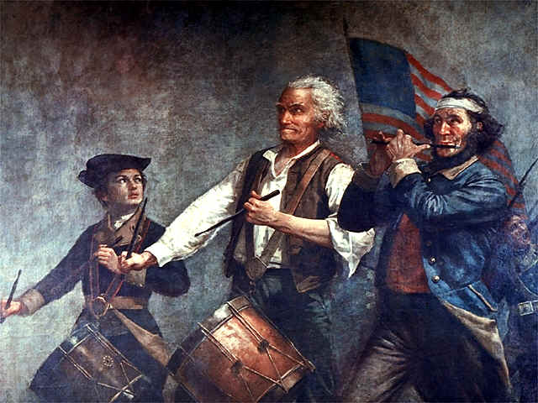
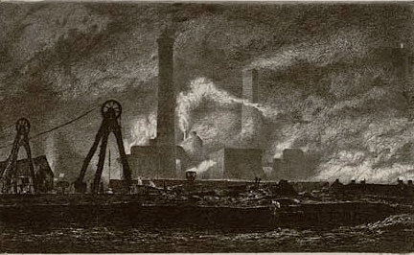
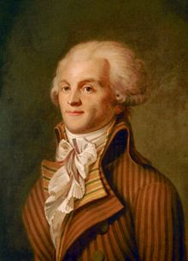
The Age of Revolutions

Slide 17
American Revolution
American: First revolution by a Declaration of Independence that ushered in democratic governments, rather than ones ruled by European monarchs.
Though the founders of the United States were Enlightenment thinkers, many were radicals.

Slide 18
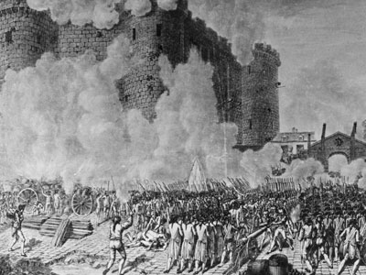
French Revolution
The bloodshed demonstrated in the French Revolution, especially the “Reign Of Terror”, coupled with the overthrow of a European monarch troubled the British.
The “Reign of Terror” was reflected in the terror of the Gothic's.

Slide 19
The Industrial Revolution
Many technological advances moved citizenry from the outskirts to the centers of cities.
Invention of the Steam Engine led to greater advancements in manufacturing and transportation.
Invention of Gas Lighting allowed factories to stay open longer and cities to light their streets.
Invention of mechanized looms allowed clothes to be made faster- at the cost of putting people out of work.

Slide 20
The Luddites
Luddites were the response to the loss of jobs created by the automatic looms.
Experienced workers were losing jobs and wages to the unskilled. They began to smash their machines.
Textile Manufacturers began receiving letters from “General Ned Ludd and his Army of Redressers”, hence Luddites.
Eventually this mayhem led to a state of martial law, with troops being stationed in cities affected by Luddism.
The Frame Breaking Act was passed in 1812, which made destroying industrial machinery a capital offence.

Slide 21
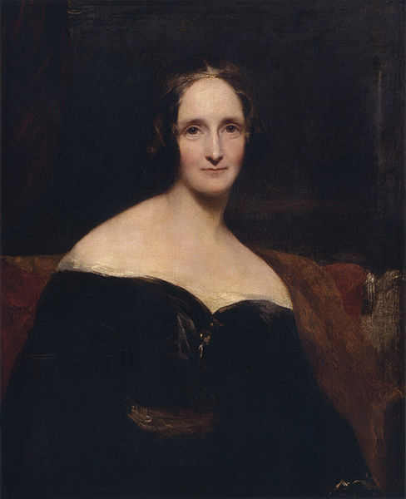
Beginning and publication
1816 (Lord Byron, ghost story)
First publication 1818
Second edition 1823
1831 Revision
The Modern Prometheus http://www.brighthubeducation.com

Slide 22
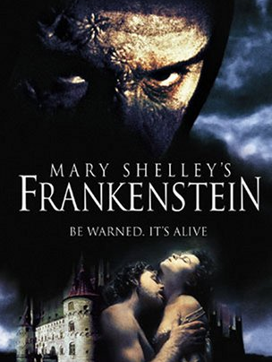
Frankenstein or the modern Prometheus

Slide 23
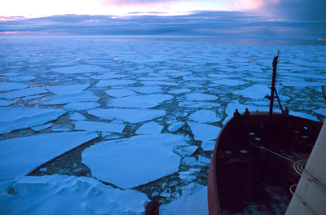
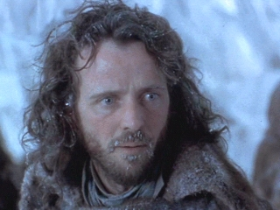
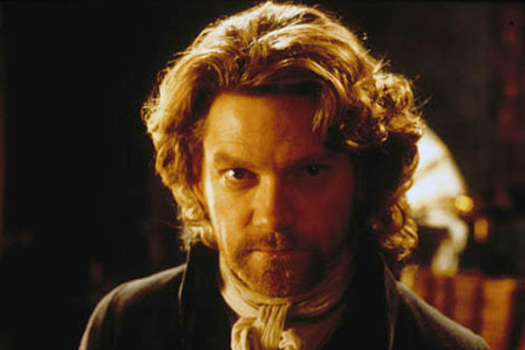
Epistolary novel
Captain Walton’s letters,
“country of eternal light”
Discovery of Victor Frankenstein
Walton takes care of Victor
Connection between Walton and Victor
Life story told
Walton’s character: caring, confident
Desire for discovery

Slide 24
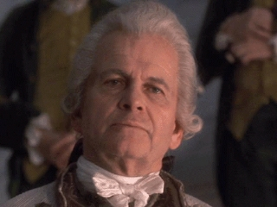
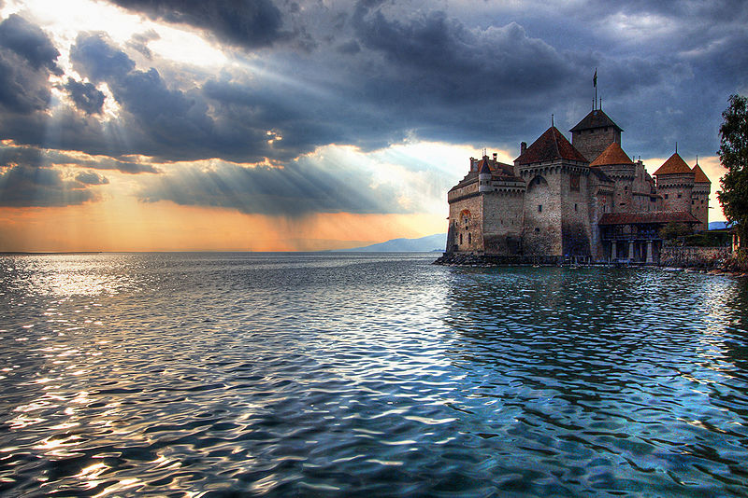
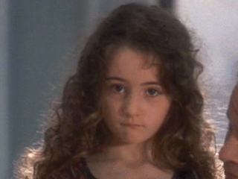
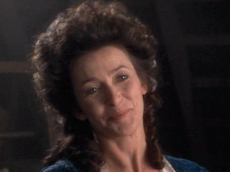
Raised in Geneva
Elizabeth is adopted
Victor becomes attached to Elizabeth
Caroline Beaumont dies.
Caroline’s desire for Victor and
Elizabeth
Victor leaves to pursue a higher
education.
Attends the university of Ingolstadt
The answer to creating life!

Slide 25
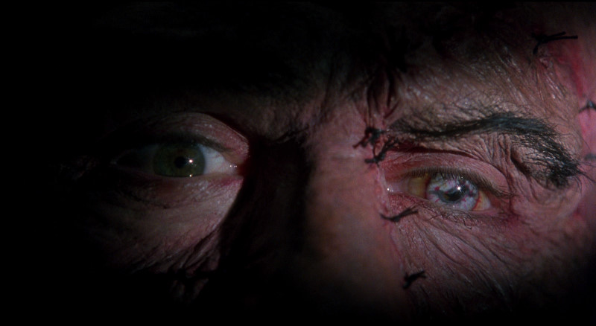
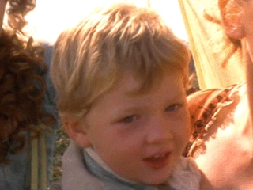
Victor creates monster!
Abandons creation to the world
Victor falls ill
Henry Clerval helps nourish him back to life
Plans to return to his family
Learns of William’s murder

Slide 26
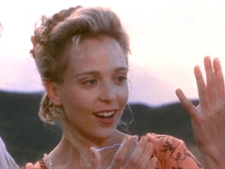
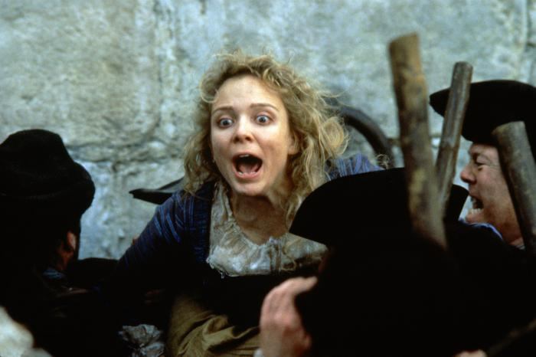
Believes his monster killed his brother
Justine Mortiz charged with William’s murder
Does not tell the court his suspicions
Justine, tried, convicted and executed.
Victor wonders the mountains alone to find peace
Contact with his creation
Creature tells his story
Monster demands a companion
be made for him.

Slide 27
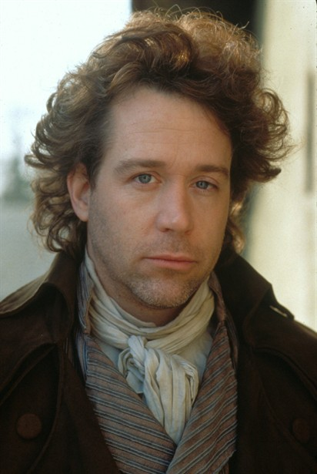
Victor agrees then discontinues his project.
Monster threatens Victor’s wedding night
Creature kills Henry.
Victor imprisoned for Henry’s murder
He returns to Geneva with father.

Slide 28
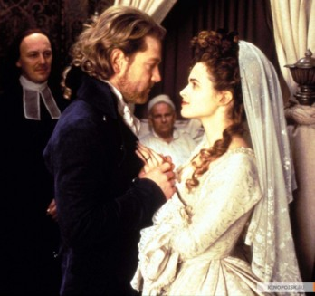
Elizabeth suspicious of Victor’s feelings
Victor confesses his love for Elizabeth.
Marriage
Elizabeth murdered on wedding night
Victor’s father dies.
Victor vows to destroy his creation
He follows creature all over the place
Meets Captain Walton.

Slide 29
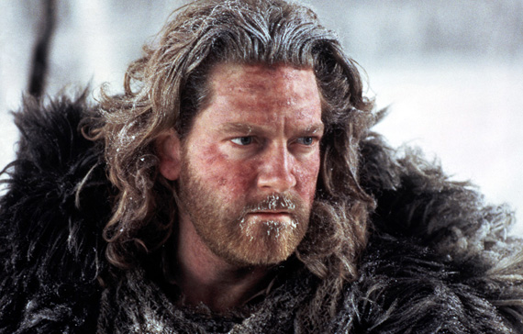
Victor pleads with Walton to not follow in his foot-steps
Victor dies aboard the Captain’s ship
Walton discovers Frankenstein’s creature weeping
Torn between happiness and sadness
Leaves the ship to die himself

Slide 30
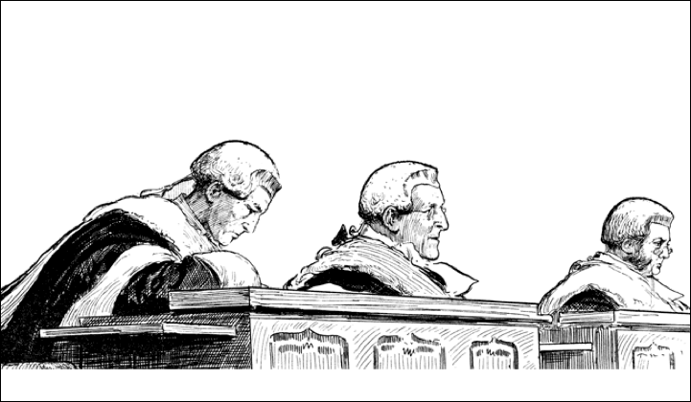
CRITICAL RESPONSE TO THE GOTHIC NOVEL
BAD!
EVIL!
I don’t like it!

Slide 31
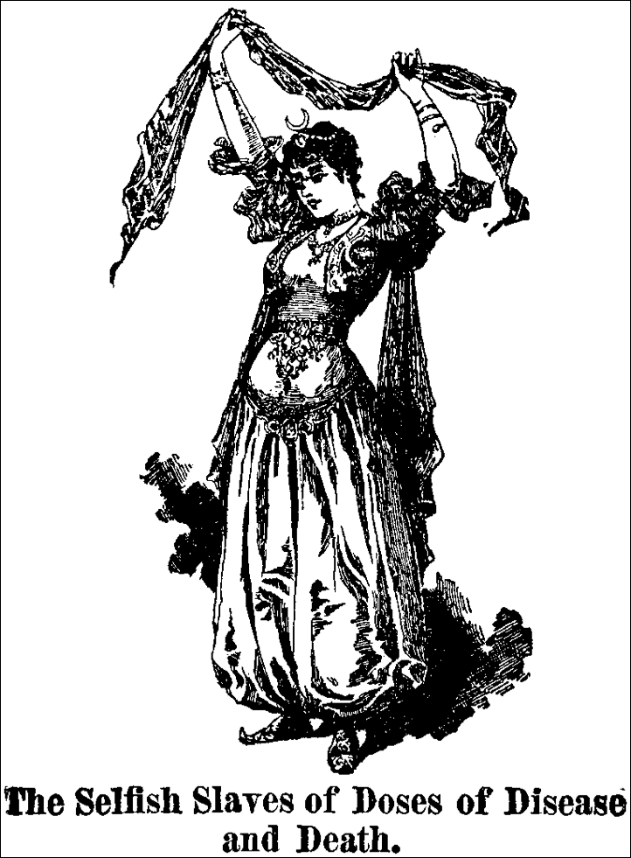
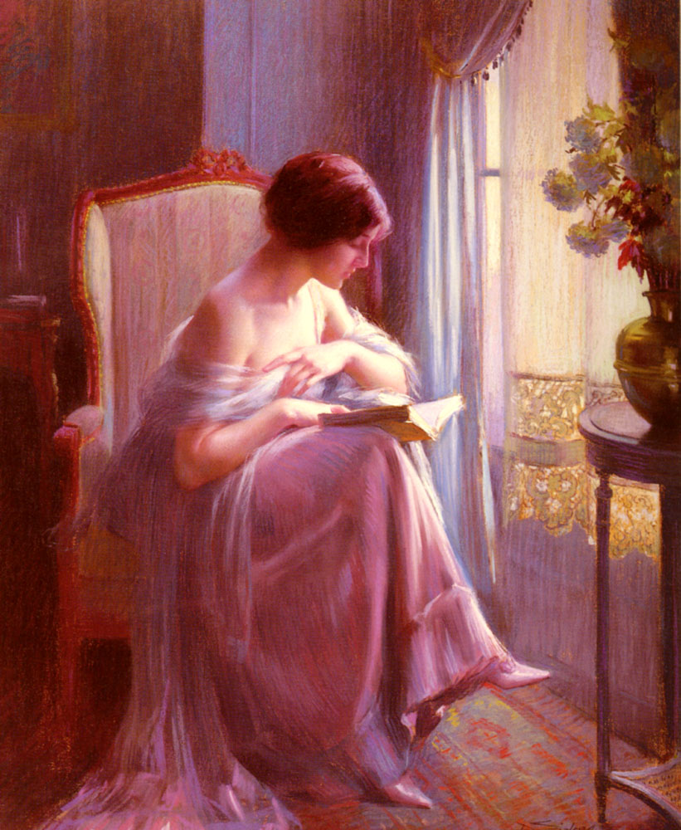
BEFORE...
... AND AFTER

Slide 32
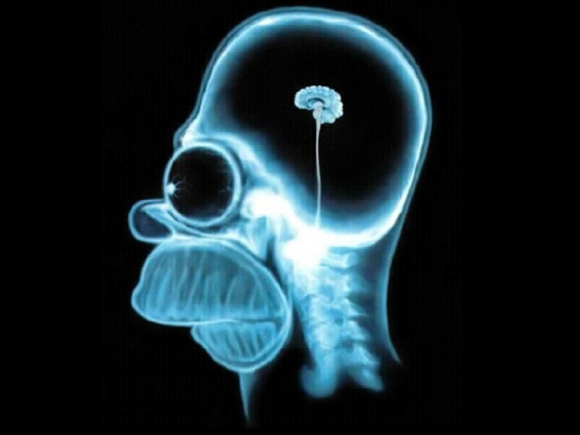
John Locke
Man was born not with innate values and principles, but with a mind like a ball of clay, waiting to be shaped by experience and input.

Slide 33
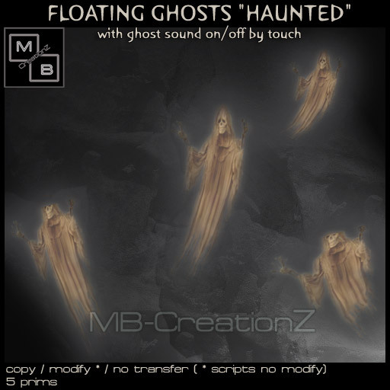
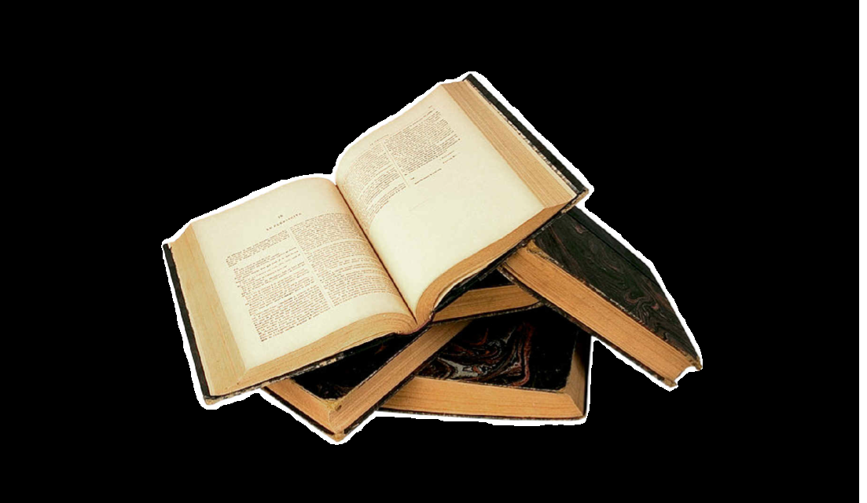
Murder
Immorality
Evil
Rebellion

Slide 34
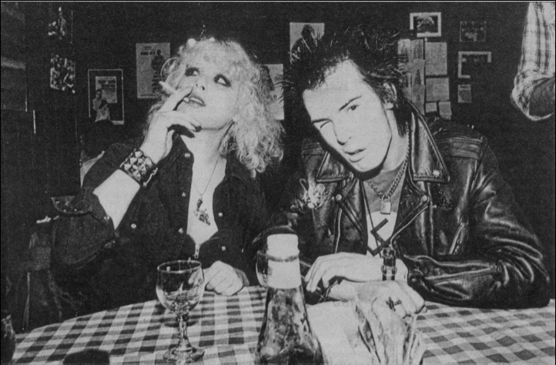
WHAT EFFECT WILL THE NOVEL HAVE ON YOUNG READERS AND IMPRESSIONABLE WOMEN?
Topics of slide

Slide 35
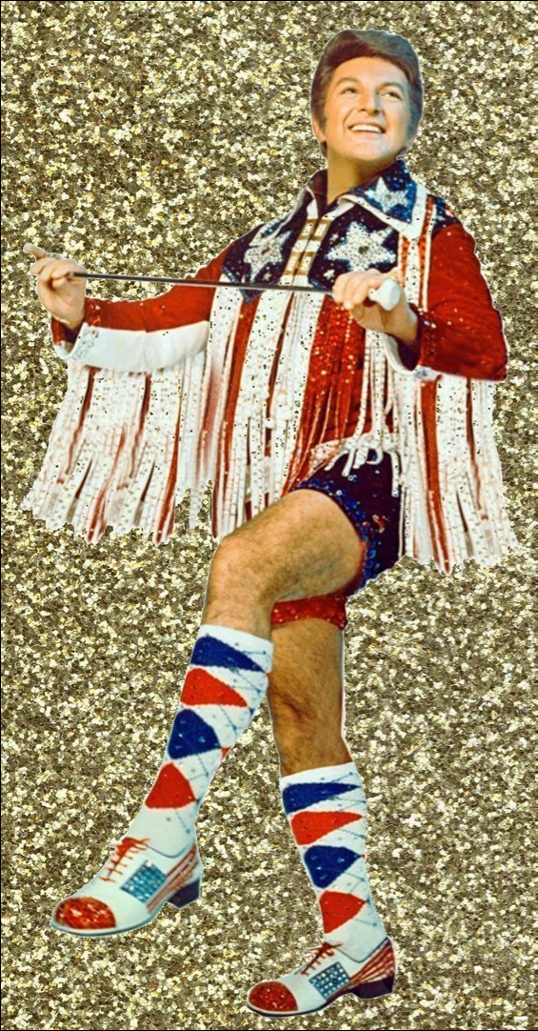
Does the novel present confusing or abnormal gender roles?

Slide 36
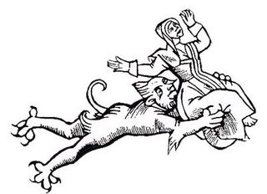
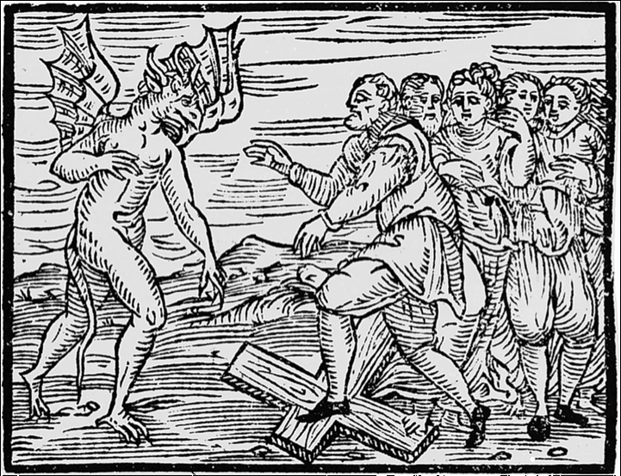
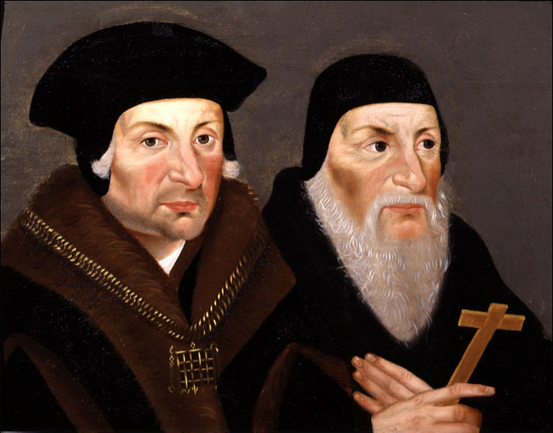
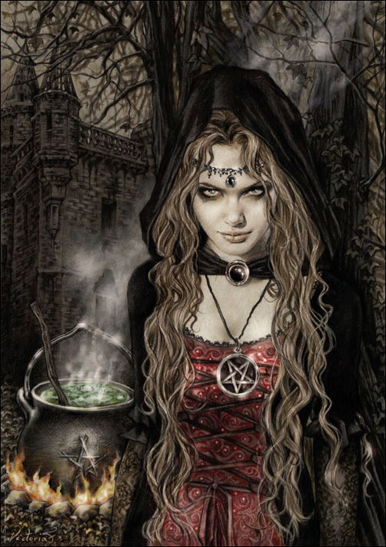
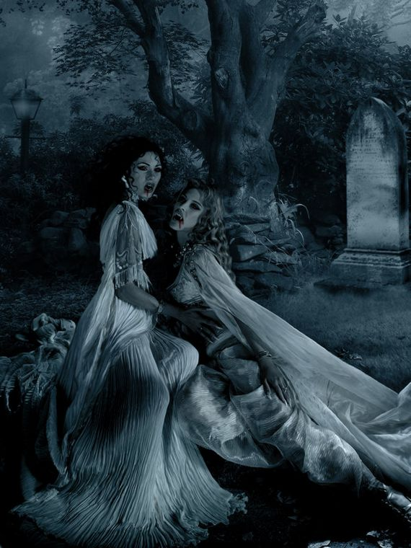
Does the novel inspire heretical supernatural beliefs?

Slide 37
