Slide 1
Narrative Vs. Expository
For many students, the hardest part is telling the difference between Information and Explanation.
So what’s the difference?

Slide 2
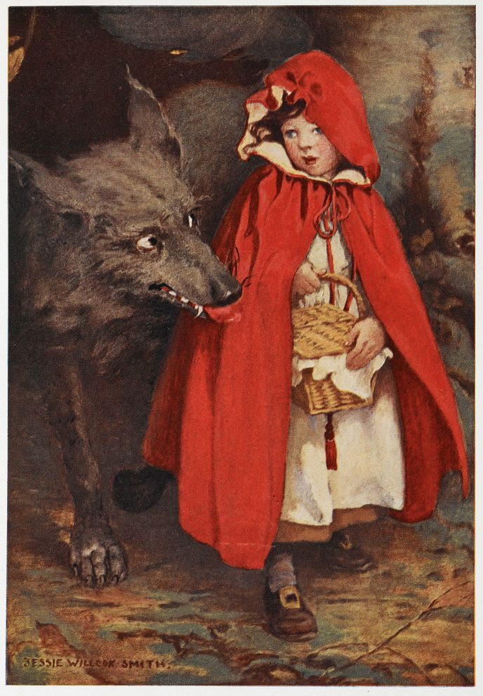
Narrative
Little Red Riding Hood

Slide 3
Expository
Little Red
Expository Version

Slide 4
The Shape of Stories

Slide 5
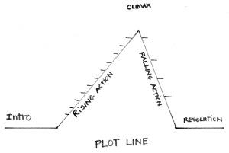
Story Arc

Slide 6
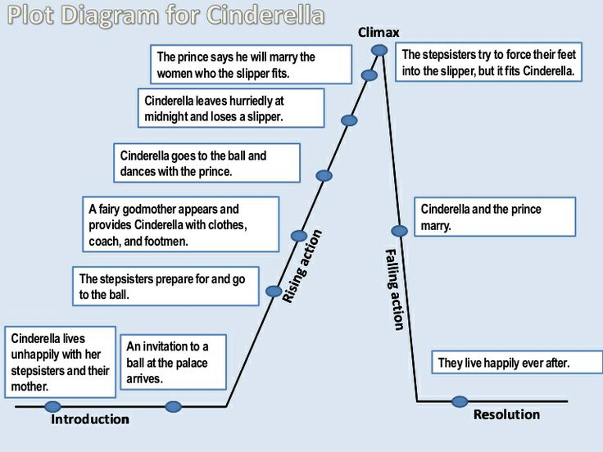

Slide 7
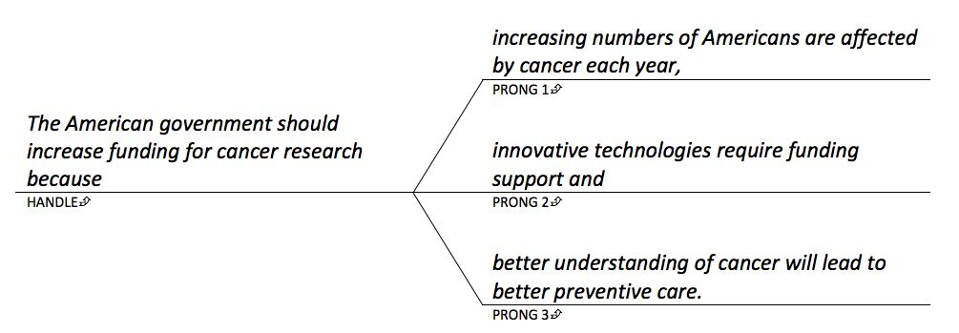
Shape of an Essay

Slide 8
Homework
“The ability to read awoke inside of me some long dormant craving to be mentally alive.” (Malcolm X).
I saw my mother in a different light. We all need to do that. You have to be displaced from what's comfortable and routine, and then you get to see things with fresh eyes, with new eyes.

