Slide 1

The Essay

Slide 2
What is an Expository Essay?
An essay is a piece of writing that makes a point about a subject, problem, issue, or question that the writer feels is worth writing about. An essay is expository insofar as it centers on explaining, rather than simply describing something or narrating an event. (Exposition essentially means explanation.) Strong expository essays explain WHY something is as it is or HOW something comes about. Strong expository essays show the connections between specific, concrete facts or events and broader ideas that allow us to make sense of the world.

Slide 3
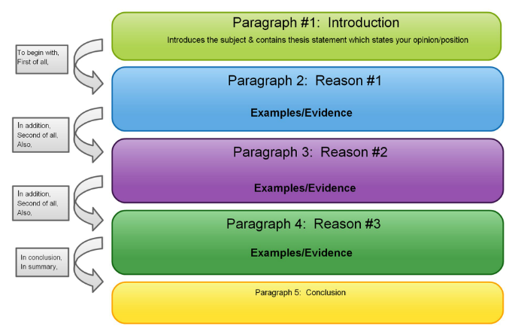
What does it look like?

Slide 4
The Introduction
The introduction is like a blueprint for the rest of your essay. By reading your introduction, your reader should be able to:
Get enough background of the story or topic to understand your thesis
Predict what the rest of your essay will be about
Thesis: In one to two sentences, tell the reader what the main idea of your essay is. This sets up the purpose for the rest of the essay, so make it specific and make it clear.

Slide 5
Body (PIE) Paragraphs
POINT (Topic Sentence): In a sentence or two, make a specific statement that previews the point of the paragraph, requires explanation.
INFORMATION (Evidence): Include a Story, personal example, quote, or fact
EXPLANATION (Analysis): 2 – 3 lines of analysis per 1 line of evidence. Connect the idea you introduced in the topic sentence and the evidence. How do they work together? How does the evidence illustrate your point?

Slide 6
POINT (Topic Sentence)
Ideas for making a TOPIC SENTENCE:
Decide what you want to say to support your thesis based on your reaction to the text
Try categorizing your ideas and make a comment on a recurring theme you’ve found
Re-read your final sentence in the paragraph. Does it sum up your point? Does it say “tada! that’s my point!” Cut and paste it at the beginning of your paragraph.

Slide 7
Information (Evidence)
Ideas for EVIDENCE:
Information from the readings or class discussions (paraphrases or, occasionally, short quotes)
Personal experience (stories, anecdotes, examples from your life)
Representations in mass media (newspapers, magazines, television)
Elements from popular culture (song lyrics, movie lines, TV characters, celebrities)
Definitions (from the dictionary, the readings, or another source)
Statistics (polls, percentages, data from research studies)

Slide 8
Explanation (Analysis)
Ideas for ANALYSIS:
Interpret, analyze, explain the information, opinion or quote you’ve included
Comment on the accuracy (or inaccuracy) of the quote, fact, data, information, etc.
Decipher the meaning or try to better your understanding of your observation, findings or experience
Suggest to your reader how the information relates to your THESIS.
Explain how, what, and why your evidence illustrates/proves your point. Evidence never speaks for itself.

Slide 9
Conclusion
The Conclusion is not just a mere summary of your paper. In the conclusion, ask yourself the questions that seem most relevant to you and your purpose:
Now that you’ve written a whole paper on a certain topic, do you feel as if you have any new insights?
What’s the last thing you want the reader to know? Do you want to elaborate on a certain point? Do you want to convince them one last time?
Did you propose anything? Do you have a solution to any of the problems you discussed?
Did you discover anything about yourself or your opinion?

Slide 10
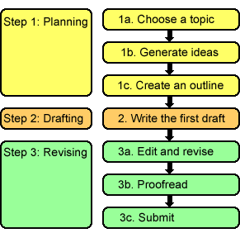
Pre-Writing!

Slide 11
Your Turn!
Pull out a piece of paper. Follow along to complete all the writing steps before you write your essay.
Essay Prompt # 1

