Slide 1

The Process Essay

Slide 2
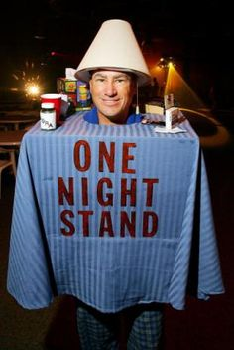
  How To?
  Go to any self help section of the bookstore and you’ll see hundreds of texts teaching us how to do something.
How to get a man to marry you
How to cheat on a test without getting caught
How to lose 10 pounds in one day
How to get out of a speeding ticket
How to make the most killer Halloween Costume for less than $5

Slide 3
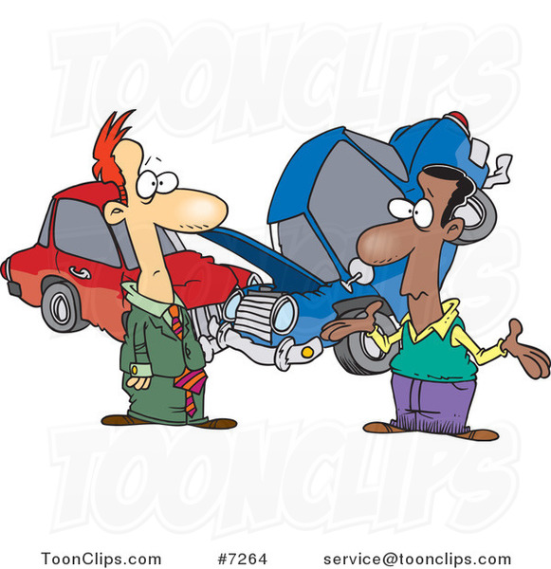
“Fender Benders: Legal Do’s and Don’ts” by Armond D. Budish

Slide 4

Introductions and Conclusions
First impression and last impression
Examine Handout:
What introductory strategy does “Fender Benders” use?
Make a Conclusion using one the concluding strategies.

Slide 5

Brainstorm
Unique You!!!!
Choose a topic that says something about you! About your culture or about an experience you had or about your beliefs.
Example:
My parents divorced when I was 2 years old
How to get along with divorced parents
My introduction would give the background why I’m an expert

Slide 6
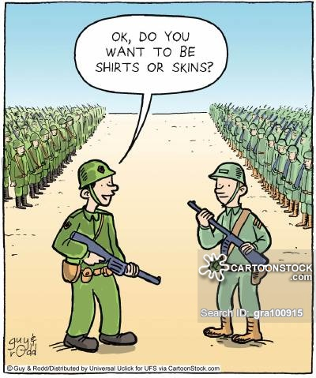
Purpose
Why am I wRiting This?
1) Informational:
This tells someone how something occurs
(example: How WWI started)
2) Directional
This tells someone how to do something
(example: How to start a war)

Slide 7

Practice
Directional or Informational?
-How to write an A paper in one hour
- How the computer was invented
- How to make the best coffee
- How the human body digests coffee
- How to give good hugs
- How the nervous system responds to good hugs

Slide 8
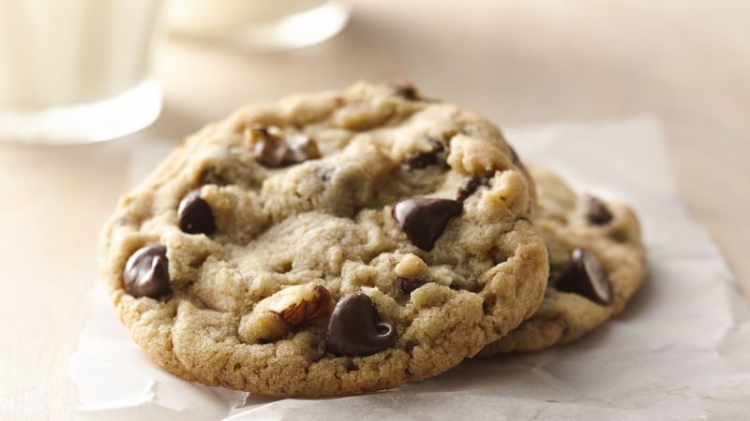
Steps:
Identify, Organize, Explain
Brainstorm to find out what steps are then divide them in 3-5 steps.
Example: Killer Chocolate Chip Cookies
- Buy best ingredients
- Get out my measuring spoons and bowls
- Mix the dry ingredients (flour, baking soda, salt, spices)
- Mix Wet ingredients (Eggs, sugar, butter, vanilla)
- Place huge balls on cookie sheet and bake at 350 for 20 minutes
- Serve hot and gooey with big glass of milk
- Share with family and friends

Slide 9
Reduce to 2-5 Paragraphs
1. Prepare: - Buy best ingredients
- Get out my measuring spoons and bowls
2. Mix: - Mix the dry ingredients (flour, baking soda, salt, spices)
- Mix Wet ingredients (Eggs, sugar, butter, vanilla)
3. Bake: - Place huge balls on cookie sheet and bake at 350 for 20 minutes
4. Enjoy! - Serve hot and gooey with big glass of milk
- Share with family and friends

Slide 10

Transitions
Make sure to clearly label one step from the next and and the let the reader know how long each step takes
Example transitions: Again, also, and, before, begin by, begin with, besides, during, finally, first, second, third, furthermore, last, late, meanwhile, moreover, next, still then, too when, while

Slide 11

Thesis
1. Limited Topic
2. Purpose
3. Opinion
4. Parts
Example: My grandmothers recipe for chocolate cookies (1) connects me to my culture and my ancestors (3) as seen in these 3 simple steps. (4)

Slide 12

Audience
Always keep in mind your audience and how much they know or don’t know about your topic!

