Slide 1
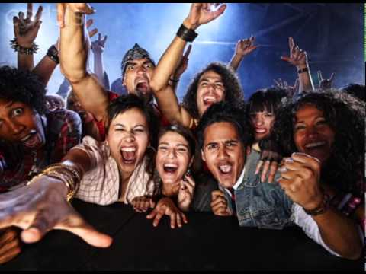
Welcome to EWRT 1A Honors Fall 2017

Slide 2
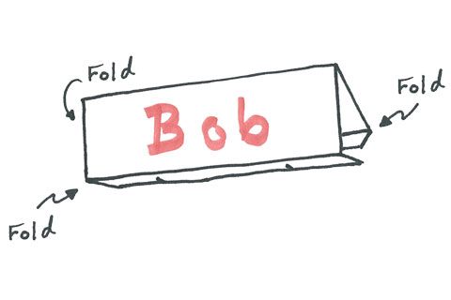
Make a Desk Name Tag
Use Markers, make very large, use first name you would like to be called.

Slide 3
Who’s Here?
Attendance Sheet

Slide 4
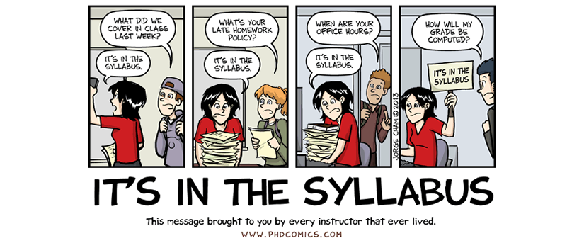
Syllabus
This is your lifeline to the class!
Everything you need to know about due dates, expectations, grading is on the syllabus.
Before you have a question, check the syllabus first, it’s probably answered there.

Slide 5
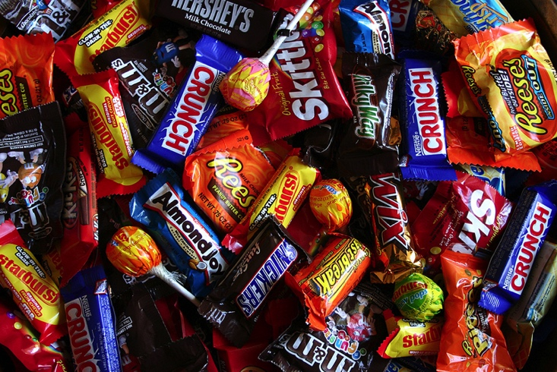
Candy Quiz
Let’s see how much you remembered!
Turn over syllabus
I’ll ask a question, raise your hand to answer. If you are correct, I’ll chuck you some chocolate.

Slide 6
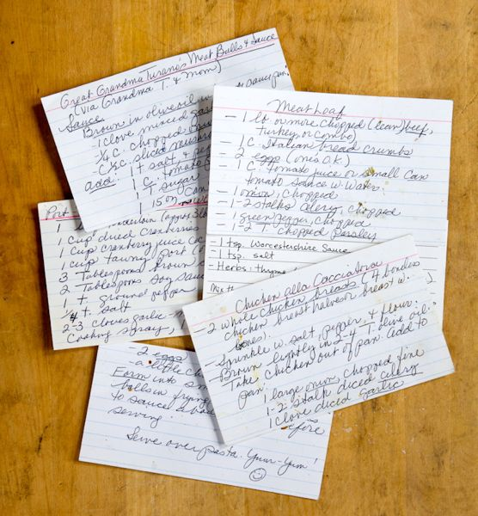
Index Cards
Let me know a bit about yourself
- Name (nicknames, special pronunciations, etc.)
- Contact Information – (e-mail, phone number)
- Previous English Class (If at De Anza, give instructor’s name)
- Strengths and Weaknesses in English
- Education and Career Goals
- Personal Interest/ Hobbies
- Work/Family/School Obligations
- Anything Else?

Slide 7
Ice Breaker

Slide 8
Writing Diagnostic
Free Write!
Why do we read and write?
Let’s check out John Greene’s Video on How and Why We Read
https://www.youtube.com/watch?v=MSYw502dJNY
Write for about 15-20 minutes about why you think it’s important to read and/or write. Give an experience you have had that demonstrates your why. It could be a time when you read or wrote a paper, an e-mail, a journal entry, a great book, an article, etc.

