Slide 1
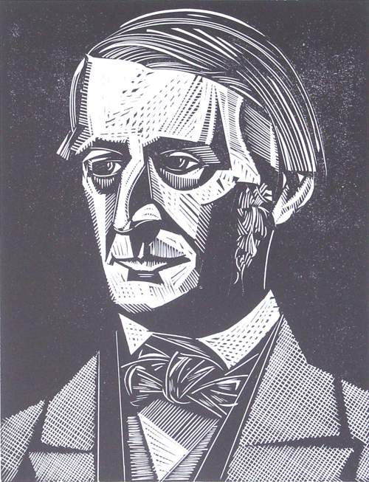
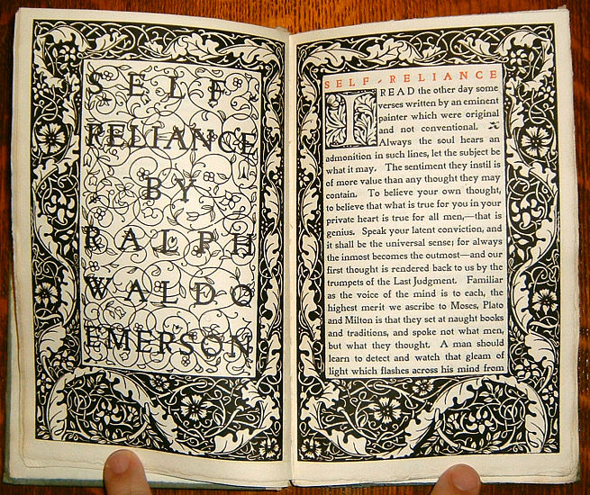
Ralph Waldo Emerson
Self-Reliance

Slide 2
Emerson’s Biography: “The Sage of Concord”
1803- Ralph Waldo Emerson born on May 25 in Boston. 2nd of 5 boys.
1817-1821- Attends Harvard College.
1829-Ordained junior pastor of Boston’s Second Church. In July of the same year was named a pastor.
1831- Wife Ellen Tucker Emerson dies of tuberculosis on Feb. 8. Faces spiritual crisis.
1832- On December 22, renounces pastorate and sails for Europe.
1833- Returns from Europe and delivers a lecture on “The Uses of Natural History” before Natural History Society in Boston.
1835- Marries Lydia Jackson of Plymouth and moves to rural Concord where his family has property.
1836-Publishes first book Nature.
1837-8-Addresses Harvard’s Phi Beta Kappa Society on the American scholar and the Divinity School’s graduates on Christianity.

Slide 3
Emerson’s Biography Cont’d
1840- Editor of The Dial
1842- Son Waldo dies at the age of 5 from which he does not recover.
1844- Son’s death pushes him to write his essay titled “Experience.” Publication of the The Dial ends. “Emancipation of the Negroes in the British West Indies” delivered at the Concord Court House on Aug. 1
1847-48-Second trip to Europe. Lectures in England and Scotland.
1855- “Lecture on Slavery” presented before the Massachusetts Anti-Slavery Society at the Tremont Temple in Boston. Spoke before the Woman’s Rights Convention to support the woman’s right to vote.
1856- Publishes English Traits
1873-Fire damages his house. Travels to Europe and Egypt with daughter Ellen and meets with Thomas Carlyle one last time.
1882-Dies in April 27.

Slide 4
Transcendentalism According to Emerson
"The Transcendentalist adopts the whole connection of spiritual doctrine. He believes in miracle, in the perpetual openness of the human mind to new influx of light and power; he believes in inspiration, and in ecstasy. He wishes that the spiritual principle should be suffered to demonstrate itself to the end, in all possible applications to the state of man, without the admission of anything unspiritual; that is, anything positive, dogmatic, personal. Thus, the spiritual measure of inspiration is the depth of the thought, and never, who said it? And so he resists all attempts to palm other rules and measures on the spirit than its own....
Emerson's Philosophy of Transcendentalism
Emerson formulated the philosophy of transcendentalism or in simple terms, an idealist who advocated self-reliance, spiritual independence, and who rejected traditional authority. He is famous for the often-quoted: "Make the most of yourself, for that is all there is of you." Emerson believed that people should rely on their reason to learn what is right and should try to live a simple life in harmony with nature and with others.

Slide 5
Themes and Style in Self-Reliance
Individualism
Nonconformist
Childhood Innocence
Bold Youth
Inconsistency
Believe in yourself
Believe in your own convictions
Self-Helping Man
No outside help
Nature
Human Nature (soul, spirit, etc.)
Nature (plants, sea, etc.)
First POV
“I,” “We,” “Us”
Second POV
“You”
Third POV
“He”
Man

Slide 6
“What pretty oracles nature yields us on this text in the face and behavior of children, babes, and even brutes” (Emerson 534).
Theme: Unconformity
Children
Babies
Youth
POV: First Person
Young minds have not been influenced by society as much as adults.
Their mind is untainted by facts or harsh realities.
They say exactly what is on their mind without worry of consequence.

Slide 7
“Whoso would be a man must be a nonconformist” (Emerson 535).
Theme: Unconformity
POV: Third Person
“ What have I to do with the sacredness of traditions, if I live wholly from within? my friend suggested-But these impulses may be from below, not from above. I replied, ‘They do not seem to me to be such; but if I am the devil’s child, I will live then from the devil’” (Emerson 535).

Slide 8
“A foolish consistency is the hobgoblin of little minds, adored by little statesmen and philosophers and divines. With consistency a great soul has simply nothing to do” (Emerson 537).
Theme: Inconsistency
POV: Third Person
Consistency is boring, so do something new. Say the unexpected.
“To be great is to be misunderstood.”

Slide 9
“Man is timid and apologetic. He is no longer upright. He dares not say ‘I think,’ ‘I am,’ but quotes some saint or sage. He is ashamed before the blade of grass or the blowing rose. These roses under my window make no reference to former roses or to better ones; they are for what they are; they exist with God to-day. There is no time to them” (Emerson 541).
Theme: Nature
Human Nature
Rose Reference
POV: Third Person
Man is unsure of what he believes and he would rather talk through someone else.
The past and the future have no say in the present.

Slide 10
“Welcome evermore to gods and men is the self-helping man” (Emerson 545).
Theme: Self-Help Man
POV: Third Person
It is better to avoid any kind of help from others.
Your actions will be celebrated more because you did them by yourself.
You gotta do what you gotta do, no outside input needed.

Slide 11
“Nothing can bring you peace but yourself. Nothing can bring you peace but the triumph of principles” (Emerson 550).
Theme: Believe in yourself.
POV: Second Person
Luck has nothing to do with it, but what you live by (morals) does.
You write your own destiny, predict your own future.
“No fate but what we make.”

