Slide 1
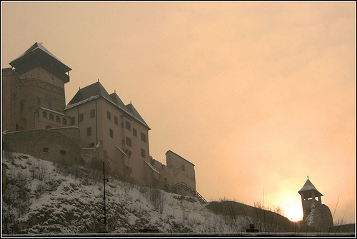
Daily Meals

Slide 2
Supper Time!
Breakfast: 6 - 7 am
Lunch: 12 – 2 pm
Dinner: 6 – 7 pm
(Accompanied by entertainment!)
Both Upper and lower classes had 3 meals a day but consisted very different menu items.
Notes:
Upper and lower had 3 meals.

Slide 3
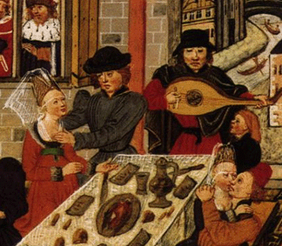
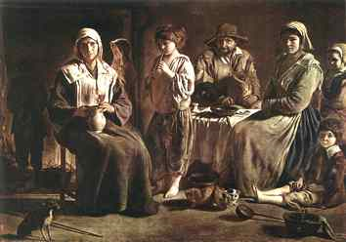
On the Table
Lower class
Bread, and lots of it
Some meat
Homegrown veggies
Some Fruits
Ale or Mead
Upper class
Lots of different meats
Fruit
Anything spicy or salty
Multi Course Meals
Very little veggies
Ale, Mead, and Wine
Notes:
Meats included Deer, fish, chickens, rabbits, etc.
Mead, Fermented honey water sometimes cooked with hops

Slide 4
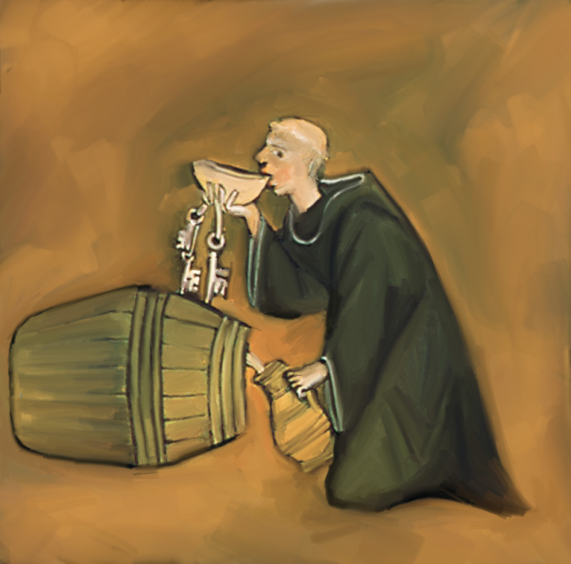
What’s to drink?
Water was thought to be unclean and was not considered as drinkable.
Ale and Mead were the best/only choices of the lower class.
While still drinking Ale and Mead the upper class also had a selection of wine at the dinner table.

Slide 5
How long’s that going to keep?
Food preservation was a big problem due to lack of refrigeration.
Options to preserve food:
Salting
Pickling
Smoking
Jams
The Stillroom

Slide 6
Cooking
Foods were prepared in a variety of ways including:
Spit
Roasting
Baking
Boiling
Smoking
Frying
Food was normally purchased from small markets and fairs.
Notes:
Meat roasting on a spit turned by a dog on a tredmill

Slide 7
Party Time!!
First Course:
Rabbit
Deer
Stuffed Chicken
Veal
A Pie that contained the meat from 1 deer, gosling, six chickens, ten pigeons, 1 rabbit.
Second Course:
Deer, Pig, Sturgeon cooked in parsley and vinegar.
Goat, chickens, pigeons, rabbits
Third Course
Wafers dipped in jelly
Fourth Course:
Cream covered in fennel seeds preserved in sugar
Slices of cheese and strawberries
Fifth Course
Everything is prepared in wines and preserves
Fruits
Sweet Pastries

Slide 8
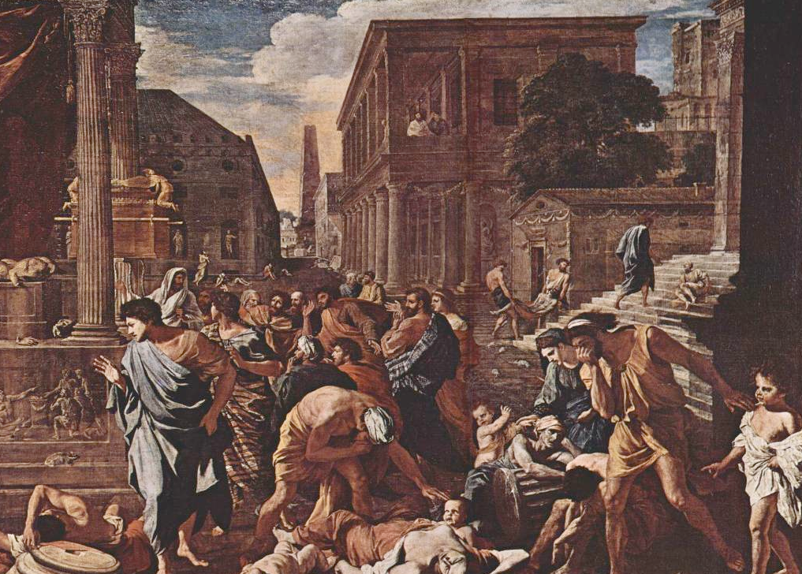
Plague

Slide 9
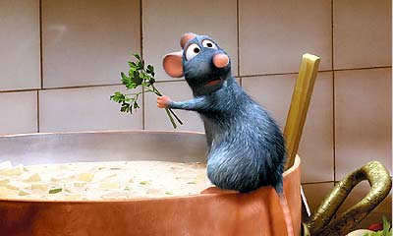
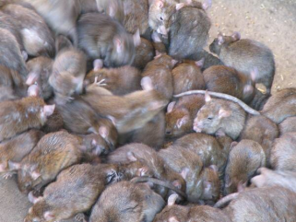
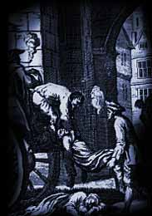
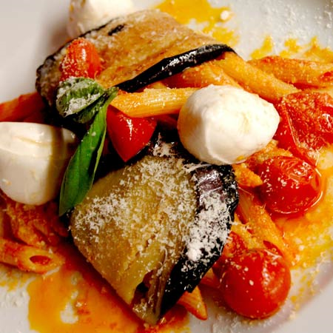
The plague afflicting Elizabethan citizens was known as the Bubonic Plague (or“The Black Death”)
Though some believe the plague was spread through food, it was not. In actually it was the rats and mice.
Murderer
Vindicated

Slide 10
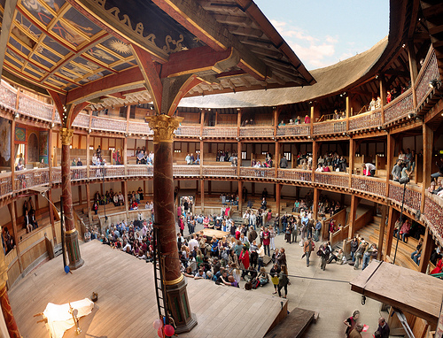
Although Shakespeare was never infected with the plague, many people close to him were, including members of his family and actors working in The Globe Theatre

Slide 11
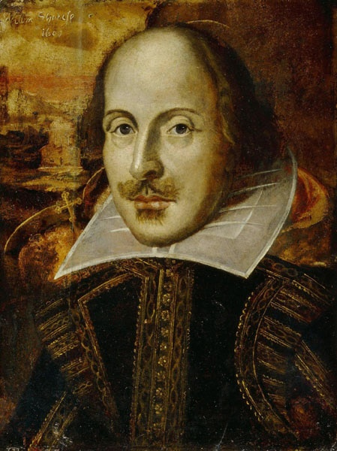
Food References in my works!

Slide 12
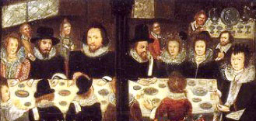
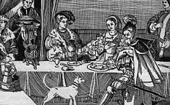
Food References in Shakespeare’s Works
In Romeo and Juliet, Much Ado About Nothing, and Taming of the Shrew each household held feasts to welcome their guests

Slide 13
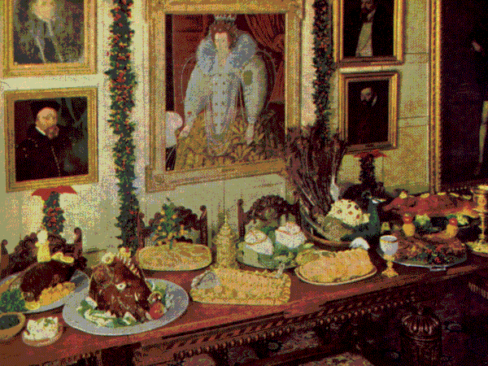
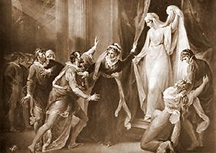
Food References in Shakespeare’s Works
In The Winter’s Tale the Bard makes references to food throughout the play
"Let me see: what am I to buy for our sheep-shearing feast? Three pound of sugar, five pound of currants, rice...I must have saffron to color the warden [winter pear] pies; mace; dates none--that's out of my note; nutmegs, seven; a race or two of ginger, but that I may beg; four pounds of pruins, and as many of raisins o'th' sun. (Act IV, Scene iii, Lines 36-49)"

Slide 14
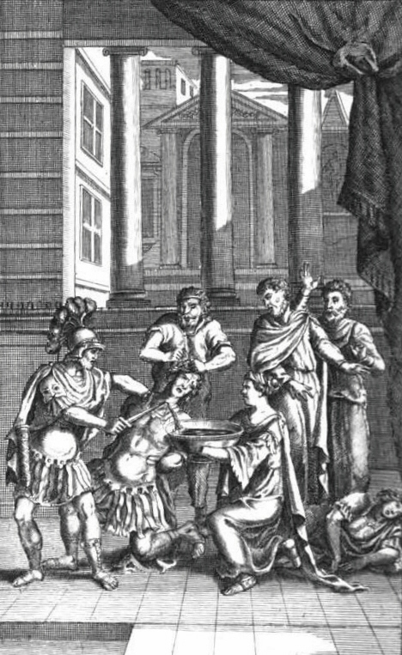
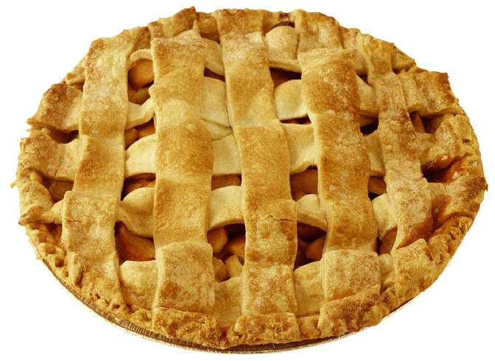
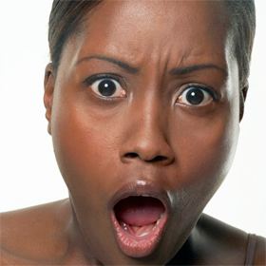
Food References in Shakespeare’s Works
In Titus Andronicus, after Titus kills his son, Mutius, he attends the love-day feast
In Titus Andronicus, Titus kills Tamora’s sons and bakes them into a pie. Unknowingly, Tamora eats them.

Slide 15
Symbolism of Food
In Much Ado About Nothing (film), Beatrice takes a bite of an apple after her conversation with Benedick at the dance. The apple, of course, is an allusion to the forbidden fruit of the Tree of the Knowledge of Good and Evil. In eating it, she demonstrates her power over Benedick, and her own strength.
Tamora eating her sons symbolizes their reluctance to leave the womb. (just kidding)
Okay, these are grapes. You just have to believe me.

Slide 16
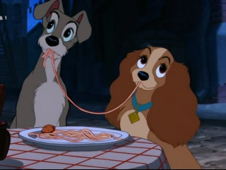
Food of 16th Century Italy

Slide 17
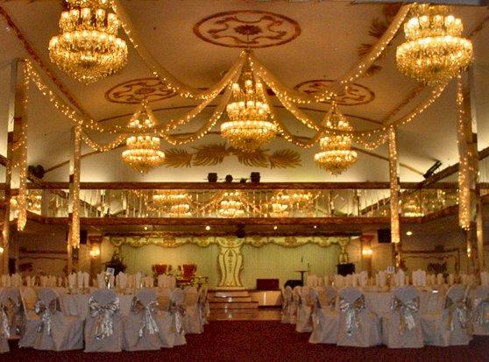
January 23, 1529
You’re Invited
To Dine with Duke Ferrara and 104 other guests

Slide 18
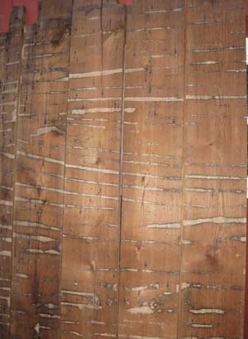
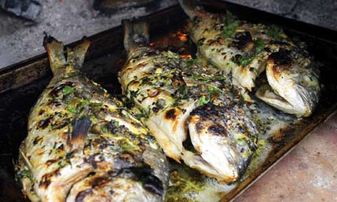
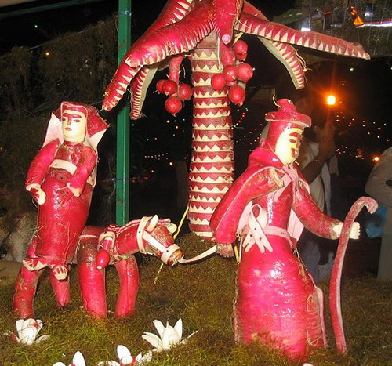
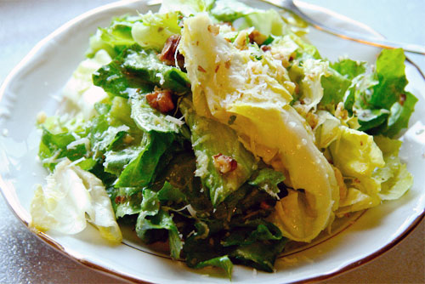
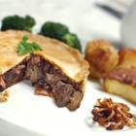
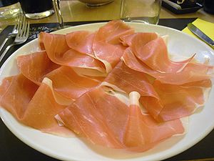
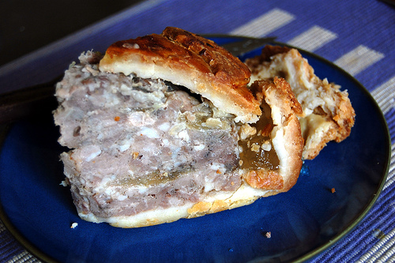
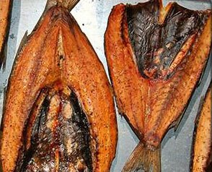
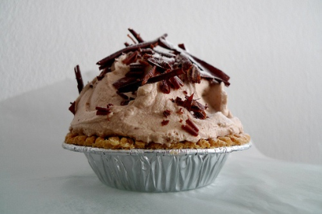
Antipasti
Gilt-head bream
Radishes carved into shapes and animals (delicious!)
Salad of greens with citron juice and anchovy
Mortadella and liver pie
Prosciutto of pork tongue
Boar pie
Smoked Mullet
Little cream pies

Slide 19
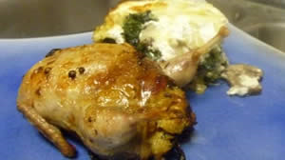
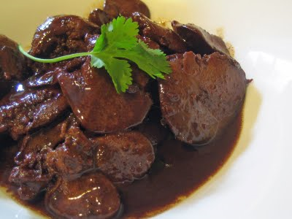
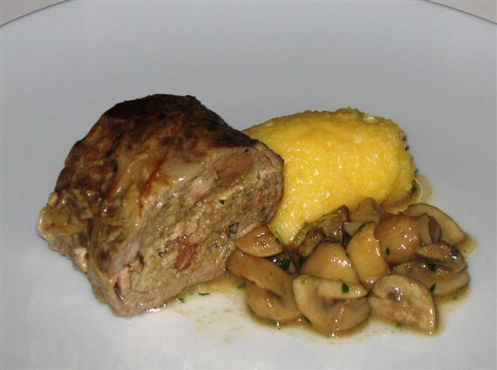
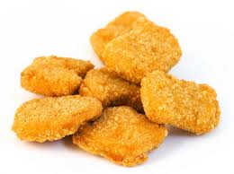
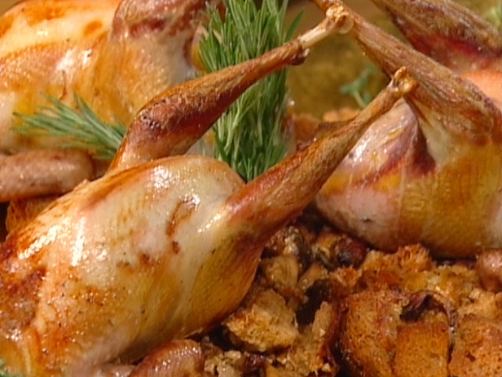
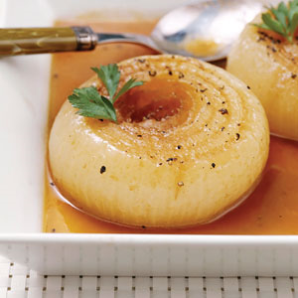
Quail
Capon liver stuffed into a caul
First Course
Tomaselle (liver sausage)
Capon fritters sprinkled with sugar
Roasted
pheasants
Onion Dish

Slide 20
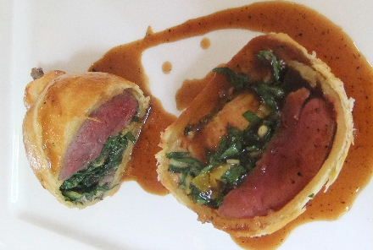
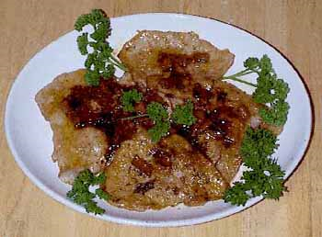
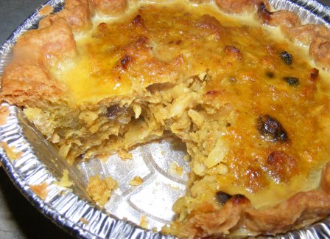
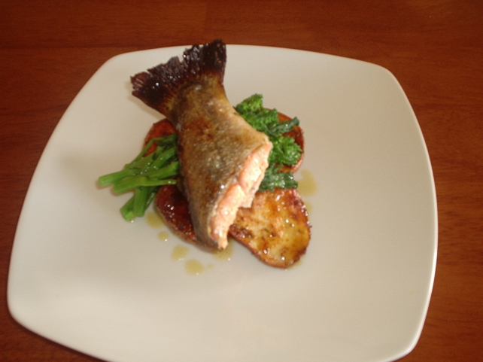
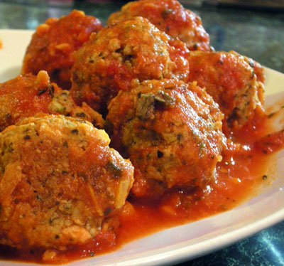
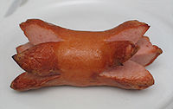
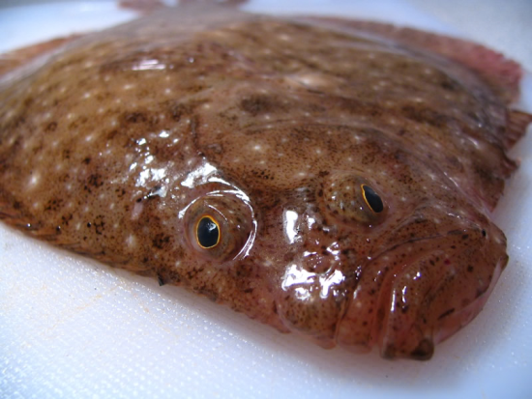
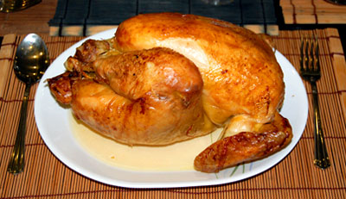
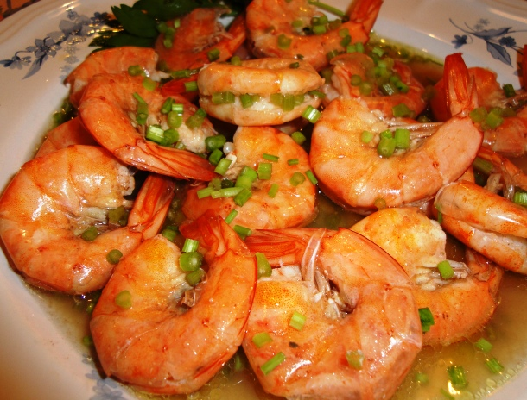
Tart of fish ilt (spleen)
Second Course
Veal
Pigeons in puff pastry
Shrimp
White cervelat sausage
Meatballs
Fried trout tails
Carp and turbot
Capone

Slide 21
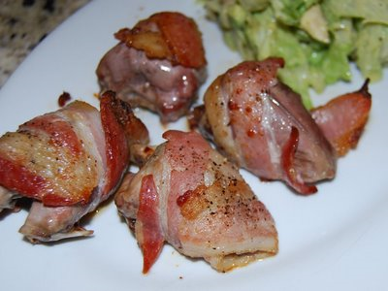
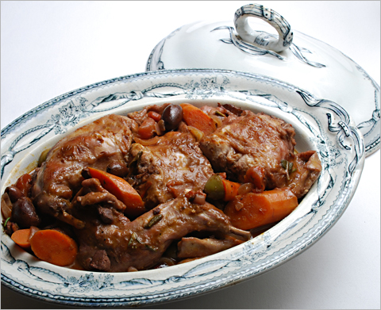
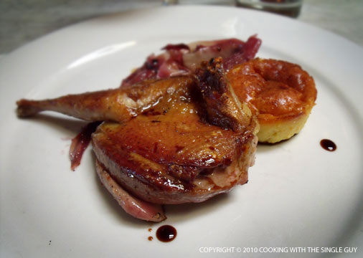
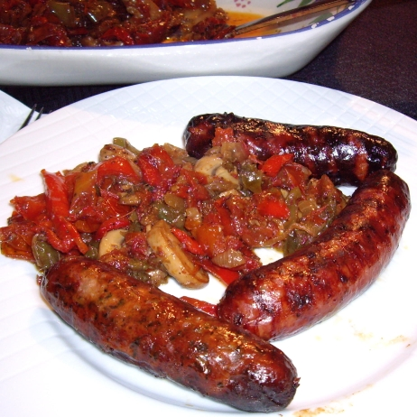
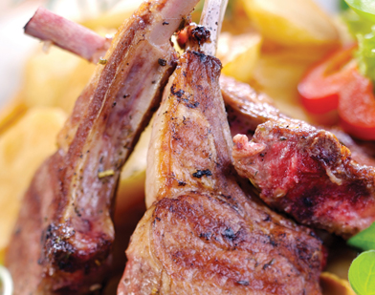
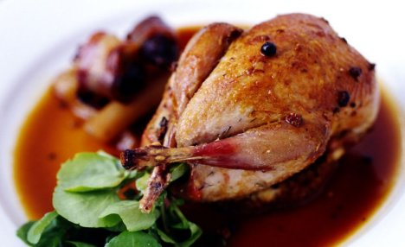
Turtledoves
Rabbit
Pigeon
Third Course
Partridge
Boned capon
Sausages

Slide 22
MORE FISH.
MORE BIRDS.
Fourth Course
Rice pie

Slide 23
More birds.
Fifth Course
Veal
Suckling pig
More fish.

Slide 24
Fish
Sixth Course
Peacock
Goat
Boar

Slide 25
Grapes
Olives
Seventh Course
Pears
Fennel
Pastries

Slide 26
Cucumbers and almonds in syrup
Various fruits and confections
More Seventh Course
Cucumbers
Lettuce

Slide 27
Um. Wait. Hello?
SPAGHETTI?
Common meals in Renaissance Italy:
Pasta: lasagna, ravioli, and pizza were prepared (without tomato sauce!)
Bread: hard biscuits
Cheese: mozzarella and pecorino
Risotto
Omelettes
Meatballs
Fresh fruit in season; dried fruit out of season
Soups for rich and poor alike
Cheesecake and flan for dessert

