Slide 1
Mythology and folklore
Jeff Anberg
Claire Kolling
Brittany Wilkins
Kristin Bustamante
Woojin Shin

Slide 2
The Gods!!
Neptune
Apollo and Daphne
Phoebe
Venus
Cupid

Slide 3
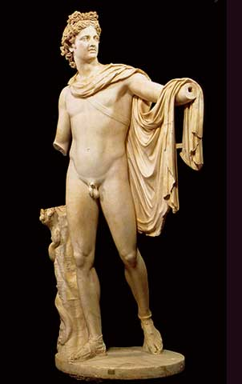
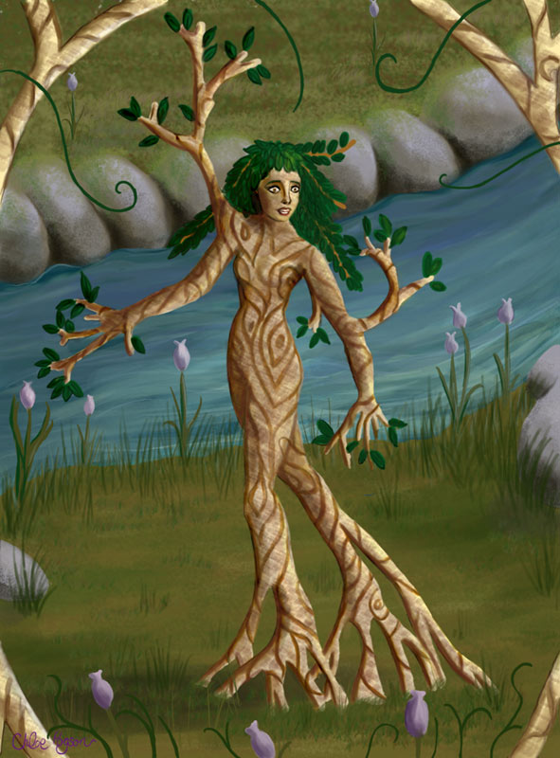
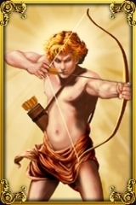
Apollo and Daphne

Slide 4
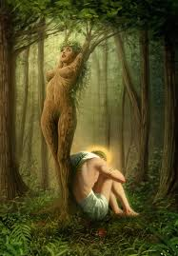
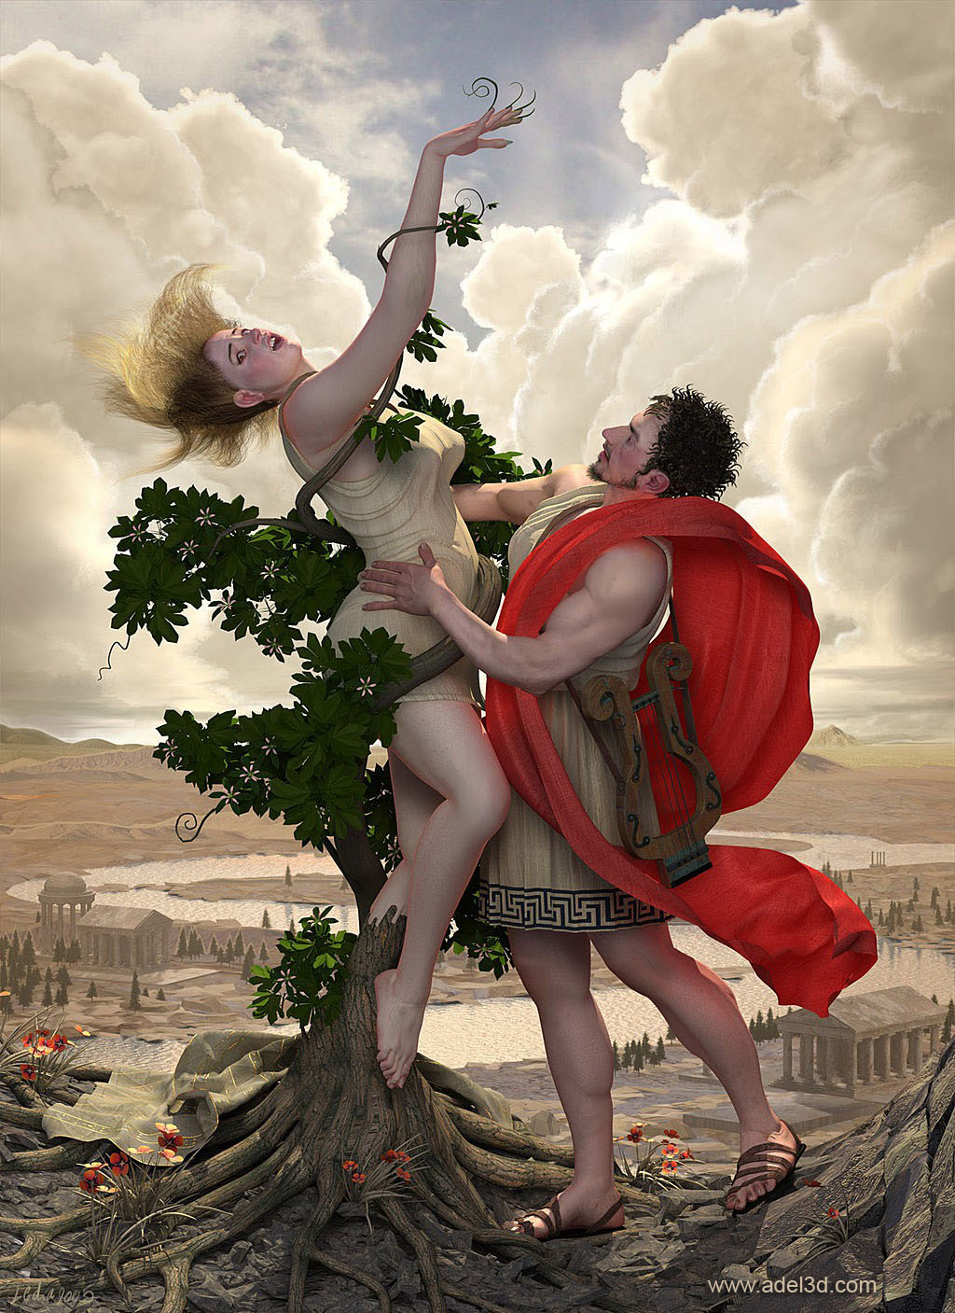
“Run when you will. The story shall be changed:/ Apollo flies and Daphne holds the chase” (2.1.237-238).

Slide 5
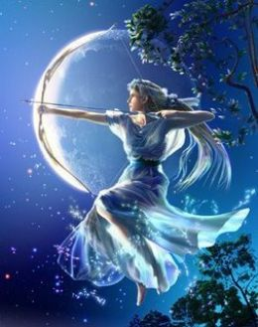
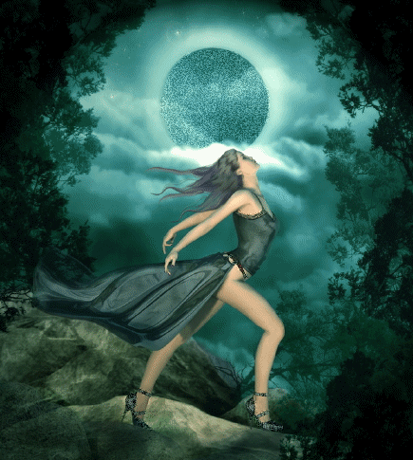
Phoebe ( ) Moon Goddess
Diana
“Tomorrow night when Phoebe doth behold/ Her silver visage in the wat’ry glass” (1.1.215-216).

Slide 6
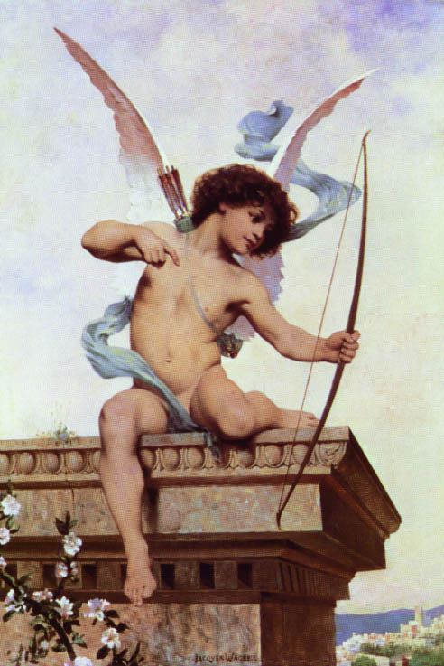
Cupid
“I swear to thee by Cupid’s strongest bow,/ By his best arrow with the golden head,/ By the simplicity of Venus’ doves,/ By that which knitteth souls and prospers loves” (1.1.172-175).
“But I might see young Cupid’s fiery shaft/ Quenched in the chaste beams of the wat’ry moon” (2.1.167-168).

Slide 7
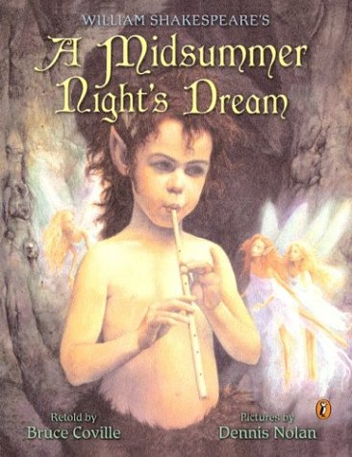
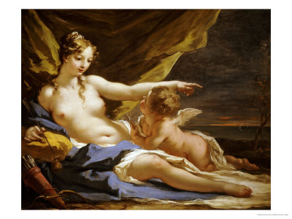
Character Robin Goodfellow, “Puck” →
Venus and Cupid ↓

Slide 8
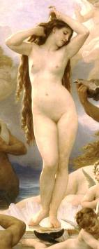
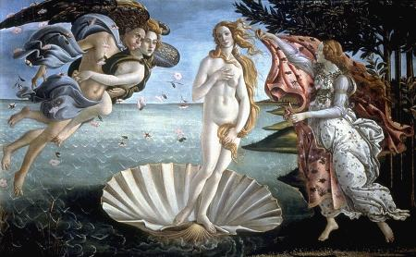
Venus “Goddess of ”
Love

Slide 9
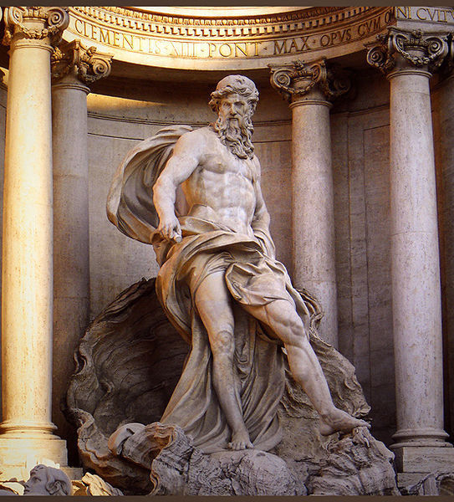
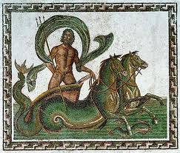
Neptune
“Full often hath she gossiped by my side/ And sat with me on Neptune’s yellow sands” (2.1.129-130).

Slide 10
Mythological Creatures
Puck (Robin Goodfellow)
Fairies
Harpies
Muses

Slide 11
Puck (Robin Goodfellow)
Background:
A mythological creature from European folklore
Fairy or mischievous nature sprite
The Old English "puca" is a kind of half-tamed woodland sprite known for leading folk astray with echoes and lights in nighttime woodlands or coming into the farmstead and souring milk in the churn.
In Celtic folklore the Púca (Irish for goblin) is one of the fairy folk and is both respected and feared by those who believe in it
According to Brewer’s Dictionary of Phrase and Fable (1898):
[Robin Goodfellow is a] "drudging fiend", and merry domestic fairy, famous for mischievous pranks and practical jokes. At night-time he will sometimes do little services for the family over which he presides. The Scots call this domestic spirit a brownie; the Germans, kobold or Knecht Ruprecht. Puck, the jester of Fairy-court, is the same.

Slide 12
Fairies
Background:
Fairies are mythological creatures originating in European folklore
they are sometimes described as any magical creature, including goblins or gnomes and at other times only describes a specific type of more ethereal creature
Folk beliefs surrounding Fairies:
In Irish and Northern English folklore fairies were described as the dead, a subclass of the dead, goblins, or elves
In Celtic Folklore fairies were seen as gods and godesses
Some concepts, like those in Persian mythology, explain fairies as demoted angels
With the growth of Puritans, people began viewing mythical creatures like fairies as purely evil, and saw them as demons

Slide 13
Harpy
Background:
Harpies are mythological creatures in greek mythology that are best known from stories related to Phineas, a Phoenician King in greek mythology
According to Greek Mythology; Phineas, had the gift of prophecy and revealed too much causing Zeus to become angry and punish him by blinding him and putting him on an island with a buffet of food which he could never eat. The harpies always arrived and stole the food out of his hands before he could satisfy his hunger, and befouled the remains of his food
This creature is similar to: sirens, sphinxes, and centaurs

Slide 14
Muses
Background:
Muses were goddesses or mythological creatures from Greek Mythology
In Greek Mythology, poetry, and literature Muses are the goddesses who inspire the creation of literature and the arts
They were considered the source of the knowledge that was contained in poetic lyrics and myths.
According to Pausanias, a Greek traveler and geographer in the 2nd C. AD, there were three original Muses, worshiped on Mount Helicon:
Aoidē ("song" or "voice")
Meletē ("practice" or "occasion")
Mnēmē ("memory").
In Delphi three Muses were worshiped as well:
Nētē
Mesē
Hypatē
the three chords of the ancient musical instrument, the lyre

Slide 15
Mythological Creatures in Shakespeare
Puck (Robin Goodfellow)
Puck is a character in William Shakespeare’s A Midsummer Night’s Dream
Act II Scene I:
“that shrewd and knavish sprite Call'd Robin Goodfellow: are not you he That frights the maidens of the villagery; Skim milk, and sometimes labour in the quern And bootless make the breathless housewife churn; And sometime make the drink to bear no barm; Mislead night-wanderers, laughing at their harm? Those that Hobgoblin call you and sweet Puck, You do their work, and they shall have good luck: Are not you he? “
Fairies
Fairies play an extremely important role in William Shakespeare’s A Midsummer Night’s Dream as well
A large portion of the play takes place in the woods which enters the realm of fairyland

Slide 16
Mythological Creatures in Shakespeare Cont’d
Much of the story’s plot and action surrounds a disturbance of nature caused by a dispute between the fairy king and queen
Many of the characters in Midsummer are fairies, including:
Oberon, King of the Fairies
Titania, Queen of the Fairies
Titania's fairy servants:
Peaseblossom
Cobweb
Moth
Mustardseed
Harpies
Shakespeare does not include harpies as characters in his plays, however there are allusions to harpies in Much Ado About Nothing (example: Act II Scene I) in order to refer to nasty or annoying women
Muses
Similarly to harpies, rather than using muses as common characters in his plays, Shakespeare makes many allusions and references to muses in both his plays and sonnets (example: Henry V, Act I Prologue)

Slide 17
Homer
Born: c. 800 BC
Herodotus
Trojan War
Birthplace: Greece
Iliad
Odyssey
Starting point of Western Literature
Mysteries

Slide 18
Iliad
Epic Poem: Dactylic Hexameters
Trojan War
King Agamemnon vs Warrior Achilles
Final year of the war
Nostos (homecoming) vs Kelos (glory)
Wrath
Fate
Loss of individual identity

Slide 19
Odyssey
Epic Poem: Dactylic Hexameter
Odysseus and his long journey home for ten years
Feminism
Mind over strength
Temptations

Slide 20
Ovid

Slide 21
Ovid
Born 43 B.C.E near Rome to an aristocratic family, died 17 or 18 C.E.
Roman poet, quite successful and popular within his lifetime
During Ovid’s life, cultural norms and sexuality were far more liberal than during the Elizabethan era of Shakespeare’s life; however, the emperor during most of Ovid’s life, Augustus, began a project of restoring “public morality”
Many of Ovid’s poems included erotic and romantic themes and were written in elegiac couplets.
In 8 CE, he is banished to the Black Sea by Emperor Augustus for murky and unannounced reasons: either for subverting his Augustus’s efforts at more conservative morality or for some personal slight
Spends the rest of his days in exile, lonely and forlorn, writing poems reflecting these feelings.

Slide 22
Ovid’s Banishment

Slide 23
Metamorphoses
Completed in 8 CE, just before his banishment from Rome, it remains his most popular work.
Formatted as a poetic compilation of stylized Greek myths, intertwined to resemble an entire continuous narrative, it covers a mixture of myths and fictionalized history from the creation of the cosmos to the deification of Julius Caesar.
Written in Latin, with dactylic hexameter. As a poetic form, it is difficult to render into English, giving rise to numerous different translations.
Many of the tales involve mortals or gods being transformed into beasts or even inanimate objects; an entire island in one instance.
Its stories are an abundant source of inspiration to Shakespeare, who not only based many plots on the myths contained within but often references or alludes to specific lines in the poem.

Slide 24
Pyramus and Thisbe
Source for the mechanic’s play in Midsummer’s Night Dream, and loose inspiration for Romeo and Juliet.
The absurdity of the mechanic’s play is somewhat explained by the specifics of the plot in the Metamorphoses.
“And then they would scold the wall: ‘You envious barrier, / why get in our way? Would it be too much to ask you / To open wide for an embrace, or even / Permit us room to kiss in? Still, we are grateful, / We owe you something, we admit; at least / You let us talk together.’ …”

Slide 25
Apollo and Daphne
Act 2 Sc. 1 ll. 236-241 Helena: “The wildest hath not such a heart as you. Run when you will. The story shall be changed: Apollo flies and Daphne holds the chase; The dove pursues the griffin; the mild hind Makes speed to catch the tiger. Bootless speed When cowardice pursues and valor flies!”
Book I, Apollo and Daphne Apollo: “Don’t run away! I am no enemy, Only your follower: don’t run away! The lamb flees from the wolf, the deer the lion, The dove, on trembling wing, flees from the eagle. All creatures flee from their foes.”

Slide 26
Theseus

Slide 27
Theseus
In the Metamorphoses, Theseus is the son of Aegeus, founder and king of Athens
Theseus hides his identity until Medea attempts to fool Aegeus into poisoning him, and Aegeus recognizes a scabbard familiar to him just before the murder.
One of the most popular events in the poem concerns Theseus battling and killing the Minotaur: a creature with the head of a bull, body of a man.
No mention of Hippolyta, but their son, Hippolytus, does play a role late in the poem.

Slide 28
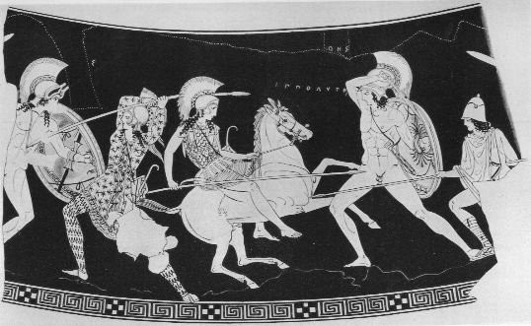
The Amazonian Woman

Slide 29
Background Information
Amazon women were brave warriors of the Greek Myth
Historically, Amazons were portrayed as beautiful women in Amazonomachies, which was an artform showing battles between the Amazons and Greeks. Amazons were trained to use all weapons and especially in single combat. They were honorable, courageous, brave and represented rebellion against sexism. Their tales spread quickly and soon stories of the Amazons were everywhere, including Africa, Asia, Europe, South America (the Amazon River was named after the female warriors), and North America in the mid-1900s with the comic book hero, Wonder Woman.

Slide 30
Famous Amazons
Hippolyte was an Amazon Queen. Daughter of Otrera and Ares, God of War. Herakles' ninth labor was to take Hippolyte's war girdle (a gift from her father). When Herakles came, Hippolyte was impressed with his strength and so gave him the girdle. When Hera, Queen of the Gods and step-mother to Herakles saw this, she told Hippolyte's Amazons, that Herakles was there to abduct their Queen. The Amazons attacked Herakles, and during the battle, Hippolyte was killed. Her name means, "Of the Stampeding Horse.”

Slide 31
A Midsummer Night’s Dream
Hippolyta – the queen of the amazons and wife of Theseus
In Shakespeare’s time -Queen Elizabeth- was called the ‘Amazon Queen’ for not ever having a husband and being so independent and powerful.
Who would we consider an amazon queen today? Qualities: -strong -independent -powerful -intimidating

Slide 32
Other Shakespeare Characters
Amazon worthy? YES/NO
-Juliet
-Cleopatra
-Lady Macbeth
-Ophelia (Hamlet)
-Viola (twelfth night)
-Katherine (Taming shrew)

Slide 33
The End

