Slide 1
Folklore and Frame Tales
Joel Chandler Harris and Charles Chesnutt

Slide 2
African Folklore in America
Surviving pieces of African culture are very important as a source of pride, cultural identity and resistance to oppression.
Slave system attempted to eradicate the culture Africans brought
Tried to always mix tribal/language groups so they couldn’t talk to each other
Forbad their religions and drums
Why? Haiti’s slave revolution in 1791-1804 was the second revolution of the new world and scared the TAR out of the south.
They communicated war plans from one plantation to the next with drums.
Voodoo (Vodun, African religion) also figured prominently as a unifying religion that made them feel empowered.
U.S. & Britain outlawed international slave trade in 1808, so no new people from Africa came into the U.S.
Made it harder to keep cultural memory alive

Slide 3
Bre’r Rabbit
Slaves preserved some of their traditions
Trickster tales are about a weak character who wins every contest through cunning
Obvious lesson for slaves on how to outwit the master/overseer
Lessons in how to act and how to talk to those who think they have more power
Brer Rabbit pretends fear and humility “oh please don’t throw me in the briar patch, I’m begging you.”
Also a moment of appropriation and exploitation by Harris
Used stories he got from slaves without acknowledgement or compensation (like Led Zepplin)

Slide 4
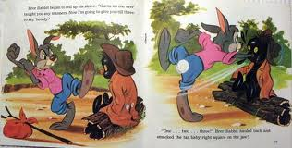
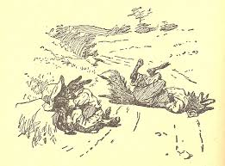
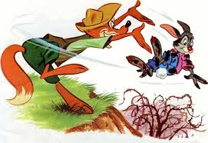

Slide 5
Frame Tale Definition
An initial narrator (usually 3rd person) presents a character in the story who tells an imbedded story to another character.
2 scenes—one where story is being told, and that story itself, which is about a different time.
Usually not much happens in the frame—it’s just a way of giving the other story a cultural context
Framing devices tell readers
where we might be expected to hear a story like this,
whose tradition/experience it belongs to, and
listeners in the story model an attitude toward the speaker & his message

Slide 6
Harris’ Frame Tale
A little white boy hangs around the slave cabin and begs for stories
This story belongs to “Uncle” Remus.
Real storyteller was George Terrell and others (Too bad George never made any money off it).
The scene is again a compensatory fantasy that has special appeal for white readers
Readers see that slaves like Uncle Remus just LOVED little white boys
Many literary critics have shied away from these stories because of this kind of paternalistic lie about slavery.
Still very important

Slide 7
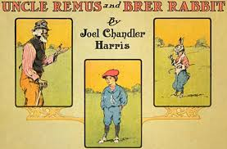
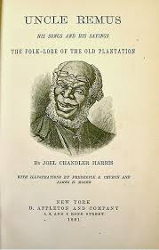
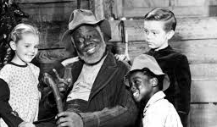

Slide 8
Does the story transcend the frame?
Boy’s attitude toward speaker?
Doesn’t recognize that “uncle” Remus is tired, has his own family to think about.
Sense of entitlement, etc.
Remus also has his own sense of trickery
gets rid of the kid when he’s had enough
works in some fairly subversive messages.
For those of us who are alert and not children, we can see Remus taking control of the situation to the extent he can.
Which part of the message is stronger to you?
Resistance or oppression?

Slide 9
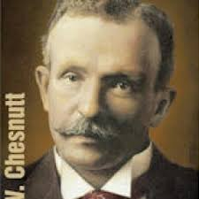
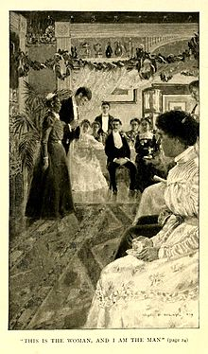

Slide 10
Dave’s Neckliss
Also a Frame Tale
Where are we (time & place)?
Whose tradition/experience is this?
What is the attitude of the listeners (John & Annie) toward Uncle Julius & story itself?
Write: How is Chesnutt’s framing different than Harris’s?

