Slide 1
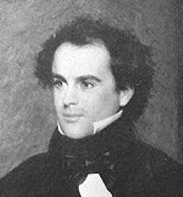
Hawthorne Intro
Puritans, literary romanticism and The Scarlet Letter

Slide 2
Questions I’ll try to address:
Why skip to Hawthorne now?
What does this text show us about the Puritan legacy?
What in his life, context, influences might have brought him to this material?
What manner of book is this?
Why is it important?
What’s the deal with that weird long introduction, “The Custom House”?

Slide 3
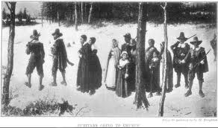
Why skip to Hawthorne now?
From Puritans & Great Awakening (1650 & 1750) to 1850
  Different literary styles and historical context
We are trying to figure out how the early settlers, including Puritans are relevant to us now and what they have to tell us.
  So is Hawthorne.
He humanizes and gives a complex interior life to them in more modern language.
    It’s an opportunity to imagine them more fully and update Hawthorne

Slide 4
What in his life, context, influences might have brought him to this material?
Hawthorne was born in Salem, Massachusetts
  The original name of the family was Hathorne,
  They included John Hathorne, a prominent judge in the Salem witch trials of 1692-3.
    Nathaniel added a 'w' to the name to distance himself from his ancestors & their story
    The Hathorne legacy was one of strict Puritanism
  Strongest influences in his life are female
    When Hawthorne was four his father, a sea-captain, died of yellow fever in Suriname and Hawthorne's upbringing was left up to his mother.
    Strong women in his life: Mom, Margaret Fuller (feminist writer), Elizabeth Peabody (education reformer)
      Hester Prynne, the heroine of the Scarlett Letter is independent like them

Slide 5
What manner of book is this?
Romance, not a novel.
Romanticism Defintion:
  European and American late-eighteenth-century and early-nineteenth-century intellectual movement. Core values: human imagination, intuition, subjectivity, emotion, and isolation.
  Romanticism treats nature as an inspiring/sublime force and idealizes the radically innovative individual (artist).
  Literary Romanticism uses many of the following techniques/tropes
    Characters: The idealized artist or aristocratic hero/heroine is isolated and super sensitive
    Settings: Usually a far-off time or place. Somewhere “exotic” that will be exciting to an artistic or psychologically intense person.
      Nature is communicates spiritual messages to people
    Plot: Not strictly realistic—may include supernatural elements. Often, a lost story is gradually rediscovered, rewritten.

Slide 6
Romance vs. Novel
“When a writer calls his work a Romance . . . he wishes to claim a certain latitude, both as to its fashion and material, which he would not have felt himself entitled to assume, had he professed by writing a Novel.” (The House of Seven Gables)
“In the old countries . . . a certain conventional privilege seems to be awarded to the romancer; his work is not put exactly side by side with nature; and he is allowed a license with regard to every-day Probability . . . This atmosphere is what the American romancer needs.” (Blithsdale Romance)
Notes:
One of the conceptual leaps that students will need to make if they are to appreciate and enjoy Hawthorne’s fiction is to understand that he was not writing realistic fiction. Indeed, Hawthorne repeatedly told his readers that his longer works of fiction should not be considered novels, per se, but that they were better described as romances. In the prefaces to The House of the Seven Gables and The Blithedale Romance, Hawthorne offers some useful distinctions between the novel and the romance as fiction genres (see the quotations in the slide and the longer excerpts below). Take some time to discuss these distinctions with your students. Put up lists on the blackboard (or whiteboard) of characteristics of the romance and characteristics of the novel, and ask the students if these distinctions hold true for different kinds of films and television programs as well. What are the advantages of opting for romance over novel? What are the disadvantages? What does Hawthorne in particular hope to gain by embracing the romance genre?
“When a writer calls his work a Romance . . . he wishes to claim a certain latitude, both as to its fashion and material, which he would not have felt himself entitled to assume, had he professed by writing a Novel. The [novel] is presumed to aim . . . the probable and ordinary course of man's experience. [Romance] . . . must rigidly subject itself to laws, and while it sins unpardonably so far as it may swerve aside from the truth of the human heart—has fairly a right to present that truth under circumstances, to a great extent, of the writer's own choosing or creation . . . The point of view in which this tale comes under the Romantic definition lies in the attempt to connect a bygone time with the very present that is flitting away from us” (preface to The House of the Seven Gables).
“In the old countries, with which Fiction has long been conversant, a certain conventional privilege seems to be awarded to the romancer; his work is not put exactly side by side with nature; and he is allowed a license with regard to every-day Probability, in view of the improved effects which he is bound to produce thereby. Among ourselves, on the contrary, there is as yet no such Faery Land, so like the real world, that, in a suitable remoteness, one cannot well tell the difference, but with an atmosphere of strange enchantment, beheld through which the inhabitants have a propriety of their own. This atmosphere is what the American romancer needs” (preface to The Blithedale Romance).

Slide 7
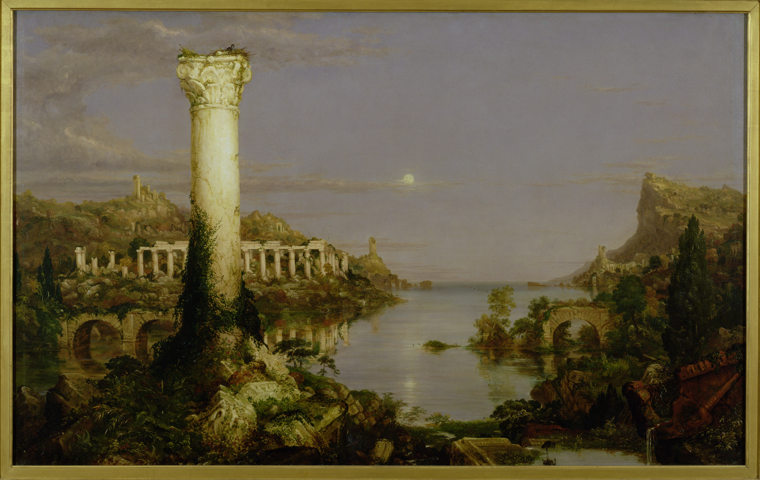
Notes:
Exotic location, ruins of ancient civilization, sublime scene dwarfs human scale, idealized (no trash or modern intrusions)

Slide 8
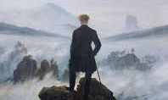
Romantic Hero

Slide 9
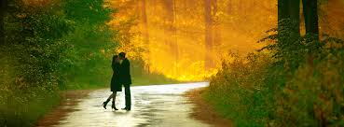
Many of the conventional ideas about romance are not accurate descriptions of literary romanticism.
Doesn’t have to include a love story
Not “mushy” or emotional in a Hallmark card sense
Women not always pure; men not always strong
  Other romantic cliches you want to bring up?

Slide 10
Why is The Scarlett Letter important?
What it shows us about women in 1850 and 1650
What it shows us about Puritans and U.S. history & national identity
What it shows us about the psychology of desire and repression
What it shows us about the creative power of the individual
The beauty and excitement of the language

Slide 11
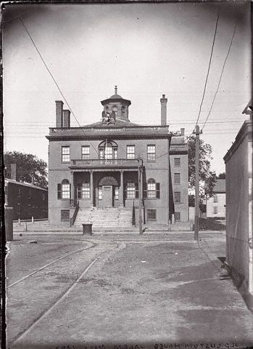
What’s the deal with that weird long introduction, “The Custom House”?
Hawthorne distancing himself from the material—he just “found” it. Also flirts with a truth claim.
“What is he?” murmurs one gray shadow of my forefathers to the other. “A writer of story-books! What kind of a business in life,—what mode of glorifying God, or being serviceable to mankind in his day and generation,—may that be?”
“Do this,” said the ghost of Mr. Surveyor Pue. . . . “But I charge you, in this matter of old Mistress Prynne, give to your predecessor’s memory the credit which will be rightfully its due!”

