Slide 1
Historical Contexts
Civil War, Economic Change, Immigration, Imperialism

Slide 2
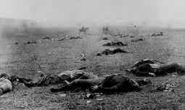
Civil War Reporting and Photos shocked the nation

Slide 3
Legacy of the Civil War
How bad was the violence?
  Numbers killed: 1,030,000 casualties
  620,000 soldier deaths—two-thirds by disease
  As many American deaths as all American deaths in other U.S. wars combined
How did they try to patch things up after the war?
    Johnson 20,000 U.S. Army troops stayed to protect former slaves & make sure Southerners didn’t try to re-start war
    Took over gov’ts, rebuild the south, sign loyalty oaths
    Gave land to some ex-slaves in S. Carolina
    Johnson tried to make it easy for southerners, but “radical republicans” rejected his ideas & over-rode his vetoes (1867)
    Radical Republicans removed all southern governments, put their own people in (carpetbaggers)
      Radical reconstruction offered massive aid for railroads, built public schools, and raised taxes

Slide 4
End of Reconstruction (1877)
  2 reasons why Reconstruction ended in the south
        Southern opposition (often violent, KKK)
        Economic instability meant republicans (liberals then) lost congress & democrats came back representing both northern and southern states
  Political re-unification
    All southern states re-admitted union and government representation by 1870
    All southerners pardoned of treason in 1872.
  Unfinished Reconstruction work
    North basically said “fine, you do it then” even though the work of rebuilding was far from over and blacks still needed legal and police protection.

Slide 5
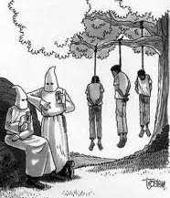
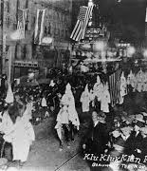
Rise of the KKK

Slide 6
Status of former slaves
  Slavery ended for the Confederacy's 3.5 million blacks
  Bumpy transition into new “free” status
    Share cropping, convict lease system
      Allowed slavery to continue under new names
    Lynching, marginalization, whole towns of blacks burned down
        1898—161 blacks lynched in the south
  In 1870 the KKK is outlawed as a “terrorist organization”
    It’s revived in big numbers as a secret club at the turn of the century after the film Birth of a Nation
  “Jim Crow” laws & Plessy v. Ferguson 1896
    Accommodation of white southerners (U.S. sold out new black citizens to patch things up with white south)

Slide 7
Economic Change
Transportation and manufacturing change the country completely
  From family farms & workshops to factories & agribusiness
First Transcontinental railroad 1869
    Wagons took 2-3 months; trains a couple days
    Goods get to markets much faster, so people can sell much more stuff, esp. farm products that would spoil otherwise
    Ended plains Indians way of life and cut in ½ the buffalo path of migration
  Telegraph comes to small towns
  Electricity on a larger scale
Mineral wealth: coal, oil, iron, gold (rush 1849), silver
Monopolies emerge in many industries (robber barons)
  Carnegie in steel—vertical integration (mines to sheet metal)
  Leads to “Gilded Age” (Twain’s term) of “conspicuous consumption”
    Ideal man is bearded (= no syphilis!) and rather fat
The economy overall climbs, but with some terrible crashes in 1873 and 1890s
  No public welfare system—unemployed simply starved or maybe church helped.

Slide 8
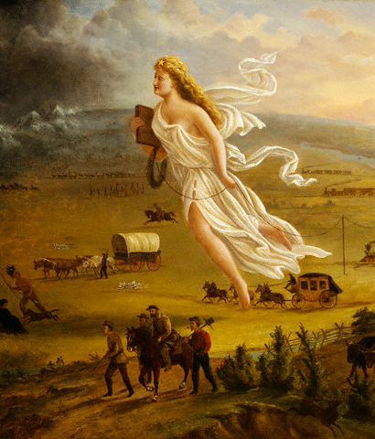
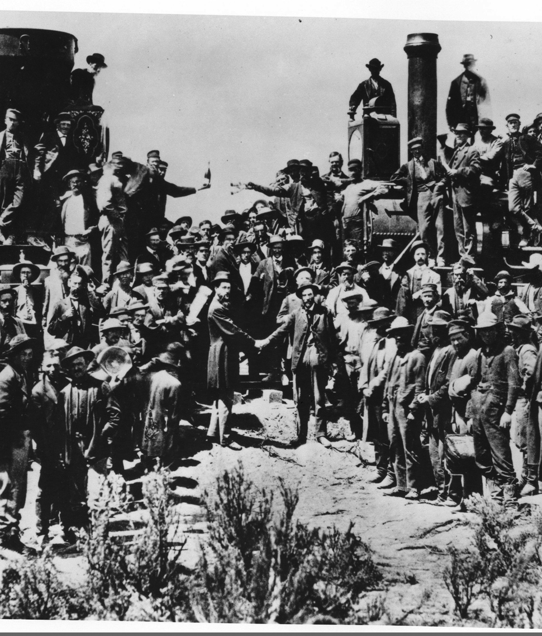
Westward Expansion and Transcontinental Railroad

Slide 9
Immigration
Nation needed more people to keep up with economic growth (and depress wages)
  Why does the Statue of Liberty (erected 1886) want the “tired, poor huddled masses”
  City populations exploded with new immigrants from Italy, Ireland, Poland, Russia, etc.
  Population growth: 1870 US. = 38.5 million; 1910 pop = 92 Million; 1920 pop = 123 million
    27.5 million total immigrants arr. From 1865-1918
New class and ethnic divisions due to immigration
  Incredible wealth of Carnegie, JP Morgan, Rockefeller, Vanderbilt
  Contrast to immigrant slums—new to American life as factories were new
    Urban immigrant workers hideously exploited—12 to 16 hour days, not enough to live on, dangerous conditions, etc.
  Workers tried to organized to get fair working conditions, but they were violently repressed
    Right to strike not recognized until 1930s
  Homestead Act 1862
    Promised land to any family that would “improve” it
    Land actually went to speculators most of the time

Slide 10
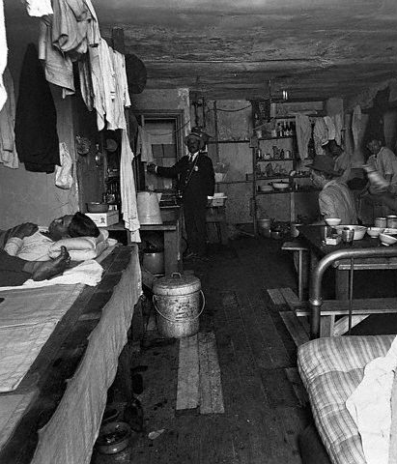
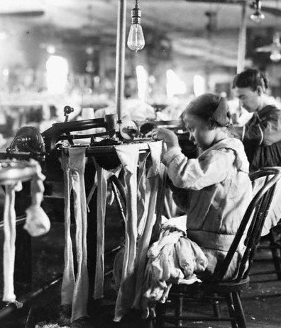
Tenements & Factories

Slide 11
American Imperialism
Conquest of continent complete in 1848
  Brought a lot of that mineral wealth (gold rush in 1849)
  End of Frontier
    Census says no place in America has les than 2 people per square mile—everywhere is settled, discovered.
    Native people pushed onto reservations
      Suddenly anthropologists want to study them
      Dawes Act ends collective holding of land
        Devastating to culture and economic well-being
New acquisitions overseas
  Stepped into Spanish-American war
    Used victory to take over Cuba, Puerto Rico and Philippines
      Twain HATED this—worse than Iraq
    Also took over Hawaii—annexed in 1898 due to the influence of big planters there

Slide 12
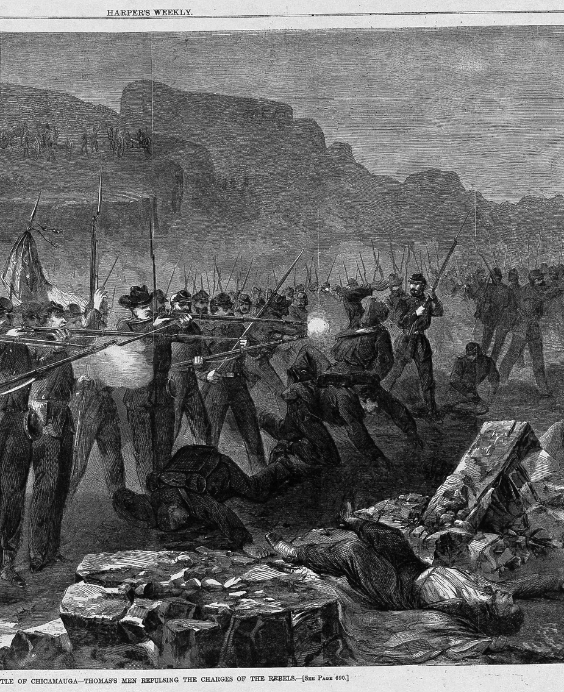
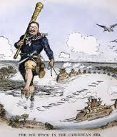
Indian Wars and Imperialism

Slide 13
What this all means for literature:
Themes and issues writers take up are different than the ones that interested the early settlers.
More economic/material focus, less spiritual & romantic
  Leads to literary movement known as Realism
Contact with more and different people, so trying to understand our differences and basic human nature become urgent concerns.
  Leads to literary movement known as Naturalism

