Slide 1
First Wave Feminism
Seneca Falls to the Civil War

Slide 2
women get political
Many women were involved in Abolitionist cause and Temperance Movement (anti-alcohol)
  Anti-slavery political groups encouraged women’s full participation—speaking, organizing, etc.
  Politically active women hated the fact that they couldn’t vote and help change laws by using the system.
    Petition to New York State Govt:
  “Your Declaration of Independence declares, that governments derive their just powers from the consent of the governed. And as women have never consented to, been represented in, or recognized by this government, it is evident that in justice no allegiance can be claimed from them ... Our numerous and yearly petitions for this most desirable object having been disregarded, we now ask your august body, to abolish all laws which hold married women more accountable for their acts than infants, idiots, and lunatics.”

Slide 3
Seneca Falls Convention
First convention to be organized by women to work toward equal rights
  1848 in Seneca Falls, New York
  Wanted: Voting rights, property rights (to own and inherit), the right to make contracts, serve on juries and better employment opportunities.
      Women were paid ½ as much as men in the same job.
Reactions:
  Some called them “hens that crow” and unnatural women
  Others supported them
    Fredrick Douglass was there and convinced them to keep the voting rights idea
Early gains:
  New York & Pennsylvania pass laws granting women property rights in 1848

Slide 4
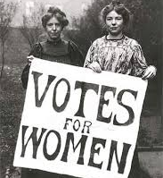
Major players
Elizabeth Cady Stanton, Lucy Stone, and Susan B. Anthony & others
  Strongly influenced by Quaker thought (pacifist)
    Some were arrested for trying to vote

Slide 5
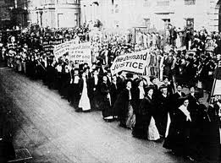
What they achieved
By 1860, right to their own children in case of divorce or widowhood
Right to own & inherit property in the U.S.
Reforms to higher education, access to more professions
  Could go to college and study same curriculum as men by 1868
19th amendment: right to vote 1920
  Required 2/3 popular vote--men
Eventually outlawed Liquor in the 18th amendment (1919-1933).
  Repealed in the 21st amendment.

Slide 6
Black women’s Movement
Free Black women wanted protections from abuse at work, especially domestic service
  Few of them were upper class, so they weren’t so interested in being “allowed” to work and inheriting property was mostly a non-issue
Had to march separately in some of the women’s rights demonstrations of the 19th century
  White women were afraid of alienating the entire South from their cause
Ideals & goals (mostly after Civil War)
  “Lifting as we climb”
    not just getting new individual rights and professional options, but helping the poor to improve their situation.
  Education as the key to getting out of poverty and preserving “virtue”
    worked to start schools and staff them
    worked to improve the image of black women across the country—raise awareness of their respectability

Slide 7
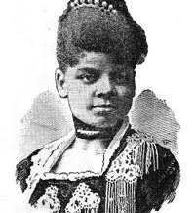
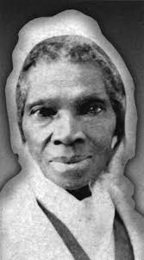
Major Players
Ida B. Wells
Sojourner Truth

Slide 8
Fanny Fern’s approach
How does she appeal to men in “A Law More Nice than Just”?
  Mr. Fern’s reaction (915)
  Mrs. Fern’s tone (end)
How does she appeal to women in Ruth Hall?
  Fear & sentiment (917)
  More forceful? (918)
Sentimentality
  Families torn apart
  Death of a child
    Emotion mobilized toward a purpose
      You feel terrible and want this to not be possible

