Slide 1
Jack London & the Klondike Gold Rush

Slide 2
Jack London
Childhood origins
Comes from childhood of abuse and neglect
Mother abandoned while pregnant with him
New father adopts him, but it’s not happy
He spends all his time with the black neighbors in S. F.
Jobs
Went to sea, became an alcoholic, socialist,
Went to Alaska for their gold rush in 1897

Slide 3
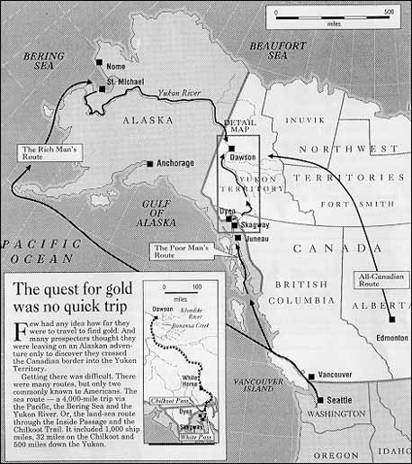
Klondike Gold

Slide 4
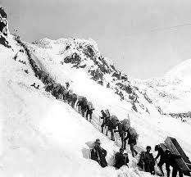
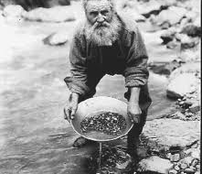
Thousands Came Looking

Slide 5
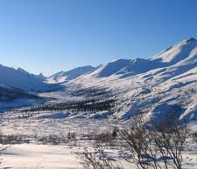
London’s Career
Was considered too “popular” and said he wrote only for money, but was very disciplined about his craft.
Wrote 18 novels, 198 stories, plays & tons of non-fiction.
He’s pretty mixed up about race, but good at what he does

Slide 6
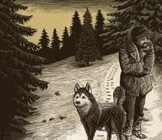
Literary Craft
Incredibly precise physical detail:
Cold of space (1052 bottom)
Lighting a match (1054)

Slide 7
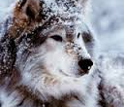
Naturalism in London
People versus animals
Man is unimaginative (1048)
Dog has more response to the cold (bottom 1049)
What allows the dog to survive and not the man?
Is this biological or scientific determinism?

