Slide 1
Authentic Happiness Ch 1
Overview & discussion

Slide 2
Why study nuns?
Rules out the interference of some lifestyle factors
  Similar bland diet
  Similar work & sex life
Easy to track
  Stay in the same job
What conclusion did he draw?
  Optimism and happiness contributes to longevity

Slide 3
Seligman’s project
First ½ of the book is about the momentary feelings of positive emotion: joy, flow, glee, pleasure, contentment, serenity, hope and ecstasy.
He has 3 questions about these emotions:
  Why has evolution endowed us with positive feelings? What are the functions and consequences of these emotions, beyond making us feel good?
  Who has positive emotion in abundance and who does not? What enables these emotions, and what disables them?
  How can you build more and lasting positive emotion into your life?

Slide 4

Hedonism is not enough
A hedonist wants as many good moments and as few bad moments as possible in his life.
  Seligman believes that adding up the total of our momentary feelings is a flawed measure of how good or bad our experience really is.
    Colonoscopy study (how it ends is important)
Relying too much on hedonistic shortcuts leads to “spiritual starvation”
  Drugs, chocolate, casual sex, masturbation, TV
    Just “fidgeting until we die” (8).

Slide 5
Gratification versus Pleasure
Afterglow of pleasure is weak compared to satisfaction of a philanthropic act.
  Read example p. 8
    “Gratification calls on your strengths to rise to an occasion and meet a challenge. Kindness is not accompanied by a separable stream of positive emotion like joy; rather it consists in total engagement and in the loss of self-consciousness.”
A stronger route to gratification & happiness is to find out what your positive traits are and develop them, work at it.
    Don’t spend a lot of time correcting your weaknesses, just develop your strengths.

Slide 6
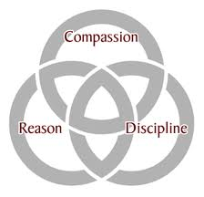
Strengths valued in most every culture include:
Wisdom and knowledge
Courage
Love and humanity
Justice
Temperance
Spirituality and transcendence
Sometimes these emerge more in difficult times

Slide 7
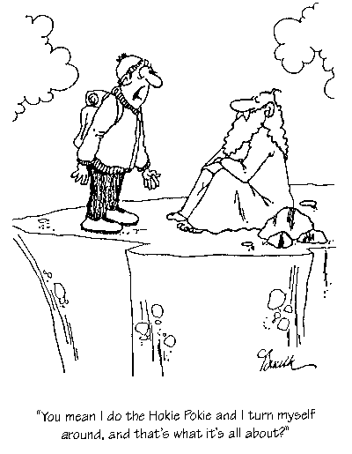
Seligman’s formula for a good life
“The good life is using your signature strengths every day to produce authentic happiness and abundant gratification” (13).
Finding meaning in life “consists in attachment to something larger” (14).
  Living for self-centered momentary pleasures (ie. eating, sex and shopping) will leave one empty.

Slide 8
Take the questionnaire (16)
Write:
Which parts of Seligman’s argument seem correct to you?
Which parts would you be reluctant to accept without a lot more information?
What in your life do you think contributes most to your happiness questionnaire results?
Share with a group
Choose a note-taker, facilitator, and speaker

