Slide 1
Carrie and the Psychology of Desire
“We spend most of our money not on necessities but to keep us amused and socially important and to prevent our being laughed at”—Dreiser in Notes on Life

Slide 2
Sister Carrie & Consumerism
Usually seen as a critique of the culture of consumption
  Characters are “fragile selves” doomed to hollow, unsatisfying lives because of the dehumanizing effects of capitalism
  They become commodities to each other and in the marketplace
    Carrie is “arm candy”
    Drouet is security
    Hurstwood is prestige

Slide 3
Consumer goods
The book is crammed with consumer goods—laces, food, shoes, jackets, etc
  To make the setting more vivid and real for us
  To document the economic history of that time
  To make a social commentary on consumerism
What I’ll focus on—to bring together economic and psychological concerns in a new theory of the self.

Slide 4
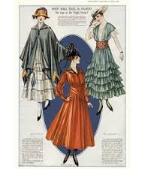
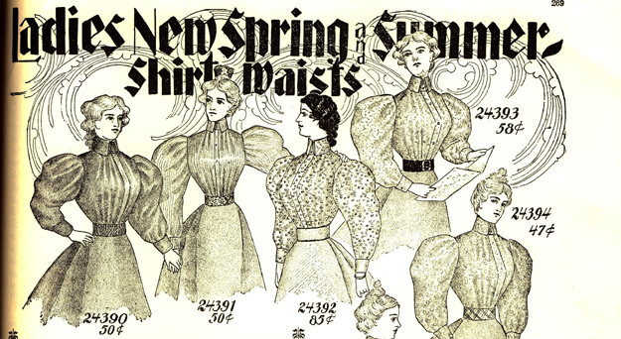
Turn of the Century Fashion

Slide 5
The “Innate” Drive to Compare
Dreiser believed that the impulse to compare oneself to others is innate—instinctive
This instinct drives us to continuously compare and (hopefully) improve oneself
  The self is thus never done.
  There is no “True Self” at the core.
    Maybe why the characters seem hollow
      no core set of beliefs, or even much personality
      just comparing, improving, creating an image inside and out

Slide 6
Carrie’s Journey
Carrie’s bildungsroman, her education, is learning who to be
  She isn’t just a helpless bit of driftwood in the marketplace, tossed, carved or mangled by everything around her
    She creates herself proactively through the things she desires and through comparison with others

Slide 7
Carrie isn’t fundamentally materialistic
Carrie’s longing for new things is not for the sake of the things themselves, not greed
She wants to be like the successful people—to be one of them
She’s always looking forward to new versions of herself she might be able to create, to greater self-perfection
  It’s painful to go out and see that you are not as good as others, but Carrie faces it, and works to get to the next level

Slide 8
Carrie As Actress
Carrie as actress arouses more desire in men than ever before
    Drouet and Hurstwood are both desperate to have her after seeing her on stage
On stage she intensifies and speeds up the whole process by which she has created her identity
    Compare, imitate, improve—not just one life-role but dozens on stage
    A role can stimulate desire but never satisfy it because it’s a role, confined to the stage
    On stage, she become desire in action

Slide 9
Why Hurstwood Fails
Hurstwood looks back, and that’s why he crumbles
  When he sees better-dressed and more confident men in New York, he hides and remembers his former glory.
  Unlike Carrie, he fails to compare and emulate, so according to Dreiser’s theory of self-construction, he has no self.
    he can’t face the painful truth that he’s not as good as some people

Slide 10
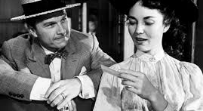
Our ½ equipped little knight

Slide 11
Why Carrie succeeds
  Carrie can deal with the fact that others are better; in fact it motivates her
    She doesn’t waste time on jealousy of better women—she just goes to work getting that
    Drieser credits her with imagination
      Her imagination is not just as a natural actress, but also in her ability to imagine new selves, new spheres for herself.

Slide 12
Self-Creation
This process of self-creation can’t end
    The goal is not consumption, but comparison and emulation
      Satiation is not possible—there are always new standards for comparison
    This is capitalism translated into selfhood: we must never be satisfied with what/who we are, or the economy/self will cease growing.

Slide 13
Discussion
Find a quote where Carrie compares herself or her things to others’.
What’s her real motivation and what’s the outcome?
Do you agree that the tendency to compare is “innate” in her and in us?

