Slide 1
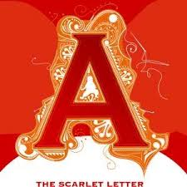
Three Major Symbols in The Scarlet Letter
The shifting meanings of the “A”
Nature imagery
The logic of the scaffold

Slide 2
Key moments in a the life of a symbol
First glimpse
Adultery: shame and shamelessness (480)
Why decorate it? Is she defiant?
What “sphere” does she occupy?
“A” Metor
Angel and Adultery (536, 537)
Shifting between, both unreal
Able
Hester’s ministrations and advice (539)
Awe
Of the life she led (593)
Apostle
Of women’s rights and the right to happiness (593)

Slide 3
Nature’s spiritual qualities
Plants have almost magical properties
Rose outside prison door (477)
Wild, delicate & beautiful, linked to Pearl
Contrasted to the “dark flower” of fate (546)
Chillingworth’s herbs (522)
Dark flabby leaf
Grown out of the heart of an unmarked grave = secret sin
plants & nature manifest truth that can’t be spoken
Burrs in the graveyard (524)
Thorny, stick to the “A”
Like Christ’s crown of thorns
Reminder of judgment after death

Slide 4
Scenes set in nature have special significance. Hester meets her ex-husband on the wasted cliff where he gathers herbs. (546) Sun doesn’t shine on this guy.

Slide 5
Contrast that cliff scene to the forest Lawless, “godless” wilderness, a place of freedom and the “Black Man” (Devil) ➔How is Hawthorne positioning readers to feel about all that the forest unleashes or enables? (554, 559, 561) Consider how Hester & Dimmesdale change in the forest. Also, Dimmesdale goes a little crazy after the forest.

Slide 6
Scaffold Scene Number 1 Who’s where, why & what’s accomplished? What’s the POV? (481—3)

Slide 7
Scaffold scene 2 Who’s where, why & what’s accomplished? POV? (531-536)

Slide 8
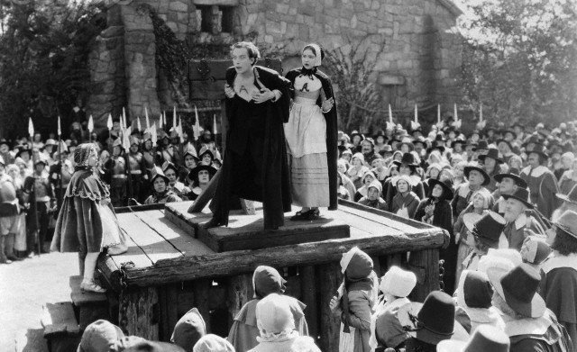
Scaffold Scene 3 What changes? Narrative POV?
Hester listens to Dimmesdale’s last sermon while standing at the foot of the scaffold. (583) Then he staggers up with her to reveal all. (589)

Slide 9
The scaffold is a symbol
Whatever happens to a symbol is the text’s comment on the idea it represents.
There’s a trajectory, something that’s necessary in order for the novel to resolve its conflicts
Of course Dimmesdale must confess
What else is required?
Is this an endorsement of Calvinist forms of punishment?
Why do some refuse to believe in his guilt?

