Slide 1
Naturalism in “The Open Boat”
Nature, Science, God, Society

Slide 2
A Naturalist Writer Assumes
Humans are part of nature, not a distinct type of creation, but a form of animal
Nature does not exist to serve humans
“Nature does not regard him as important” (1001)
Nature is indifferent to our preferences and feelings (1003)
Nature does not have spiritual meaning for humans
Not symbolic, but itself, not standing for something else

Slide 3
Nature Likes Your Flavor

Slide 4
Science and Determinism
Writers were influenced by scientific (and pseudo-scientific) ideas about human origins
Fascinated by our animal lineage and wrote situations and plots that would exert enough pressure for the animal to emerge
Biological Determinism
Some thought some races were closer to animal origins and thus biologically pre-destined to behave more like animals.
Environmental Determinism
Other writers focused on the way a person’s environment could determine his or her capacities, path and emotional life.

Slide 5
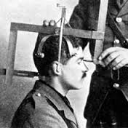
Phrenology: The Wacky Side of Biological Determinism

Slide 6
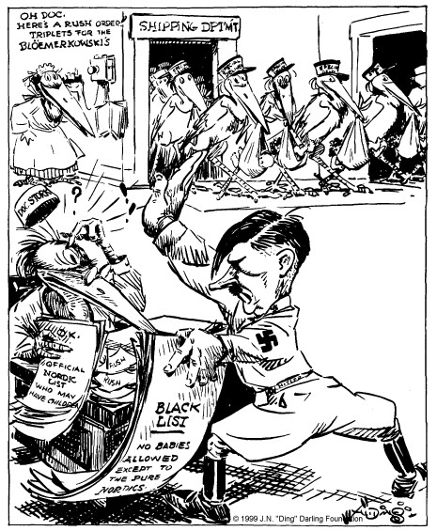
Eugenics: The Scary Side of Biological Determinism
Notes:
65,000 people were sterilized under Eugenics programs in the U.S.
Particularly vulnerable were Native people and Immigrants

Slide 7
About God
God is a human creation
Humans crave spiritual meaning, and don’t want to be “alone” in the universe without something watching over, so they create gods themselves
In the boat, they think why now; why me? (999, repeats on 1001 & end)
These thoughts reflect their longing for a god, and its absence
In the end, we know nature/universe is indifferent and it’s sort of okay

Slide 8
About Society and Morality
Humans also create societies and ethical systems
In order to survive
To provide solace and morale to frightened people
Right and wrong don’t come from God
Primitive society instinctively does what is “right” because it promotes the survival of the group
otherwise, we would die out
Advanced societies have lost sight of this, and their ethical principles are weaker

Slide 9
The Society of the Boat
“Open Boat” creates a small “primitive” society and shows how it operates when in danger.
Mutual obligation to work in turn rowing (1002)
He becomes more empathetic
Remembers the poem about the dying soldier, and it’s real now (1001-2)
Right and wrong are crystal clear (1003)
Human IS nature, animal trying to survive (1004)

Slide 10
The Society of the Shore
More “advanced” society with leisure and infrastructure
The shore itself looks like scenery in a play—fake (994)
They don’t recognize danger or get help
Meaningless waving from shore (998)
Lack of obligation to others
Lack of empathy (until the end)

Slide 11
What does this story show us about human instincts when facing danger?

