Slide 1
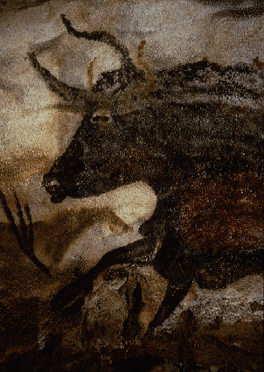
Animals of Paleolithic project: Part 1 research
Natural history-
range, diet, behavior
Status- extinct? How? Related contemporary species if extinct.
Art work depicting your animal –
describe, what colors were generally used, what caves were they located, realistic? Accurate?
Take notes on each
Meet in groups today

Slide 2
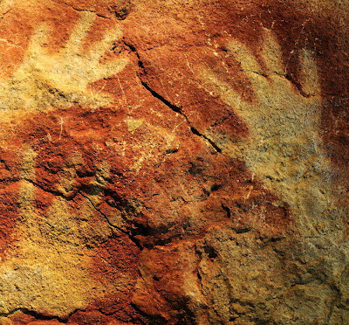
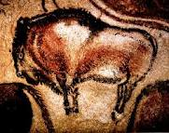
Animals of Paleolithic Art project part 2 : cave drawing panel
Review the power point images of your animal, familiarize yourself with the animal and how it was depicted in the cave art and choose an image to draw.
Each group will create a panel of drawings of your animal in the style of the Paleolithic artists.
We will present both the research information and the art panel to the class on Thurs. Jan. 24th
Project = 30 points
points in your assign. Folder score
participation = 10/30

Slide 3
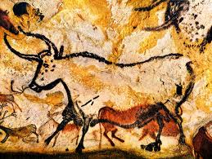
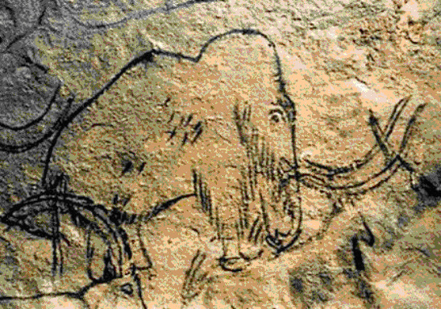
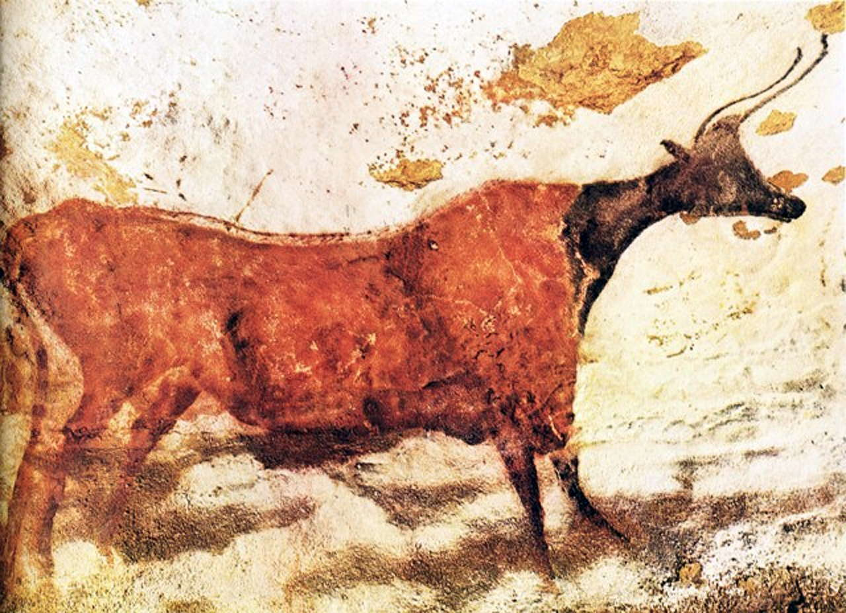
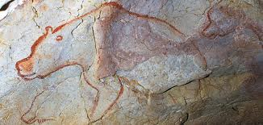
Styles of cave paintings
Contour line
Draw a simple contour line drawing showing suggestions of texture and markings but without value or shading.
Suggestions of form, texture and value (shading)
Using solid or varied color and strokes of the charcoal / paint to show tone, value and texture

Slide 4
Demonstration of Techniques
Make sure everyone has room on the panel
Brake it down sketch in pencil 1st.
Contour line drawing
Use of color
Have an image to draw from.
(3) people drawing at a time

Slide 5
Demonstration of Techniques
Make sure everyone has room on the panel
Brake it down sketch in pencil 1st.
Contour line drawing
Use of color
Have an image to draw from.
(3) people drawing at a time

Slide 6
Paleolithic panel project process
Meet in groups- organize
Pick up materials :
Cup of chalk – white, red and black- pencil
Picture references (anything you brought , drawings in your sketchbooks from Thurs. or iphone with ppt images etc.)
4’ x 6 ‘ panel
½ of group go to SRC & 3 at a time stays in room and draws- when finished go get a group member to draw …
Clean up and switch when artists are done with their drawings.
When everyone is done drawing, clean up! – everyone in group takes the panel to the hand stencil station outside.
The remainder of the class period (if there is any time left) will be spent researching your animal and/or viewing images of animal.
I will be taking role at the end of class

Slide 7
Group Discussion guidelines
Pick up your materials
Tape your panel up onto white board
Decide how the panel will be organized
Drawings have to be done in the style of the Paleolithic cave paintings.
Decide how you will make sure everyone has room on the panel. (use light pencil lines etc.)
How your group will show the diversity of techniques and styles that were used . Everyone should do a different version of the animal.
Decide what members will draw first and who will go to the SRC to research first.
Everyone in group needs to do both !!!
Decide who is going to research what ! Don’t leave the class today without deciding what you part of the research you will be responsible for.

