Slide 1
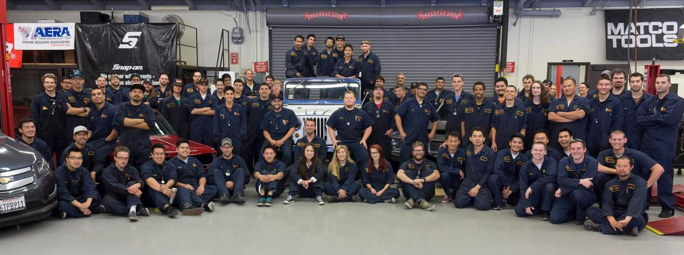
Welcome to the
Auto Tech Day Program!

Slide 2
Things You Will Purchase
- tool set, toolbox, and/or cart
- wait to buy until you hear from your teacher, ask other students
- class materials - packets, books, etc.
- coveralls (2) $60/ea
-talk to Lorna to get your size
If you need financial assistance:
check out fafsa.edu, BOG waiver, financial aid website/office, talk to instructor

Slide 3
Time Clock
ALL CLASSES: 7:30am-12:30pm
Punch in: 7:29 or before!
- and always remember to punch out!
Every hour missed = 1 hour make up time
- punch in at 7:30 = 1 hour make up
- forget to punch out = 1 hour make up

Slide 4
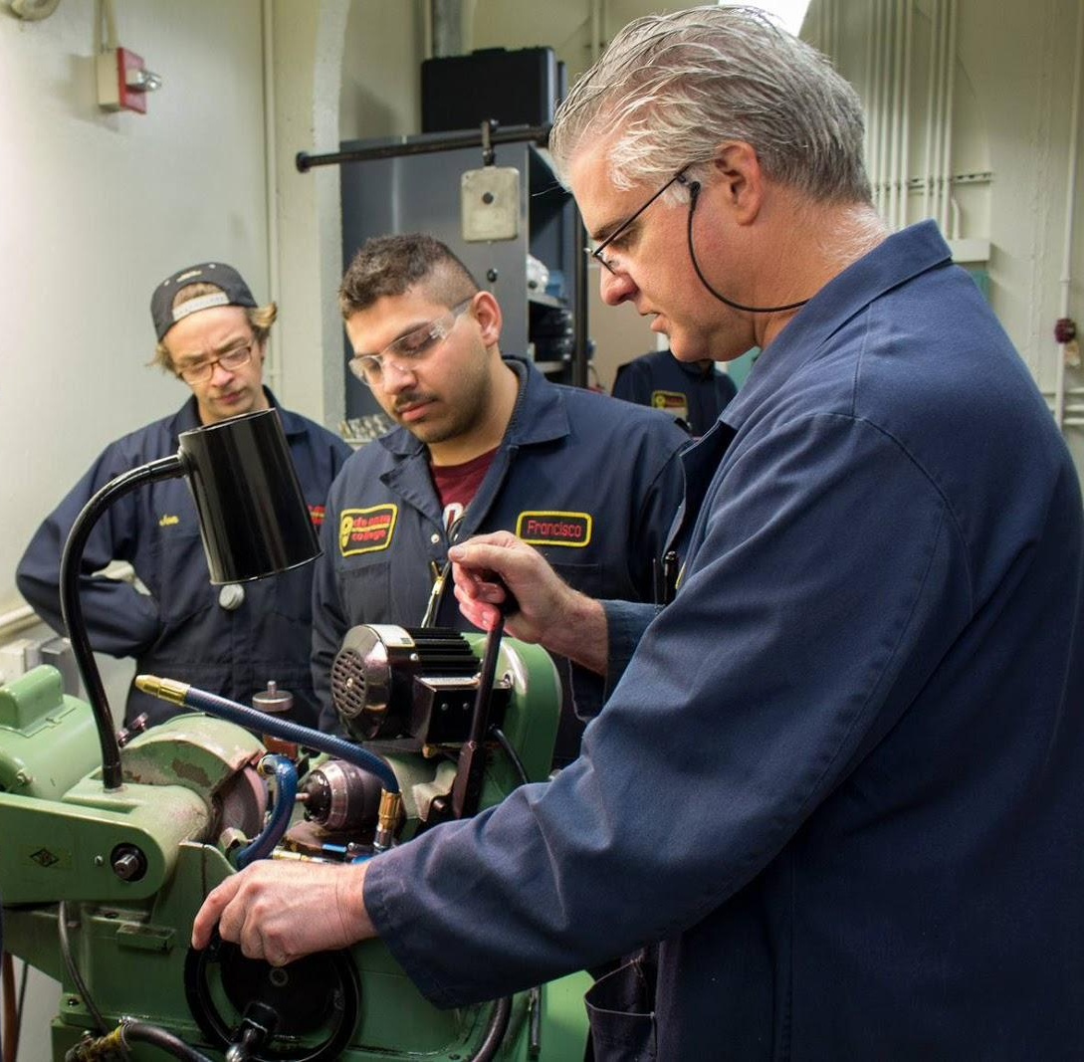
Engines and Machining
Instructor: Dave Capitolo
Schedule: Tuesday-Friday (all year)

Slide 5
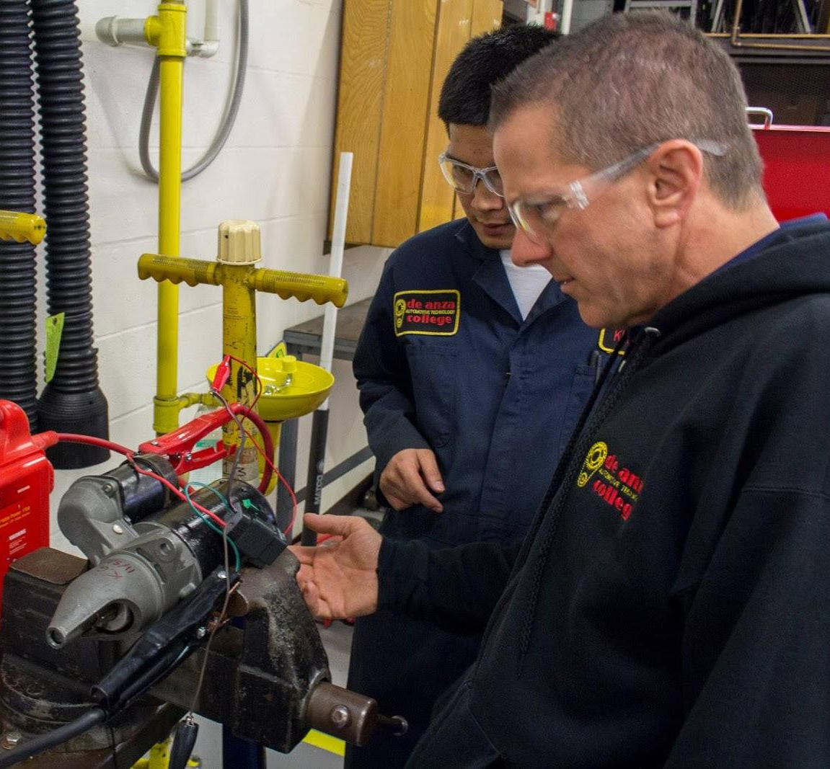
Engine Performance
Instructor: Pete Vernazza
Schedule: Monday-Friday (all year)

Slide 6
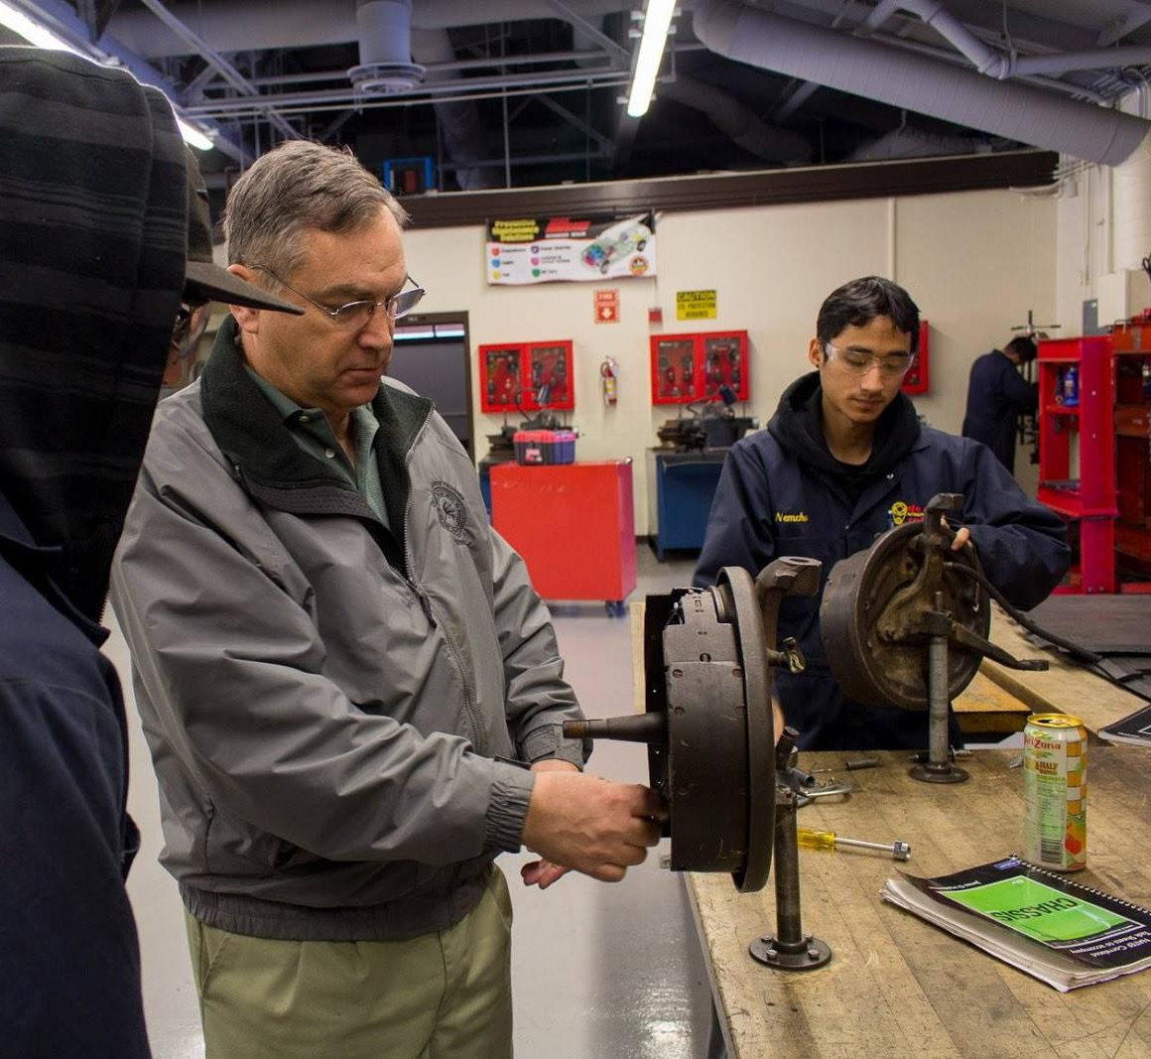
Chassis/Powertrain
Chassis - Randy Bryant
- fall quarter schedule:
Monday-Thursday
- winter quarter (1st six weeks):
Monday-Friday

Slide 7
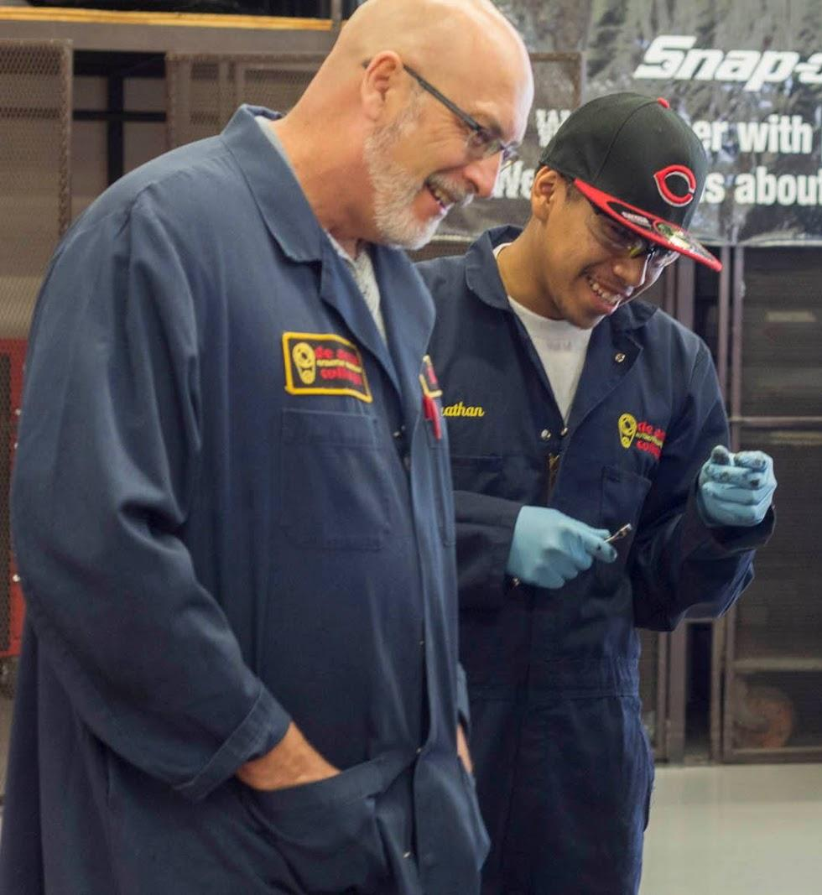
Chassis/Powertrain
Powertrain - Rick Maynard
- winter quarter (2nd six weeks)
and spring quarter both:
Monday- Friday

Slide 8
Other Familiar Faces
Lorna

Slide 9
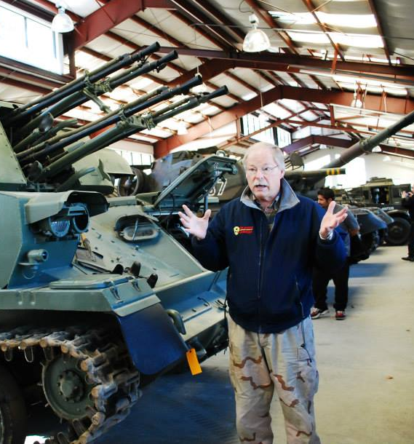
And More ...
Mr. McCart
Mr. Green
Mr. Brandt

