Slide 1
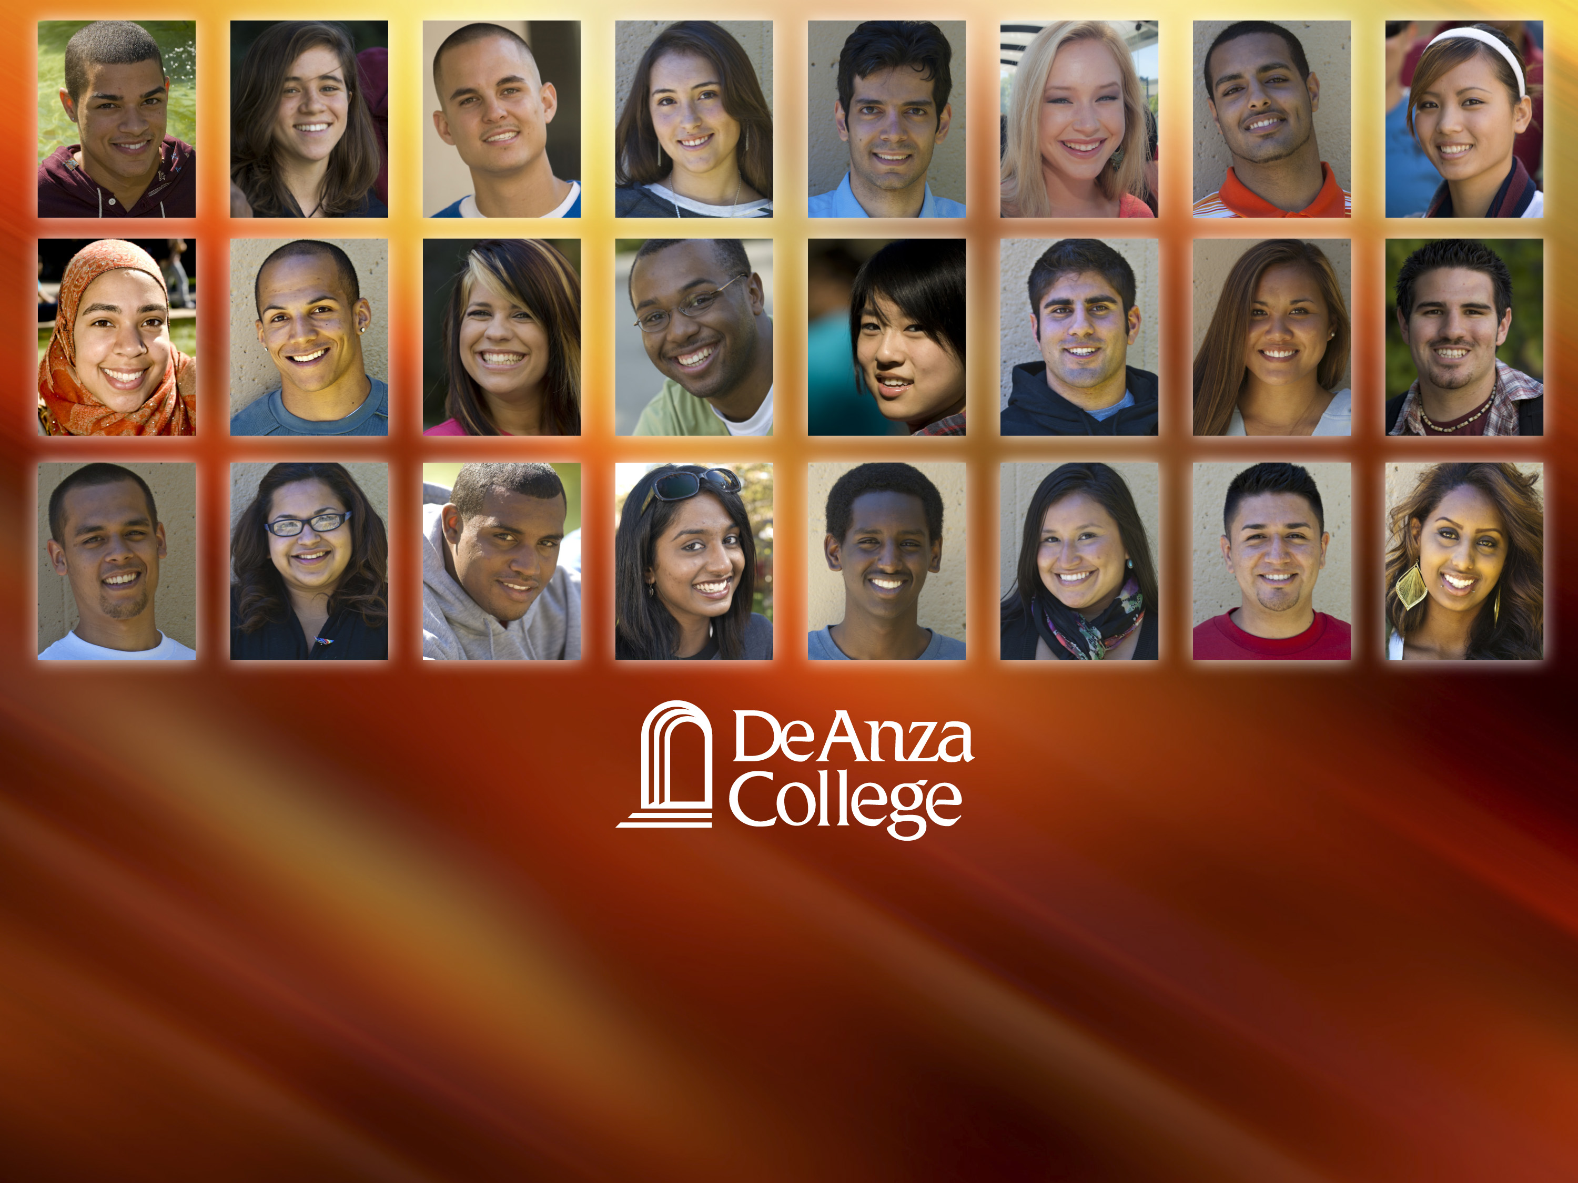
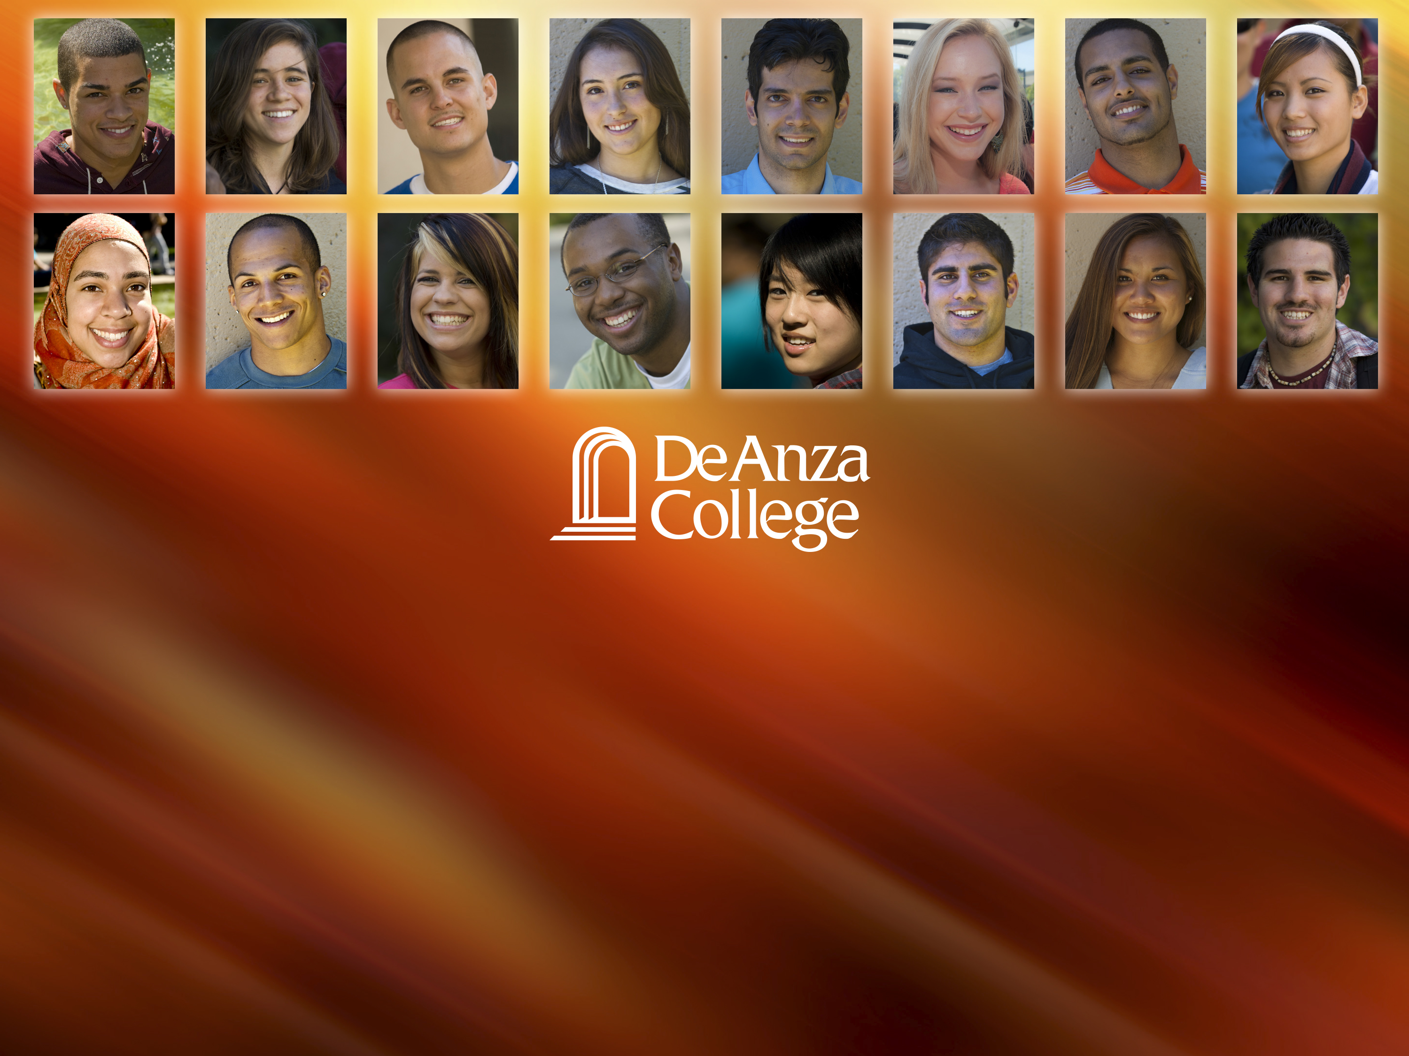
Student Equity
Veronica Neal, Director of Equity, Social Justice, and
Multicultural Education
Mallory Newell, Director of Institutional Research
Rowena Tomaneng, Associate Vice President of Instruction

Slide 2

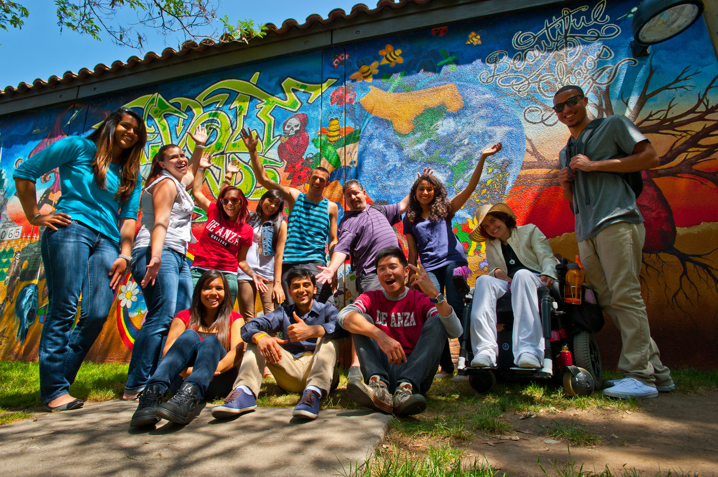
Overview
Emphasizes closing achievement gaps
among the following student populations:
African Ancestry, Latino, Filipino, EOPS,
Foster Youth, Low-Income, Veterans, and
students with disabilities
Necessitates alignment with 3SP & Requires collaboration between Student Services and Instructional areas
Strong recommendation that where possible colleges integrate student equity planning into college and/or district accreditation, educational master planning, program review, and basic skills planning processes
Original deadline was November 21, 2014. Extension given so that implementation plans now due to State Chancellor’s Office January 1, 2015

Slide 3

Student Support
Services and
Programs
Basic
Skills
Initiative
Equity
Plan

Slide 4

Planning Process
Fall 2013—3SP Campuswide committee formed (classified, faculty, and administrative representation from FCOPBT, IPBT, SSPBT, DARE, Equity Action Council, Tech Taskforce)
Fall 2013—Veronica Neal begins working with EAC in preparation for Student Equity Report Planning
Winter 2014– Senior Staff appoints tri-chairs who will draft report (Neal, Newell, and Tomaneng also working on 3SP and DARE). Larger Student Equity Committee=Equity Action Council (EAC)
February 2014—Draft 3SP-Equity Crosswalk Released
March 2014—State Chancellor’s Office releases details for Student Equity Report, including 3SP and Equity Crosswalk and recommendation that colleges use existing planning processes due to compressed timeline , i.e. Accreditation, Program Review, EAC, 3SP and Basic Skills
April-May 2014—Equity Action Council & 3SP Committee to provide initial input and data analysis of research in order to ensure alignment with 3SP report, existing college equity planning, and basic skills initiative planning
June 2014—1st draft of Student Equity report distributed to EAC, AS, CS, and DARE
July-September 2014—Revising Student Equity Plan based on review of Content of 3SP and Basic Skills Initiative Annual Report

Slide 5
Planning Process
October 2014—final draft of 3SP approved by FHDA board
October 2014–Student Equity Report Budget Planning begins as 3SP report and BSI Annual Report are finalized. Due to compressed timeline for spending for year 1, several planning meetings convened to discuss budget needs.
Senior Staff, Bret Watson, Rob Mieso, Veronica Neal, Mallory Newell, etc. review budget needs to ensure alignment with EAC, 3SP, and BSI .
October-November 2014—draft of Student Equity report with activities & budget placeholders presented for feedback (EAC, AS, CS, DASB, DARE, IPBT, SSPBT, FOCPBT, CC)
November 12-20, 2014—final revisions including more detailed budget and appendices , presentation of detailed budget for feedback (invitation to AS and CS officers)
December 8, 2014—Student Equity report brought to FHDA Board for approval
Next Steps
Fall 2014 Define AS & CS level of involvement in relation to Student Equity planning and resource allocation, i.e. senate appointments?
Winter 2015– Establish planning and resource allocation process (PBTS, EAC & 3SP Advisory Committee or alternative?)

Slide 6
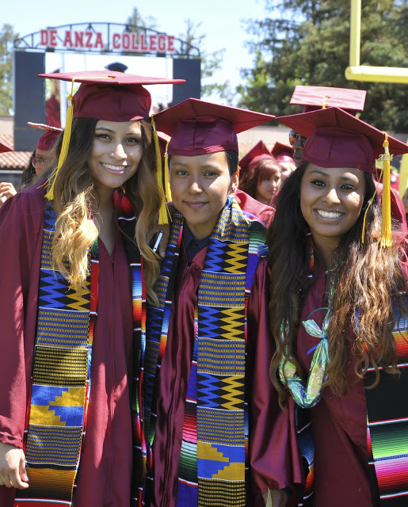
Student Equity Indicators
Access
Course and Degree Completion
ESL and Basic Skills Completion
Degree and Certificate Completion
Transfer
Notes:
Target Groups:
The target groups that will be addressed in this student equity plan are those populations that are experiencing greater than a five percent (5%) gap in their level of achievement as compared to other groups as is measured by one or more indicators of student success. Those groups are as follows:
Black (African American/African); Filipino; and Hispanic (ESL and Native English speakers).
Goals:
Student Success Indicator For Access
Compare the percentage of each population group that is enrolled to the percentage of each group in the adult population within the community served.
Student Success Indicator For Course Completion
Consider the ratio of the number of credit courses that students by population group actually complete by the end of the term compared to the number of courses in which students in that group are enrolled on the census day of the term.
Student Success Indicator For ESL and Basic Skills
Consider the ratio of the number of students by population group who complete a degree-applicable course after having completed the final ESL or basic skills course compared to the number of those students who complete such a final course.
Student Success Indicator For Degree and Certificate Completion and Transfer
Consider the ratio of the number of students by population group who receive a degree or certificate to the number of students in that group with the same informed matriculation goal. In addition,
Student Success Indicator For Transfer
Consider the ratio of the number of students by population group who complete a minimum of 12 units and have attempted a transfer level course in mathematics or English to the number of students in that group who actually transfer after one or more (up to six) years.
All Student Success Indicators: Our Additional Campus Commitment
To engage faculty and classified professionals in developing and implementing strategies and ‘Best Practices’ that will positively impact the college environment, achievement and learning outcomes of those student groups that have been identified as our target populations.

Slide 7
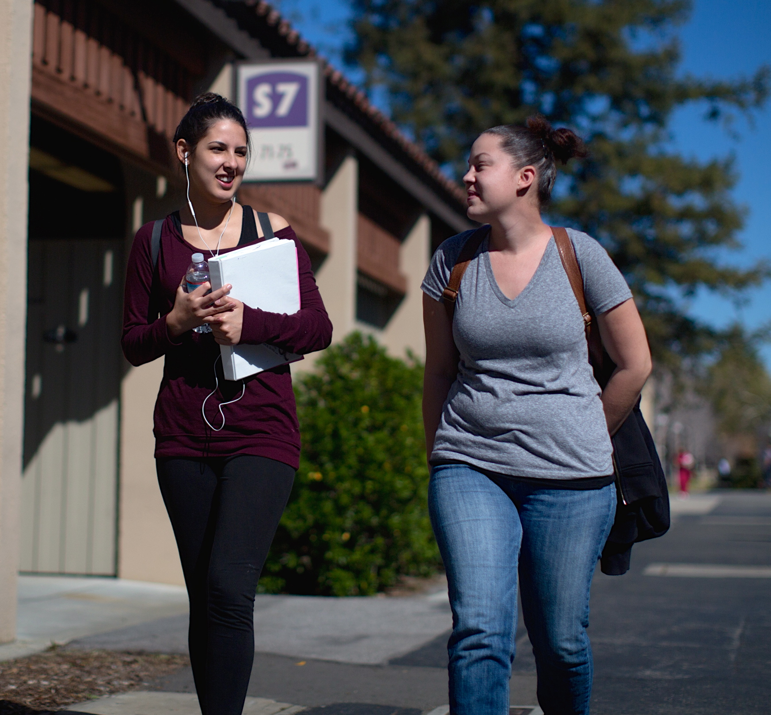
ACCESS
ACTIVITIES
De Anza will increase promotion of its designation as an AAPI-serving institution and academic & student services to targeted student populations
Conduct a detailed assessment of the needs for targeted students, including undocumented students and LGBTQQI identified student populations
EXPECTED OUTCOME
As a result of these enhancements, which include outreach strategic planning, cross-disciplinary conversations, assessments, and enhanced program linkages, we expect to see continued growth in our targeted populations

Slide 8

Course and Degree Completion
ACTIVITIES
Enhancement of professional development programs and communities of practice offerings, which center on a variety of instructional methods, specifically basic skills and equity pedagogies that improve course completion
We will continue to build on our shared governance structure so that there is deeper instructional and leadership engagement on course completion initiatives for our targeted student populations
EXPECTED OUTCOME
We will further assess and address institutional barriers and make critical policy changes through greater shared governance, faculty and staff awareness of the issues impacting course completion, and developing skills for equity problem-solving,

Slide 9

ESL and Basic Skills Completion
ACTIVITIES
Offer an annual achievement gap and basic skills institute and ongoing communities of practice, to engage staff in cross-disciplinary equity problem-solving discourse on issues such as: which students are being lost at disproportionate rates and why; what are institutional remedies for bridging the gap between basic skills and transfer level courses, etc.
A series of equity coaching and “leading from the middle” seminars will be offered to address and build the skills and capacity of campus administrators, department chairs, and program coordinators who work with ESL and Basic Skills student populations
EXPECTED OUTCOME
As a result of these programs we will develop deeper awareness and support of ESL and Basic Skills as a path to degree-applicable courses

Slide 10
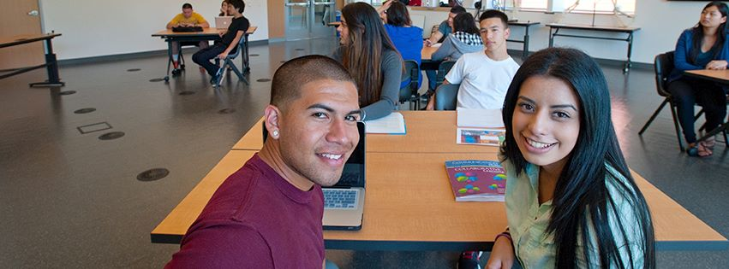
Degree and Certificate Completion
ACTIVITIES
We will strengthen our professional development programs for administrators, faculty and classified professionals on the SSSP and institution-wide activities, such as culturally responsive student orientations, discipline-specific curriculum, and faculty training in culturally responsive pedagogies
Review policies and procedures that will enhance opportunities for students to move through the system, thus, successfully obtaining their degree or certificate
EXPECTED OUTCOME
Through equity & inclusion education and culturally responsive curriculum & pedagogies, instructors and staff will work together to provide a classroom and campus climate that empowers and inspires completion of student goals

Slide 11

Transfer
ACTIVITIES
Institution-wide activities to increase the number of
students transferring to a four-year institution, aligned
with the identified enhancements recommended in
the Student Success Support Program college plan
(career and transfer resources, learning communities, tutoring, peer mentoring, etc.)
EXPECTED OUTCOME
Through student success initiatives that will increase the number of students in our targeted populations, the college will increase the number of students that transfer to a four-year institution

Slide 12
Equity Funding Allocation to the District
 | Fiscal Year | District | De Anza Credit | Notes
Equity | 2014-15 | $1,115,620 | $669,372 | Year-to-year funding
3SP | 2014-15 | $4,981,392 | $2,810, 285 | Based on funded services offered to students & required matching funds
BSI | 2012-13 2013-14 2014-15 |  | $294,859 $392,037 $348,350 | Year-to year funding based on categories related to 3SP and Equity

Slide 13
Draft DA Equity Budget 2014-2015
Activity | Equity Indicator | Responsible Parties | Allocation | Notes
Coordination | Access, ESL/Basic Skills, Course Completion, Certificates and Degrees, Transfer | VP Instruction, AVP Instruction, and VP Student Services, Office of Equity | $290,000 | Need staffing to carry out activities, i.e. equity office, learning communities, research
Academic Programs | Access, ESL/Basic Skills, Course Completion, Certificates and Degrees, Transfer | Office of Equity, Equity Action Council, Instructional Divisions, 3SP Advisory Committee | $160,000 | Recommendation to have EAC allocate funding through process similar to DARE Taskforce
Student Services Programs | Access, ESL/Basic Skills, Course Completion, Certificates and Degrees, Transfer | Office of Equity, 3SP Advisory Committee, Student Service Divisions | $160,000 | Recommendation to have 3SP advisory allocate funding through process similar to DARE Taskforce
Professional Development | Access, ESL/Basic Skills, Course Completion, Transfer | Office of Equity, Office of Organizational and Professional Development | $59,372 | This category can be subsumed equally to the 2 categories above
Total: |  |  | $669,372

Slide 14
Questions?
Veronica Neal, Director of Equity, Social Justice, and
Multicultural Education
Mallory Newell, Director of Institutional Research
Rowena Tomaneng, Associate Vice President of Instruction

