Slide 1
De Anza College 2009 Community College Survey of Student Engagement
Presented to the Academic Senate
January 10, 2011
Prepared by Mallory Newell
Institutional Research and Planning, De Anza College

Slide 2
CCSSE Overview
The Community College Survey of Student Engagement (CCSSE) was developed to:
provide information about effective educational practices in community colleges,
and to assist those colleges in using the information to promote improvements in student learning and persistence.
The survey focuses on student engagement – the amount of time and energy that students invest in meaningful educational practices.

Slide 3
CCSSE Overview - continued
Survey questions cover:
Active and Collaborative Learning
Student Effort
Academic Challenge
Student-Faculty Interaction
Support for Learners

Slide 4
CCSSE Overview - continued
Student background questions include:
Educational goal
How students pay for college
Grade point average
Day/evening course taking
Total credits taken
Number of courses taken
Marital status, children
English as native language
Educational attainment
Parent’s educational attainment

Slide 5
Survey Sample
The 2009 survey was administered in class during the spring 2009 quarter.
76 course sections were randomly selected by CCSSE in which 34 sections chose to participate, which resulted in 797 of 2,411 valid survey responses, yielding a response rate of 33%.

Slide 6
Survey Sample – Breakdown
Gender:
Male – 46% (49% in DA total student population)
Female – 54% (51%)
Ethnicity:
White – 26% (24%)
Asian – 35% (37%)
Black – 3% (6%)
Hispanic – 12% (17%)
American Indian – 1% (1%)
Other – 6% (10%)
International Students – 18% (6%)

Slide 7
Survey Sample – Breakdown
Age
18-21 – 50% (46% in DA total student population)
22-24 – 13% (15%)
25-39 – 23% (25%)
40 and over – 14% (12%)
Enrollment Status:
Part-time – 32% (61%)
Full-time – 68% (39%)

Slide 8
Class Sections Responding
ACCT001C | 36 | 4% | CDI 063A | 24 | 3% | HTEC064B | 21 | 3% | PHIL003. | 26 | 3%
ANTH001. | 35 | 4% | CDI 079C | 8 | 1% | MAND090C | 9 | 1% | PHTG064. | 23 | 3%
ARTS004A | 39 | 5% | CIS 095C | 13 | 2% | MATH114. | 27 | 3% | PHYS002A | 21 | 3%
ARTS016C | 5 | 1% | DANC038A | 34 | 4% | MATH210. | 15 | 2% | PSYC001. | 30 | 4%
BIOL010. | 19 | 2% | E S 002. | 28 | 3% | MUSI013A | 12 | 1% | READ211. | 23 | 3%
BUS 010. | 39 | 5% | ELIT001. | 10 | 1% | NURS082. | 26 | 3% | SPCH008. | 27 | 3%
BUS 018. | 24 | 3% | EWRT211. | 28 | 3% | PARA095. | 29 | 4% | SPCH010. | 21 | 3%
C D 058. | 40 | 5% | GEOL010. | 26 | 3% | PHIL002. | 32 | 4% | SPCH015. | 19 | 2%
 |  |  | HTEC060H | 22 | 3% |  |  |  | SPCH016. | 31 | 4%

Slide 9
Comparisons
The following slides compare items that were selected based on the data available in the 2007 survey for comparison purposes.
The survey was administered in spring quarter 2007 to a random sample of 57 class sections, which resulted in 1,172 of 2,057 valid survey responses from 48 sections and yielded a response rate of 57%.

Slide 10
Which of the following have you done, are you doing, or do you plan to do while attending this college? - College Orientation

Slide 11
How satisfied are you with the academic advising and planning services?

Slide 12
How much does this college emphasize providing the support you need to help you succeed at this college?

Slide 13
About how many hours do you spend per week participating in college-sponsored activities (organizations, campus publications, student government, intercollegiate or intramural sports, etc.)

Slide 14
Benchmark Report
This report highlights De Anza College’s results compared to the CCSSE Cohort (663 colleges and 400,886 student respondents) and the extra large colleges cohort (58 colleges and 15,000 students) in the “benchmark” areas.
“Benchmarks” are groups of conceptually related items that address key areas of student engagement, learning and persistence that educational research has shown to be important in high-quality educational practice.
The benchmarks can be used to compare college performance across benchmarks to similarly sized institutions and the total CCSSE population.

Slide 15
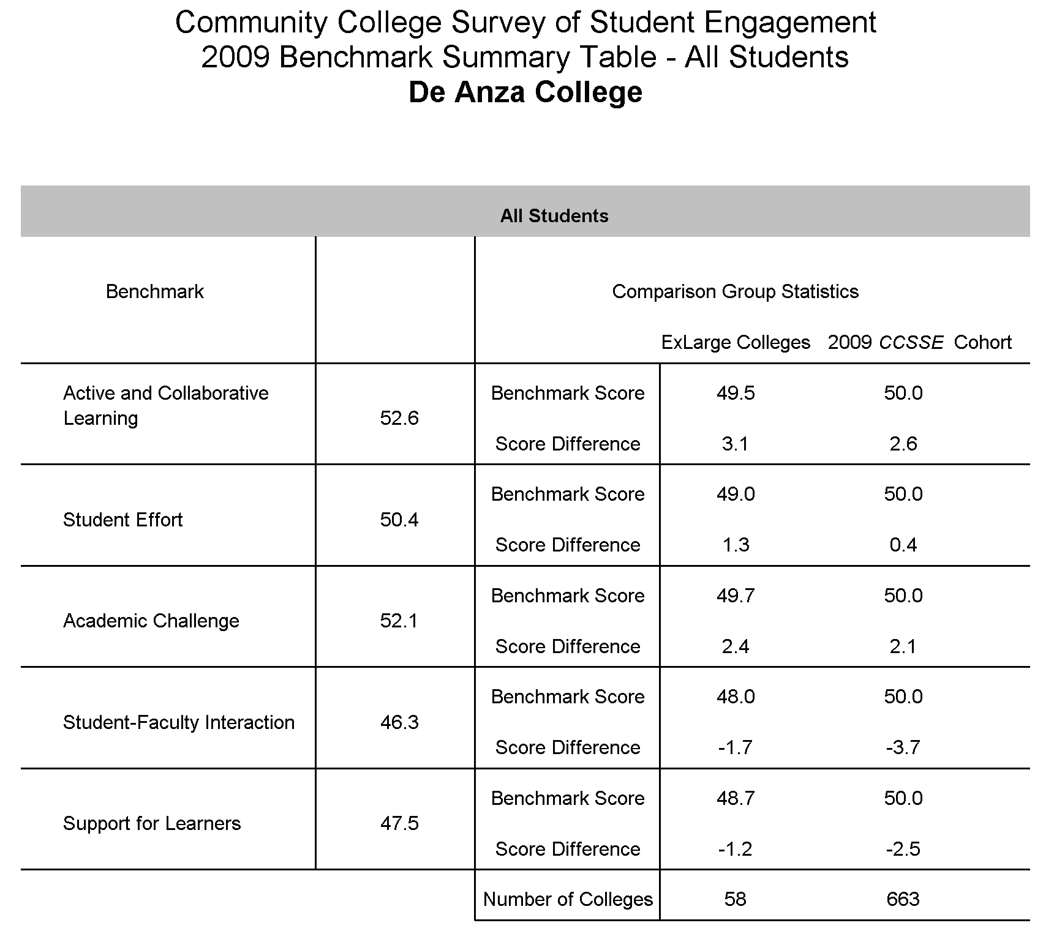
De Anza
College

Slide 16
Mean Scores
The mean scores report provides item-by-item means for all valid responses at De Anza (N= 797) compared to a comparison group of other SSPIRE Consortium colleges (N= 7,128) and the 2009 CCSSE Cohort (students who participated in CCSSE from 2007-2009, N = 40,089).
The SSPIRE Consortium was launched in 2006 and is supported by the James Irvine Foundation. It includes nine California community colleges that work to raise academic achievement, persistence rates and degree completion among low-income, underprepared and traditionally underserved students.

Slide 17
Mean Scores – Summary
De Anza College is above the mean of other SSPIRE Consortium colleges in:
Made a class presentation*
Number of written papers or reports of any length*
Preparing for class (studying, reading, writing, rehearsing, doing homework or other activities related to your program)*
Total number of credit hours earned at this college (15-29 units) not counting the courses you are currently taking this term*
*statistically significant differences between the means

Slide 18
Mean Scores - Summary
De Anza College is below the mean of other SSPIRE Consortium colleges in:
Providing the financial support you need to afford your education*
Working for pay (6-10 hours per week)*
Satisfaction with academic advising*
Satisfaction with career counseling*
Frequency of use of career counseling*
Frequency of use of financial aid advising*
Importance of financial aid advising*
*statistically significant differences between the means

Slide 19
Comparison of Means
The following tables compare the 2007 mean scores (N= 1,097) to the 2009 mean scores (N= 797) of selected questions.

Slide 20
Active and Collaborative Learning In your experiences at De Anza during the current school year, about how often have you done each of the following?
Active and Collaborative Learning | 2007 | 2009 | Diff.
Asked questions in class or contributed to class discussions | 2.62 | 2.74 | 0.12
Made a class presentation | 2.17 | 2.19 | 0.02
Worked with other students on projects during class | 2.55 | 2.60 | 0.05
Worked with classmates outside of class to prepare class assignments | 1.96 | 2.05 | 0.09
Tutored or taught other students (paid or voluntary) | 1.46 | 1.42 | -0.04
Participated in a community-based project as a part of a regular course | 1.39 | 1.42 | 0.03
Discussed ideas from your readings or classes with instructors outside of class | 1.71 | 1.69 | -0.02
1= never, 2= sometimes, 3= often, 4= very often

Slide 21
Student Effort In your experiences at De Anza during the current school year, about how often/much have you done/used each of the following?
Student Effort | 2007 | 2009 | Diff.
Prepared two or more drafts of a paper or assignment before turning it in | 2.31 | 2.37 | 0.06
Worked on a paper or project that required integrating ideas | 2.64 | 2.71 | 0.07
or information from various sources
Came to class without completing readings or assignments | 1.98 | 1.89 | -0.09
Number of books read on your own (not assigned) for personal | 2.21 | 2.23 | 0.02
enjoyment or academic enrichment
Preparing for class (studying, reading, writing, rehearsing, | 2.00 | 2.14 | 0.14
doing homework or other activities related to your program)
*Frequency: Peer or other tutoring | 1.46 | 1.52 | 0.06
*Frequency: Skill labs (writing, math, etc.) | 1.54 | 1.66 | 0.12
*Frequency: Computer Lab | 1.88 | 2.05 | 0.17
1= never, 2= sometimes, 3= often, 4= very often
*0= don't know/N/A. 1 = rarely, 2= sometimes, 3=often

Slide 22
Academic Challenge In your experiences at De Anza during the current school year, about how often/much have you done/used each of the following?
Academic Challenge | 2007 | 2009 | Diff.
Worked harder than you thought you could to meet an instructor's | 2.41 | 2.45 | 0.04
standards or expectations
Analyzing the basic elements of an idea, experience or theory | 2.87 | 2.97 | 0.10
Synthesizing and organizing ideas, information or experiences in new ways | 2.68 | 2.80 | 0.12
Making judgments about the value or soundness of information, arguments | 2.52 | 2.64 | 0.12
or methods
Applying theories or concepts to practical problems or in new situations | 2.59 | 2.76 | 0.17
Using information you have read or heard to perform a new skill | 2.65 | 2.81 | 0.16
*Number of assigned textbooks, manuals, books or book-length | 3.02 | 2.99 | -0.03
packs of course readings
*Number of written papers or reports of any length | 2.97 | 3.02 | 0.05
1= never, 2= sometimes, 3= often, 4= very often , * 1= none, 2= between 1 and 4, 3= between 5 and 10
How much does De Anza college emphasize the following?
Encouraging you to spend significant amounts of time studying 2.95 2.94 -0.01 1= very little, 2= some, 3= quite a bit, 4= very much

Slide 23
Student-Faculty Interaction In your experiences at De Anza during the current school year, about how often have you done each of the following?
Student-Faculty Interaction | 2007 | 2009 | Diff.
Used e-mail to communicate with an instructor | 2.53 | 2.65 | 0.12
Discussed grades or assignments with an instructor | 2.29 | 2.34 | 0.05
Talked about career plans with an instructor or adviser | 1.85 | 1.83 | -0.02
Discussed ideas from your readings or classes with instructors outside of class | 1.71 | 1.69 | -0.02
Received prompt feedback (written or oral) from instructors on your performance | 2.50 | 2.55 | 0.05
1= never, 2= sometimes, 3= often, 4= very often

Slide 24
Support for Learners How much does De Anza College emphasize the following?
Support for Learners | 2007 | 2009 | Diff.
Providing the support you need to help you succeed at this college | 2.75 | 2.91 | 0.24
Encouraging contact among students from different economic, | 2.63 | 2.70 | 0.07
social and racial/ethnic backgrounds
Helping you cope with your non-academic responsibilities (work, family, etc.) | 1.86 | 1.91 | 0.05
Providing the support you need to thrive socially | 2.02 | 2.05 | 0.03
Providing the financial support you need to afford your education | 2.15 | 2.06 | -0.09
1= very little, 2= some, 3= quite a bit, 4= very much
How often do you use each of the following services?
Frequency: Academic advising/planning | 1.63 | 1.65 | 0.02
Frequency: Career Counseling | 1.41 | 1.45 | 0.04
0= don't know/N/A. 1 = rarely, 2= sometimes, 3=often

Slide 25
Conclusions
Overall, the results from the comparison show that De Anza has improved from 2007 to 2009.
Areas in which De Anza has improved include Academic and Collaborative Learning, Student Effort and Academic Challenge.
Areas in which De Anza could benefit by focusing more heavily include Student-Faculty Interaction and Support for Learners.
It seems that De Anza continues to score low in are providing financial aid advising and support as well as academic and career advising and support.

Slide 26
This presentation is available on the De Anza Research website at www.deanza.edu/ir/
Additional documents for analysis are available upon request.

