Slide 1


Welcome to the Student Learning Outcome Process
Veronica Avila
Mary Pape
Tono Ramirez
SLO/SSLO/AUO Coordinators
Visit us at deanza.edu/slo

Slide 2
Contents
Our Road to “Proficiency”
6-year planning cycle document
“You” and this process

Slide 3
Outcome
Attendees will be able to complete emailed assessment summary.

Slide 4
Why Student Learning Outcome Process?
Culture of inquiry
Accreditation by ACCJC (Accrediting Commission for Community & Junior Colleges)
Stakeholders demand assessment
Notes:
Should note that for the SLO process, faculty are in charge. Faculty decide how it will be assessed and what the target or bench mark should be.

Slide 5
I. Our Road to “Proficiency”

Slide 6
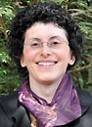
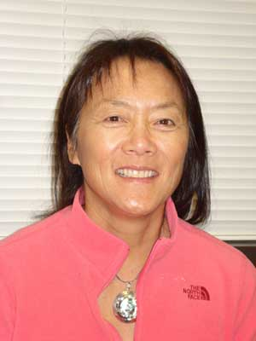
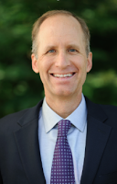
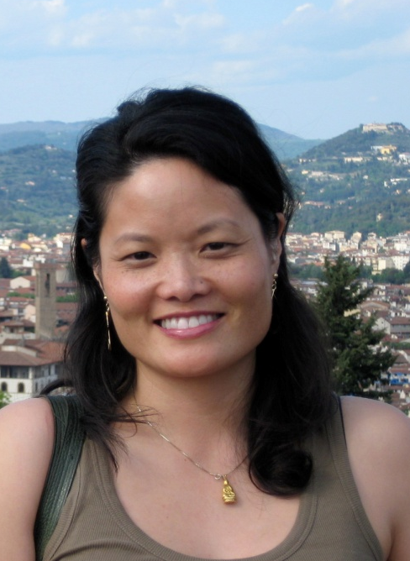
Academic Senate
Support from Presidents and Vice Presidents of Academic Senate:

Slide 7
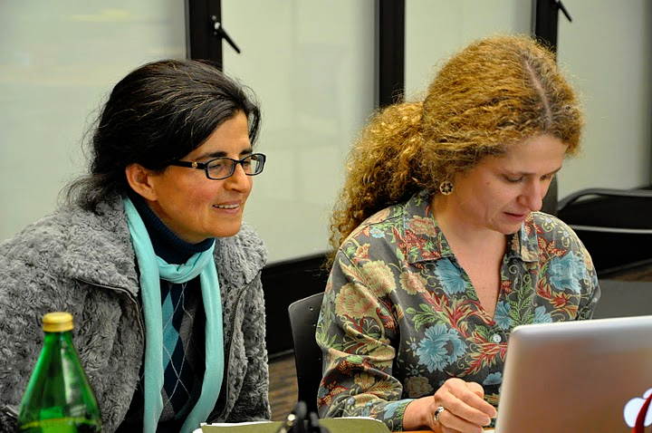
Leadership Structure
- Faculty Driven

Slide 8
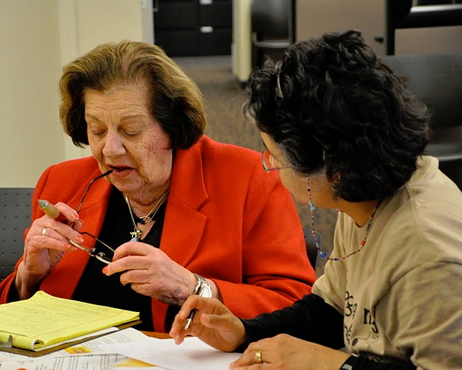

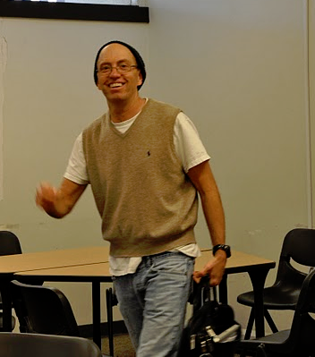
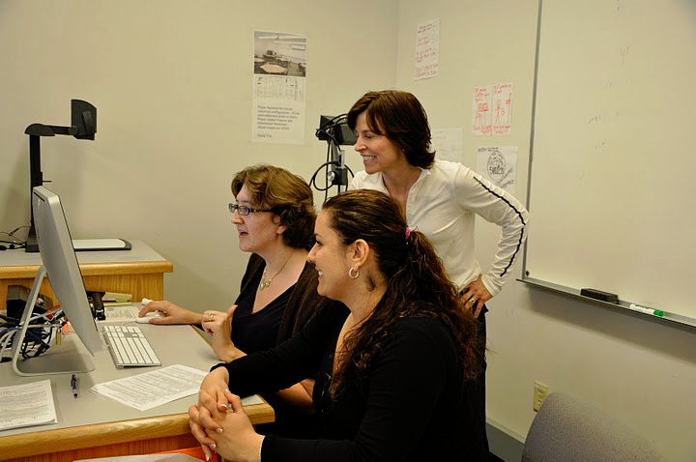

Slide 9

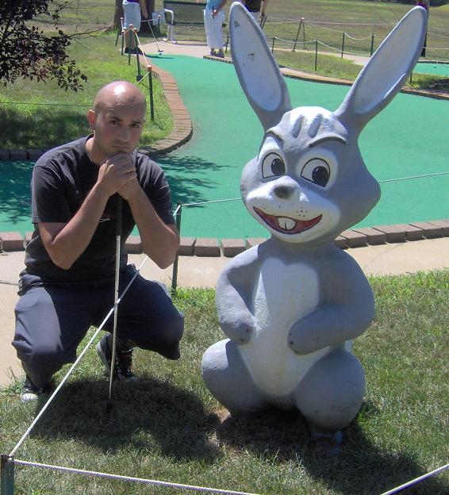
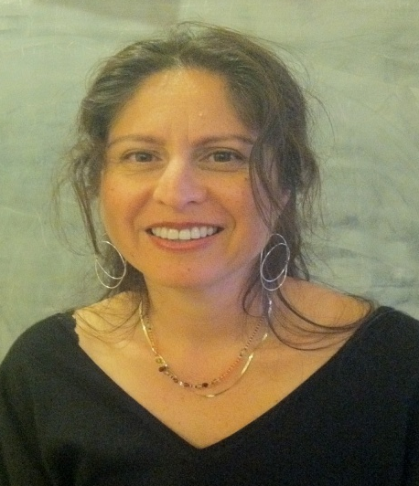
SLO Core Team
Student Services & Administrative Units Coordinator:
Veronica Avila
Instructional Coordinators:
Mary Pape & Toño Ramirez
Coleen Lee-Wheat **Amy Leonard ** Mallory Newell ** Jim Nguyen

Slide 10
SLO Steering Committee
Administrators:
VP, Instruction
VP, Finance & Educational Resources
Director, Institutional Research
Director, Marketing
Associate VP, Instruction
Dean, PE & Athletics
SLO/SSLO/AUO Coordinators

Slide 11


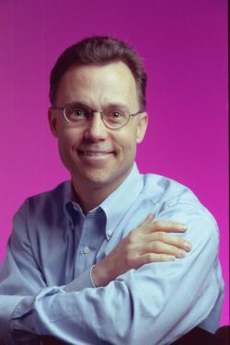
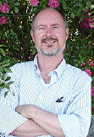
Division SLO Liaisons
Language Arts
Physical Science/
Math/
Engineering
Business/
Computer
Systems
Student Service:
Counselor

Slide 12
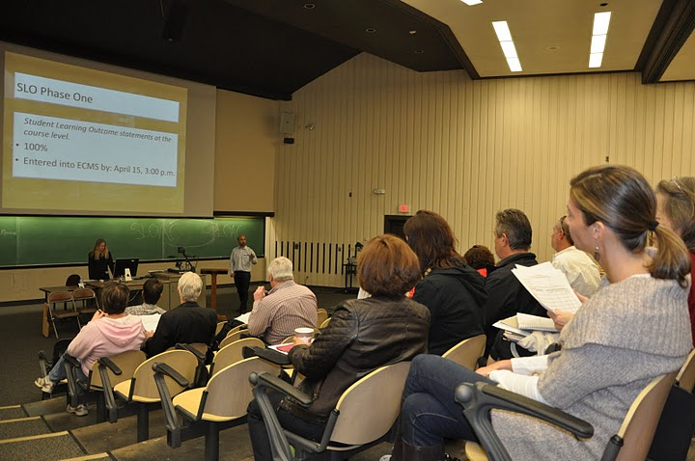
Dialog - Annual Convocation

Slide 13
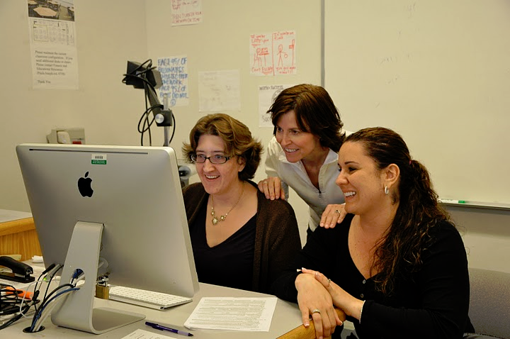
Dialog - Workshops

Slide 14

Dialog - SLO Office Hours
SLO Process Drop-In Help in Academic Senate Office (Admin 117)
Tuesdays 12:30 – 1:20 pm
Wednesdays 4:00 – 5:00 pm

Slide 15
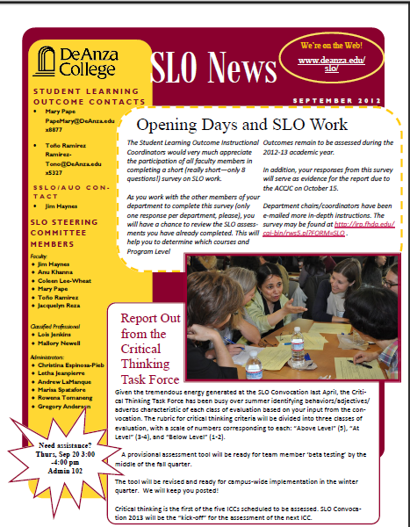
Dialog - SLO Newsletter

Slide 16
Institutional
Level Outcomes
Program Level Outcomes & Assessments
SLOACs/SSLOACs/AUOACs

Slide 17
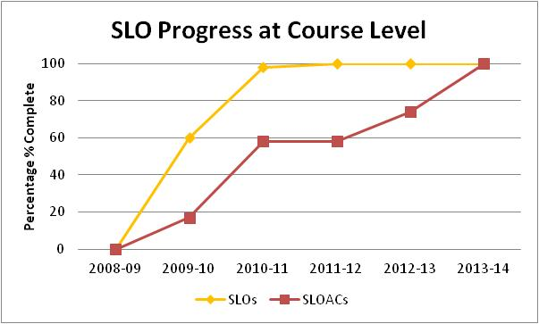
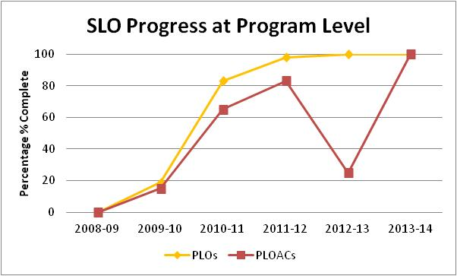
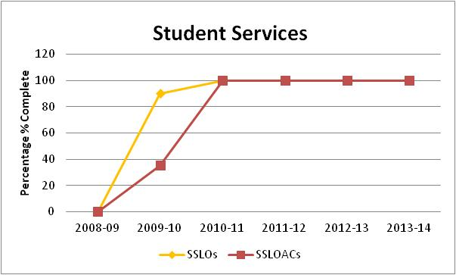
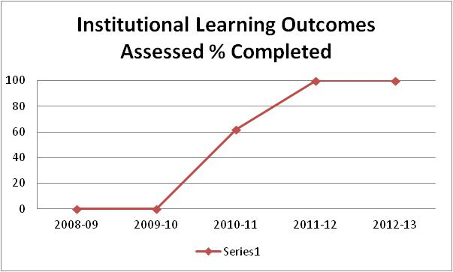
->ACCJC Report on 2012 Follow-Up Visit
“The team found evidence that the College is at proficiency level for SLOs”

Slide 18
II. Developing Our Institution’s Planning Cycle

Slide 19
SLOAC
Resource
Needs
SSLOAC
Resource Needs
AUOAC
Resource
Needs
Identify

Slide 20
Divisional
prioritization
Divisional
prioritization
Divisional
prioritization
SLOAC
Resource
Needs
SSLOAC
Resource Needs
AUOAC
Resource
Needs
Identify

Slide 21
Instructional
Program Reviews
Student Services
Program Reviews
Finance & Resources
Program Reviews
Affirm
Divisional
prioritization
Divisional
prioritization
Divisional
prioritization
SLOAC
Resource
Needs
SSLOAC
Resource Needs
AUOAC
Resource
Needs
Identify

Slide 22
Focus
Focus and Alignment Lens
Mission – Strategic Initiatives – ICCs – Educational Master Plan
Instructional
Program Reviews
Student Services
Program Reviews
Finance & Resources
Program Reviews
Affirm
Divisional
prioritization
Divisional
prioritization
Divisional
prioritization
SLOAC
Resource
Needs
SSLOAC
Resource Needs
AUOAC
Resource
Needs
Identify

Slide 23
IPBT
SSPBT
FRPBT
Focus
Focus and Alignment Lens
Mission – Strategic Initiatives – ICCs – Educational Master Plan
Instructional
Program Reviews
Student Services
Program Reviews
Finance & Resources
Program Reviews
Affirm
Divisional
prioritization
Divisional
prioritization
Divisional
prioritization
SLOAC
Resource
Needs
SSLOAC
Resource Needs
AUOAC
Resource
Needs
Identify

Slide 24
COLLEGE COUNCIL
Allocate
IPBT
SSPBT
FRPBT
Focus
Focus and Alignment Lens
Mission – Strategic Initiatives – ICCs – Educational Master Plan
Instructional
Program Reviews
Student Services
Program Reviews
Finance & Resources
Program Reviews
Affirm
Divisional
prioritization
Divisional
prioritization
Divisional
prioritization
SLOAC
Resource
Needs
SSLOAC
Resource Needs
AUOAC
Resource
Needs
Identify

Slide 25
College Planning Committee
5/15/13
2011-12
2012-13
2013-14
2014-15
2015-16
2016-17
2017-18
Year 1
Year 2
Year 3
Year 4
Year 5
Year 6
Year 1
SITE
VISIT
Follow-up Site Visit
(Recs #1,#2,#3)
Follow-up Letter
(Rec #1)
MID-TERM
REPORT
Form Teams
SELF
STUDY
SITE
VISIT
ACCJC
Cycles/
Reports
Ongoing Preparation and Submission of ACCJC Reports
CPC
Assessment/
Planning
Governance
Review
Values
Review
Mission
Review
EMP
REVIEW
“Quilt”
Review
Outcomes
Review
Governance
Review
Ongoing Assessment of Governance (annual survey)
PBTs &
College
Council
Planning & Resource
Allocation
(PRA)
Planning & Resource
Allocation
(PRA)
Planning & Resource
Allocation
(PRA)
Planning & Resource
Allocation
(PRA)
Planning & Resource
Allocation
(PRA)
Planning & Resource
Allocation
(PRA)
Planning & Resource
Allocation
(PRA)
Equity
Assessment/
Planning
Ongoing Development and Assessment of Student Equity Plans
DAC - Detailed Planning Cycle - 2011 - 2017
APRU # 3
APRU #4
CPR
&
5-Year
Plan
Reflect
APRU #1
APRU #2
APRU #2
Six-Year Program Review Process
ICC/GE
Assessment
Cycles
Critical Thinking
GCS&E
3rd ICC
4th ICC
5th ICC
Critical Thinking
Outcomes
Assessment Cycles
Outcomes
Assessment Cycles
PLOAC
CLOAC
DLOAC
Outcomes
Assessment Cycles
Outcomes
Assessment Cycles
CLOAC
DLOAC
PLOAC
Outcomes
Assessment Cycles
Outcome/
Assessment
Cycles
Curriculum
Review
Cycles
5 Year cycle
5 Year cycle
5 Year cycle
5 Year cycle
5 Year cycle
5 Year cycle
5 Year cycle
Notes:
25

Slide 26
III. YOU in this process

Slide 27
Outcome Defined
(Redefined)
Conduct assessments
Summarizing data
Reflection
Enhancement
Plan methods of assessment

Slide 28
Improving the Student Experience
Student Learning Outcomes
Course Level
Program Level
Institutional Level
Student Services Learning Outcomes
Administrative Unit Outcomes

Slide 29
Improving the Student Experience
Administrative Unit Outcomes are overarching, clear, and assessable statements that identify and define what a client/customer/student will be able to know, do, or feel at the successful completion of a specific activity or process.

Slide 30
Improving the Student Experience
Administrative Unit Outcomes
Our goal is to provide the necessary information for clubs to carry out proper cash handling and submit supporting documentation to account for all money received documenting an audit trail.(Dept FER – FIN – Student Accounts)

Slide 31
Improving the Student Experience
Student Services Learning Outcomes are overarching, clear, and assessable statements that identify and define what a student will be able to know, do, or feel at the successful completion of a specific program, activity, or process.

Slide 32
Improving the Student Experience
Student Services Learning Outcomes
Upon completion of intake and orientation CalWORKs students will be able to demonstrate their ability to identify and access services available through the Financial Aid system.(Dept SS – Occupational Training Institute)

Slide 33
Improving the Student Experience
Student Learning Outcomes
Institutional Level
(Institutional Core Competencies)
Communication and expression
Information literacy
Physical/mental wellness and personal responsibility
Civic capacity for global, cultural, social and environmental justice
Critical thinking

Slide 34
Improving the Student Experience
Student Learning Outcomes
Program Level
What the student will be able to do after completing a certain certificate/degree or just after completing courses within your department.

Slide 35
Improving the Student Experience
Student Learning Outcomes
Program Level
Develop a critical way of thinking with the goal of optimal decision- making in everyday life using marginal benefit and marginal cost concepts. (Economics Department PLO_1)

Slide 36
Improving the Student Experience
Student Learning Outcomes
Course Level
What the student will be able to do at the end of the course.

Slide 37
Improving the Student Experience
Student Learning Outcomes
Course Level
Design mobile applications using object-oriented methodology and advanced Objective C concepts using iOS Development Kit. (CIS 55)

Slide 38
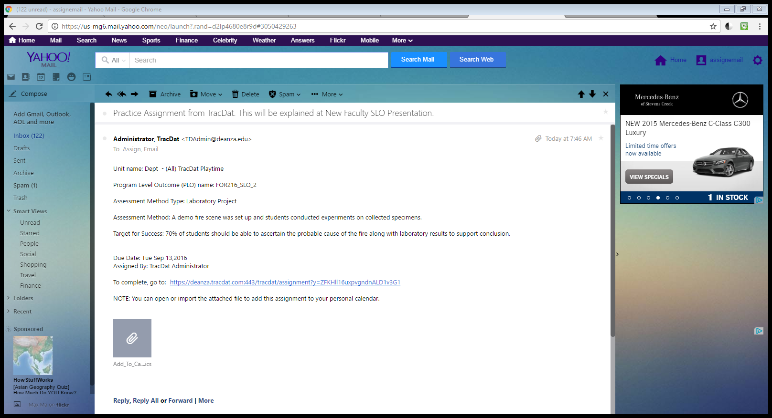
Your Assignment

Slide 39
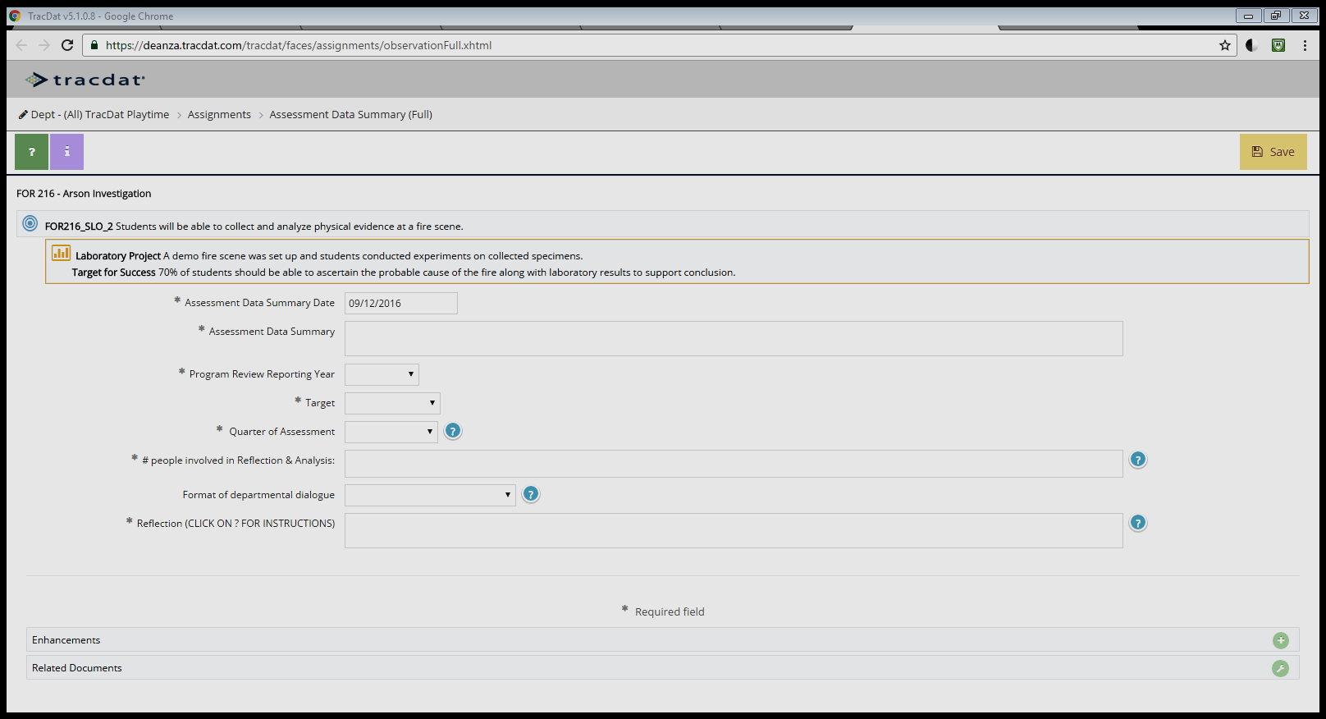
Your Assignment
SLO Web Page

