Slide 1
Healthy News Habits
Cynthia Kaufman De Anza 2016

Slide 2
Why?
Information literacy is one Of our Core competencies
I was worried that as the ways people engage with news changes, perhaps they are no longer interested in the news and thus not becoming informed global citizens
According to a De Anza College Office of Institutional Research’s 2015 Student Civic Engagement survey, “73% of respondents stated they obtained news daily/weekly prior to entering this college while 72% stated the same after they entered this college.” In other words it is possible that we are making no impact on student’s news gathering habits.
https://www.deanza.edu/ir/deanza-research-projects/2015-16.html

Slide 3
Habits are changing but not getting worse
New study finds millennials are strong news consumers, but take an indirect path By Rick Edmonds March 16, 2015
“Millennials are getting a bad rap as a newsless and disengaged generation, according to a new study of their news habits. But print newspapers and digital home pages are not their main way of finding what they are looking for. Rather social media and search are the two top avenues for finding news, according to a report released today by the American Press Institute, Associated Press and NORC center at the University of Chicago. Facebook is the top way of encountering news, used by 88 percent of those who do.”
http://www.poynter.org/2015/new-study-finds-millennials-are-strong-news-consumers-but-take-an-indirect-path/327033/

Slide 4
Findings from that study:
Eighty-five percent of Millennials surveyed said keeping up with news is at least somewhat important to them, and 38% said it is “very” or “extremely” important. Forty-five percent said they follow five or more “hard news topics.”
Just under two-thirds (64%) said they regularly follow what’s going on in the world and/or consume news articles or broadcasts.
Among the activities that Millennials engage in online, accessing news ranks somewhere in the middle

Slide 5
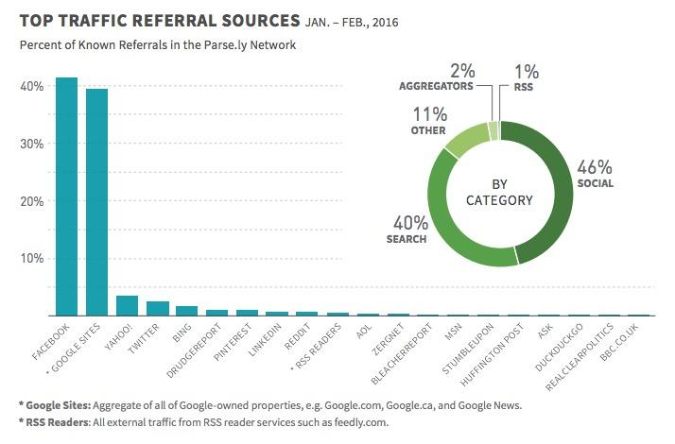
How readers get to a news story
http://www.niemanlab.org/2016/04/twitter-has-outsized-influence-but-it-doesnt-drive-much-traffic-for-most-news-orgs-a-new-report-says/

Slide 6
What I heard
I had discussions with student in two classes, English 210 and POLY 1
Virtually all got their news online and most through social media
They were adamant that they did not feel pressure around being informed but that they wanted to be informed to keep up socially
I heard very little worry about reliability of sources

Slide 7
What I think we need to do
We don't need to get them to consume news
We do need to engage them in conversations about the reliability of their sources and perhaps about broader purposes of why to be informed

Slide 8
Discussion Questions
What have you done to engage with students about being informed?
What are some ways you can work with them to help them to be better consumers of news?

