Slide 1
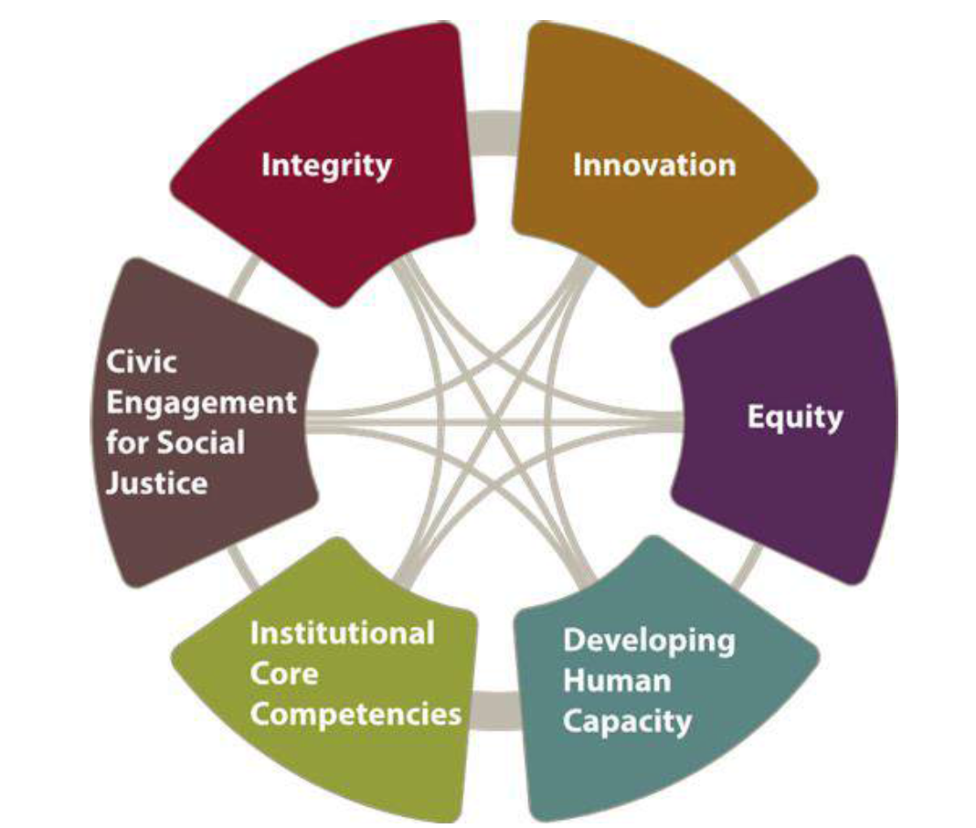
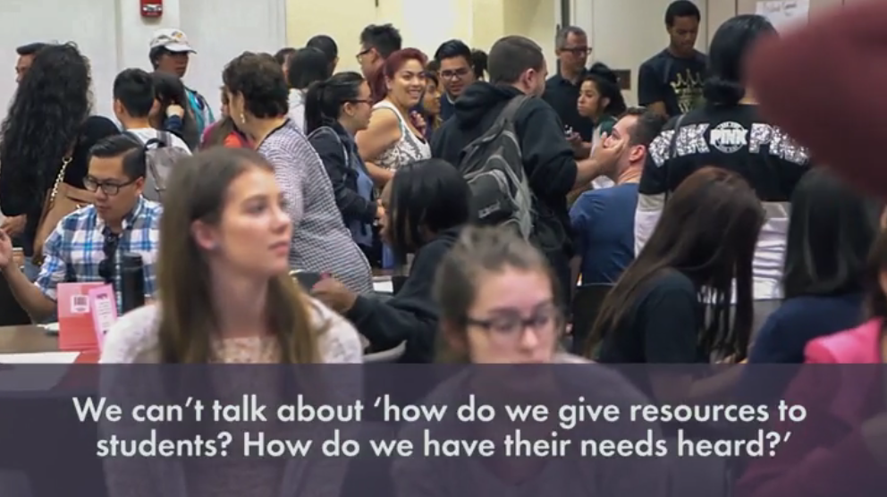
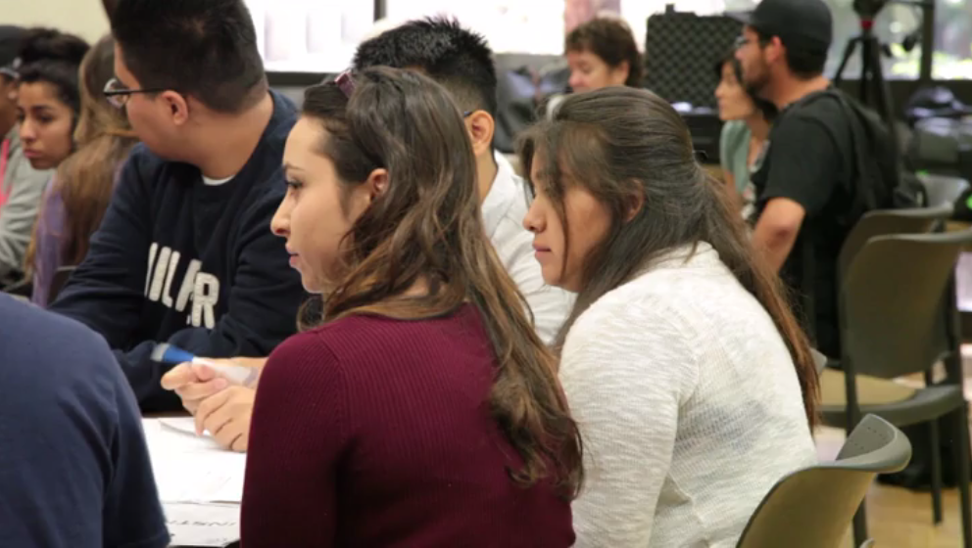
Workshop Title: Student Voices Sept 21st, 2017: District Opening Day: 9:30am-11:45am, Media and Learning Center Sept 22nd, 2017: Division Opening Day: 1:30am-3pm, MLC 102

Slide 2
Welcome!

Slide 3
Student Voices
‘Student Voices’ workshops:
Purpose: problem solving.
Feedback we Receive
Interactive data collection concerning campus issues
Third space: not classroom, not office hours
Safe spaces: foster diversity but still hierarchical
‘Critical collective space’ (Wallin-Ruschman and Patka): value safe space but welcome focus on dialectical tensions between students and De Anza employees
SS/H Equity Core Team
Carolyn Wilkins-Greene, Division Dean
Jim Nguyen
Jila Maleksalehi
Ameeta Tiwana
Rich Booher
Steve Nava

Slide 4
Student Voice Workshop: Agenda Sept 21st, 2017: District Opening Day: 9:30am-11:45am, Media and Learning Center
9:45am Greetings, Snack Grab, and Sign-in (Jim Nguyen)
10:00am Background: Origins (Jim Nguyen) and Testimony (Jila Maleksalehi)
10:05am College-wide Equity Gap and ‘Safe-spaces’ to ‘critical collective spaces’ and (Steve Nava)
IV. 10:20am Student Panel: Needed Student resources? (please volunteer to lead this portion)
V. 10:50am Past Event Summary and Panel Summary of Needs; Past Student Voices 5-minute Video (Carolyn)
VI. 11:05am Student-led Break-out Brainstorm with Faculty: Problems; Solutions; Resources & Suggestions (Steve and Jila)
VII. 11:35am Closing: What will you take from this experience? (please volunteer to lead this portion)
VIII. 11:45am Evaluation Sheet for Workshop

Slide 5
Student Voice Workshop: Agenda Sept 22nd, 2017: Division Opening Day: 1:30am-3pm, MLC 102
1:30pm Greetings, Snack Grab, and Sign-in (Jim Nguyen)
1:40pm Background: Origins (Jim Nguyen) and Testimony (Jila Maleksalehi)
1:45pm College-wide Equity Gap and ‘Safe-spaces’ to ‘critical collective spaces’ and (Steve Nava)
IV. 2:00pm Student Panel: Needed Student resources? (please volunteer to lead this portion)
V. 2:30am Past Event Summary and Panel Summary of Needs; Past Student Voices 5-minute Video (Carolyn)
VI. 2:40pm Student-led Break-out Brainstorm with Faculty: Problems; Solutions; Resources & Suggestions (Steve and Jila)
VII. 2:50:pm Closing: What will you take from this experience? (please volunteer to lead this portion)
VIII. 3:00pm Evaluation Sheet for Workshop

Slide 6
Student Voices
‘ ‘Critical collective space’ (Wallin-Ruschman and Patka 2016): Similar to prefigurative politics, critical collective spaces could provide individuals a way to begin practicing alternative relationship building strategies that counter alienating and hierarchical relations found in many organizations and institutions.
SS/H Equity Core Team
Carolyn Wilkins-Greene, Division Dean
Jim Nguyen
Jila Maleksalehi
Ameeta Tiwana
Rich Booher
Steve Nava

Slide 7
FHDA Program Review - page 5 of 6 - 9/20/2016

Slide 8
FHDA Program Review - page 5 of 6 - 9/20/2016

Slide 9
The students experiencing greater than a five percent (5%) gap in their level of achievement
Black (African American/African)
Filipino; and
Hispanic/Latinx (ESL and Native English speakers).
De Anza College Office of Institutional Research and Planning
Notes:
as compared to other groups as is measured by one or more indicators of student success:
Ray Olenburg (1990) Third spaces are places outside home or work where folks can: unwind, discuss and talk about things that matter to them, their neighbourhood and their community, where they can let down their guard, relax, be themselves, develop new friendships and deepen existing ones.

Slide 10
Why do some students not return to De Anza after completing a term at De Anza?
Spring 2016-Fall 2016
43% left as transfers to a 4-year
9% completed their educational goals
7% reported courses at the right time were unavailable
6% reported they enrolled at another 2-year college
1% the national political climate not safe
De Anza College Office of Institutional Research and Planning

Slide 11
De Anza College Office of Institutional Research and Planning
Of the 79% that transferred to 4-year institutions reported “Being supported by family and friends” was helpful to them reaching their transfer goals. (2016 and 2017 survey)
66% reported “Being supported by faculty and staff was helpful to them in reaching their transfer goal.

Slide 12
Why is it important to have a third-space dialogue about our challenges?
Ray Olenburg (1989) Third spaces are places outside home or work where folks can: unwind, discuss and talk about things that matter to them, their neighborhood and their community, where they can let down their guard, relax, be themselves, develop new friendships and deepen existing ones.
Notes:
Ray Olenburg (1989) Third spaces are places outside home or work where folks can: unwind, discuss and talk about things that matter to them, their neighbourhood and their community, where they can let down their guard, relax, be themselves, develop new friendships and deepen existing ones.

Slide 13
Discussion Questions for Student Panel
What is the biggest challenge to your education right now? What would make your experience at De Anza better in this regard?
How would you rate the campus in terms of safety?
Without mentioning names, what would you want your professors to know about their teaching or the classroom experience but were afraid to say it in class or office hours? What works and does not work in class? Certain assignments?
How often do you meet students struggling with mental illness or other health challenges and how can students and faculty be supportive of them?

Slide 14
Accessibility to information/resources
Resources for night students
Welcome PDF/Packet (on the app?)
Mental Health/Psych Services
Respect & Kindness/Compassion
Availability of Instructors
Providing the opportunity to students
Empathy for student lives/experiences
Support for students & instructors
Modalities
Different ways of teaching
Accountability
List of Items from the last Student Voices (III) panel:
Notes:
How would you describe the typical students’ attitude or approach to their education at De Anza College? What do you think shapes these attitudes and approaches?
What type of teaching do you find engaging?
How have you shown students and colleagues praise and support?
How do you make expectations of your students clear? How do students respond to such approaches?
Students report wanting their professors to be more accessible to them. What are proven ways instructors have made themselves more accessible to their students?

Slide 15
Summary of Student Voices III
Openness
Constructive criticism
College is like a second home (family)
Outlet to be open minded
Retention and success focused
Space for candid comments
Feeling like we are a part of this: feel honored to be part of the conversation
Feel things can change
Like hearing even the bad stories
Humanizing experience

Slide 16
Workshop Evaluation

Slide 17
Notes:

Slide 18
Reports from Past Student Voices Events Summary How are we using the information for the Equity Core Teams’ Student Voices Events? Student Resources Page and ideas that came from it; Faculty advising*; connecting departments; equity consciousness raising…

Slide 19
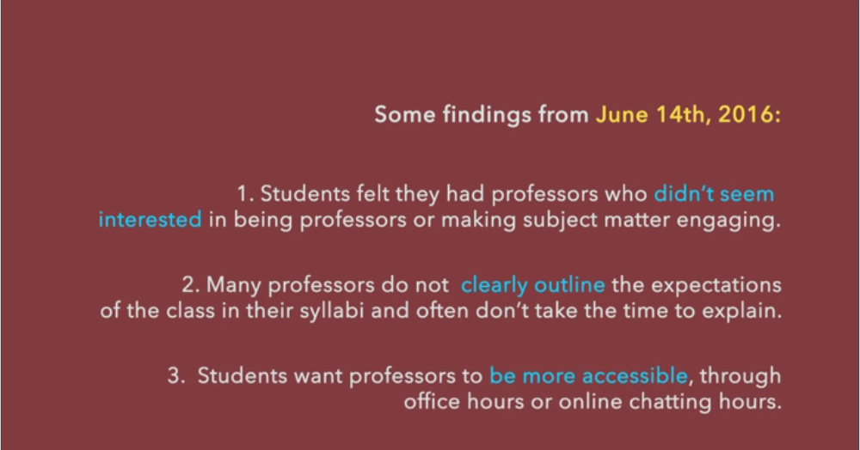
Reports from Past Student Voices Events

