Slide 1
What I Won My $500 LOAC Award For
By Byron Lilly
March 3, 2017 Convocation

Slide 2
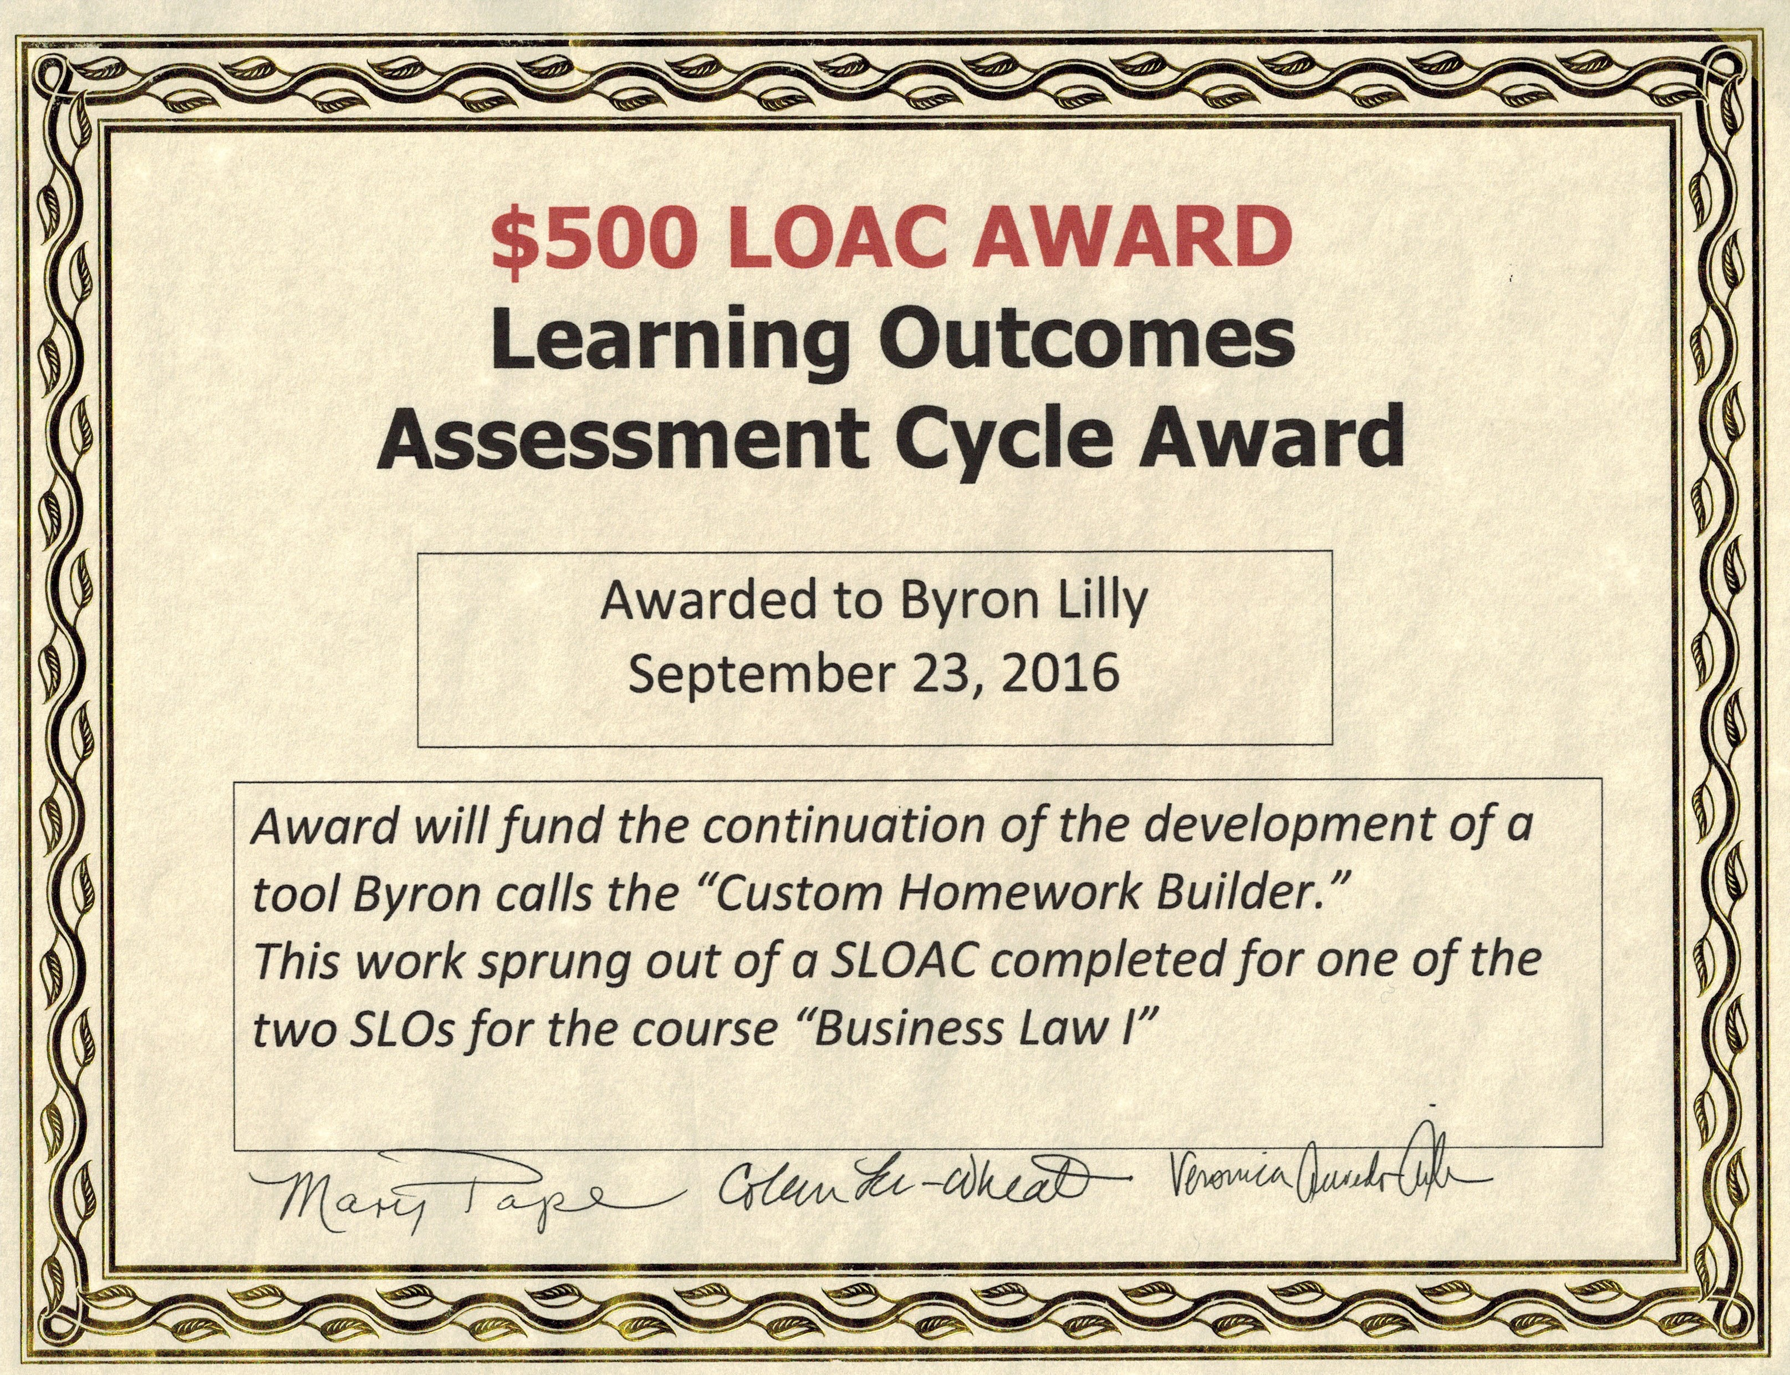

Slide 3
Business Law I, Section 4 - Course Design
On campus
14 chapters in 11 weeks
Weekly Catalyst quizzes are 25% of the grade
Closed-book, closed-note midterm is 36% of the grade
Closed-book, closed-note final exam is 39% of the grade

Slide 4
Midterm Retakes: My Policy Before
If and only if you earn a D+ or below on the midterm, you may retake the midterm.
If you retake the midterm, your midterm grade will be the higher of
Your original score, or
Your retake score times 0.90 (Wtr 14, Fall 14)
Your retake score times 0.95 (Spr 15, Fall 15, Wtr 16)

Slide 5
Midterm Retake Results Before HW Builder
The average improvement in raw midterm score (before applying the 5%-10% retake penalty) in these 5 quarters was 4 percentage points.

Slide 6
Proof of Concept Test: Spring 2014
A student who receives a D+ or below on the midterm (69% or below) can make themselves eligible for a midterm re-take only by requesting and then completing, on a timely basis, a custom assignment based on the questions they answered incorrectly on the midterm.
A student who completes a midterm re-take will receive the higher of their original score on the midterm or their re-take score (no retake penalty.)

Slide 8
Fall 2015: Five Enhancements
I built an Access database and used it to carefully analyze all missed questions. I removed about 10 “bad questions” from the midterm, re-wrote or modified 10 more, and wrote 21 new questions to round out the coverage of the most important concepts from the first half of the course on the midterm.
I extensively re-wrote my lengthy “Preparation Hints for the Midterm Exam” document to more thoroughly and clearly prepare students for an additional 25-30 midterm questions.

Slide 9
Fall 2015: Five Enhancements
I created a new study hints document called “Midterm Preparation Hints Supplement” to complement the Midterm Preparation Hints document I have made available every quarter for about the past 8 years.
I built 12 flashcard “decks” in “Quizlet,” a free online flashcard quizzing tool, covering everything that’s on the midterm and encouraged my students to use these flashcards as part of their preparation.

Slide 10
Fall 2015: Five Enhancements
At my request, the Student Success Center (Sandra Blackborow) hired two new student tutors for Business Law.

Slide 11
Winter 2016: The Sixth Enhancement
I enhanced my Access database so that it knew which custom homework questions to assign for each missed question on the midterm, using the work I had done in Spring 2014.
I then hired a programmer to write the code needed to produce the custom homework assignments from this database. This Custom Homework Builder lets me offer custom homework to all my Bus Law I students in a fraction of the time.
Notes:
This cost me $212.50. 2.5 hours at $85 per hour.

Slide 12
What My “Custom Homework Builder” Does
Enables me to build a custom homework assignment for each student based on the questions that student missed on my Business Law I midterm.
Enables me to see how my students did on each question for all of my in-class exams (midterms and final exams). This lets me analyze and improve my exam questions in a variety of ways.

Slide 13
Custom Homework Assignments
Average 150 questions in length.
Produce an average 11-13 percentage point improvement on students’ midterm scores!
All questions are “short answer”
Each wrong answer on the midterm puts one or more questions on the homework.

Slide 14
Custom Homework Assignments: Example
This midterm examination question:
True or False? A defendant’s response to a complaint and summons, giving a brief reply to each of the allegations in the complaint, is called a counter-claim in most jurisdictions.
…if answered incorrectly, causes all of these questions to be added to the student’s CHA:
1. What is your textbook’s definition of pleadings in chapter 3?
2. What is your textbook’s definition of complaint in chapter 3?
3. What is your textbook’s definition of a summons, which is buried in the text on page 55?
4. What is your textbook’s definition of reply in chapter 3?
5. What is the definition of counter-claim found in the glossary at the back of your textbook?

Slide 15
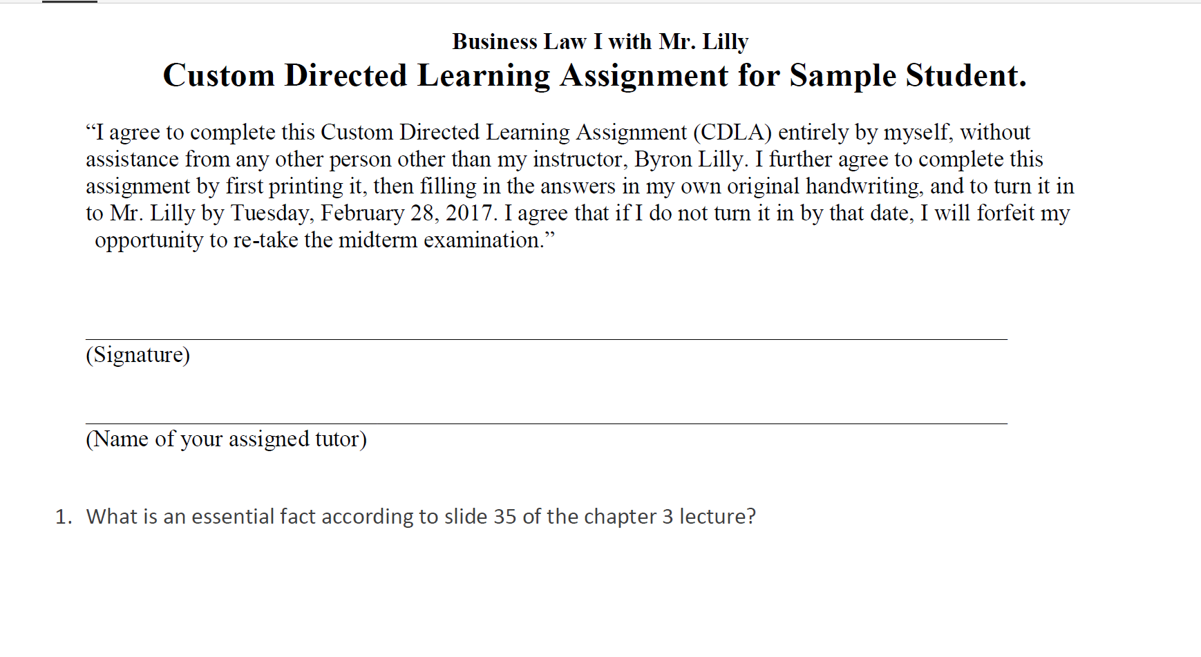

Slide 16
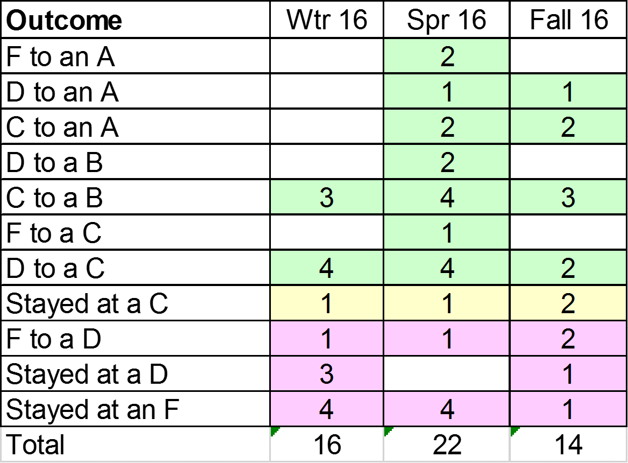
Of Those Who Re-took the Midterm (Bus Law I)

Slide 17
Notes:
This is the highest Total success rate I have ever had in this class and the second-highest success rate for the targeted groups, topped only by Fall 2015 – the quarter I put four other improvements in place.

Slide 18
What I Used My $500 LOAC Award For
I hired a De Anza student to make a number of cosmetic improvements to the custom homework:
Question numbers
Page numbers
Prepopulated custom header
Variable space between questions
Notes:
This cost me $231.20 at $16/hour.

Slide 19
Next Steps
I am in the process of repeating for the final exam the steps I performed on the midterm in Fall 2015.
Deleted 28 questions
Clarified 13 questions
Updated Final Exam Preparation Hints
Writing 28 new questions

Slide 20
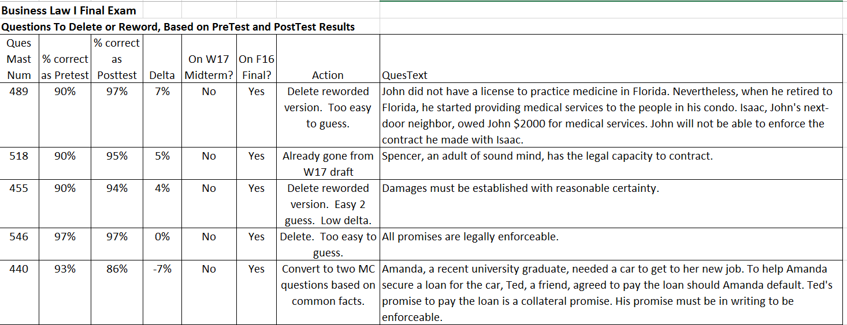
Sample Exam Question Analysis

Slide 21
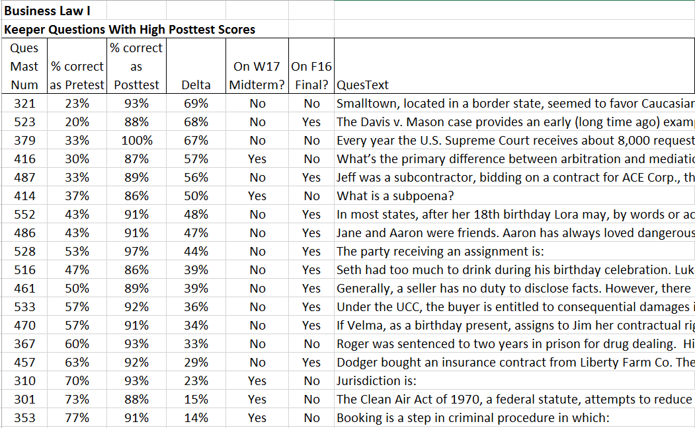
Sample Exam Question Analysis 2

Slide 22
Next SLOAC Assessment
Winter 2017

