Slide 1
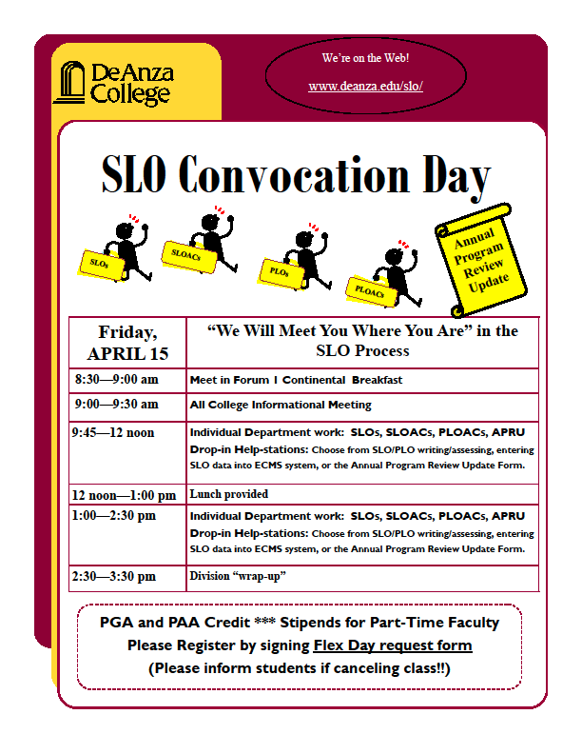
“We Met You Where You Were”
SLO Coordinators:
Mary Pape
Toño Ramirez
Photos: Julie Ceballos

Slide 2
Roadmap for the day –Forum 1

Slide 3
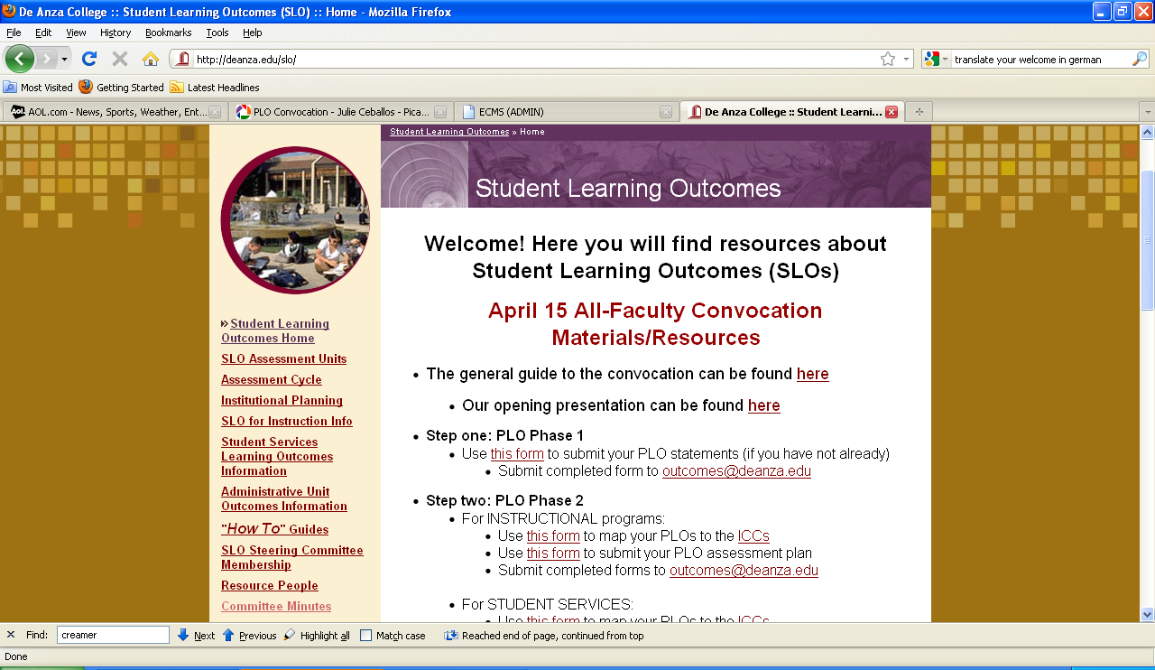
Roadmap for the day –Forum 1

Slide 4
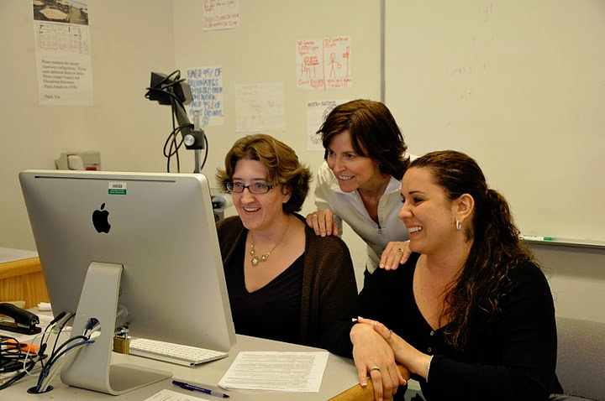
Help Stations AT 205

Slide 5
PLO Work

Slide 6
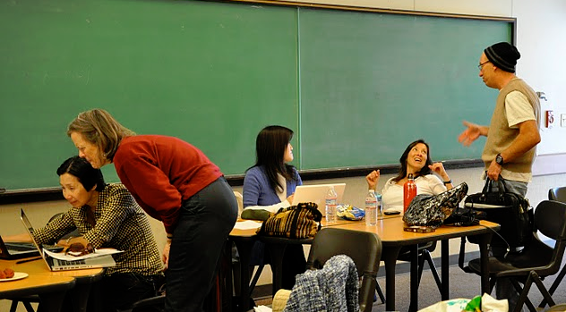
PLO Work must be:
Meaningful
Reasonable
Systematic

Slide 7
Step 1 Program Level Outcomes
Phase One: State Program Level Outcomes
Phase Two:
PLO Planned Assessment
Mapping PLOs to Institutional Core Competencies
Phase Three: Assess, Reflect, Enhance

Slide 8
PLO Phase One: PLO Statements

Slide 9
PLO Phase Two:PLO Assessment Plan
Mock Example

Slide 10
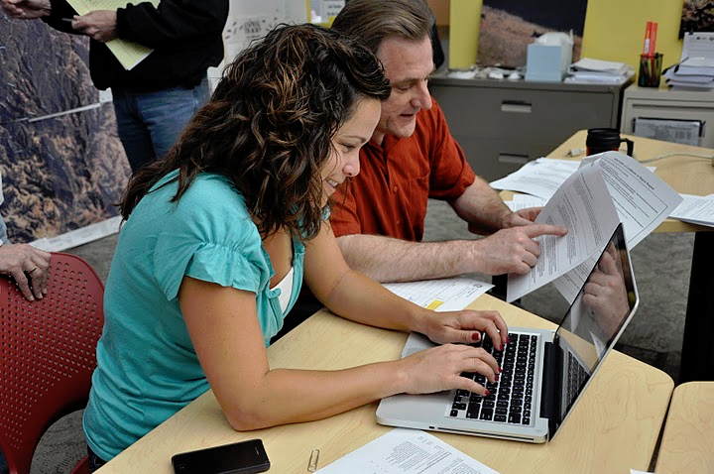
PLO Phase Two: Mapping PLOs to ICCs

Slide 11
PLO Phase Two: Mapping PLOs to ICCs

Slide 12
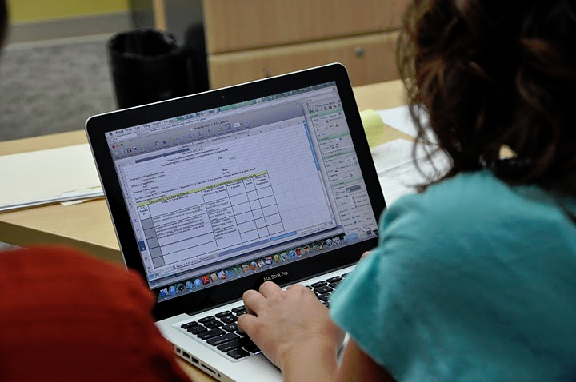
PLO Phase Two: Mapping PLOs to ICCs

Slide 13
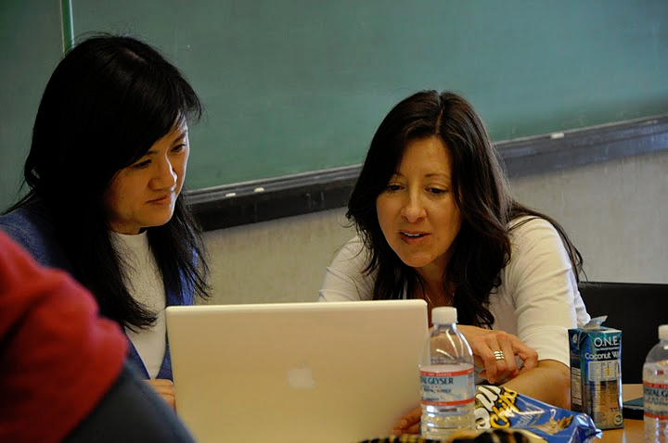
Complete Program PLOs
-> outcomes@deanza.edu
Complete Assessment Plan
-> outcomes@deanza.edu
Complete Mapping PLOs to ICCs
-> outcomes@deanza.edu
Complete SLOs, Phase II, Phase III -> ECMS

Slide 14
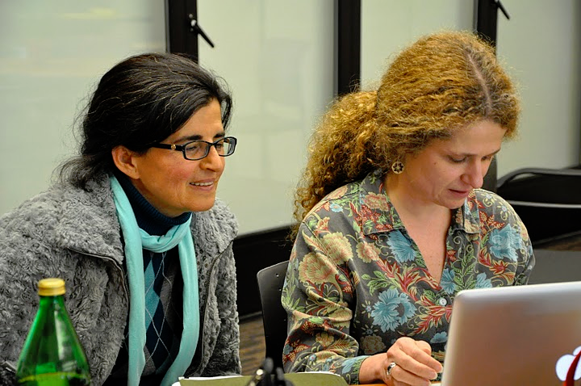
SLO Work

Slide 15
SLO Phase One Student Learning Outcome statements at the course level.
Goal:
100% Entered into ECMS by: April 15, 3:00 p.m.

Slide 16
SLO Phase Two: SLO (course level) Assessment Plan
Goal100%
Entered into ECMS by: April 15, 3:00 p.m.

Slide 17
SLO Phase Three: SLOAC Complete
60% college minimum
Entered into ECMS by July
15

Slide 18
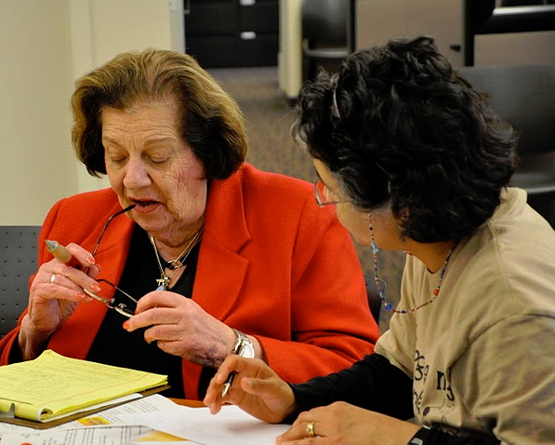
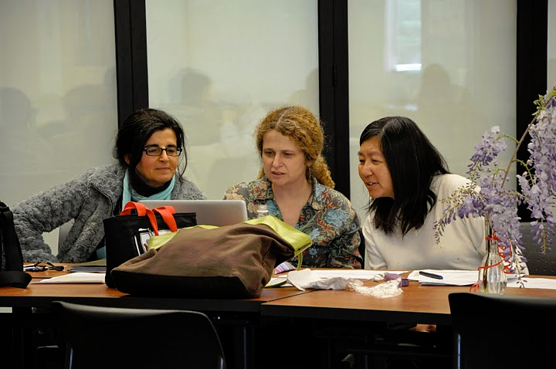
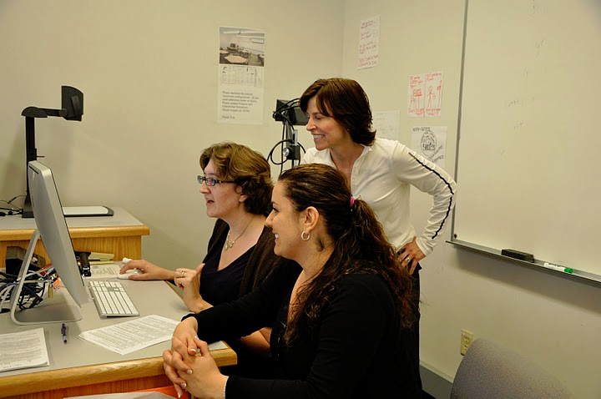
Thank you to the 175 plus faculty that made the
First Annual SLO Convocation Day
a success

