Slide 1


Welcome to the Student Learning Outcome Process
Veronica Avila
Mary Pape
Tono Ramirez
SLO/SSLO/AUO Coordinators
Visit us at deanza.edu/slo

Slide 2
Contents
Our Road to “Proficiency”
6-year planning cycle document

Slide 3
Why Student Learning Outcome Process?
Culture of inquiry
Accreditation by ACCJC (Accrediting Commission for Community & Junior Colleges)
Stakeholders demand assessment
Notes:
Should note that for the SLO process, faculty are in charge. Faculty decide how it will be assessed and what the target or bench mark should be.

Slide 4
Improving the Student Experience
Student Learning Outcomes
Course Level
Program Level
Institutional Level
Student Services Learning Outcomes
Administrative Unit Outcomes

Slide 5
Improving the Student Experience
Student Learning Outcomes
Course Level
What the student will be able to do at the end of the course.

Slide 6
Improving the Student Experience
Student Learning Outcomes
Course Level
Design mobile applications using object-oriented methodology and advanced Objective C concepts using iOS Development Kit. (CIS 55)

Slide 7
Improving the Student Experience
Student Learning Outcomes
Program Level
What the student will be able to do after completing a certain certificate/degree or just after completing courses within your department.

Slide 8
Improving the Student Experience
Student Learning Outcomes
Program Level
Develop a critical way of thinking with the goal of optimal decision- making in everyday life using marginal benefit and marginal cost concepts. (Economics Department PLO_1)

Slide 9
Improving the Student Experience
Student Learning Outcomes
Institutional Level
(Institutional Core Competencies)
Communication and expression
Information literacy
Physical/mental wellness and personal responsibility
Civic capacity for global, cultural, social and environmental justice
Critical thinking

Slide 10
Improving the Student Experience
Student Services Learning Outcomes are overarching, clear, and assessable statements that identify and define what a student will be able to know, do, or feel at the successful completion of a specific program, activity, or process.

Slide 11
Improving the Student Experience
Student Services Learning Outcomes
Upon completion of intake and orientation CalWORKs students will be able to demonstrate their ability to identify and access services available through the Financial Aid system.(Dept SS – Occupational Training Institute)

Slide 12
Improving the Student Experience
Administrative Unit Outcomes are overarching, clear, and assessable statements that identify and define what a client/customer/student will be able to know, do, or feel at the successful completion of a specific activity or process.

Slide 13
Improving the Student Experience
Administrative Unit Outcomes
Our goal is to provide the necessary information for clubs to carry out proper cash handling and submit supporting documentation to account for all money received documenting an audit trail.(Dept FER – FIN – Student Accounts)

Slide 14
Outcome Defined
(Redefined)
Conduct assessments
Summarizing data
Reflection
Enhancement
Plan methods of assessment

Slide 15
I. Our Road to “Proficiency”

Slide 16
Institutional
Level Outcomes
Program Level Outomes & Assessments
SLOACs/SSLOACs/AUOACs

Slide 17
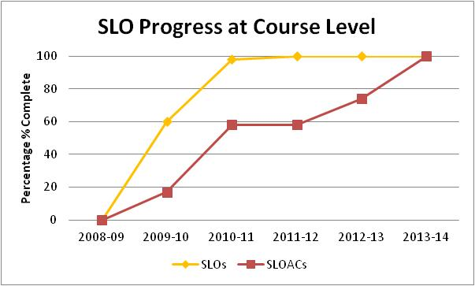
Our Progress ->

Slide 18
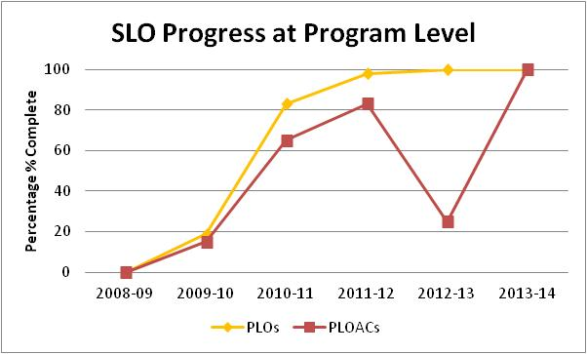
Our Progress ->

Slide 19
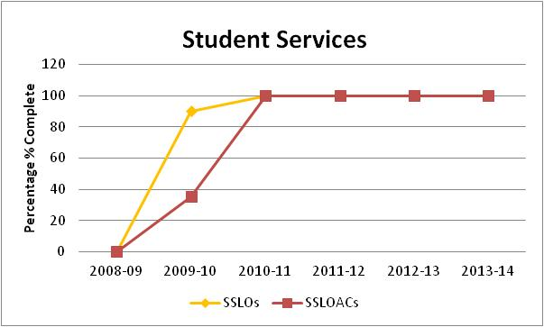
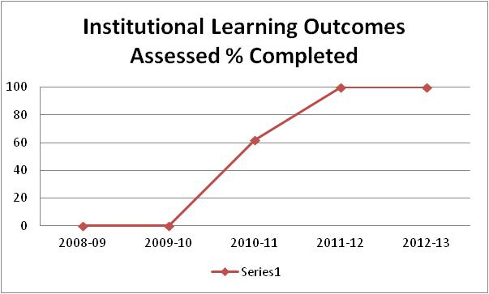
->ACCJC Report on 2012 Follow-Up Visit
“The team found evidence that the College is at proficiency level for SLOs”

Slide 20
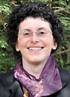
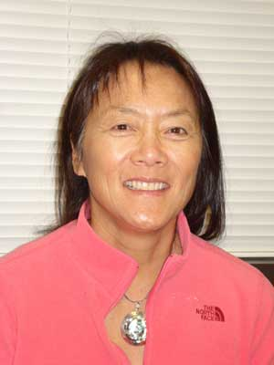
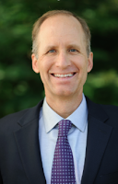

Academic Senate
Support from Presidents and Vice Presidents of Academic Senate:

Slide 21
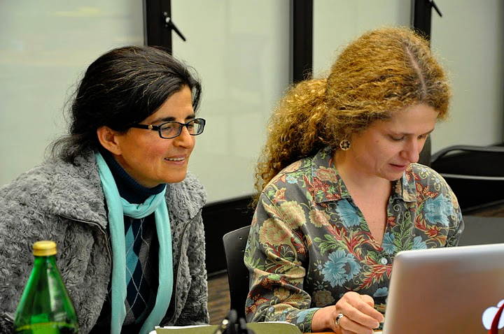
Leadership Structure
- Faculty Driven

Slide 22
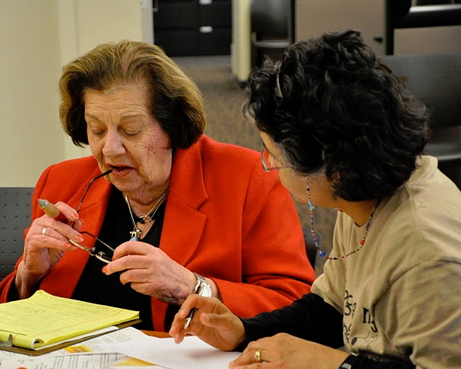

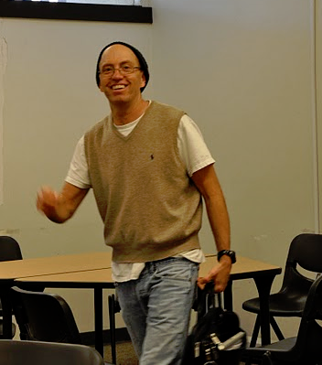


Slide 23

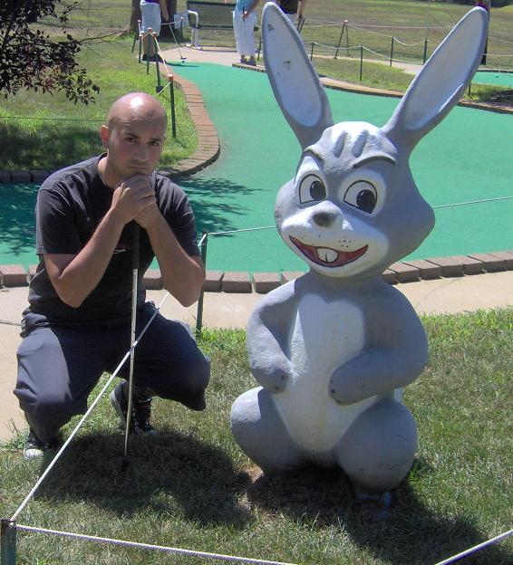
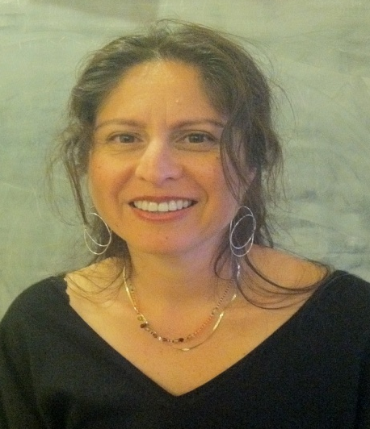
SLO Core Team
Student Services & Administrative Units Coordinator:
Veronica Avila
Instructional Coordinators:
Mary Pape & Toño Ramirez
Randy Bryant ** Anu Khanna ** Coleen Lee-Wheat ** Mallory Newll

Slide 24

SLO Core Team
Coleen Lee-Wheat
Amy Leonard

Slide 25
SLO Steering Committee
Administrators:
VP, Instruction
VP, Finance & Educational Resources
Director, Institutional Research
Director, Marketing
Associate VP, Instruction
Dean, PE & Athletics
SLO/SSLO/AUO Coordinators

Slide 26




Division SLO Liaisons
Language Arts
Physical Science/
Math/
Engineering
Business/
Computer
Systems
Student Service:
Counselor

Slide 27
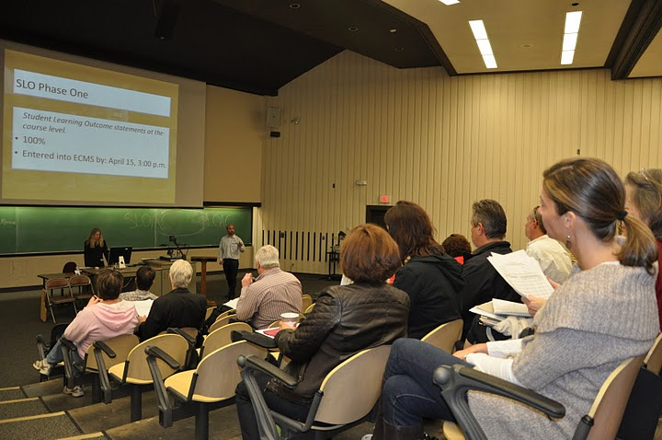
Dialog - Annual Convocation

Slide 28

Dialog - Workshops

Slide 29
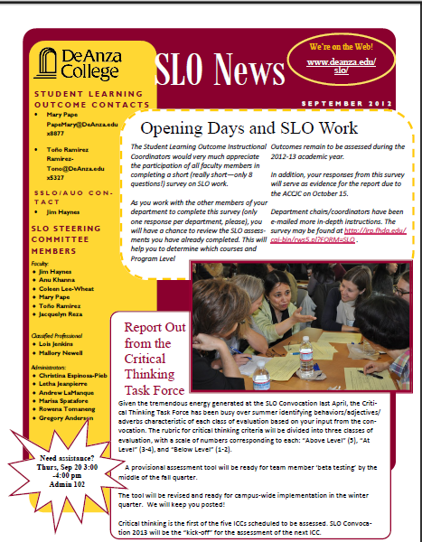
Dialog - SLO Newsletter

Slide 30
II. Developing Our Institution’s Planning Cycle

Slide 31
Our Mantra
It’s one thing to have De Anza College fully engaged in writing outcome statements, performing assessments, and documenting results for the purpose of improving student learning and achievements, but if all that work does not drive our Institutional Planning at all levels of the College we will not have met the expectations of the ACCJC Institutional Planning and Program Review Standards.

Slide 32
SLOAC
Resource
Needs
SSLOAC
Resource Needs
AUOAC
Resource
Needs
Identify

Slide 33
Divisional
prioritization
Divisional
prioritization
Divisional
prioritization
SLOAC
Resource
Needs
SSLOAC
Resource Needs
AUOAC
Resource
Needs
Identify

Slide 34
Instructional
Program Reviews
Student Services
Program Reviews
Finance & Resources
Program Reviews
Affirm
Divisional
prioritization
Divisional
prioritization
Divisional
prioritization
SLOAC
Resource
Needs
SSLOAC
Resource Needs
AUOAC
Resource
Needs
Identify

Slide 35
Focus
Focus and Alignment Lens
Mission – Strategic Initiatives – ICCs – Educational Master Plan
Instructional
Program Reviews
Student Services
Program Reviews
Finance & Resources
Program Reviews
Affirm
Divisional
prioritization
Divisional
prioritization
Divisional
prioritization
SLOAC
Resource
Needs
SSLOAC
Resource Needs
AUOAC
Resource
Needs
Identify

Slide 36
IPBT
SSPBT
FRPBT
Focus
Focus and Alignment Lens
Mission – Strategic Initiatives – ICCs – Educational Master Plan
Instructional
Program Reviews
Student Services
Program Reviews
Finance & Resources
Program Reviews
Affirm
Divisional
prioritization
Divisional
prioritization
Divisional
prioritization
SLOAC
Resource
Needs
SSLOAC
Resource Needs
AUOAC
Resource
Needs
Identify

Slide 37
COLLEGE COUNCIL
Allocate
IPBT
SSPBT
FRPBT
Focus
Focus and Alignment Lens
Mission – Strategic Initiatives – ICCs – Educational Master Plan
Instructional
Program Reviews
Student Services
Program Reviews
Finance & Resources
Program Reviews
Affirm
Divisional
prioritization
Divisional
prioritization
Divisional
prioritization
SLOAC
Resource
Needs
SSLOAC
Resource Needs
AUOAC
Resource
Needs
Identify

Slide 38
College Planning Committee
5/15/13
2011-12
2012-13
2013-14
2014-15
2015-16
2016-17
2017-18
Year 1
Year 2
Year 3
Year 4
Year 5
Year 6
Year 1
SITE
VISIT
Follow-up Site Visit
(Recs #1,#2,#3)
Follow-up Letter
(Rec #1)
MID-TERM
REPORT
Form Teams
SELF
STUDY
SITE
VISIT
ACCJC
Cycles/
Reports
Ongoing Preparation and Submission of ACCJC Reports
CPC
Assessment/
Planning
Governance
Review
Values
Review
Mission
Review
EMP
REVIEW
“Quilt”
Review
Outcomes
Review
Governance
Review
Ongoing Assessment of Governance (annual survey)
PBTs &
College
Council
Planning & Resource
Allocation
(PRA)
Planning & Resource
Allocation
(PRA)
Planning & Resource
Allocation
(PRA)
Planning & Resource
Allocation
(PRA)
Planning & Resource
Allocation
(PRA)
Planning & Resource
Allocation
(PRA)
Planning & Resource
Allocation
(PRA)
Equity
Assessment/
Planning
Ongoing Development and Assessment of Student Equity Plans
DAC - Detailed Planning Cycle - 2011 - 2017
APRU # 3
APRU #4
CPR
&
5-Year
Plan
Reflect
APRU #1
APRU #2
APRU #2
Six-Year Program Review Process
ICC/GE
Assessment
Cycles
Critical Thinking
GCS&E
3rd ICC
4th ICC
5th ICC
Critical Thinking
Outcomes
Assessment Cycles
Outcomes
Assessment Cycles
PLOAC
CLOAC
DLOAC
Outcomes
Assessment Cycles
Outcomes
Assessment Cycles
CLOAC
DLOAC
PLOAC
Outcomes
Assessment Cycles
Outcome/
Assessment
Cycles
Curriculum
Review
Cycles
5 Year cycle
5 Year cycle
5 Year cycle
5 Year cycle
5 Year cycle
5 Year cycle
5 Year cycle
Notes:
38

