Slide 1
Assign an assessment without attaching to method
N. B. Best to login to your TracDat account while viewing these slides since the font is sometimes difficult to see.
If using Microsoft Office click on the audio icon and then the play icon to hear Mary Pape explain each slide.

Slide 2
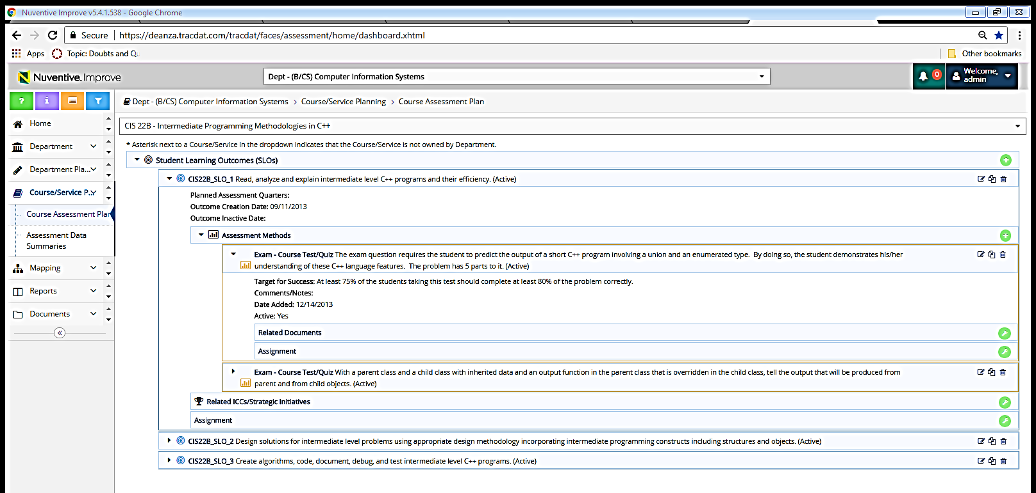

Old way: Prepare to send assignment that will be related to an established method of assessment already in TracDat

Slide 3
Prepare to send assignment that will be related directly to student learning outcome (bypassing the method(s) entered).

Slide 4
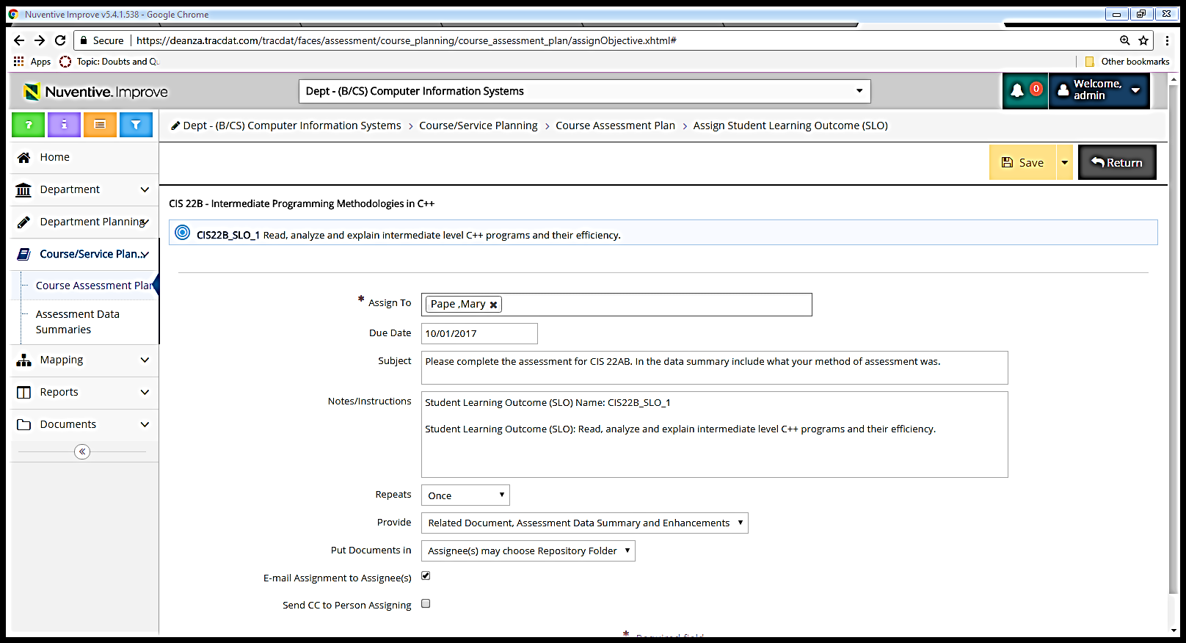
Same form but in subject heading you might wish to ask them to state method of assessment when entering the data in the Assessment Data Summary box.

Slide 5
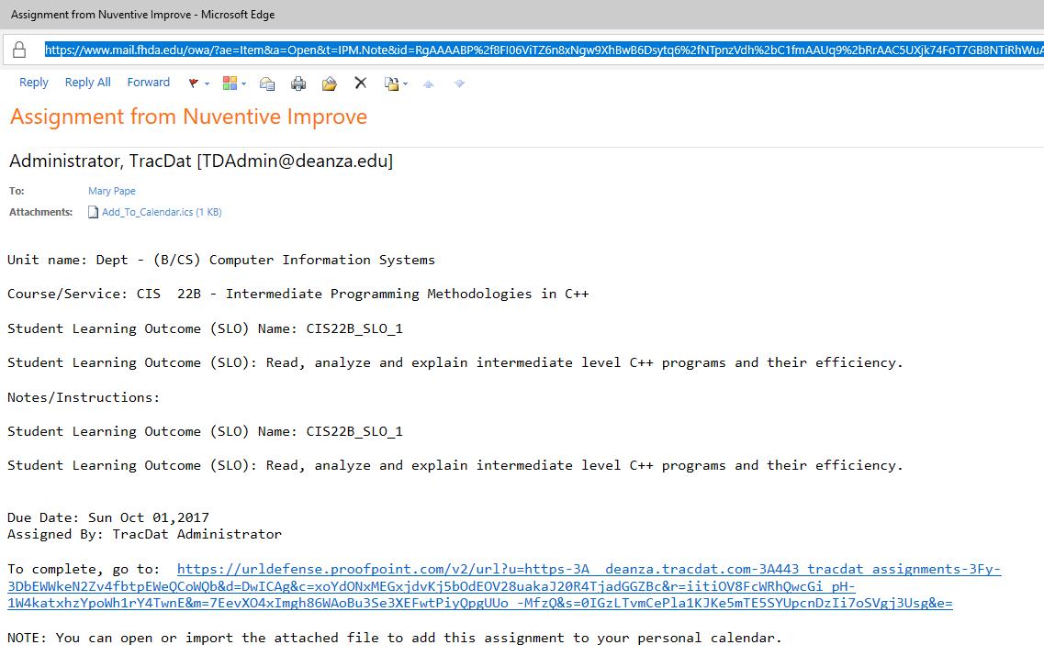
Email coming to the assignee looks the same whether assigning related to method or related directly to student learning outcome.

Slide 6
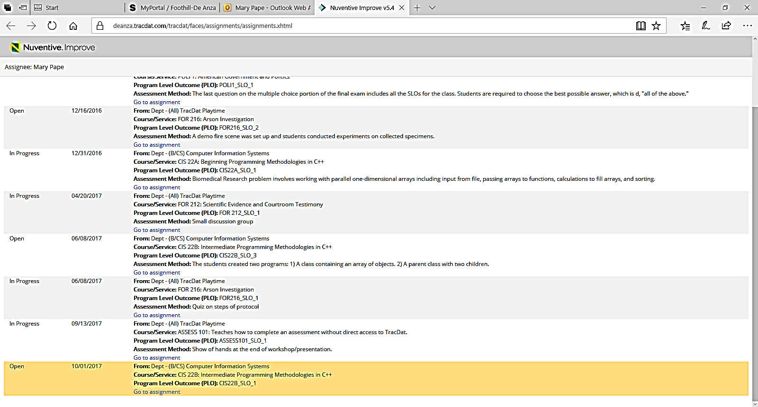

Slide 7
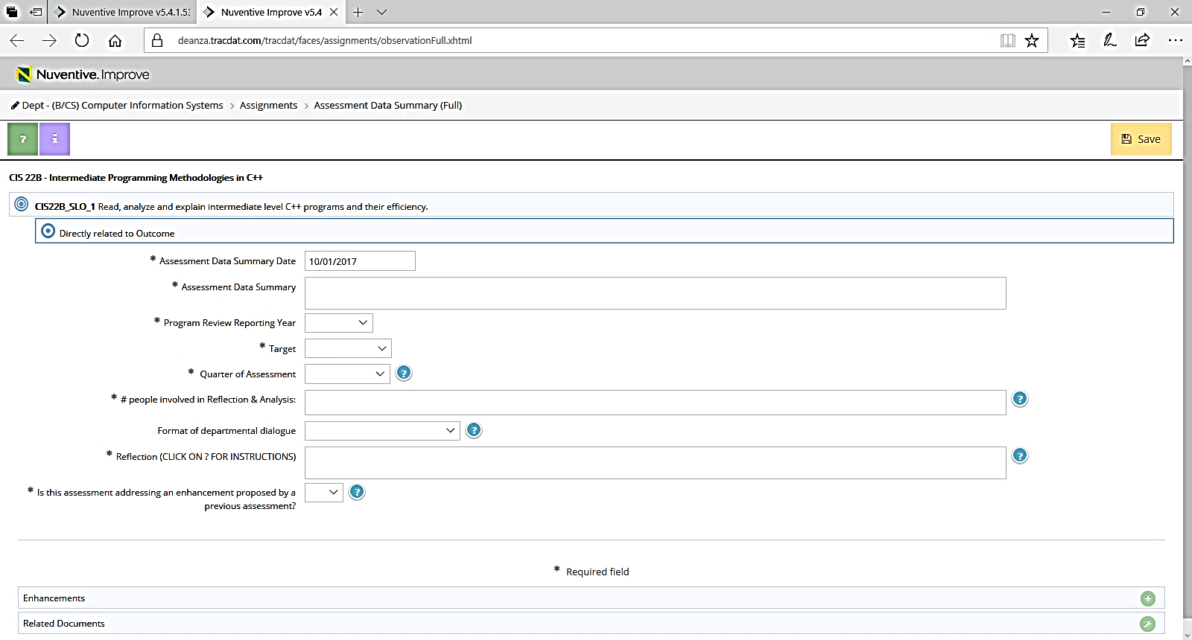
For for the assignee looks the same whether assigning related to method or related directly to student learning outcome.

