Slide 1
Presentation to DASG

Slide 2

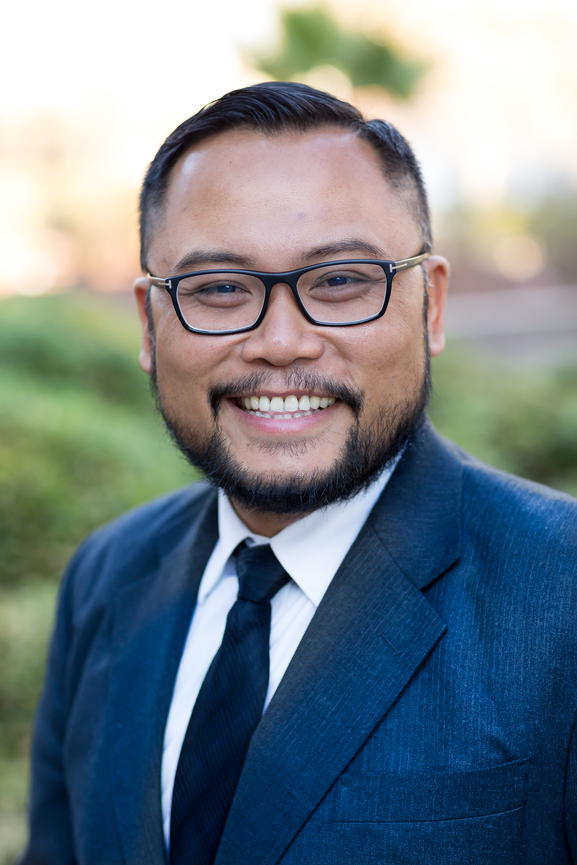
Introduction and Bio
De Anza’s Legal Advice Counselor since April 2023
Partner, Justice at Work Law Group since 2013
Co-Founder and Boardmember, Vietnamese American Roundtable since 2017 (Core member since 2011)
Executive Director at Services, Immigrant Rights and Education Network (SIREN) since May 2023

Slide 3
Agenda
Introduction and Bio
Service that we provide
Current Usage
Trends and concerns

Slide 4
Legal Advice Service
Free Service offered through Office of College Life
Stricly confidential (attorney-client privilege applies)
Only advice, not representation
30 min-sessions – standard hours are 9am-10am on Tuesdays and Wednesdays. Other hours can be accommodated by request.

Slide 5
Current Usage
Total scheduled appointments since May 2023: 74
New vs returning clients: 59 to 15

Slide 6
Current Usage – Race

Slide 7
Current Usage – Top Issues

Slide 8
Asian students were the main users in 2023, but that has started to diversify
Immigration issues were the main concern in 2023, but that has started to diversify
Usage was very consistent during late afternoon hours and much less consistent during morning hours. Usage has decreased significantly in 2024 compared to 2023. (Avg 8 appts per week to now less than 1 per week)

Slide 9
THANK YOU
QUESTIONS?

