Slide 1

STRATEGIC PLANNING WORKSHOP #4
Ensuring Learning Through the Student Success Factors
March 14, 2022

Slide 2

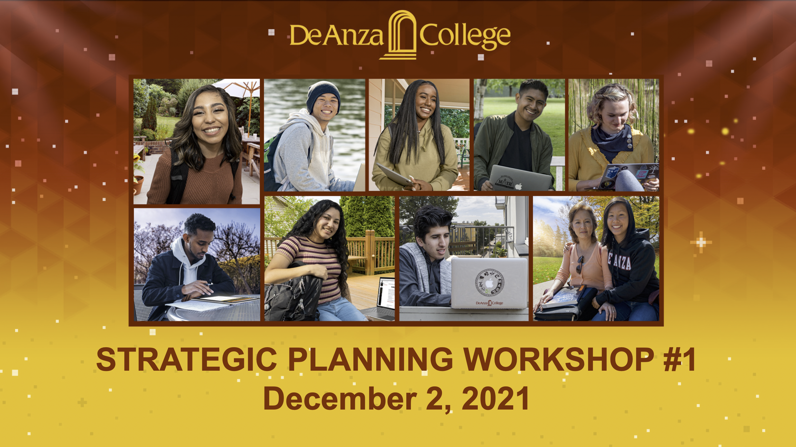

Strategic Planning Series
Workshop No. 1:
Overview, Data and Initiatives
(Introductory Workshop)
Workshop No. 2:
Supporting Cultural and Structural Equity Through Guided Pathways

Slide 3
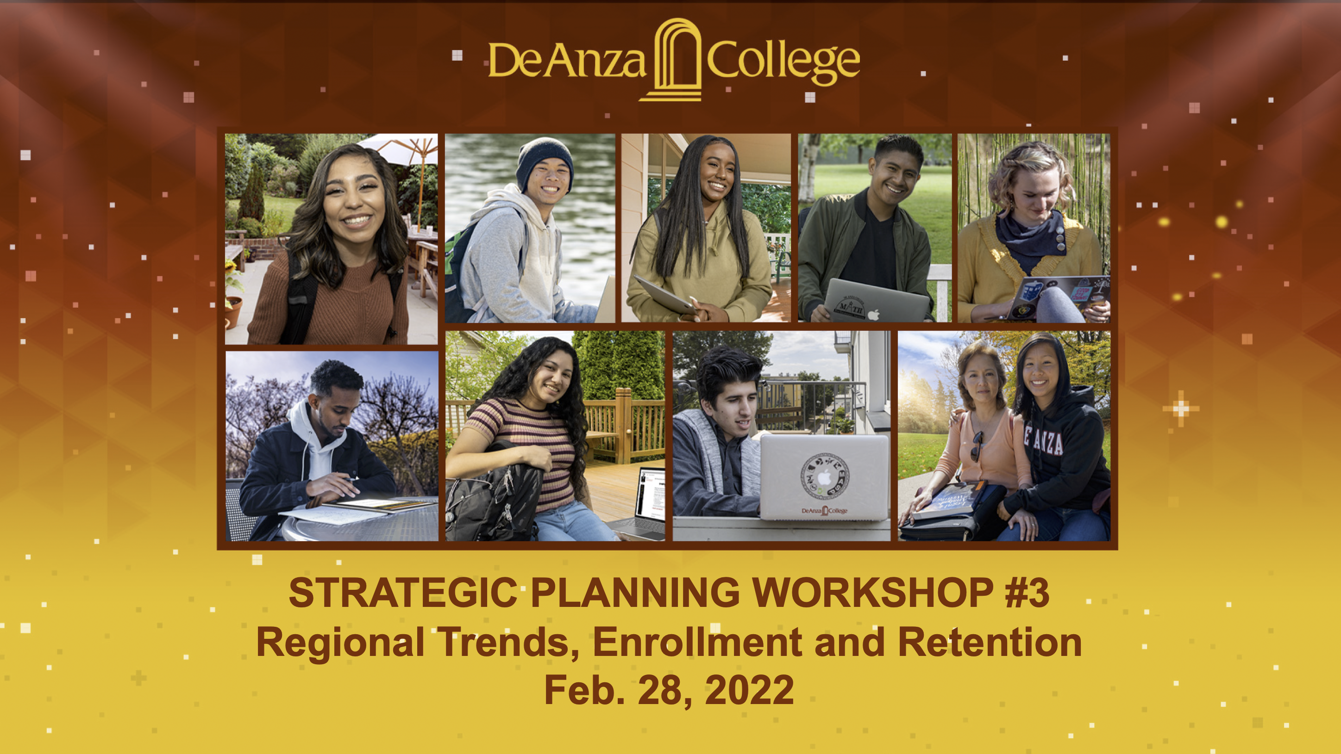
Strategic Planning Series
Workshop No. 4:
Ensuring Learning Through Student Success Factors
(Special Q&A with Senior Staff)
Monday, March 14: 1-2:30 p.m.
Join via Zoom
The last of four workshops will explore how the college can build on Guided Pathways Pillar Four (“Ensuring Learning”) to enhance the student experience, within and outside the classroom.
Workshop No. 3:
Regional Trends, Enrollment and Retention
Monday, Feb. 28: 1-2:30 p.m.

Slide 4
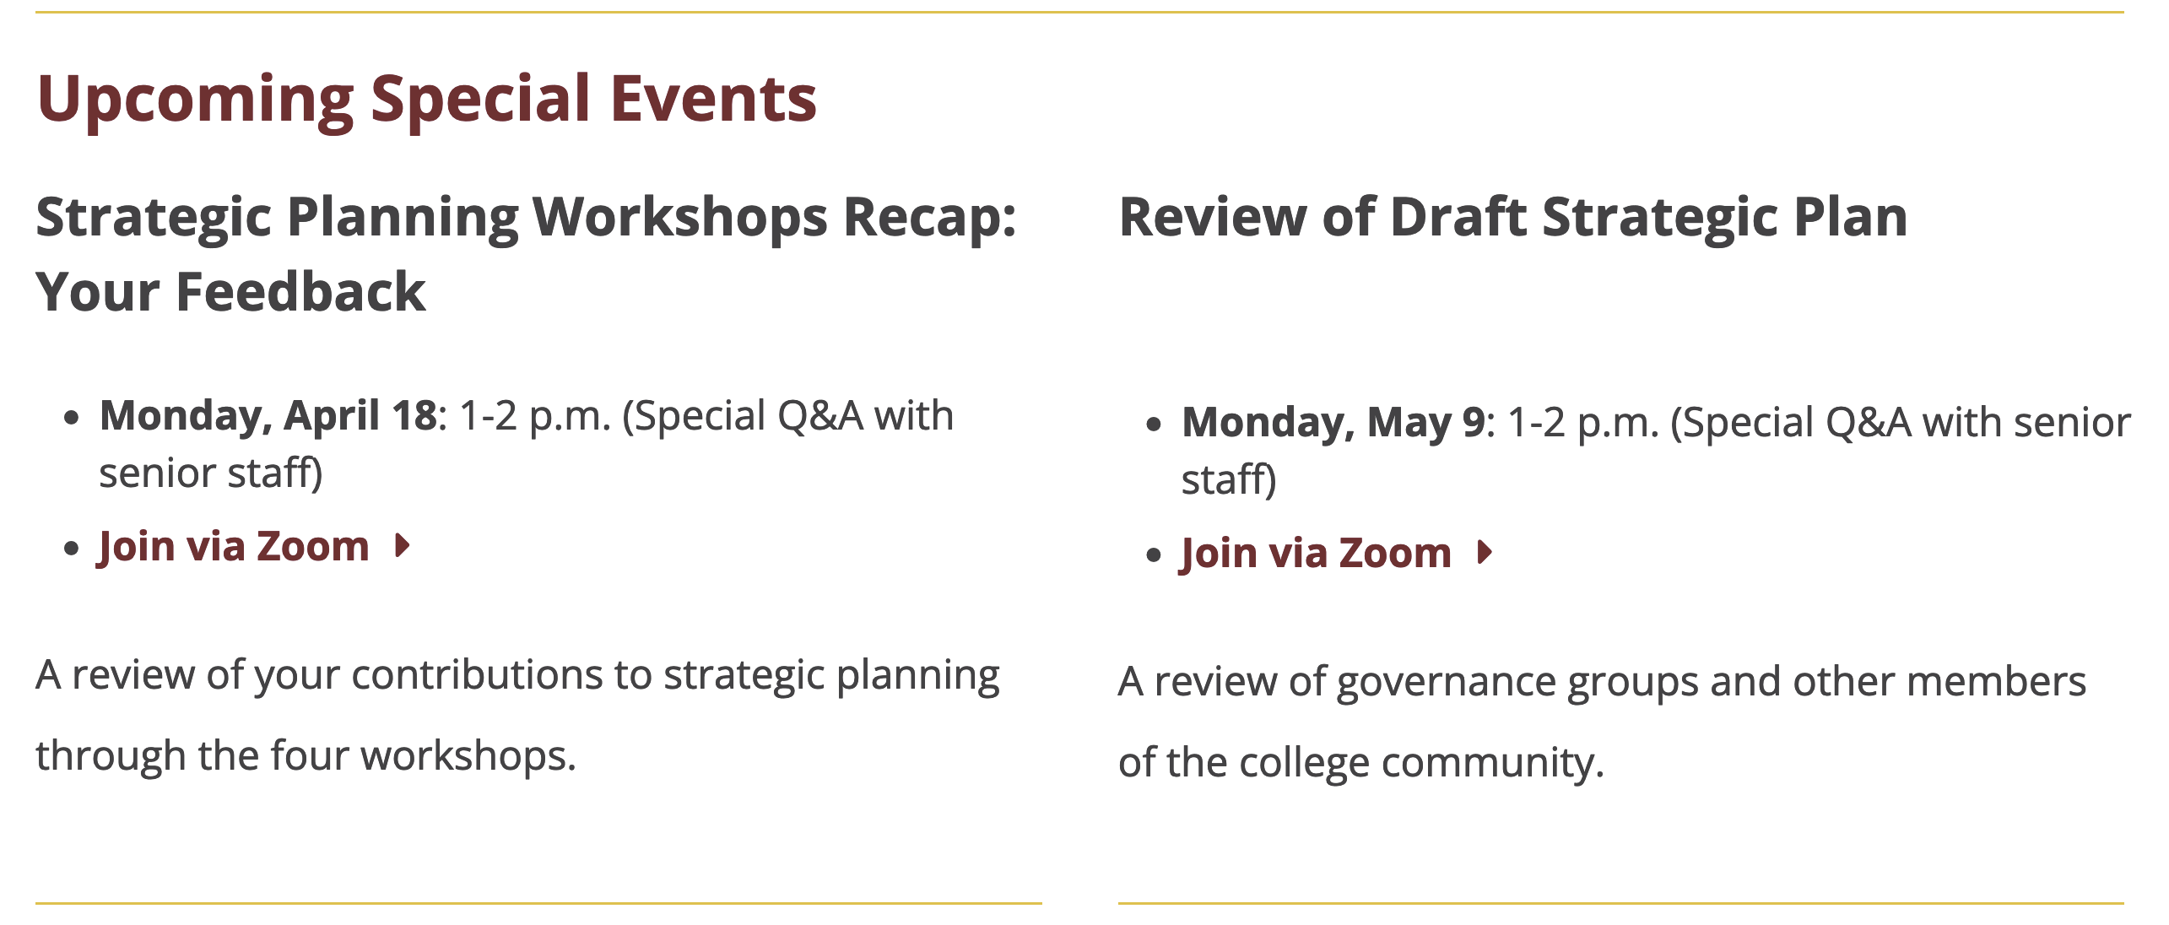
Strategic Planning Series

Slide 5

Strategic Planning Series
deanza.edu/strategic

Slide 6
Institutional Initiatives (Proposed)
Outreach
Student-Centered Instruction and Services
Retention
Civic Capacity for Community and Social Change
Incorporating Guided Pathways and achieving Student Success Factors, with Equity at the core

Slide 7
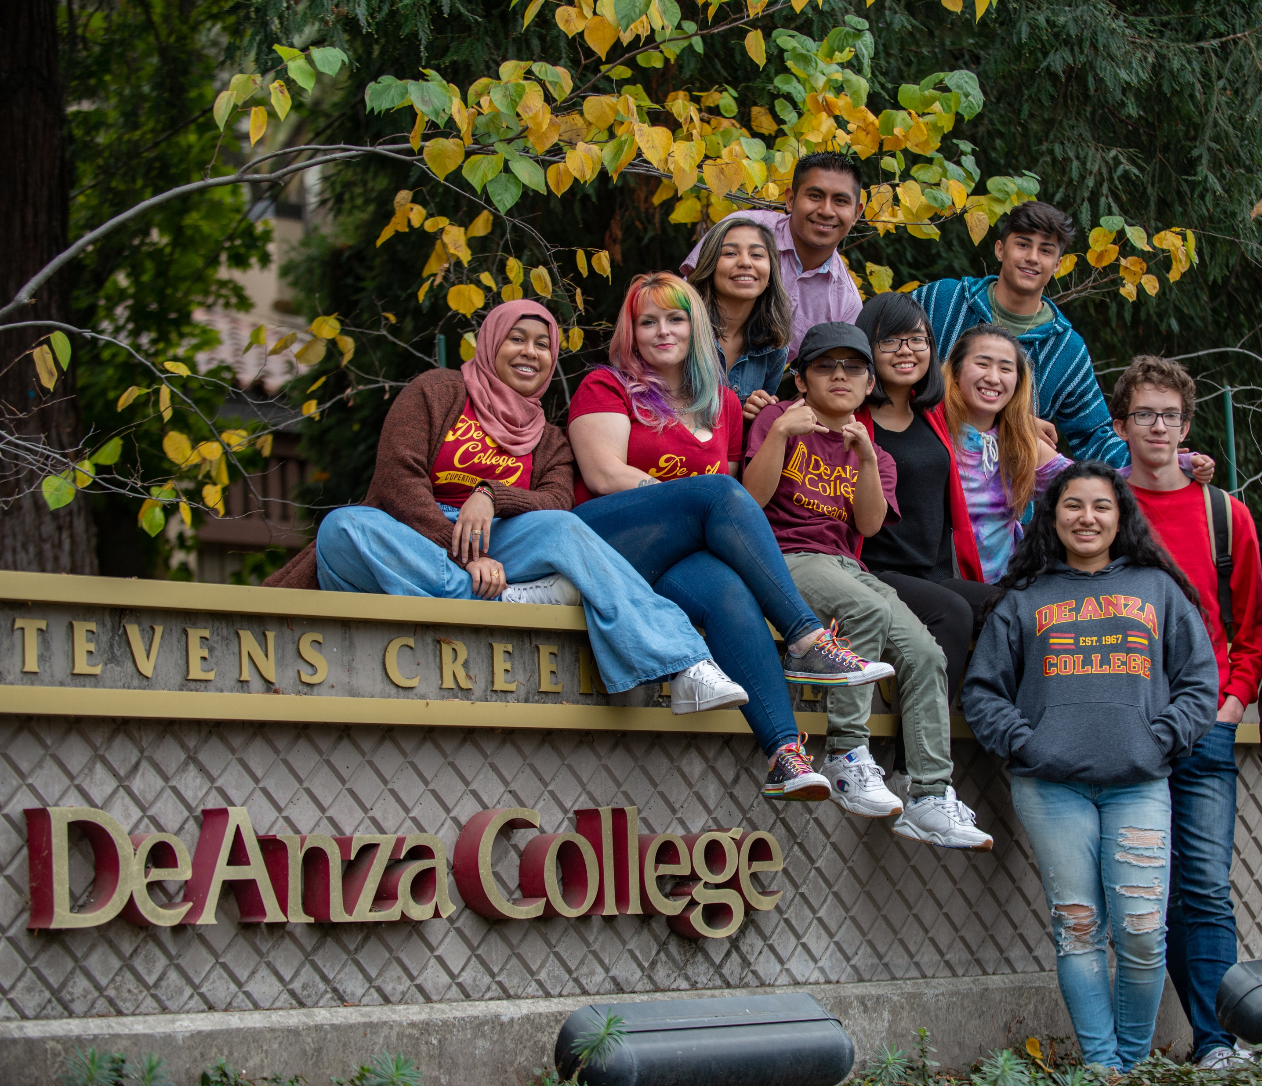
Student Population Areas of Focus (Proposed)
Black
Filipinx
Foster Youth
Latinx
LGBTQ+
Native American
Pacific Islander

Slide 8


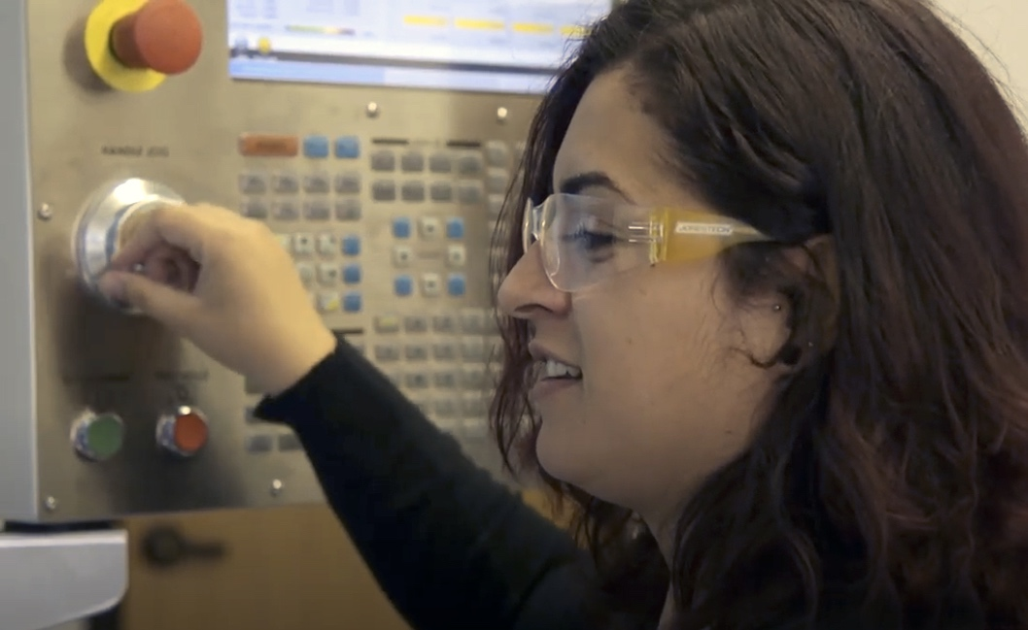
Institutional Goals (Proposed)
Outreach to Underrepresented Populations
Achieving the Student Success Factors
Course Success
English and Math Completion
Transfer
Degree Attainment
Certificate Attainment
Workforce Training
Developing Civic Capacity for Community and Social Change
Meeting Basic Needs

Slide 9
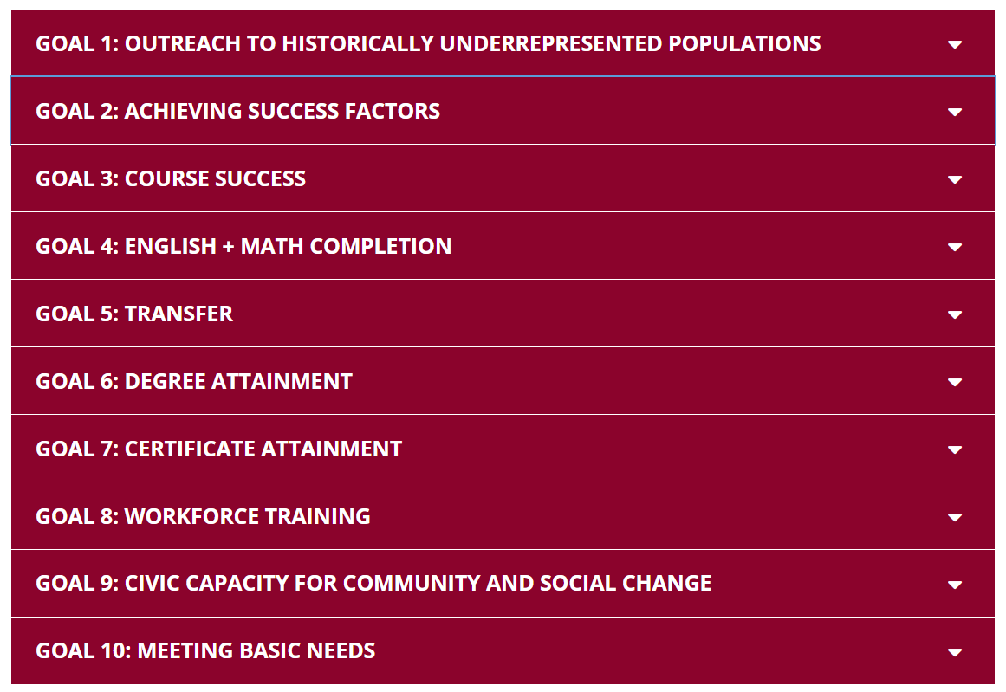
Institutional Metrics (Proposed)

Slide 10
Areas of Focus (Proposed)
Faced with a continuing enrollment decline and incorporating input from the strategic planning process thus far, we are proposing that we focus on five main areas:
Continue to attract traditional student populations, including those from historically underrepresented communities
Emphasize retention efforts within the classroom
Strengthen retention efforts beyond the classroom
Target pockets of enrollment growth
Continue to integrate transfer and CTE pathways and align with high-demand careers

Slide 11
Summary of Key Trends
We are faced with regional population declines and local enrollment declines.
The Silicon Valley region experienced its first population decline in more than 12 years
Families are moving out of the area and state, while others are moving in at historically lower rates
Birth rates declined 18-20 years ago, and are again at their lowest rate since 1979
De Anza College enrollment has declined 20% in the past nine years

Slide 12
What Do We Look Like When We Emerge
From the Pandemic?
Before the pandemic, 79% of enrollment was in-person or hybrid (combination of in-person and online), and 21% was fully online.
As we transition post-pandemic and respond to student needs, it is possible to adjust the way in which we have historically offered instruction.
We anticipate students will want a large selection of hybrid offerings, with many in-person classes including an online component.

Slide 13
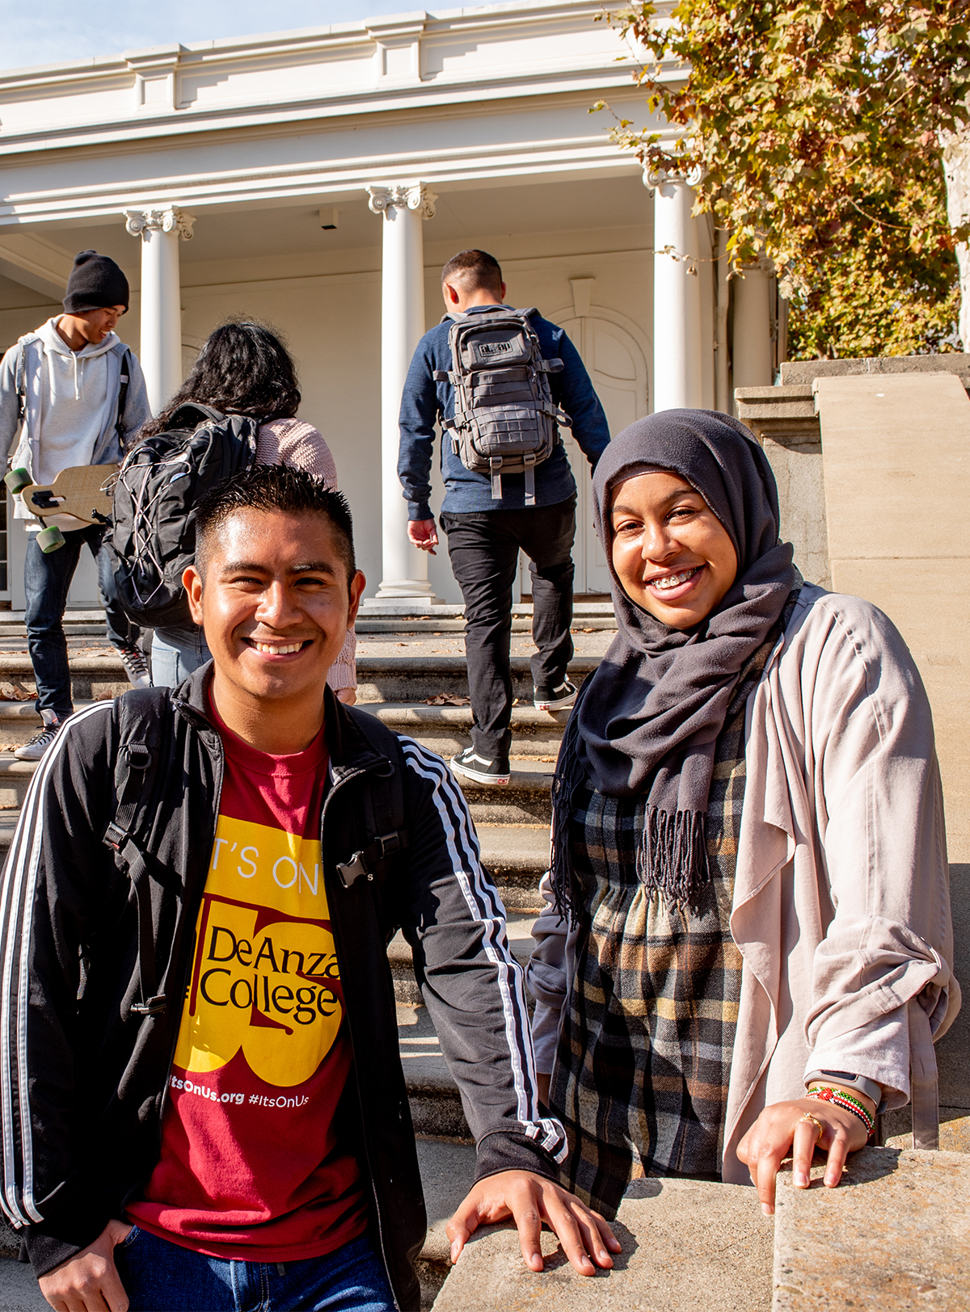
Poll
In order to best serve students, what percentage of classes do you think we will need to offer with an in-person component during the next five years?
  70-80% (~ pre-pandemic level)
  60%
  50%
  40%
  20-30% (~ current level)

Slide 14


Ensuring Learning
Because we know we will emerge from the pandemic with multiple class and services modalities, this is a key question we need to address as part of strategic planning:
How do we ensure learning in ALL formats?

Slide 15
Student Success Factors

Slide 16

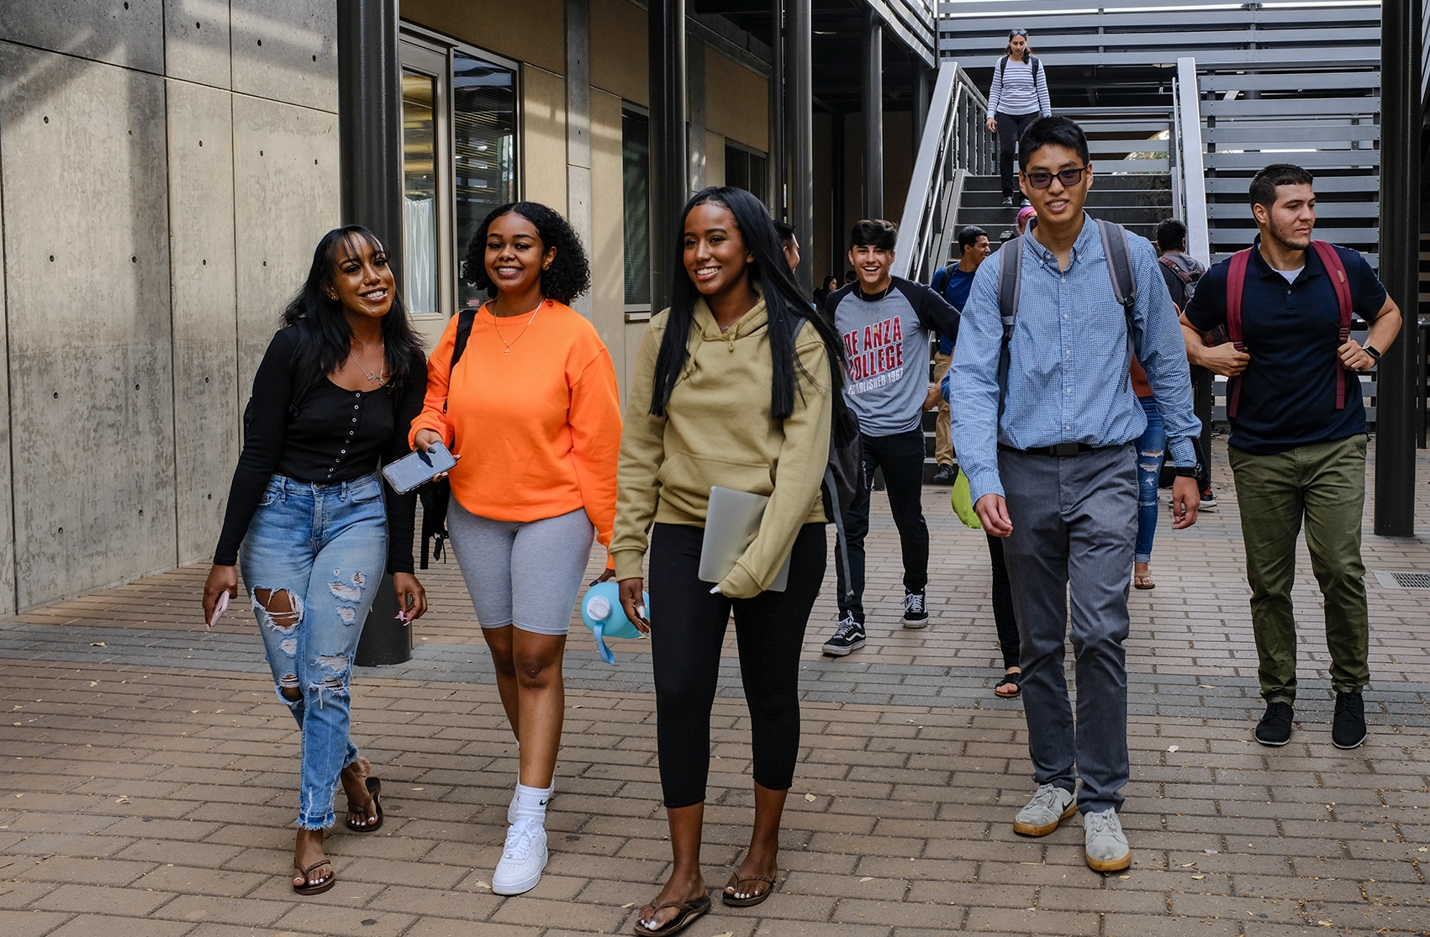
Ensuring Learning
Provide information at the beginning and throughout the quarter that is essential to your students’ success
Make expectations for your course explicit to help ensure students know what is required of them to succeed
Learn about your students, and help them learn about you and each other
Additional resource

Slide 17

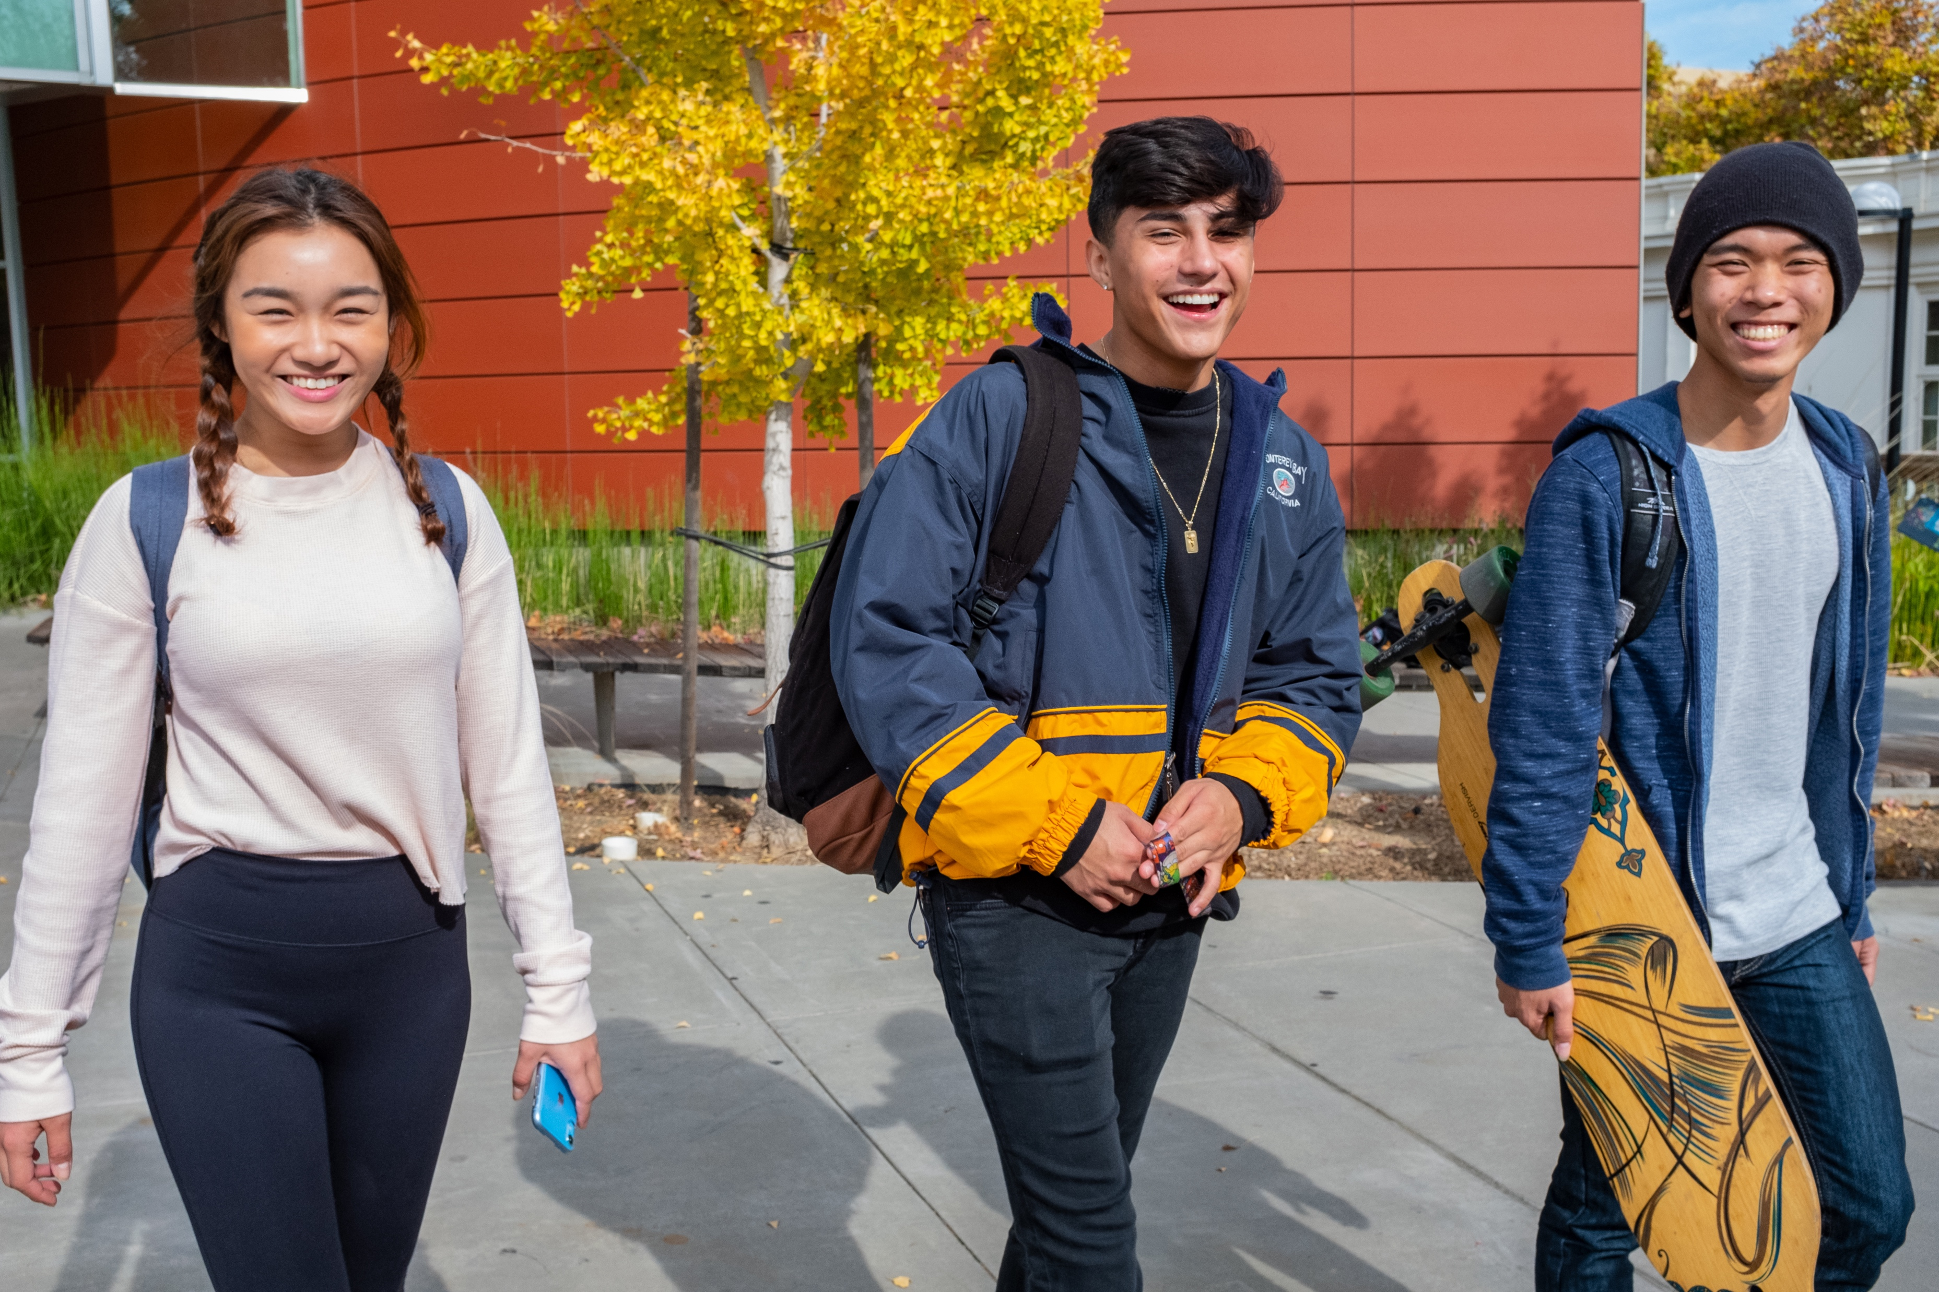
Ensuring Learning
Build a sense of community and belonging and demonstrate to your students that you care about their success
Create an environment that encourages student learning
Encourage the development of adaptive mindset skills
Demonstrate the relevance of your course to students’ lives and goals
Additional resource

Slide 18
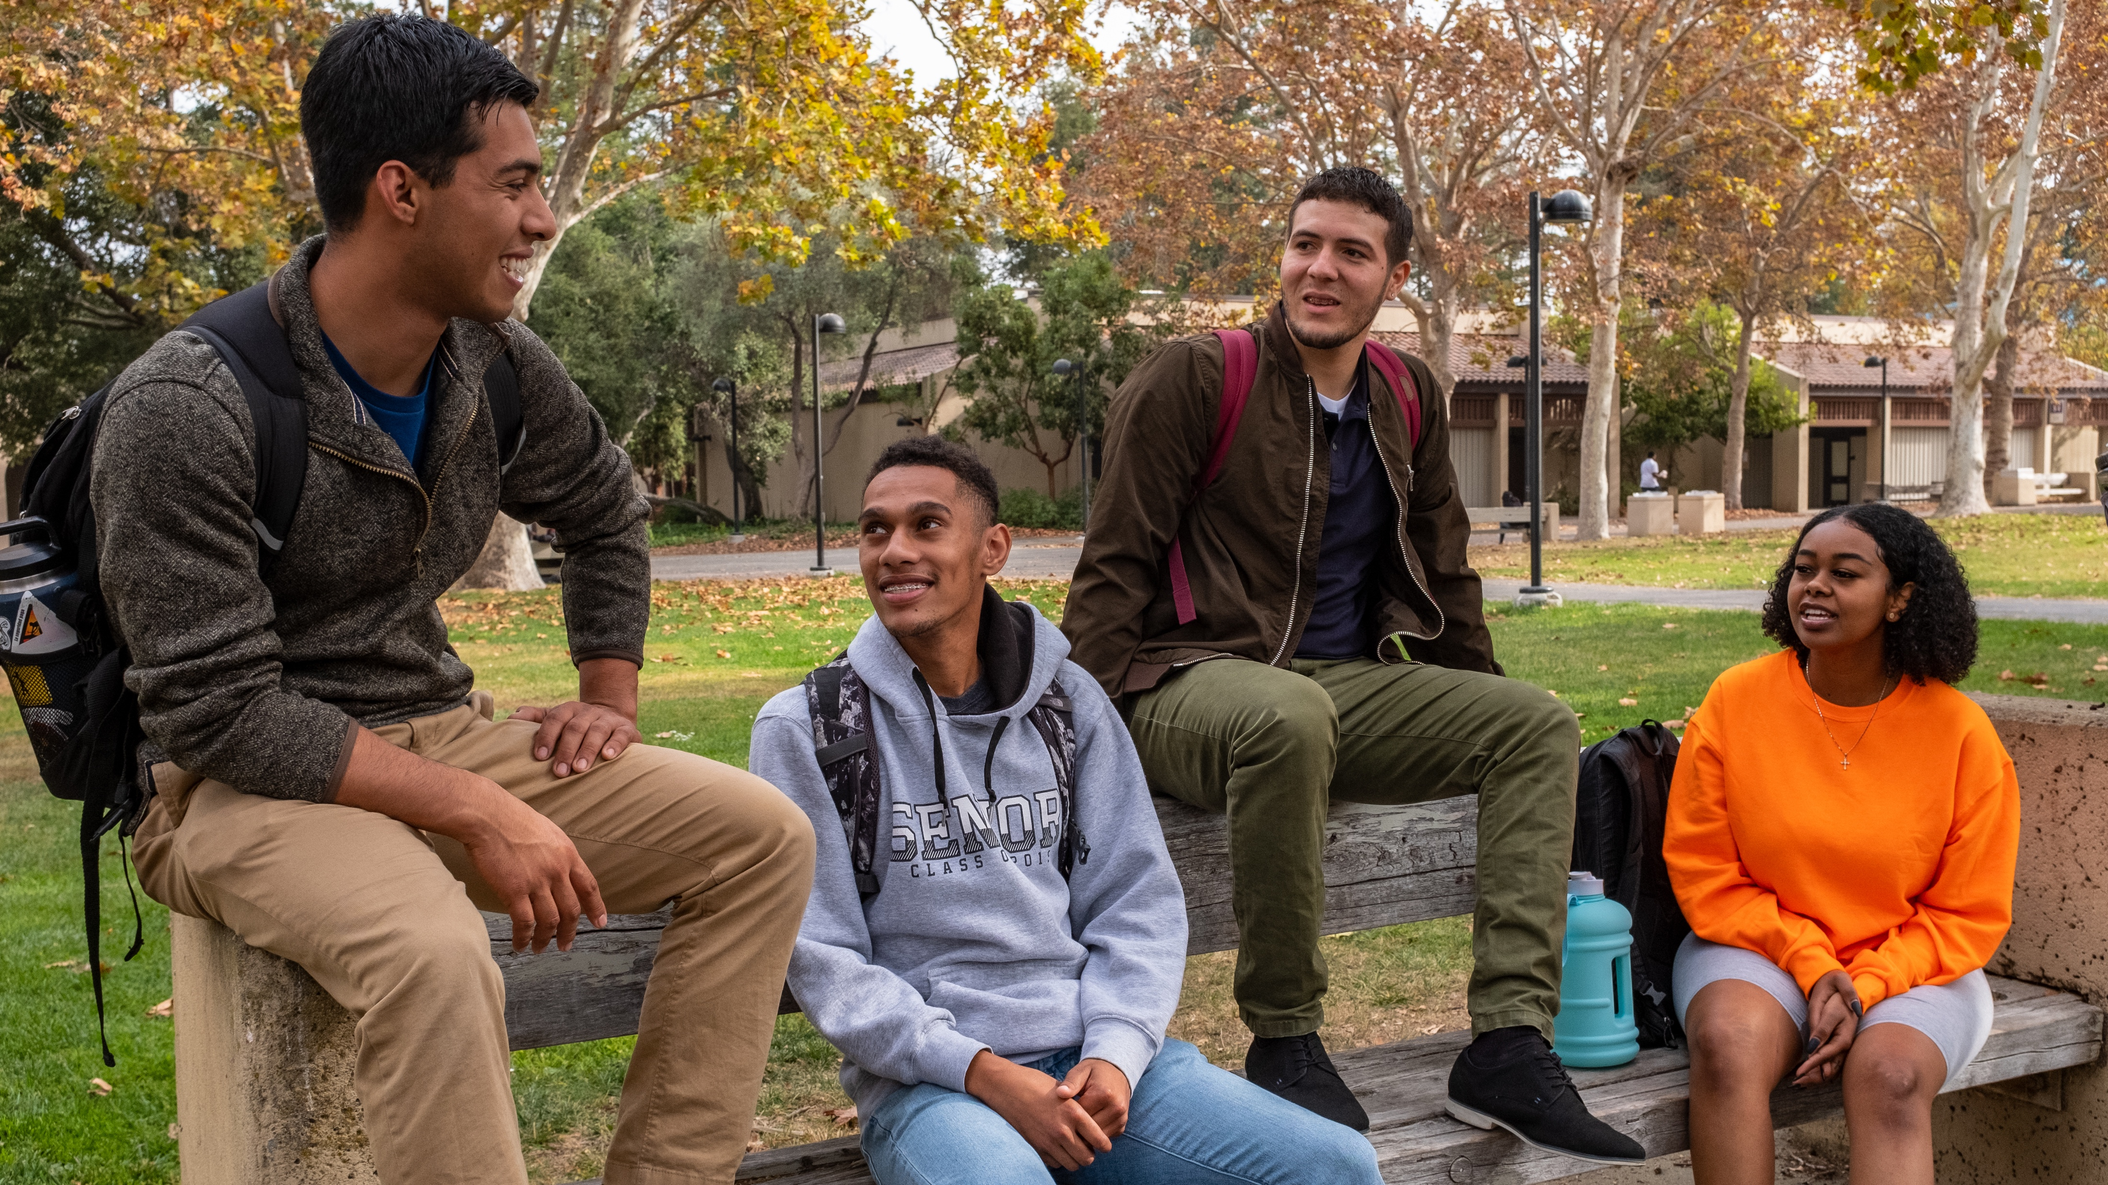
Directed and Focused
Faculty
Integrate career and educational goal exploration into assignments
Provide regular and meaningful feedback to students about their performance and progress towards their goals
Campuswide
Ask students about their educational and career goals
Have high expectations for students and hold them accountable

Slide 19
Engaged and Connected
Faculty
Regularly ask students if they understand the material and direct them to available assistance when needed
Connect or provide students with opportunities to help their peers
Provide opportunities for and encourage students to connect with and support each other
Campuswide
Ask students for feedback about their experience, including what works, what needs improvement and what’s missing
Encourage participation in out-of-class activities
Show students that you are proud to work at your school and that they should be proud to be enrolled at your school

Slide 20
Nurtured and Valued
Faculty
Ask your students how they are doing and listen to their response
Incorporate opportunities for students to share their personal and family history and culture in class assignments
Create opportunities for students to provide feedback on their experience
Campuswide
Communicate and demonstrate to students that you care about their success
Recognize the value of students’ talents, abilities, skills and experiences and connect them with opportunities to contribute

Slide 21
Success Factors and Ensuring Learning
Success Factor | When we… | Through efforts such as…
Directed | Know and communicate what it takes to be successful at the next phase of their education or career | Alignment of program learning outcomes to transfer institutions and employers’ expectations Student and college personnel relationships with transfer institutions Advisory committees Employer engagement
Focused | Help students to know that they are making gains in their learning | Database of student learning outcomes accessible to students that allows them to track their learning Classroom assessment techniques Assessment of program-level outcomes Regular feedback from the faculty to students on their performance
Nurtured | Show students that individuals on the campus care about their learning as well as the factors that can either enhance or hinder their learning | Mentoring or counseling Student success teams Faculty advising Learning management systems

Slide 22
Success Factors and Ensuring Learning (cont’d)
Success Factor | When we… | Through efforts such as…
Nurtured (cont’d) | Improve teaching practices based on analyses of student learning outcomes data | Course or program assessments Classroom assessment techniques Student portfolios
Engaged | Involve students in culturally-responsive pedagogy and active learning strategies | Student-centered learning Capstone project Community-based learning Project-based learning Diverse scholar voices Faculty-led improvement of teaching practices Study and peer groups
Engaged (cont’d) | Engage students in applied learning experiences | Internships Clinical experiences Apprenticeships Work experience Community-based learning Service learning

Slide 23
Success Factors and Ensuring Learning (cont’d)
Success Factor | When we… | Through efforts such as…
Connected | Offer structured opportunities for students to connect in the classroom and on campus | Mentoring and advising Student clubs and government Faculty office hours Campus jobs Service learning Academic and career communities
Valued | Provide opportunities for students to give feedback on their classroom experiences | Faculty evaluation surveys Student focus groups Interviews Surveys

Slide 24
Institutional Initiatives (Proposed)
Outreach
Student-Centered Instruction and Services
Retention
Civic Capacity for Community and Social Change
Incorporating Guided Pathways and achieving Student Success Factors, with Equity at the core

Slide 25
Breakout Room Topics
Institutional Initiatives and Student Success Factors
How do we achieve each goal – both online and in-person – while keeping equity and the success factors in mind?
Outreach (Goal 1)
Retention – achieving success factors (Goal 2)
Student-Centered Instruction and Services (for short-term success) – course success (Goal 3) and math and English completion (Goal 4)
Student-Centered Instruction and Services (for longer term success) – transfer (Goal 5), degree (Goal 6), certificate (Goal 7) and workforce training (Goal 8)
Civic Capacity for Community and Social Change (Goal 9)
Meeting Basic Needs (Goal 10)

Slide 26
Breakout Room Instructions
We’ll have five discussion topics – you may choose which room
to enter.
If the first room on the topic is full (about 10 people), please select the second room on the same topic.
You will have approximately 40 minutes.
Address the prompts for each room that are listed in the Padlet.
Write your thoughts in the Padlet.
We will reconvene in the main room and share thoughts from two
or three breakout rooms.

Slide 27
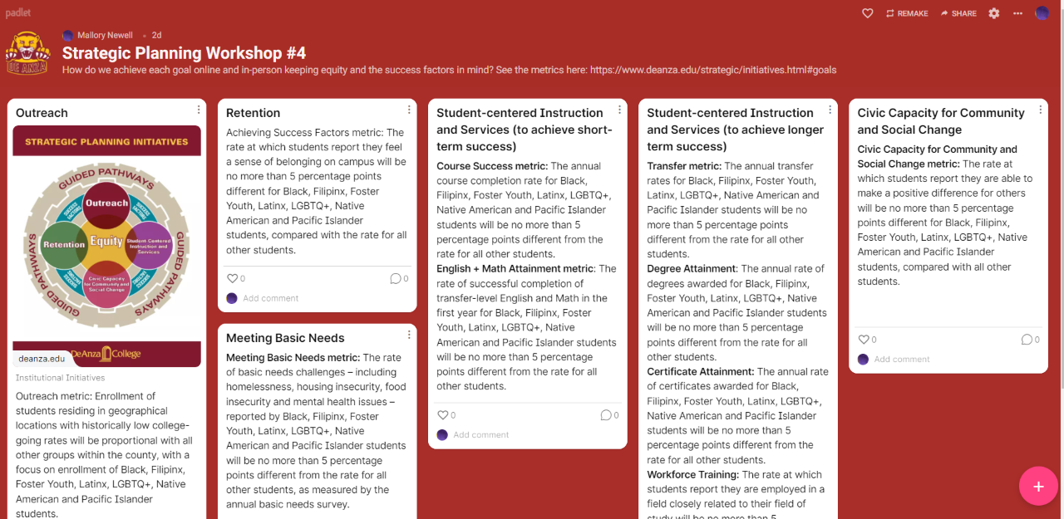
Padlet

Slide 28
Welcome Back!
Let’s hear from two or three rooms.
Please keep your answers brief – up to two minutes for each speaker.

Slide 29
Thank You!
Please join us for our upcoming special event
Strategic Planning Workshops Recap:
Your Feedback
Monday, April 18, 1-2 p.m.
Thank you for participating!

Slide 30
STRATEGIC PLANNING WORKSHOP #4
Ensuring Learning Through the Student Success Factors
March 14, 2022

