Slide 1
Culture in Nursing and Healthcare
Catherine Hrycyk, MScN, RN

Slide 2
Work with the colleague sitting next to you:
  Identify two culturally specific health maintenance practices from your culture.
  What are the effects of illness on a family as a system?
  How does culture influences the way people use healthcare services?

Slide 3
Introduction
Systems Theory – a change in one part of the system results in changes in other parts
  Example: Family as a system. A change in one member affects the other members.
Nursing supports health, manages illness, and addresses complex changes and human responses to illness.

Slide 4
Illness
Illness is a personal experience
Acute illness:
  Sudden onset,
  Limited duration,
  Can return to the state of relative health.
Chronic illness:
  Gradual onset,
  Requires ongoing attention and care,
  Progressive course (unlikely return to pre-morbid state of health)

Slide 5
Adjusting to Illness
Follows Kubler-Ross Model:
Disbelief and denial
Irritability and anger
Attempting to gain control
Depression and grief
Acceptance and participation

Slide 6
Influences on Illness Behaviors
Internal:
Dependence / independence
Coping ability
Resourcefulness
Resilience
Spirituality and religion
External:
Past experiences
Culture

Slide 7
Cultural Competence
Definition: It is having the attitudes, knowledge, and skills necessary for providing quality care to diverse populations (AACN, 2008).
It focuses on patient-specific needs shaped by culture.
The culturally competent nurse is more likely attuned to health disparities.
The “non-compliant” patient and the need to understand the patient’s perception of illness

Slide 8
What is Culture?
A set of beliefs, values, and assumptions about life that are widely held among a group of people and that are transmitted intergenerationally (Leininger, M. & McFarland, 2002)
Learned behavior of a society or a group (Sardar & Van Loon, 2013)
The ensemble of stories we tell ourselves about ourselves (Sardar & Van Loon, 2013)

Slide 9
Culture is ….
Socially acquired
Shared by a group
Lends identity to individuals and groups
Influences perceptions and defines the worldview
Develops over time and is resistant to change

Slide 10
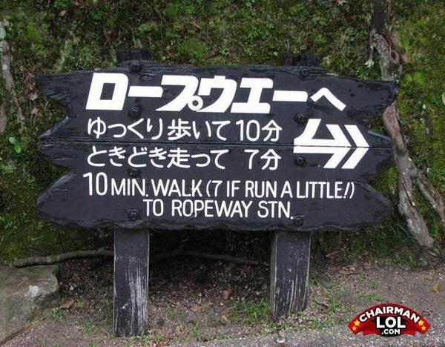

Slide 11
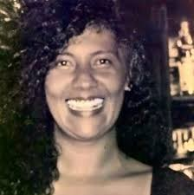
Ms. Fellner: Case Study on Race
Born in Recife, Brazil
Paternal grandparents:
  Grandfather Danish
  Grandmother African slave in Brazil
Maternal grandparents:
  Grandfather Serbian
  Grandmother Greek Jew
Racial classification changed when she moved to USA

Slide 12
Race
A social classification that relies on physical markers to assign group membership
Race is NOT culture
    Individuals may be the same race but of different cultures
Biological aspect becoming obsolete with advancement of science and a greater focus on individual origins

Slide 13
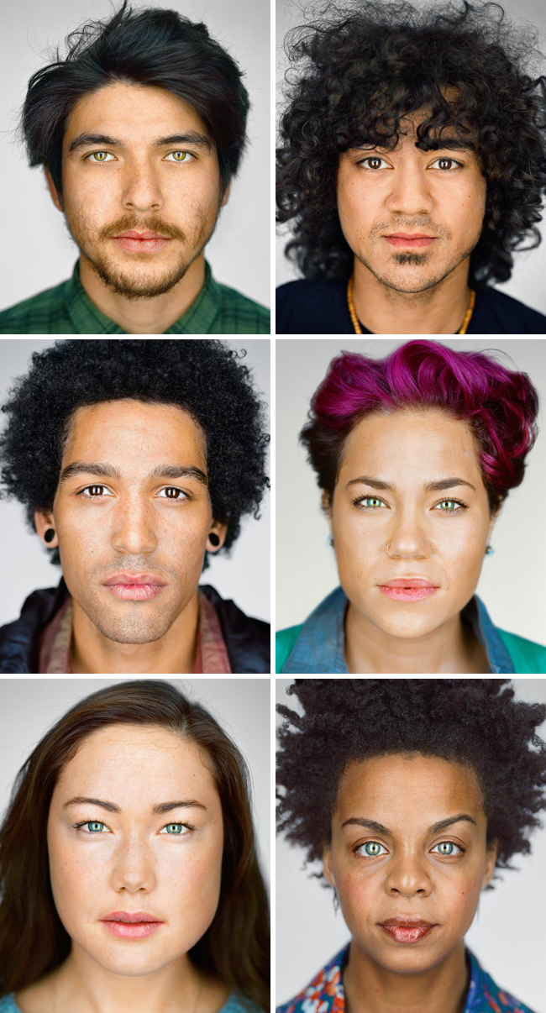
Ethnicity
Sociocultural category
A group of qualities that marks one’s association with a particular group
Ethnic group is a collection of people who share culture and cultural identity

Slide 14
US Census Bureau Nomenclature
Widely used by health agencies and academia
What are the possible implications / problems associated with these labels?
    Caucasian / White
    Asian / Asian American
    Latino / Hispanic
    African American / Black
    Native Indian / Alaska Native
    Native Hawaiian / Other Pacific Islander

Slide 15
Transcultural Nursing (TN)
Cultural studies:
    Center for Contemporary Cultural Studies, University of Birmingham, UK – 1964
Theories of transcultural nursing predate establishment of cultural studies as a distinct discipline - GO NURSES!!!!!
    Leininger’s Sunrise Model – 1955
Cultural Humility / Competence:
  A core competency for all registered nurses
  Requires lifelong learning

Slide 16
Barriers to Cultural Competence
Cultural Conflict
Prejudice and Racism
Ethnocentrism
Cultural Shock
Stereotyping
Cultural Imposition

Slide 17
Discuss the difference…
Generalization
Stereotype

