Slide 1
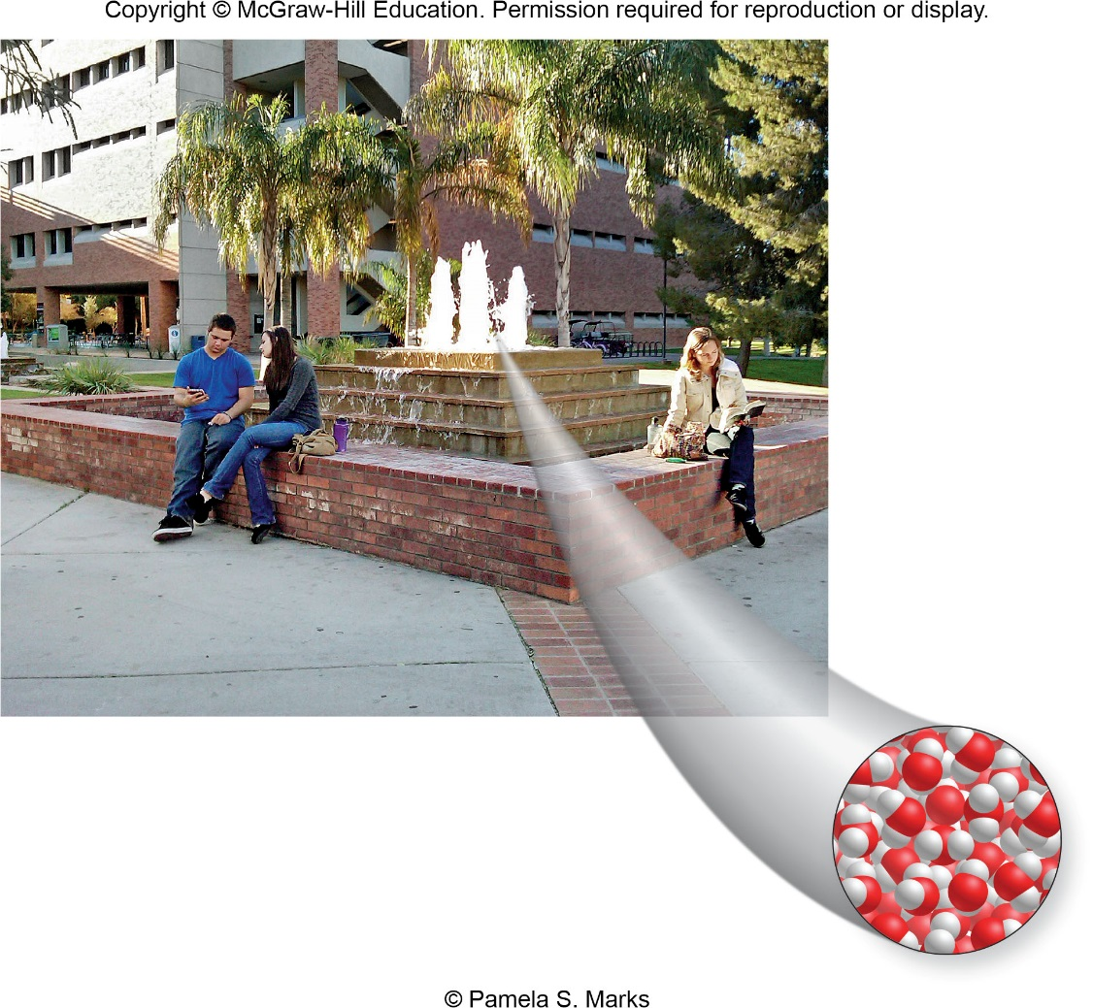
Chapter 1:
Matter and Energy

Slide 2
Questions for Consideration
What characteristics distinguish different types of matter?
What are some properties of matter?
What is energy and how does it differ from matter?
What approaches do scientists use to answer these and other questions?

Slide 3
Chapter 1 Topics:
Matter and its Classification
Physical and Chemical Changes and Properties of Matter
Energy and Energy Changes
Scientific Inquiry

Slide 4
Chapter 1 Math Toolboxes:
1.1 Scientific Notation
-- Also called exponential notation
1.2 Significant Figures
1.3 Units and Conversions

Slide 5
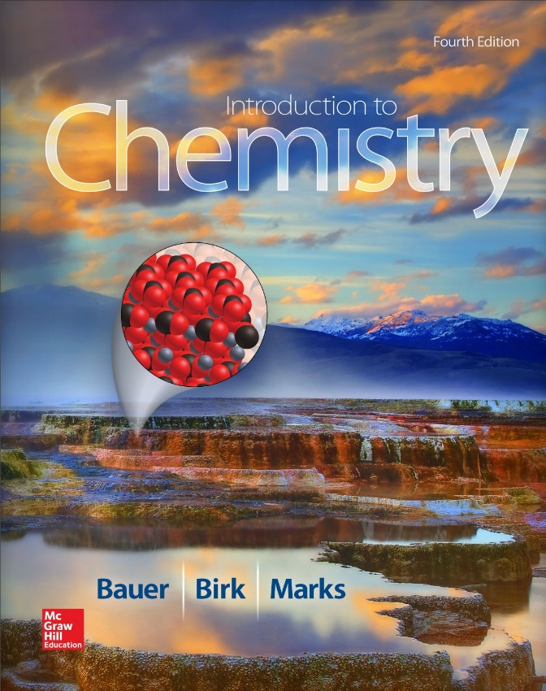
1.1 Matter and Its Classification
Matter is anything that occupies space and has mass.
Forms of energy are NOT matter. Heat and light, for example, do not occupy space and have no mass.
Consider the different forms of matter and energy in this picture.

Slide 6
Activity: Classifying Matter
Look around your chemistry classroom.
What objects do you see that are related to chemistry?
If you were asked to classify these objects, what categories might you use to group similar objects together?
Why group these similar items together? What makes them similar? What makes other objects different?

Slide 7
Composition of Matter
We classify matter so that we can understand it better.
  One way to classify matter is as pure substances or mixtures.
Matter
Pure Substances
Mixtures

Slide 8
Chemical Classifications of Matter
Matter – anything that occupies space and has mass
Pure Substances – have uniform (the same) chemical composition throughout and from sample to sample
Mixtures – are composed of two or more pure substances and may or may not have uniform composition

Slide 9
Composition of Matter
Pure Substances:
have the same composition throughout, and from sample to sample.
can be further classified as either elements or compounds.
Pure
Substances
Elements
Compounds

Slide 10
Pure Substances
Have uniform, or the same, chemical composition throughout and from sample to sample.
Two kinds of pure substances
  Elements
    An element is a substance that cannot be broken down into simpler substances even by a chemical reaction.
    Elements are separated further into metals and nonmetals.
  Compounds
    A compound is a substance composed of two or more elements combined in definite proportions.

Slide 11
Elements
An element is a substance that cannot be broken down into simpler substances even by a chemical reaction.
All known elements are organized on the periodic table.

Slide 12
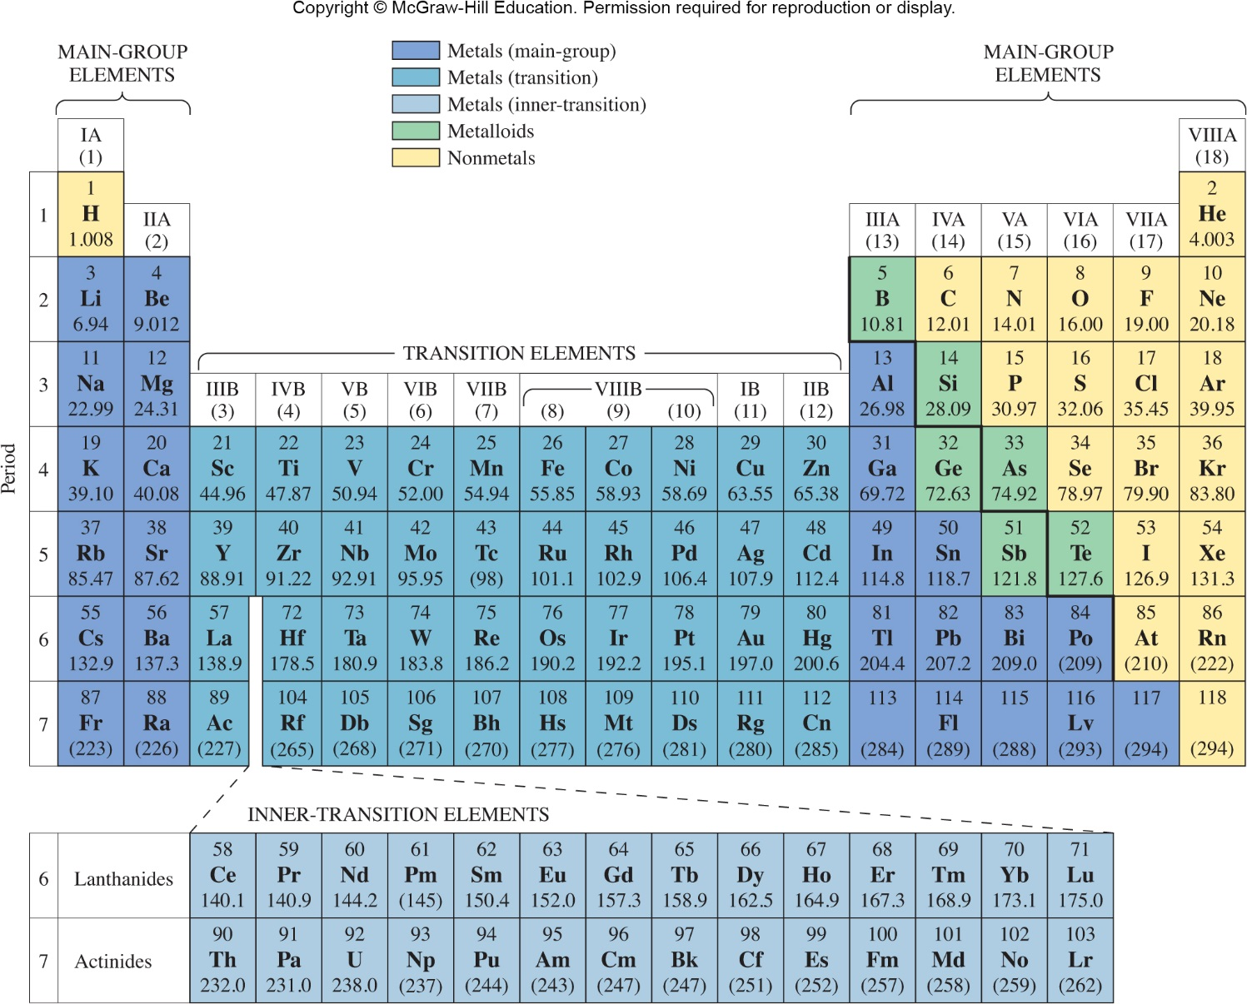
The Periodic Table
Figure 1.3

Slide 13
Pure Substances
Pure
Substances
Elements
Metals
Nonmetals
Compounds

Slide 14
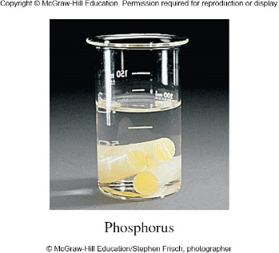
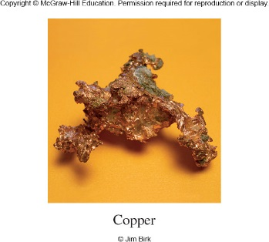
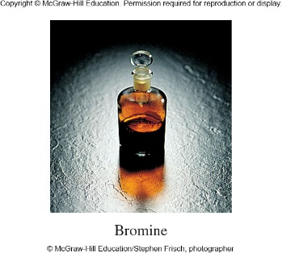
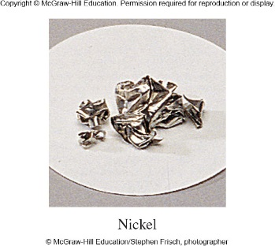
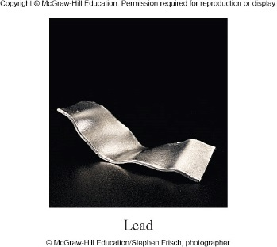
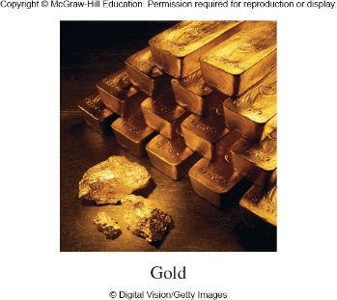
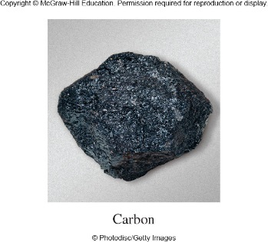
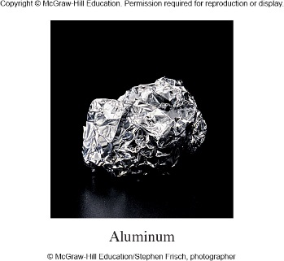
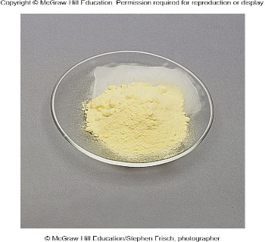
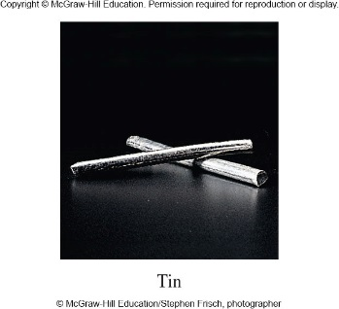
Activity: Classification of Matter
Identify the nonmetals. Explain the characteristics you considered in making your decision.
Figure 1.4

Slide 15
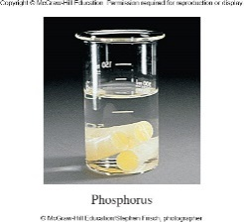
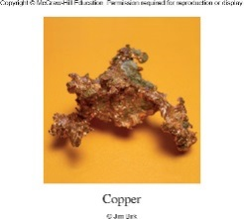
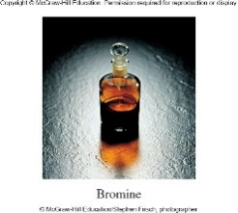
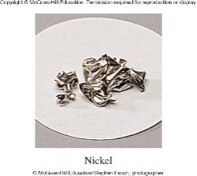


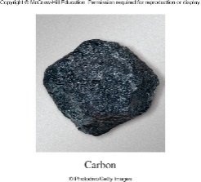
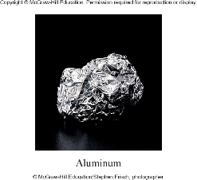
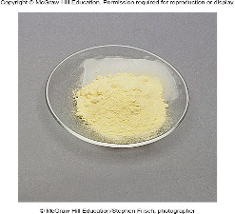
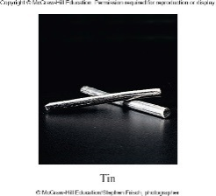
Activity Solution: Classification of Matter
Metals can be distinguished from nonmetals by the
luster and ability to conduct electricity.
Since we do not know how each of the elements conducts electricity, we need to use luster as our measure.
Nonmetals are usually dull, with the exception of carbon (as diamond). Elements that are gases at room temperature are also nonmetals.
Figure 1.4

Slide 16
Activity Solution: Classification of Matter
Identify the nonmetals. Phosphorus, bromine, carbon, and sulfur.
Figure 1.4

Slide 17
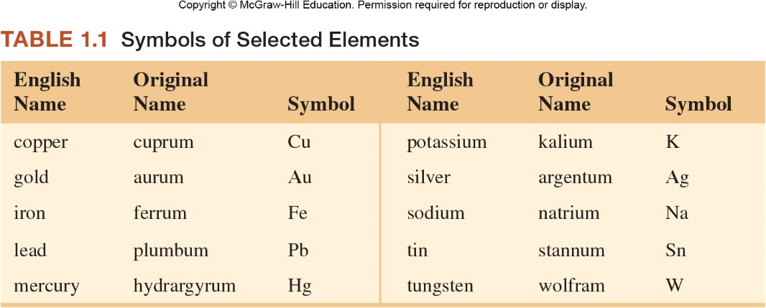
Elements and their Symbols
Element symbols often consist of one or two letters of the element’s name.
Examples: carbon: C calcium: Ca
How do we explain that Fe is the symbol for iron?

Slide 18
Elements and their Symbols
Know the names and symbols of the most common elements indicated.

Slide 19
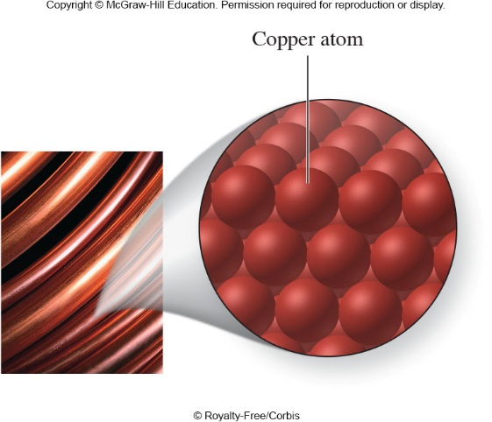
Atoms
Matter is composed of atoms.
  An atom is the smallest unit of an element that retains the chemical properties of that element.
Figure 1.8

Slide 20
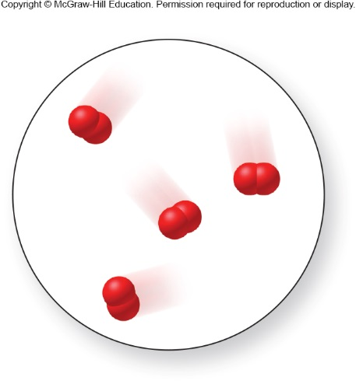
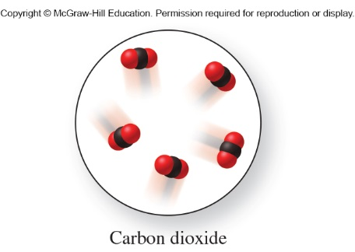
Atoms and Molecules
Atoms can be found combined together in molecules.
  Molecules are composed of two or more atoms bound together in a discrete arrangement.
  The atoms bound together in a molecule can be from the same element or from different elements.
Figure 1.11
Figure from p. 21

Slide 21
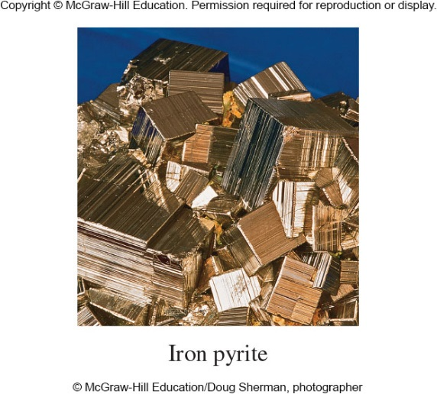
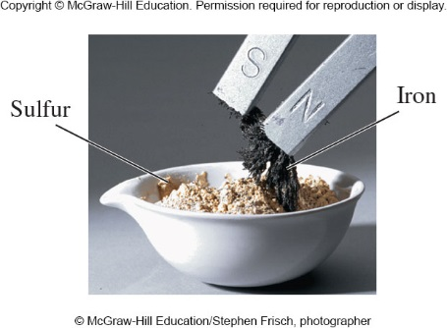
Compounds
A compound is a pure substance composed of two or more elements combined chemically in definite proportions.
A compound has properties that are different from those of its component elements.
Figure 1.5
Compound: Iron pyrite, Fe₂S₃
Mixture of Elements: Iron, Fe, and Sulfur, S

Slide 22
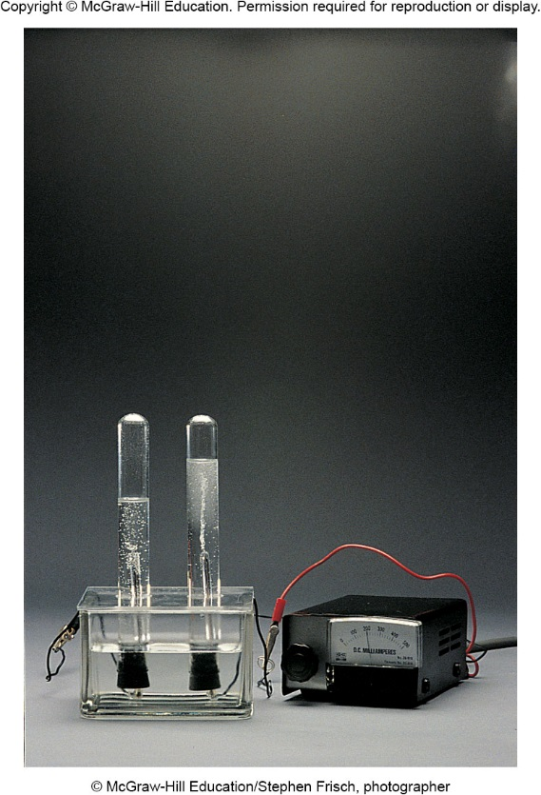
Water, H₂O, is a Compound
Water, H₂O, can be broken down by a chemical process, known as electrolysis, to its elements H₂ and O₂.
The hydrogen (left) and oxygen (right) can be seen bubbling to the top of the tubes.
Figure 1.2

Slide 23

Compounds
Pure sand is the compound silicon dioxide, which has the formula SiO₂.
What does the formula tell us about the combination of elements in this compound?
Figure 1.1

Slide 24
Activity: Elements and Compounds
Identify each of the following as an element or compound.
  He
  H₂O
  sodium chloride
  copper
element
compound
compound
element

Slide 25
Mixtures
A mixture is a combination of two or more elements or compounds .
Mixtures differ from pure compounds in that their components can be separated by physical processes.
Examples:
  Pencil lead
  Salt water
  Air

Slide 26
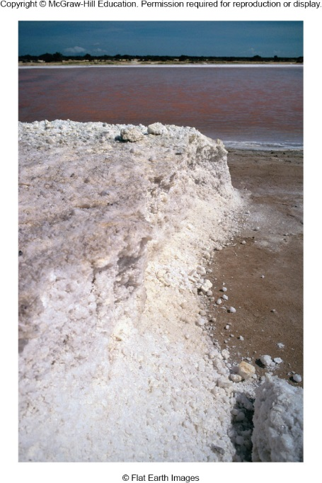
Salt Being Separated by Evaporation
Salt water is a mixture.
Salt and water can be separated by the process of evaporation, which is physical process.
Figure 1.6

Slide 27
Mixtures
Mixtures –
consist of 2 or
more pure
substances
Homogeneous
Mixtures (solutions) - have uniform
composition
throughout
Heterogeneous
Mixtures – do not have uniform
composition
throughout
Mixtures can be further classified as homogeneous and heterogeneous.
Homogeneous mixtures have the same composition throughout.
Heterogeneous mixtures do not.

Slide 28
Activity: Mixtures
Classify each of the following mixtures as homogeneous or heterogeneous:
  Salt water
  Lake water
  Tap water
  Air
  Brass (an alloy of Cu and Zn)
  Potting soil
  Cake mix
homogeneous*
homogeneous*
homogeneous
homogeneous*
homogeneous
heterogeneous
heterogeneous
*depends on presence or absence of suspended solids

Slide 29
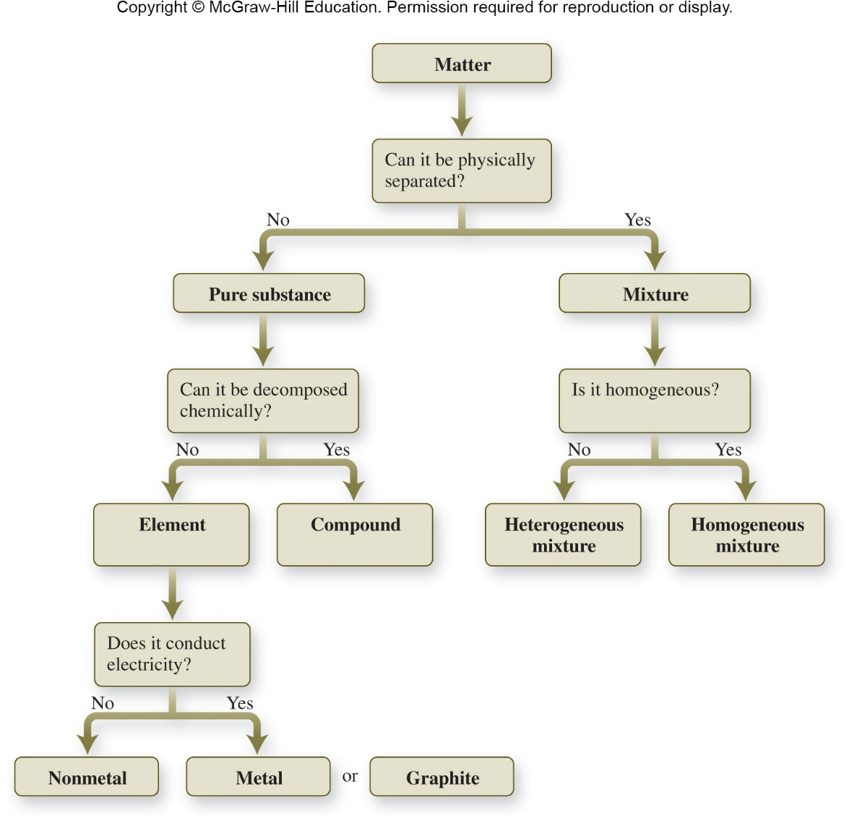
Classification of Matter
Figure 1.7

Slide 30
Representations of Matter
Macroscopic – we can see with our eyes
Molecular level – a magnification to a level that shows atoms
Symbolic – shorthand using element symbols
Atom – the smallest unit of an element; represented as single sphere.
Molecule – two or more bound atoms

Slide 31
Molecular-Level Representations of Matter – Copper Atoms
Figure 1.8

Slide 32
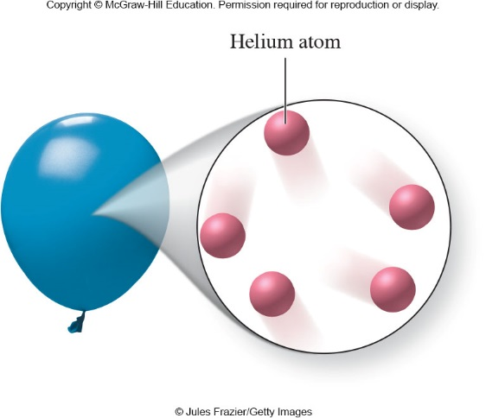
Molecular-Level Representations of Matter – Helium Atoms
Figure 1.9

Slide 33
Activity: Molecular-Level Representations
Does this image represent atoms or molecules?
Is this an element, compound, or mixture?
Molecules
Element
Figure 1.11

Slide 34
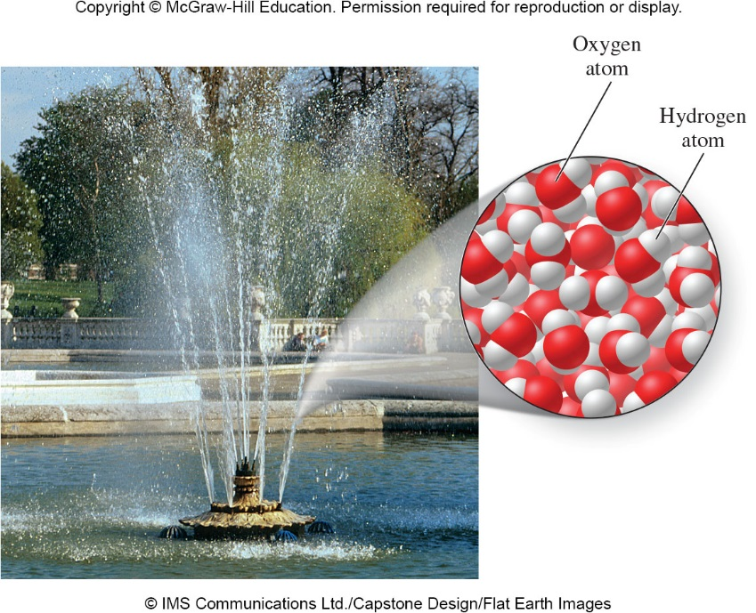
Molecular-Level Representations of Matter – water molecules
Figure 1.10

Slide 35
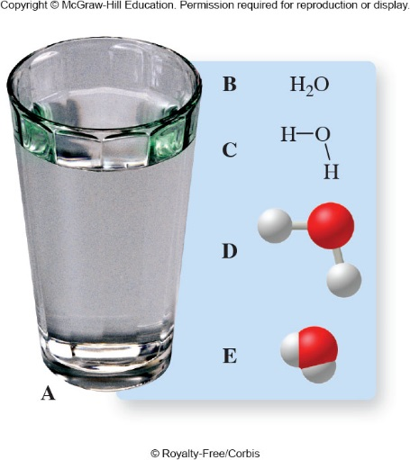
Different Ways to Represent Water
Figure 1.12

Slide 36
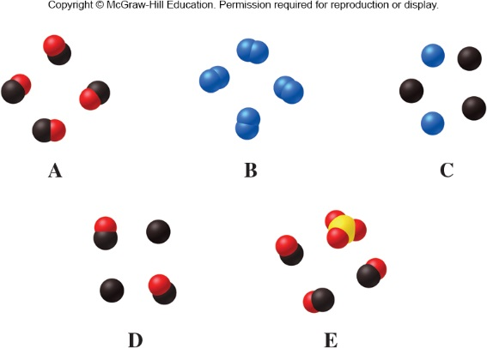
Activity: Classification
Classify each of the following as an element, compound, or mixture.
Compound
Element
Mixture of elements
Mixture of element and compound
Mixture of compounds
Figure from p. 49

Slide 37
States of Matter
A different way to classify matter is by its physical state: solid, liquid, or gas.
  What are the macroscopic properties of each?
  How do the atoms and molecules of solids, liquids, and gases behave differently?

Slide 38
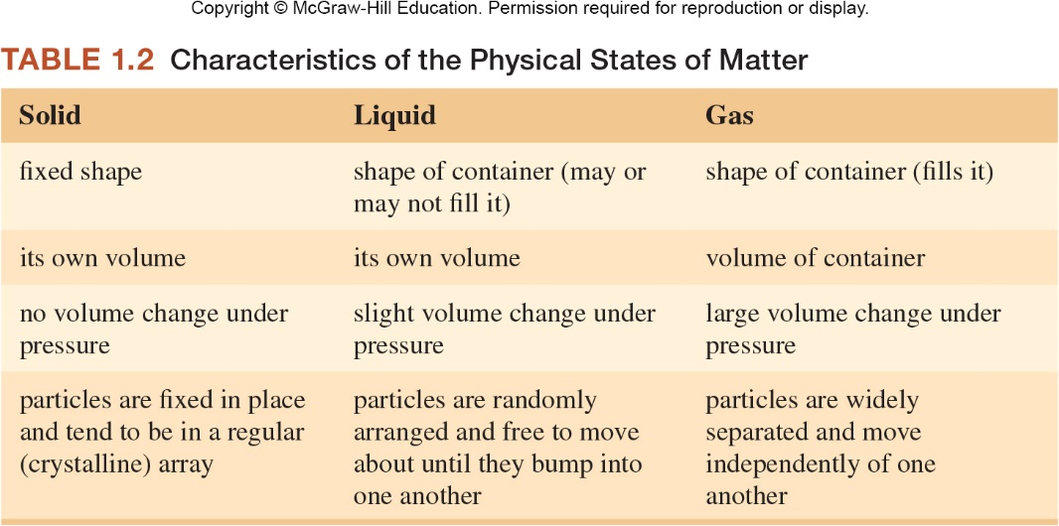
States of Matter

Slide 39
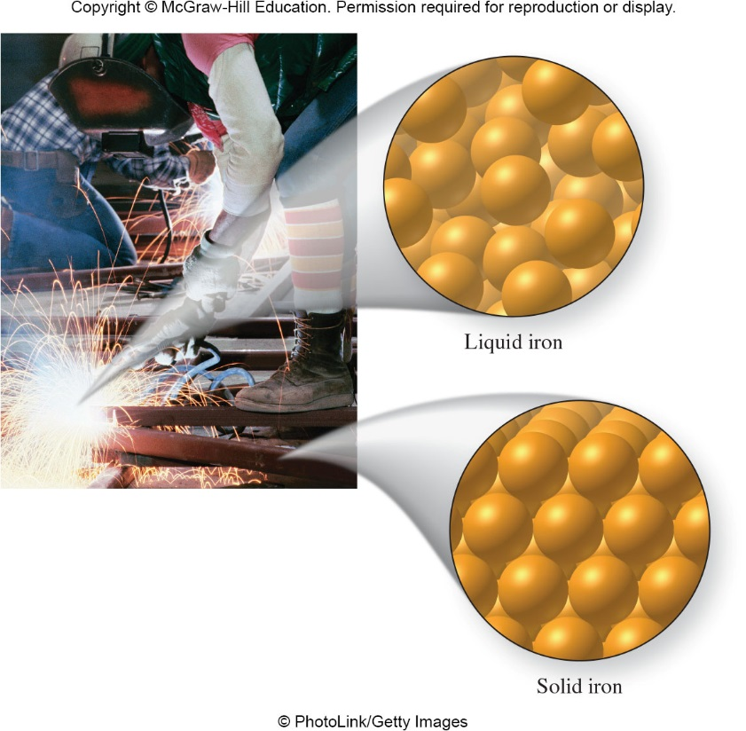
Activity: States of Matter
Discuss the following questions:
  How does a solid differ from a liquid?
  How does a gas differ from a liquid?
  How does a solid differ from a gas?
Figure 1.14

Slide 40
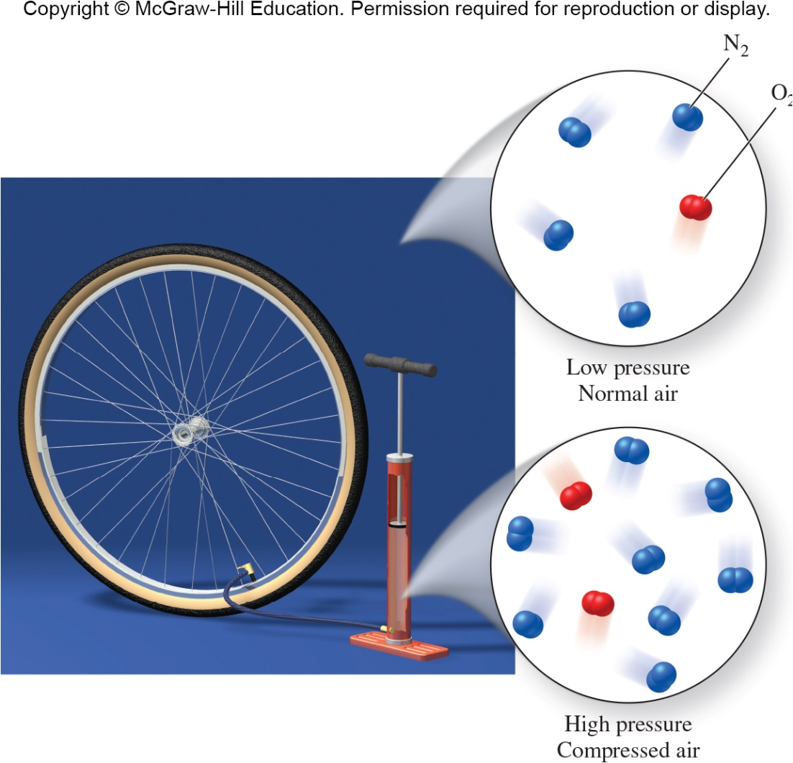
Gases can be compressed
Figure 1.15

Slide 41
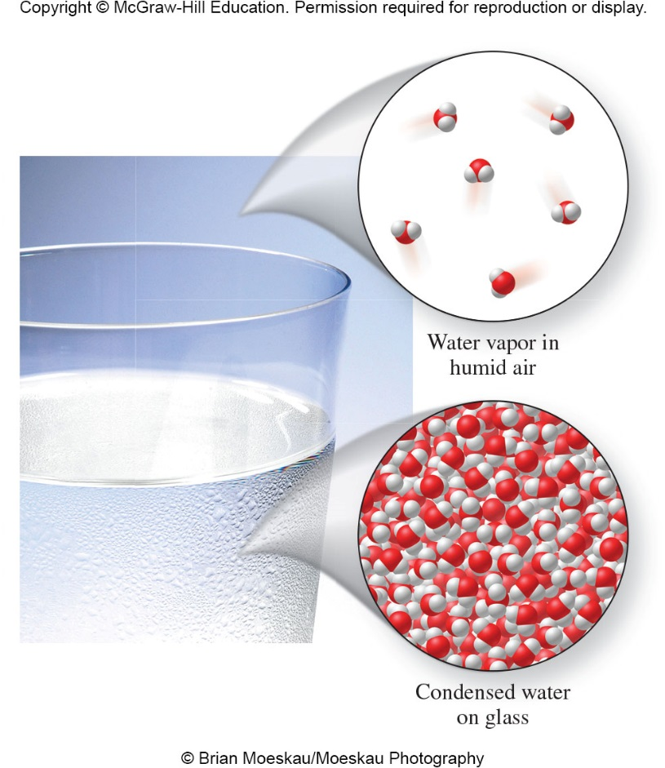
Water vapor condenses from the air onto the cold surface of the glass.
Figure 1.16

Slide 42
Symbols Used in Chemistry
Elemental symbols
  are a shorthand version of an element’s longer name
  can be 1-2 letters and can be derived from the Latin or Greek name [ex. Ag]
Chemical formulas
  describe the composition of a compound
  use the symbols for the elements in that compound [ex. H₂O and CO₂]

Slide 43
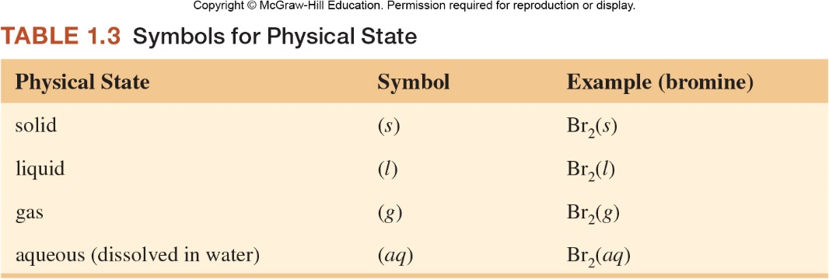
Symbols Used in Chemistry
Symbols for physical states
  are found in parenthesis by the elemental symbol or chemical formula
  designate the physical state
  (ex. solid, liquid, gas, aqueous)

Slide 44
Symbols Used in Chemistry
Name | Symbol
helium | He(g)
chlorine | Cl₂(g)
silver | Ag(s)
water | H₂O(l)
carbon dioxide | CO₂(g)
methane (natural gas) | CH₄(g)

Slide 45
1.2 Physical and Chemical Changes and Properties of Matter
A physical property is a characteristic that we can observe without changing the composition of a substance.
Examples
  Color
  Odor
  Mass
  Volume
  Density
  Temperature
qualitative properties
quantitative properties

Slide 46
Units and Conversions
(See Math Toolbox 1.3)
Metric Base Units and Derived Units
Length: meter (m)
Mass: kilogram (kg)
Time: second (s)
Temperature: kelvins (K)
Number of particles: mole (mol)

Slide 47
Mass
Mass:
  measures the quantity of matter
  is essentially the same physical quantity as weight, with the exception that weight is bound by gravity, mass is not
  common units are grams (g)

Slide 48
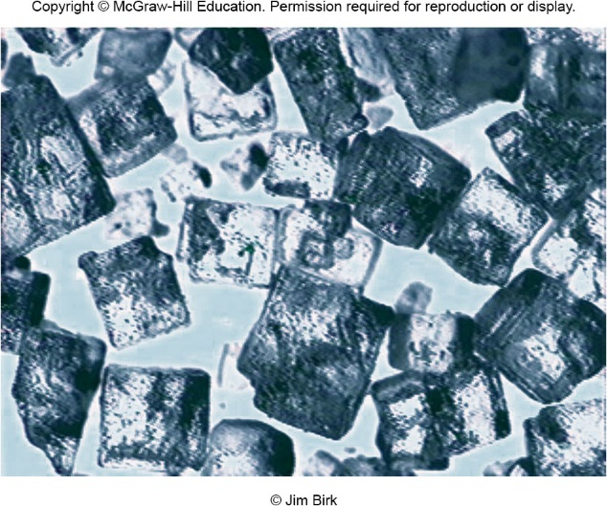
Mass
We usually measure the mass of an object by weighing it on a balance.
The mass of a salt crystal is about 50 mg.
How many milligrams in a gram?
The average mass of a person is about 70 kg. How many grams are in a kilogram?
1000 mg = 1 g
Figure 1.17. Salt Crystals viewed
through a microscope
1000 g = 1 kg

Slide 49
Conversion
(See Math Toolbox 1.3
& back cover of text)
Prefixes (Table 1.4) Mass measurements
giga- G 10⁹ 1 Gg = 10⁹ g
mega- M 10⁶ 1 Mg = 10⁶ g
kilo- k 10³ 1 kg = 10³ g
centi- c 10⁻² 1 cg = 10⁻² g
milli- m 10⁻³ 1 mg = 10⁻³ g
micro- μ 10⁻⁶ 1 μg = 10⁻⁶ g
nano- n 10⁻⁹ 1 ng = 10⁻⁹ g
pico- p 10⁻¹² 1 pg = 10⁻¹² g

Slide 50
Conversion
(See Math Toolbox 1.3 & back cover of text)
Prefixes (Table 1.4) Length measurements
giga- G 10⁹ 1 Gm = 10⁹ m
mega- M 10⁶ 1 Mm = 10⁶ m
kilo- k 10³ 1 km = 10³ m
centi- c 10⁻² 1 cm = 10⁻² m
milli- m 10⁻³ 1 mm = 10⁻³ m
micro- μ 10⁻⁶ 1 μm = 10⁻⁶ m
nano- n 10⁻⁹ 1 nm = 10⁻⁹ m
pico- p 10⁻¹² 1 pm = 10⁻¹² m

Slide 51
Activity: Mass Unit Conversions
(See Math Toolbox 1.3)
Convert 12.0 grams to milligrams.
Convert 12.0 grams to ounces (1 oz = 28.34 g)
Why is this number not given as 0.42 or 0.4234?

Slide 52
Significant Figures
(See Math Toolbox 1.2)
Significant Figures
  All non-zero digits are significant. (435 g)
  A zero that falls between two significant digits is significant. (405 g; 40.5 g)
  Zeros to the right of a sig. digit and to the right of a decimal pt. are significant. (5.00 g)
  Zeros to the left of the first significant digit are not significant. (0.151 g; 0.00405 g)
  If a number is >1, the zeros to the right of the last nonzero digit may or may not be significant. Use scientific notation to specify.

Slide 53
Volume
Volume:
  amount of space a substance occupies
  can be calculated by measuring the sides of a cube or rectangular side, then multiplying them
Volume = length × width × height
  Common units are centimeters cubed (cm³), sometimes called cubic centimeters.

Slide 54
Volume
We can measure the volume of a cube by measuring the length of one of its sides, and then cubing the length. If the length of a side is 2.0 cm, what is the volume of this cube?
2.0 centimeters
Answer: 8.0 cm³

Slide 55
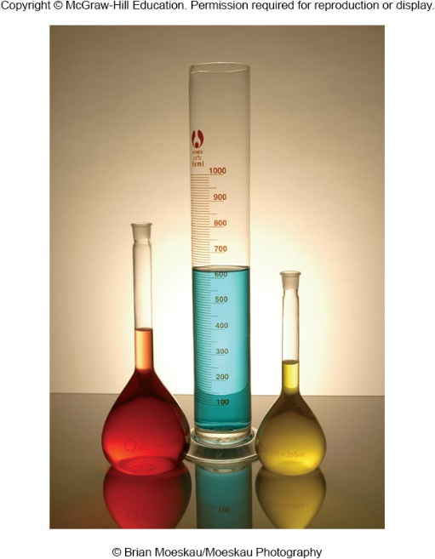
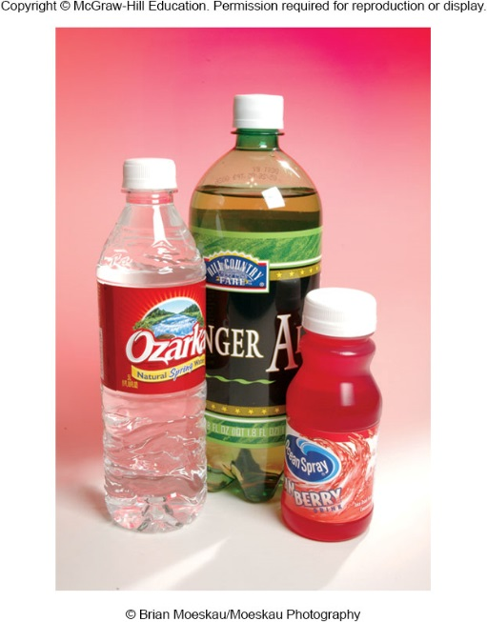
Volume
Volumes of liquids are usually measured in units of milliliters (mL).
1 mL = 1 cm³ exactly
How many mL in 1 L?
Some 250-mL, 500-mL, and 1-L containers
Figure 1.18

Slide 56
Activity: Volume Unit Conversions
Convert 25.0 mL to L.
Convert 25.0 mL to quarts (1 L = 1.057 qt)

Slide 57
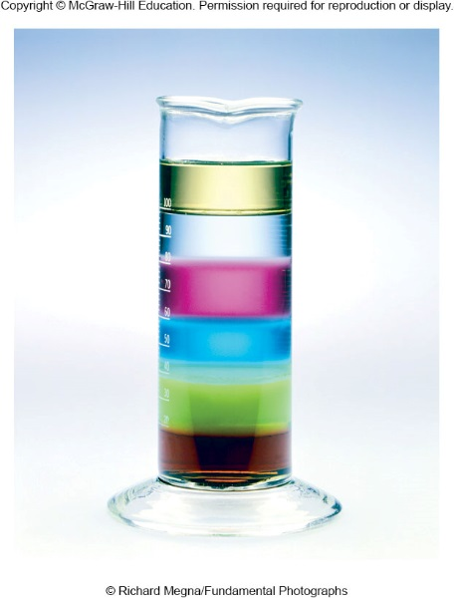
Density
Density:
  the ratio of the mass to its volume
  units are g/mL (solids and liquids) or g/L (gases)
  See Table 1.6 for a listing of densities for common substances
Figure 1.19

Slide 58
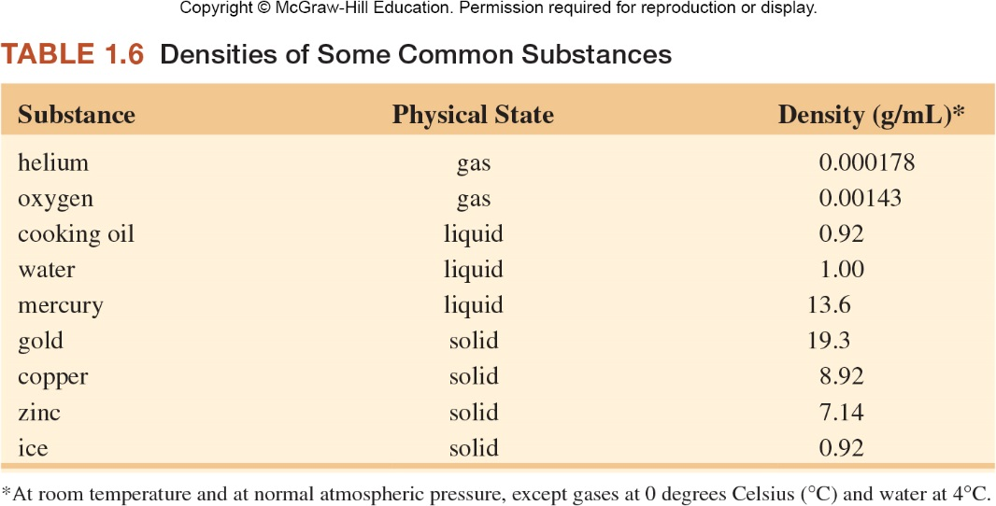
Density

Slide 59
Density
The density of a substance is the ratio of its mass to volume:
If the mass of the cube is 11.2 grams, what is its density?
2.0 centimeters

Slide 60
Density
This cylinder contains:
  Antifreeze
  Corn oil
  Dish detergent
  Maple syrup
  Shampoo
  Water
Which layer is which?
Figure 1.19

Slide 61

Density
Compare the density of the Dead Sea water and of the person.
© Jim Birk

Slide 62
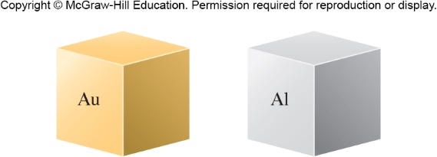
The cube of gold has a greater mass than that of aluminum. Which cube has the greater density?
Gold
Figure 1.20

Slide 63
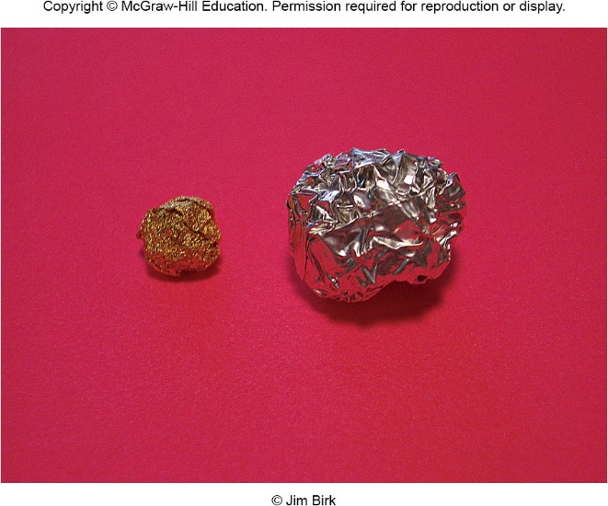
Given that these samples of metals have the same mass, which has the greater density?
Gold
Aluminum
Gold
Figure from p. 19

Slide 64
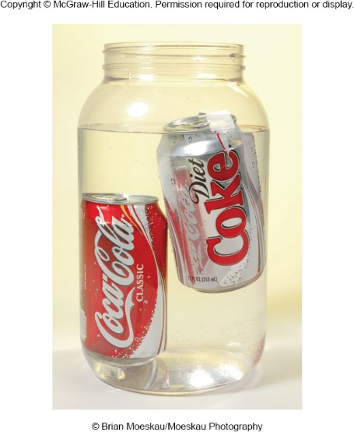
Density = mass/volume
Which is more dense, regular soda or diet soda? Why?
Regular soda
Figure from p. 19

Slide 65
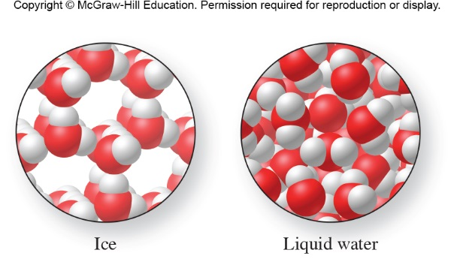
What is less dense, liquid water or ice? Why?
Figure from Example 1.8, p. 21

Slide 66
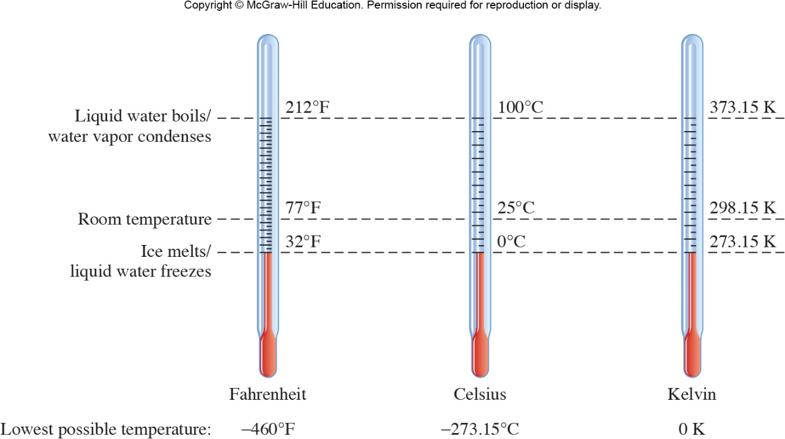
Temperature
Temperature:
  a measure of how hot or cold something is relative to some standard
  is measured with a thermometer
  units used in science are degrees Celsius (°C) and kelvins (K)
Figure 1.22

Slide 67
Temperature Scales
T_{K} = T_{°C} + 273.15
T_{°F} = 1.8(T_{°C}) + 32
Boiling Point of Water:
  212°F, 100°C, 373.15 K
Freezing Point of Water:
  32°F, 0°C, 273.15 K
Lowest Possible Temperature:
  −273.15°C, 0.00 K

Slide 68
Physical Changes
A physical change is a process that changes the physical properties of a substance without changing its chemical composition.
Changes in physical state are physical changes.

Slide 69
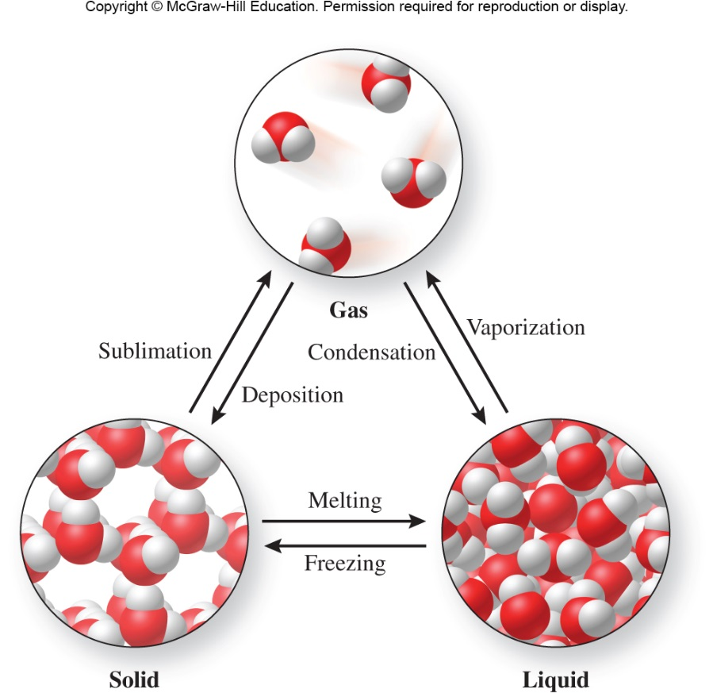
Physical Changes
  Evidence of a physical change includes:
    a change of state
      Example: water changes from a solid to a gas
    an expected change in color
Figure 1.24

Slide 70

Vaporization or Evaporation
Figure 1.23

Slide 71


Activity: Sublimation of Dry Ice (CO₂)
CO₂(s) → CO₂(g)
Draw a molecular-level representation for the sublimation of CO₂.
Figure 1.13
Before
After

Slide 72
Activity: Sublimation of Dry Ice (CO₂)
CO₂(s) → CO₂(g)
Draw a molecular-level representation for the sublimation of CO₂.
Figure 1.13
Before
After

Slide 73

Physical State Transitions
(know these)
Figure 1.24

Slide 74
Chemical Changes
A chemical change is a process where one or more substances are converted into one or more new substances. (Also called a chemical reaction.)
Examples:
  Pennies tarnishing
  Burning gasoline
  The reaction of hydrogen and oxygen to form water

Slide 75

Chemical
Changes
A chemical change
  is a process in which one or more substances are converted into one or more new substances
Evidence of a chemical change includes:
  bubbling
  a permanent color change
  a sudden change in temperature
Figure 1.25

Slide 76

Is Boiling Water a Chemical or Physical Change?
Figure 1.27B

Slide 77

Activity: Physical and Chemical Changes
Answer: Chemical change

Slide 78

Activity: Physical and Chemical Changes
Answer: Physical change (sublimation)

Slide 79
Activity: Physical vs. Chemical Changes
Classify each of the following as a physical or chemical change:
  Evaporation of water
  Burning of natural gas
  Melting a metal
  Converting H₂ and O₂ to H₂O
physical
chemical
physical
chemical

Slide 80
Chemical Properties
Chemical properties are descriptions of the ability of a substance to undergo a chemical change.
Examples:
  Hydrogen burns easily with oxygen
  Helium is unreactive
  Iron rusts
  Silver tarnishes
  Gold is very unreactive

Slide 81
1.3 Energy and Energy Changes
Energy
  is the capacity to do work or to transfer heat
Two main forms of energy are:
  Kinetic energy: the energy of motion
  Potential energy: energy possessed by an object because of its position
    Other energies are forms of kinetic and potential energy (chemical, mechanical, electrical, heat, etc.)

Slide 82
Energy and Energy Changes
When chemical or physical changes occur, energy changes also occur.
Some processes release energy and some require an energy input.
Examples:
  When wood burns with oxygen, energy in the form of heat is released.
  When ammonium nitrate dissolves in water in a cold pack, energy in the form of heat is absorbed.

Slide 83

When hydrogen burns with oxygen, energy in the form of heat is released.
Figure 1.28

Slide 84

Electricity is used to decompose water into its elements.
Figure 1.2

Slide 85

Electrical energy is used to run electric vehicles.

Slide 86
Energy
Kinetic energy – energy of motion
  The kinetic energy of a sample will increase as temperature is increased.
Potential energy – energy possessed by an object because of its position; stored energy
  As a ball is raised up in the air, its potential energy increases.
  Very reactive substances have high potential energy.

Slide 87

Kinetic and Potential Energy
Figure 1.29

Slide 88

Which pair of molecules has more kinetic energy?
Figure from p. 52

Slide 89
1.4 Scientific Inquiry
The scientific method is an approach to asking questions and seeking answers that employs a variety of tools, techniques, and strategies
The method generally includes observations, hypotheses, laws, and theories.

Slide 90
The Scientific Method
Observations include:
  experimentation
  collection of data
A hypothesis is a tentative explanation for the properties or behavior of matter that accounts for a set of observations and can be tested.
A scientific law describes the way nature operates under a specified set of conditions.
Theories explain why observations, hypotheses, or laws apply under many different circumstances.

Slide 91

The Scientific Method
Figure 1.32

Slide 92
Chapter 1 Math Toolboxes:
1.1 Scientific Notation
-- Also called exponential notation
1.2 Significant Figures
1.3 Units and Conversions

Slide 93
Math Toolbox 1.1
Scientific Notation
A number written in scientific notation is expressed as:
C × 10^{n}
where C is the coefficient (a number equal to or greater than 1 and less than 10) and n is the exponent (a positive or negative integer)
  C is obtained by moving the decimal point to immediate right of the leftmost nonzero digit in the number
  n is equal to the number of places moved to obtain C
    If the decimal point is moved to the left, then n is positive.
    If the decimal point is moved to the right, then n is negative.

Slide 94
Scientific Notation
Math Toolbox 1.1
Normal Notation | Direction Decimal Moved | Scientific Notation
3245 | Left | 3.245 × 10³
0.000003245 | Right | 3.245 × 10⁻⁶
3,245,000,000 | Left | 3.245 × 10⁹
0.0050607 | Right | 5.0607 × 10⁻³
88 | Left | 8.8 × 10¹
2.45 | Neither | 2.45 × 10⁰

Slide 95
Scientific Notation – Using Your Calculator
Math Toolbox 1.1
The general approach to enter numbers expressed
in scientific notation into your calculator is:
  Enter the coefficient, including the decimal point.
  Press the EE or EXP (depending on your calculator model) to express the exponent. This button (EE or EXP) basically stands for “× 10^{n}”.
  Enter the exponent (n), using the change sign (+/− or (−)) to express negative exponents if needed.

Slide 96
Activity: Math Toolbox 1.1
Convert the values shown in decimal form to scientific notation.
Decimal Notation | Scientific Notation
9,000,000,655.00
0.00000834
1.21
14.82
299,800,000
63

Slide 97
Activity Solutions: Math Toolbox 1.1
Convert the values shown in decimal form to scientific notation.
Decimal Notation | Scientific Notation
9,000,000,655.00
0.00000834
1.21
14.82
299,800,000
63
9.00000065500 × 10⁹
8.34 × 10⁻⁶
1.21 × 10⁰
1.482 × 10¹
2.99800000 × 10⁸
6.3 × 10¹

Slide 98
Scientific Notation
Math Toolbox 1.1
You will use your calculator to perform mathematical operations in chemistry. Use these simple rules for mathematical operations involving exponents to confirm that your answer makes sense.
Three operations are most common:
  Multiplication
  (4.0 × 10⁶)(1.5 × 10⁻³) = (4.0 × 1.5) × 10⁶⁺⁽⁻³⁾
  = 6.0 × 10³
When multiplying numbers in scientific notation, multiply the coefficients and add the exponents.

Slide 99
Scientific Notation
Math Toolbox 1.1
  Division
(4.0 × 10⁻²)/(2.0 × 10³) = (4.0/2.0) × 10⁽⁻²⁾⁻³ = 2.0 × 10⁻⁵
When dividing numbers in scientific notation, divide the coefficients and subtract the exponents.
  Raising the exponent to a power
  (3.0 × 10⁴)² = (3.0)² × 10^{4×2} = 9.0 × 10⁸
When raising numbers in scientific notation to a power, raise the coefficient to that power, then multiply the exponents.

Slide 100
Activity: Math Toolbox 1.1
Multiplication and Division of Exponents
(6.78 × 10³)(5.55 × 10⁻⁴) =
(2.99 × 10⁻⁹) / (4.03 × 10⁻⁶) =
(7 × 10³)⁴ =

Slide 101
Activity Solutions: Math Toolbox 1.1
Multiplication and Division of Exponents
(6.78 × 10³)(5.55 × 10⁻⁴) =
(2.99 × 10⁻⁹) / (4.03 × 10⁻⁶) =
(7 × 10³)⁴ =
3.76 × 10⁰
1.20 × 10⁻¹⁴
2 × 10¹⁵

Slide 102
Math Toolbox 1.2
Precision vs. Accuracy
The precision of a measured number is
  the extent of the agreement between repeated measurements of its value.
  If repeated measurements are close in value, then the number is precise, but not necessarily accurate.
Accuracy is
  the difference between the value of a measured number and its expected or correct value.
  The number is accurate if it is close to its true value.
Notes:
Putter picture on pg. 37

Slide 103

Precision vs. Accuracy
Math Toolbox 1.2
Figures from p. 37

Slide 104
Significant Figures
Math Toolbox 1.2
We need rules to determine the number of
significant figures in a given measurement.
  All nonzero digits are significant.
  Ex. 9.876 cm (4 significant figures)
  Zeros to the left of the leftmost nonzero digit (often called leading zeros) are not significant.
  Ex. 0.009876 cm (4 significant figures)

Slide 105
Significant Figures (continued)
We need rules to determine the number of
significant figures in a given measurement.
  Zeros to the right of the rightmost nonzero digit (typically called trailing zeros) are significant.
  Ex. 9876.000 cm (7 significant figures)
    Note: a decimal point is mandatory for #3 to be true. Otherwise the number of significant figures is ambiguous.
  Ex. 98,760 cm (?? significant figures)
  Zeros between two nonzero digits are significant.
  Ex. 9.800076 cm (7 significant figures)

Slide 106
Activity: Significant Figures
Determine the number of significant figures in each of the following values.
Given number | # of significant digits
26
19628.00
0.003416
9 × 10¹⁹
1.2407661 × 10⁻²

Slide 107
Activity Solutions: Significant Figures
Determine the number of significant figures in each of the following values.
Given number | # of significant digits
26
19628.00
0.003416
9 × 10¹⁹
1.2407661 × 10⁻²
2
7
4
1
8

Slide 108
Significant Figures (continued)
When performing a calculation, your final answer must reflect the number of significant figures in the least accurate (most uncertain) measurement.
The least accurate measurement is expressed differently depending on the mathematical operation you are performing.
  Multiplication and Division
234.506 cm
4455.9 cm
× 0.12 cm
1.3 × 10⁵ cm
The least accurate measurement in a multiplication or division problem is the one with the smallest number of significant digits overall. Therefore, because the 3rd measurement has 2 significant digits overall, the final answer must have 2 significant digits overall.

Slide 109
Significant Figures (continued)
When performing a calculation, your final answer must reflect the number of significant figures in the least accurate (most uncertain) measurement.
  Addition and Subtraction
234.5 06 cm
0.1 2 cm
+ 4455.9 cm
4690.5 26 cm
The least accurate measurement in an addition or subtraction problem is the one with the smallest number of significant figures to the right of the decimal point. Therefore, because the 3rd measurement has 1 significant digit to the right of the decimal point, the answer must have 1 significant digit to the right of the decimal point.

Slide 110
Activity: Significant Figures
Calculate the following:
  14.6608 + 12.2 + (1.500000 × 10²) =
  (5.5 × 10⁻⁸)(4 × 10¹⁰) =
  6.65 × 10⁴⁵

Slide 111
Activity Solutions: Significant Figures
Calculate the following:
  14.6608 + 12.2 + (1.500000 × 10²) =
  (5.5 × 10⁻⁸)(4 × 10¹⁰) =
  6.65 × 10⁴⁵
176.9
3 × 10⁻⁴³

Slide 112
Math Toolbox 1.3
Units and Conversions
Unit | Symbol | Quantity
meter | m | length
kilogram | kg | mass
second | s | time
ampere | A | electric current
kelvin | K | temperature
mole | mol | amount of substance
Measurement
  is the determination of the size of a particular quantity
  Measurements are defined by both a quantity (number) and unit.
  Most scientists use SI (from the French for Système Internationale) units (see top chart or chart on pg. 41).

Slide 113
Units and Conversions Continued
Prefix | Factor | Symbol
giga | 10⁹ | G
mega | 10⁶ | M
kilo | 10³ | k
deci | 10⁻¹ | d
centi | 10⁻² | c
milli | 10⁻³ | m
micro | 10⁻⁶ | μ
nano | 10⁻⁹ | n
Scientists also use the metric system to define base units of measure, with the understanding that a special prefix denotes fractions or multiples of that base (see chart on left or on p. 41).

Slide 114
Dimensional Analysis
A possible approach to problem solving involves 4 steps:
  Decide what the problem is asking for.
  Decide what relationships exist between the information given in the problem and the desired quantity.
  Set up the problem logically, using the relationships decided upon in step 2.
  Check the answer to make sure it makes sense, both in magnitude and units.
Notes:
Page 40 flowchart

Slide 115


Dimensional Analysis
Figure from p. 43

Slide 116
Activity: Dimensional Analysis
How many inches are in 2 kilometers?
[1 in = 2.54 cm; 100 cm = 1 m; 1000 m = 1 km]
What is the volume in cubic centimeters of a 14 lb block of gold?
[1 lb = 453.6 g; density_{Au} = 19.3 g/cm³]
Dan regularly runs a 5-minute mile. How fast is Dan running in feet per second?
[1 min = 60 s; 1 mile = 1760 yds; 1 yd = 3 ft]

Slide 117
Activity Solutions: Dimensional Analysis
How many inches are in 2 kilometers?
[1 in = 2.54 cm; 100 cm = 1 m; 1000 m = 1 km]
First, decide what the problem is asking for: inches.
Next, decide what relationships could be used to get to the desired quantity. In this case, the relationships that may be useful are provided in brackets.

Slide 118
Activity Solutions: Dimensional Analysis
What is the volume in cubic centimeters of a 14 lb block of gold?
[1 lb = 453.6 g; density_{Au} = 19.3 g/cm³]
First, decide what the problem is asking for: volume.
Next, decide what relationships could be used to get to the desired quantity. In this case, the relationships that may be useful are provided in brackets.

Slide 119
Activity Solutions: Dimensional Analysis
Dan regularly runs a 5-minute mile. How fast is Dan running in feet per second?
[1 min = 60 s; 1 mile = 1760 yds; 1 yd = 3 ft]
First, decide what the problem is asking for: feet per second.
Next, decide what relationships could be used to get to the desired quantity. In this case, the relationships that may be useful are provided in brackets.

