Slide 1

Chapter 3:
Chemical Compounds

Slide 2
Questions for Consideration
How do ionic compounds differ from molecular compounds?
What kinds of ions are in ionic compounds?
What do formulas for ionic compounds represent?
How are ionic compounds named?
What do formulas for molecular compounds represent and how are they named?
What are some common acids and bases and how are they named?
How do names of compounds communicate their classification and properties?

Slide 3
Chapter 3 Topics:
Ionic and Molecular Compounds
Monatomic and Polyatomic Ions
Formulas for Ionic Compounds
Naming Ionic Compounds
Naming and Writing Formulas for Molecular Compounds
Acids and Bases
Predicting Properties and Naming Compounds

Slide 4
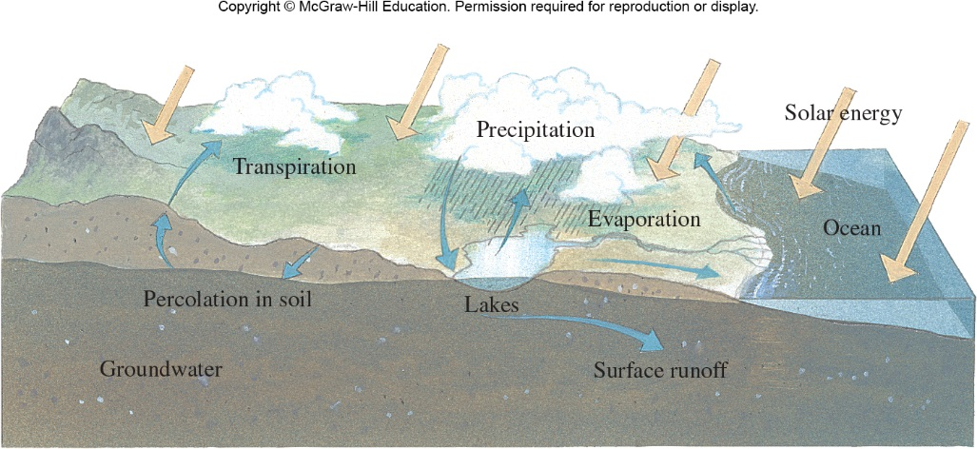
The Water Cycle
Water is part of the earth, ocean, rivers, and atmosphere. As a liquid, it carries many different kind of compounds.
Figure 3.2

Slide 5

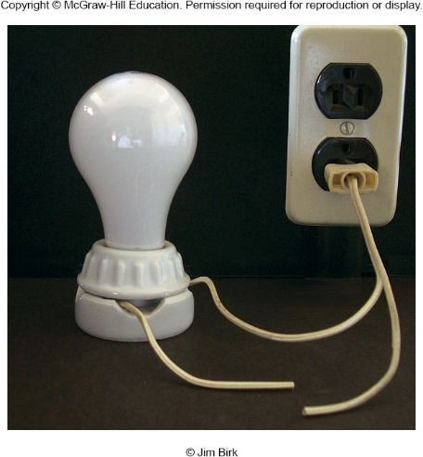
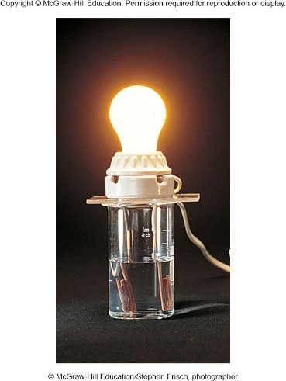
3.1 Ionic and Molecular Compounds
How does water conduct electricity?
Water conducts electricity because it contains ions. When compounds containing ions dissolve in water, the ions exist separate from each other. The mobility of ions allows a current to pass through water.
Figure 3.3

Slide 6
Electrolytes and Nonelectrolytes
Electrolytes
  substances that release ions when dissolved in water
    This process is also called dissociation or ionization
  conduct electricity
Nonelectrolytes
  substances that do NOT dissociate in water
  do NOT conduct electricity
  Example: methanol

Slide 7
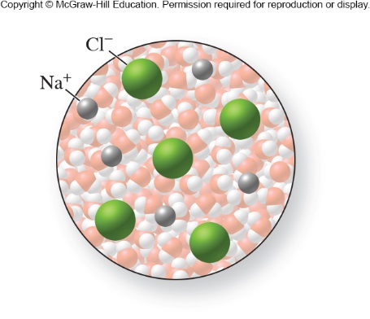
Electrolytes
Solutions containing ions are electrolytes.
Sodium chloride dissolved in water is an electrolyte.
Figure 3.5

Slide 8
Strong and Weak Electrolytes
Strong electrolytes
  dissociate completely into ions in water
  conduct electricity well
  Examples: NaCl and HCl
Weak electrolytes
  do not dissociate completely into ions in water
  do not conduct electricity well
  Example: acetic acid
Notes:
Figure 3.6

Slide 9
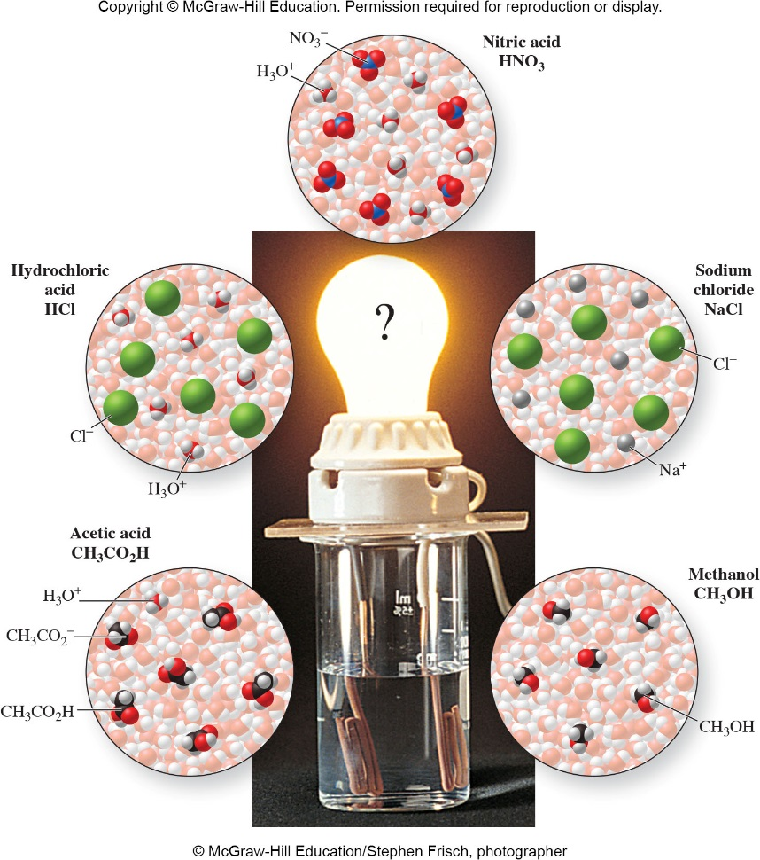
Compound Names and Classifications
CH₃CO₂H – acetic acid, acid, weak electrolyte
HCl – hydrochloric acid, acid, strong electrolyte
HNO₃ – nitric acid, acid, strong electrolyte
NaCl – sodium chloride, ionic compound, strong electrolyte
CH₃OH – methanol, molecular compound, nonelectrolyte
Figure 3.6

Slide 10
Types of Compounds
Ionic – electrolytes
Molecular – nonelectrolytes
Acids and Bases - electrolytes

Slide 11
Ionic Compounds
Are usually composed of a metal cation and a nonmetal anion
  Metals cations are positively charged ions
  Nonmetals anions are negatively charged ions
Their cations and anions exist in proportions that give electrical neutrality.
  These ions are arranged in a crystal lattice.
Also called salts
Are one of the major categories of chemical compounds

Slide 12
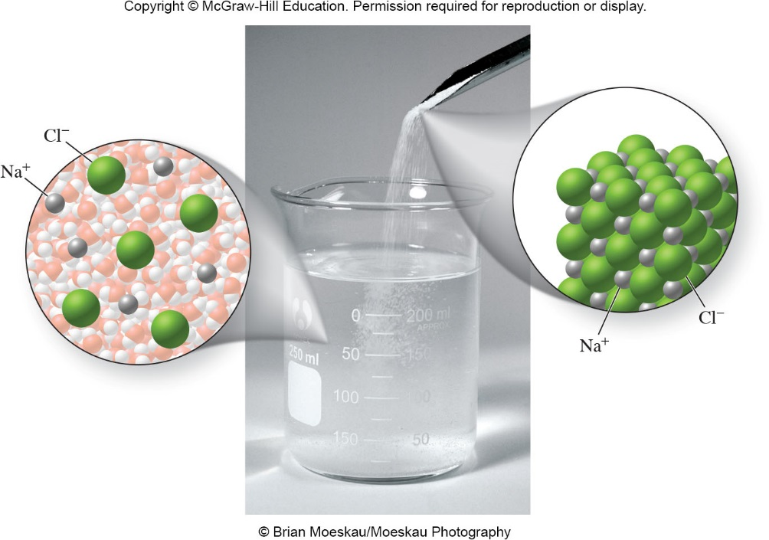
Ionic Compounds
Figure 3.8

Slide 13

Molecular Compounds
Are composed of 2 or more different nonmetals
Have no overall charge
Exist as discrete units of atoms
Are the other major category of chemical compounds
Figure 3.7B
CO₂

Slide 14
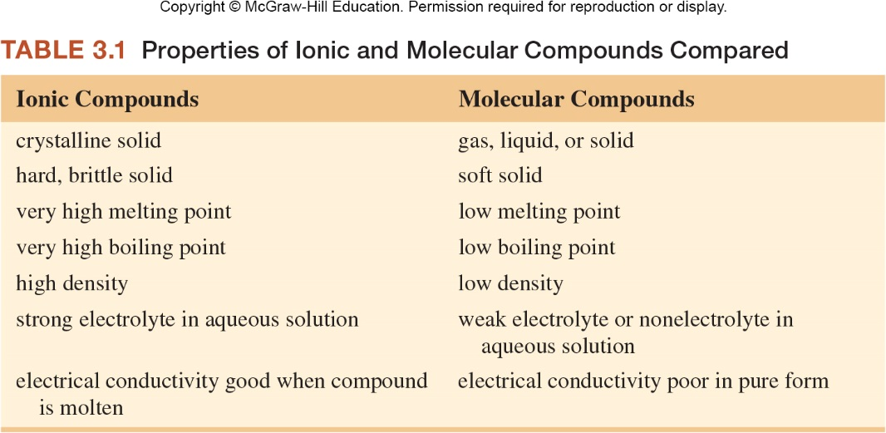
Ionic and Molecular Compounds

Slide 15
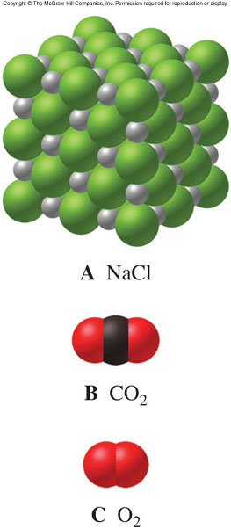
NaCl is an ionic compound
CO₂ is a molecular compound
O₂ is a molecular element
Figure 3.7

Slide 16
Activity: Identifying Ionic and Molecular Compounds
Identify each compound as ionic or molecular.
CCl₄
CaF₂
SF₆
CuCO₃
H₂O
molecular
ionic
molecular
ionic
molecular

Slide 17
Activity: Comparative Properties
Which has the highest melting point?
  CsCl
  CCl₄
Which has the highest boiling point?
  CO₂
  CaF₂
Which has the highest density?
  K₂O
  SO₂
CsCl
CaF₂
K₂O
Ionic compounds have higher melting points.

Slide 18
Activity: Ionic and Molecular Compounds
Based on their formulas, which of the following are ionic compounds? Which are molecular compounds?
  SO₂
  CaO
  Na₃N
  NF₃
molecular
ionic
molecular
ionic

Slide 19
Activity: Ionic and Molecular Compounds
Which of the following compounds has a higher boiling point?
  KCl or CCl₄
  SO₃ or Na₂SO₄
  Cu₃PO₄ or P₄O₁₀
KCl
Na₂SO₄
Cu₃PO₄
Ionic compounds have higher boiling points.

Slide 20
When an ionic compound dissolves in water, it dissociates into its ions.
NaCl(s)  Na⁺(aq) + Cl⁻(aq)
Update with Figure 3.8
Figure 3.8

Slide 21
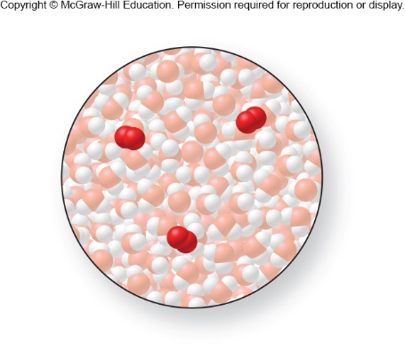
Most molecular substances do not dissociate in water.
Most molecular substances, such as O₂ or CH₃OH, do not dissociate into ions in aqueous solution. The molecules remain intact.
O₂(g)  O₂(aq)
CH₃OH(l)  CH₃OH(aq)
O₂ dissolved in water
Figure 3.10

Slide 22
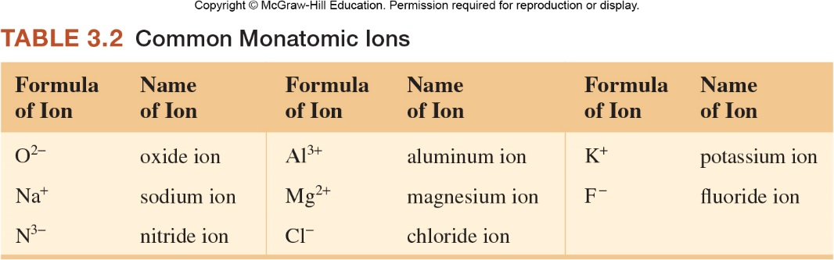
3.2 Monatomic and Polyatomic Ions
In Chapter 2 we saw that we can predict charges on some monatomic ions from their positions in the periodic table.
Look at the names of ions listed. Do you notice any patterns in their names?

Slide 23
Monoatomic Ions
Are ions of single atoms
Many are shown on Figure 3.12 and Table 3.2
Most main-group elements tend to form their ion charge based on how far away their group is from the noble gases because they have the same number of electrons as the nearest noble gas
Transition metals tend to form multiple charges

Slide 24
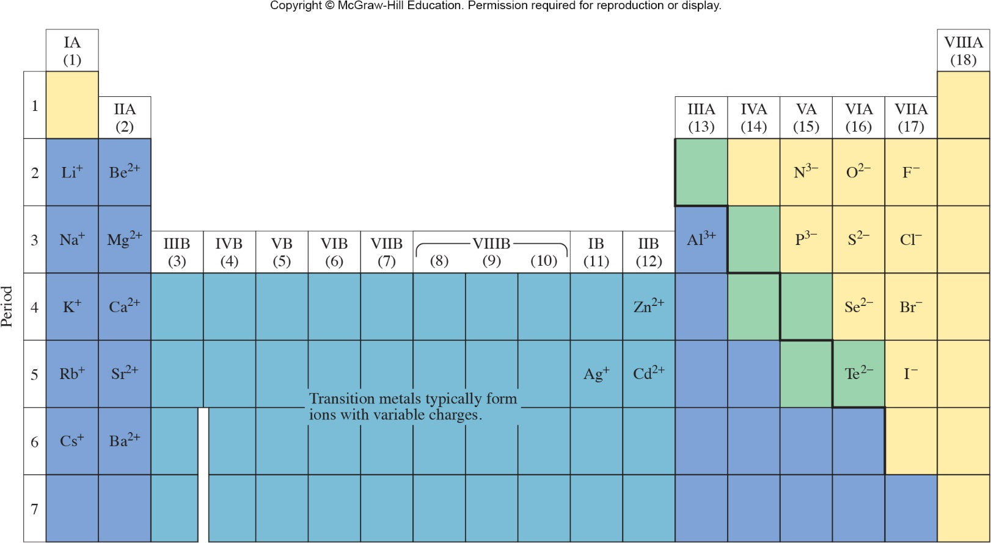
Common Monatomic Ions
You must know the charges for all these ions.
Figure 3.12

Slide 25
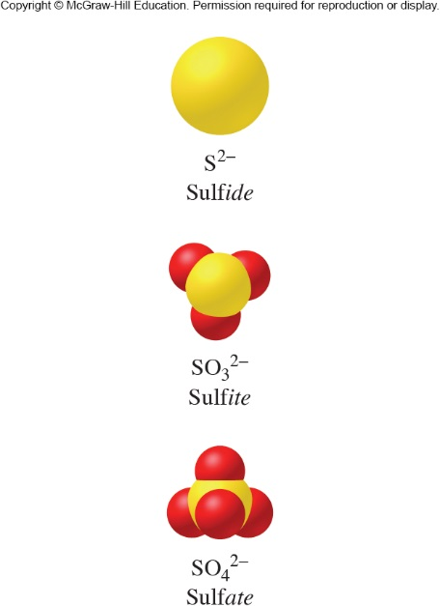
Polyatomic Ions
A polyatomic ion consists of a group of atoms with an overall net charge.
These two are also called oxoanions because they contain oxygen attached to some other element.
The most common polyatomic cation is NH₄⁺.
Figure 3.14

Slide 26
Ionic Compounds with Polyatomic Ions
Many ionic compounds contain a polyatomic anion:
  CaCO₃, calcium carbonate
  NaHCO₃, sodium bicarbonate
  NaCN, sodium cyanide
  KNO₃, potassium nitrate
The only common polyatomic cation is the ammonium ion, NH₄⁺:
  NH₄NO₃, ammonium nitrate

Slide 27
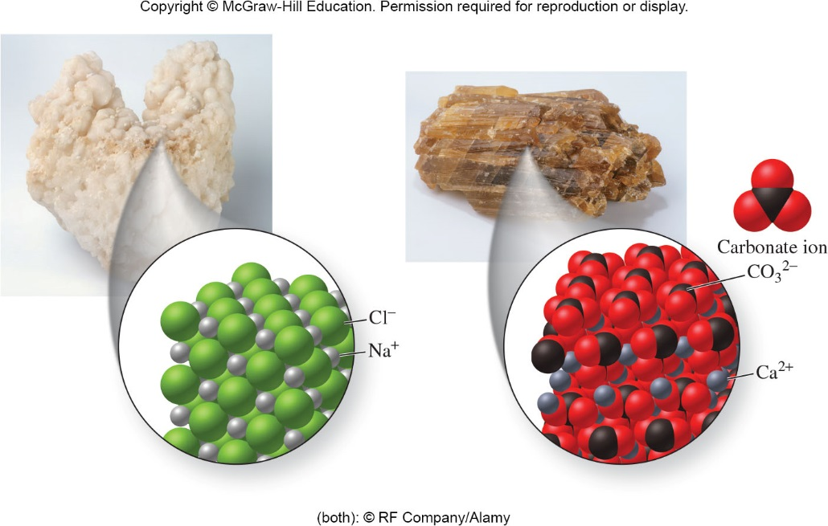
Ionic Compounds
Figure 3.18

Slide 28
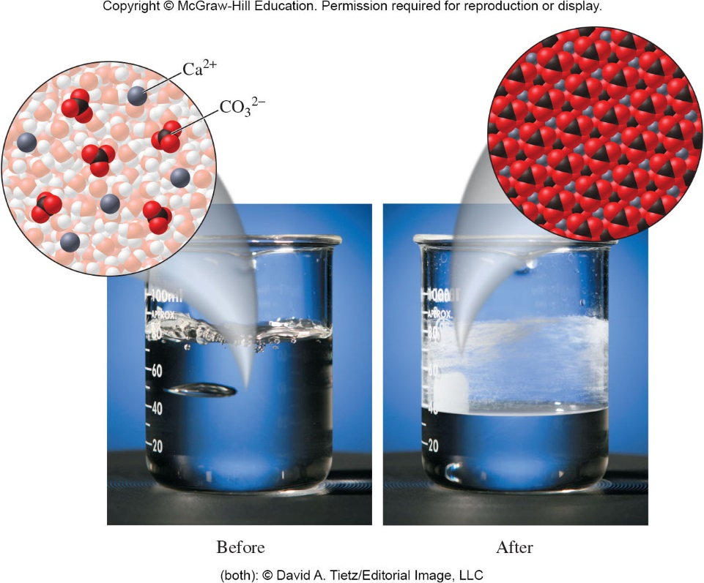
Calcium carbonate dissolved in hard water deposits as a solid as water evaporates.
Figure 3.16

Slide 29
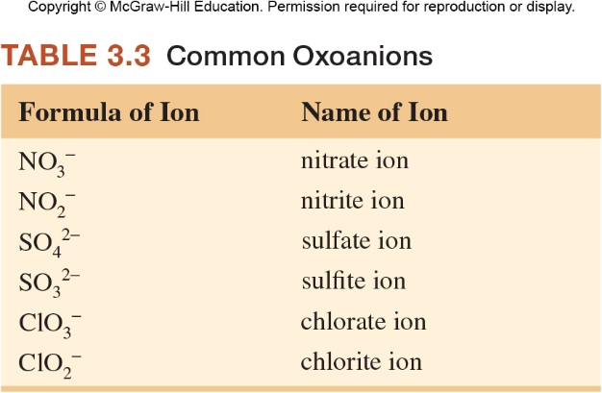
Naming Polyatomic Ions
The name of the oxoanion changes when the number of oxygen atoms bonded to the central atom changes. Can you see any patterns?

Slide 30
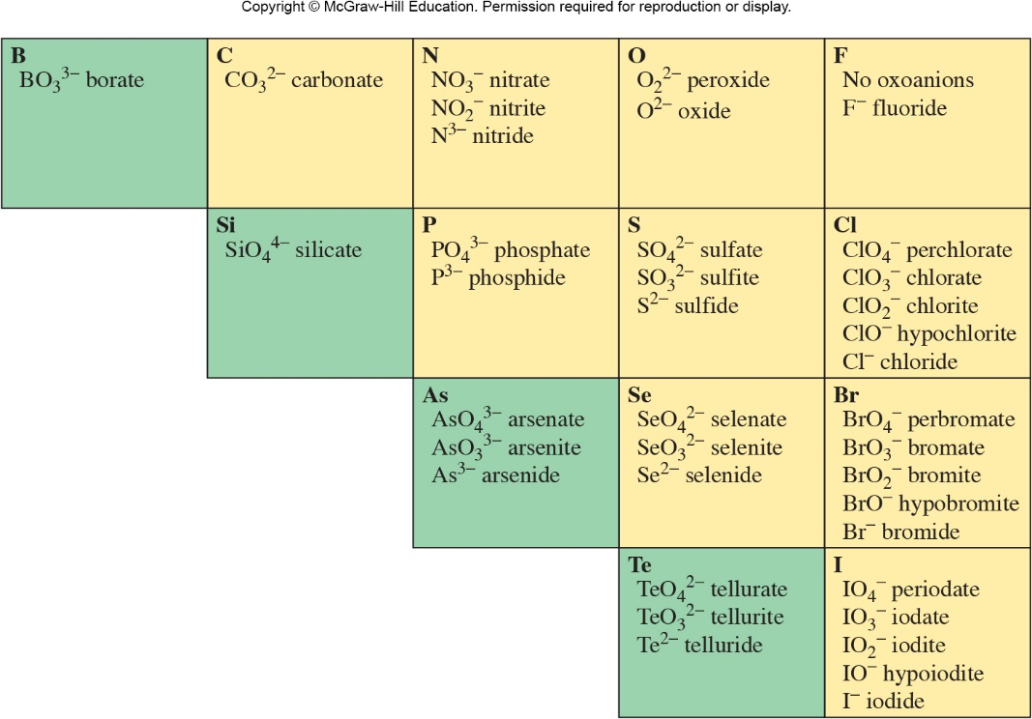
Patterns for Polyatomic Ions
Figure 3.17

Slide 31
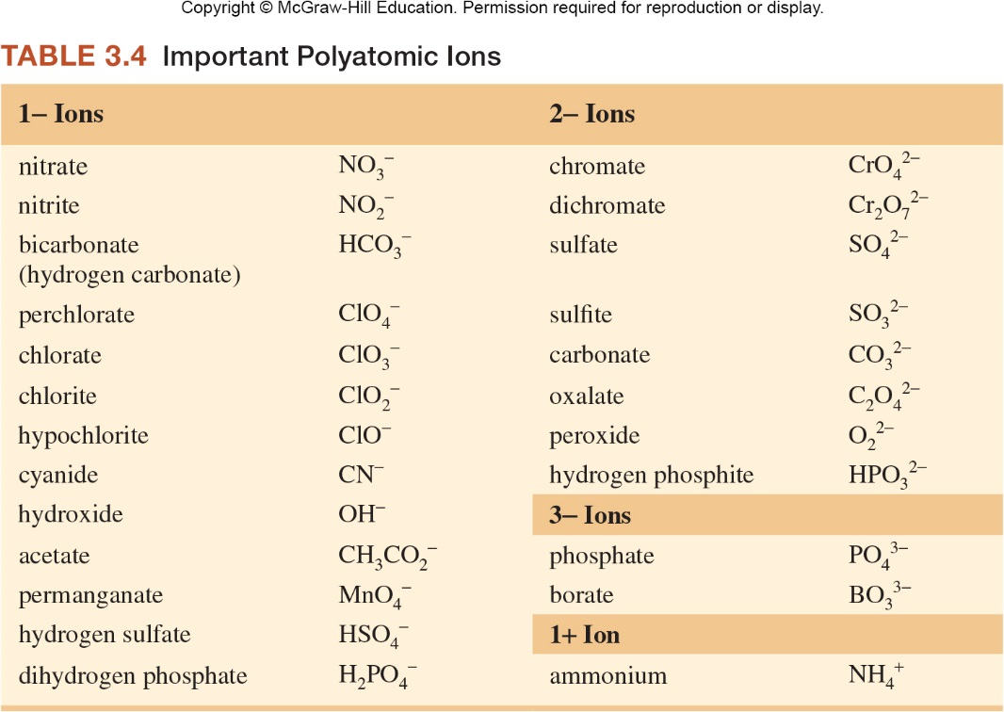
Polyatomic Ions

Slide 32
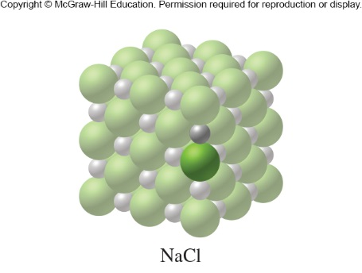
3.3 Formulas for Ionic Compounds
An ionic compound has no overall charge, so the charges on the cations and anions must cancel one another. This is the case in a pure substance, or when it is dissolved.
The formula that shows this ratio with the smallest whole numbers is called its formula unit.
Figure 3.19

Slide 33
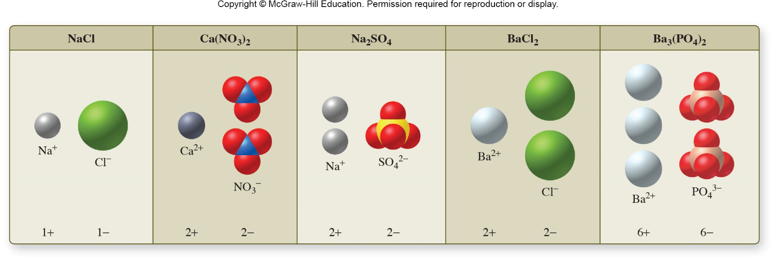
Writing Formulas for Ionic Compounds
When writing a formula for an ionic compound, the sum of the positive charges must equal the sum of the negative charges.
Total positive charge + total negative charge = zero net charge
from cations from anions
The crystal structures or lattices are composed of repeating units called formula units.
Figure 3.21

Slide 34
Activity: Writing Ionic Formulas
Write the formulas for compounds containing the following ions:
  calcium ion and nitride ion
    Least common multiple: 6
    3 Ca²⁺ ions for every 2 N^{3–} ions: Ca₃N₂
  barium ion and nitrate ion
    Least common multiple: 2
    1 Ba²⁺ ion for every 2 NO₃– ions: Ba(NO₃)₂
  potassium ion and sulfate ion
    Least common multiple:2
    2 K⁺ ions for every 1 SO₄^{2–} ion: K₂SO₄
Ca²⁺ and N^{3–}
Ba²⁺ and NO₃–
K⁺ and SO₄^{2–}

Slide 35
Activity: Writing Ionic Formulas
Write the formulas for compounds containing the following ions:
  calcium ion and fluoride ion
  aluminum ion and oxide ion
  sodium ion and sulfate ion
  sodium ion and sulfite ion
  ammonium ion and phosphate ion
  lithium ion and nitrate ion
CaF₂
Al₂O₃
Na₂SO₄
Na₂SO₃
(NH₄)₃PO₄
LiNO₃

Slide 36
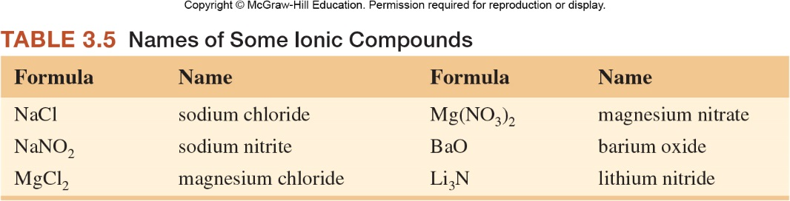
3.4 Naming Ionic Compounds
Look at the names listed. Do you see any patterns?
Notice that all the metals are cations with charges that we could predict from the name of the compound they are in.

Slide 37

Common Monatomic Ions
Figure 3.12

Slide 38
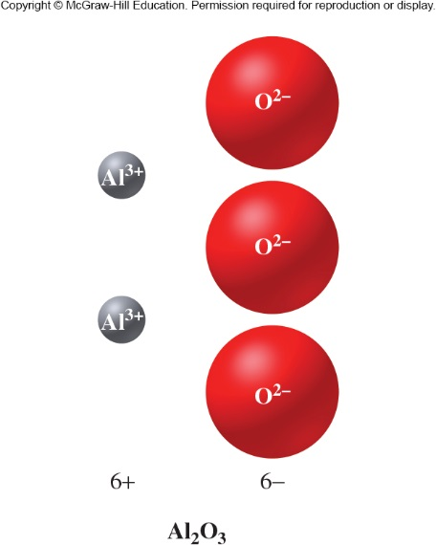
What is the name of this compound?
aluminum oxide
Figure 3.22

Slide 39
Activity: Naming Ionic Compounds
Name these ionic compounds:
  NaCl
  NaNO₂
  MgCl₂
  Mg(NO₃)₂
  BaO
  Li₃N
sodium ion and chloride ion
name: sodium chloride
sodium ion and nitrite ion
name: sodium nitrite
magnesium ion and chloride ion
name: magnesium chloride
magnesium ion and nitrate ion
name: magnesium nitrate
barium ion and oxide ion
name: barium oxide
lithium ion and nitride ion
name: lithium nitride

Slide 40
Naming Ionic Compounds Containing Metals with Variable Charges
Many metals, including most of the transition metals, can form more than one type of ion. When these metals are present in ionic compounds, and additional component must be added to the name to distinguish between similar compounds.
How can we distinguish between CuO and Cu₂O?
What is the difference between them?
Why do they combine in different ratios?

Slide 41
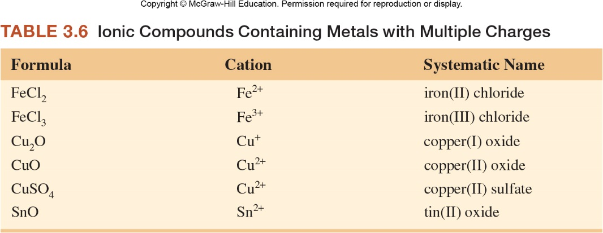
What are the rules for naming these compounds?
Look at the names listed. Do you see any patterns?

Slide 42
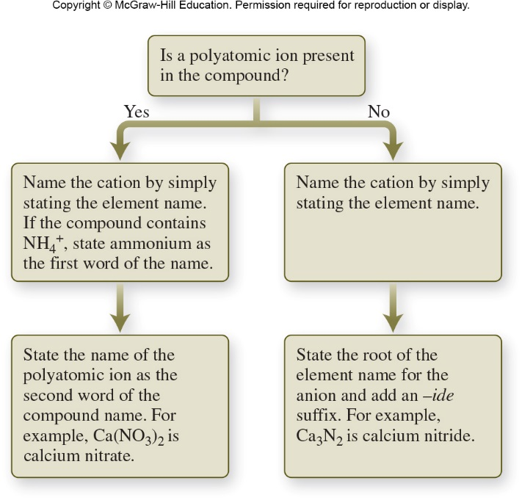
Procedure for Naming Ionic Compounds
Figure 3.23

Slide 43
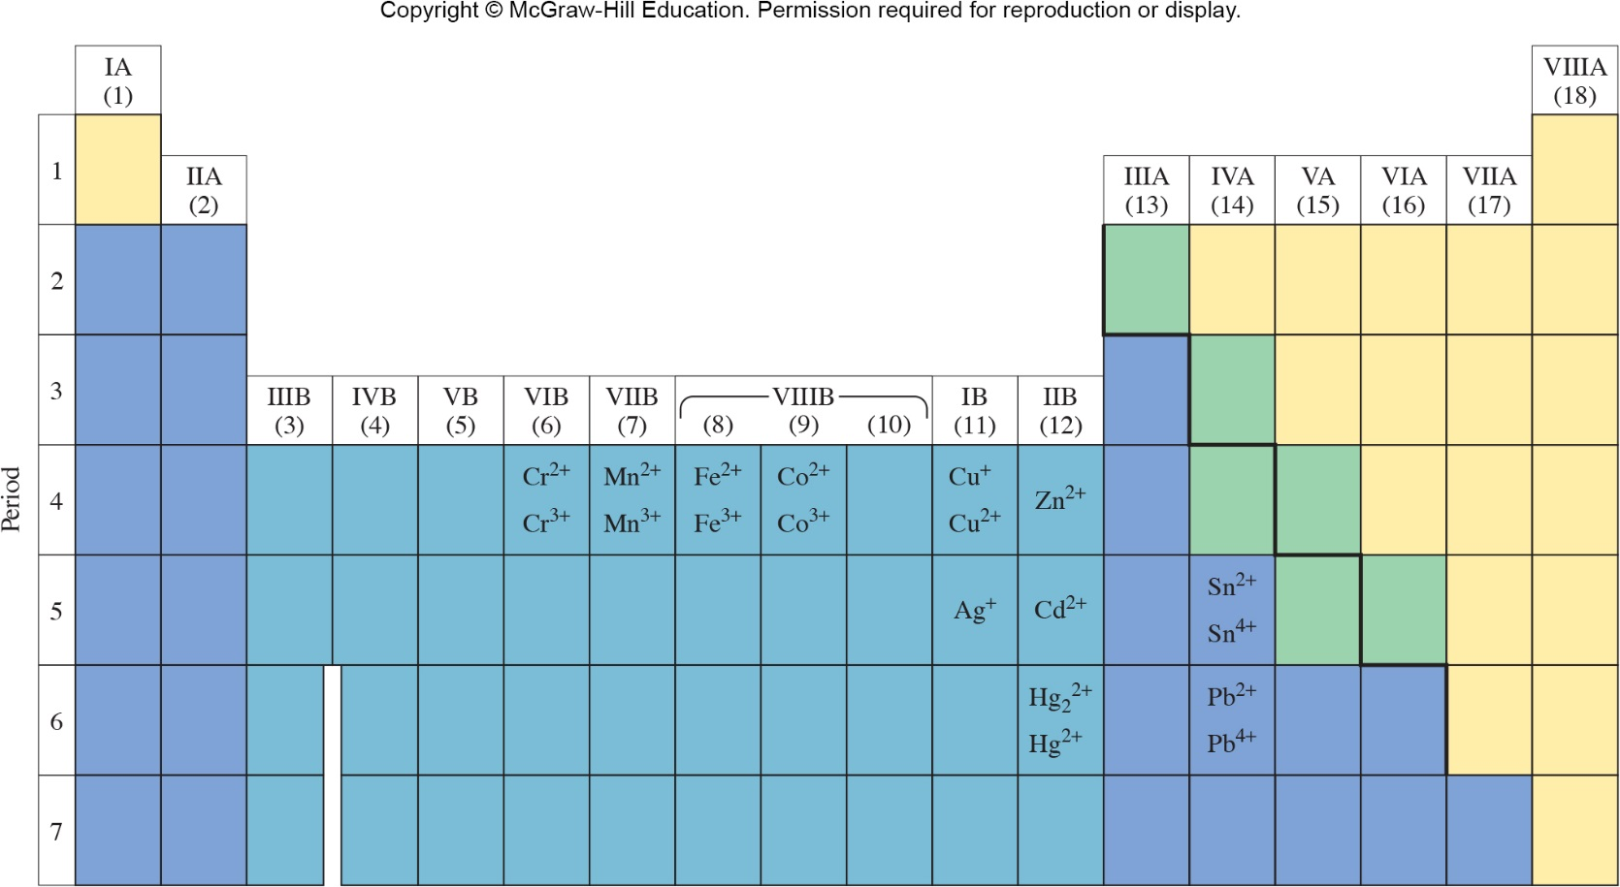
Some (not all) Charges for Metals that can have Ions of More than One Charge
Figure 3.24

Slide 44
Naming Ionic Compounds when Roman Numerals are Needed
Name the following compounds
  MnO
  MnO₂
  CuSO₄
  CrO₃
  Fe(NO₃)₃
manganese(II) oxide
manganese(IV) oxide
copper(II) sulfate
chromium(VI) oxide
iron(III) nitrate

Slide 45
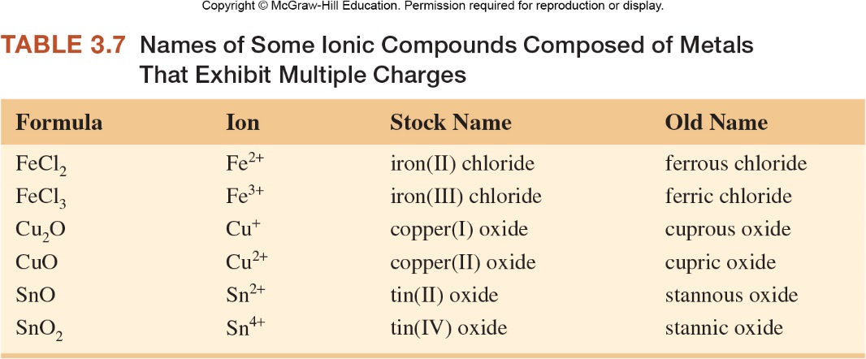
Older Method for Naming…

Slide 46
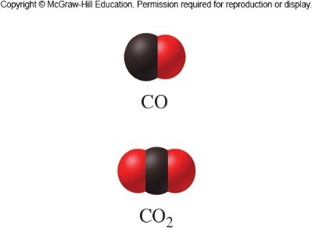
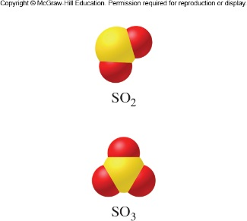
3.5 Naming and Writing Formulas for Molecular Compounds
Because molecular compounds do not consist of ions, the nonmetals that compose them are in ratios that are difficult to predict.
Also, there are sometimes many different compounds composed of the same elements but just in different ratios or different number of atoms per molecule:
CO, CO₂
SO₂, SO₃
NO, NO₂, NO₃, N₂O,
N₂O₄, N₂O₅
Figures 3.26 and 3.27
Notes:
and

Slide 47
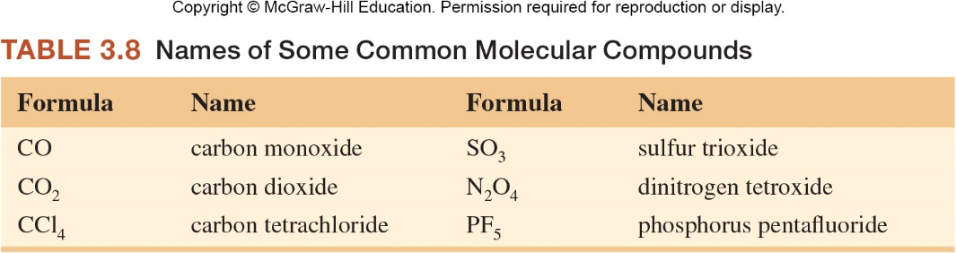
Naming Molecular Compounds
Look at the formulas and the names of the molecular compounds below. Can you determine the rules for naming them?

Slide 48
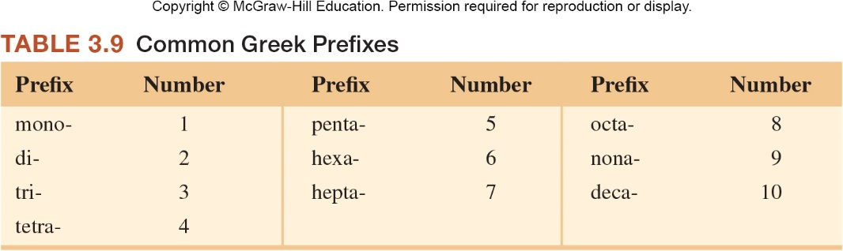
Prefixes used for Naming Molecular Compounds
The mono prefix is not used for the first element in a compound. The mono prefix is not used for the second element when there are no other compounds with the same combination of elements.

Slide 49
Activity: Naming Molecular Compounds
Try naming these compounds using the rules you developed.
  SO₂
  NF₃
  P₄O₁₀
sulfur dioxide
nitrogen trifluoride
tetraphosphorus decoxide

Slide 50
Naming Molecular Compounds
Naming binary molecular compounds:
  Binary Compounds
    A compound containing atoms or ions of only two elements
To name molecular compounds, we:
  Name the leftmost element as we would a main-group metal – according to the periodic table.
  Name the rightmost element as we would a monatomic anion – drop the ending of the element name and add an “-ide”.
  Use Greek prefixes to denote the number of atoms of each element.

Slide 51
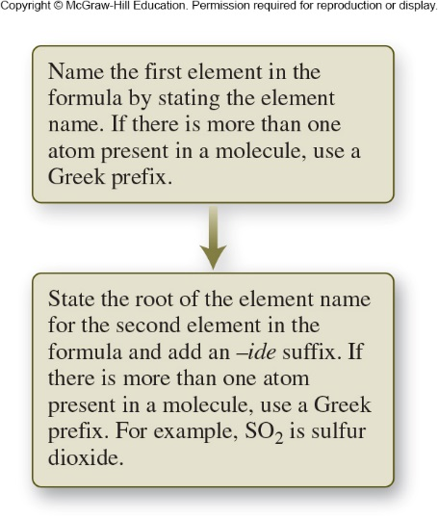
Naming Molecular Compounds Summary
Figure 3.28

Slide 52
Activity: Naming Molecular Compounds
Name the following compounds:
  SO₃
  SF₆
  N₂O₄
  CO
  PCl₅
sulfur trioxide
sulfur hexafluoride
dinitrogen tetraoxide
carbon monoxide
phosphorus pentachloride

Slide 53
Nonsystematic Names for Molecular Compounds (know these)
Water – H₂O
Ammonia – NH₃
Hydrogen peroxide – H₂O₂

Slide 54
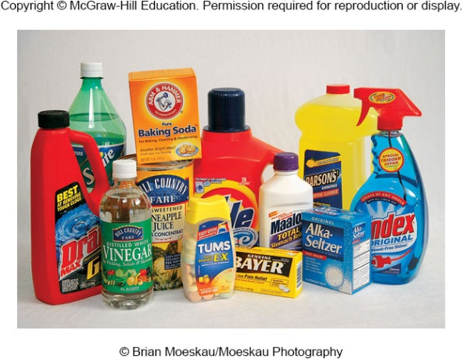
3.6 Acids and Bases
Figure 3.33
Acids and bases exist as ions when dissolved in water. Many bases are ionic compounds, but acids are not – they are molecular compounds. How do acids form ions in solution when they are not composed of ions?
Acids form ions as a result of their interaction with water:
HCl(g)  H⁺(aq) + Cl⁻(aq)
The H⁺(aq) that forms is often represented as H₃O⁺(aq).
H₂O

Slide 55
Acids and Bases
Bases are substances that react with acids in aqueous solution to form water
  An example of the ionization of a base:
NaOH(s) → Na⁺(aq) + OH⁻(aq)
H₂O

Slide 56
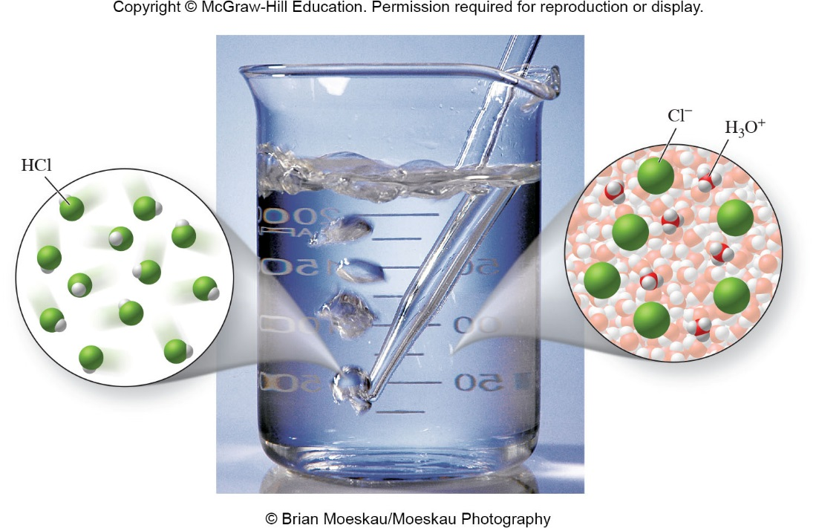
Ionization of HCl in Water
Cl⁻
H₃O⁺
Figure 3.29

Slide 57
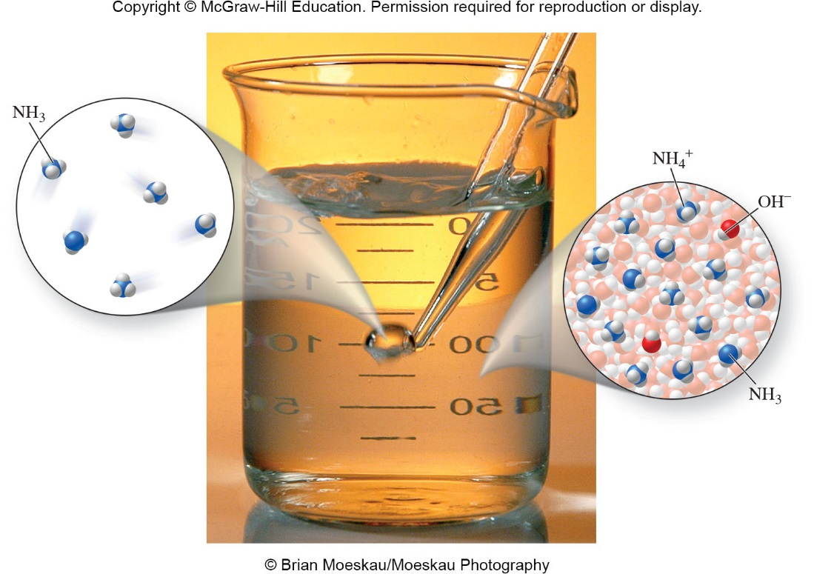
Bases ionize in water to form OH⁻ ions
Figure 3.32

Slide 58
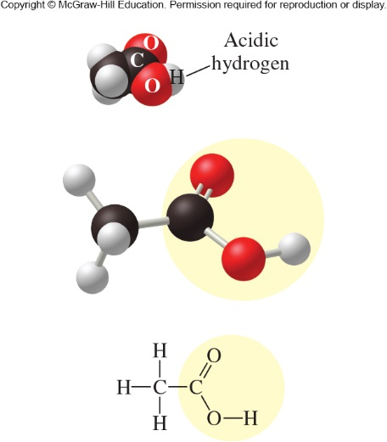
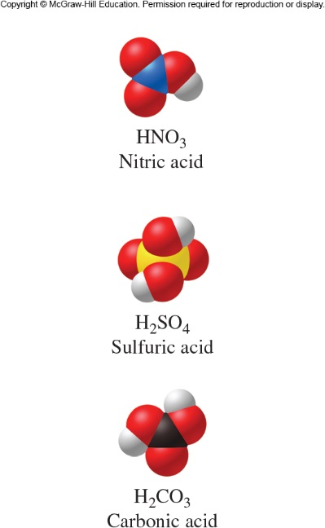
Oxoacids
Figure 3.30
Figure 3.31

Slide 59
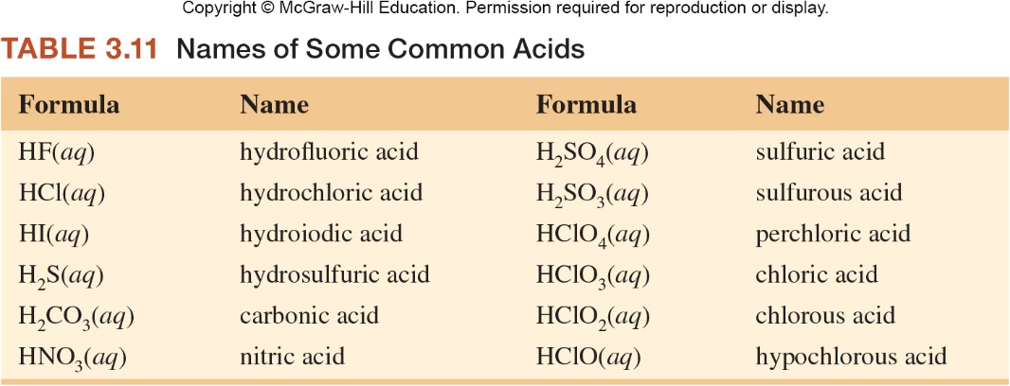
Naming Binary Acids
How are the first four acids similar and how are they named?

Slide 60
Naming Oxoacids
Why do some of the oxoacids have an -ic suffix while others have an -ous suffix? How can you predict the suffix?

Slide 61
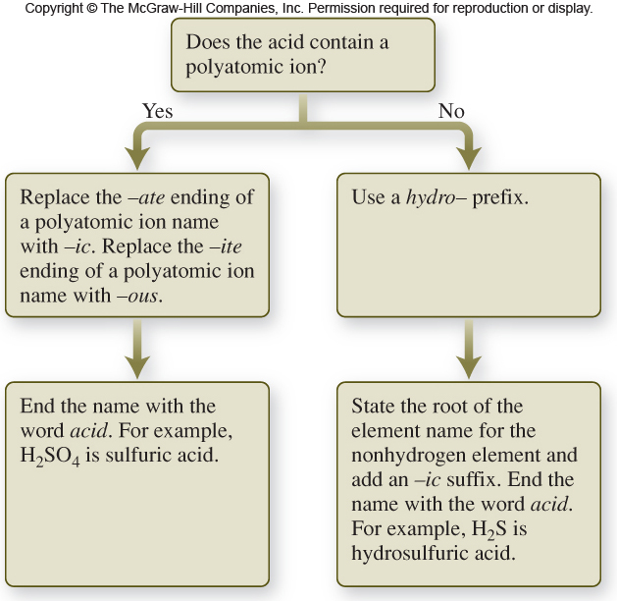
Naming Acids Summary
Figure 3.35

Slide 62
Naming Acids
Since most acids have a hydrogen as their 1st element in the molecular formula, the acids are named according to the anion, not the cation (H⁺).
Binary acids are named as hydro- followed by the root of the element (2nd element or anion) name with an –ic suffix and the word acid placed at the end of the name.
Acids containing polyatomic ions (as the anion) are named by taking the root of the polyatomic ion name, replacing –ate with –ic or replacing –ite with –ous and adding the word acid at the end.

Slide 63
Activity: Naming Molecular Compounds
Name the following acids:
  HBr(aq)
  H₂SeO₄(aq)
  H₃PO₃(aq)
hydrobromic acid
selenic acid
phosphorous acid

Slide 64
Activity: Naming Acids
Name the following acids:
  HCl(aq)
  HNO₃(aq)
  HNO₂(aq)
  H₂SO₄(aq)
hydrochloric acid
nitric acid
nitrous acid
sulfuric acid

Slide 65
3.7 Predicting Properties and
Naming Compounds
Before naming a compound, you must first classify it as either an ionic compound, molecular compound, or acid.
  If it is an ionic compound, you must also decide if the cation is an ion that can vary in charge.
These classifications allow you to name the compound with the proper rules.

Slide 66
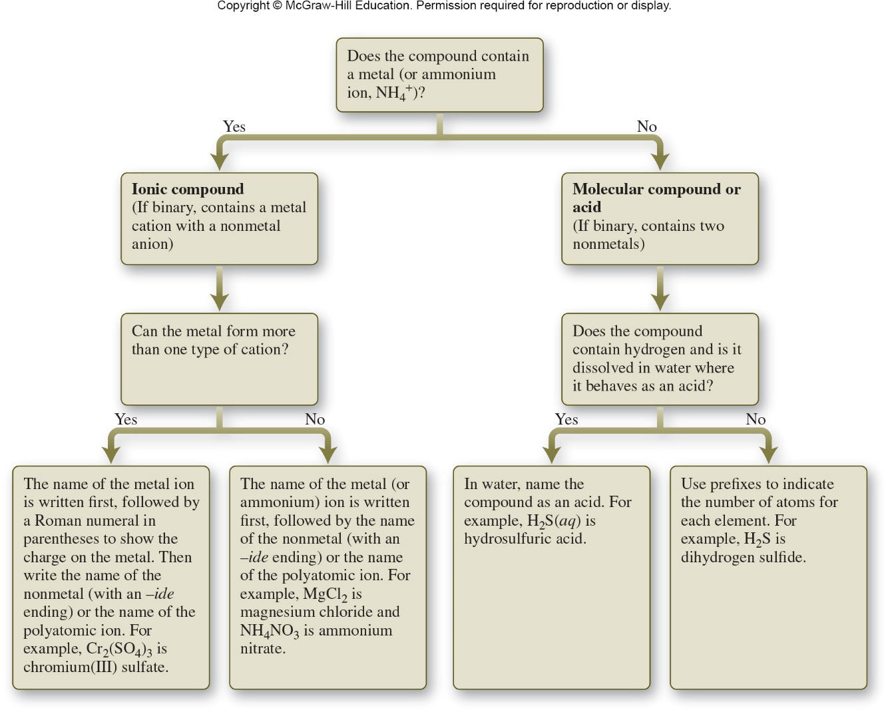
Naming Compounds Summary
Figure 3.36

Slide 67
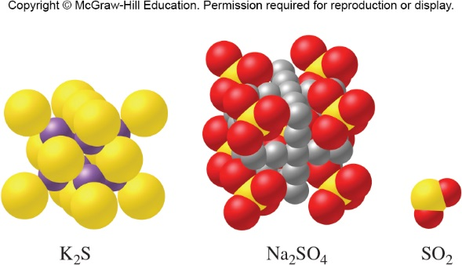
Activity: Naming
Classify and then name these compounds.
Figure from p. 119
Ionic compound,
potassium sulfide
Ionic compound,
sodium sulfate
Molecular compound,
sulfur dioxide

Slide 68
Activity: Naming Compounds
Classify and then name the following:
  NO₂
  Mg₃N₂
  CaSO₄
  H₃PO₄(aq)
  FeCl₃
Which of these does not form ions when dissolved in water?
Which of these is most likely a gas at room temperature?
Which of these is an electrolyte?
  molecular compound, nitrogen dioxide
  ionic compound, magnesium nitride
  ionic compound, calcium sulfate
  acid, phosphoric acid
  ionic compound, iron(III) chloride
  NO₂
  NO₂
  Mg₃N₂, CaSO₄,
  H₃PO₄(aq), FeCl₃

Slide 69
Activity: Naming Compounds
Name the following compounds:
  Al₂S₃
  HNO₂(aq)
  HCl(aq)
  P₂O₅
  Cu(OH)
  H₂SO₃(aq)
  K₂O
  CS₂
  (NH₄)₂CO₃
  Fe(C₂H₃O₂)₃
  aluminum sulfide
  nitrous acid
  hydrochloric acid
  diphosphorus pentoxide
  copper(II) hydroxide
  sulfurous acid
  potassium oxide
  carbon disulfide
  ammonium carbonate
  iron(III) acetate

Slide 70
Activity: Naming Compounds
Write formulas for the following compounds:
  Lead(II) chloride
  Magnesium phosphate
  Nitrogen triiodide
  Hydrofluoric acid
  Tin(IV) oxide
  Calcium nitride
  Cyanic acid
  Dichlorine pentoxide
  Sodium hydrogen carbonate
  Hydrogen peroxide
  PbCl₂
  Mg₃(PO₄)₂
  NI₃
  HF(aq)
  SnO₂
  Ca₃N₂
  HCN(aq)
  Cl₂O₅
  NaHCO₃
  H₂O₂

