Slide 1
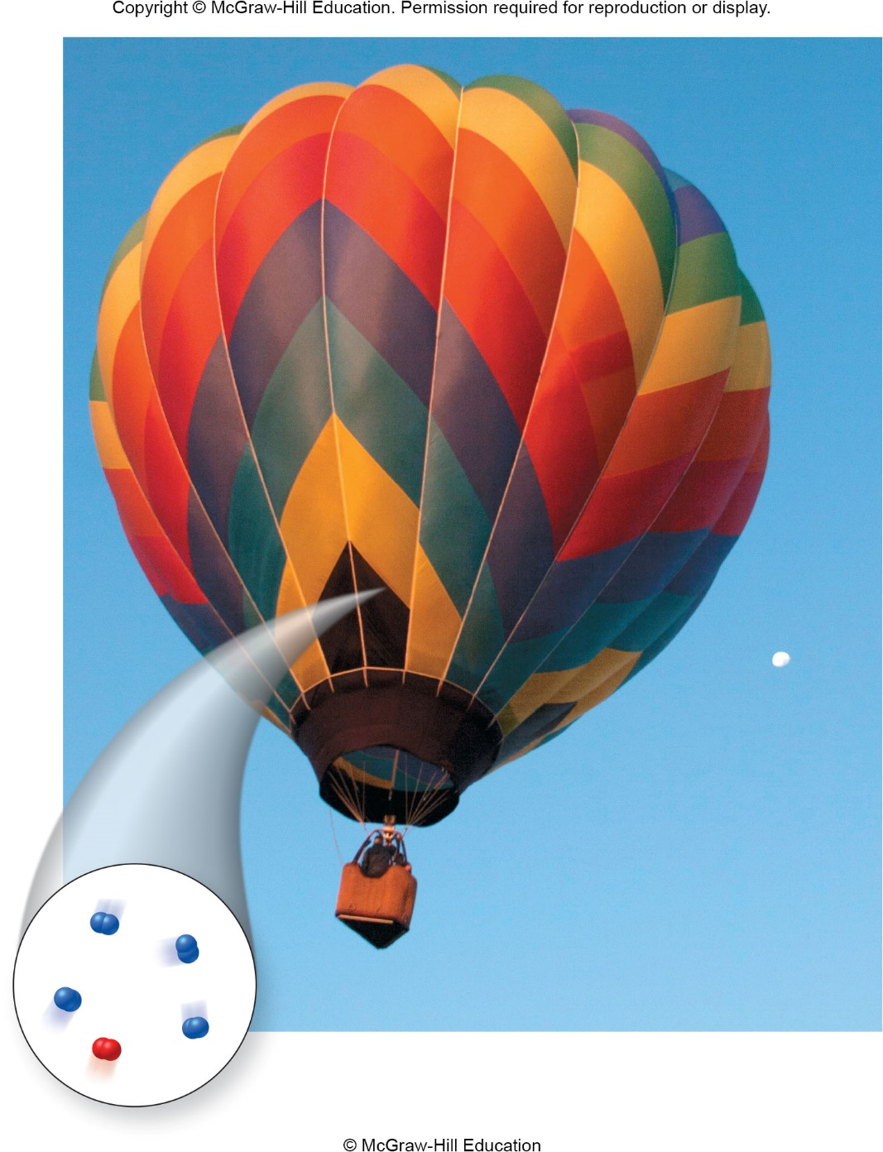
Chapter 9:
The Gaseous State

Slide 2
Questions for Consideration
What are some general properties of gases?
How does the behavior of gases vary with changes in pressure, temperature, volume and number of molecules (atoms)?
What are the mathematical relationships between volume, pressure, temperature, and amount of gas?
What is the theory that explains the behavior of gases in terms of atomic or molecular motion?
How can quantities of gases in chemical reactions be calculated?

Slide 3
Chapter 9 Topics:
The Behavior of Gases
Factors that Affect the Properties of Gases
The Ideal Gas Law
Kinetic-Molecular Theory of Gases
Gases and Chemical Reactions

Slide 4
Chapter 9 Math Toolboxes:
9.1 Graphing
9.2 Solving Simple Algebraic Equations

Slide 5
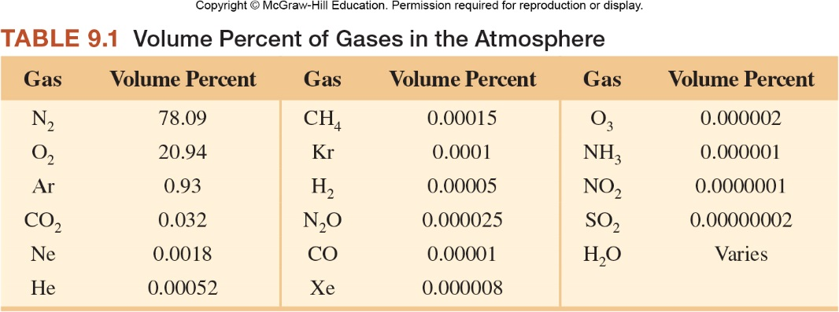
Gases in Our Atmosphere
Although we don’t see them, we are surrounded by mixtures of various gases in our atmosphere.

Slide 6
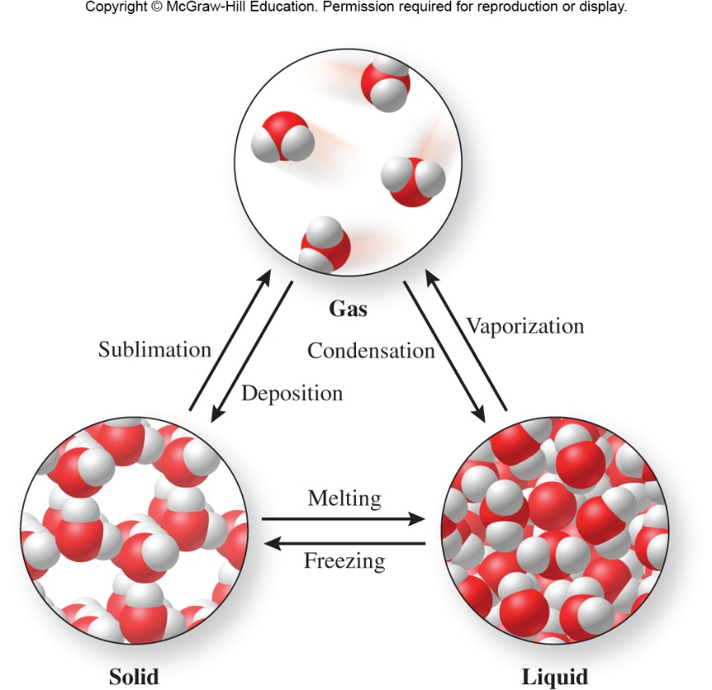
9.1 The Behavior of Gases
One way that we can describe gases is by their density.
All gases have relatively low densities in comparison to liquids and solids, due to the large amount of empty space between molecules.
Figure 1.24

Slide 7

Density
Because of their low densities, gases exist above the Earth and bubble up through liquids.
Figure 9.13

Slide 8
Behavior of Gases at the
Molecular Level
Gases consist of particles (atoms or molecules) that are relatively far apart.
Gas particles move about rapidly.
  An average O₂ molecule moves at a velocity of 980 mi/hr at room temperature.
Gas particles have little effect on one another unless they collide. When they collide, they do not stick to one another.
Gases expand to fill their containers.

Slide 9
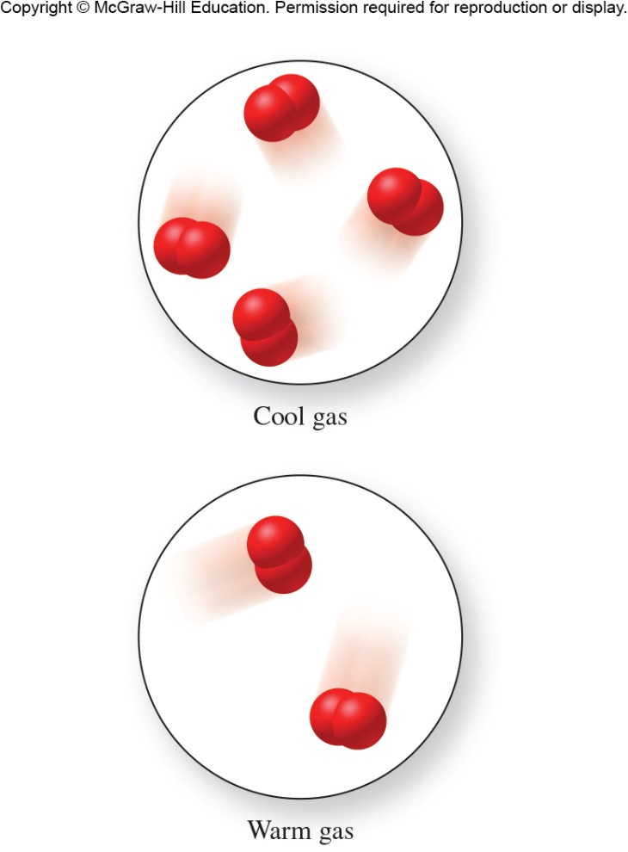
Temperature and Density
All gases expand when heated. Why?
  Because the resulting temperature increase causes an increase in the kinetic energy of the gas molecules, making them move faster, collide harder, and spread out.
Which gas has the greater density?
Cool gas
Figure 9.3

Slide 10
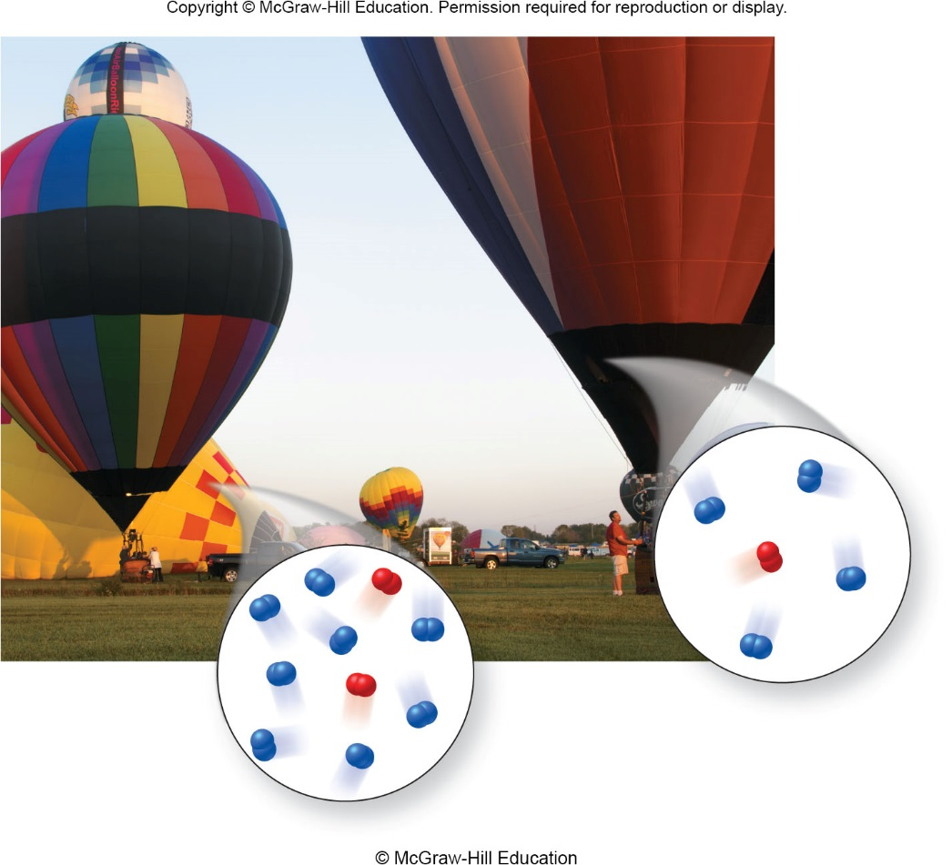
Why does a hot air balloon rise in the atmosphere?
Figure 9.4

Slide 11
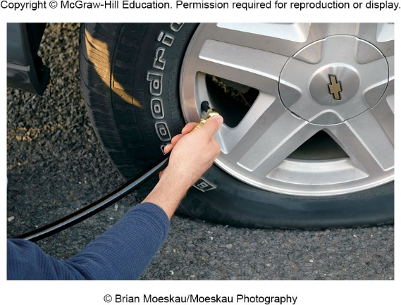

Pressure
Changes in pressure and amount of gas can affect the properties of a gas.
What happens to volume and pressure when air molecules are added to the tire?
What happens to density?
Figure 9.5

Slide 12
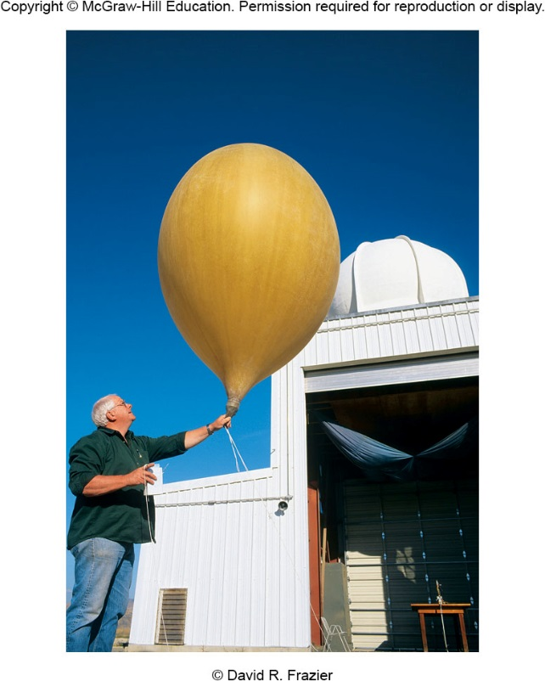
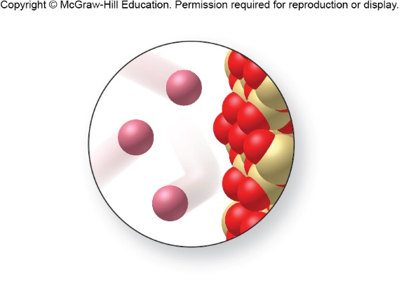
Pressure
What causes the balloon to inflate?
Figure 9.1
Figure 9.7

Slide 13
Pressure
Pressure (P) is the amount of force applied per unit area:
We can describe the pressure exerted by gas particles by:
Figure 9.7

Slide 14
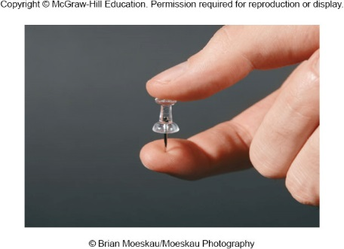
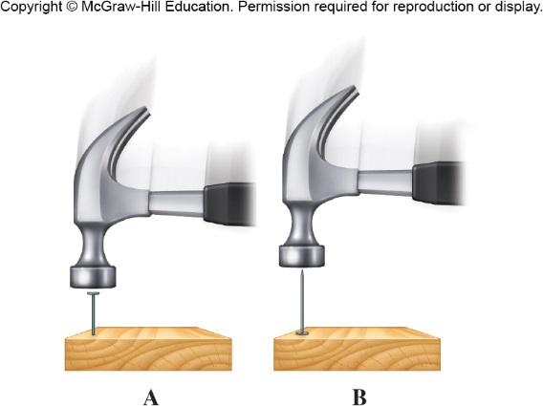
Pressure
Which finger hurts?
Figure from p. 338
Figure 9.8

Slide 15
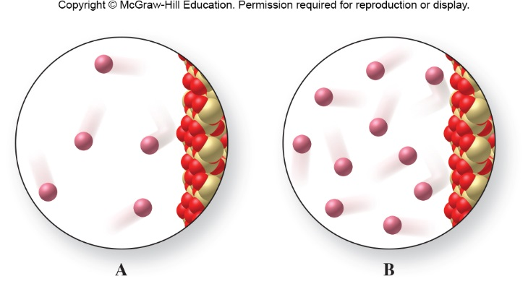
Which gas has the greater pressure? (assume they are at the same temperature)
Figure 9.9

Slide 16
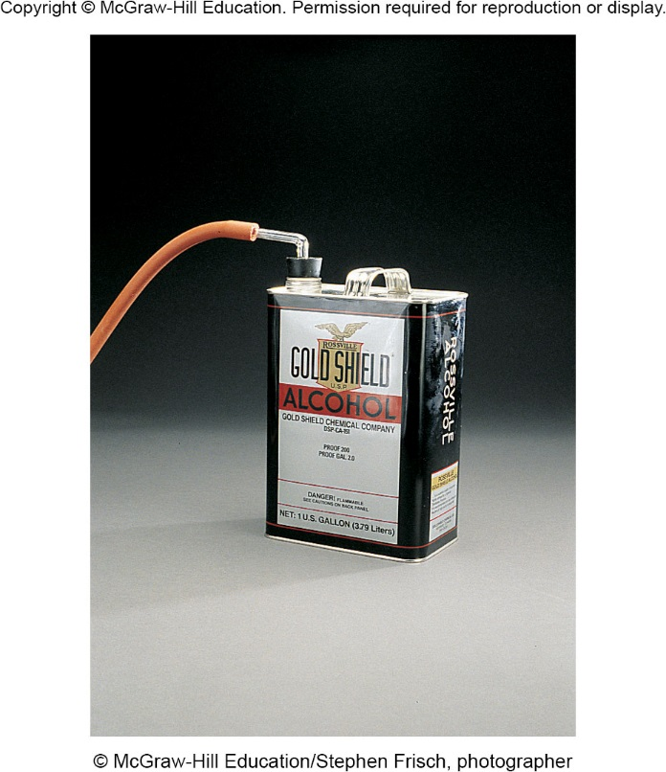
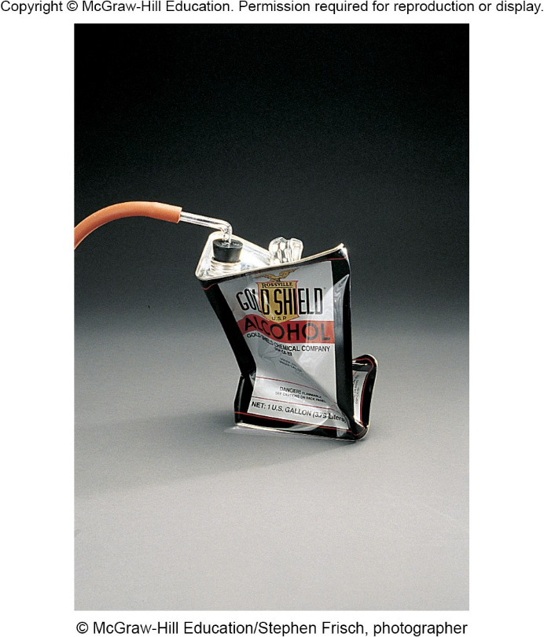
Pressure
Why does the can crush when the air is removed from the inside?
Figure 9.10

Slide 17
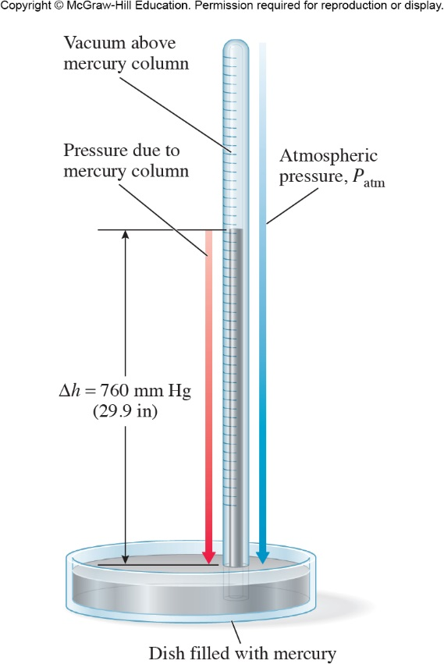
Measuring Pressure (Units)
psi
  pounds per square inch
  lb/in²
Atmospheric pressure is commonly measured with a barometer.
  inches of Hg
  mmHg
  torr
  atm
1 atm = 760 mmHg
1 atm = 760 torr
1 atm = 101,325 Pa
Figure 9.11

Slide 18
Activity Solutions: Pressure Conversions
The pressure of a gas is 8.25 × 10⁴ Pa. What is this pressure expressed in units of atm and torr?
1 atm = 760 mmHg
1 atm = 760 torr
1 atm = 101,325 Pa

Slide 19
Activity Solutions: Pressure Conversions
The pressure of a gas is 8.25 × 10⁴ Pa. What is this pressure expressed in units of atm and torr?
The conversion factor between atm and Pa is: 1 atm = 101, 325 Pa
The conversion between atm and torr is: 1 atm = 760 torr

Slide 20
9.2 Factors That Affect the Properties of Gases
Volume
  Measured in liters (L)
Pressure
  Measured in atmospheres (atm)
Temperature
  Measured in kelvins (K)
Amount of particles
  Measured in moles
An ideal gas is a gas that behaves according to predicted linear relationships

Slide 21

Factors that Affect the Properties of Gases
Volume and Pressure
  As a weather balloon ascends to higher altitudes of lower pressures, its volume increases.
  As bubbles rise in water from greater pressures to lower pressures, they increase in size.
Figure 9.12
Figure 9.13

Slide 22
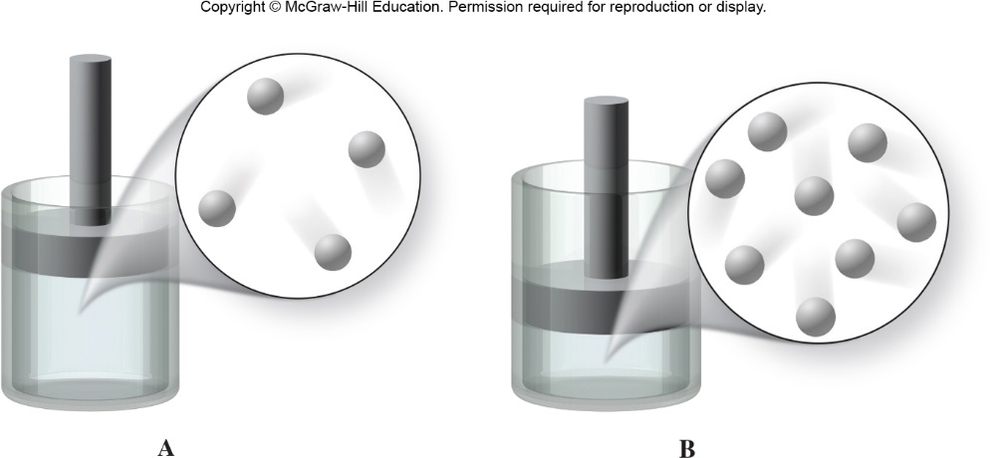
Volume and Pressure
How are volume and pressure related?
Figure 9.14
For a given amount of gas at the same temperature, the pressure goes up as the volume gets smaller.

Slide 23
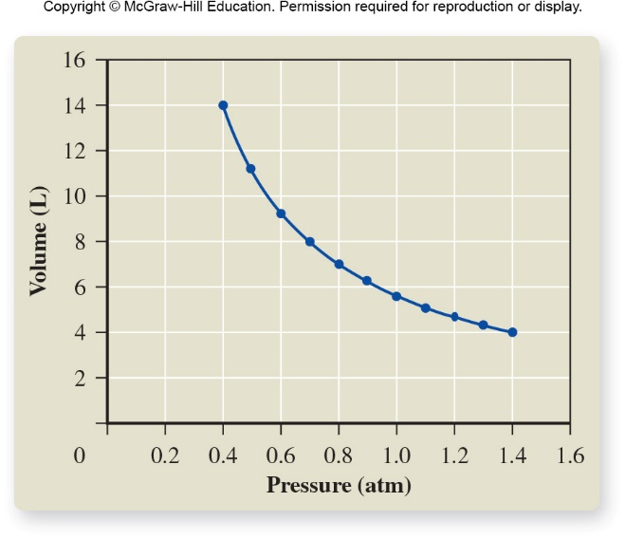
Graph of Volume vs. Pressure
What does this graph illustrate regarding the relationship between volume and pressure?
Figure 9.15

Slide 24
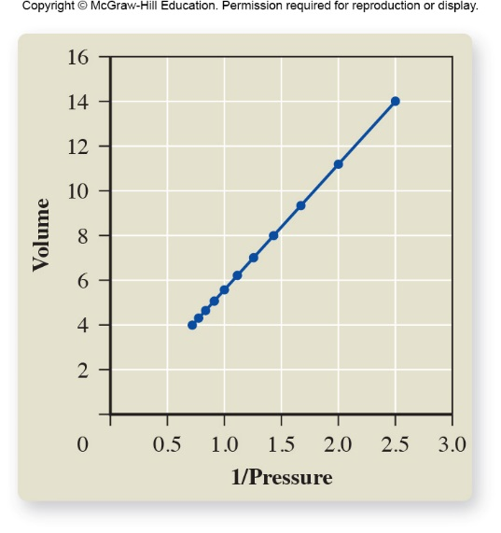
Graph of Volume vs. 1/Pressure shows that they are inversely related.
V = (constant) × 1/P
(at constant temperature)
Figure 9.16

Slide 25
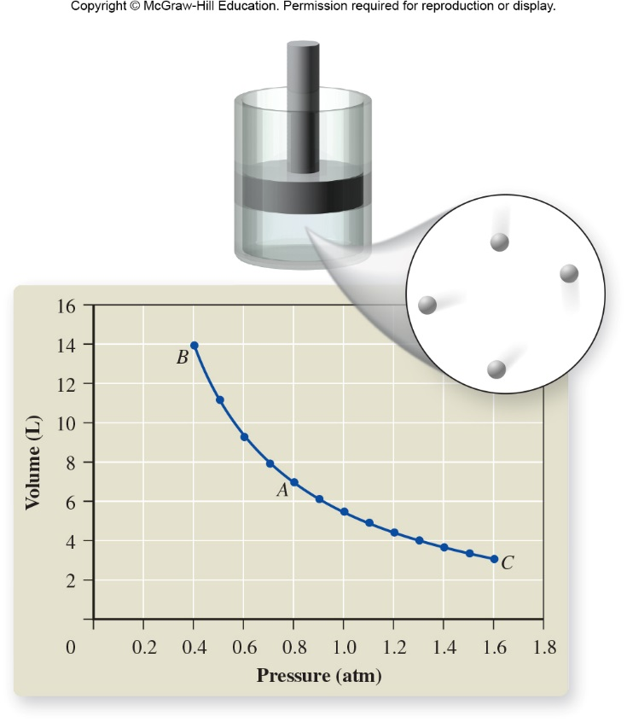
What happens to pressure when the volume is doubled?
Pressure is halved when the volume is doubled.
Figure from p. 352

Slide 26
Boyle’s Law
P  1/V
PV = constant
P = constant × 1/V
V = constant × 1/P
P₁V₁ = P₂V₂

Slide 27
Activity: Boyle’s Law
P₁V₁ = P₂V₂
If the pressure of a 2.0-L sample of gas is decreased from 1.2 atm to 0.25 atm at constant temperature, what is the new volume?

Slide 28
Extra Activity: Boyle’s Law
What pressure is needed to compress 455 mL of oxygen gas at 2.50 atm to a volume of 282 mL?
P₁ = 2.50 atm P₂ = ?
V₁ = 455 mL V₂ = 282 mL
Using Boyle’s Law: P₁V₁ = P₂V₂
Solving for P₂:

Slide 29
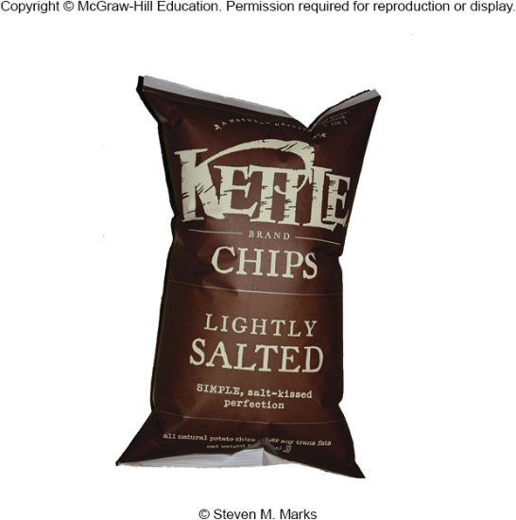
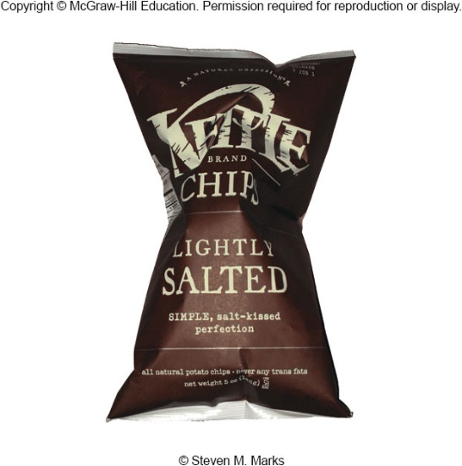
Boyle’s Law Application
Use Boyle’s Law to explain why potato chip bags are puffier with greater volume at higher altitudes.
The lower atmospheric pressure causes the particles to spread out and occupy a larger volume.

Slide 30
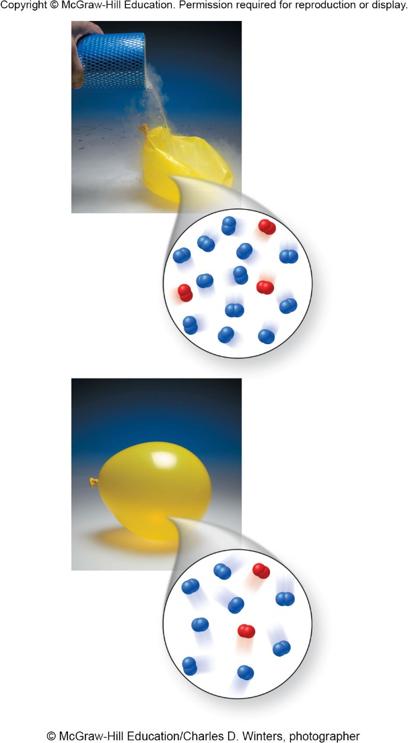
Volume and Temperature
What is the relationship between volume and temperature (at constant pressure)?
As temperature increases, volume increases.
Figure 9.17

Slide 31
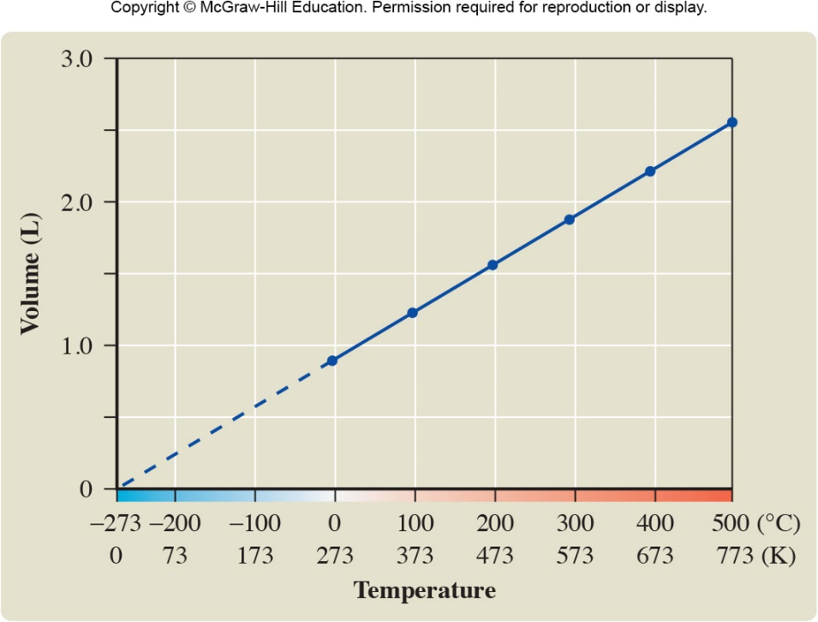
Charles’s Law
V  T
V/T = constant
V = constant × T
T = constant × V
Temperature must be in units of Kelvin. Why?
Figure 9.18
V vs. T at constant pressure

Slide 32
Activity: Charles’s Law
A sample of carbon monoxide gas occupies 150.0 mL at 25.0°C. It is then cooled at constant pressure until it occupies 100.0 mL. What is the new temperature in degrees Celsius?
You MUST convert temperatures to kelvins when dealing with gases – ALWAYS!
T₁ = 25.0°C + 273.15 = 298.2 K
T₂ = ?

Slide 33
Activity: Charles’s Law
A sample of carbon monoxide gas occupies 150.0 mL at 25.0°C. It is then cooled at constant pressure until it occupies 100.0 mL. What is the new temperature in degrees Celsius?
V₁ = 150.0 mL V₂ = 100.0 mL
T₁ = 298.2 K T₂ = ?
Using Charles’s Law:
Solving for T₂:
T₂ (in °C) = 198.8 K – 273.15 = −74.4°C

Slide 34
Extra Activity: Charles’s Law
If a balloon filled with air has a volume of 15.0 L at 25ºC, what is its volume at −100ºC? Assume constant pressure.

Slide 35
Volume, Pressure and Temperature
Combined gas law
  For a constant amount of gas, volume is proportional to absolute temperature and inversely proportional to pressure.
  V  (T/P)

Slide 36
Activity: The Combined Gas Law
A sample of hydrogen gas occupies 1.25 L at 80.0°C and 2.75 atm. What volume will it occupy at 185°C and 5.00 atm?

Slide 37
Activity Solution: The Combined Gas Law
A sample of hydrogen gas occupies 1.25 L at 80.0°C and 2.75 atm. What volume will it occupy at 185°C and 5.00 atm?
First, convert the temperatures into kelvins:
T₁ = 80.0°C + 273.15 K = 353.2 K
T₂ = 185°C + 273.15 K = 458 K
V₁ = 1.25 L V₂ = ?
T₁ = 353.2 K T₂ = 458 K
P₁ = 2.75 atm P₂ = 5.00 atm

Slide 38
Activity Solution: The Combined Gas Law
A sample of hydrogen gas occupies 1.25 L at 80.0°C and 2.75 atm. What volume will it occupy at 185°C and 5.00 atm?
V₁ = 1.25 L V₂ = ?
T₁ = 353.2 K T₂ = 458 K
P₁ = 2.75 atm P₂ = 5.00 atm
Combined Gas Law:
Solving for V₂:

Slide 39
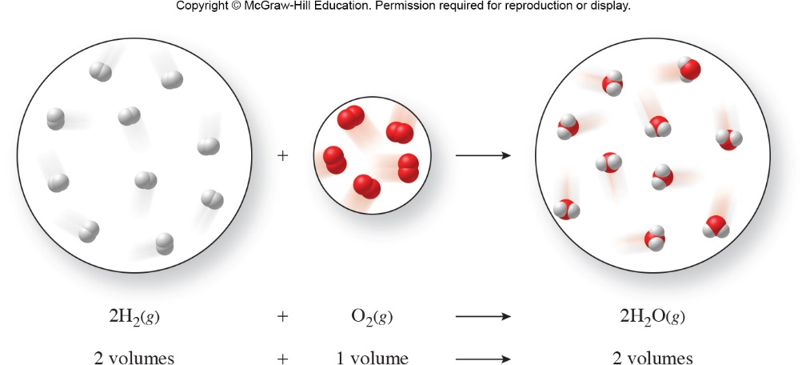
Gay-Lussac’s Law of
Combining Volumes (1808)
Gases combine in simple whole-number volume proportions at constant temperature and pressure.
Figure 9.19

Slide 40
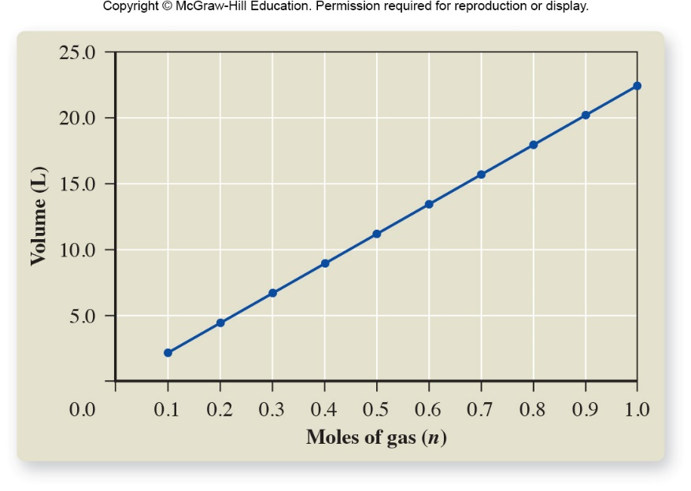
Volume vs. Amount of Gas
Avogadro’s hypothesis
  The volume occupied by a gas at a given temperature and pressure is directly proportional to the number of gas particles and thus to the moles of gas.
V  n
As the moles of gas increase, the volume increases (at constant T and P).
Figure 9.20

Slide 41
Volume vs. Amount of Gas
Avogadro’s hypothesis
  At a given pressure and temperature, equal volumes of all gases contain equal numbers of moles (or particles).
Special conditions of temperature and pressure are defined as the standard temperature and pressure (STP):
0°C and 1 atm
The volume of an ideal gas at STP is called its molar volume:
1 mole of gas = 22.414 L
One mole of any gas occupies this same volume at STP.

Slide 42
Activity: Avogadro’s Law
If a balloon initially contains 0.35 mol of gas and occupies 8.2 L, what is the volume of the balloon when 1.2 mol of gas is present if temperature and pressure remain constant?

Slide 43
Activity Solution: Avogadro’s Law
If a balloon initially contains 0.35 mol of gas and occupies 8.2 L, what is the volume of the balloon when 1.2 mol of gas is present if temperature and pressure remain constant?
n₁ = 0.35 mol n₂ = 1.2 mol
V₁ = 8.2 L V₂ = ?
Using Avogadro’s Hypothesis equation:
Solving for V₂:

Slide 44
Summary of The Gas Laws
Boyle’s law
V  1 at constant T, n
P
Charles’s law
V  T at constant P, n
Avogadro’s hypothesis
V  n at constant T, P
Combining them all into one proportionality:
V  nT
P
To express this as an equality, we use a constant:
PV = constant
nT

Slide 45
Equation that Includes Moles in the Combined Gas Law

Slide 46
9.3 The Ideal Gas Law

Slide 47
The Ideal Gas Law

Slide 48
The Ideal Gas Law
The ideal gas law allows us to calculate pressure, volume, moles, or temperature, when three out of the four variables are known.
If the identity of the gas is known, molar mass can be used to convert between moles and grams.

Slide 49
Activity: The Ideal Gas Law
What mass of oxygen gas will occupy a 6.0-liter container, at a pressure of 700 torr and at a temperature of 25ºC?
To use the ideal gas law with the value of R is in units of
(L atm)/(mol K), torr must be converted to atm, and ºC must be converted to K.

Slide 50
Activity: Calculating Moles with the Ideal Gas Law
The volume of an oxygen cylinder used as a portable breathing supply is 2.025 L. When the cylinder is “empty” at 29.2°C, it has a pressure of 723 torr. How many moles of oxygen gas remain in the cylinder?

Slide 51
Activity Solution: Calculating Moles with the Ideal Gas Law
The volume of an oxygen cylinder used as a portable breathing supply is 2.025 L. When the cylinder is “empty” at 29.2°C, it has a pressure of 723 torr. How many moles of oxygen gas remain in the cylinder?
When using the Ideal Gas Law, you want to make sure the units of each variable (V, P, n, and T) match those of R:
R = 0.08206 (L atm)/(mol K)
T = 29.2°C + 273.15 = 302.4 K V = 2.025 L
P = 723 torr × 1 atm = 0.951 atm n = ?
760 torr

Slide 52
Activity Solution: Calculating Moles with the Ideal Gas Law
The volume of an oxygen cylinder used as a portable breathing supply is 2.025 L. When the cylinder is “empty” at 29.2°C, it has a pressure of 723 torr. How many moles of oxygen gas remain in the cylinder?
R = 0.08206 L atm/(mol K)
T = 29.2°C + 273.15 = 302.4 K V = 2.025 L
P = 723 torr × 1 atm = 0.951 atm n = ?
760 torr
Using the Ideal Gas Law: PV = nRT
Solving for n:

Slide 53
Activity Solution: Calculating Moles with the Ideal Gas Law
The volume of an oxygen cylinder used as a portable breathing supply is 2.025 L. When the cylinder is “empty” at 29.2°C, it has a pressure of 723 torr. How many moles of oxygen gas remain in the cylinder?
Answer: 0.0776 mol O₂
What mass of oxygen gas remains in the cylinder?

Slide 54
Density of a Gas
We can solve for density in the Ideal Gas Law using substitution:
PV = nRT

Slide 55
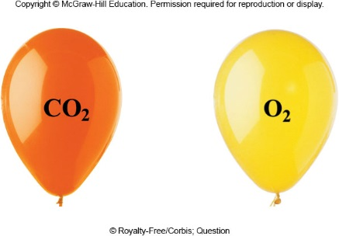
Activity: Gas Properties
Which balloon has the greatest number of gas molecules?
Which balloon has the greatest number of moles of gas?
Which balloon has the greatest mass?
Which balloon has the greatest density?
equal
equal
CO2
CO2
Figure from p. 388

Slide 56
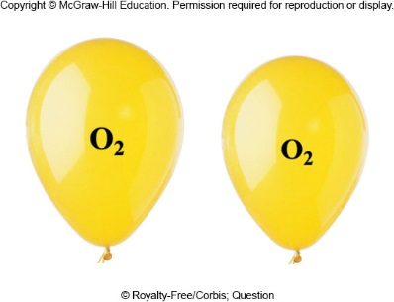
Activity: Gas Properties
If the O₂ balloon had been filled to a smaller volume, which of the following quantities would be different for the O₂ gas?
  number of molecules
  moles
  mass
  density
Smaller
Smaller
Smaller
Same

Slide 57
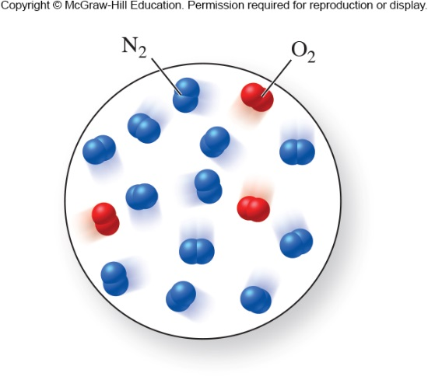
Dalton’s Law of Partial Pressures
Dalton’s Law of Partial Pressures
  Gases in a mixture behave independently and exert the same pressure they would exert if they were in a container alone.
  P_{total} = P_{A} + P_{B} + P_{C} + …
Figure 9.21

Slide 58
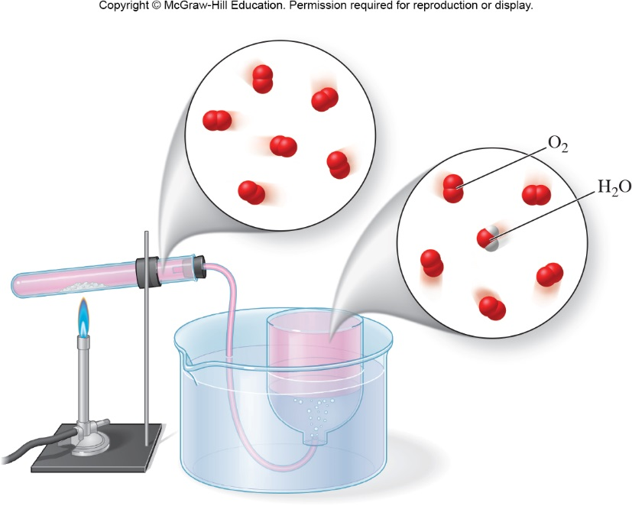
Dalton’s Law of Partial Pressures
When a gas is collected above a liquid, such as water, the liquid’s vapor adds to the gas and to the total pressure.
P_{total} = P_{gas} + P_{H2O vapor}
P_{gas} = P_{total} − P_{H2O vapor}
P_{H2O vapor} is a constant at a specific temperature, so we can just look up its value. (See Table 9.2.)
Figure 9.22
2KBrO3(l) → 2KBr(s) + 3O2(g)

Slide 59
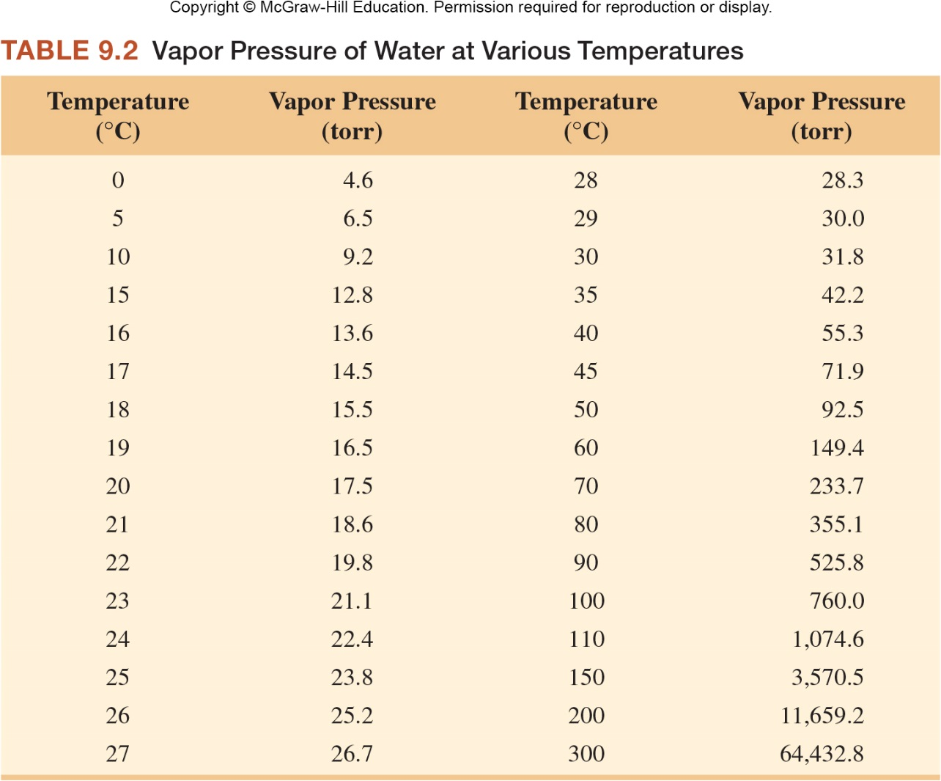
Vapor Pressure of Water at
Various Temperatures

Slide 60
Activity: Partial Pressures
Suppose 2.25 L of H₂ gas is collected over water at 18.0°C and 722.8 torr. How many moles of H₂ are produced in this reaction?

Slide 61
Activity Solution: Partial Pressures
Suppose 2.25 L of H₂ gas is collected over water at 18.0°C and 722.8 torr. How many moles of H₂ are produced in this reaction?
V = 2.25 L n = ?
T = 18.0°C + 273.15 = 291.2 K
From Table 9.2, we find the vapor pressure of water to be 15.5 torr.

Slide 62
Activity Solution: Partial Pressures
Suppose 2.25 L of H₂ gas is collected over water at 18.0°C and 722.8 torr. How many moles of H₂ are produced in this reaction?
V = 2.25 L R = 0.08206 L atm/(mol K)
T = 291.2 K n = ?
P = 0.931 atm
Using the Ideal Gas Law: PV = nRT
Solving for n:

Slide 63
9.4 Kinetic-Molecular Theory of Gases
A model that explains experimental observations about gases under normal temperature and pressure conditions that we encounter in our environment.

Slide 64
Kinetic-Molecular Theory of Gases
Postulates of KMT
  Gases are composed of small and widely separated particles (molecules or atoms).
  Particles of a gas behave independently of one another.
  Each particle of a gas is in rapid, straight-line motion, until it collides with another molecule or with its container.
  The pressure of a gas arises from the sum of the collisions of the particles with the walls of the container.
  The average kinetic energy of gas particles depends only on the absolute temperature: KE_{ave}  T_{Kelvin}

Slide 65
Postulates of Kinetic-Molecular Theory
  Gases are composed of small and widely separated particles (molecules or atoms).
  Explains:
    Low volumes of particles
    (In a normal gas, less than 0.1% of the space is due to the volume of the gas particles. The rest is empty space.)
    Low densities of gas
    High compressibility

Slide 66
Postulates of Kinetic-Molecular Theory
  Particles of a gas behave independently of one another.
    Independent movement, unless two particles collide.
    No forces of attraction or repulsion operate between or among gas particles.
  Each particle in a gas is in rapid, straight-line motion, until it collides with another molecule or with its container.
    When collisions occur, the collisions are perfectly elastic.
      Energy transferred from one particle to another with no net loss of energy.

Slide 67
Postulates of Kinetic-Molecular Theory
  The pressure of a gas arises from the sum of the collisions of the particles with the walls of the container.
    The smaller the container, the more collisions between the gas particles and the walls of the container, resulting in higher pressures.
    KMT predicts pressure should be proportional to the number of gas particles.

Slide 68
Postulates of Kinetic-Molecular Theory
  The average kinetic energy of gas particles depends only on the absolute temperature.
    Relationship between kinetic energy (KE) and velocity (v) of the gas particles:
KE_{av} = ½m(v_{av})²
    The average velocity for gas particles is greater at higher temperatures.
    Thus, if the particles move faster, they hit the walls of the container more often, resulting in higher pressure.
    All gases have the same average KE when at the same temperature.

Slide 69
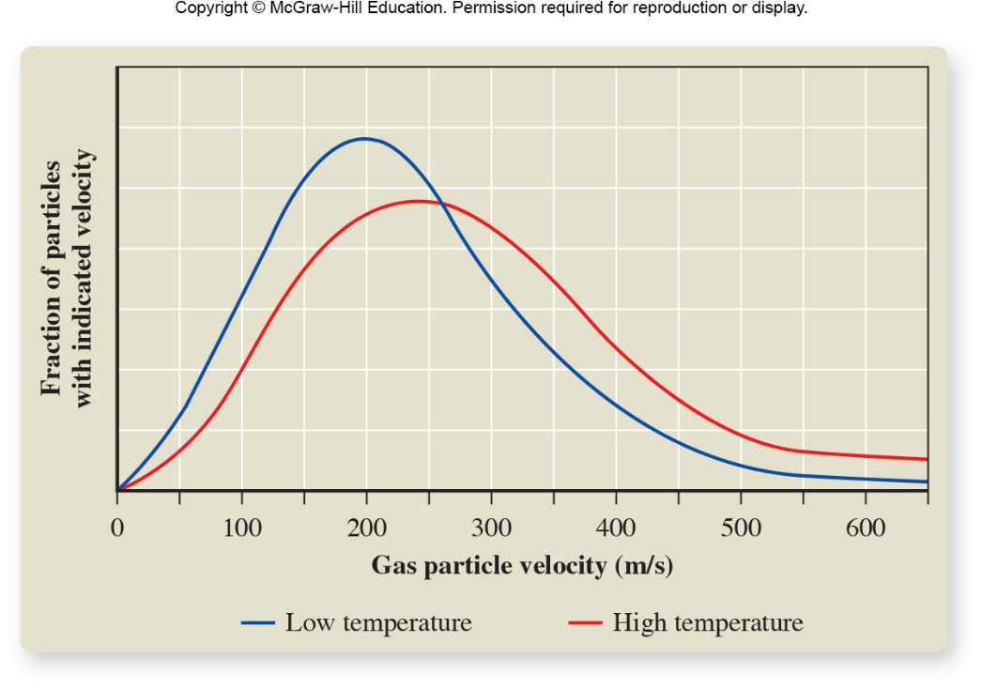
Kinetic Energy, Molecular Velocity, and Temperature
For a particular gas, KE is related to molecular velocity:
KEave=½m(vave)²
Figure 9.23

Slide 70
Activity: Kinetic Energy, Molecular Velocity, and Temperature
Ar, CO₂, and H₂ all at the same temperature
  Which of these gases has the greatest average kinetic energy?
  Which has the greatest average velocity?
Same for each since T is the same.
The lightest gas, H2, has the greatest velocity.

Slide 71
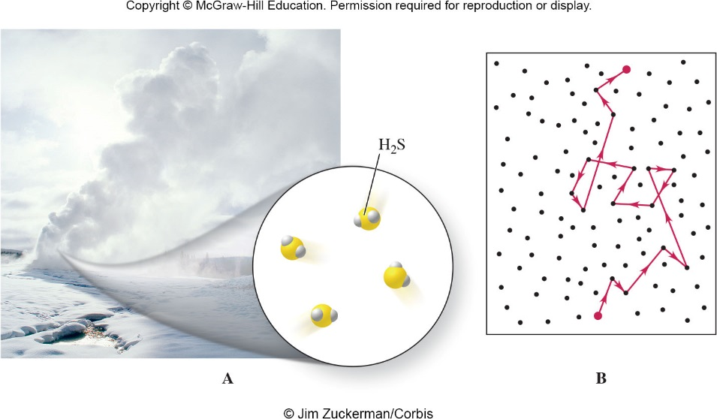
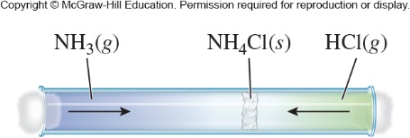
Diffusion
Figure 9.24
m1v1² = m2v2²
Figure 9.25

Slide 72
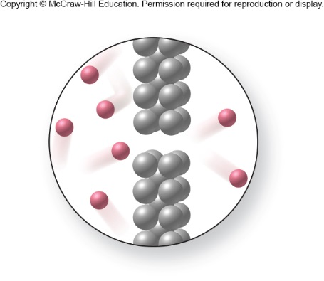
Effusion
A helium balloon loses volume more quickly than an “air” balloon because helium effuses through the balloon’s pores more quickly.
Figure 9.26

Slide 73
Activity: Diffusion and Effusion
Ar, CO₂, and H₂ all at the same temperature
  Which of these gases diffuses at the greatest rate?
  Which of these gases effuses at the greatest rate?
The lightest gas, H2, diffuses at the greatest rate.
The lightest gas, H2, effuses at the greatest rate.

Slide 74
9.5 Gases and Chemical Reactions
Product volume from reactant volume
  When we have gaseous reactants and products, we can use the ideal gas law to convert between volume and moles:

Slide 75
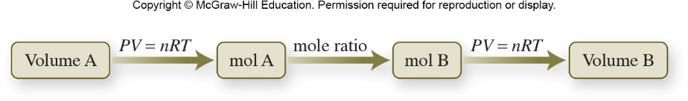
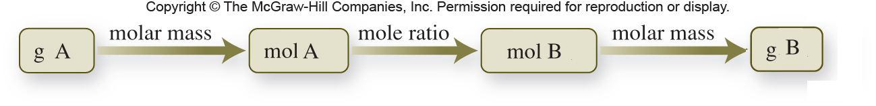
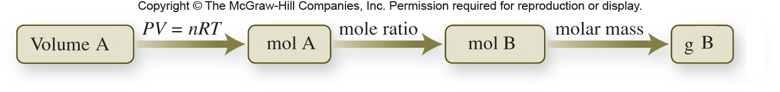
Gases and Chemical Reactions
The ideal gas law allows us to predict the volume of a reactant or a product from the amount of another substance in a reaction:
Remember the steps we used to determine the mass of a reactant or product:
Modifying the pattern to include volume:

Slide 76
Activity: Gas Reactions
A sample of hydrogen gas has a volume of 7.49 L at a pressure of 22.0 atm and a temperature of 32.0°C. What volume of gaseous water is produced by the following reaction at 125.0°C and 0.975 atm, if all the hydrogen gas reacts with iron(III) oxide?
Fe₂O₃(s) + 3 H₂(g) → 2 Fe(s) + 3 H₂O(g)

Slide 77
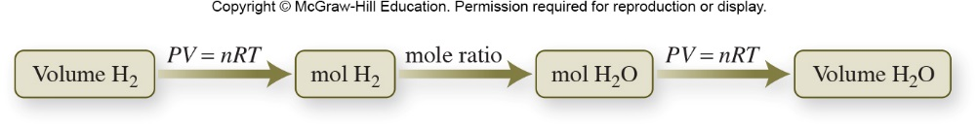
Activity Solution: Gas Reactions
A sample of hydrogen gas has a volume of 7.49 L at a pressure of 22.0 atm and a temperature of 32.0°C. What volume of gaseous water is produced by the following reaction at 125.0°C and 0.975 atm, if all the hydrogen gas reacts with iron(III) oxide?
Fe₂O₃(s) + 3 H₂(g) → 2 Fe(s) + 3 H₂O(g)
V_{hydrogen} = 7.49 L V_{water} = ?
P₁ = 22.0 atm P₂ = 0.975 atm
T₁ = 32.0°C + 273.15 = 305.2 K
T₂ = 125.0°C + 273.15 = 398.2 K

Slide 78
Activity Solution: Gas Reactions
Fe₂O₃(s) + 3 H₂(g) → 2 Fe(s) + 3 H₂O(g)
V_{hydrogen} = 7.49 L V_{water} = ?
P₁ = 22.0 atm P₂ = 0.975 atm
T₁ = 305.2 K T₂ = 398.2 K
First, we need to find moles of hydrogen gas. For this, we use the ideal gas law.
PV = nRT

Slide 79
Activity Solution: Gas Reactions
Fe₂O₃(s) + 3 H₂(g) → 2 Fe(s) + 3 H₂O(g)
V_{hydrogen} = 7.49 L V_{water} = ?
P₁ = 22.0 atm P₂ = 0.975 atm
T₁ = 305.2 K T₂ = 398.2 K
Then, we need to find moles of water from moles of hydrogen gas. We use the mole ratio from the balanced chemical equation to do this.

Slide 80
Activity Solution: Gas Reactions
Fe₂O₃(s) + 3 H₂(g) → 2 Fe(s) + 3 H₂O(g)
V_{hydrogen} = 7.49 L V_{water} = ?
P₁ = 22.0 atm P₂ = 0.975 atm
T₁ = 305.2 K T₂ = 398.2 K
Finally, we need to find the volume of gaseous water. For this, we use the ideal gas law.
PV = nRT
V_{water} = 221 L

Slide 81
Activity Solution: Gas Reactions
How many moles of H₂SO₄ form if 2.38 L of SO₃ gas, measured at 65.0°C and 1.05 atm, react with sufficient water? How many grams? The balanced equation is as follows:
SO₃(g) + H₂O(l) → H₂SO₄(l)

Slide 82
Activity Solution: Gas Reactions
How many moles of H₂SO₄ form if 2.38 L of SO₃ gas, measured at 65.0°C and 1.05 atm, react with sufficient water? How many grams? The balanced equation is as follows:
SO₃(g) + H₂O(l) → H₂SO₄(l)
V_{SO3} = 2.38 L n_{H2SO4} = ?
T = 65.0°C + 273.15 = 338.2 K
P = 1.05 atm m_{H2SO4} = ?
First, we need to find moles of SO₃.
PV = nRT

Slide 83
Activity Solution: Gas Reactions
SO₃(g) + H₂O(l) → H₂SO₄(l)
V_{SO3} = 2.38 L n_{H2SO4} = ?
T = 65.0°C + 273.15 = 338.2 K
P = 1.05 atm m_{H2SO4} = ?
Next, we will find moles of H₂SO₄. We use the mole ratio to convert from SO₃ to H₂SO₄.
Finally, we need to find the mass of H₂SO₄. The conversion factor between moles and mass is Molar Mass.

Slide 84
Chapter 9 Math Toolboxes:
9.1 Graphing
9.2 Solving Simple Algebraic Equations

Slide 85
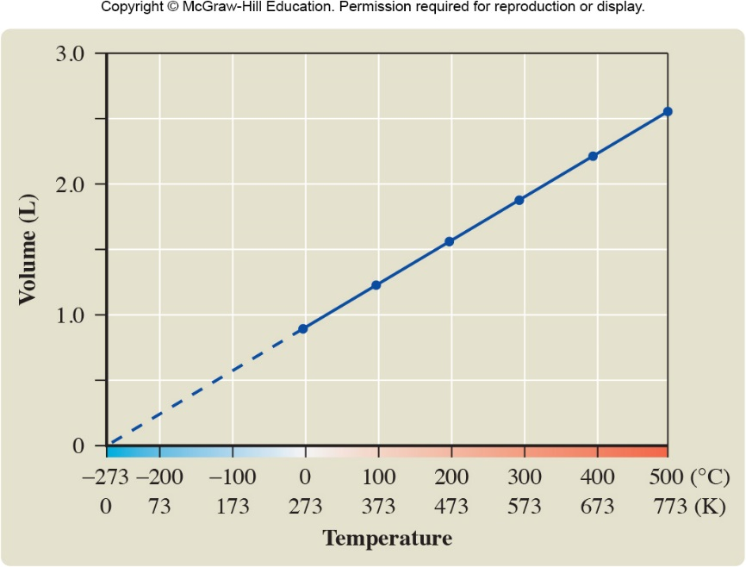
Math Toolbox 9.1: Graphing
Steps for graphing (by hand):
  Examine and organize the data to be plotted.
    Placing the data in a table may be the easiest way to transfer them to the graph.
Figure 9.18

Slide 86
Math Toolbox 9.1: Graphing
Steps for graphing (by hand):
  Identify and label the axes.
  The dependent variable is the variable measured experimentally. Plot it on the vertical axes (the y axis).
  The independent variable is the variable controlled and varied by the experimenter. Plot it on the horizontal axis (the x axis).
  Clearly label each axis with the name of the variable and the units. Put the units either in parenthesis after the name of the variable or separated from the variable name by a comma: volume (L) or volume, L.

Slide 87
Math Toolbox 9.1: Graphing
Steps for graphing (by hand):
  Decide on the scales and limits of values to be plotted along each axis.
  The graph should nearly fill the graph paper.
  Adjust the scale so the data can be entered easily on the graph and read off the graph with about the same precision as they were measured.
  You don’t need to begin each axis scale with zero if it is not convenient.
  Increments on the x axis can differ from those on the y axis.
  After selecting the scales for each axis, clearly mark the value of each major division along each axis.

Slide 88
Math Toolbox 9.1: Graphing
Steps for graphing (by hand):
  Place dots on the graph at the intersection of x and y values to represent a data point.
  Place a circle 1-2 mm in diameter around each data point to emphasize its location.
  Use squares or triangles to represent different sets of data.
  Draw a smooth line through the data set.
  Do NOT connect the dots with separate straight-line segments.
  Not all data points may actually fall on the line.
  Label the completed graph with an appropriately identifying title in a clear space at the top.

Slide 89
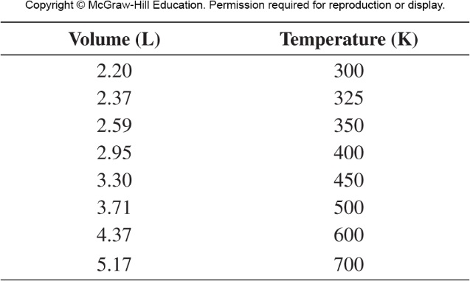
Math Toolbox 9.1: Graphing

Slide 90
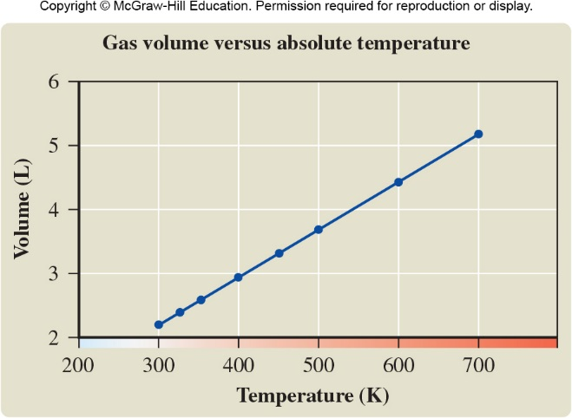
Math Toolbox 9.1: Graphing

Slide 91
Math Toolbox 9.2: Solving Simple Algebraic Equations
We can manipulate equations in any way that does not destroy the equality.
Operations that maintain equalities are:
  adding the same number to both sides of the equation.
  subtracting the same number from both sides of the equation.
  multiply or dividing both sides of the equation by the same number.
  raising both sides of the equation to the same power.

Slide 92
Math Toolbox 9.2: Solving Simple Algebraic Equations
For example, let’s say we need to solve for volume (V) in the ideal gas law.
PV = nRT
When we solve for a variable (this time V), we want it alone by itself on one side of the equality. To rearrange the Ideal Gas Law, we need to divide both sides by P:
PV = nRT
P P
On the left side of the equation, P is both in the numerator and the denominator; it therefore cancels out.
V = nRT
P

