Slide 1

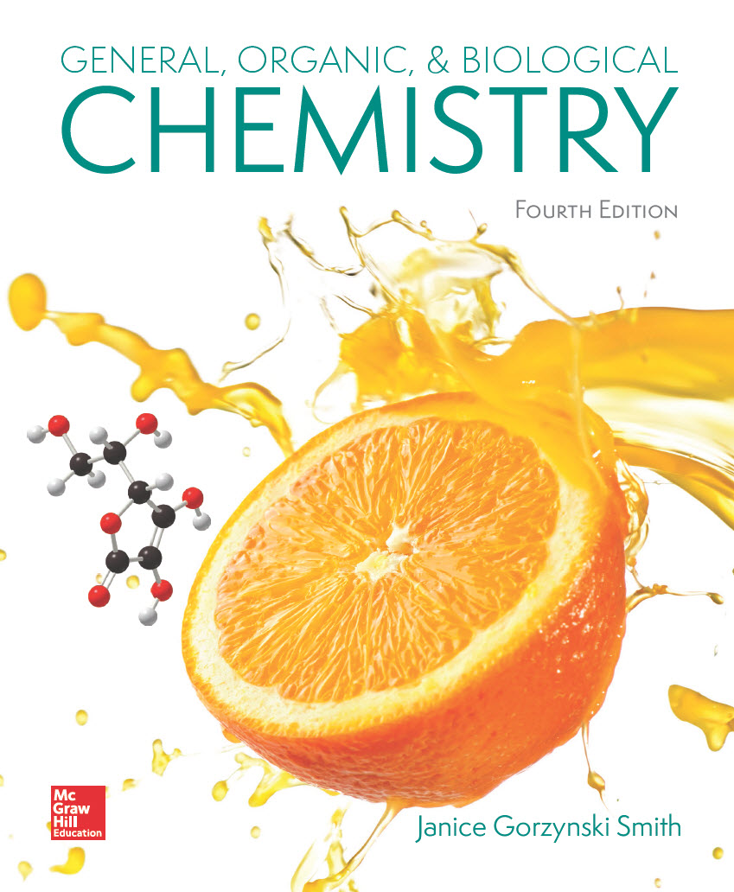
Chapter 11
Lecture Outline
Prepared by
Harpreet Malhotra
Florida State College at Jacksonville

Slide 2
11.1 Introduction to Organic Chemistry
Organic chemistry is the study of compounds that contain the element carbon.
Organic chemicals affect virtually every facet of our lives.
Products such as clothes, foods, medicines, gasoline, refrigerants, and soaps are composed almost solely of organic compounds.
Some organic products can be obtained directly from natural sources—cotton, wool, and silk.
Others can be synthetically produced—nylon and polyester.

Slide 3
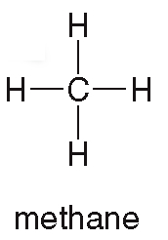
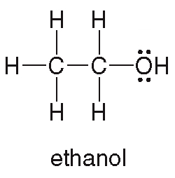
11.2 Characteristics of Organic Compounds (1)
Some examples of organic compounds:
Methane is the main component of natural gas.
Ethanol is the alcohol present in alcoholic beverages.

Slide 4
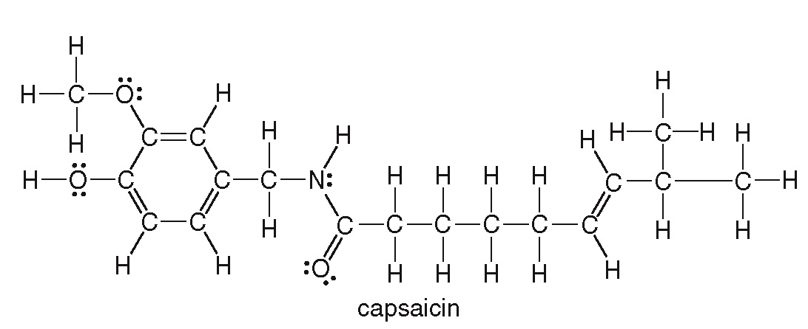
11.2 Characteristics of Organic Compounds (2)
Some examples of organic compounds:
Capsaicin is responsible for the spiciness of peppers, and is used for topical pain-relief medicines.

Slide 5
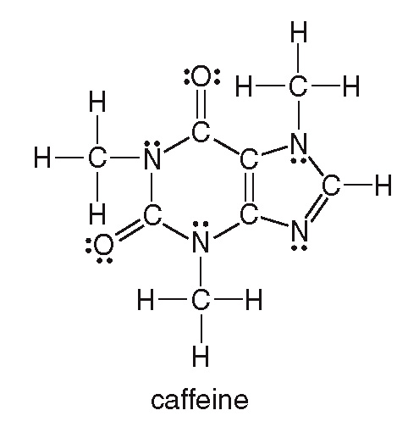
11.2 Characteristics of Organic Compounds (3)
Some examples of organic compounds:
Caffeine is the stimulant found in coffee, tea, cola beverages, and chocolate.

Slide 6
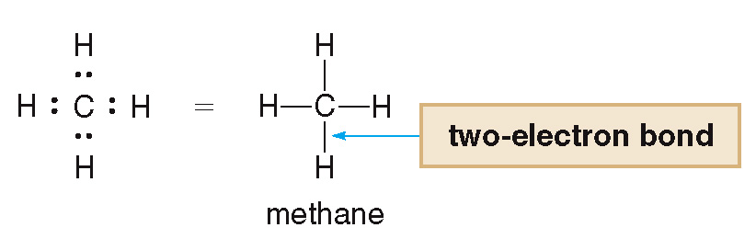
11.2 Characteristics of Organic Compounds (4)
All organic compounds contain carbon atoms and most contain hydrogen atoms:
Carbon always forms four covalent bonds.
Hydrogen always forms one covalent bond.

Slide 7
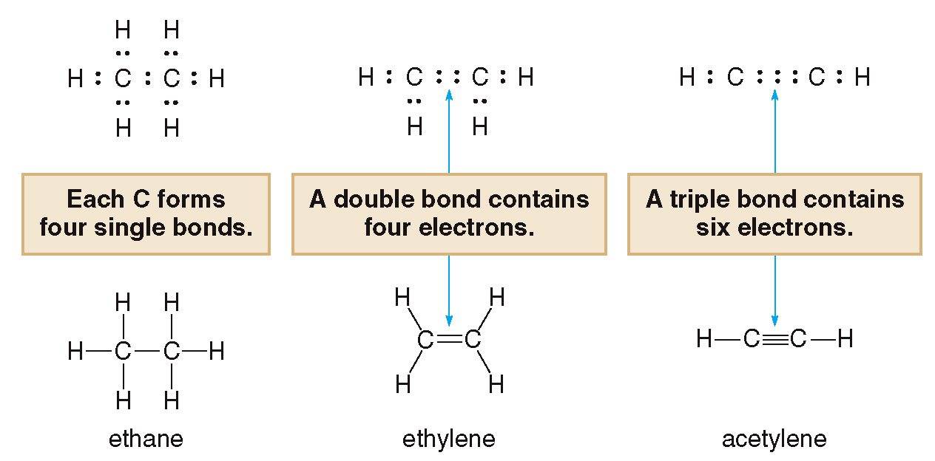
11.2 Characteristics of Organic Compounds (5)
Carbon forms single, double, and triple bonds to other carbon atoms.

Slide 8
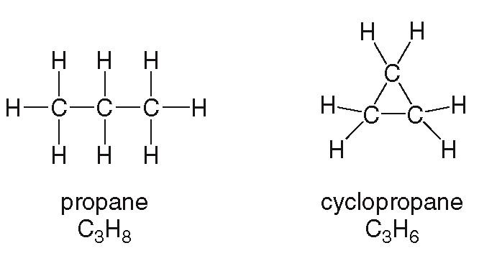
11.2 Characteristics of Organic Compounds (6)
Some compounds have chains of atoms and some compounds have rings.

Slide 9
11.2 Characteristics of Organic Compounds (7)
Organic compounds may also contain elements other than carbon and hydrogen.
Any atom that is not carbon or hydrogen is called a heteroatom.
Each heteroatom forms a characteristic number of bonds, determined by its location in the periodic table.
The common heteroatoms (N, O, F, Cl, Br, and I) also have nonbonding, lone pairs of e⁻, so that each atom is surrounded by an octet of e⁻.
Number of bonds + Number of lone pairs = 4

Slide 10
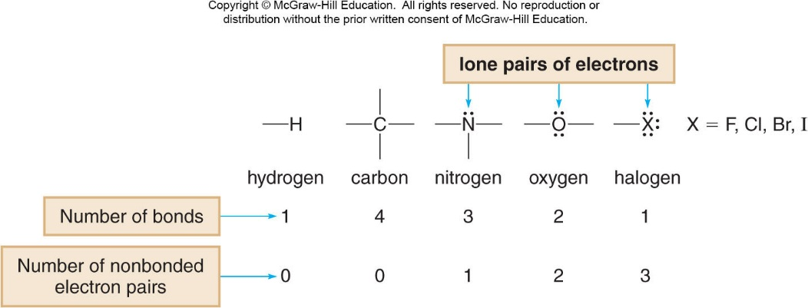
11.2 Characteristics of Organic Compounds (8)

Slide 11
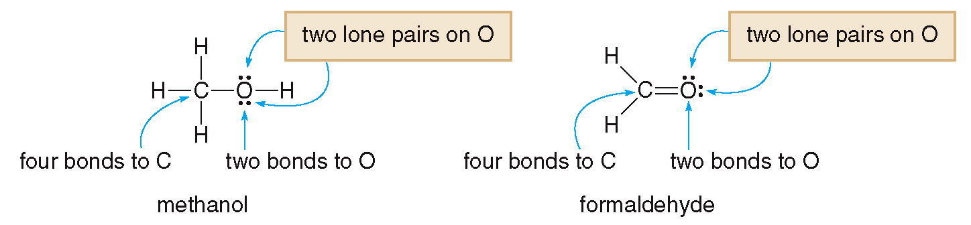
11.2 Characteristics of Organic Compounds (9)
The most common multiple bond between carbon and a heteroatom is a carbon–oxygen double bond.

Slide 12
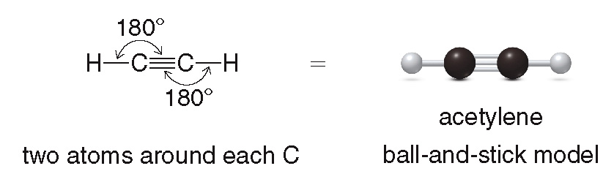
11.3 Shapes of Organic Molecules (1)
VSEPR theory: The most stable arrangement keeps the groups on a central atom as far away from each other as possible.
An atom surrounded by two groups is linear and has a bond angle of

Slide 13
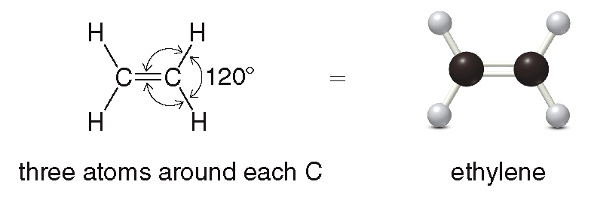
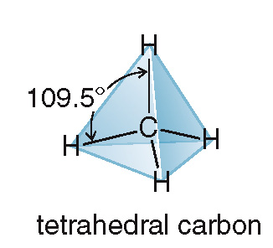
11.3 Shapes of Organic Molecules (2)
An atom surrounded by three groups is trigonal planar and has a bond angle of
An atom surrounded by four groups is tetrahedral and has bond angles of

Slide 14
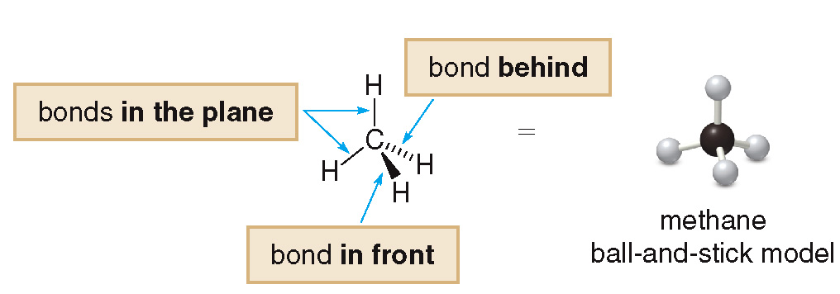
11.3 Shapes of Organic Molecules (3)
To draw a 3D tetrahedron on a page, we use:
A solid line for bonds in the plane
A wedge for a bond in front of the plane
A dashed line for a bond behind the plane
Every carbon with four single bonds is tetrahedral.

Slide 15
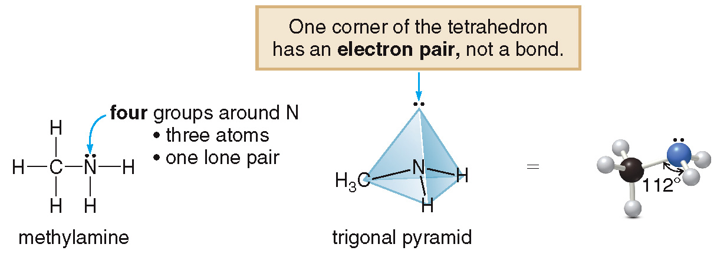
11.3 Shapes of Organic Molecules (4)
Nitrogen is attached to 3 atoms and has 1 lone pair, making its shape a trigonal pyramid.

Slide 16
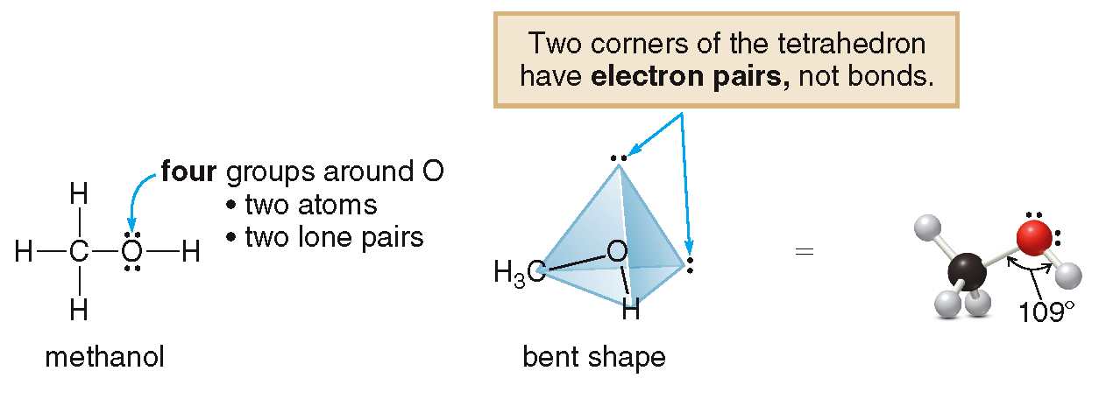
11.3 Shapes of Organic Molecules (5)
Oxygen is attached to 2 atoms and has 2 lone pairs, making its shape bent.

Slide 17
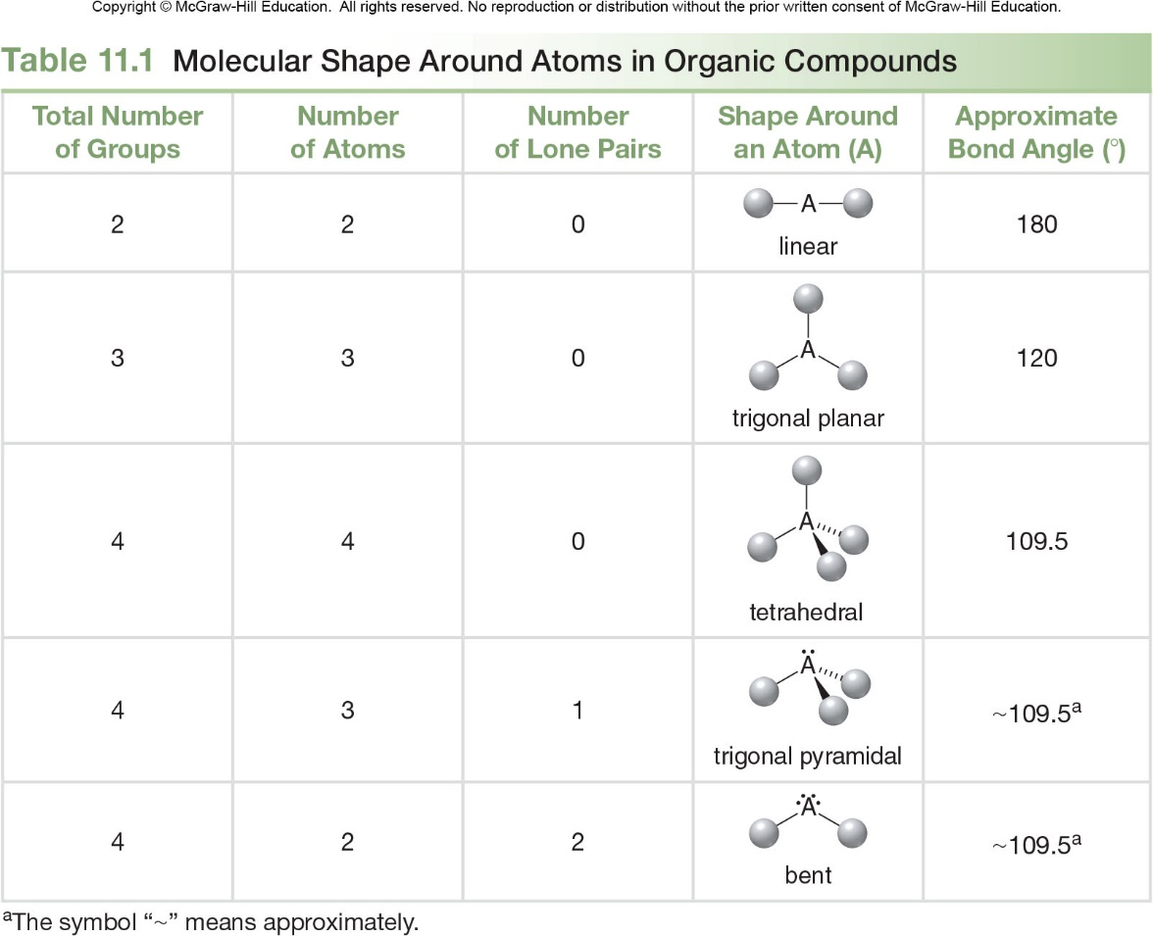
11.3 Shapes of Organic Molecules (6)
Table 11.1 Molecular Shape Around Atoms in Organic Compounds
Total Number of Groups
Number of Atoms
Number of Lone Pairs
Shape Around an Atom (A)
2
2
0
180
3
3
0
120
4
4
0
109.5
4
3
1
approximately
4
2
2
approximately
symbol “
” means approximately.

Slide 18
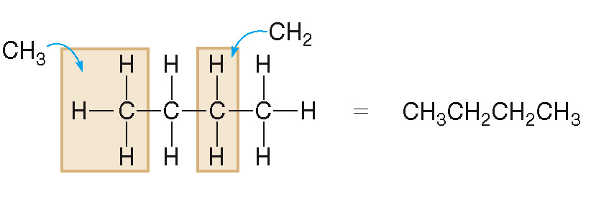
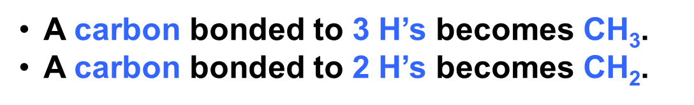
11.4 Drawing Organic Molecules (1)
Condensed Structures
In a condensed structure, all of the atoms are drawn in, but the two-electron bond lines and lone pairs on heteroatoms are generally omitted.
A carbon bonded to 3 H’s becomes CH₃$\text{.}$
A carbon bonded to 2 H’s becomes CH₂.

Slide 19
11.4 Drawing Organic Molecules (2)
Condensed Structures
Some bond lines can be drawn in for effect or to show specific bonding.
A carbon bonded to 1 H becomes CH.

Slide 20
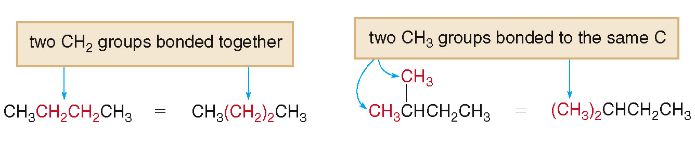
11.4 Drawing Organic Molecules (3)
Condensed Structures
Identical groups can be condensed further:

Slide 21
11.4 Drawing Organic Molecules (4)
Condensed Structures
Sample Problem 11.4
Convert each compound into a condensed structure:

Slide 22
11.4 Drawing Organic Molecules (5)
Condensed Structures
Sample Problem 11.4
Solution

Slide 23
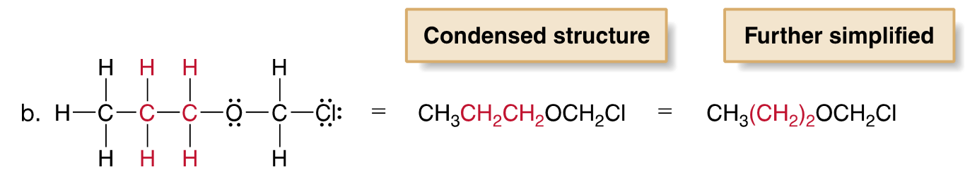
11.4 Drawing Organic Molecules (6)
Condensed Structures
Sample Problem 11.4
Solution

Slide 24
11.4 Drawing Organic Molecules (7)
Skeletal Structures
When drawing a skeletal structure:
Assume there is a carbon atom at the junction of any two lines or at the end of any line
Assume there are enough hydrogens around each carbon to give it four bonds
Draw in all heteroatoms and the hydrogens directly bonded to them

Slide 25
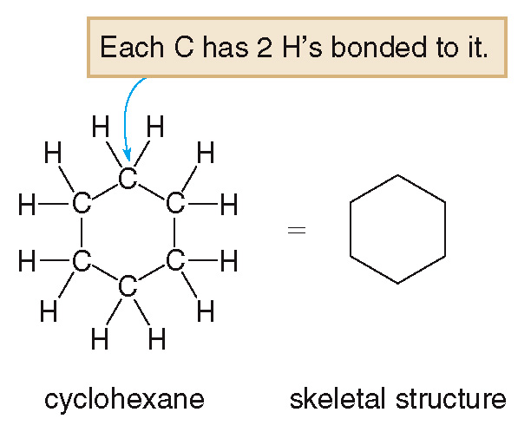
11.4 Drawing Organic Molecules (8)
Skeletal Structures

Slide 26
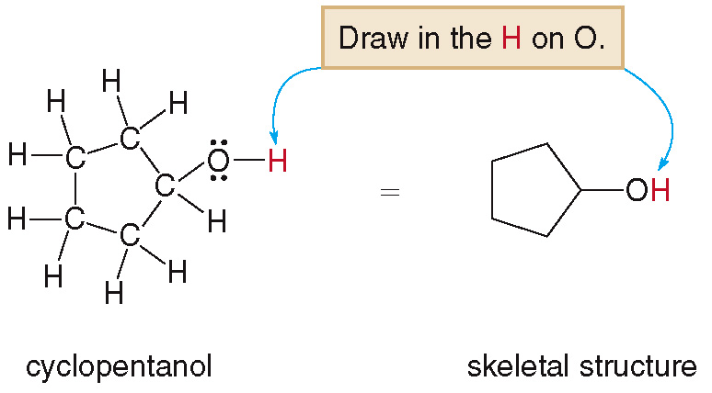
11.4 Drawing Organic Molecules (9)
Skeletal Structures

Slide 27
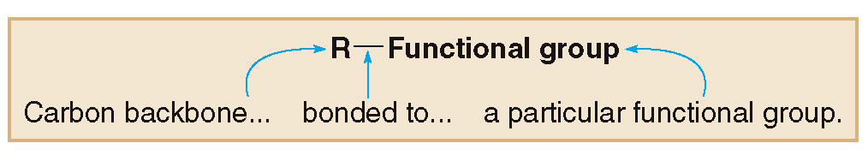
11.5 Functional Groups (1)
A functional group is an atom or group of atoms with characteristic chemical and physical properties.
A functional group contains a heteroatom, a multiple bond, or sometimes both.
The letter R is used to abbreviate the carbon and hydrogen portion of a molecule.

Slide 28
11.5 Functional Groups (2)
Hydrocarbons
Hydrocarbons are compounds that contain only
carbon and hydrogen.
Alkanes have only C–C single bonds and no functional group.
Alkenes have a C–C double bond as their functional group.
Alkynes have a C–C triple bond as their functional group.
Aromatic hydrocarbons contain a benzene ring, a six-membered ring with three double bonds.

Slide 29
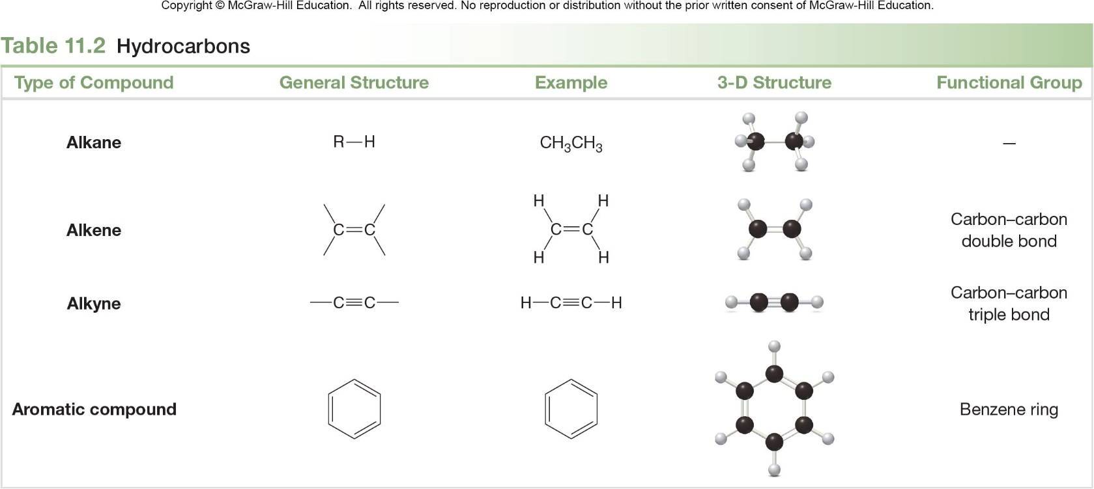
11.5 Functional Groups (3)
Hydrocarbons
Table 11.2 Hydrocarbons
Type of Compound
General Structure
Example
3-D Structure
Functional Group
Alkane
R–H
CH₃CH₃
_
Alkene
Carbon-carbon double bond
Alkyne
Carbon-carbon triple bond
Aromatic compound
Benzene ring

Slide 30
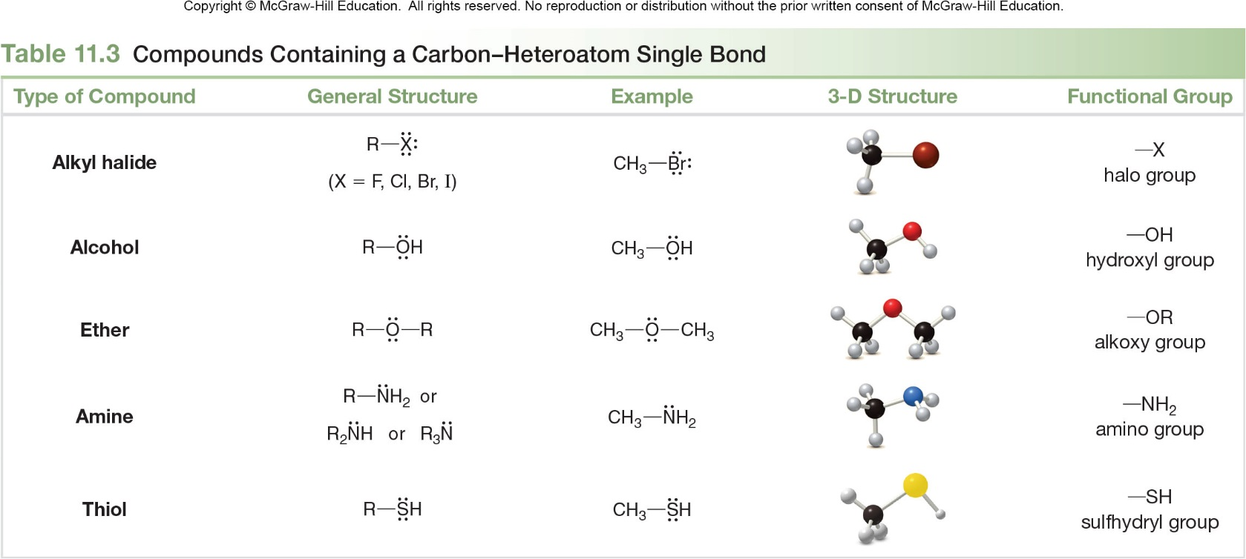
11.5 Functional Groups (4)
Compounds Containing a Single Bond to a Heteroatom
Table 11.3 Compounds Containing a Carbon-Heteroatom Single Bond
Type of Compound
General Structure
Example
3-D Structure
Functional Group
Alkyl halide
—X
halo group
Alcohol
—OH
hydroxyl group
Ether
—OR
alkoxy group
Amine
or
—NH₂
amino group
or
Thiol
—SH
sulfhydryl group

Slide 31
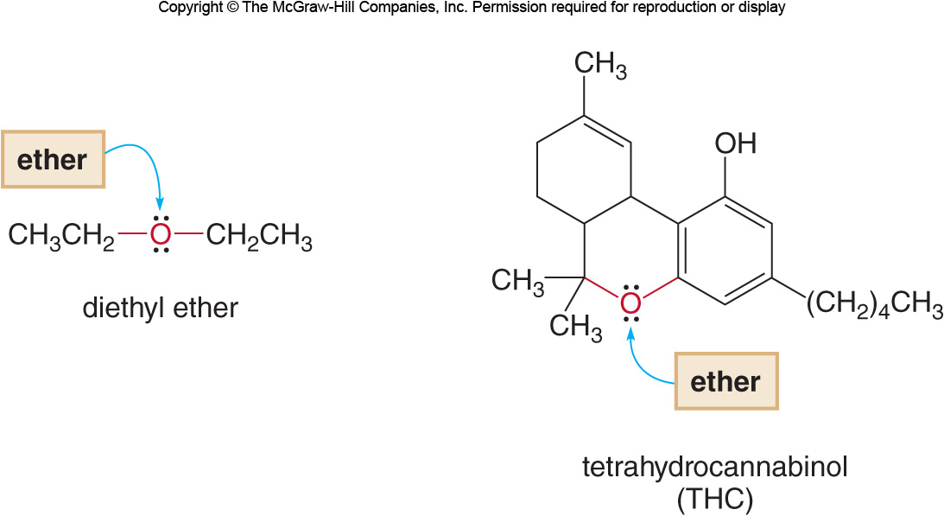
11.5 Functional Groups (5)
Compounds Containing a Single Bond to a Heteroatom
Some examples:

Slide 32
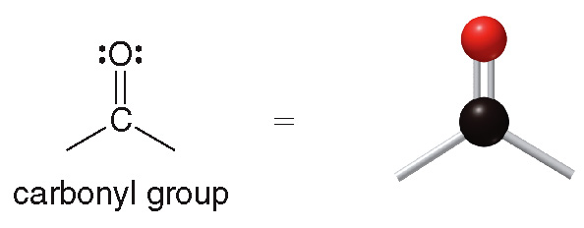
11.5 Functional Groups (6)
Compounds Containing a C=O Group
Carbonyl groups (carbon–oxygen double bonds) are present in several different compounds.

Slide 33
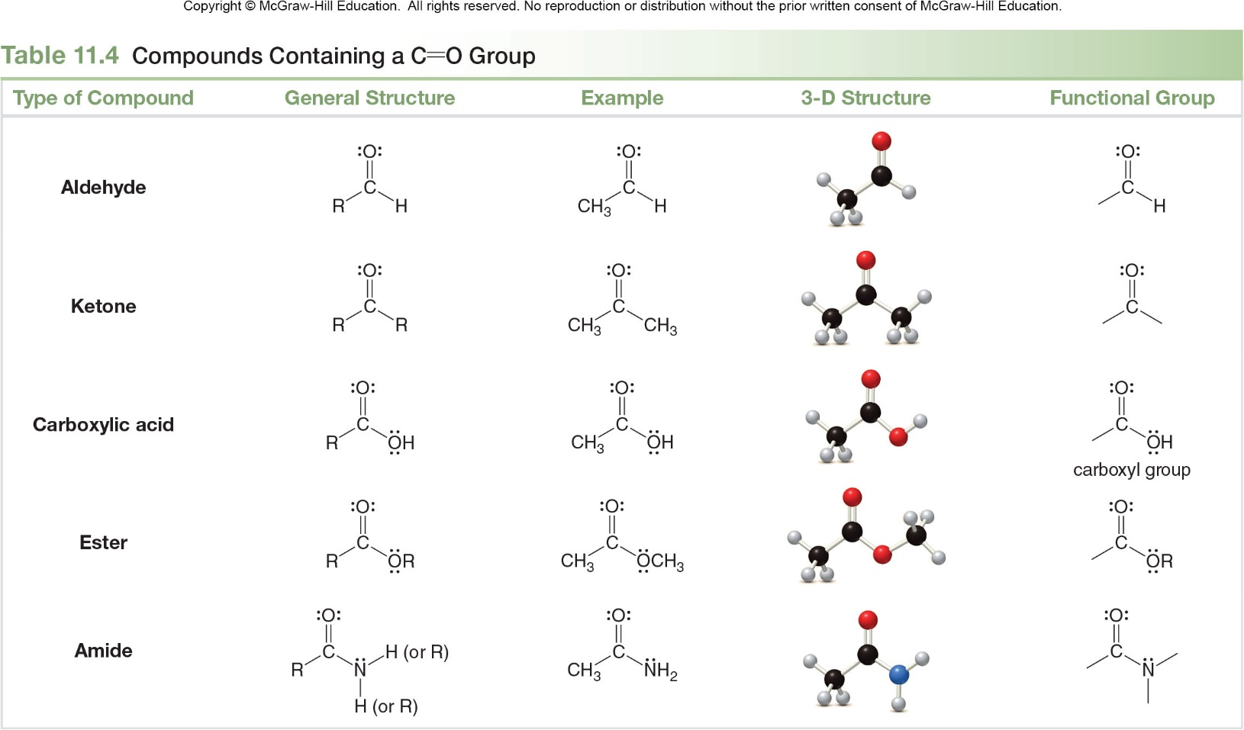
11.5 Functional Groups (7)
Compounds Containing a C=O Group

Slide 34
11.5 Functional Groups (8)
Compounds Containing a C=O Group
An aldehyde contains a hydrogen atom directly bonded to the carbonyl carbon.

Slide 35
11.5 Functional Groups (9)
Compounds Containing a C=O Group
A carboxylic acid contains an OH group directly bonded to the carbonyl carbon.

Slide 36
11.5 Functional Groups (10)
Compounds Containing a C=O Group
An ester contains an OR group directly bonded to the carbonyl carbon.

Slide 37
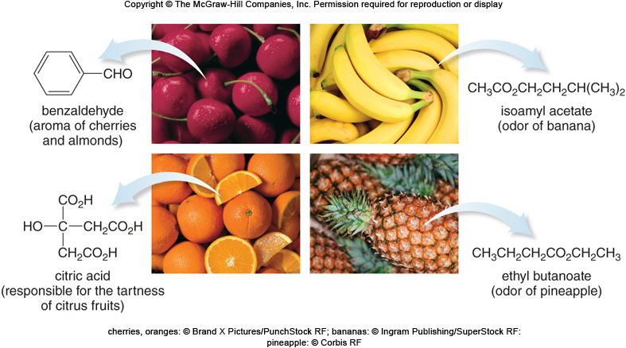
11.5 Functional Groups (11)
Compounds Containing a C=O Group
cherries, oranges: © Brand X Pictures/PunchStock RF; bananas: © Ingram Publishing/SuperStock RF: pineapple: © Corbis RF

Slide 38
11.6 Properties of Organic Compounds (1)
Organic compounds are composed of covalent bonds only.
Organic compounds exist as discrete molecules with much weaker intermolecular forces than those seen in ionic compounds.
As a result, organic compounds have lower boiling points and melting points than ionic compounds.
Organic compounds tend to be liquids or gases at room temperature, while ionic compounds are solids.

Slide 39
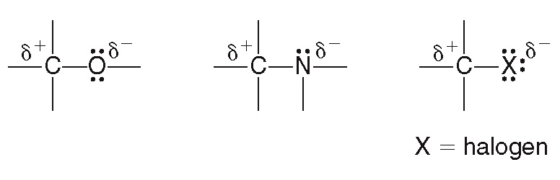
11.6 Properties of Organic Compounds (2)
Polarity
A covalent bond is nonpolar when two atoms of identical or similar electronegativity are bonded.
Thus, C–C and C–H bonds are nonpolar bonds.
A covalent bond is polar when atoms of different electronegativity are bonded.
Thus, bonds between C and N, O, and the halogens are polar bonds.

Slide 40
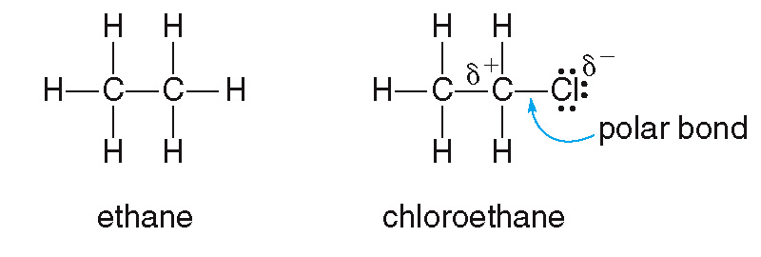
11.6 Properties of Organic Compounds (3)
Polarity
Hydrocarbons contain only nonpolar C–C and C–H bonds, so they are nonpolar molecules.
If a single bond is polar, the molecule is polar because it contains a net dipole.
no polar bonds nonpolar molecule
one polar bonds polar molecule

Slide 41
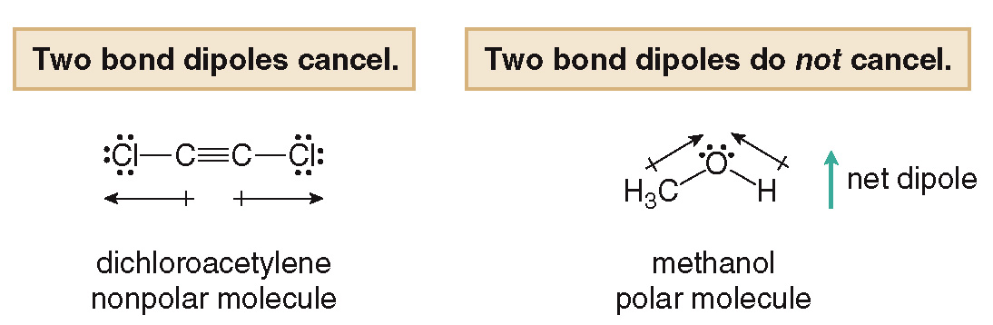
11.6 Properties of Organic Compounds (4)
Polarity
If the individual polar bonds (dipoles) cancel in a molecule, the molecule is nonpolar.
If the individual bond dipoles do not cancel, the molecule is polar.

Slide 42
11.6 Properties of Organic Compounds (5)
Polarity
Sample Problem 11.10
Explain why CH₂Cl₂ is a polar molecule.
Solution

Slide 43
11.6 Properties of Organic Compounds (6)
Solubility
The rule of solubility is “like dissolves like.”
Most organic compounds are soluble in organic solvents.
Hydrocarbons and other nonpolar organic compounds are insoluble in water.
Polar organic compounds are water soluble only if they are small and contain a N or O atom that can hydrogen bond with water.

Slide 44
11.6 Properties of Organic Compounds (7)
Solubility
CH₃CH₂CH₂CH₂CH₂CH₃
CH₃CH₂−OH
hexane
ethanol
Small nonpolar molecule No O or N present
H₂O insoluble
Small polar molecule O atom present
H₂O soluble

Slide 45
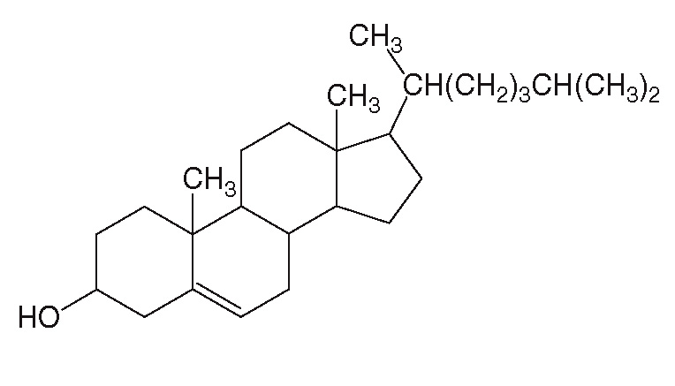
11.6 Properties of Organic Compounds (8)
Solubility
cholesterol
Very large molecule
O atom present
Too many nonpolar C—C and C—H bonds H₂O insoluble

Slide 46
11.7 Focus on Health and Medicine (1)
Vitamins are organic compounds needed in small
amounts for normal cell function.
The body cannot synthesize these compounds; they must be obtained in the diet.
A fat-soluble vitamin dissolves in an organic solvent but is insoluble in water.
Fat-soluble vitamins have many nonpolar C–C and C–H bonds and few polar functional groups.
A water-soluble vitamin dissolves in water.
Water-soluble vitamins have many polar bonds.

Slide 47
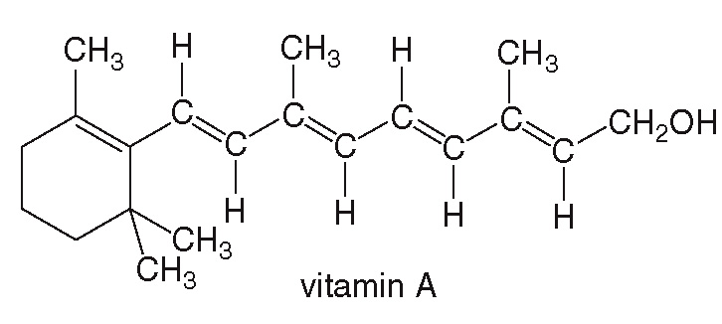
11.7 Focus on Health and Medicine (2)
Vitamin A
Vitamin A—retinol—is an essential component of the vision receptors in the eyes.
It also helps to maintain the health of the mucous membranes and the skin.
Vitamin A is a very large, mostly nonpolar molecule with only one OH group, making it a fat-soluble vitamin.

Slide 48
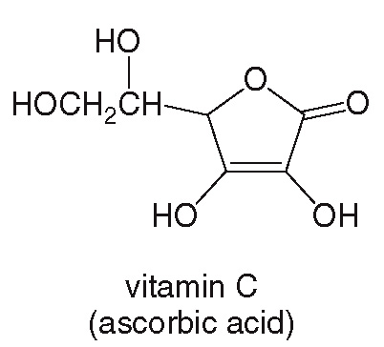
11.7 Focus on Health and Medicine (3)
Vitamin C
Vitamin C—ascorbic acid—is important in the formation of collagen, the connective tissue of the skin.
A deficiency in vitamin C causes scurvy, a condition of sailors in the 1600s who had no access to fresh fruit while at sea.
It has many polar bonds and many O atoms, making it a water-soluble vitamin.

Slide 49
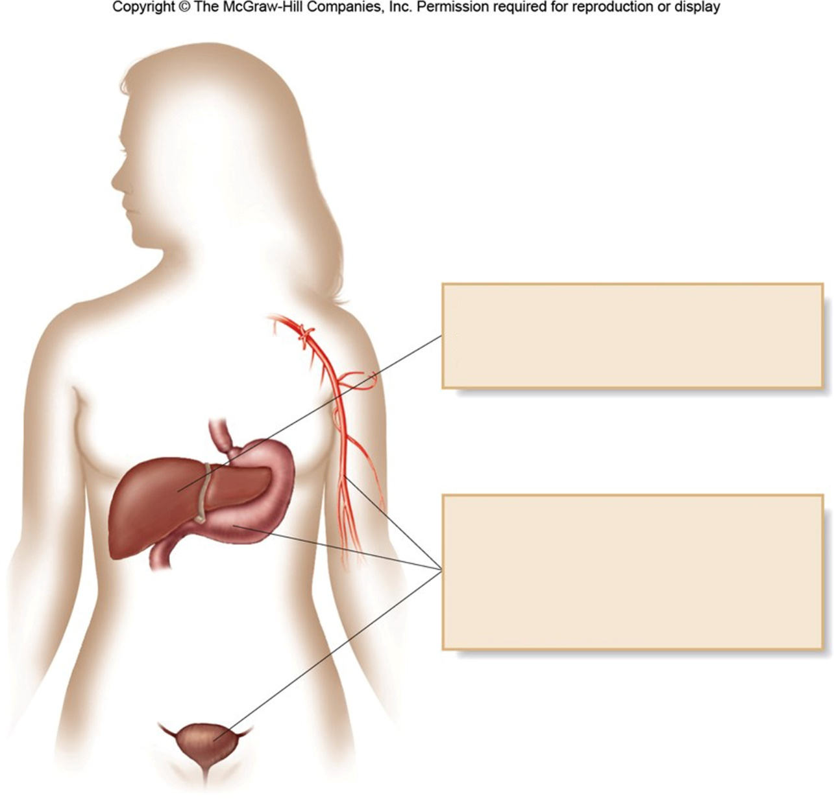
11.7 Focus on Health and Medicine (4)
Vitamin A and other fat-soluble vitamins are readily stored in the liver and fatty tissue.
Vitamin C and other water-soluble vitamins are soluble in the gastric juices of the stomach and the blood. These vitamins are readily excreted in urine.

