Slide 1

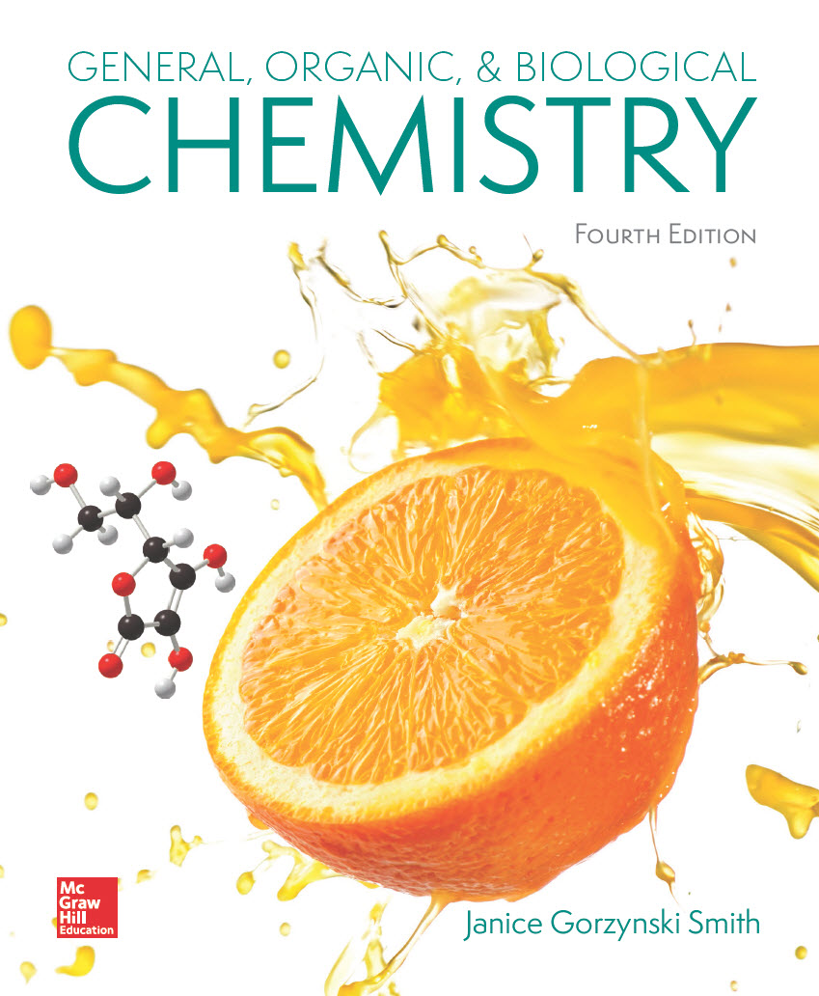
Chapter 12
Lecture Outline
Prepared by
Harpreet Malhotra
Florida State College at Jacksonville

Slide 2
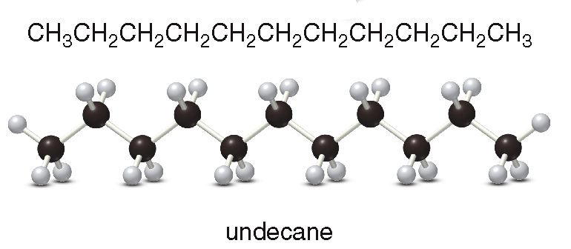
12.1 Introduction (1)
Alkanes are hydrocarbons having only C–C and
C–H single bonds.
Alkanes that contain chains of C atoms but no rings are acyclic alkanes and have the general formula C_{n}H_{2n+2}.
Acyclic alkanes are called saturated alkanes because they have the maximum number of H atoms per C atom.

Slide 3
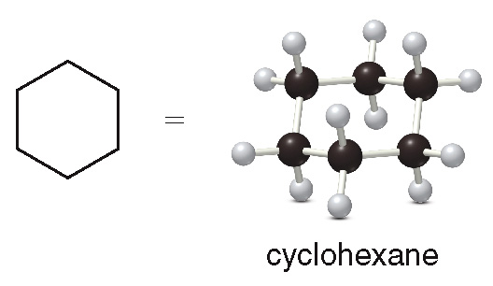
12.1 Introduction (2)
Cycloalkanes contain C atoms joined in one or more rings.
They have the general formula C_{n}H_{2n}.
All alkane molecules have names that end in the suffix “-ane.”

Slide 4
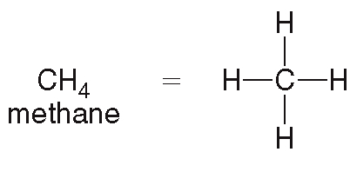
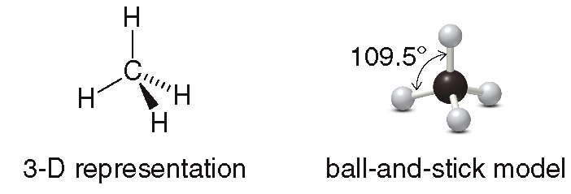
12.2 Simple Alkanes (1)
Acyclic Alkanes Having Fewer than Five Carbons
Methane is a one-carbon alkane.

Slide 5
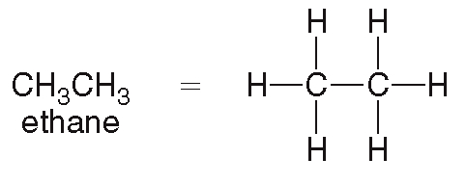
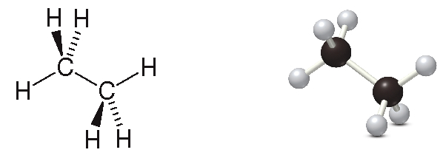
12.2 Simple Alkanes (2)
Acyclic Alkanes Having Fewer than Five Carbons
Ethane is a two-carbon alkane.

Slide 6
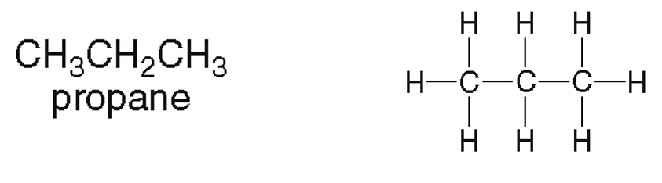
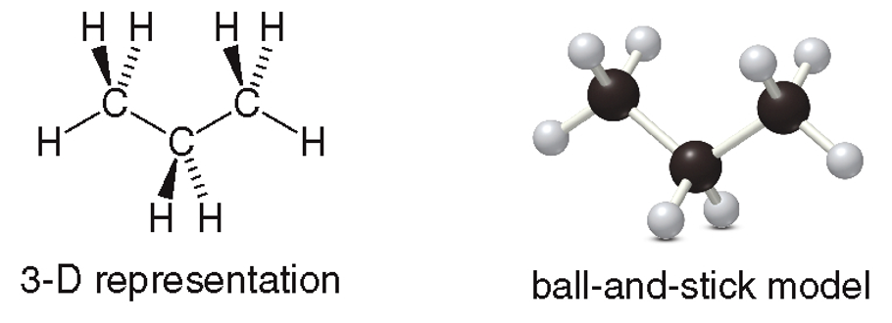
12.2 Simple Alkanes (3)
Acyclic Alkanes Having Fewer than Five Carbons
Propane is a three-carbon alkane.

Slide 7
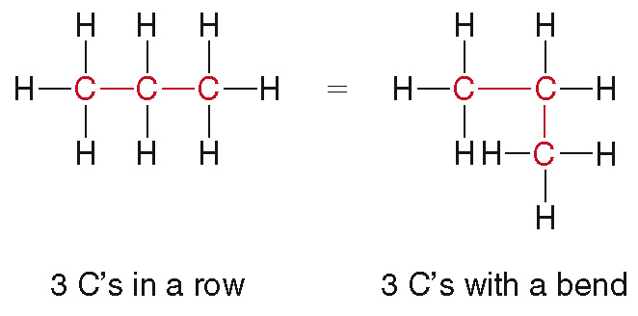
12.2 Simple Alkanes (4)
Acyclic Alkanes Having Fewer than Five Carbons
The following two representations of propane are equivalent:
The bends in a carbon chain don’t matter when it comes to identifying different compounds.

Slide 8
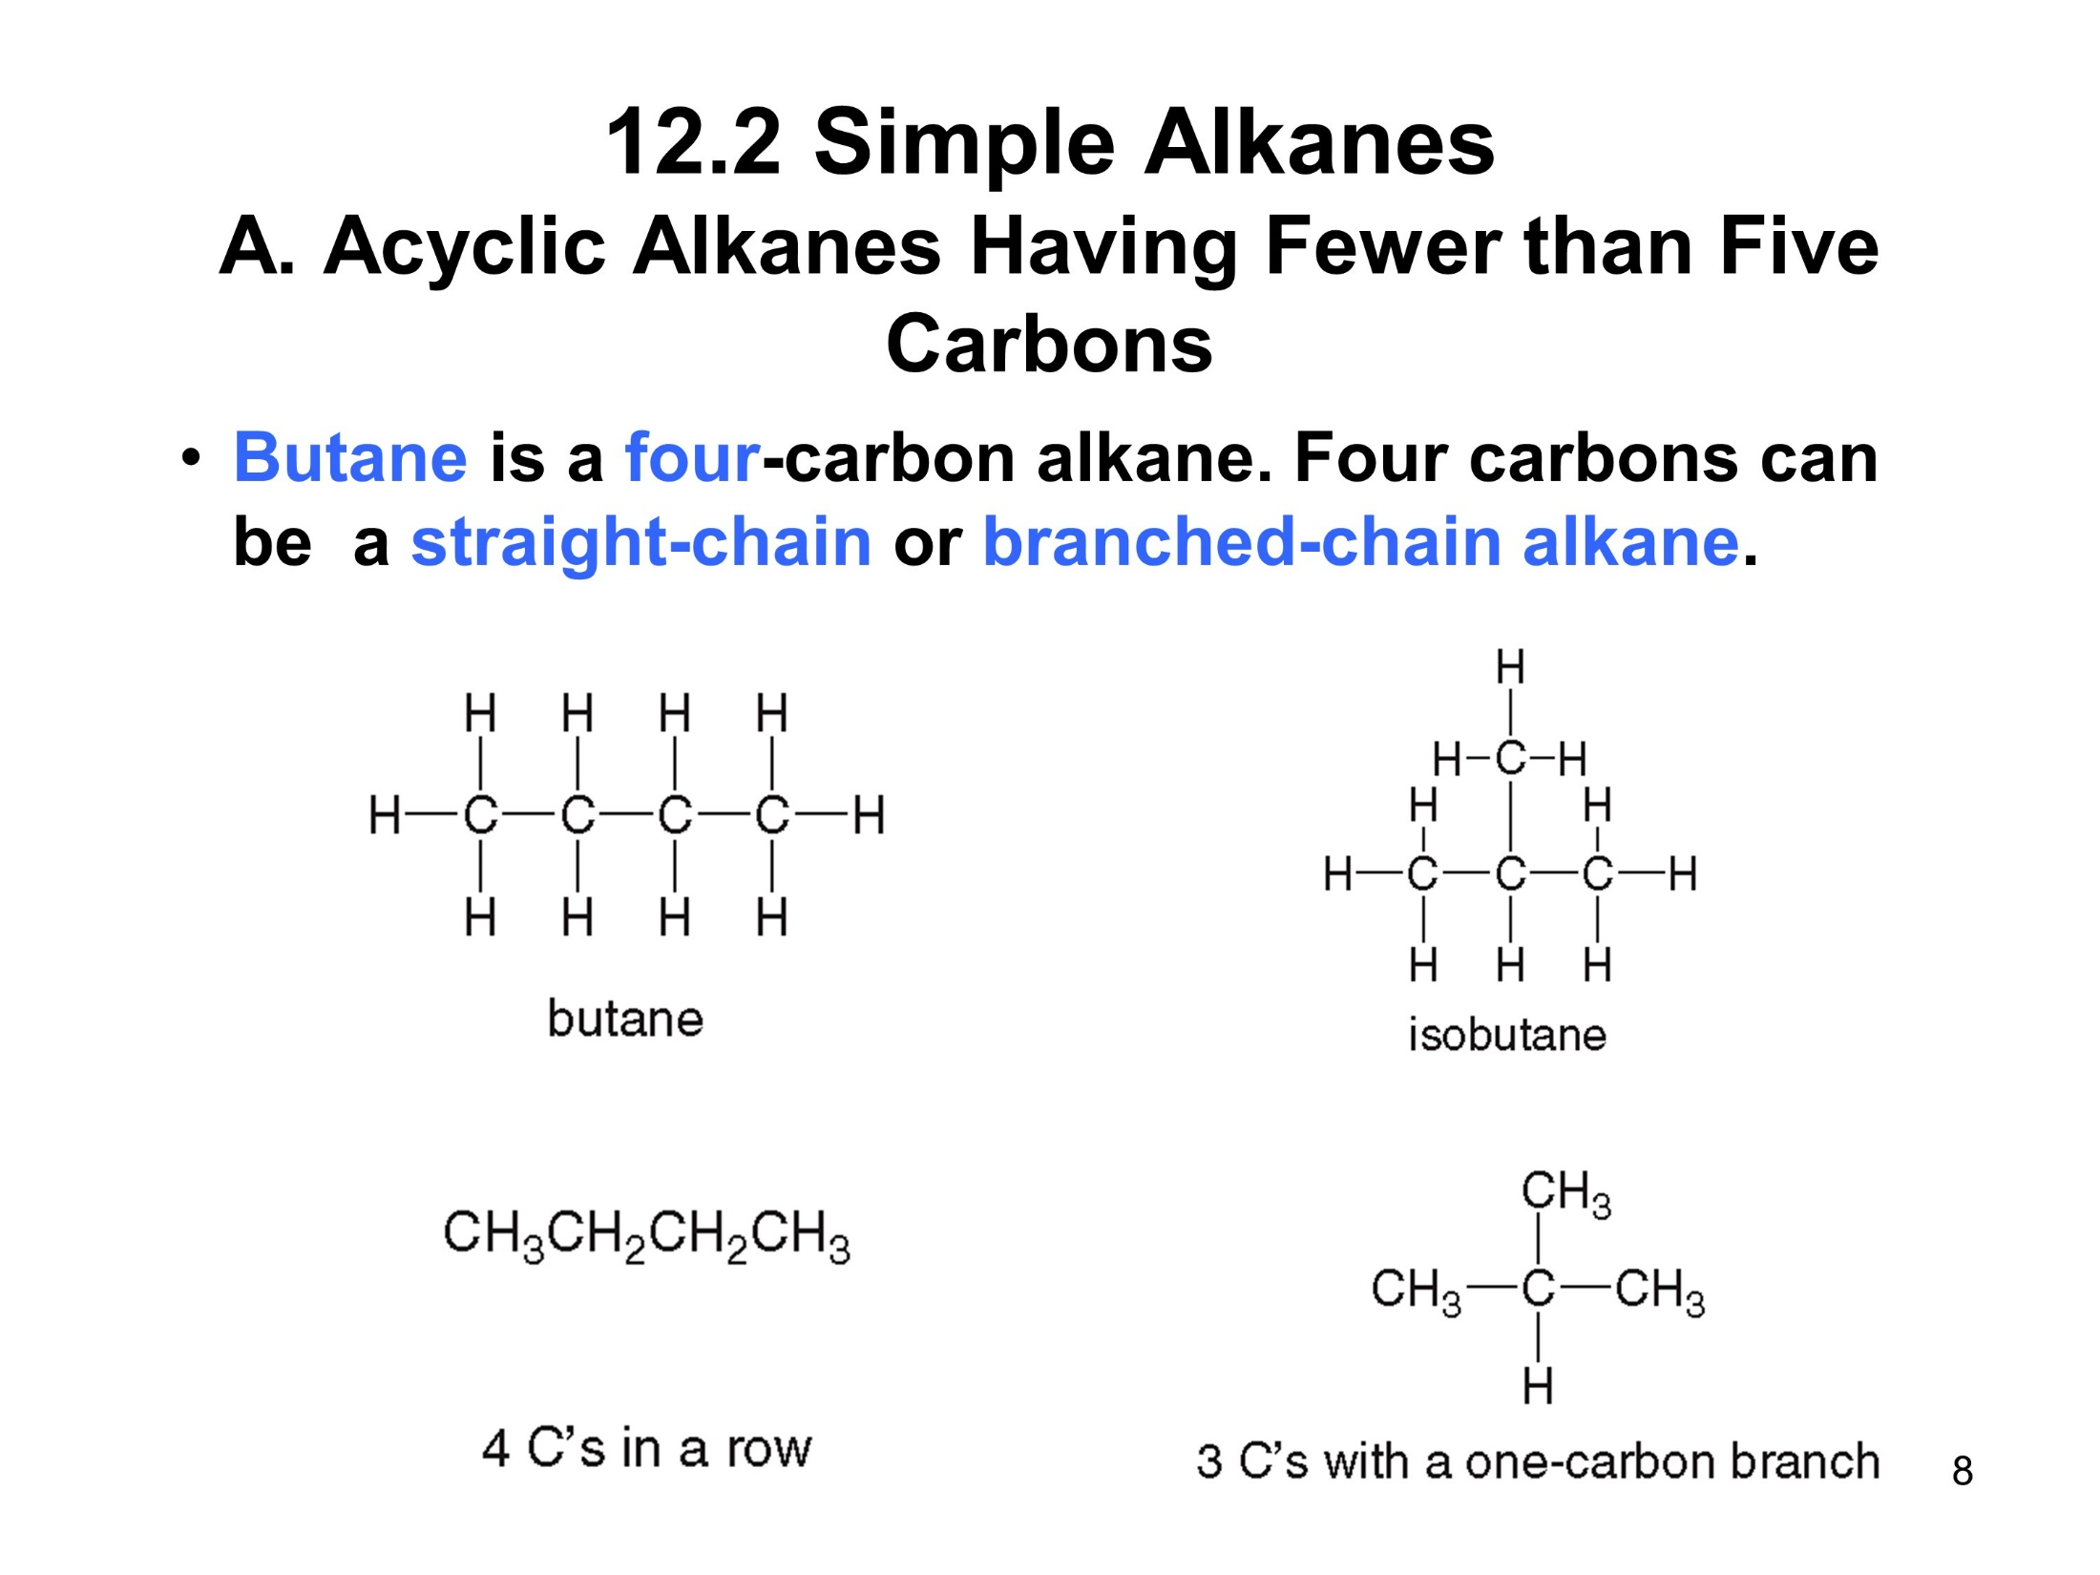
12.2 Simple Alkanes (5)
Acyclic Alkanes Having Fewer than Five Carbons
Butane is a four-carbon alkane. Four carbons can be a straight-chain or branched-chain alkane.

Slide 9
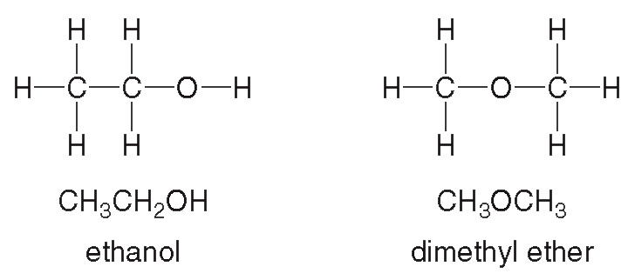
12.2 Simple Alkanes (6)
Acyclic Alkanes Having Fewer than Five Carbons
Butane and isobutane are isomers of each other.
Isomers are two different compounds with the same molecular formula.
Constitutional isomers differ in the way the atoms are connected to each other.
Another example of constitutional isomers:

Slide 10
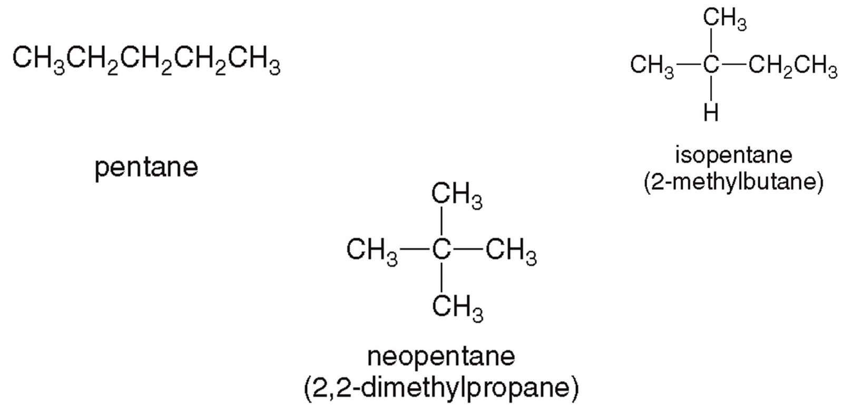
12.2 Simple Alkanes (7)
Acyclic Alkanes Having Five or More Carbons
As the number of C atoms increases, the number of possible isomers increases.
Pentane is a five-carbon alkane with three isomers:

Slide 11
12.2 Simple Alkanes (8)
Acyclic Alkanes Having Five or More Carbons
After pentane, the following names apply:
# of C’s | Name | Structure
6 | hexane | CH₃CH₂CH₂CH₂CH₂CH₃
7 | heptane | CH₃CH₂CH₂CH₂CH₂CH₂CH₃
8 | octane | CH₃CH₂CH₂CH₂CH₂CH₂CH₂CH₃
9 | nonane | CH₃CH₂CH₂CH₂CH₂CH₂CH₂CH₂CH₃
10 | decane | CH₃CH₂CH₂CH₂CH₂CH₂CH₂CH₂CH₂CH₃

Slide 12
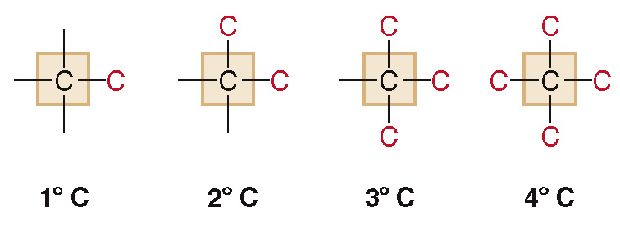
12.2 Simple Alkanes (9)
Classifying Carbon Atoms
A primary carbon
is bonded to one other C.
A secondary carbon
is bonded to two other C
A tertiary carbon
is bonded to three other C.
A quarternary carbon
is bonded to four other C.

Slide 13
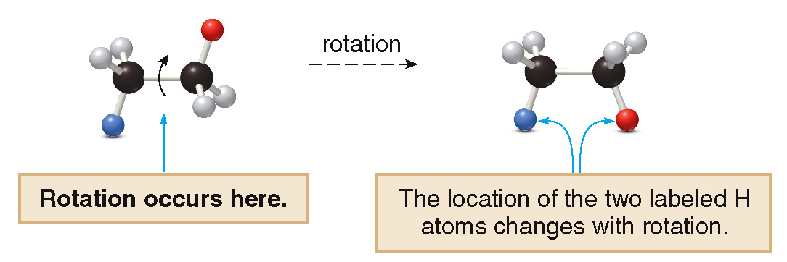
12.2 Simple Alkanes (10)
Bond Rotation and Skeletal Structures for
Acyclic Alkanes
Rotation can occur around carbon–carbon single bonds.

Slide 14
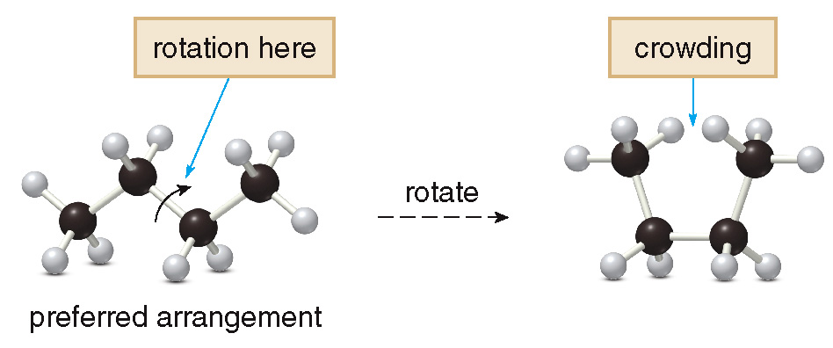
12.2 Simple Alkanes (11)
Bond Rotation and Skeletal Structures for
Acyclic Alkanes
The zigzag arrangement of atoms is the most stable, because it avoids crowding.

Slide 15
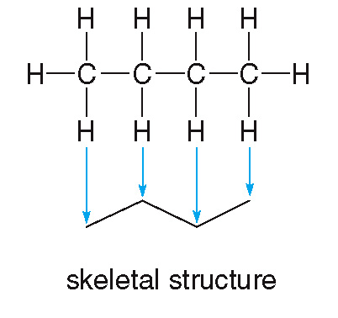
12.2 Simple Alkanes (12)
Bond Rotation and Skeletal Structures for
Acyclic Alkanes
The skeletal structures of alkanes follow the same zigzag pattern.

Slide 16
12.3 An Introduction to Nomenclature (1)
The IUPAC System of Nomenclature
IUPAC stands for International Union of Pure and Applied Chemistry.
The IUPAC system of nomenclature provides a system of naming organic compounds.
Using the IUPAC system, each organic compound gets a unique and unambiguous name.

Slide 17
12.3 An Introduction to Nomenclature (2)
Naming New Drugs
Most drugs have three names:
Systematic: The IUPAC name—for example, 2-[4-(2-methylpropyl)phenyl]propanoic acid
Generic: The official, internationally approved name of the drug—for example, ibuprofen
Trade: The name assigned by the company that manufactures the drug—for example, Motrin or Advil

Slide 18
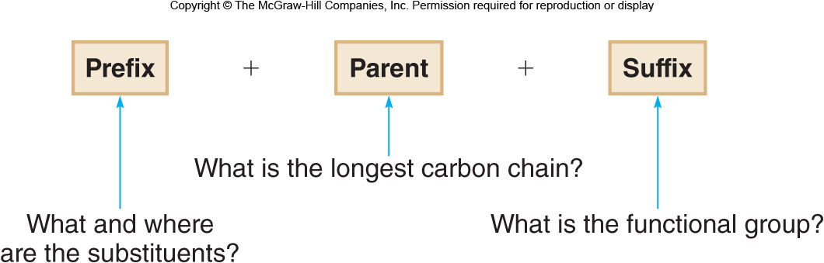
12.4 Alkane Nomenclature (1)
The names of alkanes with substituents have three parts:
The parent name indicates the number of C’s in the longest continuous carbon chain in the molecule.
The suffix indicates what functional group is present.
The prefix tells the identity, location, and number of substituents attached to the carbon chain.

Slide 19
12.4 Alkane Nomenclature (2)
Naming Substituents
Carbon substituents are called alkyl groups.
An alkyl group is formed by removing 1 H from an alkane.
To name an alkyl group, change the “-ane” ending of the parent alkane to “-yl.”
Each alkyl group has a bond that can then be attached to something else.

Slide 20
12.4 Alkane Nomenclature (3)
Naming Substituents

Slide 21
12.4 Alkane Nomenclature (4)
Naming Substituents
Table 12.2 Some Common Alkyl Groups
Number of C’s | Structure | Name
1 | CH₃− | methyl
2 | CH₃CH₂− | ethyl
3 | CH₃CH₂CH₂− | propyl
4 | CH₃CH₂CH₂CH₂− | butyl
5 | CH₃CH₂CH₂CH₂CH₂− | pentyl
6 | CH₃CH₂CH₂CH₂CH₂CH₂− | hexyl

Slide 22
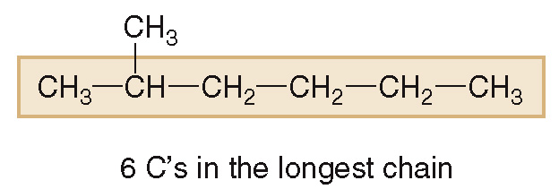
12.4 Alkane Nomenclature (5)
Naming an Acyclic Alkane
HOW TO Name an Alkane Using the IUPAC System
Step [1]
Find the parent carbon chain and add the suffix.
Find the longest continuous carbon chain, and name it with an “-ane” ending.
6 C’s ---→ hexane

Slide 23
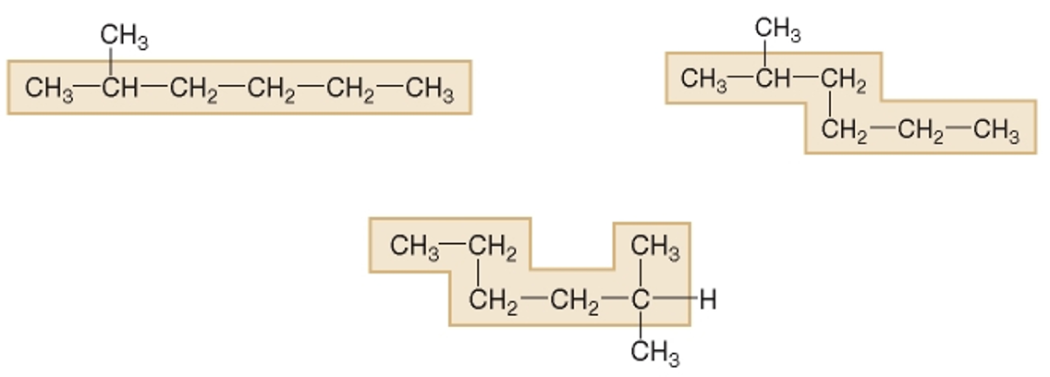
12.4 Alkane Nomenclature (6)
Naming an Acyclic Alkane
HOW TO Name an Alkane Using the IUPAC System
The longest chain may not be written horizontally
It does not matter if the chain is straight or has bends.
All three examples below have 6 C’s in their longest chain:

Slide 24
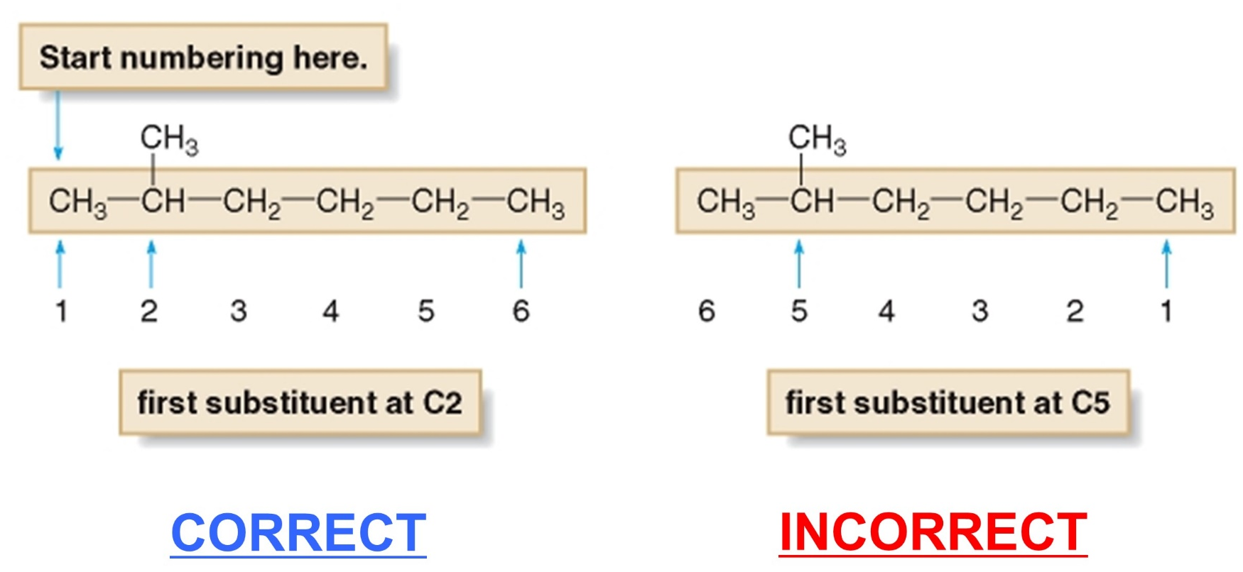
12.4 Alkane Nomenclature (7)
Naming an Acyclic Alkane
HOW TO Name an Alkane Using the IUPAC System
Step [2]
Number the atoms in the carbon chain to give the first substituent the lower number.

Slide 25
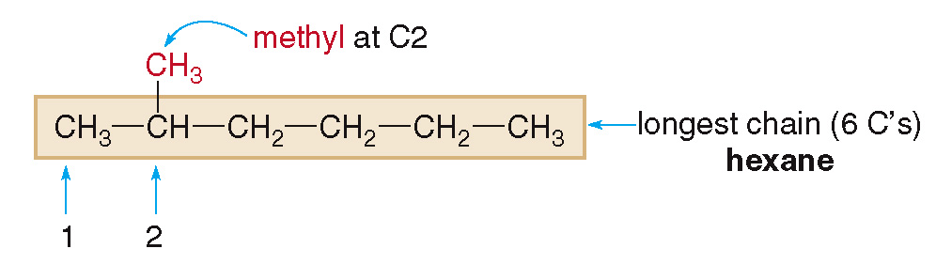
12.4 Alkane Nomenclature (8)
Naming an Acyclic Alkane
HOW TO Name an Alkane Using the IUPAC System
Step [3]
Name and number the substituents.
Name the substituents as alkyl groups.
Use the numbers from step [2] to designate their location.

Slide 26
12.4 Alkane Nomenclature (9)
Naming an Acyclic Alkane
HOW TO Name an Alkane Using the IUPAC System
Every carbon belongs to either the longest chain or a substituent, but not both.
Each substituent needs its own number.
If two or more substituents are identical, use prefixes to indicate how many.
# of Substituents | Prefix
2 | di-
3 | tri-
4 | tetra-

Slide 27
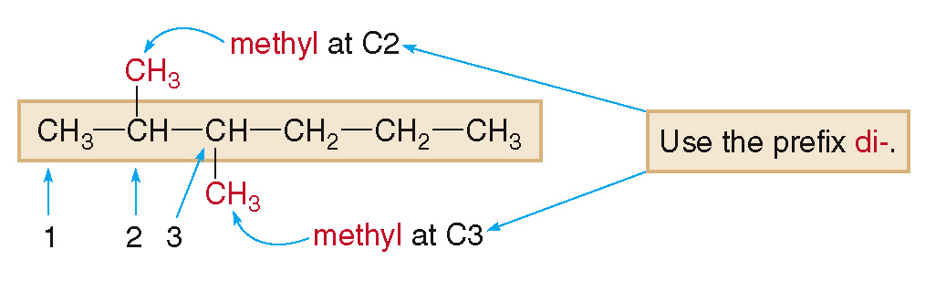
12.4 Alkane Nomenclature (10)
Naming an Acyclic Alkane
HOW TO Name an Alkane Using the IUPAC System
The following compound contains two methyl groups, so we use the name dimethyl for them.

Slide 28
12.4 Alkane Nomenclature (11)
Naming an Acyclic Alkane
HOW TO Name an Alkane Using the IUPAC System
Step [4]
Combine substituent names and numbers + parent + suffix.
Alphabetize the substituents, ignoring prefixes.
Precede the name of each substituent by the number that indicates its location.
There must be one number for each substituent.
Separate numbers by commas and separate numbers from letters by dashes.

Slide 29
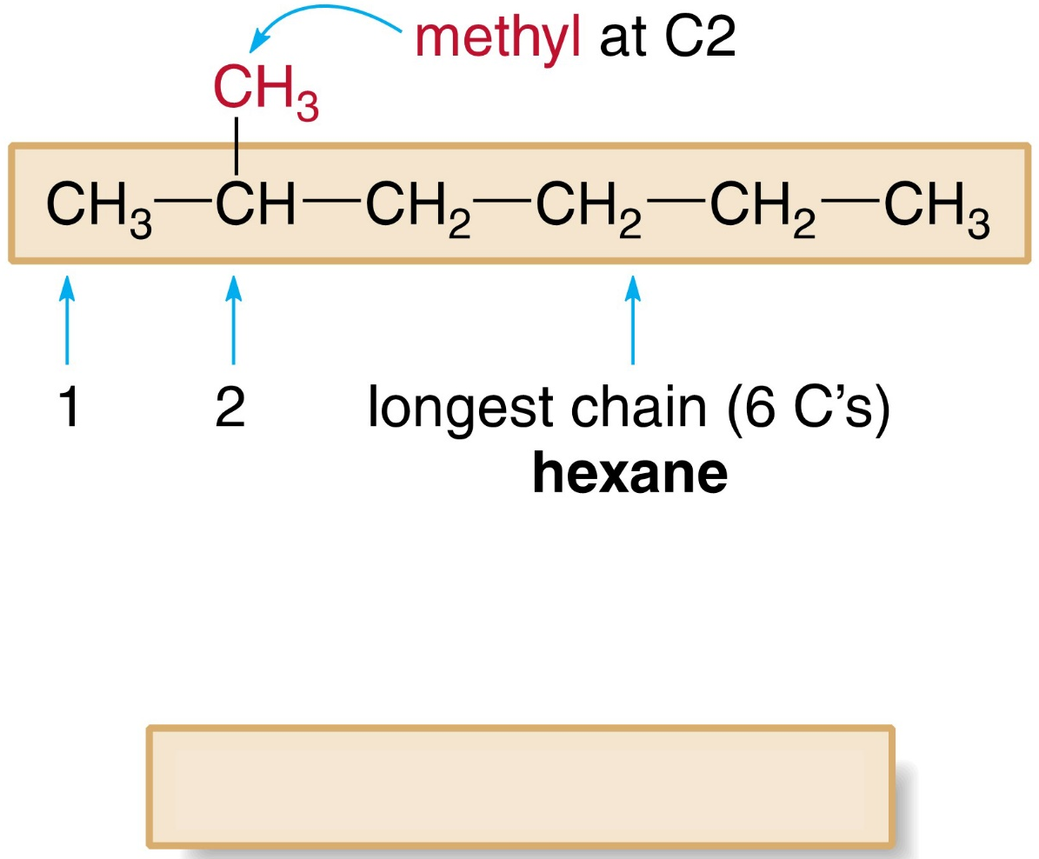
12.4 Alkane Nomenclature (12)
Naming an Acyclic Alkane
HOW TO Name an Alkane Using the IUPAC System
Answer: 2-methylhexane

Slide 30
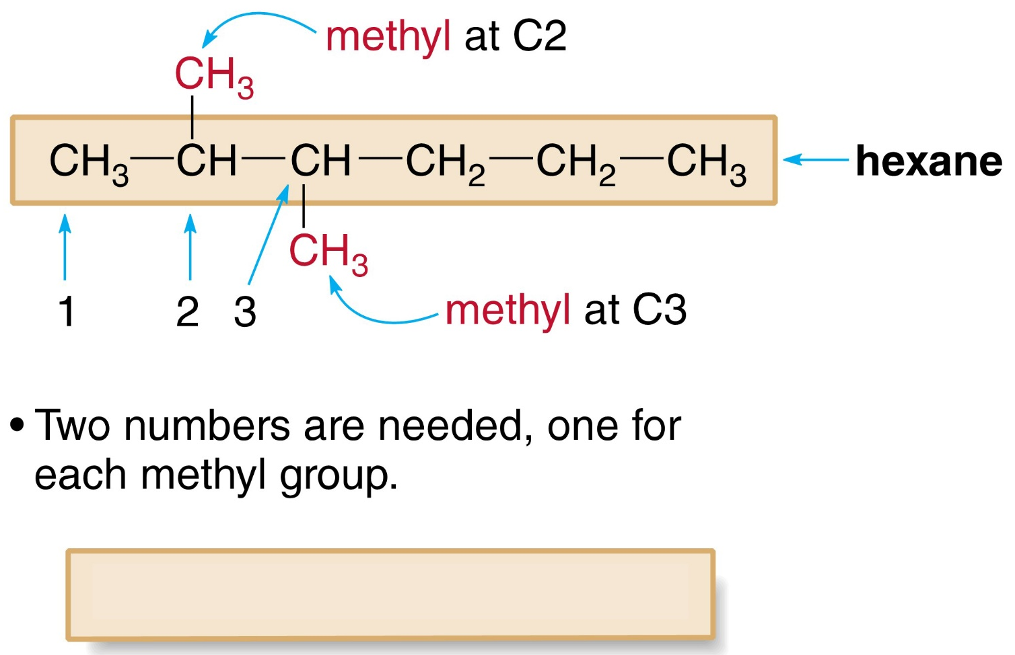
12.4 Alkane Nomenclature (13)
Naming an Acyclic Alkane
HOW TO Name an Alkane Using the IUPAC System
Answer: 2,3-dimethylhexane

Slide 31
12.4 Alkane Nomenclature (14)
Naming an Acyclic Alkane
Sample Problem 12.4
Give the IUPAC name for the following compound.

Slide 32
12.4 Alkane Nomenclature (15)
Naming an Acyclic Alkane
Sample Problem 12.4
Name the parent chain and use the suffix “-ane” since this molecule is an alkane
8 C’s in the longest chain $−−−→$ octane

Slide 33
12.4 Alkane Nomenclature (16)
Naming an Acyclic Alkane
Sample Problem 12.4
Number the chain to give the first substituent the lower number.

Slide 34
12.4 Alkane Nomenclature (17)
Naming an Acyclic Alkane
Sample Problem 12.4
Name and number the substituents.
Answer: 5-ethyl-2,6-dimethyloctane

Slide 35
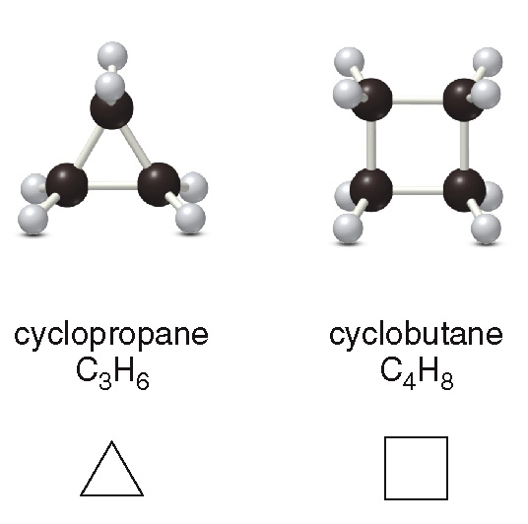
12.5 Cycloalkanes (1)
Simple Cycloalkanes
Cycloalkanes contain carbon atoms arranged in a ring.

Slide 36
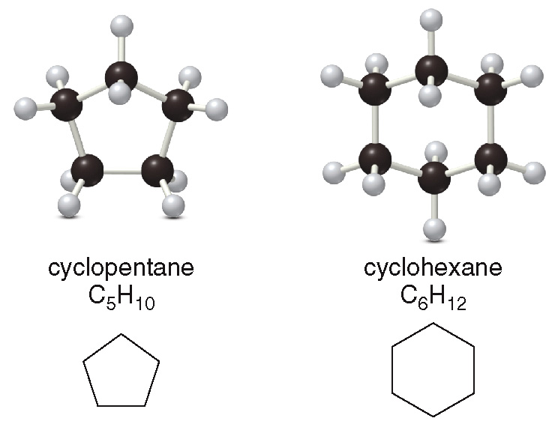
12.5 Cycloalkanes (2)
Simple Cycloalkanes

Slide 37
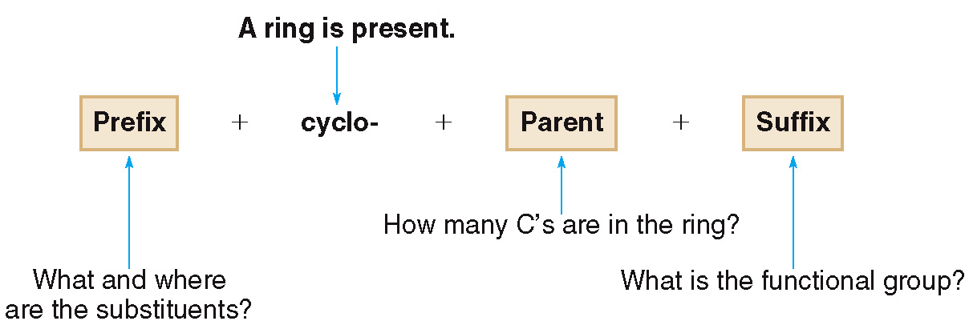
12.5 Cycloalkanes (3)
Naming Cycloalkanes

Slide 38
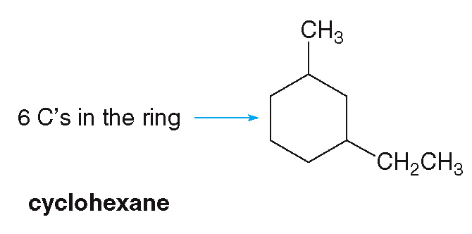
12.5 Cycloalkanes (4)
Naming Cycloalkanes
HOW TO Name a Cycloalkane Using the IUPAC System
Step [1]
Find the parent cycloalkane.

Slide 39
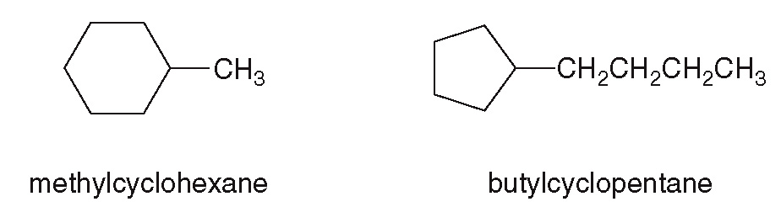
12.5 Cycloalkanes (5)
Naming Cycloalkanes
HOW TO Name a Cycloalkane Using the IUPAC System
Step [2]
Name and number the substituents.
No number is needed for a cycloalkane with a single substituent.

Slide 40
12.5 Cycloalkanes (6)
Naming Cycloalkanes
HOW TO Name a Cycloalkane Using the IUPAC System
For rings with two or more substituents:
Begin numbering at one substituent
Then, proceed around the ring to give the second substituent the lower number
For two different substituents, number the ring to assign the lower number to the substituents alphabetically.

Slide 41
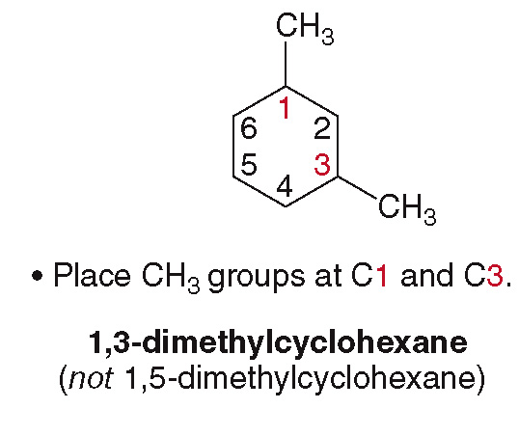
12.5 Cycloalkanes (7)
Naming Cycloalkanes
HOW TO Name a Cycloalkane Using the IUPAC System

Slide 42
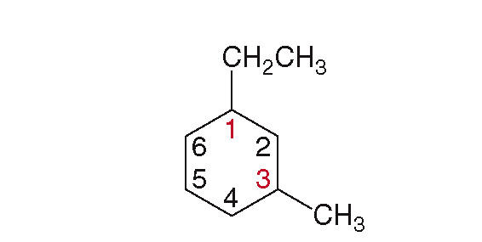

12.5 Cycloalkanes (8)
Naming Cycloalkanes
HOW TO Name a Cycloalkane Using the IUPAC System
Earlier letter $−−−→$ lower number
ethyl group at C1
methyl group at C3
1-ethyl-3-methylcyclohexane (not 3-ethyl-1-methylcyclohexane)

Slide 43
12.6 Focus on the Environment Fossil Fuels (1)
Natural gas is composed mostly of methane, which burns in the presence of oxygen, releasing energy for cooking and heating.
Petroleum is a complex mixture of compounds that must be refined to separate it into usable fractions.
Gasoline (C₅H₁₂ − C₁₂H₂₆), kerosene (C₁₂H₂₆ − C₁₆H₃₄), and diesel fuel (C₁₅H₃₂ − C₁₈H₃₈) are some of the products of petroleum refinement.
Other portions are used to make plastics, drugs, fabrics, dyes, and pesticides.

Slide 44
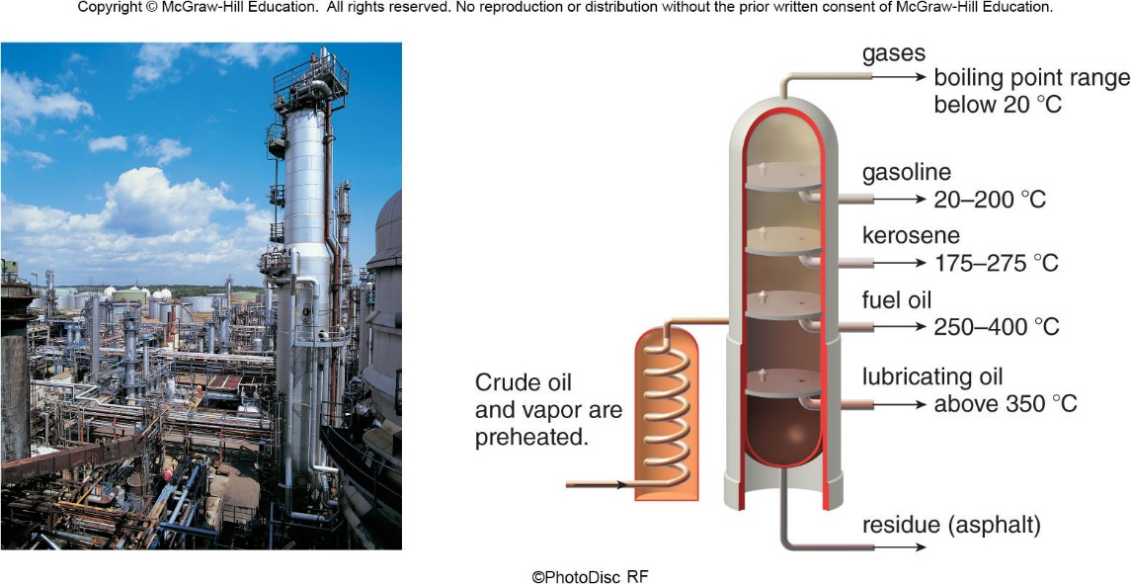
12.6 Focus on the Environment Fossil Fuels (2)
©PhotoDisc RF

Slide 45
12.7 Physical Properties (1)
Alkanes contain only nonpolar C–C and C–H bonds.
Alkanes exhibit only weak intermolecular forces, so they have low melting points and boiling points.
Smaller alkanes are gases at room temperature, whereas larger alkanes are liquids.
Alkanes are insoluble in water.
Alkanes are less dense than water, meaning that they will float on the surface of water.

Slide 46
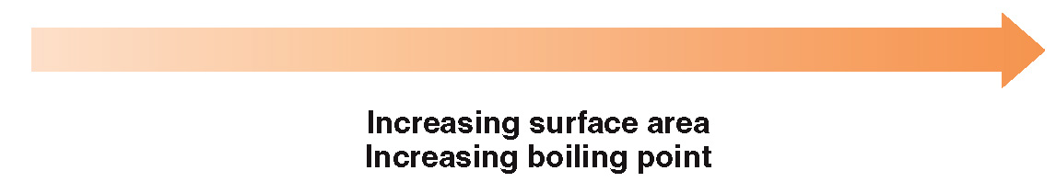
12.7 Physical Properties (2)
As the number of carbons in an alkane increases, the boiling point increases:
CH₃CH₂CH₂CH₃ butane
CH₃CH₂CH₂CH₂CH₃ pentane
CH₃CH₂CH₂CH₂CH₂CH₃ hexane

Slide 47
12.8 Focus on the Environment Combustion (1)
Alkanes have no functional group, so they undergo few reactions.
Combustion is an oxidation–reduction reaction (Section 5.4).
In the combustion reaction, alkanes burn in the presence of O₂ gas to form CO₂ and H₂O.
The products, CO₂ + H₂O, are the same, regardless of the identity of the alkane that undergoes combustion.

Slide 48
12.8 Focus on the Environment Combustion (2)

Slide 49
12.8 Focus on the Environment Combustion (3)
If there is not enough O₂ to react, incomplete combustion may occur, and carbon monoxide (CO) is formed instead of carbon dioxide (CO₂).
Carbon monoxide is a poisonous gas that binds to hemoglobin in blood, thereby reducing the amount of O₂ that can be transported to cells.

Slide 50
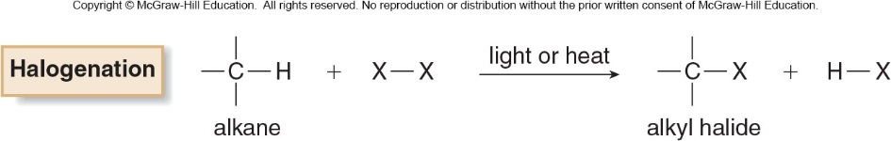
12.9 Halogenation of Alkanes
The reaction of an alkane with a halogen (CI₂ or Br₂) is called halogenation.
The reaction forms an alkyl halide (RCl or RBr) and a hydrogen halide (HCl or HBr).
Halogenation is a substitution reaction, an atom is replaced by another atom or group of atoms.

