Slide 1

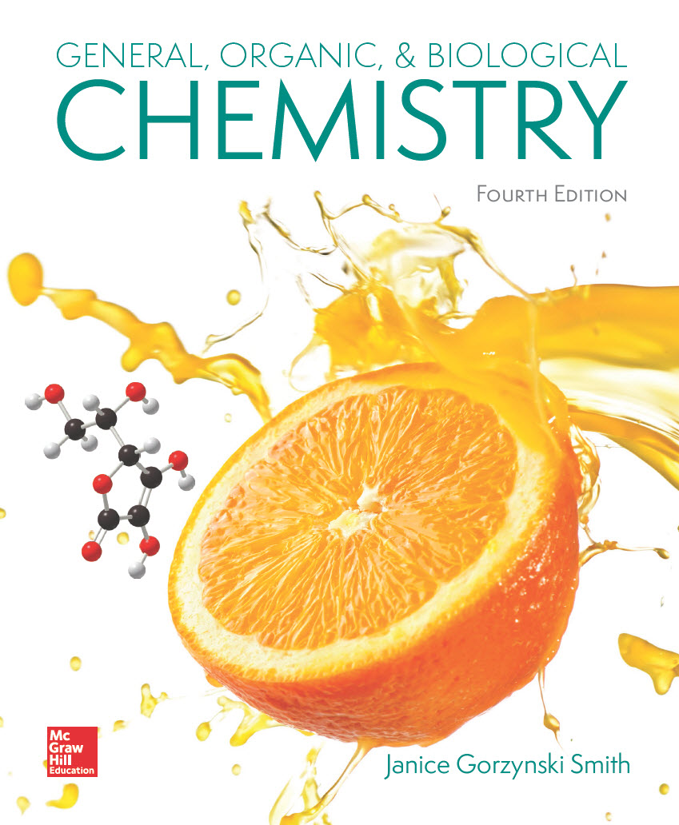
Chapter 14
Lecture Outline
Prepared by
Harpreet Malhotra
Florida State College at Jacksonville

Slide 2
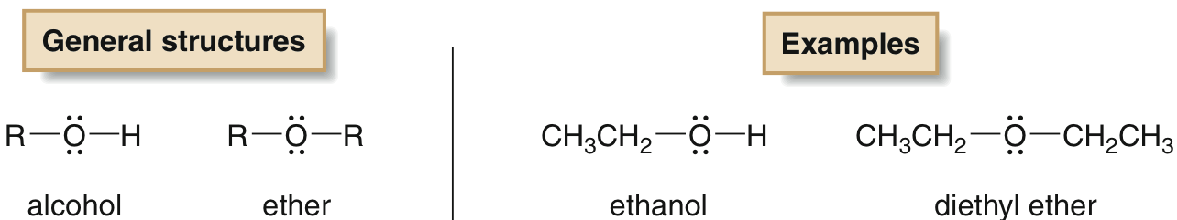
14.1 Introduction (1)
Four families of compounds that contain a C atom singly bonded to O, S, or X (F, Cl, Br, or I) are:
Alcohols, which contain an OH (hydroxyl) group.
Ethers, which have two alkyl groups bonded to an O atom.

Slide 3
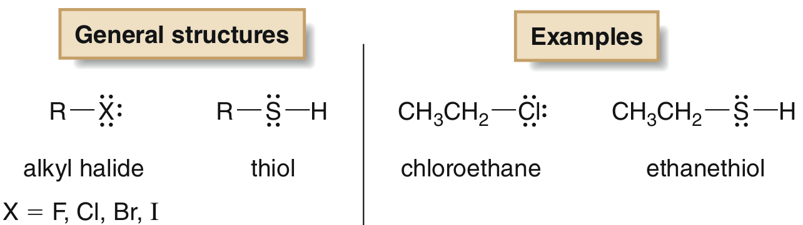
14.1 Introduction (2)
Alkyl halides, which contain a halogen atom X (X = F, Cl, Br, or I)
Thiols, which contain a SH (sulfhydryl) group

Slide 4
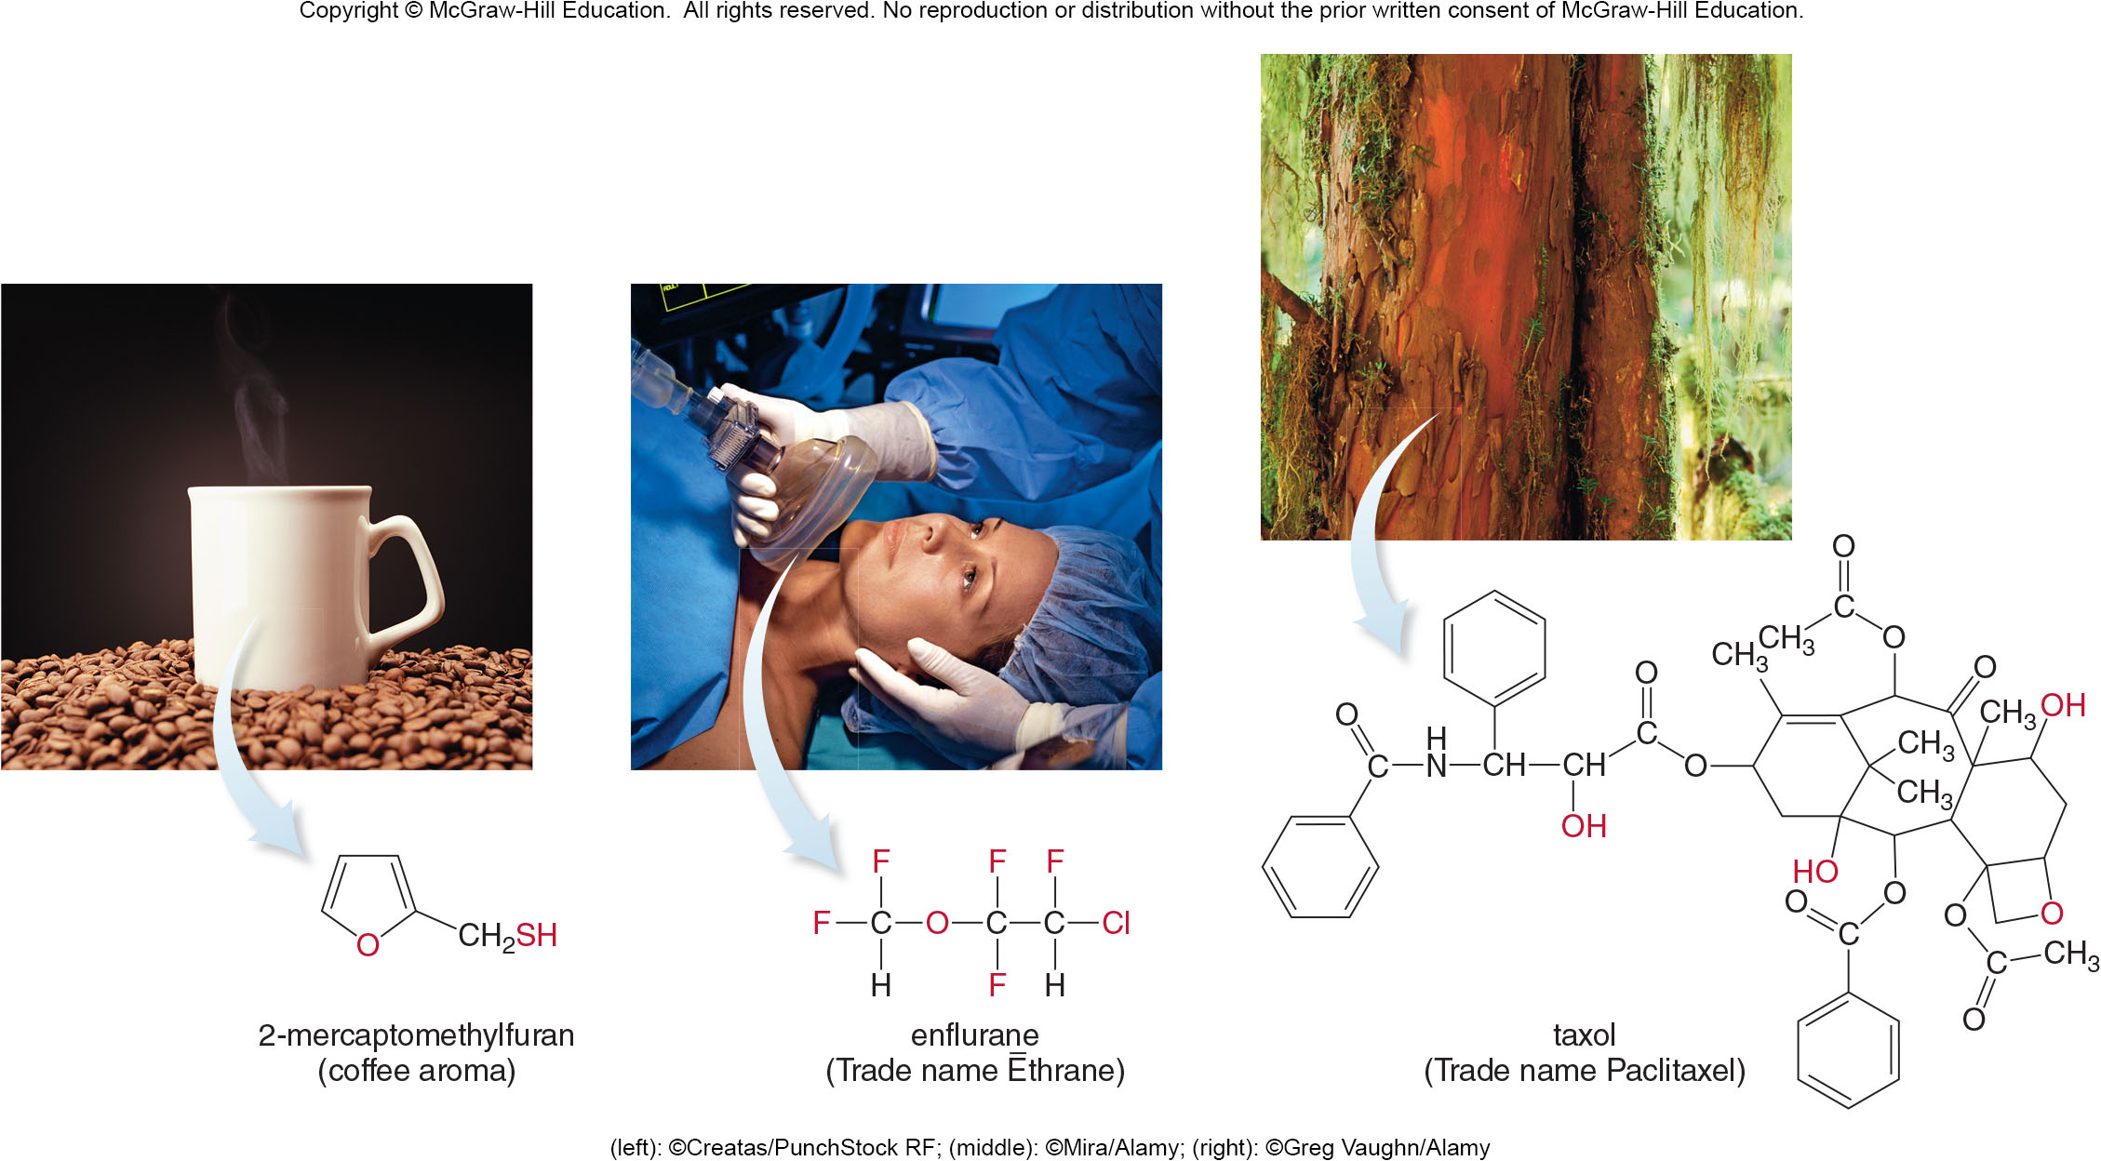
14.1 Introduction (3)
(left): ©Creatas/PunchStock RF; (middle): ©Mira/Alamy; (right): ©Greg Vaughn/Alamy

Slide 5
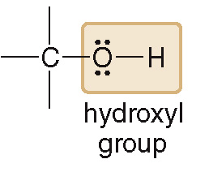
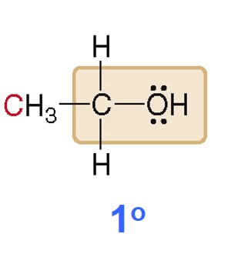
14.2 Structure and Properties of Alcohols (1)
Alcohols contain a hydroxyl (OH) group.
Alcohols are classified by the number of C atoms bonded to the C with the OH group.
A primary
alcohol has
an OH group on a C bonded only to 1 C atom.

Slide 6
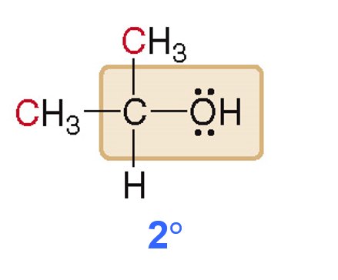
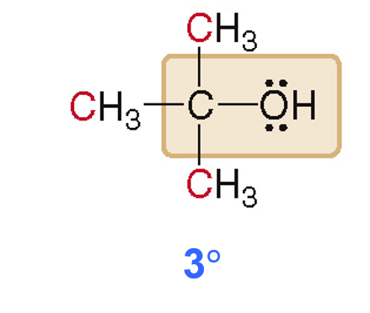
14.2 Structure and Properties of Alcohols (2)
A secondary
alcohol has
an OH group on a C bonded only to 2 C atoms.
alcohol has
A tertiary
an OH group on a C bonded only to 3 C atoms.

Slide 7
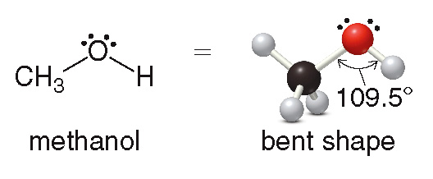
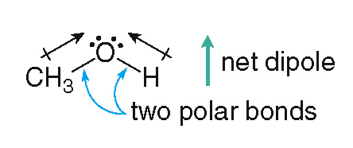
14.2 Structure and Properties of Alcohols (3)
An alcohol contains an O atom with a bent shape like H₂O, with a bond angle of
Alcohols have two polar bonds, C—O and O—H, with a bent shape, therefore it has a net dipole.

Slide 8
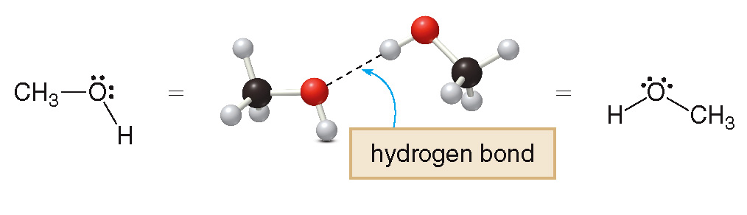
14.2 Structure and Properties of Alcohols (4)
Alcohols have an H atom bonded to an O atom, making them capable of intermolecular hydrogen bonding.
All of these properties give alcohols much stronger intermolecular forces than alkanes and alkenes.

Slide 9
14.2 Structure and Properties of Alcohols (5)
Therefore, alcohols have higher boiling and melting points than hydrocarbons of comparable size and shape.
CH₃CH₂CH₂CH₃
CH₃CH₂CH₂OH
butane
1-propanol
melting point:
melting point:
boiling point:
boiling point:
stronger intermolecular forces higher boiling point and melting point

Slide 10
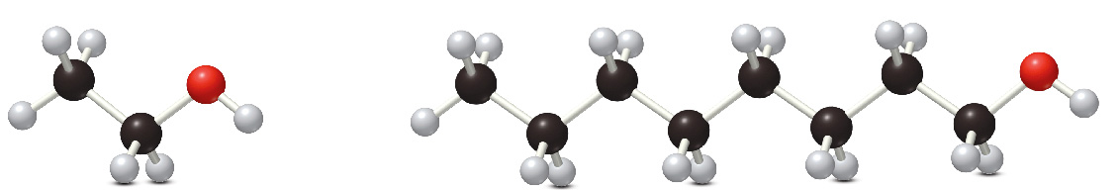
14.2 Structure and Properties of Alcohols (6)
Alcohols are soluble in organic solvents.
Low molecular weight alcohols (6 C’s or less) are soluble in water.
Higher molecular weight alcohols (6 C’s or more) are not soluble in water.
2 C’s in chain water soluble
8 C’s in chain water insoluble

Slide 11
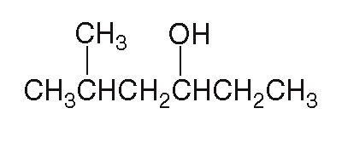
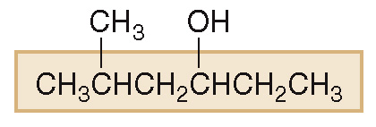
14.3 Nomenclature of Alcohols (1)
HOW TO Name an Alcohol Using the IUPAC System
Example
Give the IUPAC name of the following alcohol.
Find the longest carbon chain containing the C bonded to the OH group.
Step [1]
Change the –e ending of the parent alkane to the suffix –ol.
6 C’s in longest chain
hexane → hexanol

Slide 12
14.3 Nomenclature of Alcohols (2)
HOW TO Name an Alcohol Using the IUPAC System
Number the carbon chain to give the OH group the lower number, and apply all other rules of nomenclature.
Step [2]
Number the chain.
Name and number the substituents.
Answer: 5-methyl-3-hexanol

Slide 13
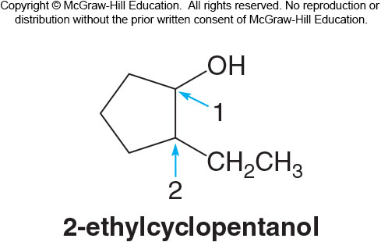
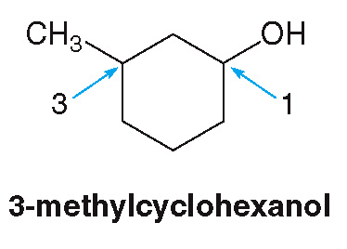
14.3 Nomenclature of Alcohols (3)
When an OH group is bonded to a ring, the OH is automatically on C1.
The “1” is usually omitted from the name.
The ring is then numbered to give the next substituent the lower number.

Slide 14
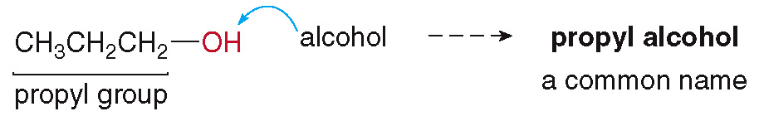
14.3 Nomenclature of Alcohols (4)
Common names are often used for simple alcohols.
Name all the C atoms of the molecule as a single alkyl group.
Add the word alcohol, separating the words with a space.

Slide 15
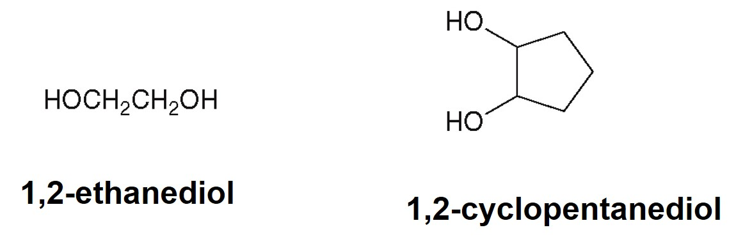
14.3 Nomenclature of Alcohols (5)
Compounds with two OH groups are called diols or glycols.
Compounds with three OH groups are called triols.

Slide 16
14.4 Interesting Alcohols (1)
Methanol (CH₃OH) is a useful as a solvent and a starting material for plastics, but it is toxic due to its oxidation in the liver.
Ethanol (CH₃CH₂OH) is the alcohol present in alcoholic beverages, and it is formed from the fermentation of carbohydrate chains.
2-Propanol [(CH₃)₂CHOH), isopropyl alcohol] is the major component of rubbing alcohol, which is used to sterilize skin and medical instruments.

Slide 17
14.4 Interesting Alcohols (2)
Ethylene glycol (HOCH₂CH₂OH), a diol, is the major component of antifreeze; it is sweet tasting but extremely toxic.
Glycerol [(HOCH₂)₂CHOH], a triol, is used in lotions, liquid soap, and shaving cream; it is also sweet tasting, but nontoxic, so it can be used in food products.

Slide 18
14.4 Interesting Alcohols (3)
Carbohydrates are very long, alcohol-containing, and naturally occurring polymers, synthesized primarily by plants.
Starch is the main carbohydrate in seeds and the roots of plants, and it can be metabolized by humans into glucose.
Cellulose, the major component of wood, cotton, and flax, gives rigidity to plants, however it cannot be metabolized by humans.

Slide 19
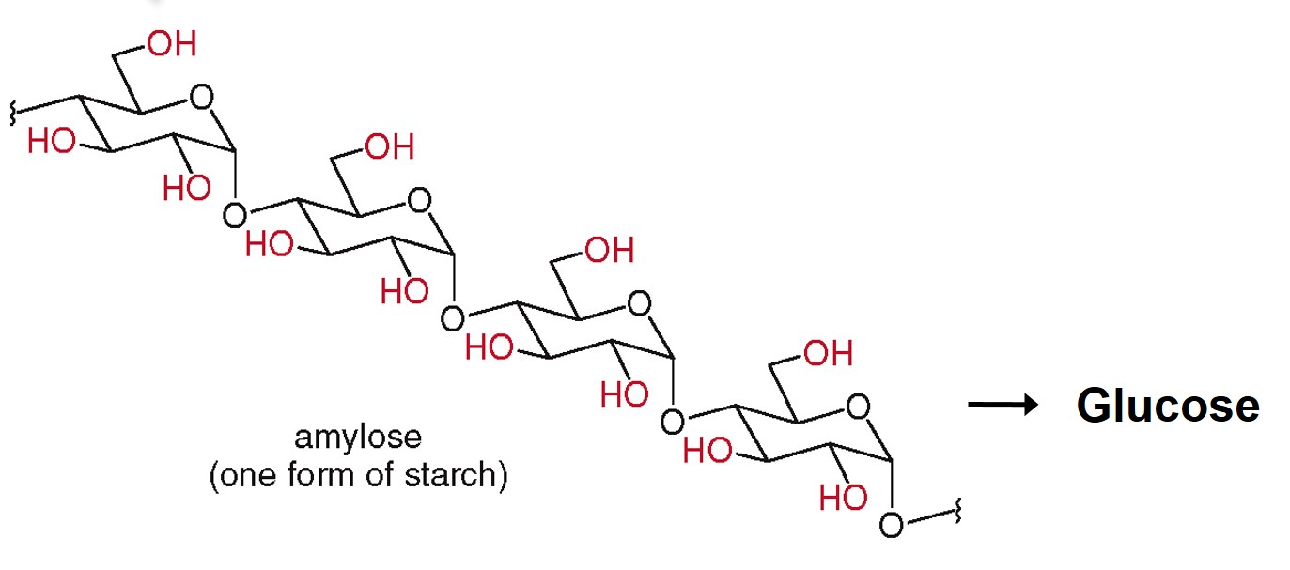
14.4 Interesting Alcohols (4)

Slide 20
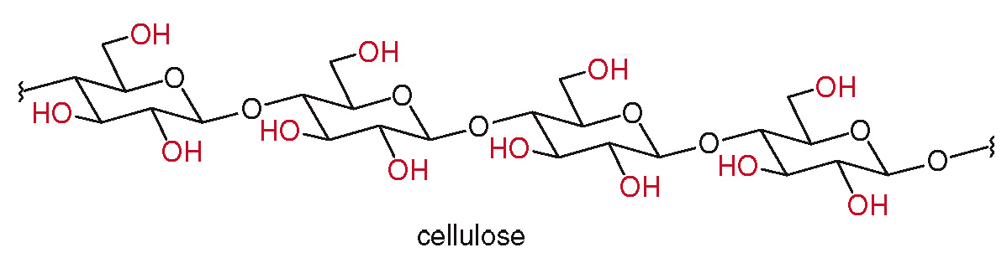
14.4 Interesting Alcohols (5)

Slide 21
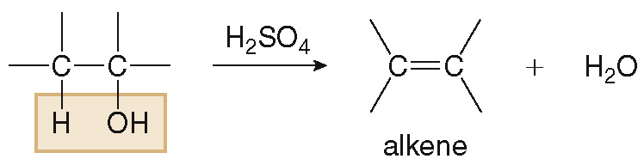
14.5 Reactions of Alcohols (1)
Dehydration
Dehydration is the loss of H₂O from a starting material.
It occurs when an alcohol is treated with a strong acid, like H₂SO₄, and forms an alkene product.
Dehydration is an example of an elimination reaction, in which parts of the starting material are “lost” and a multiple bond is formed.

Slide 22
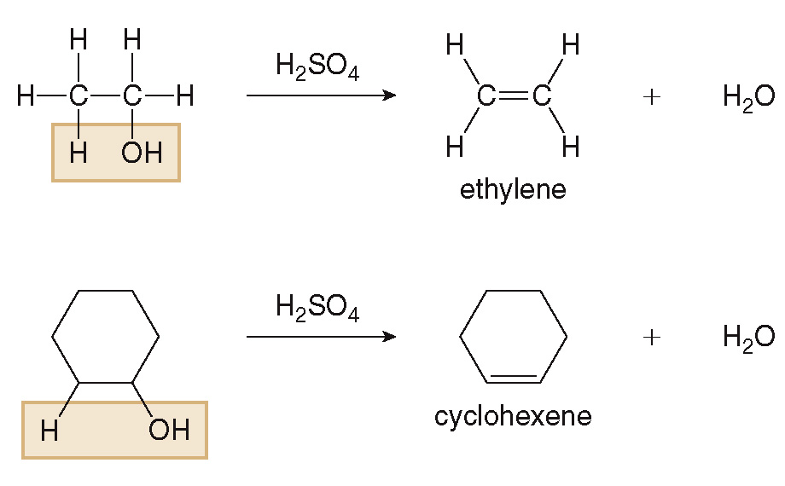
14.5 Reactions of Alcohols (2)
Dehydration

Slide 23
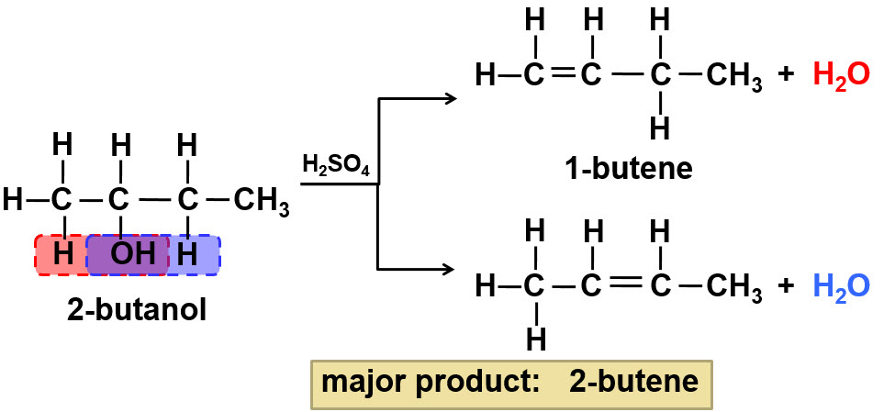
14.5 Reactions of Alcohols (3)
Dehydration
Asymmetric alcohols can form two possible products.
Zaitsev Rule: the major product has the most alkyl groups bonded to the C═C.

Slide 24
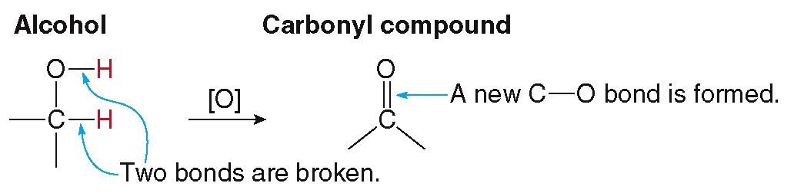
14.5 Reactions of Alcohols (4)
Oxidation
Oxidation results in an:
increase in the number of C—O bonds
decrease in the number of C—H bonds
The symbol [O] indicates an oxidation reagent (commonly K₂Cr₂O₇) has been added.

Slide 25
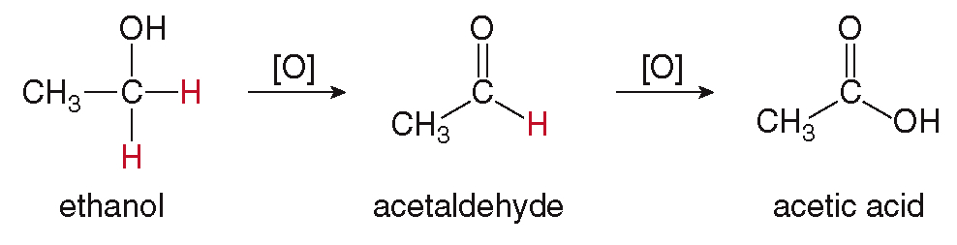
14.5 Reactions of Alcohols (5)
Oxidation
Primary
alcohols first oxidize to aldehydes
(RCHO), replacing 1 C—H with 1 C—O.
Aldehydes are further oxidized to carboxylic acids (RCOOH), replacing 1 C—H with 1 C—O.
alcohol (ROH)
aldehyde (RCHO)
carboxylic acid (RCOOH)

Slide 26
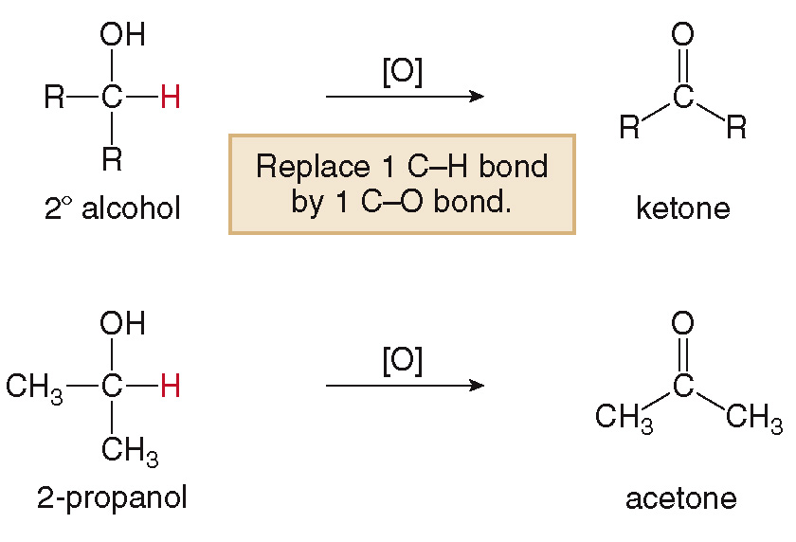
14.5 Reactions of Alcohols (6)
Oxidation
Secondary
alcohols are oxidized to ketones
(R₂CO).

Slide 27
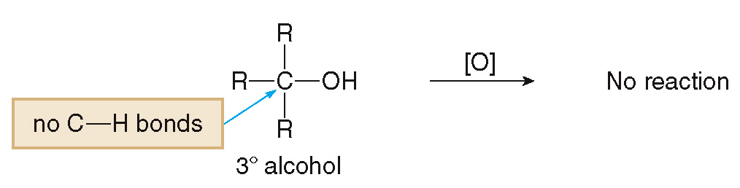
14.5 Reactions of Alcohols (7)
Oxidation
Tertiary
alcohols have no H atoms on the C
with the OH group, so they are not oxidized.

Slide 28
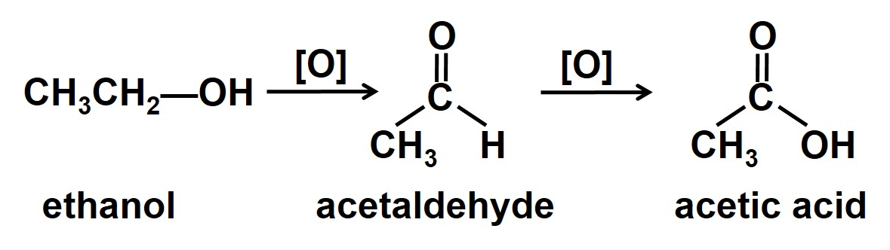
14.6 Focus on Health & Medicine (1)
The Metabolism of Ethanol
When ethanol is consumed it is quickly absorbed in the stomach and small intestines.
In the liver, the enzymes alcohol and aldehyde dehydrogenase act as oxidizing reagents.
Consuming more ethanol than can be metabolized leads to a buildup of acetaldehyde, which is toxic.

Slide 29
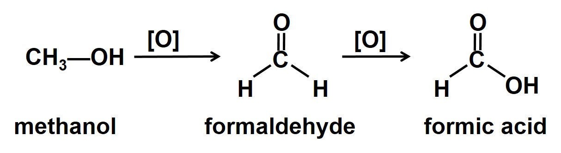
14.6 Focus on Health & Medicine (2)
The Metabolism of Methanol
Methanol is oxidized into formaldehyde and then to formic acid by the same enzymes as ethanol.
Both of these compounds are extremely toxic, and consumption of methanol leads to decreased blood pH, blindness, and finally death.

Slide 30
14.6 Focus on Health & Medicine (3)
Health Effects of Alcohol Consumption
Alcohol consumption in small amounts causes dizziness, giddiness, and decrease of social inhibitions.
Large amounts of alcohol causes decreased coordination and reaction time.
Even larger amounts result in coma or death.
Chronic excessive alcohol consumption leads to cirrhosis of the liver.
Pregnant women should not drink alcohol as the ethanol crosses the placenta and affects the fetus, which lacks the enzymes to metabolize it properly.

Slide 31
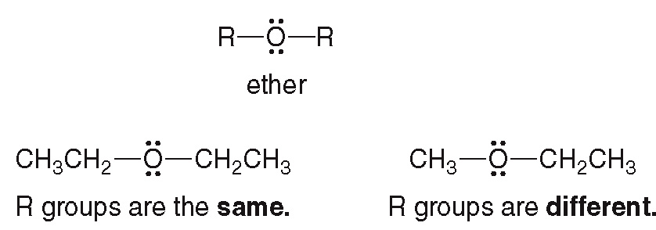
14.7 Structure and Properties of Ethers (1)
Ethers have two alkyl groups bonded to an O atom.
The two alkyl groups can be the same, or they can be different.

Slide 32
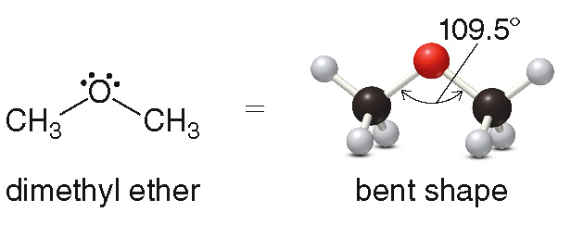
14.7 Structure and Properties of Ethers (2)
An ether has an O atom with a bent shape like H₂O, with a bond angle of

Slide 33
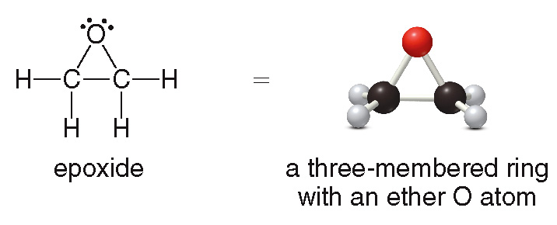
14.7 Structure and Properties of Ethers (3)
The ether O can be found contained in a ring.
A ring that contains a heteroatom is called a heterocycle.
A 3 carbon ether heterocycle is called an epoxide.

Slide 34
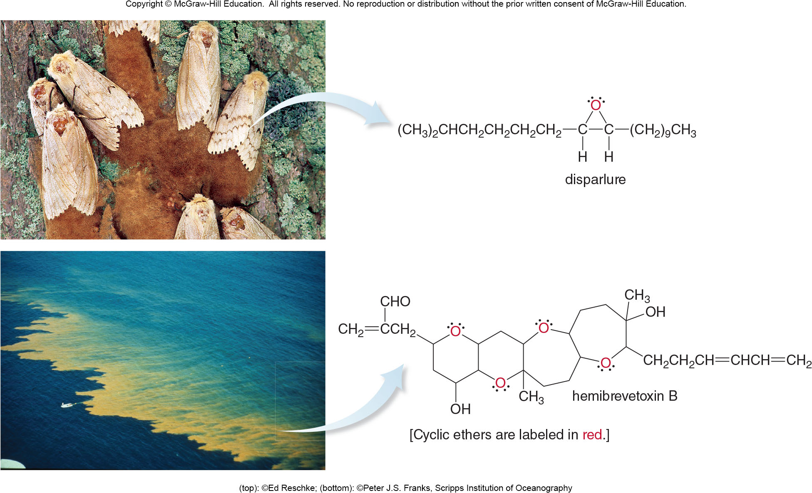
14.7 Structure and Properties of Ethers (4)
(top): ©Ed Reschke; (bottom): ©Peter J.S. Franks, Scripps Institution of Oceanography

Slide 35
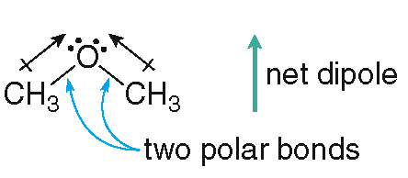
14.7 Structure and Properties of Ethers (5)
Physical Properties
Ethers have two polar C—O bonds with a bent shape, and therefore have a net dipole.
Ethers do not contain an H atom bonded to an O atom, so two ethers cannot form intermolecular hydrogen bonds.

Slide 36
14.7 Structure and Properties of Ethers (6)
Physical Properties
These facts give ethers:
stronger intermolecular forces than alkanes
weaker intermolecular forces than alcohols
As a result, ethers of comparable size and shape tend to have:
higher melting and boiling points than hydrocarbons
lower melting and boiling points than alcohols

Slide 37
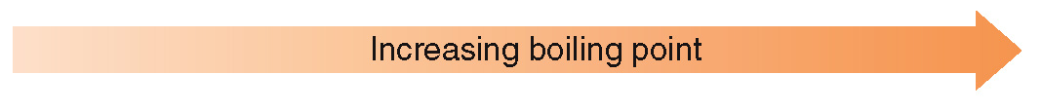
14.7 Structure and Properties of Ethers (7)
Physical Properties
CH₃CH₂CH₂CH₃ butane
boiling point
CH₃OCH₂CH₃ ethyl methyl ether boiling point
CH₃CH₂CH₂OH 1-propanol boiling point

Slide 38
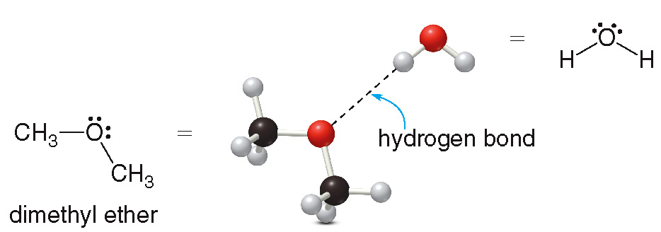
14.7 Structure and Properties of Ethers (8)
Physical Properties
Ethers are soluble in organic solvents.
Low molecular weight ethers (5 C’s or less) are soluble in water, as water can hydrogen bond to the ether’s O atom.
Higher molecular weight ethers (6 C’s or more) are not soluble in water.

Slide 39
14.7 Structure and Properties of Ethers (9)
Naming Ethers
Simple ethers are usually assigned common names:
name both alkyl groups bonded to the O atom
arrange these names alphabetically
finally, add the word “ether” to the end

Slide 40
14.7 Structure and Properties of Ethers (10)
Naming Ethers
More complex ethers are named using the IUPAC
system:
one alkyl group is named as a hydrocarbon chain
the other is named as part of a substituent bonded to that chain
CH₃O—methoxy
CH₃CH₂O—ethoxy

Slide 41
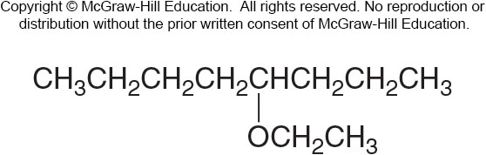
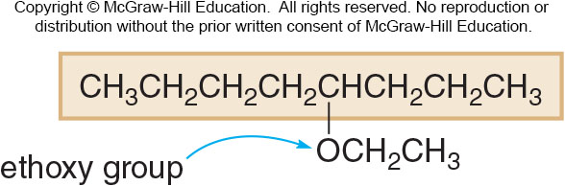
14.7 Structure and Properties of Ethers (11)
Naming Ethers
HOW TO Name an Ether Using the IUPAC System
Sample Problem 14.6
Give the IUPAC name of the following ether.
Name the longer chain as an alkane and the shorter chain as an alkoxy group
Step [1]
8 C’s in longest chain → octane

Slide 42
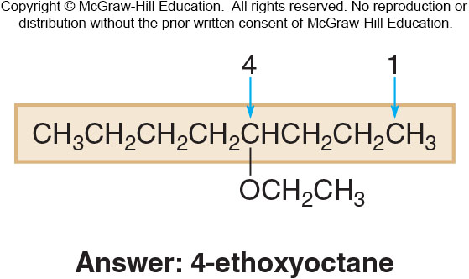
14.3 Nomenclature of Alcohols (6)
HOW TO Name an Ether Using the IUPAC System
Step [2]
Apply other nomenclature rules to complete the name.

Slide 43
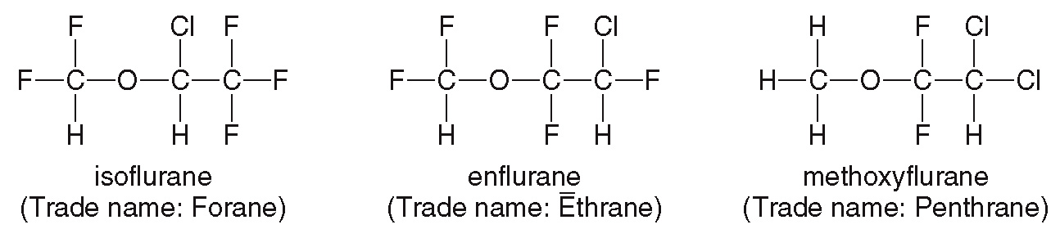
14.8 Focus on Health & Medicine
Ethers as Anesthetics
Diethyl ether was first demonstrated as an anesthetic in 1846 by the dentist Dr. William Morton.
Prior to this, patients undergoing surgery had to tolerate excruciating pain.
Modern variations include the three ethers below:

Slide 44
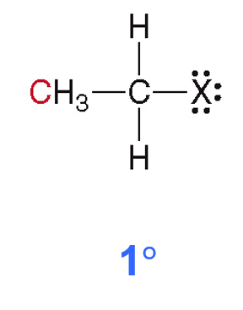
14.9 Alkyl Halides (1)
Alkyl halides contain a halogen atom X (where X = F, Cl, Br, I).
They are classified by the number of C atoms bonded to the C with the halogen.
A primary
alkyl halide
has an X group on a C bonded only to 1 C atom.

Slide 45
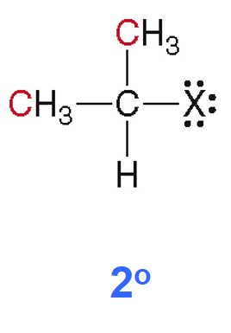
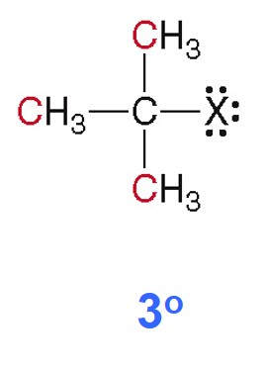
14.9 Alkyl Halides (2)
A secondary
alkyl halide
has an X group on a C bonded only to 2 C atoms.
A tertiary
alkyl halide
has an X group on a C bonded only to 3 C atoms.

Slide 46
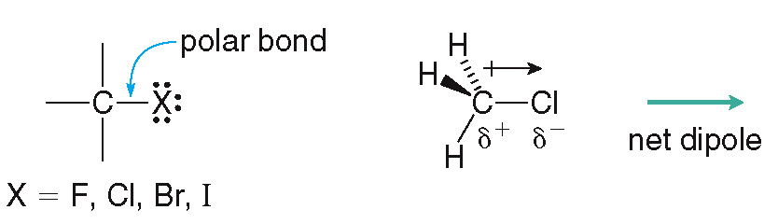
14.9 Alkyl Halides (3)
Physical Properties
Alkyl halides contain a polar C—X bond, thus they contain a net dipole.
They are not capable of intermolecular hydrogen bonding.
As a result, they have higher melting and boiling points than similar alkanes, but lower than alcohols.

Slide 47
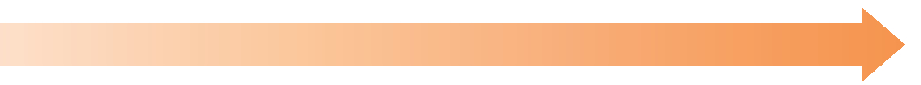
14.9 Alkyl Halides (4)
Physical Properties
The boiling and melting points of an alkyl halide will increase with:
the size of the alkyl group
the size of the halogen
CH₃CH₂Cl chloroethane
CH₃CH₂CH₂Cl
1-chloropropane
CH₃CH₂CH₂Br
1-bromopropane
All alkyl halides are insoluble in water.

Slide 48
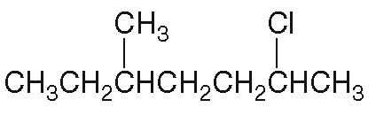
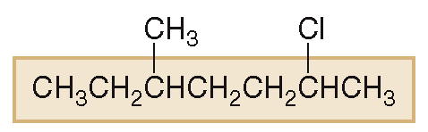
14.9 Alkyl Halides (5)
Nomenclature
HOW TO Name an Alkyl Halide Using the IUPAC System
Example
Give the IUPAC name of the following alkyl halide.
Find the parent carbon chain containing the halogen.
Step [1]
7 C’s = heptane

Slide 49
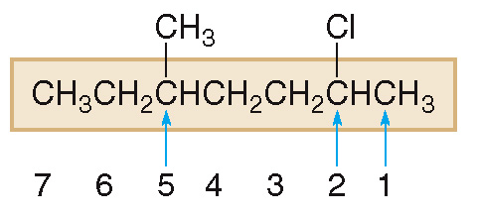
14.9 Alkyl Halides (6)
Nomenclature
HOW TO Name an Alkyl Halide Using the IUPAC System
Step [2]
Apply all other rules of nomenclature.
Number the chain, give the halogen the lowest possible number.

Slide 50
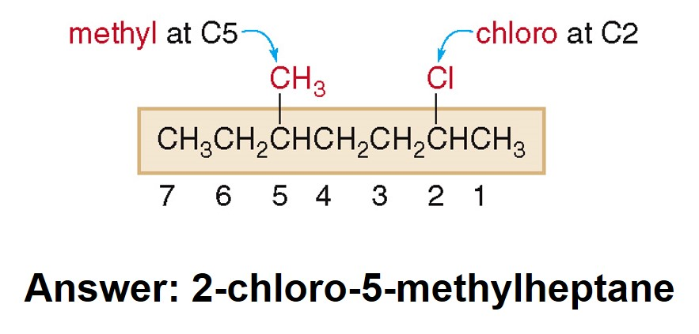
14.9 Alkyl Halides (7)
Nomenclature
HOW TO Name an Alkyl Halide Using the IUPAC System
Step [2]
Apply all other rules of nomenclature.
Name and number, then alphabetize the substituents.

Slide 51
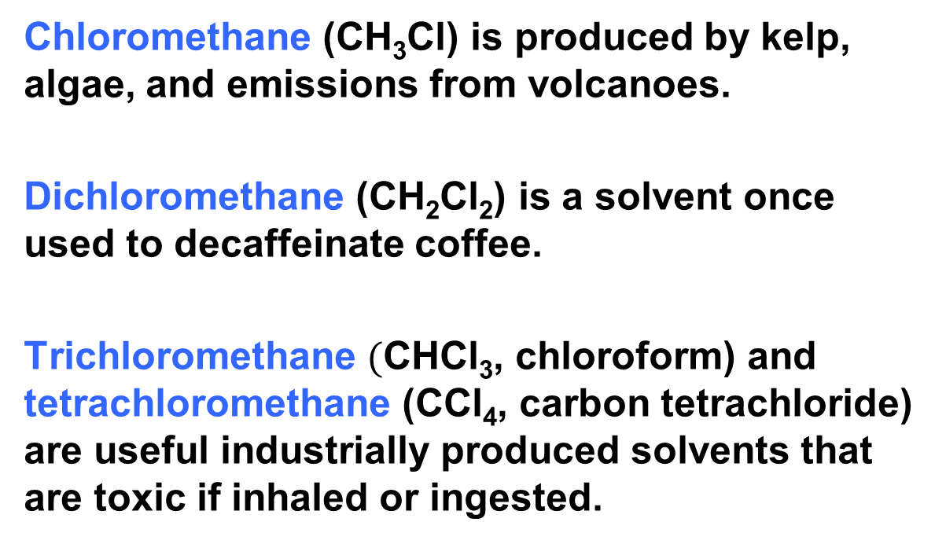
14.9 Alkyl Halides (8)
Interesting Alkyl Halides
Chloromethane (CH₃Cl) is produced by kelp, algae, and emissions from volcanoes.
Dichloromethane (CH₂Cl₂) is a solvent once used to decaffeinate coffee.
Trichloromethane $($CHCl₃, chloroform) and tetrachloromethane (CCl₄, carbon tetrachloride) are useful industrially produced solvents that are toxic if inhaled or ingested.

Slide 52

14.10 Organic Compounds that Contain Sulfur (1)
Thiols contain a SH (sulfhydryl) group.
S is just below O on the periodic table, thiols are similar to alcohols.
Thiols have a bent shape around the S atom.

Slide 53
14.10 Organic Compounds that Contain Sulfur (2)
However, thiols contain no O—H bonds, so they are incapable of intermolecular hydrogen bonding.
This gives thiols lower boiling and melting points than similar alcohols.
CH₃CH₂—OH ethanol
CH₃CH₂—SH ethanethiol

Slide 54
14.10 Organic Compounds that Contain Sulfur (3)
To name a thiol in the IUPAC system:
name the parent hydrocarbon chain as an alkane
add the suffix “-thiol”
number the chain to give the SH the lowest number
CH₃—SH
CH₃CH₂CH₂—SH
methanethiol
1-propanethiol

Slide 55

14.10 Organic Compounds that Contain Sulfur (4)
Thiols have a characteristic foul odor (skunk, onions, etc.)
They can be oxidized to disulfides.

Slide 56

14.10 Organic Compounds that Contain Sulfur (5)
The disulfides can be converted back to thiols with a reducing agent, [H], through a reduction reaction.

Slide 57

14.10 Organic Compounds that Contain Sulfur (6)
To make straight hair curly, the disulfide bonds holding the hair proteins together are reduced.
The hair is then turned around curlers, and an oxidizing agent is applied.
This re-forms the disulfide bonds in the hair, now giving it a curly appearance.

