Slide 1
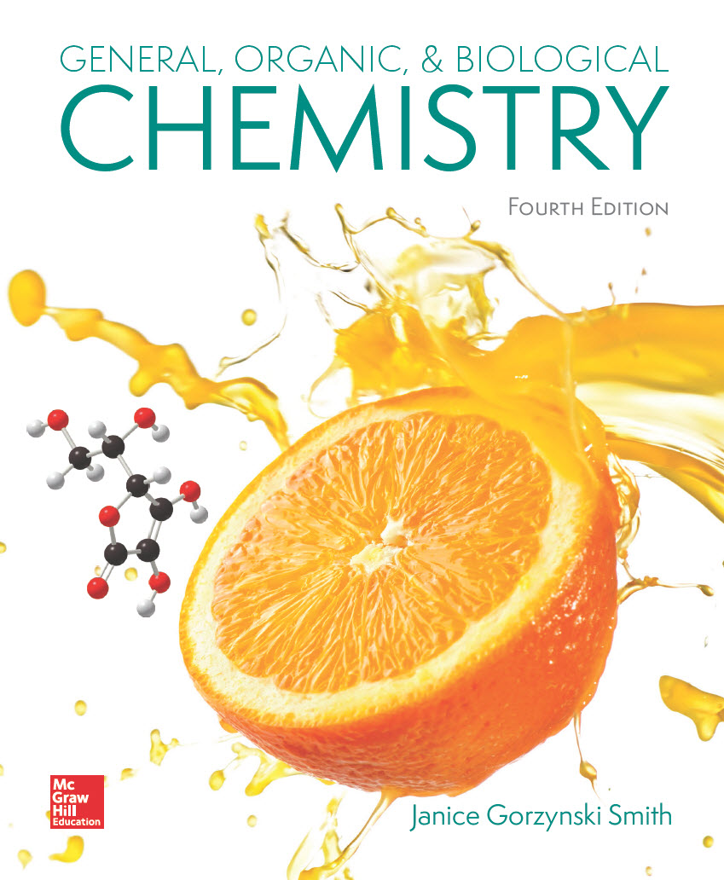
Chapter 15
Lecture Outline
Prepared by
Harpreet Malhotra
Florida State College at Jacksonville

Slide 2
15.1 Isomers—A Review (1)
Isomers are different compounds with the same molecular formula.
Constitutional isomers differ in the way atoms are connected to each other.
Constitutional isomers with the same functional group:

Slide 3
15.1 Isomers—A Review (2)
Constitutional isomers with different functional groups:

Slide 4
15.1 Isomers—A Review (3)
Stereoisomers differ only in the 3-dimensional arrangement of atoms.
Stereoisomers always have the same functional group.
The cis and trans examples below are stereoisomers

Slide 5
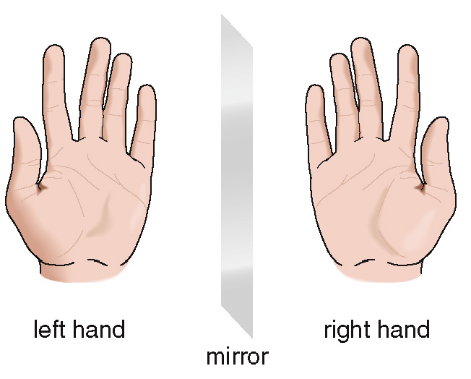
15.2 Molecules and Their Mirror Images (1)
What It Means to be Chiral or Achiral
Left hands and right hands are mirror images of each other.

Slide 6
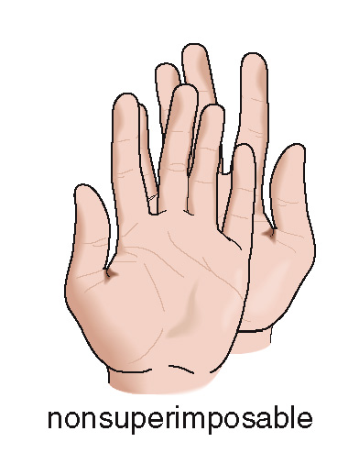
15.2 Molecules and Their Mirror Images (2)
What It Means to be Chiral or Achiral
Left and right hands are not identical (nonsuperimposable).
A molecule that is not superimposable on its mirror image is chiral.

Slide 7
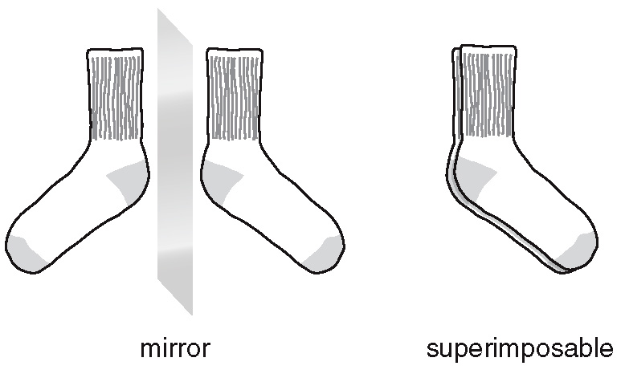
15.2 Molecules and Their Mirror Images (3)
What It Means to be Chiral or Achiral
Two socks from a pair are mirror images that are superimposable.
A molecule that is superimposable on its mirror image is achiral.

Slide 8
15.2 Molecules and Their Mirror Images (4)
The Chirality of Molecules
To test whether a molecule is chiral or achiral:
Draw the molecule in 3 dimensions.
Draw its mirror image.
Try to align all bonds and atoms.
To superimpose a molecule and its mirror image you can perform any rotation but you cannot break bonds.

Slide 9
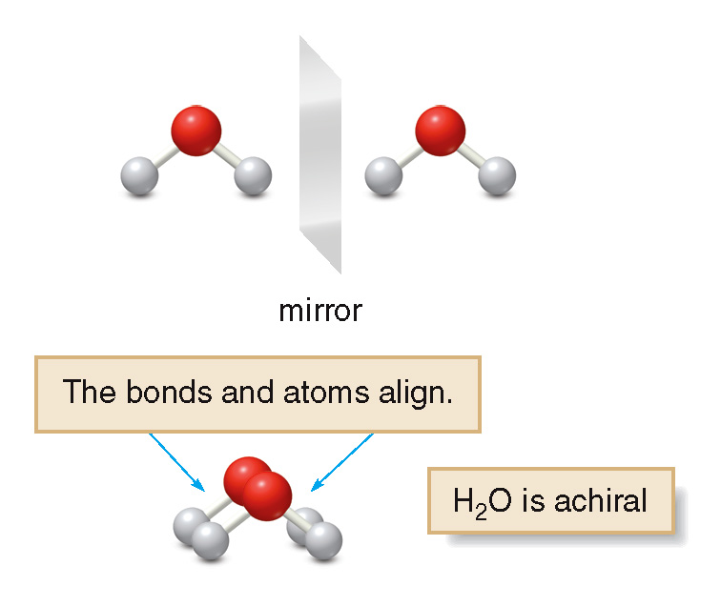
15.2 Molecules and Their Mirror Images (5)
The Chirality of Molecules
For H₂O:

Slide 10
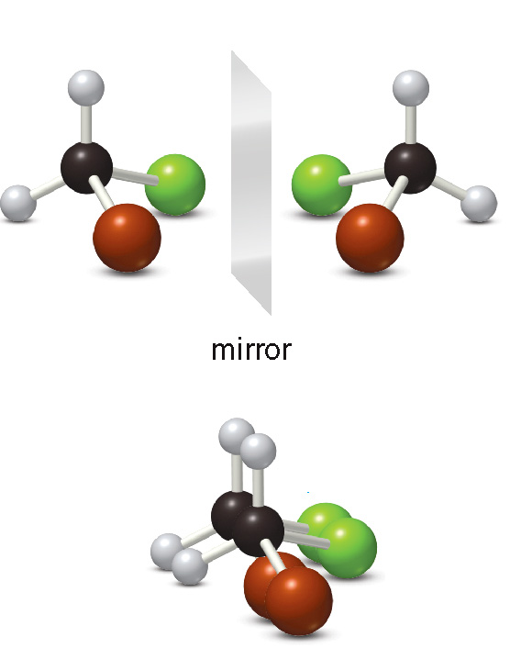
15.2 Molecules and Their Mirror Images (6)
The Chirality of Molecules
For CH₂BrCl:
Rotate the molecule to align bonds:

Slide 11
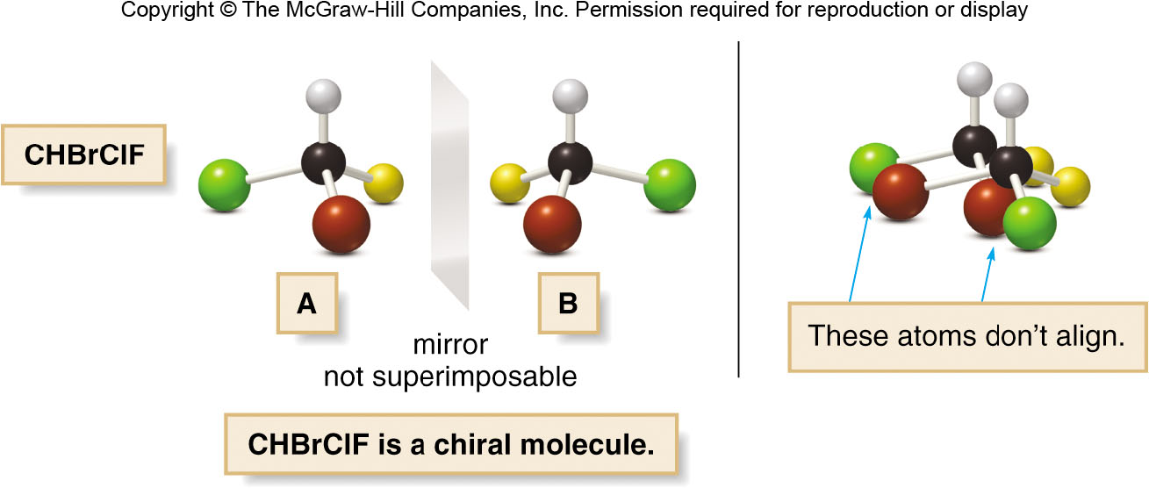
15.2 Molecules and Their Mirror Images (7)
The Chirality of Molecules
For CHBrClF:

Slide 12
15.2 Molecules and Their Mirror Images (8)
The Chirality of Molecules
The two mirror images of CHBrClF are enantiomers, mirror images that are not superimposable.
A molecule that is not superimposable on its mirror image is a chiral molecule.
A carbon atom with four different groups like CHBrClF is called a chirality center.
Molecules can contain zero, one, or many chirality centers.

Slide 13
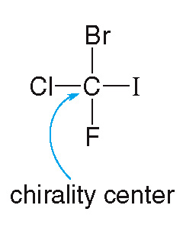
15.3 Chirality Centers (1)
Locating Chirality Centers
To locate a chirality center, look at each tetrahedral C atom in a molecule.
Look at the four groups—not the four atoms— bonded to it.

Slide 14
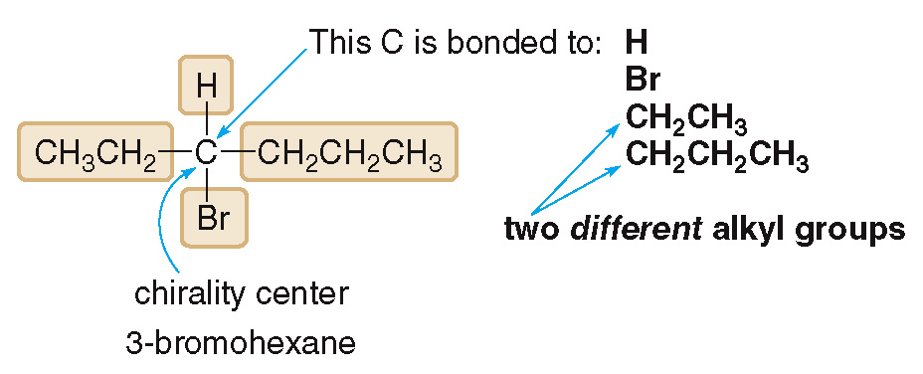
15.3 Chirality Centers (2)
Locating Chirality Centers
We consider all atoms in a group as a whole unit.

Slide 15
15.3 Chirality Centers (3)
Locating Chirality Centers
A C atom bonded to two or more like groups is never a chirality center.
CH₂ and CH₃ groups have more than one H atom bonded to the same C, so those C’s are never chirality centers.
A C that is part of a multiple bond does not have four groups around it, so it is never a chirality center.

Slide 16
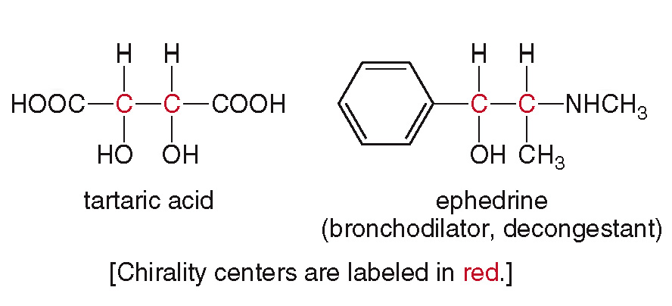
15.3 Chirality Centers (4)
Locating Chirality Centers
Chirality centers in the examples below are labeled in red:

Slide 17
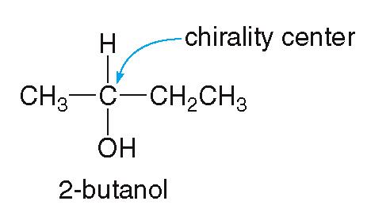
15.3 Chirality Centers (5)
Drawing a Pair of Enantiomers
HOW TO Draw Two Enantiomers of a Chiral Compound
Draw two enantiomers of 2-butanol in 3D around the chirality center.
Example

Slide 18
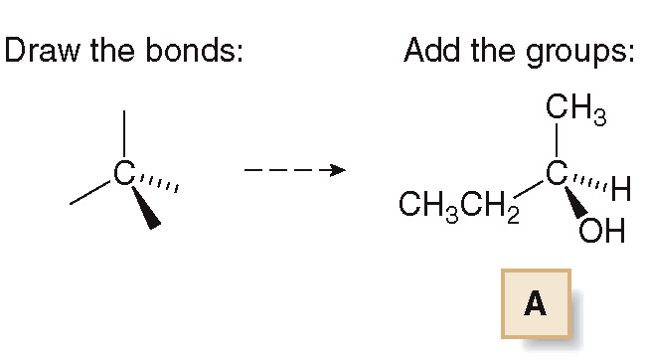
15.3 Chirality Centers (6)
Drawing a Pair of Enantiomers
HOW TO Draw Two Enantiomers of a Chiral Compound
Draw one enantiomer by arbitrarily placing the four different groups at opposite corners of a tetrahedron.
Step [1]

Slide 19
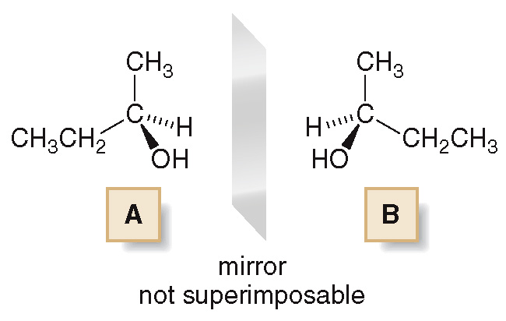
15.3 Chirality Centers (7)
Drawing a Pair of Enantiomers
HOW TO Draw Two Enantiomers of a Chiral Compound
Draw a mirror plane and arrange the substituents in the mirror image so that they are the reflection of the first molecule.
Step [2]
enantiomers

Slide 20
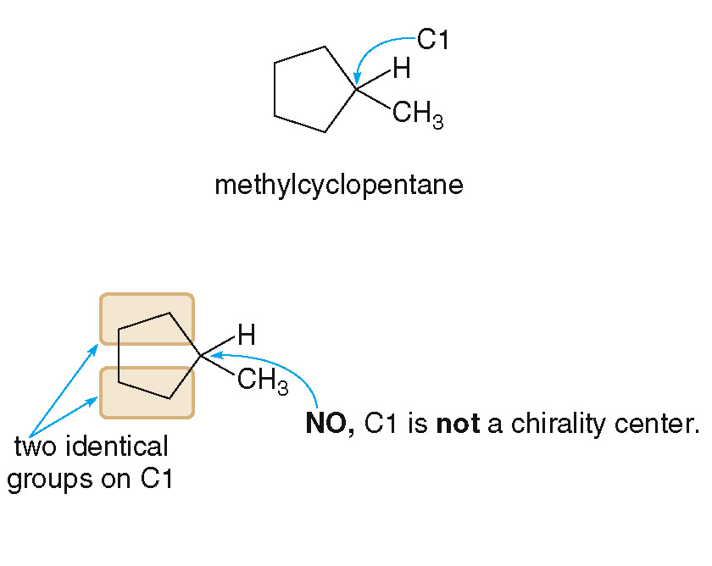
15.4 Chirality Centers in Cyclic Compounds (1)
Locating Chirality Centers on Ring Carbons
Is C1 a chirality center?

Slide 21
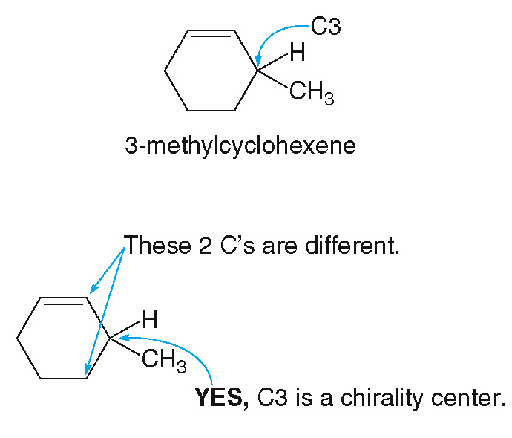
15.4 Chirality Centers in Cyclic Compounds (2)
Locating Chirality Centers on Ring Carbons
Is C3 a chirality center:

Slide 22
15.4 Chirality Centers in Cyclic Compounds (3)
Focus on Health and Medicine
Many biologically active compounds contain 1 or more chirality centers.
The anti-nausea drug thalidomide, which was given to pregnant women in the early 1960’s had a chirality center.
Unfortunately, thalidomide was sold as a mixture of its two enantiomers, both of which did not have the same biological effect.
One enantiomer prevented nausea, while the other caused catastrophic birth defects in the unborn infants of those pregnant women.

Slide 23
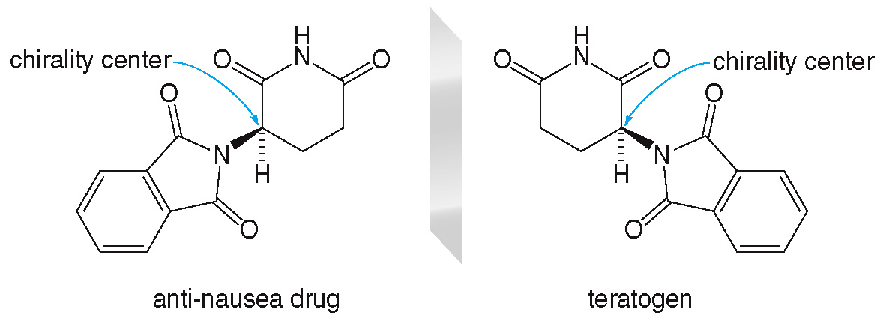
15.4 Chirality Centers in Cyclic Compounds (4)
Focus on Health and Medicine

Slide 24
15.5 Focus on Health & Medicine Chiral Drugs (1)
Many drugs are chiral, and often they must interact with a chiral receptor to be effective.
One enantiomer of a drug may be effective in treating a disease whereas its mirror image may be ineffective.
If the other enantiomer is not biologically active, the pair is usually sold as a racemic mixture.
A racemic mixture is an equal mixture of two enantiomers.

Slide 25
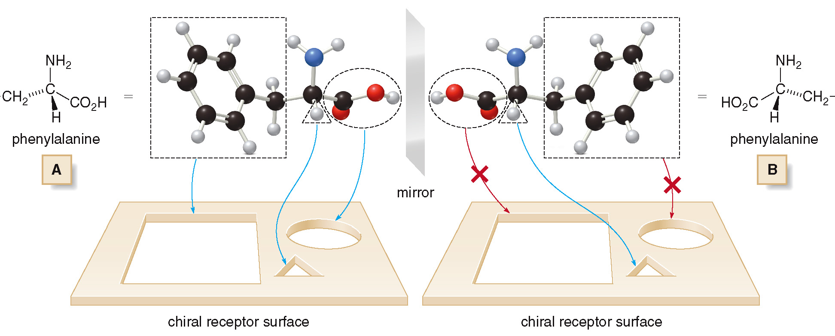
15.5 Focus on Health & Medicine Chiral Drugs (2)

Slide 26
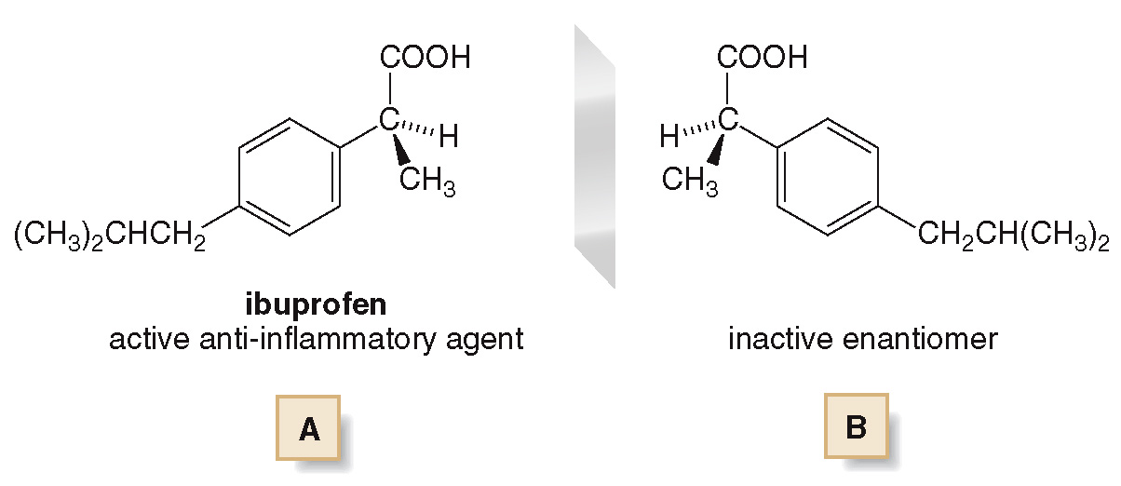
15.5 Focus on Health & Medicine (1)
Chiral Pain Relievers
Ibuprofen is an active anti-inflammatory agent whose enantiomer is inactive, and it is sold as a racemic mixture.

Slide 27
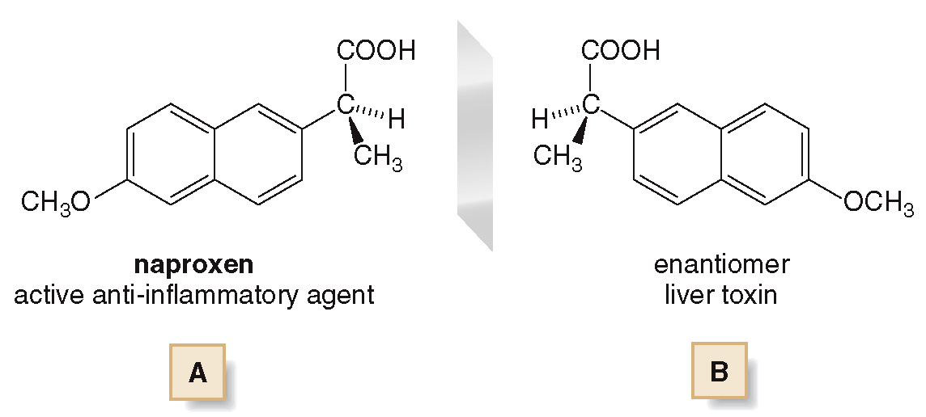
15.5 Focus on Health & Medicine (2)
Chiral Pain Relievers
Naproxen (the pain reliever in Alleve) has a toxic enantiomer, so care must be taken in its manufacture.

Slide 28
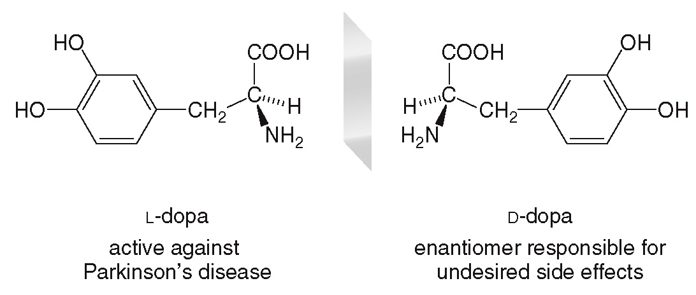
15.5 Focus on Health & Medicine (3)
Parkinson’s Disease and L-Dopa
L-Dopa, a dopamine precursor, is used to help treat the dopamine deficient brains of Parkinson’s patients.
Dopamine cannot be directly taken by a patient because it cannot cross the blood-brain barrier.

Slide 29
15.5 Focus on Health & Medicine (4)
Parkinson’s Disease and L-Dopa
Parkinson’s disease is characterized by degeneration of dopamine nerve pathways in the basal ganglia.
Dopamine is released by one nerve cell, and then binds to a receptor site in a target cell.

Slide 30
15.6 Fischer Projections (1)
A Fischer Projection takes a 3D tetrahedral shape, and re-draws it:

Slide 31
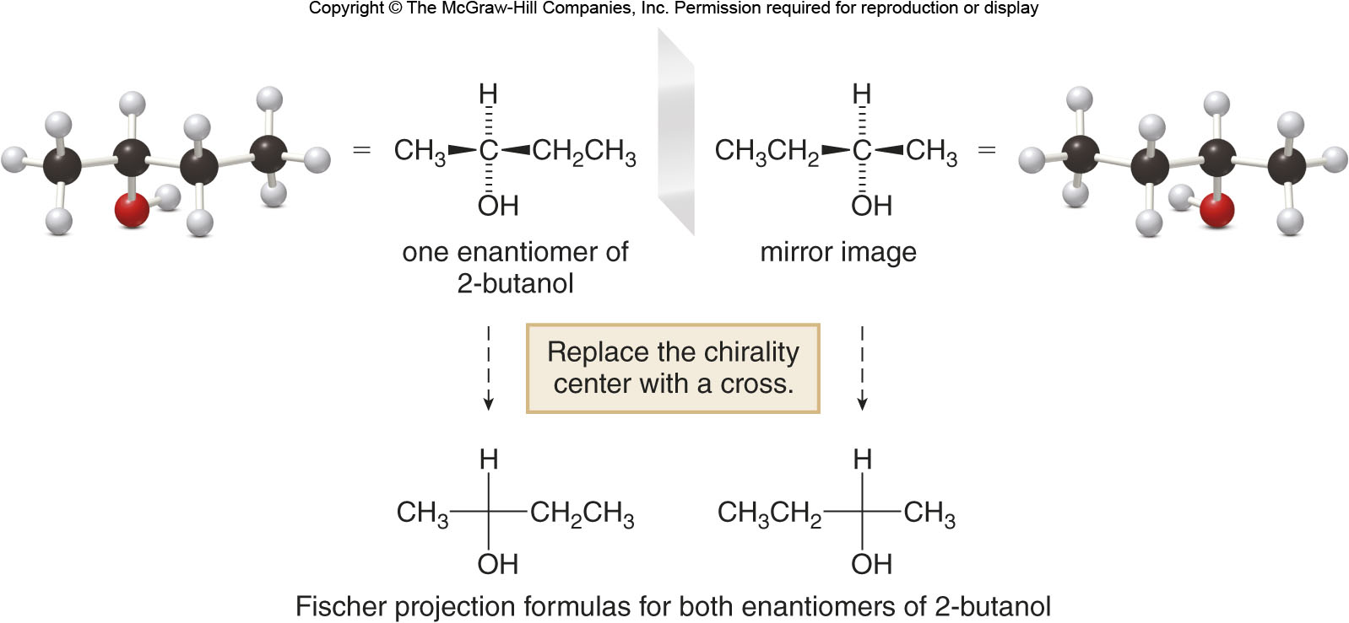
15.6 Fischer Projections (2)
We can draw the cross and Fischer projection for both enantiomers of 2-butanol:

Slide 32
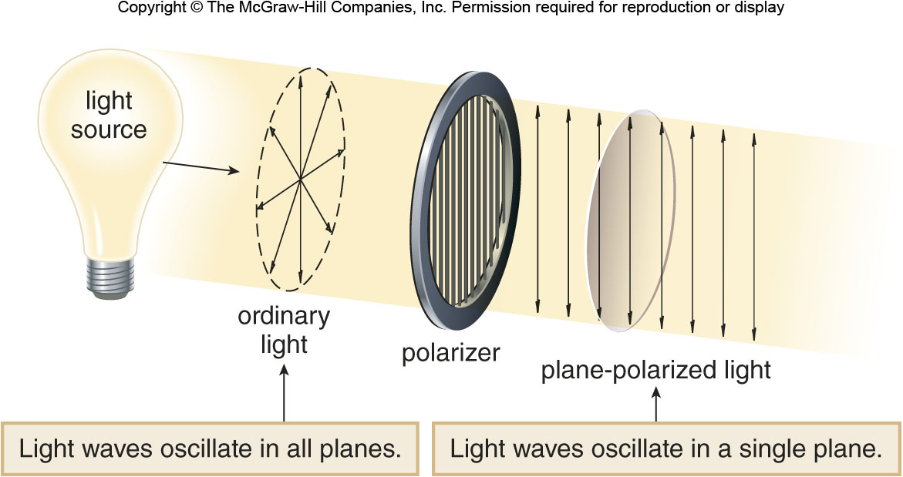
15.7 Optical Activity (1)
The Physical Properties of Enantiomers
Two enantiomers have identical physical properties (melting pt., boiling pt., solubility, etc.)
They differ in how they interact with plane-polarized light.

Slide 33
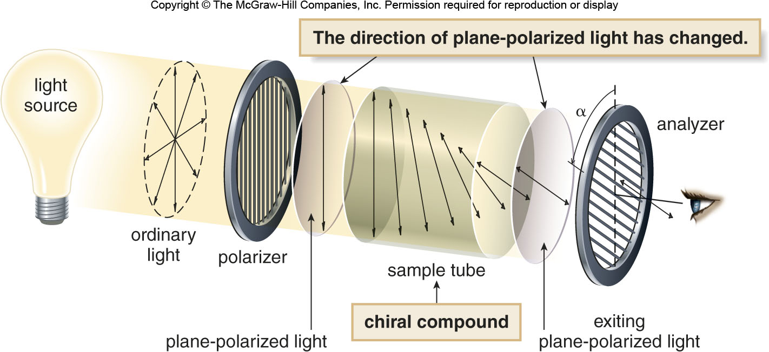
15.7 Optical Activity (2)
The Physical Properties of Enantiomers
An achiral compound does not change the direction of plane-polarized light and is optically inactive.
A chiral compound rotates the plane of polarized light through an angle
and is optically active.

Slide 34
15.7 Optical Activity (3)
The Physical Properties of Enantiomers
If the rotation is clockwise, the compound is dextrorotatory and the (+)-enantiomer.
If the rotation is counterclockwise, the compound is levorotatory and the (−)-enantiomer.
Two enantiomers rotate plane-polarized light to an equal extent but in opposite directions.

Slide 35
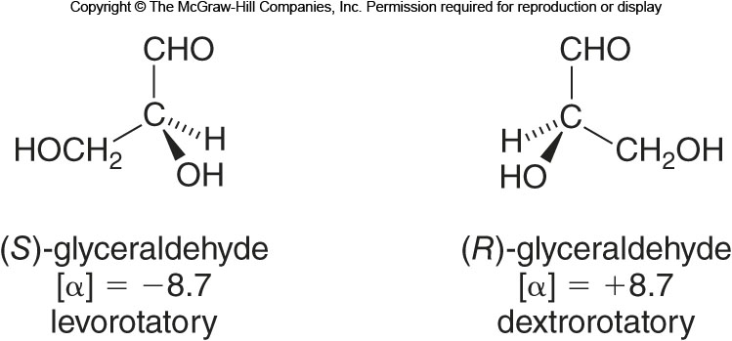
15.7 Optical Activity (4)
Specific Rotation
The specific rotation is the standardized
angle for
a specific enantiomer of a specific compound.

Slide 36
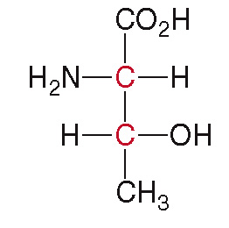
15.8 Compounds with Two or More Chirality Centers (1)
A compound with 1 chirality center has two stereoisomers—a pair of enantiomers.
A compound with 2 chirality centers has four possible stereoisomers.
The amino acid threonine has two chirality centers (labeled in red):

Slide 37
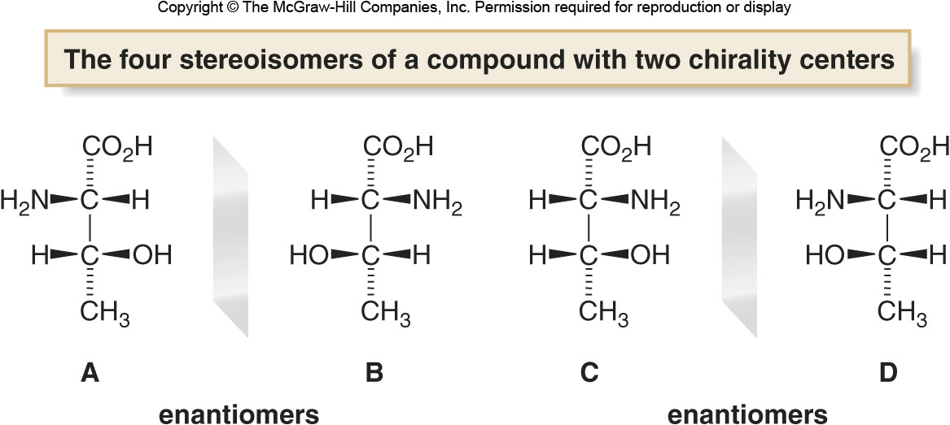
15.8 Compounds with Two or More Chirality Centers (2)
A, B, C, and D are the four stereoisomers of
threonine:
Only the A & B and the C & D pairs are enantiomers.
The A & C and the B & D pairs are diastereomers, stereoisomers that are non-mirror images.

Slide 38
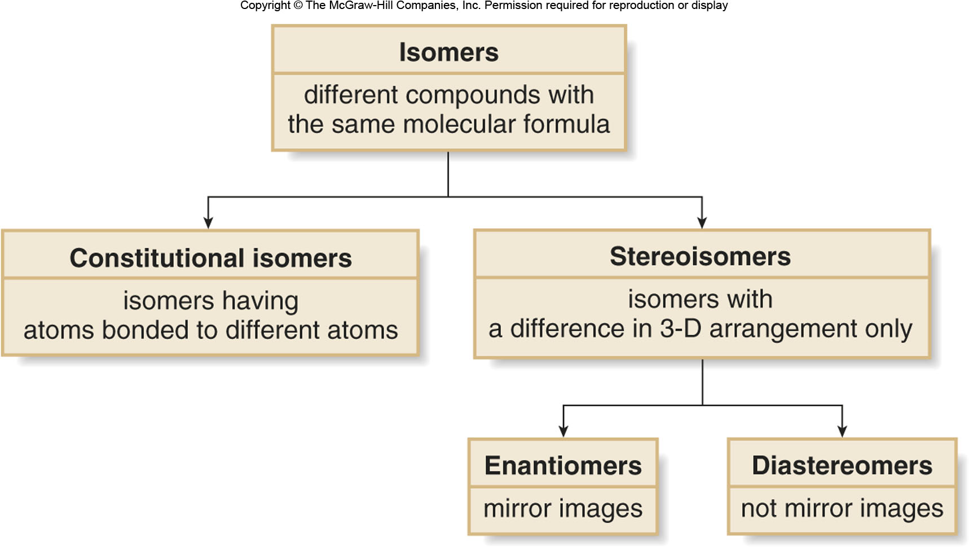
15.8 Compounds with Two or More Chirality Centers (3)

Slide 39
15.9 Focus on the Human Body The Sense of Smell (1)
Research suggests that the odor of a molecule is determined by its shape rather than its functional groups.
Both of the above molecules have a camphor-like odor because they are both roughly spherical shaped.

Slide 40
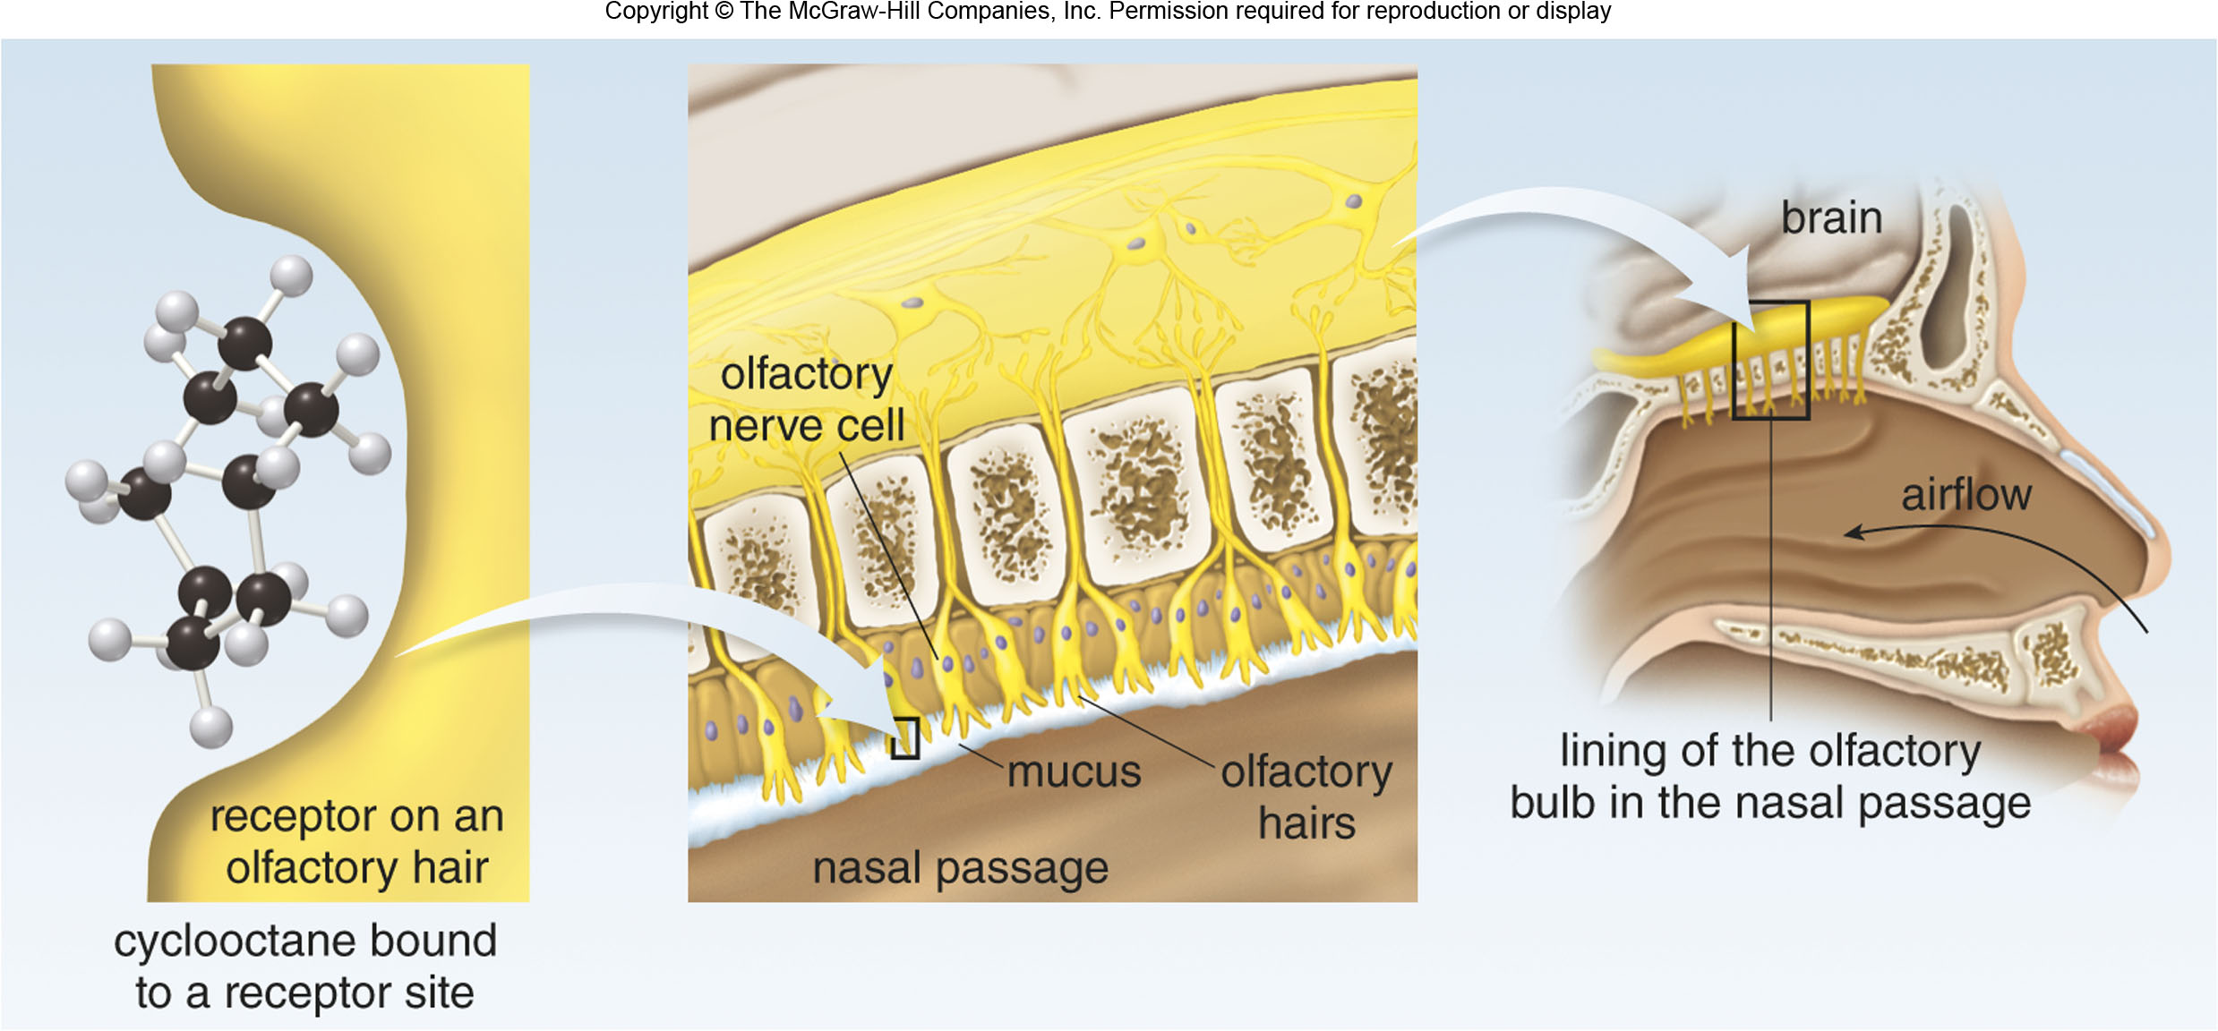
15.9 Focus on the Human Body The Sense of Smell (2)

Slide 41
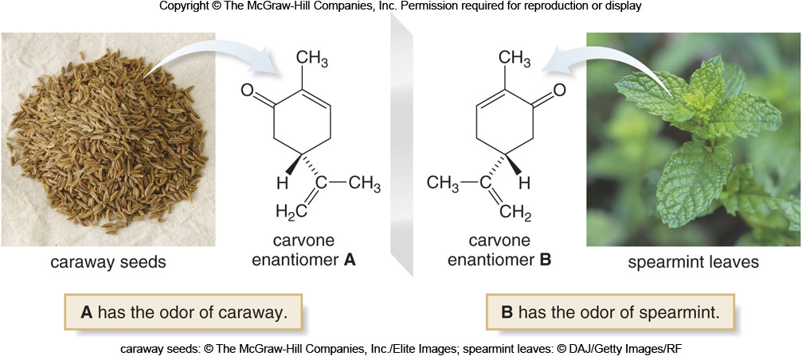
15.9 Focus on the Human Body The Sense of Smell (3)
Two different enantiomers can interact differently with smell receptors in the brain and have different perceived odors.
caraway seeds: © The McGraw-Hill Companies, Inc./Elite Images; spearmint leaves: © DAJ/Getty Images/RF

