Slide 1

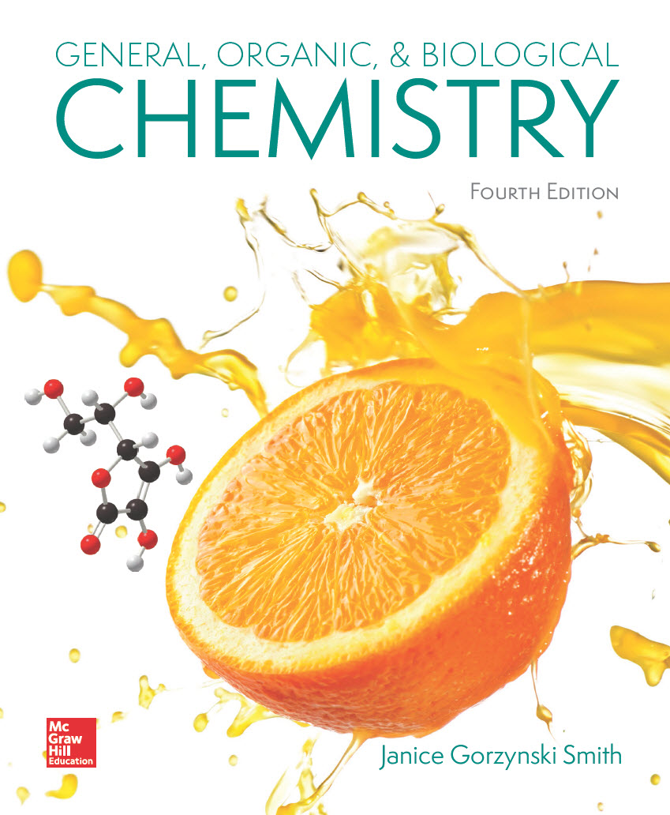
Chapter 18
Lecture Outline
Prepared by
Harpreet Malhotra
Florida State College at Jacksonville

Slide 2
18.1 Structure and Bonding (1)
Amines are organic nitrogen compounds, which are classified by the number of alkyl groups bonded to the N atom.
A secondary
amine has
amine
A primary
1 C—N bond, and has the general structure RNH₂.
has 2 C—N bonds, and has the general structure R₂NH.

Slide 3
18.1 Structure and Bonding (2)
Amines are organic nitrogen compounds, which are classified by the number of alkyl groups bonded to the N atom.
A tertiary
amine has
3 C—N bond, and has the general structure R₃N.

Slide 4
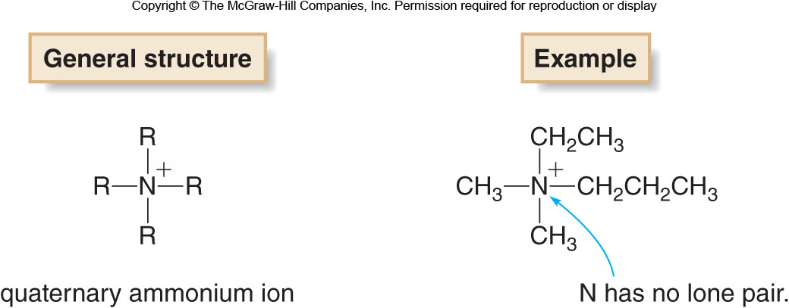
18.1 Structure and Bonding (3)
The
, and
amine N atom has a lone pair of
e⁻ , which is omitted in condensed structures.
The quarternary
amine has no lone pair and
bears a positive charge.

Slide 5
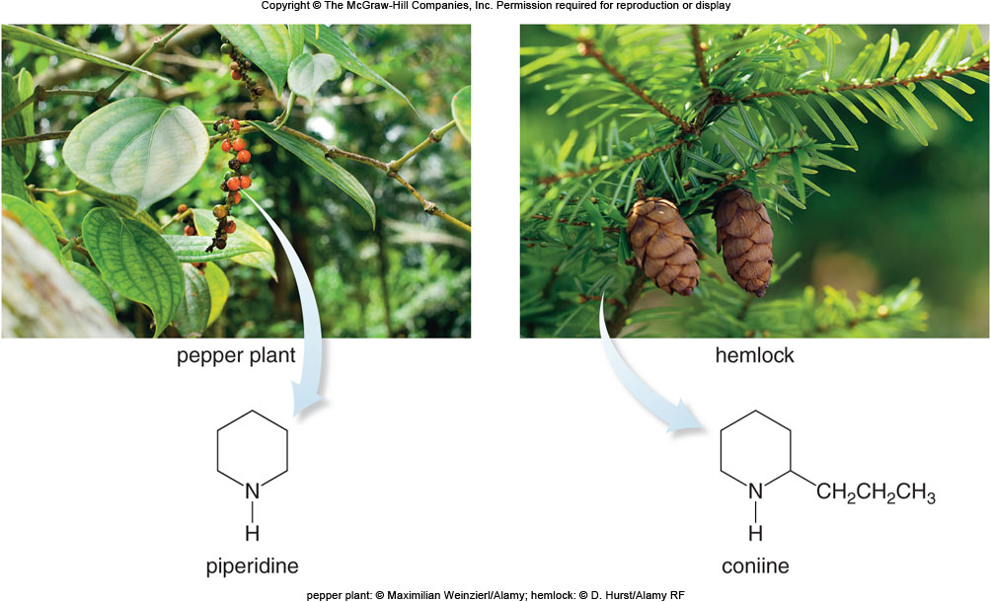
18.1 Structure and Bonding (4)
The amine N atom can also be part of a ring in a heterocycle.
pepper plant: © Maximillian Weinzierl/Alamy; hemlock: © D. Hurst/Alamy RF

Slide 6
18.1 Structure and Bonding (5)
The amine N has a trigonal pyramidal shape, with bond angles of approximately

Slide 7
18.2 Nomenclature (1)
Primary Amines
amines are named with either systematic or
common names.
To find the systematic name:
find the longest carbon chain bonded to the amine N atom
change the “-e” ending of the parent alkane to “-amine”
number and name substituents using usual rules of nomenclature

Slide 8
18.2 Nomenclature (2)
Primary Amines
For the common name, name the alkyl group bonded to the N atom with the suffix “-amine.”
CH₃NH₂
Common name: methylamine
Systematic name: methanamine
Common name: butylamine
Systematic name: 1-butanamine

Slide 9
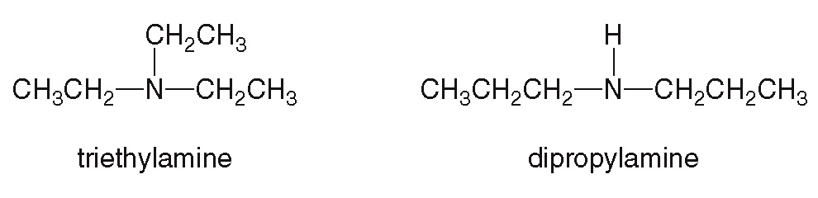
18.2 Nomenclature (3)
Secondary and Tertiary Amines
and
amines with identical alkyl groups are
named using the prefix “di-” or “tri-”:

Slide 10
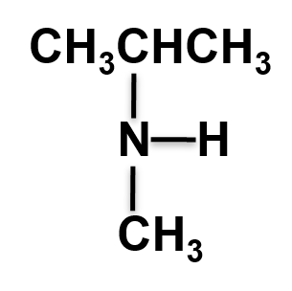
18.2 Nomenclature (4)
Secondary and Tertiary Amines
HOW TO Name
and
Amines with Different
Alkyl Groups
Name the following
Example
amine:

Slide 11
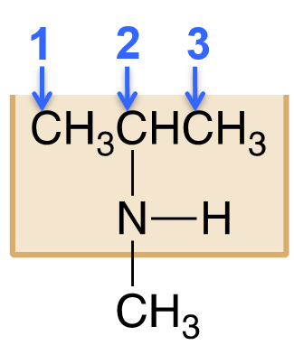
18.2 Nomenclature (5)
Secondary and Tertiary Amines
HOW TO Name
and
Amines with Different
Alkyl Groups
Step [1]
Name the longest alkyl chain bonded to the N atom as the parent amine.
The longest chain has 3 C’s, so it is named propanamine.
The N is on C2, so it is named 2-propanamine.

Slide 12
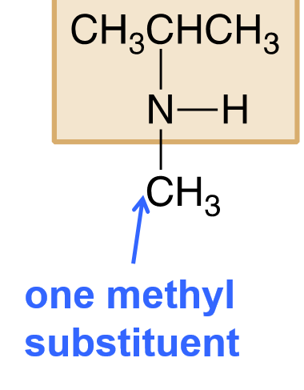
18.2 Nomenclature (6)
Secondary and Tertiary Amines
HOW TO Name
and
Amines with Different
Alkyl Groups
Step [2]
Name the other groups on the N as “N-” alkyl groups.
Answer:
N-methyl-2-propanamide

Slide 13
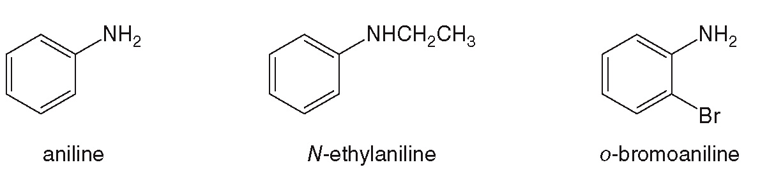
18.2 Nomenclature (7)
Aromatic Amines
Amines with the N directly bonded to a benzene ring are named as derivatives of aniline:

Slide 14
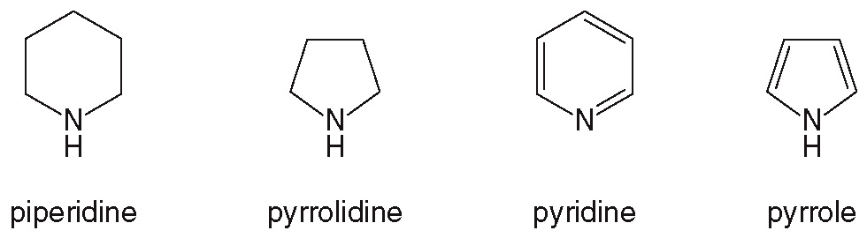
18.2 Nomenclature (8)
Miscellaneous Nomenclature Facts
An NH₂ group is called an amino group when named as a substituent.
Below are come of the common amine hetero-cycles:

Slide 15
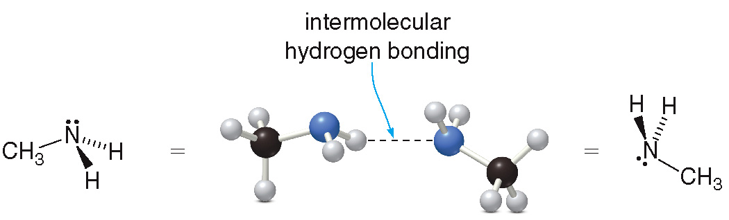
18.3 Physical Properties (1)
Many amines have very foul odors like rotting fish, urine, and bad breath.
Amines are polar molecules, containing either polar C—N or polar H—N bonds.
and
amines can have intermolecular hydrogen
bonding:

Slide 16
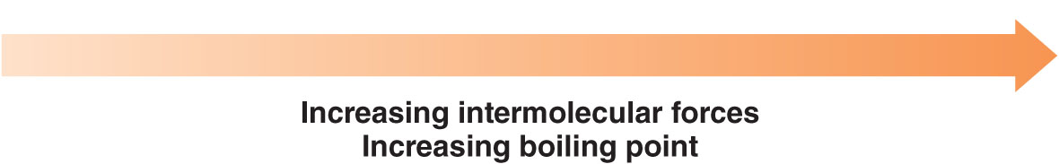
18.3 Physical Properties (2)
and
amines have higher boiling points than
compounds that do not have intermolecular hydrogen bonding.
CH₃CH₂OCH₂CH₃diethyl ether
CH₃CH₂CH₂CH₂NH₂ 1- butanamine
CH₃CH₂CH₂CH₂OH1- butanol
and
amines have lower boiling points than
alcohols, as alcohols have stronger intermolecular hydrogen bonds.

Slide 17
18.3 Physical Properties (3)
amines have lower boiling points than
or
amines because they have no N—H bonds.

Slide 18
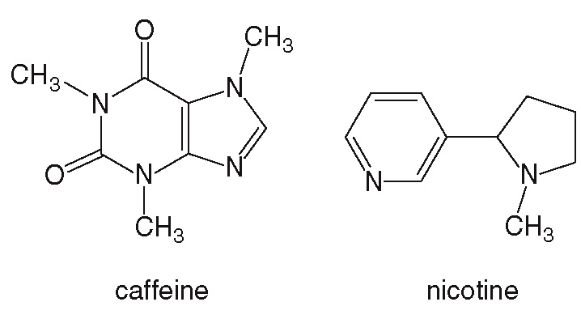
18.4 Focus on Health & Medicine (1)
Caffeine and Nicotine
Caffeine and nicotine are widely used stimulants of the central nervous system that contain amine heterocycles.
They are naturally occurring plant alkaloids.

Slide 19
18.4 Focus on Health & Medicine (2)
Caffeine
Caffeine is a bitter tasting amine found in coffee, tea, soft drinks, and chocolate.
It is a mild stimulant, increasing the heart rate and signaling for glucose production so a person feels energetic.
The effects are temporary, so people must consume more to maintain the same “high.”
In moderation, caffeine poses no health risks, but pregnant and nursing women should limit their intake to reduce exposure to the baby.
Caffeine is somewhat addicting.

Slide 20
18.4 Focus on Health & Medicine (3)
Caffeine
Table 18.1 Average Caffeine Content in Common Foods and Drugs
Product | Serving Size | Caffeine (mg)
Coffee, brewed | 8 oz | 133
Coffee, instant | 16 oz | 47
Coffee, decaffeinated | 8 oz | 5
Tea, brewed | 8 oz | 53
Coca-Cola Classic | 12 oz | 35
Diet Coke | 12 oz | 47
Hershey’s Chocolate Bar | 1.55 oz | 9
Hershey’s Special Dark Chocolate | 1.45 oz | 31
Anacin | 2 tablets | 64
NoDoz | 1 tablet | 200

Slide 21
18.4 Focus on Health & Medicine (4)
Nicotine
Nicotine is a highly toxic amine isolated from tobacco, which acts as a stimulant in small doses.
It is the addictive compound present in inhaled tobacco smoke.
Cigarette smoking causes lung and heart disease, cancer, etc., and is known to be a major health risk.
Because of the powerful addictiveness of nicotine, trying to quit smoking is very difficult.
One quitting method is a nicotine patch placed on the skin, providing the nicotine at ever-decreasing doses until the addiction is overcome.

Slide 22
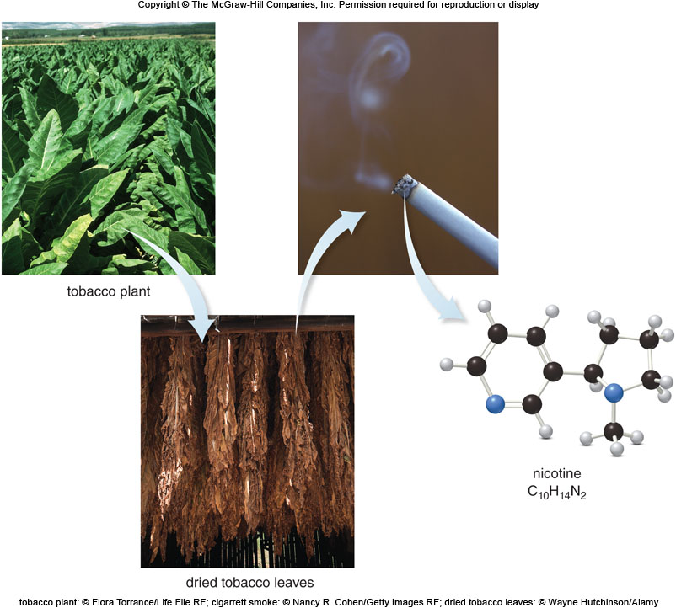
18.4 Focus on Health & Medicine (5)
Nicotine
tobacco plant: © Flora Torrance/Life File RF; cigarrett smoke: © Nancy R. Cohen/Getty Images RF; dried tobacco leaves: © Wayne Hutchinson/Alamy

Slide 23
18.5 Alkaloids (1)
Morphine and Related Alkaloids
Morphine is obtained from the opium poppy, and has been used as a pain reliever for centuries.
Morphine is very addictive, and patients using it long-term must take ever-increasing doses to reach the same effect.
Codeine is also present in the opium poppy, but in smaller amounts.
Codeine is used for less severe pain, but it is still very addictive.

Slide 24
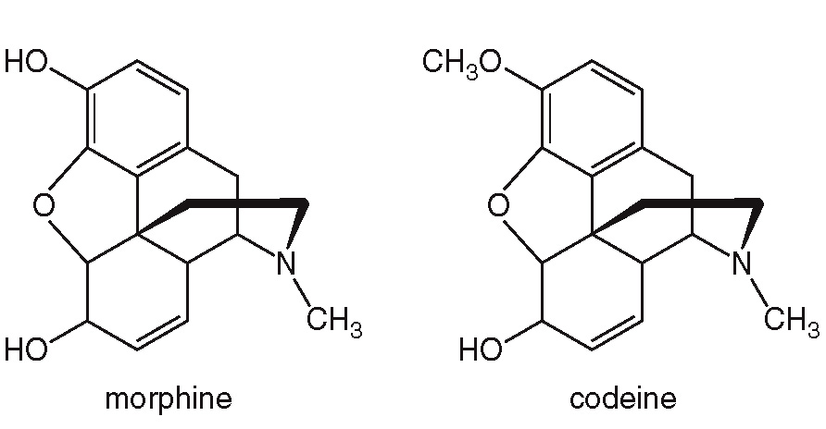
18.5 Alkaloids (2)
A. Morphine and Related Alkaloids

Slide 25
18.5 Alkaloids (3)
Morphine and Related Alkaloids
Heroin, the very addictive illegal drug, is made from morphine.
It is less polar than morphine, making it more soluble in the body’s fat cells.
This makes heroin 2 to 3 times more potent than morphine in producing euphoria and pain relief.

Slide 26
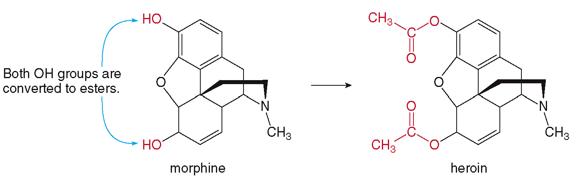
18.5 Alkaloids (4)
Morphine and Related Alkaloids

Slide 27
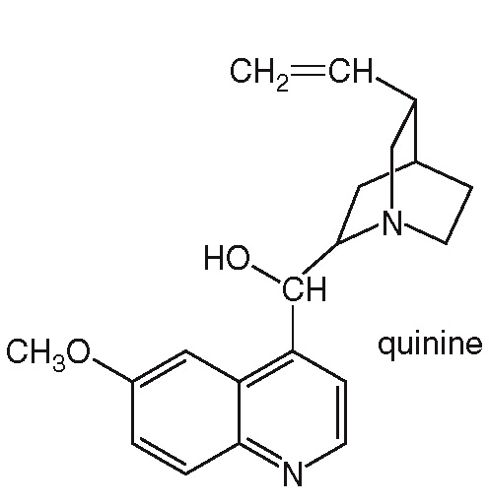
18.5 Alkaloids (5)
Quinine
Quinine is isolated from the bark of the cinchona tree native to the Andes Mountains.
It is a powerful antipyretic (fever reducer), used to treat malaria.
Quinine gives tonic water its characteristic bitter flavor.

Slide 28
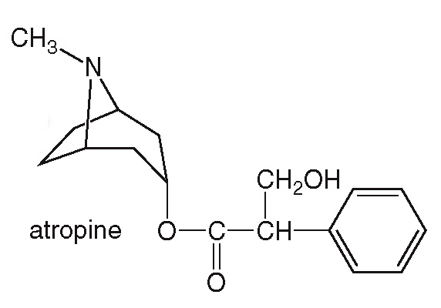
18.5 Alkaloids (6)
Atropine
Atropine is isolated from the Atropa belladonna, or deadly nightshade plant.
During the Renaissance, women used the juice of nightshade berries to enlarge the pupils of their eyes.
It relaxes smooth muscle and interferes with nerve impulses, and is toxic in high doses.

Slide 29
18.6 Amines as Bases (1)
Amines are bases; they are proton
acceptors.

Slide 30
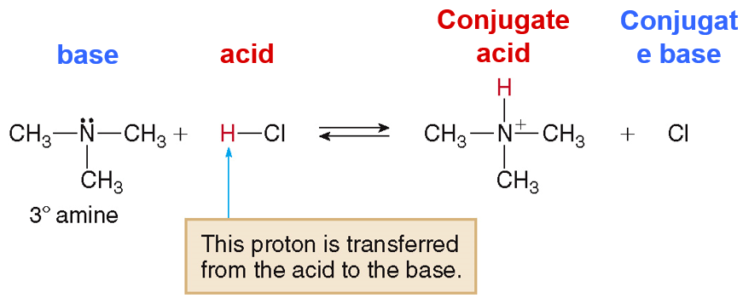
18.6 Amines as Bases (2)
Reaction of Amines with Acids
Amines react with acids (HCl) to form water-soluble salts.

Slide 31
18.6 Amines as Bases (3)
Ammonium Salts
The products of the acid/base reaction form an ammonium salt.

Slide 32
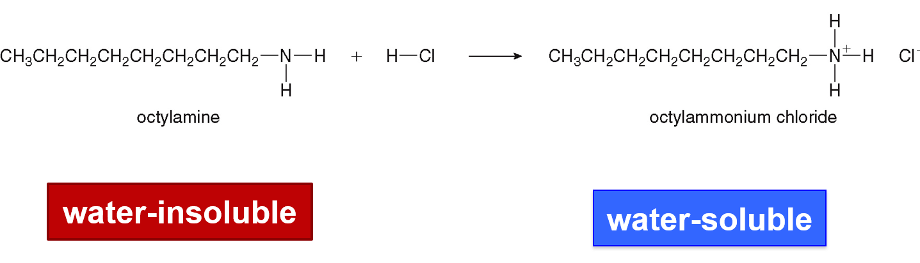
18.6 Amines as Bases (4)
Ammonium Salts
A water-insoluble amine is converted to a water-
soluble ammonium salt by treatment with acid.

Slide 33
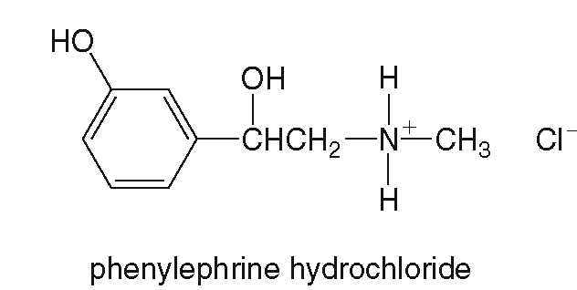
18.7 Focus on Health & Medicine
Ammonium Salts as Useful Salts (1)
Many amines with medicinal properties are sold as their ammonium salts, which are transported through the aqueous bloodstream.
Some examples include Sudafed, sold as the salt phenylephrine hydrochloride, shown below.

Slide 34
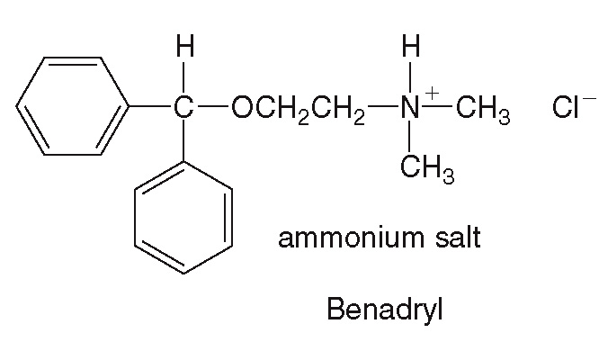
18.7 Focus on Health & Medicine
Ammonium Salts as Useful Salts (2)
The antihistimine Benadryl is sold as the salt diphenhydramine hydrochloride.

Slide 35
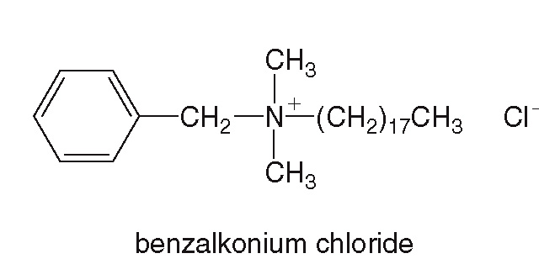
18.7 Focus on Health & Medicine
Ammonium Salts as Useful Salts (3)
The antiseptic benzalkonium chloride is used as a disinfectant and in mouthwash. It is also used to deter children from biting their nails or sucking their thumbs, due to its foul taste.

Slide 36
18.8 Neurotransmitters (1)
A neurotransmitter is a chemical messenger that transmits nerve impulses from one neuron to another.
The space between the two neurons is called a synapse.
The presynaptic neuron releases the neuro-transmitter.
The postsynaptic neuron contains the receptors that bind the neurotransmitter.

Slide 37
18.8 Neurotransmitters (2)
Once the neurotransmitter is bound to the receptor, the chemical message is delivered.
The transmitter is then degraded or returned to the presynaptic neuron to begin the process again.
Some drugs are used to prevent the release of a neurotransmitter or to block its binding to a receptor.
Other drugs increase the amount of neuro-transmitter released.

Slide 38
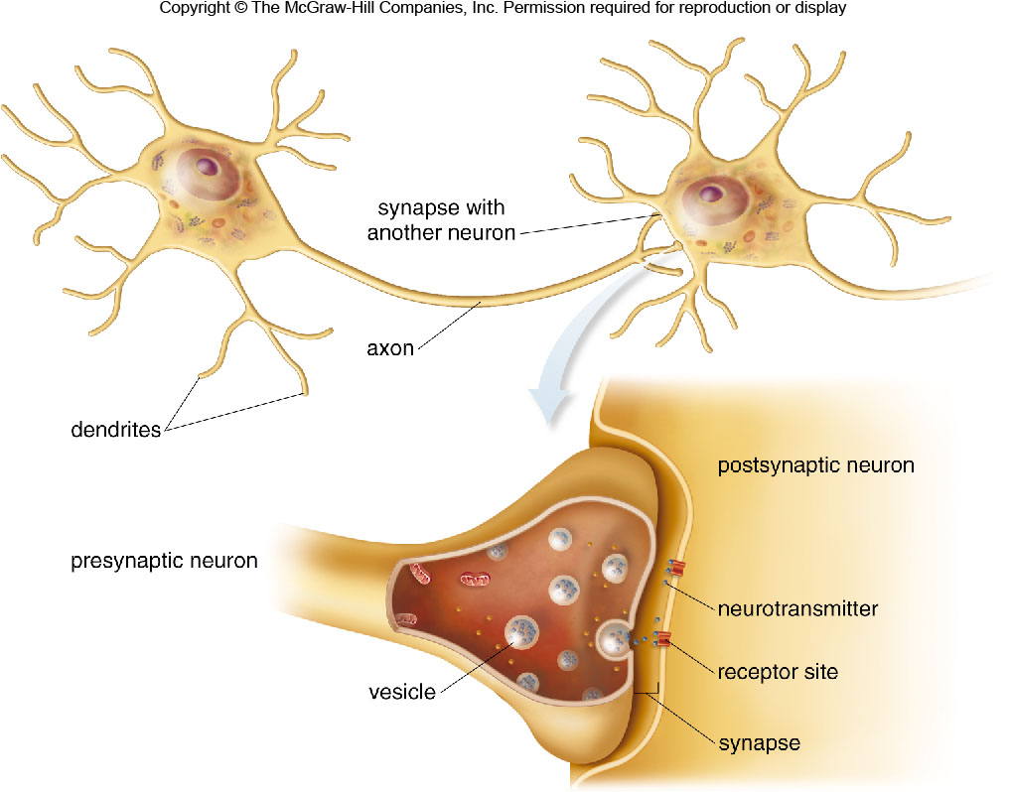
18.8 Neurotransmitters (3)

Slide 39
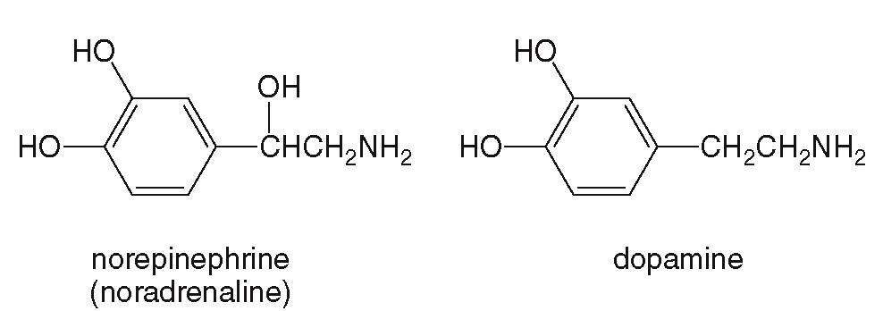
18.8 Neurotransmitters (4)
Norepinephrine and Dopamine

Slide 40
18.8 Neurotransmitters (5)
Norepinephrine and Dopamine
These two are structurally related as they are both synthesized from the amino acid tyrosine.
When norepinephrine levels increase, a person feels elated, and then manic if levels go too high.
Norepinephrine is converted into adrenaline when a person experiences fear or stress.
Dopamine affects the brain processes that control movement, emotions, and pleasure.
Patients with Parkinson’s disease have decreased levels of dopamine in the body.

Slide 41
18.8 Neurotransmitters (6)
Norepinephrine and Dopamine
Injecting dopamine is not a treatment for Parkinson’s because it cannot cross the blood- brain barrier.
L-Dopa, a precursor, can be used because it does cross the barrier into the brain where it is converted into dopamine.
Overly high levels of dopamine are unhealthy and are associated with schizophrenia.

Slide 42
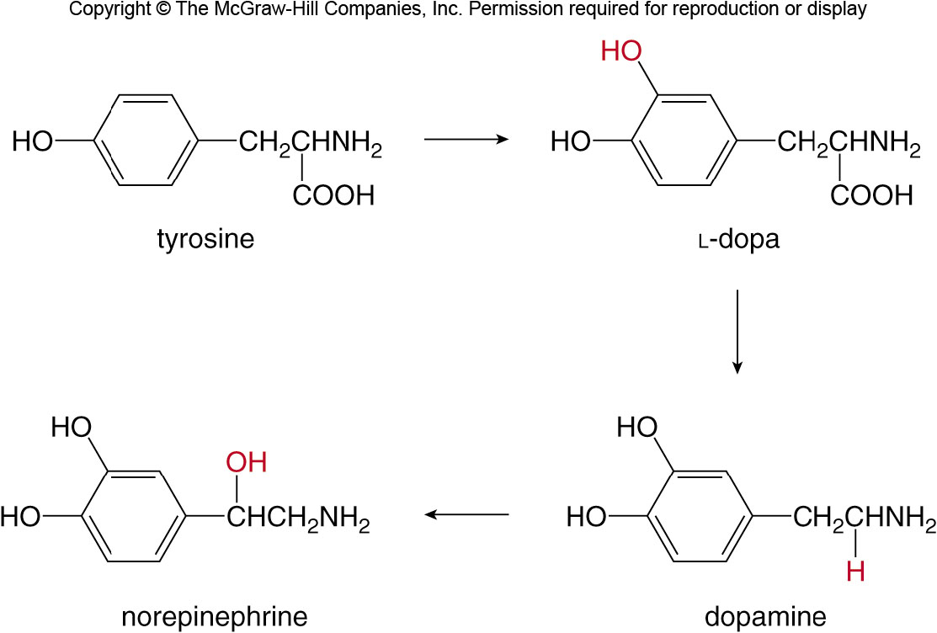
18.8 Neurotransmitters (7)
Norepinephrine and Dopamine

Slide 43
18.8 Neurotransmitters (8)
Norepinephrine and Dopamine
Dopamine plays an important role in addiction.
Drugs such as heroin, cocaine, and alcohol increase dopamine levels and give a sensation of pleasure.
When dopamine receptors are over-stimulated, they decrease in number and sensitivity.
The person needs to take more of the pleasure-inducing drug to reach the same “high” sensation as before.

Slide 44
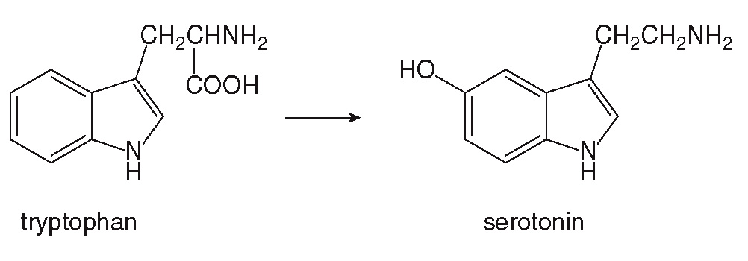
18.8 Neurotransmitters (9)
Serotonin
Serotonin is synthesized from the amino acid tryptophan.

Slide 45
18.8 Neurotransmitters (10)
Serotonin
Serotonin is important in mood, sleep, perception, and temperature regulation.
A deficiency of serotonin causes depression, so many antidepressant drugs are selective serotonin reuptake inhibitors (SSRIs).
The drugs inhibit the reuptake of serotonin by the presynaptic neuron, effectively increasing its concentration.

Slide 46
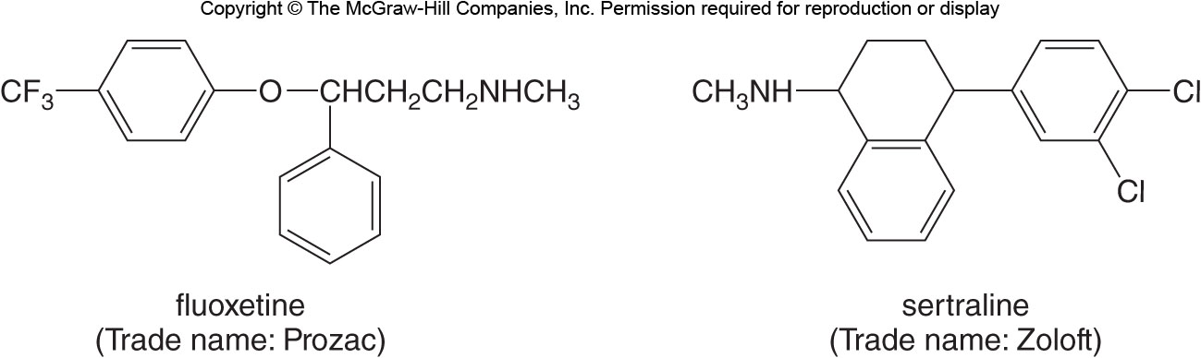
18.8 Neurotransmitters (11)
Serotonin
Examples of antidepressant drugs are shown below:

Slide 47
18.8 Neurotransmitters (12)
Serotonin
Improper levels of serotonin can also cause migraine headaches.
These combine pain, nausea, and sensitivity to light and are being combated with medicines like the ones shown below:

Slide 48
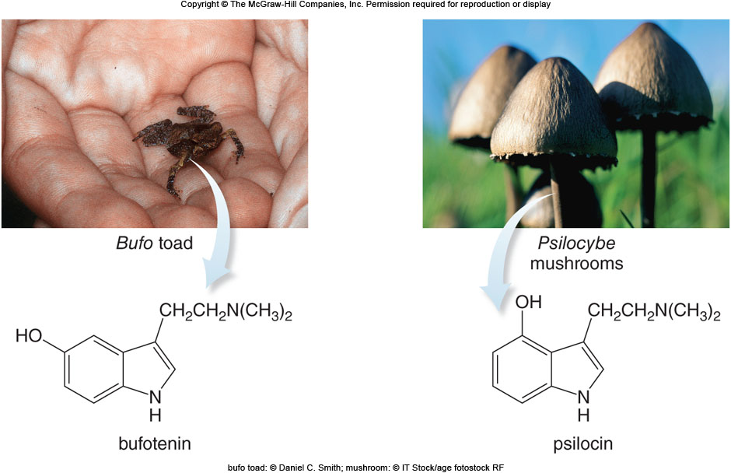
18.8 Neurotransmitters (13)
Serotonin
Compounds bufotenin and psilocin are very similar in structure to serotonin, and they both cause intense hallucinations.
bufo toad: © Daniel C. Smith; mushroom: © IT Stock/age fotostock RF

Slide 49
18.8 Neurotransmitters (14)
Acetylcholine and Nicotine Addiction
Acetylcholine is a quaternary ammonium ion that serves as a neurotransmitter between neurons and muscle cells.

Slide 50
18.8 Neurotransmitters (15)
Acetylcholine and Nicotine Addiction
At low concentrations, nicotine binds to acetyl-choline receptors, resulting in feelings of wellbeing and alertness.
This triggers other nerve cells to release dopamine, which increases the pleasure sensation.
A person becomes addicted to the pleasure sensation gained from taking in nicotine.
As the dopamine receptors deplete over time, a person will crave more nicotine to reproduce the “high” feelings.

Slide 51
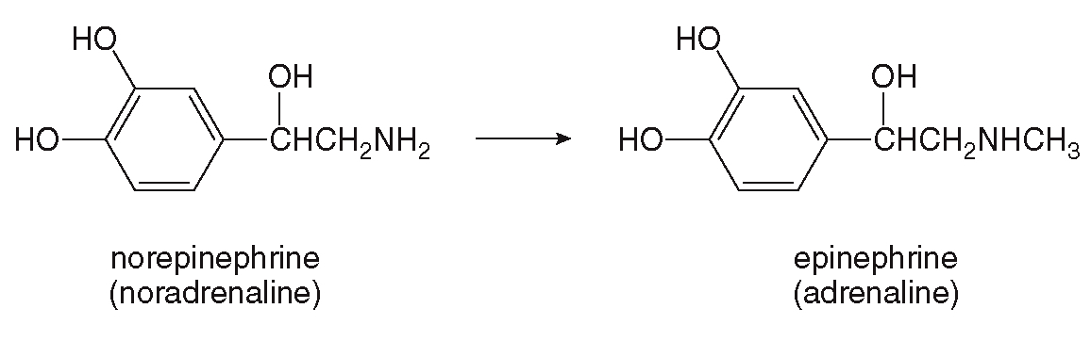
18.9 Focus on the Human Body
Epinephrine and Related Compounds (1)
A hormone is a compound produced by an endocrine gland, which travels through the bloodstream to a target tissue or organ.
Epinephrine (adrenaline) is a hormone made from norepinephrine, the neurotransmitter.

Slide 52
18.9 Focus on the Human Body
Epinephrine and Related Compounds (2)
Danger or emotional stress causes the formation of epinephrine.
The body will metabolize stored carbohydrates to form glucose, which is further metabolized to provide an energy boost.
The heart rate increases and lung passages are dilated.
This effect is known as a “rush of adrenaline” or “fight or flight” response.

Slide 53
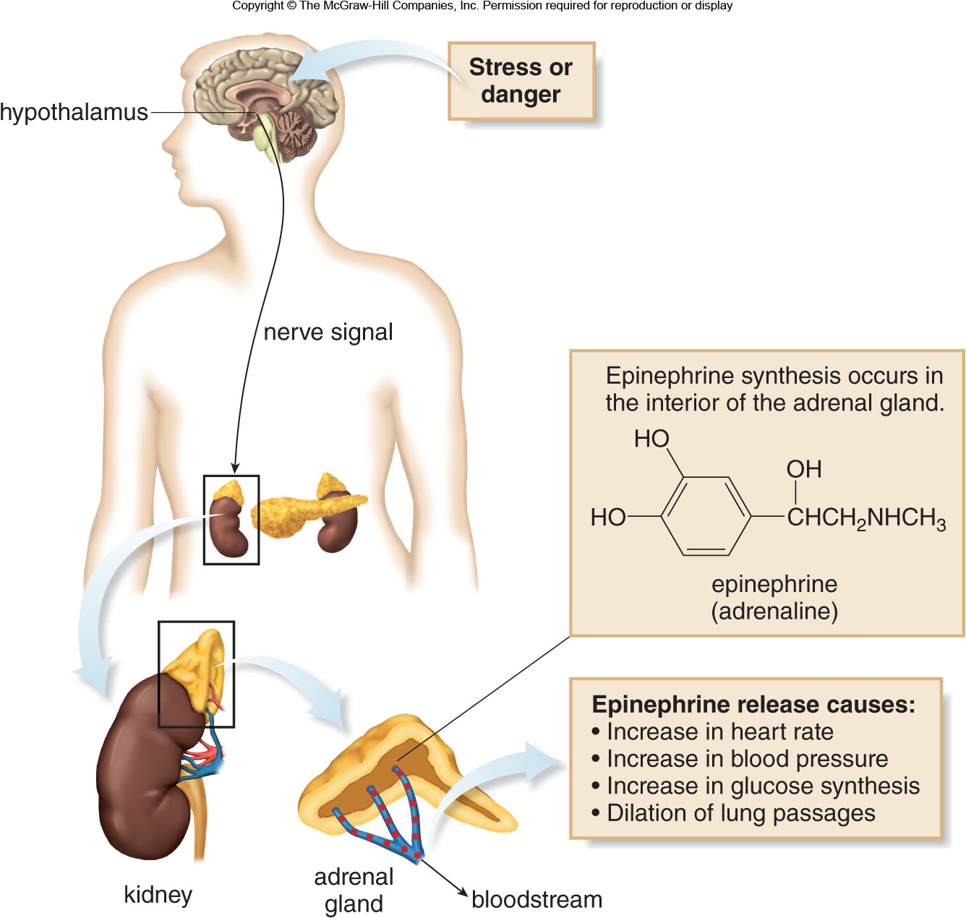
18.9 Focus on the Human Body
Epinephrine and Related Compounds (3)

Slide 54
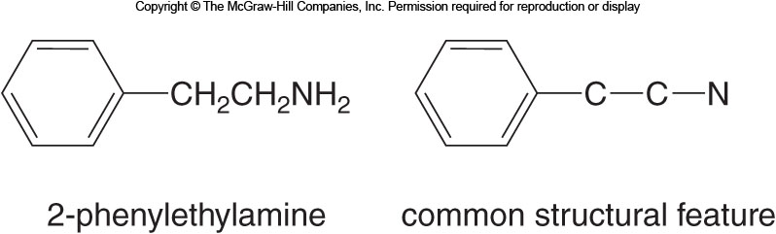
18.9 Focus on the Human Body (1)
Derivatives of 2-Phenylethylamine
A large number of physiologically active compounds are derived from 2-phenylethylamine:

Slide 55
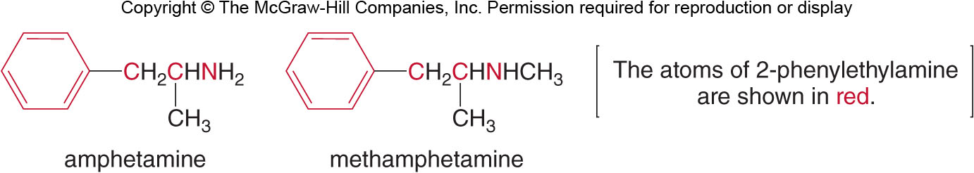
18.9 Focus on the Human Body (2)
Derivatives of 2-Phenylethylamine
Amphetamine and methamphetamine are examples which are powerful stimulants of the central nervous system.
While these drugs are useful as treatment for Attention Deficit Hyperactivity Disorder (ADHD), they are also highly addictive and widely abused.

Slide 56
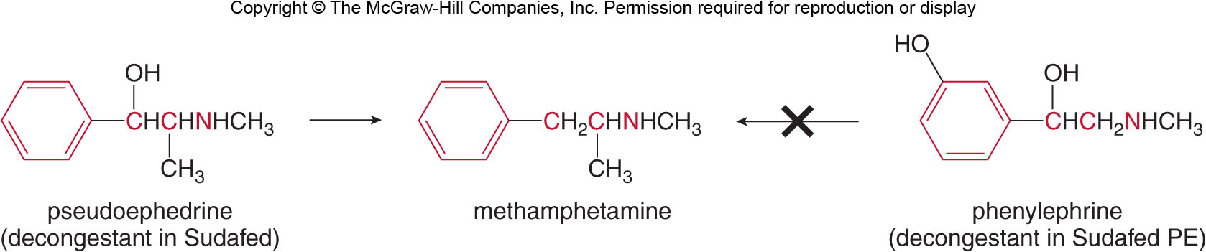
18.9 Focus on the Human Body (3)
Derivatives of 2-Phenylethylamine
Pseudoephedrine, sold over the counter as Sudafed, can be readily converted to methamphetamine.
This ingredient is being replaced by phenylephedrine which does not undergo a similar conversion.

Slide 57
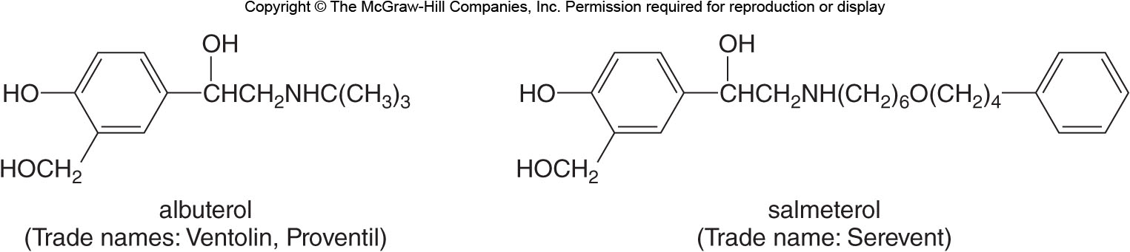
18.9 Focus on the Human Body (4)
Drugs to Treat Asthma
Drugs that are structurally similar to epinephrine are used as bronchodilators.
They do not stimulate the heart, but they do dilate lung tissue which helps patients with asthma breath normally.

Slide 58
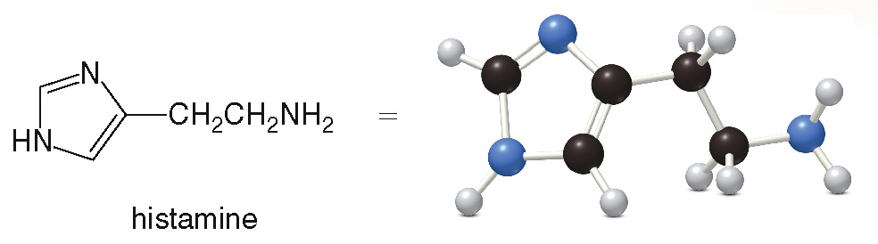
18.10 Focus on the Health & Medicine Histamine and Antihistamines (1)
Histamine is a biologically active amine formed in many tissues.
Histamine is a neurotransmitter with two different receptors (H1 and H2) with a wide range of effects on the body.

Slide 59
18.10 Focus on Health & Medicine
Histamine and Antihistamines (2)
Histamine dilates capillaries (vasodilator), causes the symptoms of allergies, and stimulates the secretion of stomach acid.
Common antihistamines block histamine uptake by binding to the H1 receptor.
This prevents vasodilation, easing cold and allergy symptoms, but it causes drowsiness when H1 receptors in the brain are also blocked.
Newer antihistamines cannot cross the blood-brain barrier, leaving brain H1 receptors open, and preventing drowsiness.

Slide 60
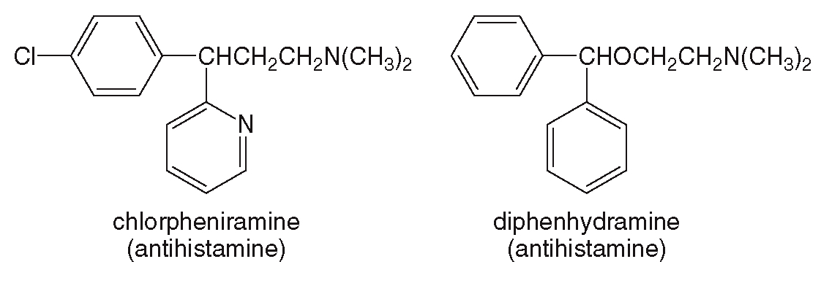
18.10 Focus on Health & Medicine
Histamine and Antihistamines (3)
Some common drowsiness-inducing antihistamines:

Slide 61
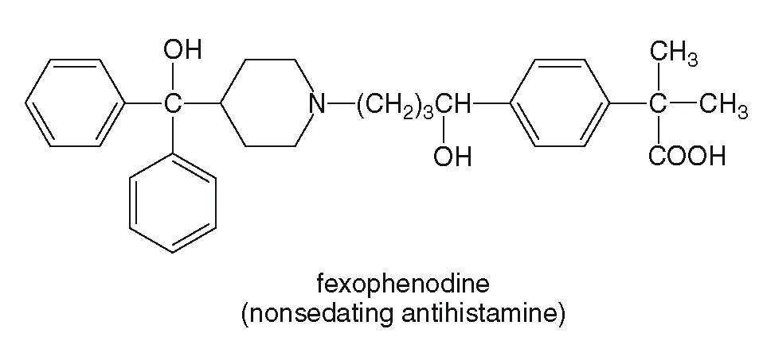
18.10 Focus on Health & Medicine
Histamine and Antihistamines (4)
A newer antihistamine which does not cause drowsiness (sold as Allegra):

Slide 62
18.10 Focus on Health & Medicine
Histamine and Antihistamines (5)
Drugs that bind to the H2 receptor product a different effect.
For example, cimetidine, which is sold as Tagamet, reduces stomach acid secretion, and is therefore an anti-ulcer medication.

