Slide 1

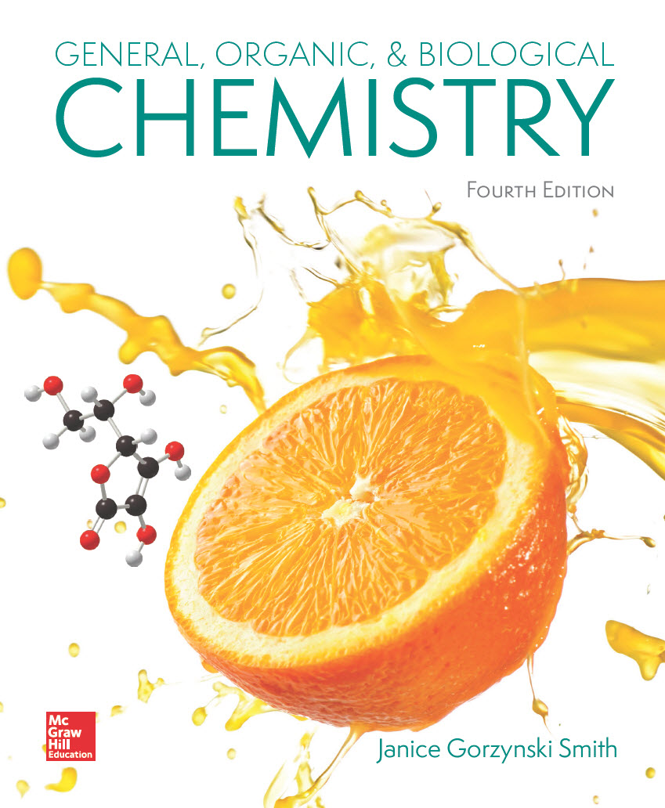
Chapter 20
Lecture Outline
Prepared by
Harpreet Malhotra
Florida State College at Jacksonville

Slide 2
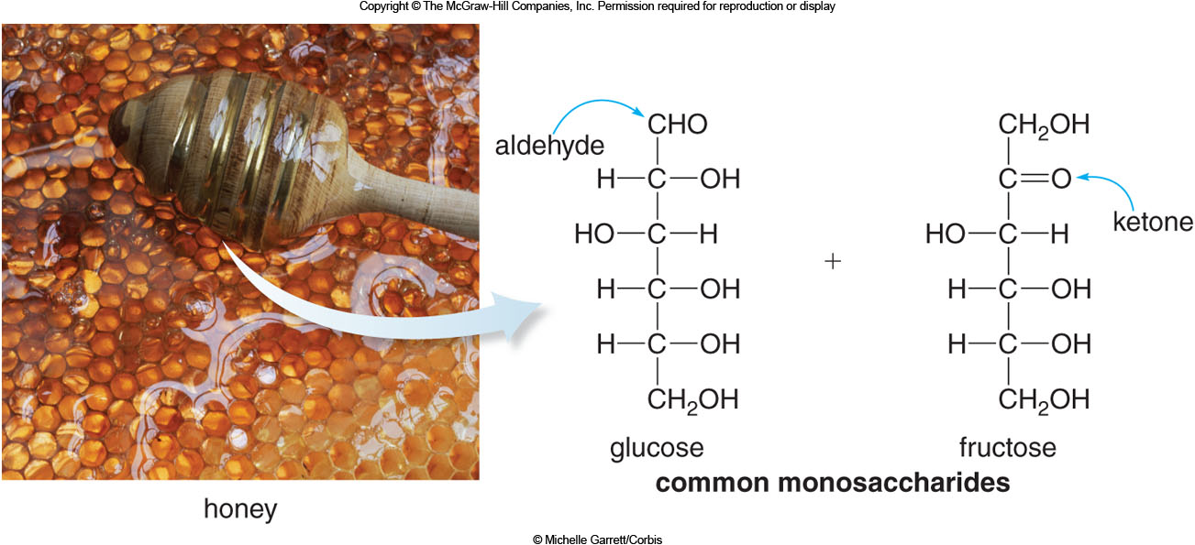
20.1 Carbohydrates (1)
Carbohydrates, called sugars and starches, are polyhydroxy aldehydes or ketones, or compounds that can be hydrolyzed to them.
The simplest carbohydrates are monosaccharides.
© Michelle Garrett/Corbis

Slide 3
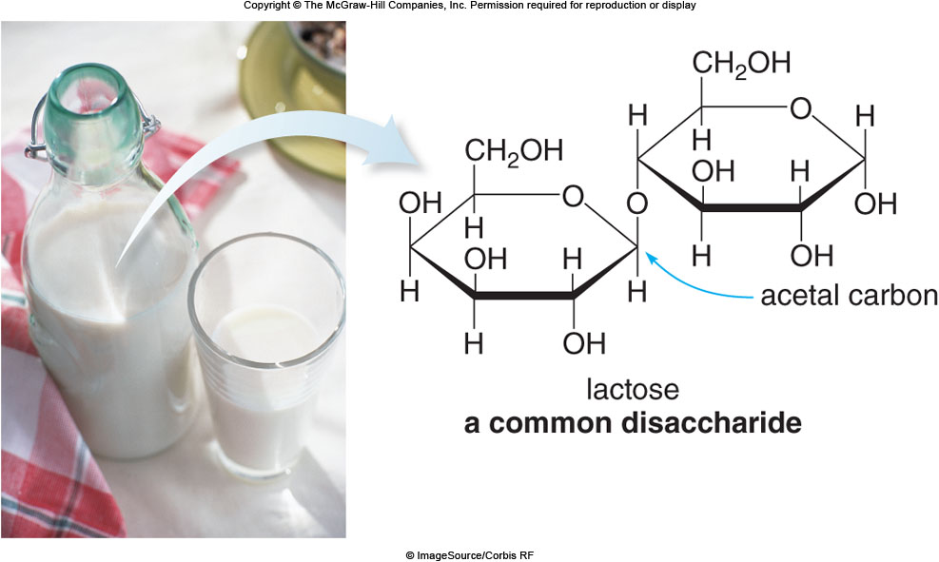
20.1 Carbohydrates (2)
Disaccharides are composed of two monosaccharide units joined together.
© ImageSource/Corbis RF

Slide 4
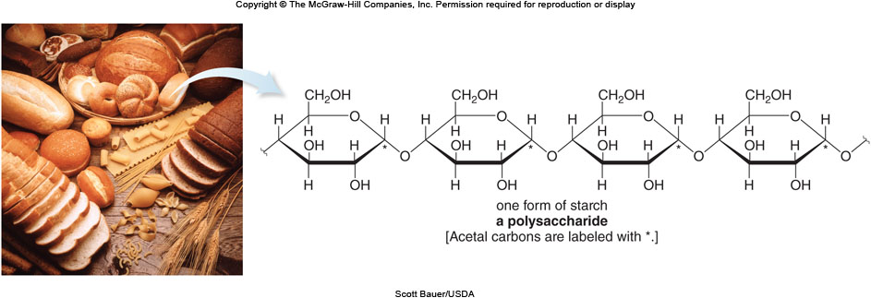
20.1 Carbohydrates (3)
Polysaccharides are composed of three or more monosaccharide units joined together.
Scott Bauer/USDA

Slide 5
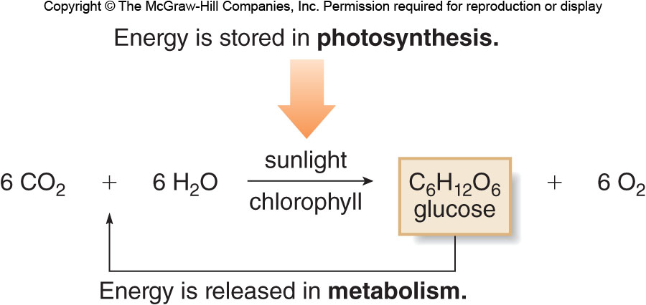
20.1 Carbohydrates (4)
Carbohydrates are synthesized in green plants by photosynthesis, whereby energy from the sun is stored as chemical energy in carbohydrates.
In the body, they are used for bursts of energy needed during exercise in the form of glucose.

Slide 6
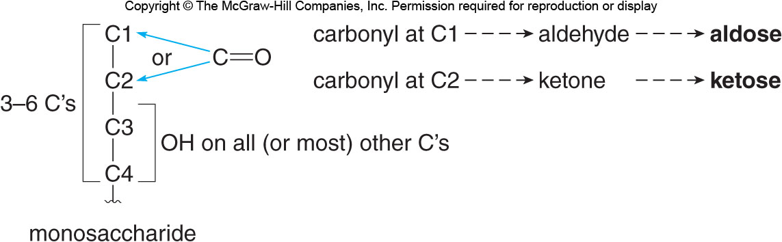
20.2 Monosaccharides (1)
Monosaccharides, the simplest carbohydrates, generally have 3 to 6 C atoms in a chain with an aldehyde or ketone ending and many –OH groups.
Aldehyde monosaccharides are aldoses; ketone monosaccharides are ketoses.

Slide 7
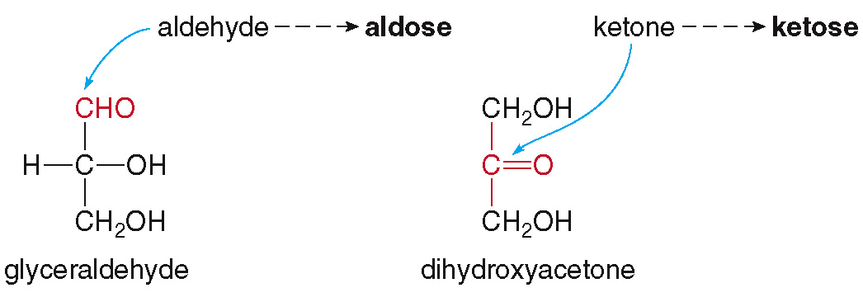
20.2 Monosaccharides (2)
The simplest aldose is glyceraldehyde.
The simplest ketose is dihydroxyacetone.
They are constitutional isomers of each other, sharing the formula C₃H₆O₃.

Slide 8
20.2 Monosaccharides (3)
A monosaccharide is characterized by the number
of C atoms in its chain:
A triose has 3 C’s.
A tetrose has 4 C’s.
A pentose has 5 C’s.
A hexose has 6 C’s.
The terms are then combined with the words aldose
and ketose:
Glyceraldehyde is an aldotriose.
Dihydroxyacetone is a ketotriose.

Slide 9
20.2 Monosaccharides (4)
Monosaccharides are sweet tasting, but their relative sweetness varies greatly.
They are polar compounds with high melting points.
The presence of so many polar functional groups capable of hydrogen bonding makes the monosaccharides very water soluble.

Slide 10
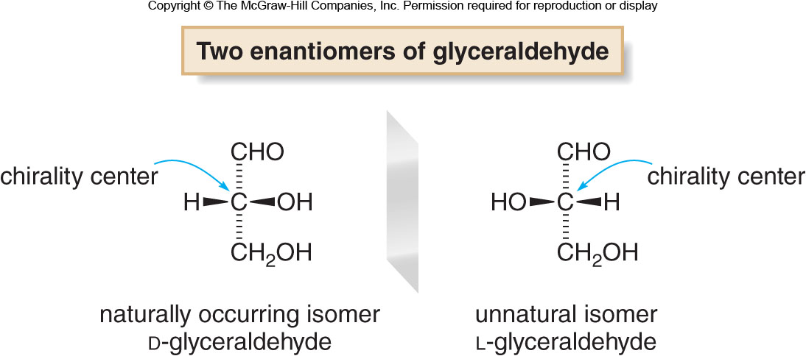
20.2 Monosaccharides (5)
Fischer Projection Formula
All carbohydrates have 1 or more chirality centers.
Glyceraldehyde, the simplest aldose, has one chirality center, and has two possible enantiomers.

Slide 11
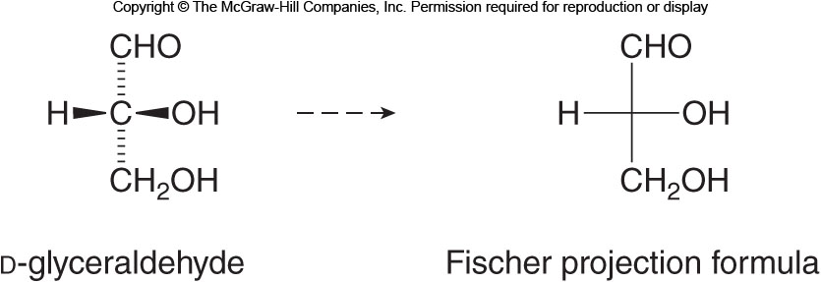
20.2 Monosaccharides (6)
Fischer Projection Formula
The prefix D is used when the –OH group is drawn on the right side of the carbon chain.
The prefix L is used when the –OH group is drawn on the left side of the carbon chain.
The wedged and dashed lines can be re-drawn in a Fischer projection formula:

Slide 12
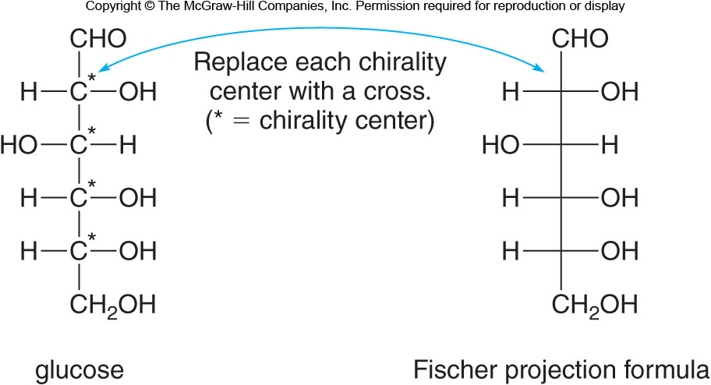
20.2 Monosaccharides (7)
More than One Chirality Center
Glucose has four chirality centers and is drawn as:

Slide 13
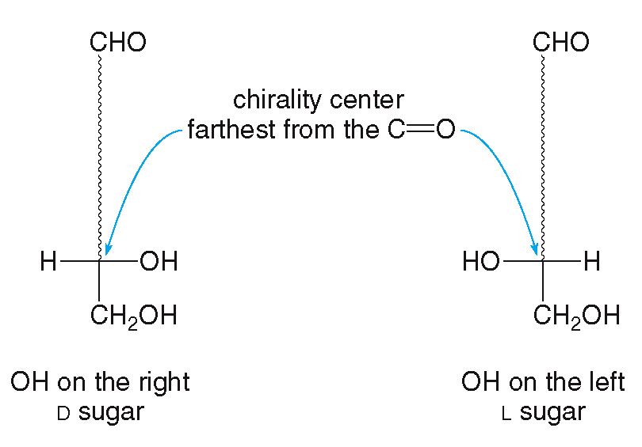
20.2 Monosaccharides (8)
More than One Chirality Center
The configuration of the chirality center farthest from the carbonyl group determines whether a monosaccharide is D or L.

Slide 14
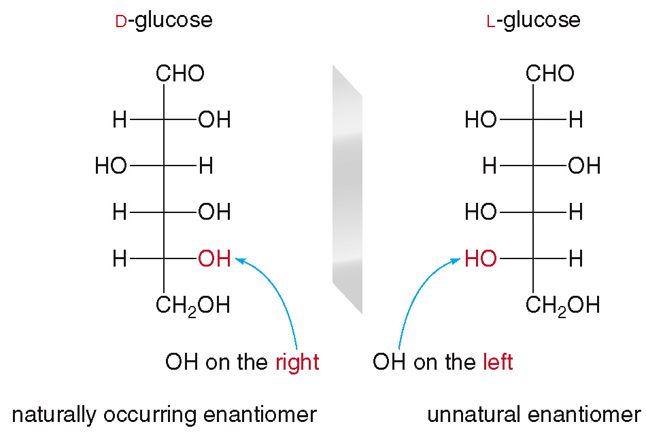
20.2 Monosaccharides (9)
More than One Chirality Center
All naturally occurring sugars are D sugars.

Slide 15
20.2 Monosaccharides (10)
Common Monosaccharides
Glucose (dextrose) is blood sugar and the most abundant monosaccharide.
Normal blood glucose levels are 70-110 mg/dL.
Excess glucose is stored as the polysaccharide glycogen or as fat.
Insulin regulates blood glucose levels by stimulating the uptake of glucose into tissues or the formation of glycogen.
Patients with diabetes produce insufficient insulin to adequately regulate blood sugar levels, so they must monitor their diet and/or inject insulin daily.

Slide 16
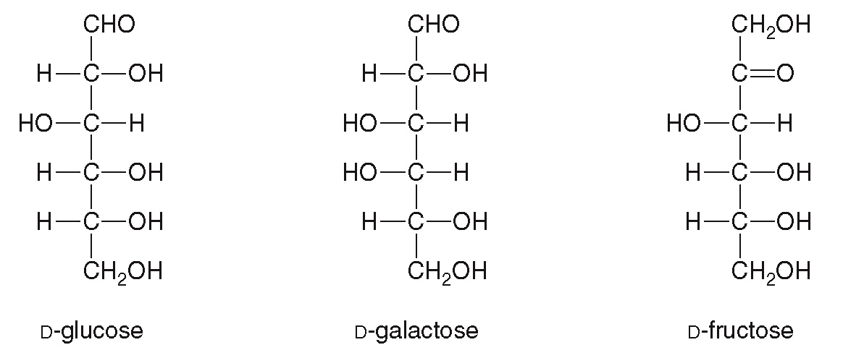
20.2 Monosaccharides (11)
Common Monosaccharides

Slide 17
20.2 Monosaccharides (12)
Common Monosaccharides
Galactose is one of the components of the disaccharide lactose.
Patients with galactosemia lack an enzyme needed to metabolize galactose, which accumulates and causes cataracts and cirrhosis.
Fructose is one of the components of the disaccharide sucrose.
It is a ketohexose found in honey and almost twice as sweet as table sugar with the same number of calories per gram.

Slide 18
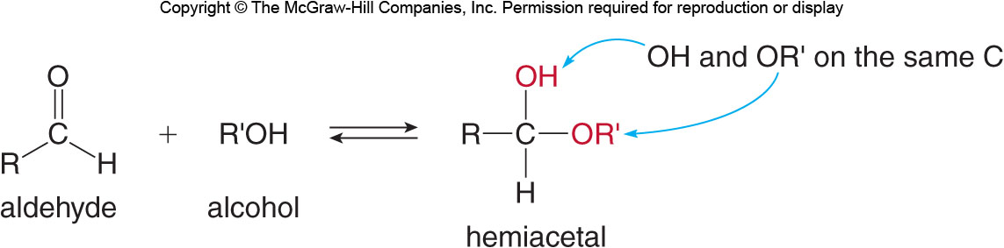
20.3 The Cyclic Forms of Monosaccharides (1)
When an aldehyde reacts with an alcohol, a hemiacetal is formed (Section 16.8):

Slide 19
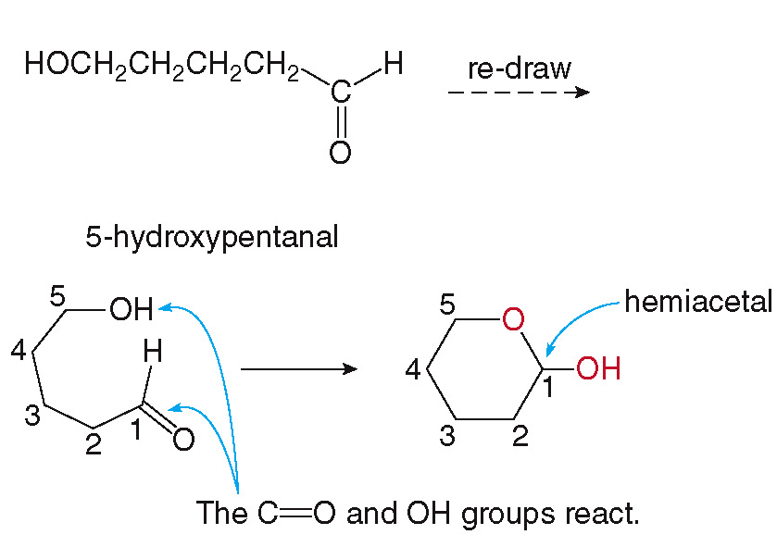
20.3 The Cyclic Forms of Monosaccharides (2)
When the aldehyde and alcohol are on the same molecule, a stable cyclic hemiacetal is formed:

Slide 20
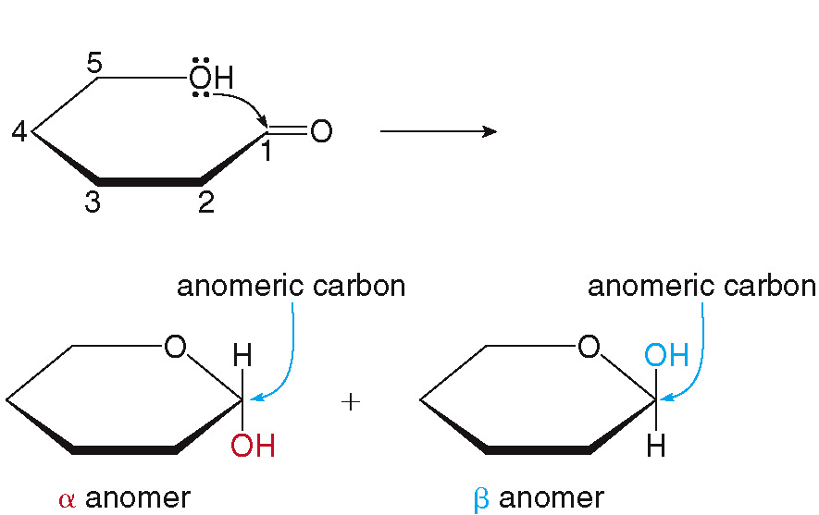
20.3 The Cyclic Forms of Monosaccharides (3)
The C atom that is part of the hemiacetal is a new chirality center, called the anomer carbon.

Slide 21
20.3 The Cyclic Forms of Monosaccharides (4)
The Cyclic Forms of D-Glucose
To cyclize D-glucose, first we must determine which alcohol to use to make a six-membered ring.

Slide 22
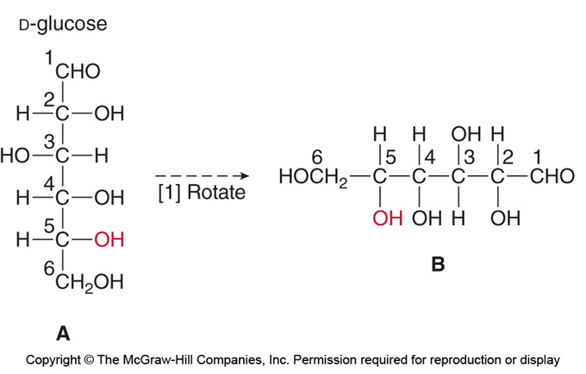
20.3 The Cyclic Forms of Monosaccharides (5)
The Cyclic Forms of D-Glucose
The first step in cyclization is to rotate glucose

Slide 23
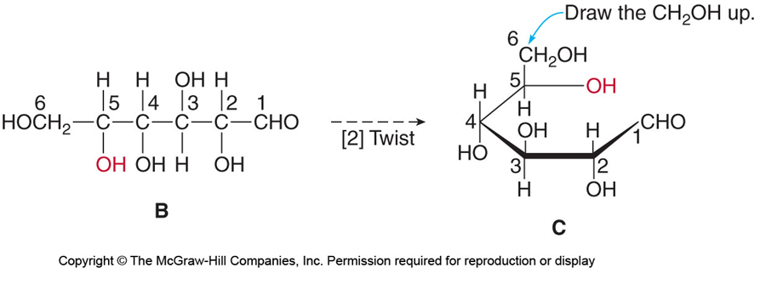
20.3 The Cyclic Forms of Monosaccharides (6)
The Cyclic Forms of D-Glucose
Next, the chain must be twisted around, forming a six-membered ring:

Slide 24
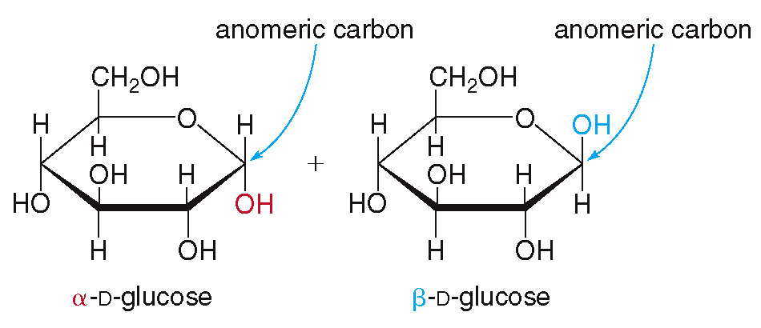
20.3 The Cyclic Forms of Monosaccharides (7)
The Cyclic Forms of D-Glucose
As the reaction occurs, there are two cyclic forms of D-glucose, an
anomer and a
anomer.
These rings are called Haworth projections.

Slide 25
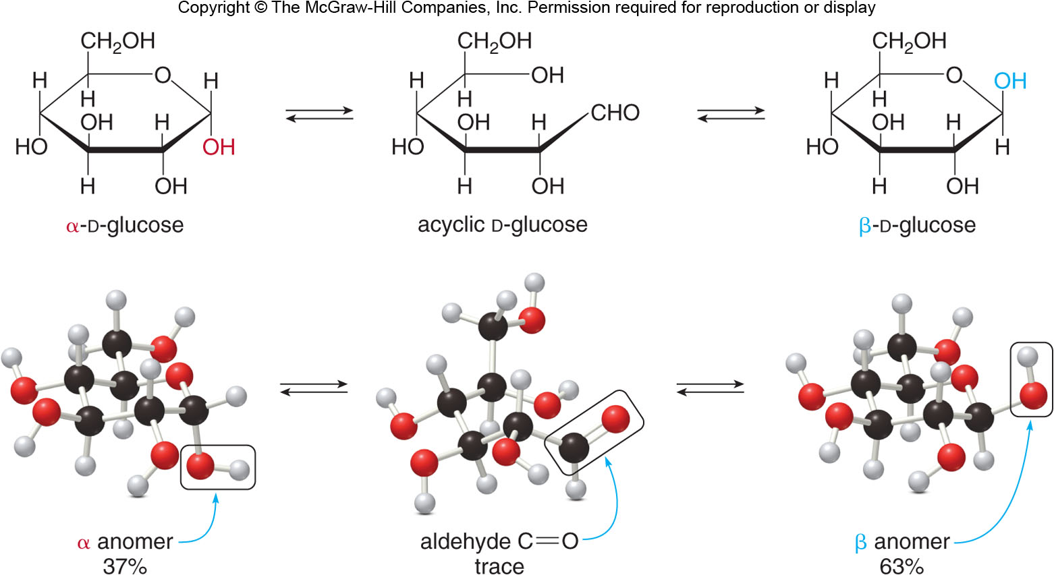
20.3 The Cyclic Forms of Monosaccharides (8)
The Cyclic Forms of D-Glucose
The cyclization reaction exists in an equilibrium
called mutarotation.

Slide 26
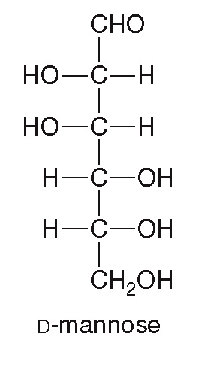
20.3 The Cyclic Forms of Monosaccharides (9)
HOW TO Draw a Haworth Projection from an Acyclic
Aldohexose
Example
Draw both anomers of D-mannose in a Haworth projection.

Slide 27
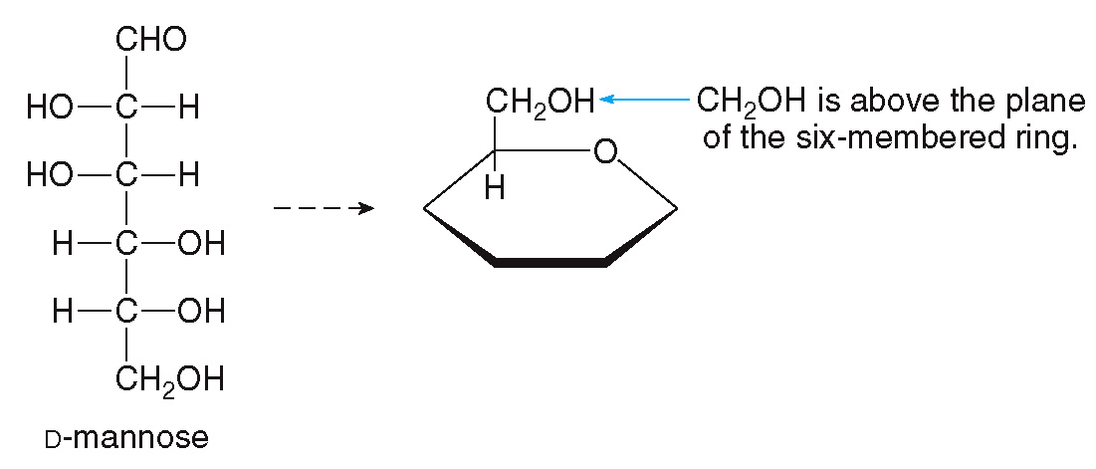
20.3 The Cyclic Forms of Monosaccharides (10)
HOW TO Draw a Haworth Projection from an Acyclic
Aldohexose
Place the O atom in the upper right corner of
a hexagon, and add the CH₂OH group to the
right of the O atom.
Step [1]

Slide 28
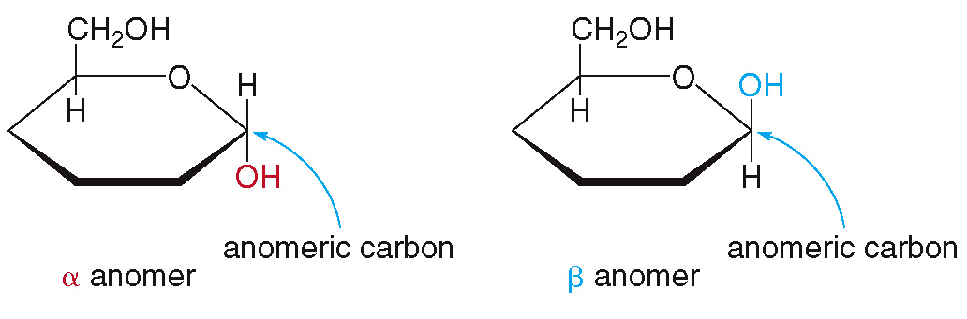
20.3 The Cyclic Forms of Monosaccharides (11)
HOW TO Draw a Haworth Projection from an Acyclic
Aldohexose
Place the anomeric C on the first C clock-
wise from the O atom.
Step [2]

Slide 29
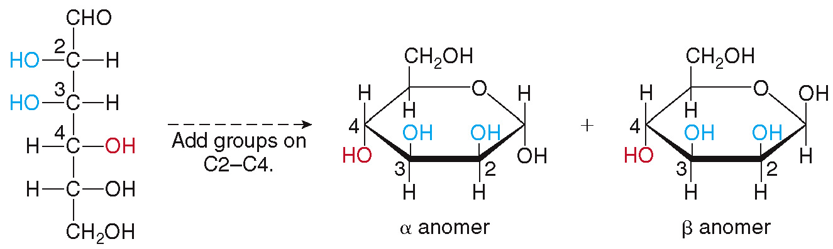
20.3 The Cyclic Forms of Monosaccharides (12)
HOW TO Draw a Haworth Projection from an Acyclic
Aldohexose
Add the other substituents to the remaining
carbons, clockwise around the ring.
Step [3]

Slide 30
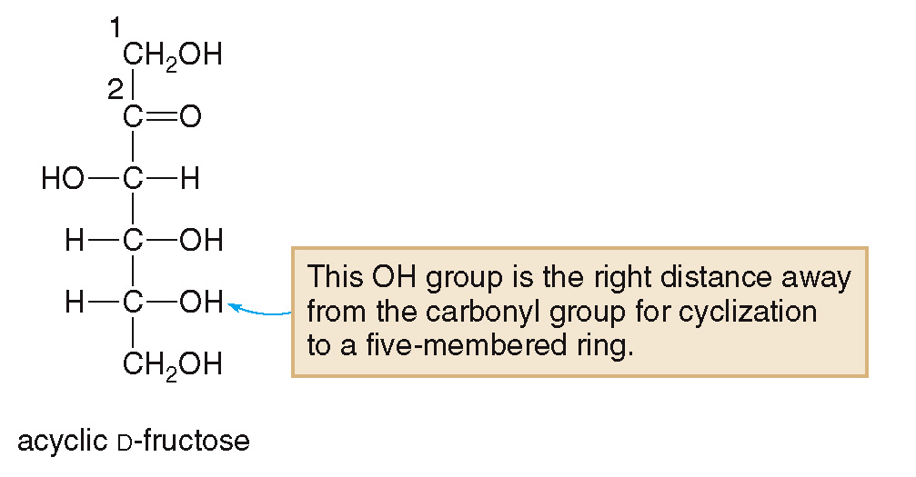
20.3 The Cyclic Forms of Monosaccharides (13)
The Cycle Forms of Fructose
Ketohexoses like fructose form five-membered rings with two anomers.

Slide 31
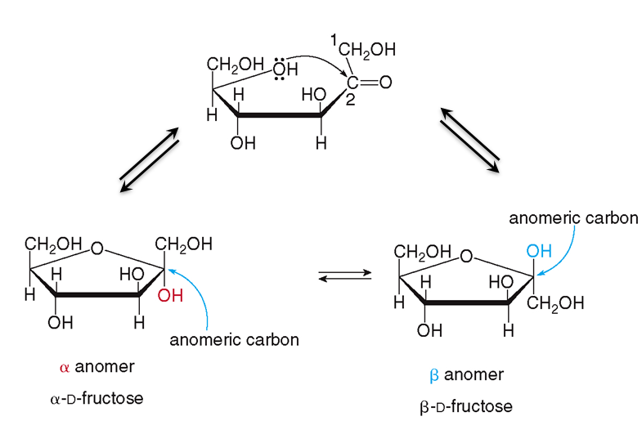
20.3 The Cyclic Forms of Monosaccharides (14)
The Cycle Forms of Fructose

Slide 32
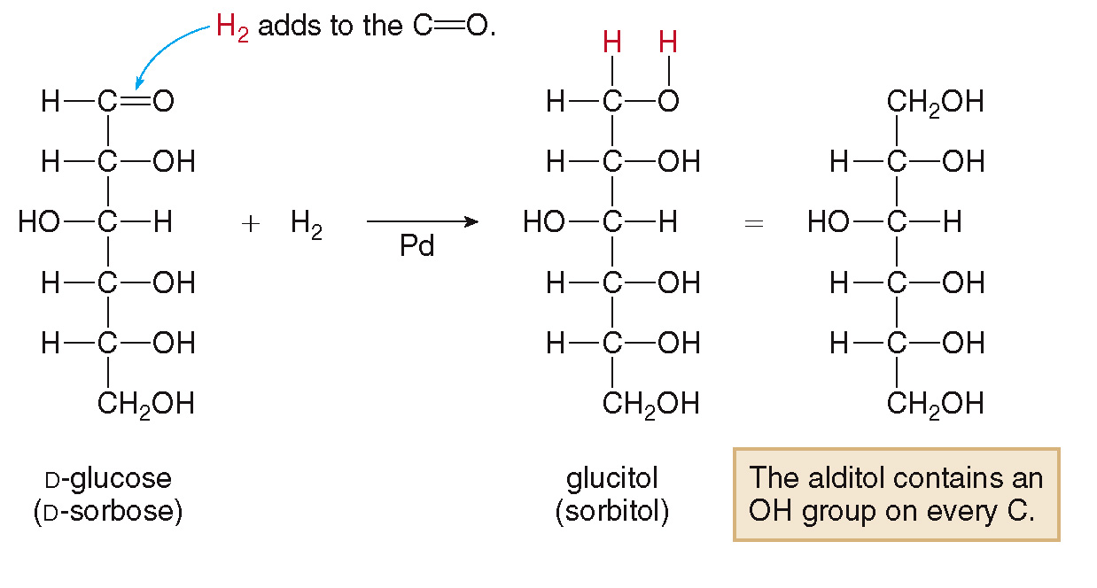
20.4 Reduction and Oxidation (1)
Reduction of the Aldehyde Carbonyl Group
The carbonyl group of an aldose is reduced to a
alcohol using H₂ with Pd.

Slide 33
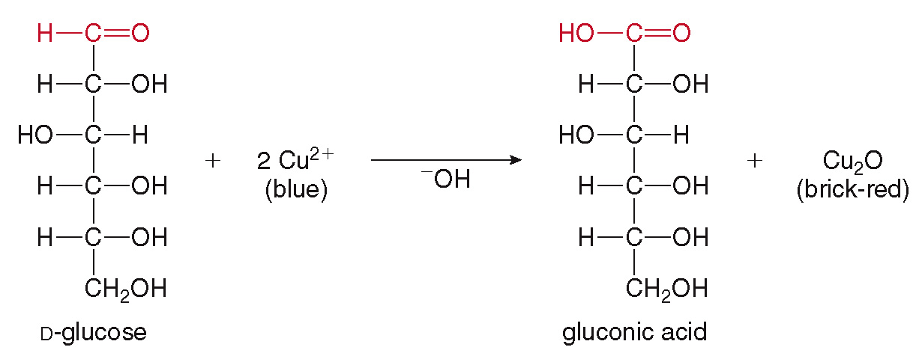
20.4 Reduction and Oxidation (2)
Oxidation of the Aldehyde Carbonyl Group
The aldehyde group is easily oxidized to a carboxylic acid using Benedict’s reagent.
Ketoses cannot be readily oxidized, but they can undergo a rearrangement in basic environment to form an aldose, which can be oxidized.

Slide 34
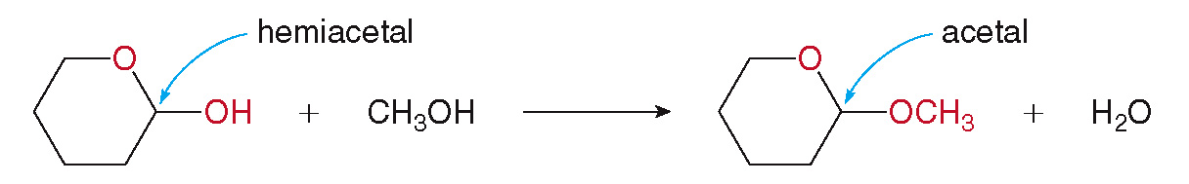
20.5 Disaccharides (1)
Disaccharides are composed of two monosaccharides.
They link together by forming an acetal (Section 16.8):

Slide 35
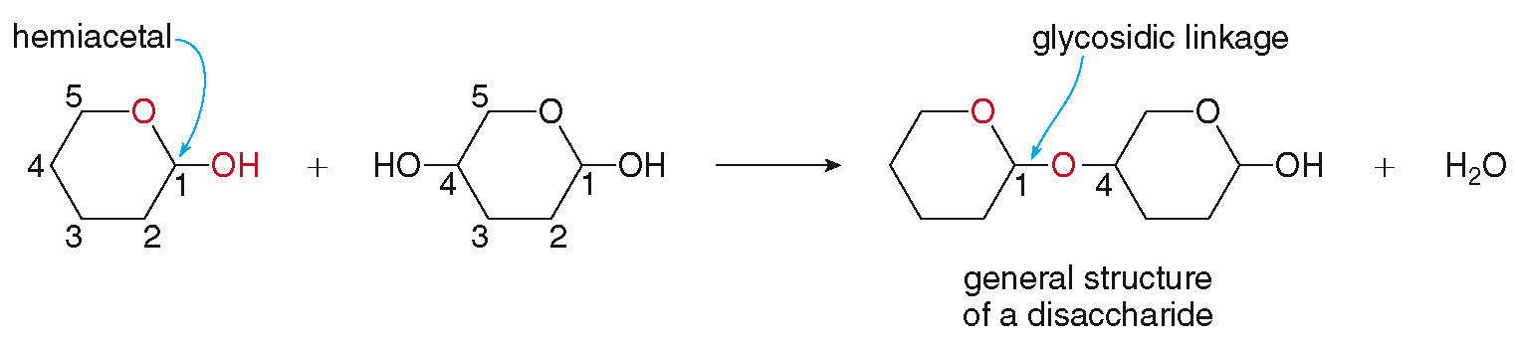
20.5 Disaccharides (2)
When this reaction occurs between two monosaccharides, the bond that joins them together is called a glycosidic linkage.

Slide 36
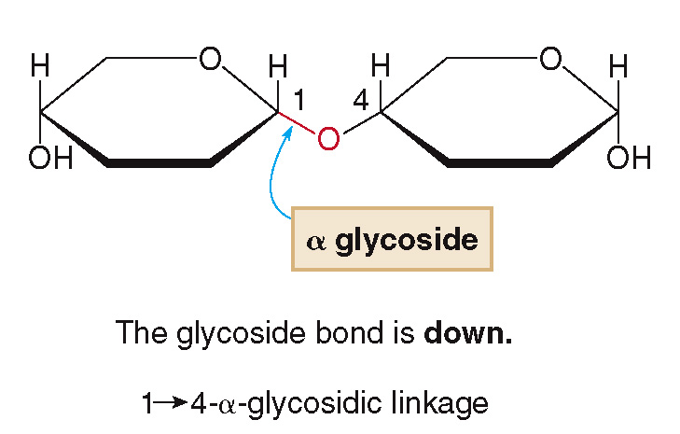
20.5 Disaccharides (3)
The glycosidic linkage joining the two rings can be alpha
or beta
If the bond is alpha
the glysodisidic bonds
points down.

Slide 37
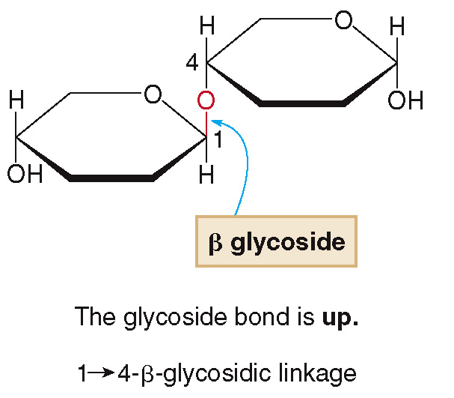
20.5 Disaccharides (4)
If the bond is beta
the glysodisidic bonds
points up.

Slide 38
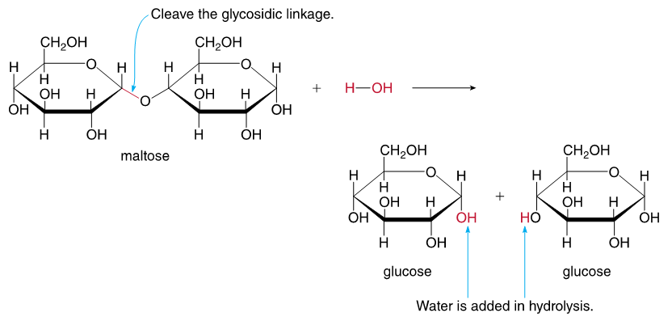
20.5 Disaccharides (5)
Hydrolysis cleaves the C—O glycosidic linkage and forms two monosaccharides.
Hydrolysis of maltose yields 2 glucose molecules.

Slide 39
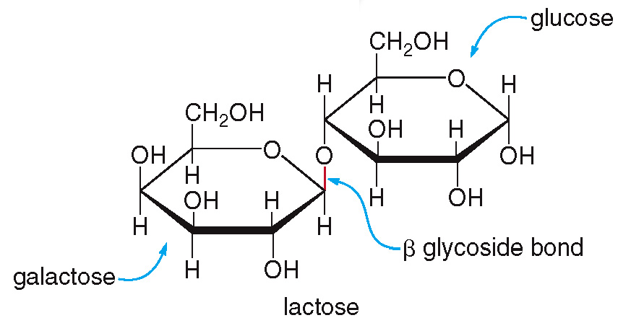
20.5 Focus on Health & Medicine (1)
Lactose Intolerance
Lactose is the disaccharide in milk; it consists of 1 galactose ring and 1 glucose ring joined by a

Slide 40
20.5 Focus on Health & Medicine (2)
Lactose Intolerance
The disaccharide bond is cleaved by the enzyme lactase in the body.
Individuals who are lactose intolerant no longer produce this enzyme.
Without the enzyme, lactose cannot be digested, causing abdominal cramps and diarrhea.

Slide 41
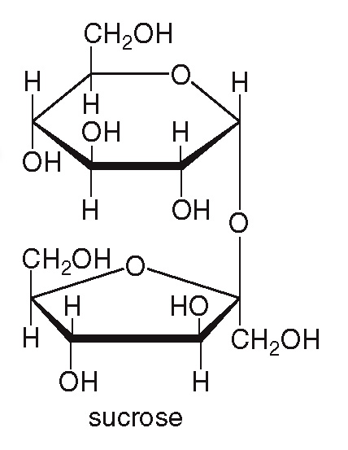
20.5 Focus on Health & Medicine (3)
Sucrose and Artificial Sweeteners
Sucrose (table sugar) is a disaccharide consisting of 1 glucose ring and 1 fructose ring.
Sucrose is very sweet, but contains many calories.
To reduce caloric intake, many artificial sweeteners have been developed.

Slide 42
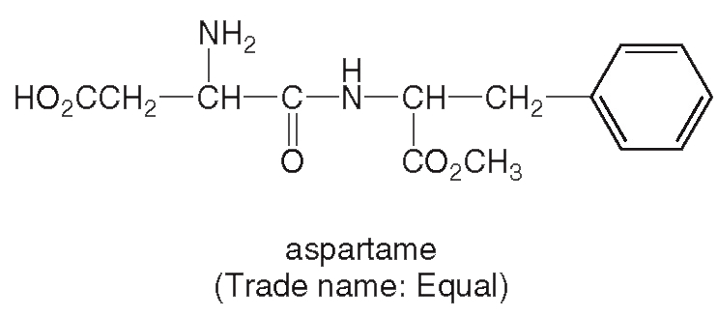
20.5 Focus on Health & Medicine (4)
Sucrose and Artificial Sweeteners
Aspartame (sold as Equal) is hydrolyzed into phenylalanine, which cannot be processed by those individuals with the condition phenylketonuria.

Slide 43
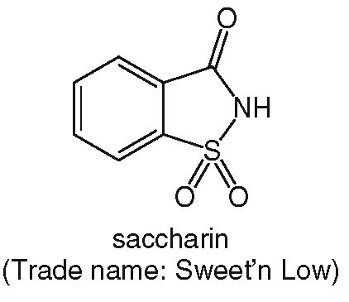
20.5 Focus on Health & Medicine (5)
Sucrose and Artificial Sweeteners
Saccharine (sold at Sweet’n Low) was used extensively during World War I.

Slide 44
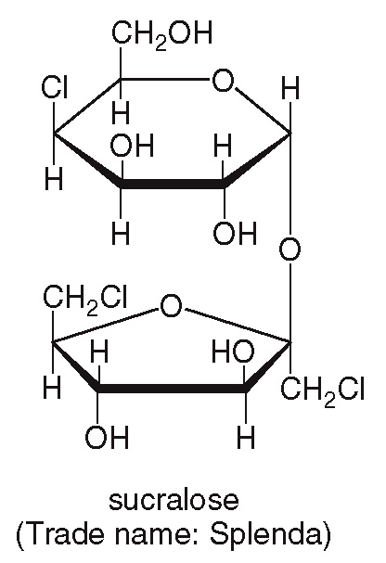
20.5 Focus on Health & Medicine (6)
Sucrose and Artificial Sweeteners
Sucralose (sold as Splenda) has a very similar structure to sucrose.

Slide 45
20.6 Polysaccharides (1)
Cellulose
Polysaccharides contain three or more monosaccharides joined together.
Cellulose is an unbranched polymer made up of repeating glucose units joined by
glycosidic linkages.
Cellulose is found in the cell walls of all plants, where it gives support and rigidity to wood, plant stems, and grass.
Humans do not posses the enzyme to hydrolyze cellulose
and cannot digest it.

Slide 46
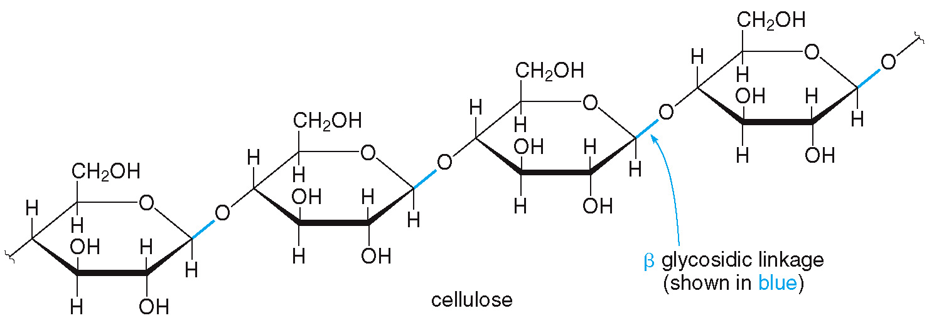
20.6 Polysaccharides (2)
Cellulose
Cellulose makes up the insoluble fiber in our diets, which is important in adding bulk to waste to help eliminate it more easily.

Slide 47
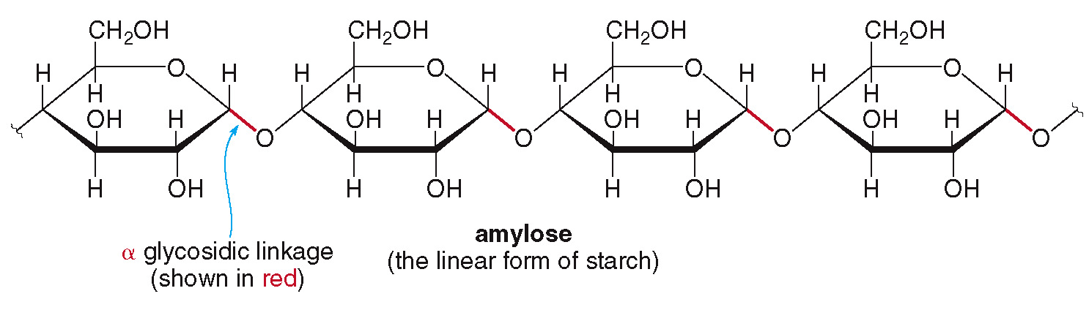
20.6 Polysaccharides (3)
Starch
Starch is a polymer made up of repeating glucose units joined by
Starch is present in corn, rice, wheat, and potatoes.
The first main type of starch is amylose:

Slide 48
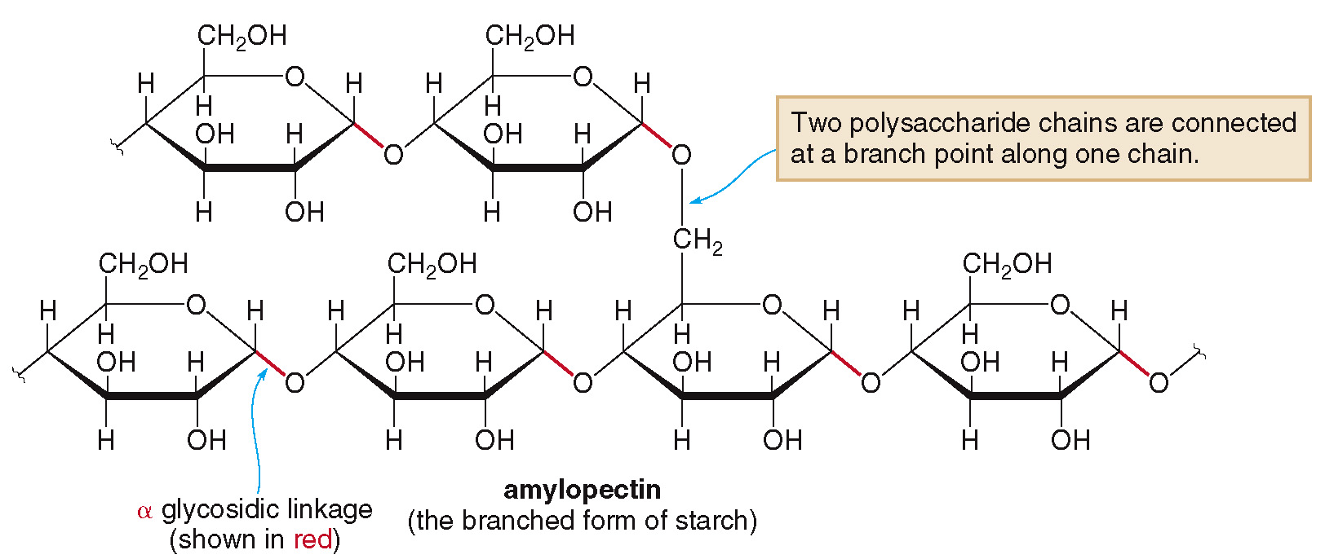
20.6 Polysaccharides (4)
Starch
The second type of starch is amylopectin.

Slide 49
20.6 Polysaccharides (5)
Starch
Amylose is an unbranched polymer linked by
Amylopectin is a branched polymer linked by
and
Both starch molecules can be digested by humans using the enzyme amylase.

Slide 50
20.6 Polysaccharides (6)
Glycogen
Glycogen is the major form of polysaccharide storage in animals, similar in structure to amylopectin.
It is stored mainly in the liver and in muscle cells.
When glucose is needed for energy, glucose units are hydrolyzed from the ends of the glycogen polymer.
Because glycogen is highly branched, there are many ends available for hydrolysis.

Slide 51
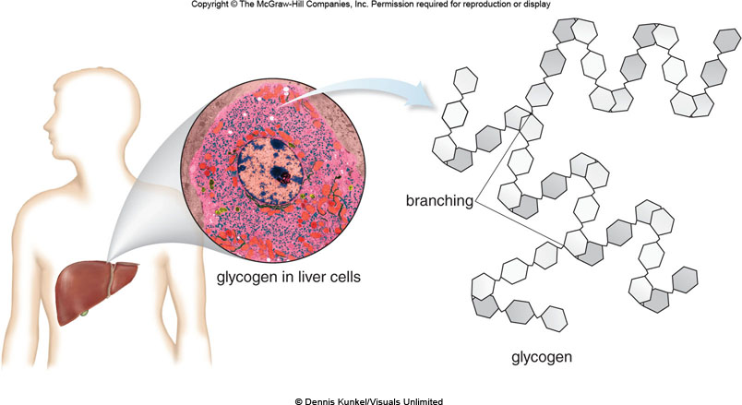
20.6 Polysaccharides (7)
Glycogen
© Dennis Kunkel/Visuals Unlimited

Slide 52
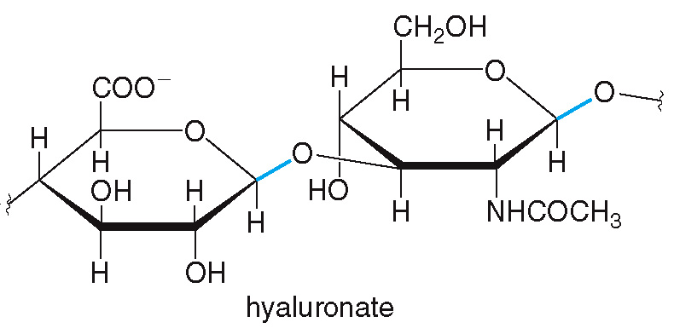
20.7 Focus on the Human Body (1)
Glycosaminoglycans
Glycosaminoglycans (GAGs) are a group of unbranched carbohydrates derived from alternating amino sugar and glucuronate units.
Examples include hyaluronate, extracellular fluids that lubricate joints and in the vitreous humor of the eye.

Slide 53
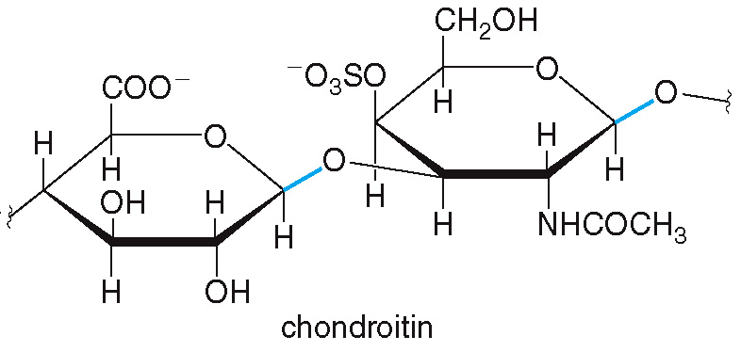
20.7 Focus on the Human Body (2)
Glycosaminoglycans
Another example is chondroitin, a component of cartilage and tendons.

Slide 54
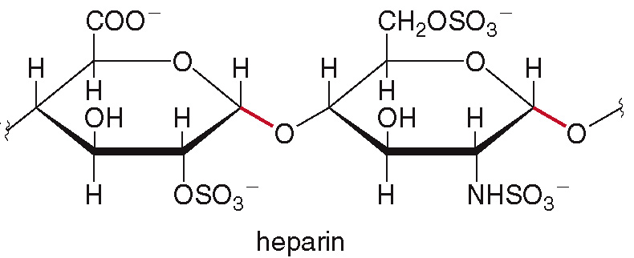
20.7 Focus on the Human Body (3)
Glycosaminoglycans
Heparin, stored in the mast cells of the liver, helps prevent blood clotting.

Slide 55
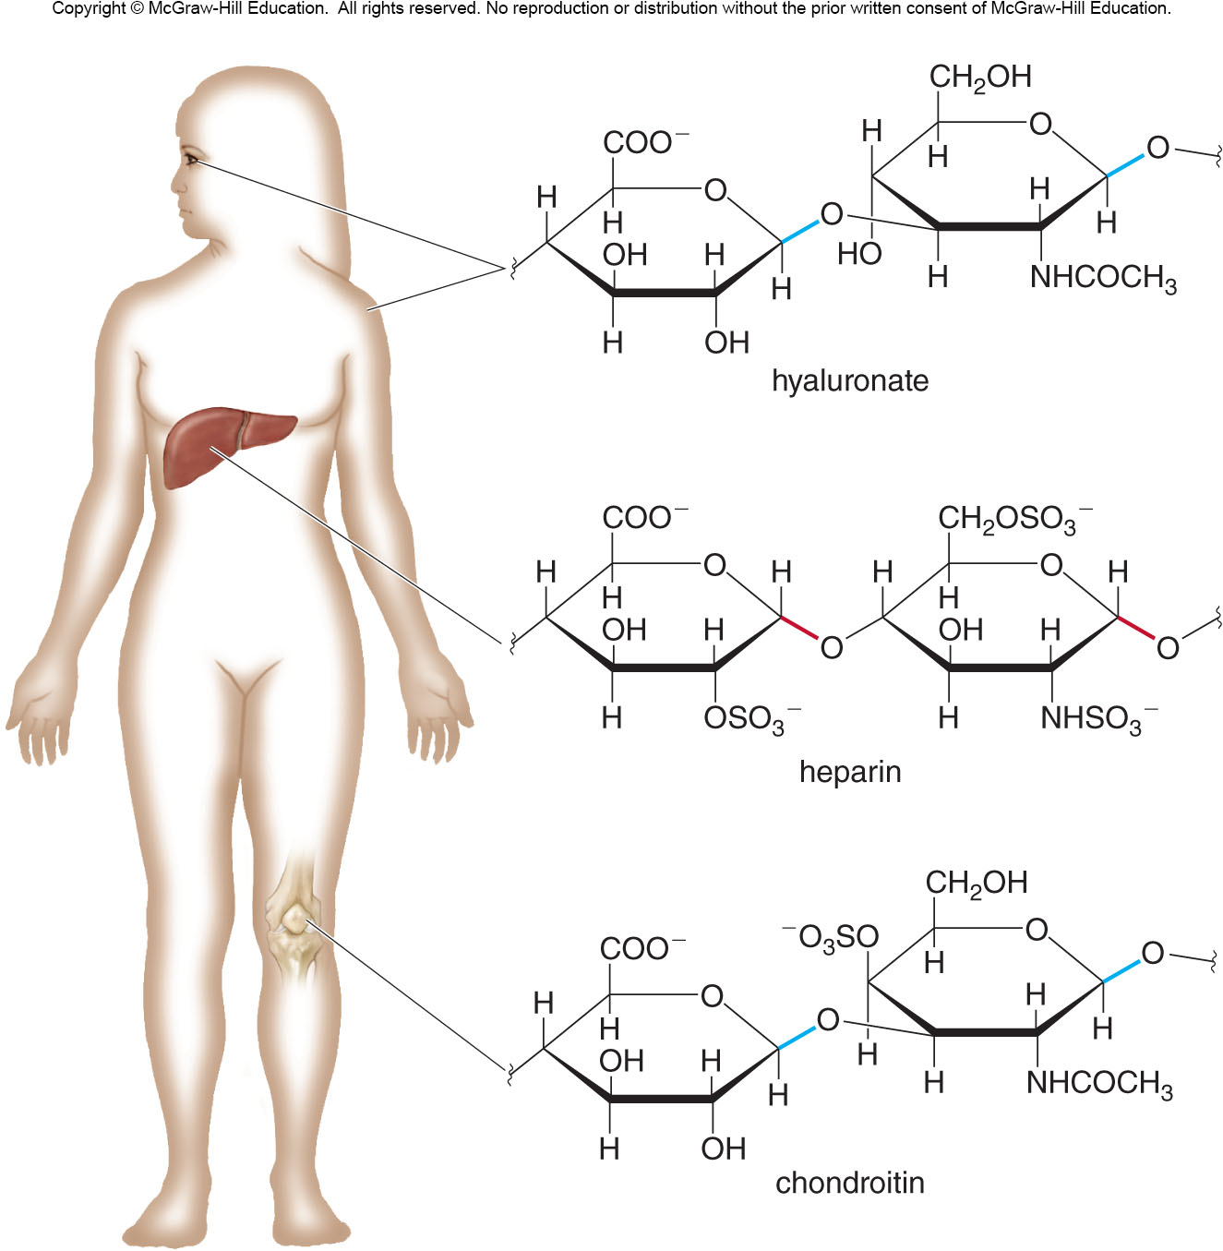
20.7 Focus on the Human Body (4)
Glycosaminoglycans

Slide 56
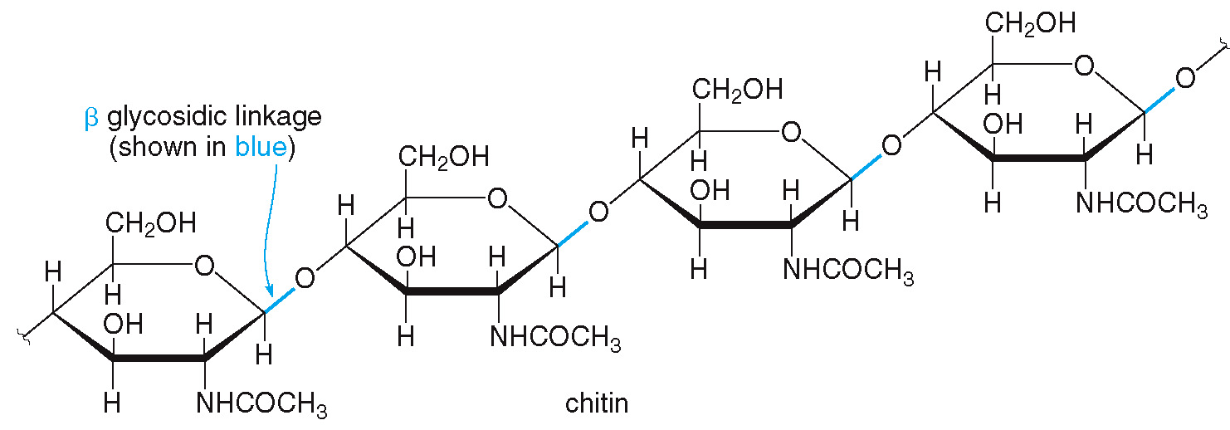
20.7 Focus on the Human Body (5)
Chitin
Chitin is a polysaccharide formed from N-acetyl-D-glucosamine units joined together by
glycosidic linkages.

Slide 57
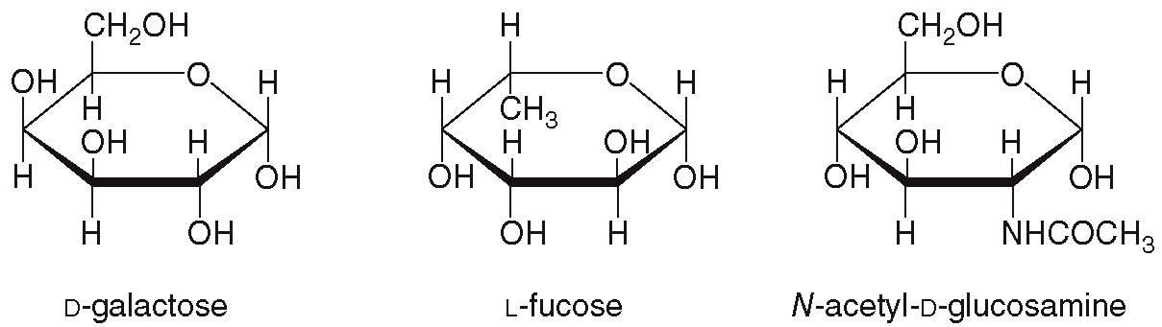
20.8 Focus on the Human Body Blood Type (1)
There are four blood types—A, B, AB, and O.
Blood type is based on 3 or 4 monosaccharides attached to a membrane protein of red blood cells.
Each blood type has the monosaccharides below:

Slide 58
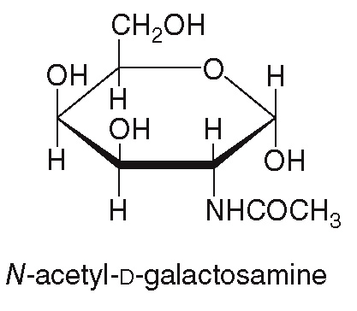
20.8 Focus on the Human Body Blood Type (2)
Type A blood contains a fourth monosaccharide:
Type B contains an additional D-galactose unit.
Type AB has both type A and type B carbohydrates.

Slide 59
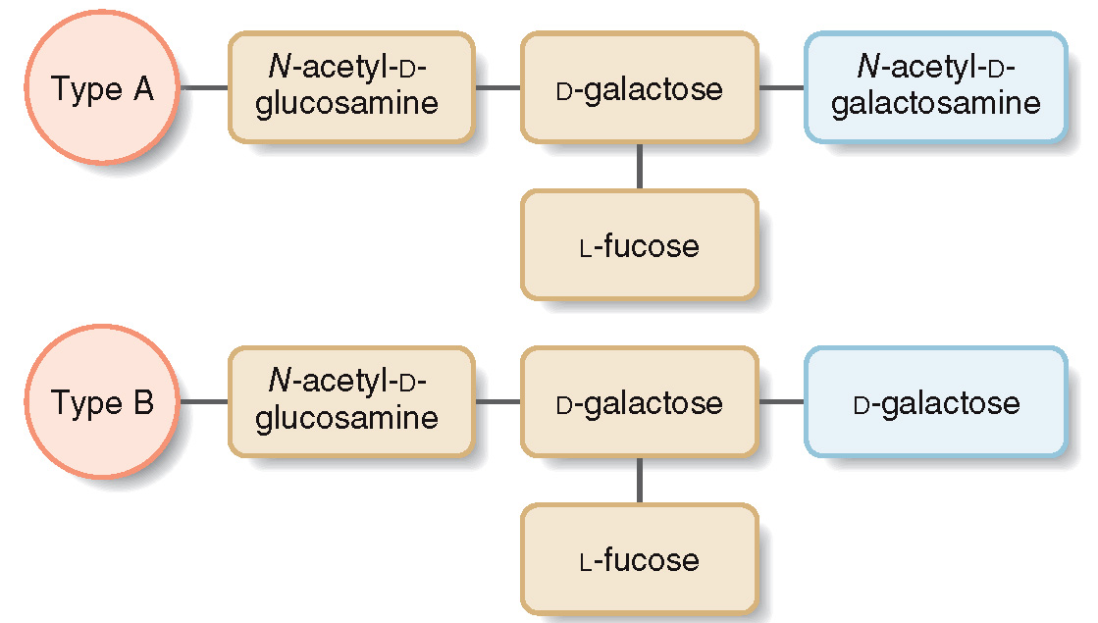
20.8 Focus on the Human Body Blood Type (3)

Slide 60

20.8 Focus on the Human Body Blood Type (4)

Slide 61
20.8 Focus on the Human Body Blood Type (5)
The blood of one individual may contain antibodies to another type.
Those with type O blood are called universal donors, because people with any other blood type have no antibodies to type O.
Those with type AB blood are universal recipients because their blood contains no antibodies to A, B, or O.

