Slide 1

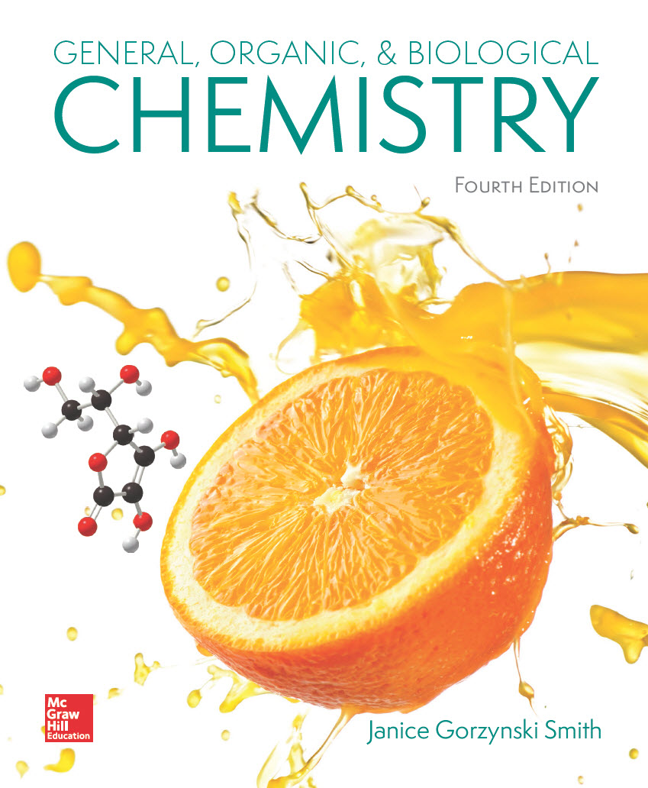
Chapter 22
Lecture
Outline
Prepared by
Harpreet Malhotra
Florida State College at Jacksonville

Slide 2
22.1 Nucleosides and Nucleotides (1)
Nucleic acids are unbranched polymers composed of repeating monomers called nucleotides.
There are two types of nucleic acids: DNA and RNA.
DNA (deoxyribonucleic acid) stores the genetic information of an organism and transmits that information from one generation to another.
RNA (ribonucleic acid) translates the genetic information contained in DNA into proteins needed for all cellular function.

Slide 3
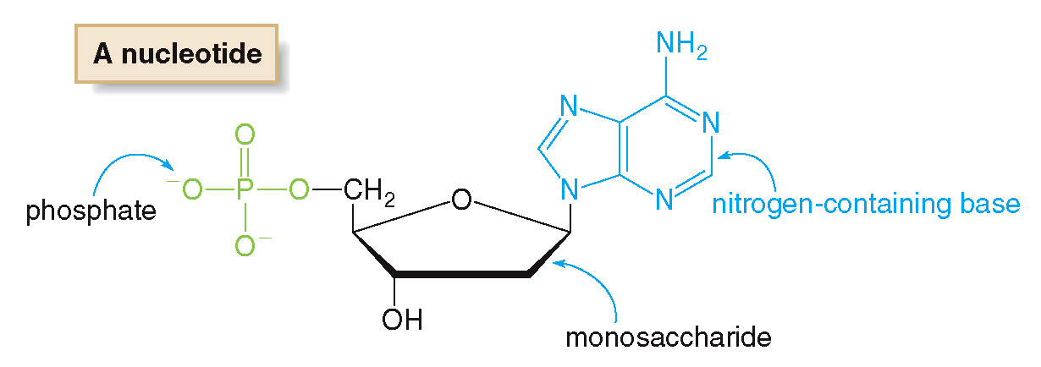
22.1 Nucleosides and Nucleotides (2)
The nucleotide monomers that compose DNA and RNA consist of: a monosaccharide, a N-containing base, and a phosphate group:

Slide 4
22.1 Nucleosides and Nucleotides (3)
DNA molecules contain several million nucleotides, while RNA molecules have only a few thousand.
DNA is contained in the chromosomes of the nucleus, each chromosome having a different type of DNA.
Humans have 46 chromosomes (23 pairs), each made up of many genes.
A gene is the portion of the DNA molecule responsible for the synthesis of a single protein.

Slide 5
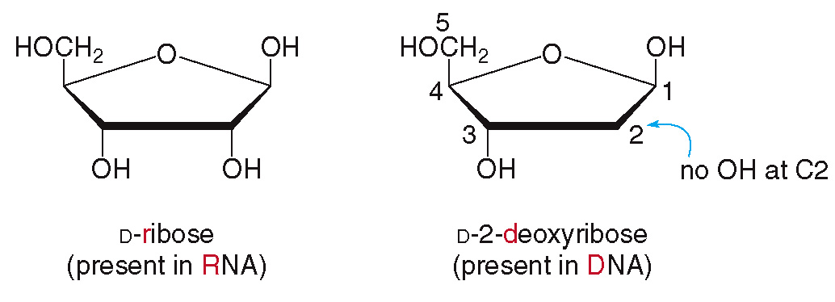
22.1 Nucleosides and Nucleotides (4)
Nucleosides
In RNA the monosaccharide is the aldopentose D-ribose.
In DNA, the monosaccharide is the aldopentose D-2-deoxyribose.

Slide 6
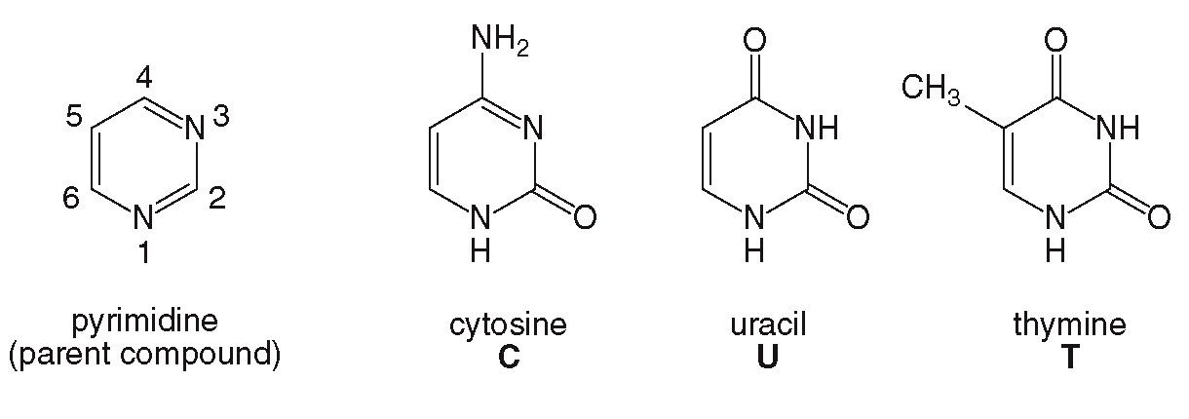
22.1 Nucleosides and Nucleotides (5)
Nucleosides
The N-containing base is one of 5 types.
Cytosine (C), uracil (U), and thymine (T) are all based on the structure of pyrimidine.

Slide 7
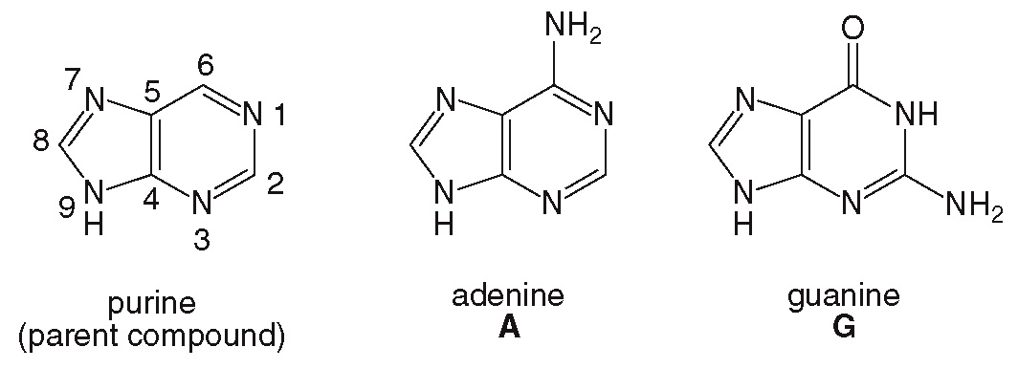
22.1 Nucleosides and Nucleotides (6)
Nucleosides
Adenine (A) and guanine (G) are based on the structure of purine.
DNA contains bases A, G, C, and T.
RNA contains bases A, G, C, and U.

Slide 8
22.1 Nucleosides and Nucleotides (7)
Nucleosides
A nucleoside is formed by joining the anomeric carbon of the monosaccharide with a N atom of the base.
To name a nucleoside derived from a pyrimidine base, use the suffix “-idine”.
To name a nucleoside derived from a purine base, use the suffix “-osine”.
For deoxyribonucleosides, add the prefix “deoxy-”.

Slide 9
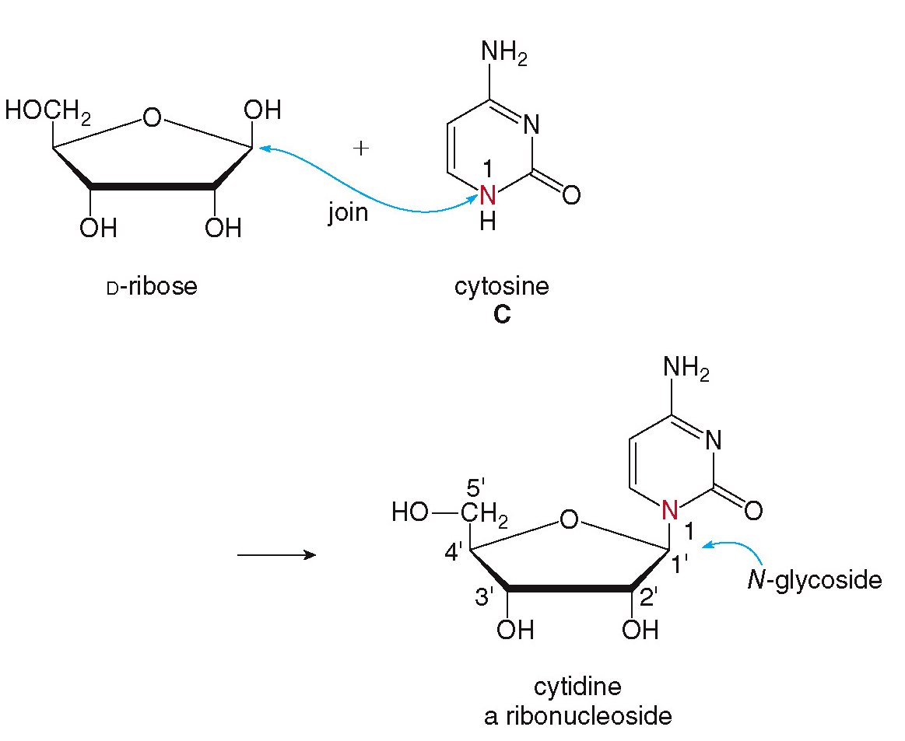
22.1 Nucleosides and Nucleotides (8)
Nucleosides

Slide 10
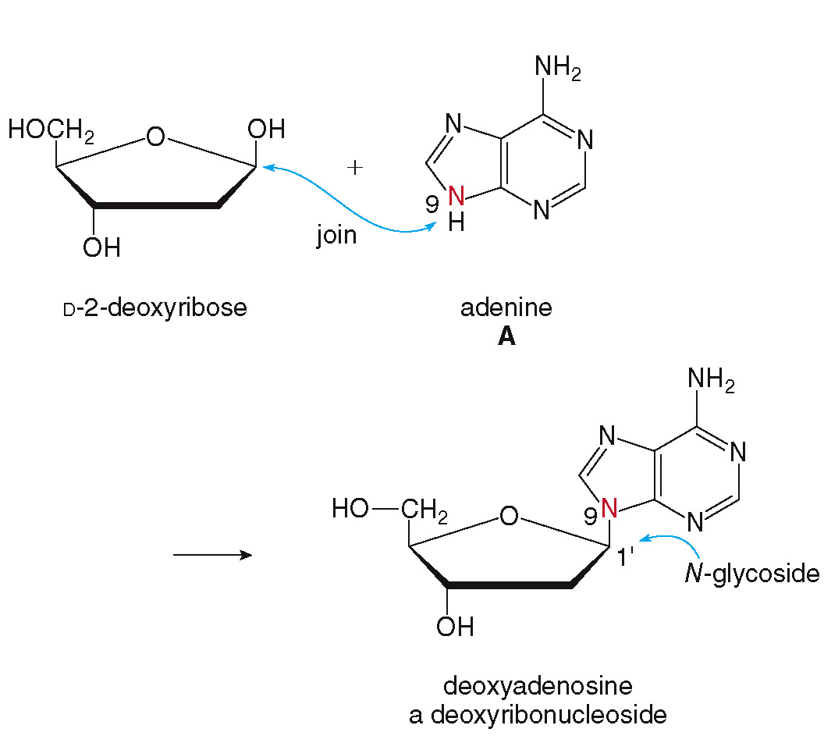
22.1 Nucleosides and Nucleotides (9)
Nucleosides

Slide 11
22.1 Nucleosides and Nucleotides (10)
Nucleotides
Nucleotides are formed by adding a phosphate group to the 5′-OH of a nucleoside.
The name cytidine 5′-monophosphate is abbreviated as CMP.

Slide 12
22.1 Nucleosides and Nucleotides (11)
Nucleotides
The name deoxyadenosine 5’-monophosphate is abbreviated as dAMP.

Slide 13
22.1 Nucleosides and Nucleotides (12)
Nucleotides
ADP is an example of a diphosphate:

Slide 14
22.1 Nucleosides and Nucleotides (13)
Nucleotides
ATP is an example of a triphosphate:

Slide 15
22.2 Nucleic Acids (1)
Nucleic acids (DNA and RNA) are polymers of nucleotides joined by phosphodiester linkages.

Slide 16
22.2 Nucleic Acids (2)
A polynucleotide contains a backbone consisting of alternating sugar and phosphate groups.
The identity and order of the bases distinguish one polynucleotide from another (primary structure).
A polynucleotide has one free phosphate group at the 5’ end and one free OH group at the 3’ end.
In DNA, the sequence of the bases carries the genetic information of the organism.

Slide 17
22.2 Nucleic Acids (3)

Slide 18
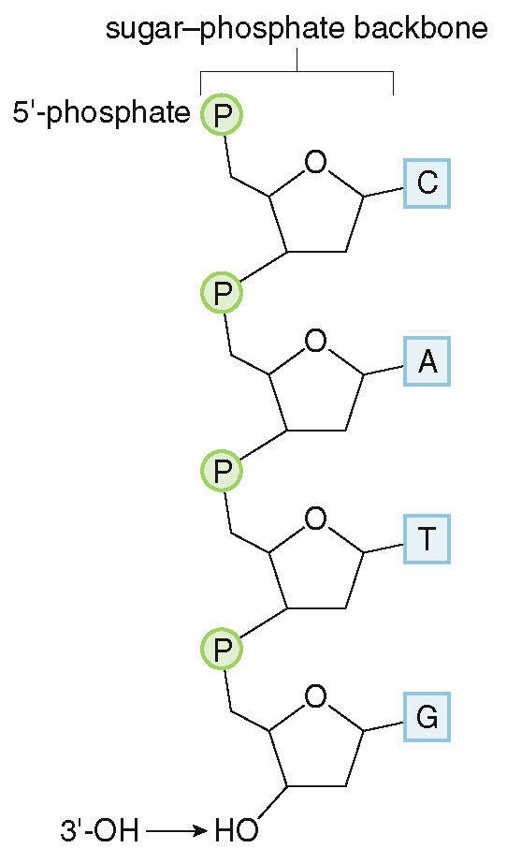
22.2 Nucleic Acids (4)
This polynucleotide would be named CATG, reading from the 5’ end to the 3’ end.

Slide 19
22.3 The DNA Double Helix (1)
The DNA model was initially proposed by Watson and Crick in 1953.
DNA consists of two polynucleotide strands that wind into a right-handed double helix.
The two strands run in opposite directions; one runs from the 5’ end to the 3’ end and the other runs from the 3’ end to the 5’ end.
The sugar-phosphate groups lie on the outside of the helix and the bases lie on the inside.

Slide 20
22.3 The DNA Double Helix (2)
The bases always line up so that a pyrimidine derivative can hydrogen bond to a purine derivative on the other strand.
Thus, there are complementary base pairs that always hydrogen bond together in a particular manner.

Slide 21
22.3 The DNA Double Helix (3)
Adenine pairs with thymine with 2 hydrogen bonds to form an A—T base pair.
Cytosine pairs with guanine using 3 hydrogen bonds to form a C—G base pair.

Slide 22
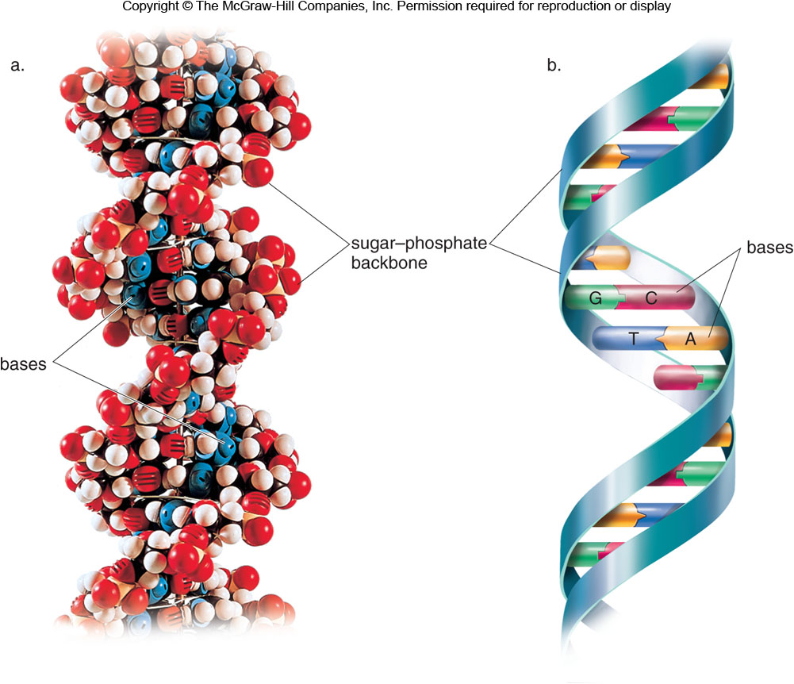
22.3 The DNA Double Helix (4)

Slide 23
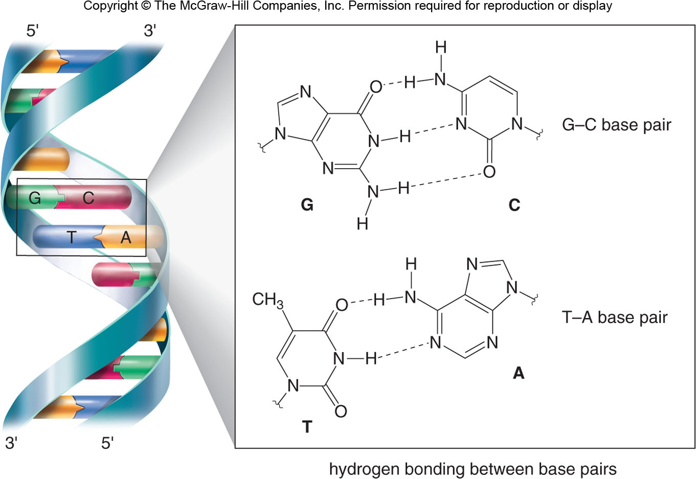
22.3 The DNA Double Helix (5)

Slide 24
22.3 The DNA Double Helix (6)
The information stored in DNA is used to direct the synthesis of proteins.
Replication is the process by which DNA makes a copy of itself when a cell divides.
Transcription is the ordered synthesis of RNA from DNA; the genetic information stored in DNA is passed onto RNA.
Translation is the synthesis of proteins from RNA; the genetic information determined the specific amino acid sequence of the protein.

Slide 25
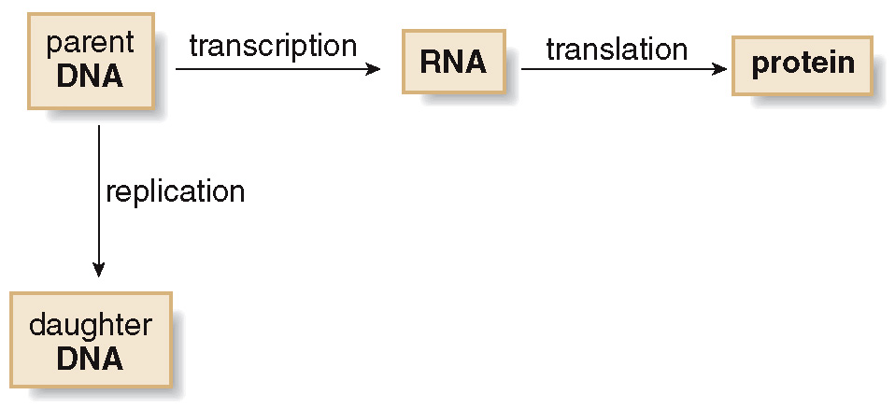
22.3 The DNA Double Helix (7)

Slide 26
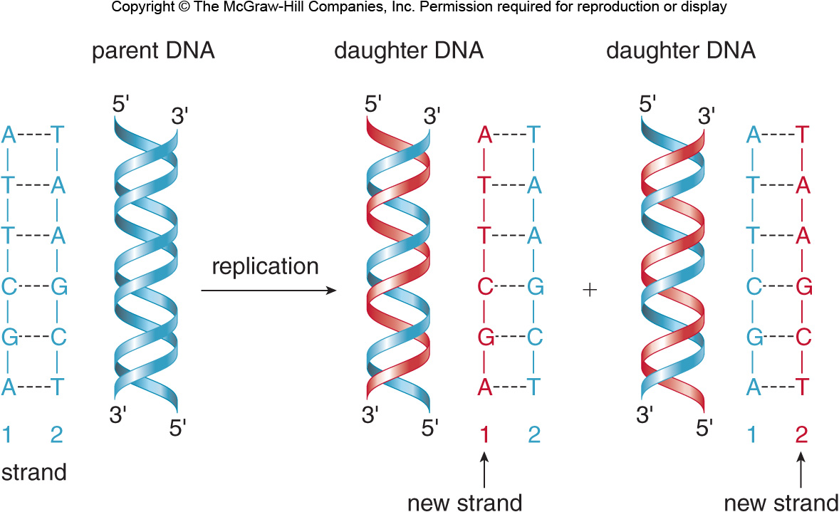
22.4 Replication (1)
The original DNA molecule forms two new DNA molecules, each of which contains a strand from the parent DNA and one new strand.

Slide 27
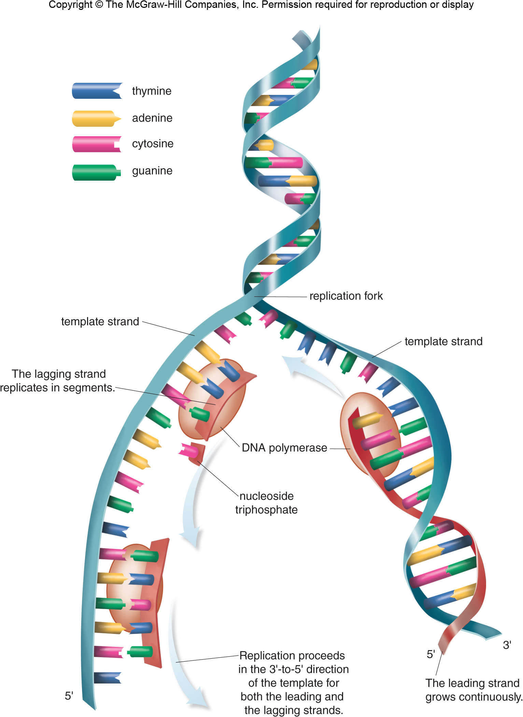
22.4 Replication (2)
Formation of Replication Fork
A replication fork forms as the two strands split apart.

Slide 28
22.4 Replication (3)
Synthesis of Lagging Strand

Slide 29
22.4 Replication (4)
The identity of the bases on the template strand determines the order of the bases on the new strand.
A must pair with T, and G must pair with C.
A new phosphodiester bond is formed between the 5’-phosphate of the nucleoside triphosphate and the 3’-OH group of the new DNA strand.
Replication occurs in only one direction on the template strand, from the 3’ end to the 5’ end.
The new strand is either a leading strand, growing continuously, or a lagging strand, growing in small fragments.

Slide 30
22.5 RNA (1)
There are important differences between DNA and RNA.
In RNA, the monosaccharide is ribose.
The thymine (T) base is not present in RNA; instead, the uracil (U) base is used.
RNA is a single strand, and smaller than DNA.
The three types of RNA molecules are ribosomal RNA (rRNA), messenger RNA (mRNA), and transfer RNA (tRNA).

Slide 31
22.5 RNA (2)
Ribosomal RNA (rRNA) provides the site where polypeptides are assembled during protein synthesis in the ribosomes.
Messenger RNA (mRNA) carries the information from DNA (in the nucleus) to the ribosome.
Transfer RNA (tRNA) brings specific amino acids to the ribosomes for protein synthesis.

Slide 32
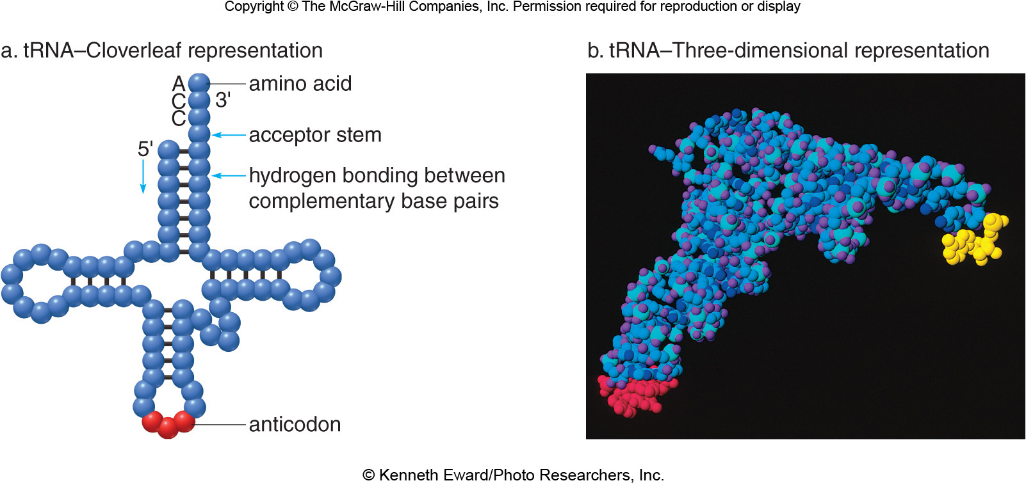
22.5 RNA (3)
tRNA is drawn as a cloverleaf shape, with an acceptor stem at the 3’ end, which carries the needed amino acid, and an anticodon, which identifies the needed amino acid.
© Kenneth Eward/Photo Researchers, Inc.

Slide 33
22.6 Transcription (1)
Transcription is the synthesis of mRNA from DNA.
The DNA splits into two strands, the template strand, which is used to synthesize RNA, and the informational strand which is not used.
Transcription proceeds from the 3’ end to the 5’ end of the template.
Transcription forms a mRNA with a complementary sequence to the template DNA strand and an exact sequence as the informational DNA strand.
The difference between mRNA and the information DNA strand is that the base U replaces T on mRNA.

Slide 34
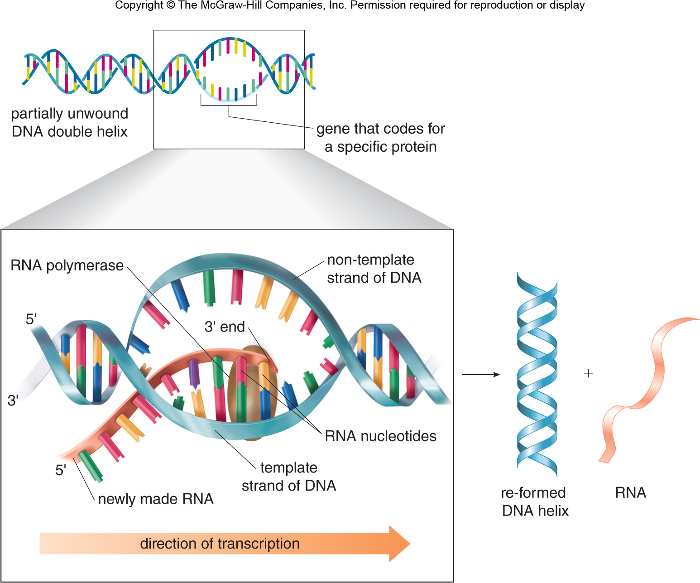
22.6 Transcription (2)

Slide 35
22.6 Transcription (3)
Sample Problem 22.6
From the template strand of DNA below, write out
the mRNA and informational strand of DNA
sequences:
Template strand:
3’—C T A G G A T A C—5’
mRNA:
5’—G A U C C U A U G—3’
Informational strand:
5’—G A T C C T A U G—3’

Slide 36
22.7 The Genetic Code (1)
A sequence of three nucleotides (a triplet) codes for a specific amino acid.
Each triplet is called a codon.
For example, UAC is a codon for the amino acid serine; UGC is a codon for the amino acid cysteine.
Codons are written from the 5’ end to the 3’ end of the mRNA molecule

Slide 37
22.7 The Genetic Code (2)
Table 22.3 The Genetic Code—Triplets in Messenger RNA
 | Second Base U | Second Base | Second Base C | Second Base | Second Base A | Second Base | Second Base G | Second Base
First Base (5’ end) U | UUU | Phe | UCU | Ser | UAU | Tyr | UGU | Cys | Third Base (3’ end) U
First Base (5’ end) U | UUC | Phe | UCC | Ser | UAC | Tyr | UGC | Cys | Third Base (3’ end) C
First Base (5’ end) U | UUA | Leu | UCA | Ser | UAA | Stop | UGA | Stop | Third Base (3’ end) A
First Base (5’ end) U | UUG | Leu | UCG | Ser | UAG | Stop | UGG | Trp | Third Base (3’ end) G
First Base (5’ end) C | CUU | Leu | CCU | Pro | CAU | His | CGU | Arg | Third Base (3’ end) U
First Base (5’ end) C | CUC | Leu | CCC | Pro | CAC | His | CGC | Arg | Third Base (3’ end) C
First Base (5’ end) C | CUA | Leu | CCA | Pro | CAA | Gln | CGA | Arg | Third Base (3’ end) A
First Base (5’ end) C | CUG | Leu | CCG | Pro | CAG | Gln | CGG | Arg | Third Base (3’ end) G

Slide 38
22.7 The Genetic Code (3)
Table 22.3 The Genetic Code—Triplets in Messenger RNA
 | Second Base U | Second Base | Second Base C | Second Base | Second Base A | Second Base | Second Base G | Second Base
First Base (5’ end) A | AUU | Ile | ACU | Thr | AAU | Asn | AGU | Ser | Third Base (3’ end) U
First Base (5’ end) A | AUC | Ile | ACC | Thr | AAC | Asn | AGC | Ser | Third Base (3’ end) C
First Base (5’ end) A | AUA | Ile | ACA | Thr | AAA | Lys | AGA | Arg | Third Base (3’ end) A
First Base (5’ end) A | AUG | Met | ACG | Thr | AAG | Lys | AGG | Arg | Third Base (3’ end) G
First Base (5’ end) G | GUU | Val | GCU | Ala | GAU | Asp | GGU | Gly | Third Base (3’ end) U
First Base (5’ end) G | GUC | Val | GCC | Ala | GAC | Asp | GGC | Gly | Third Base (3’ end) C
First Base (5’ end) G | GUA | Val | GCA | Ala | GAA | Glu | GGA | Gly | Third Base (3’ end) A
First Base (5’ end) G | GUG | Val | GCG | Ala | GAG | Glu | GGG | Gly | Third Base (3’ end) G

Slide 39
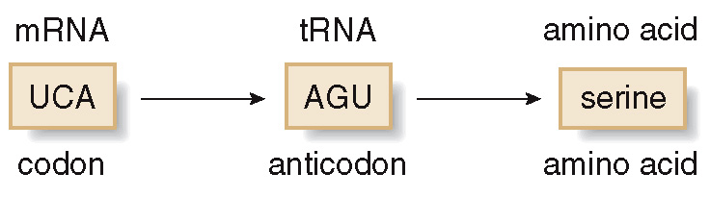
22.8 Translation and Protein Synthesis (1)
mRNA contains the sequence of codons that determine the order of amino acids in the protein.
Individual tRNAs bring specific amino acids to the peptide chain.
rRNA contains binding sites that provide the platform on which protein synthesis occurs.

Slide 40
22.8 Translation and Protein Synthesis (2)
Each tRNA contains an anticodon of three nucleotides that is complementary to the codon in mRNA and identifies individual amino acids.
Table 22.4 Relating Codons, Anticodons, and Amino Acids
mRNA Codon |  | tRNA Anticodon |  | Amino Acid
ACA | → | UGU | → | threonine
GCG | → | CGC | → | alanine
AGA | → | UCU | → | arginine
UCC | → | AGG | → | serine
The three main parts of translation are initiation, elongation, and termination.

Slide 41
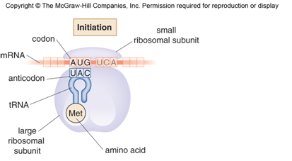
22.8 Translation and Protein Synthesis
[1] Initiation
Initiation begins with mRNA binding to the ribosome.
A tRNA brings the first amino acid, always at codon AUG (methionine).

Slide 42
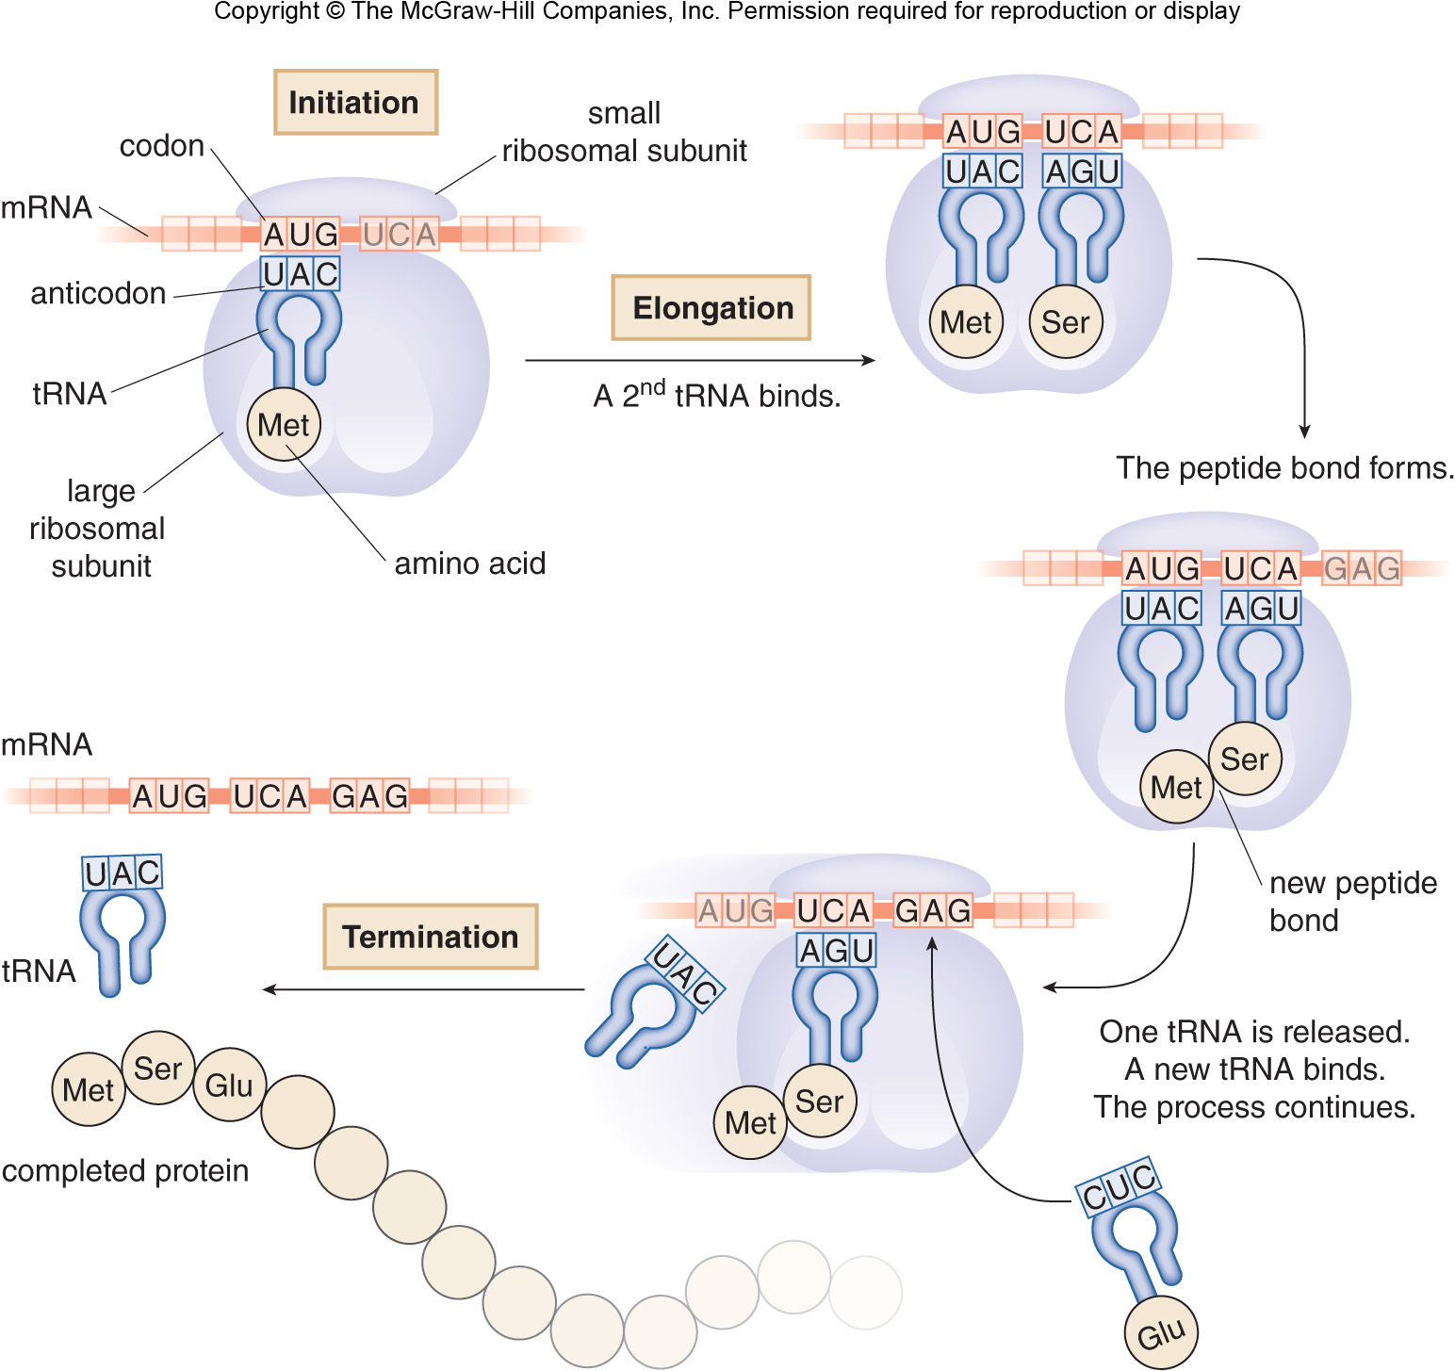
22.8 Translation and Protein Synthesis
[2] Elongation
Elongation proceeds as the next tRNA molecule delivers the next amino acid, and a peptide bond forms between the two amino acids.

Slide 43
22.8 Translation and Protein Synthesis
[3] Termination
Translation continues until a stop codon (UAA, UAG, or UGA) is reached, which is called termination; the completed protein is released.

Slide 44
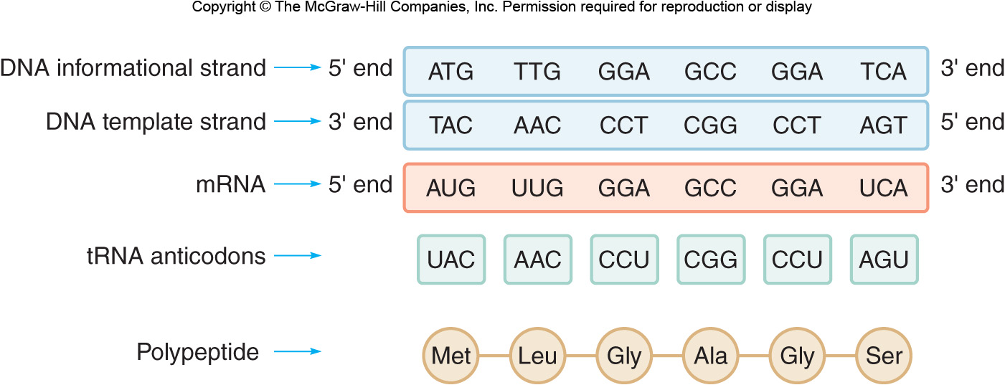
22.8 Translation and Protein Synthesis

Slide 45
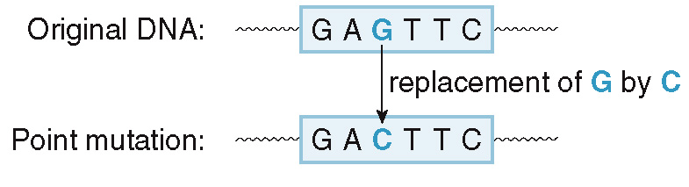
22.9 Mutations and Genetic Disease (1)
A mutation is a change in the nucleotide sequence in a molecule of DNA.
Some mutations are random, while others are caused by mutagens.
A point mutation is the substitution of one nucleotide for another.

Slide 46
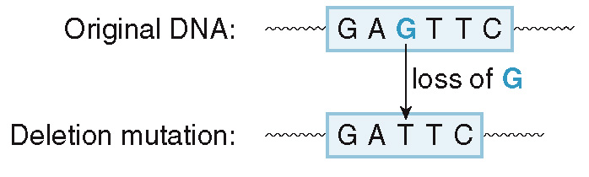
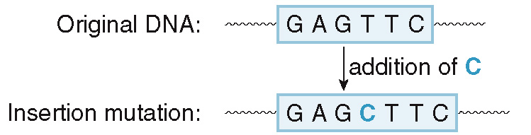
22.9 Mutations and Genetic Disease (2)
A deletion mutation occurs when one or more nucleotides is/are lost from a DNA molecule.
An insertion mutation occurs when one or more nucleotides is/are added to a DNA molecule.

Slide 47
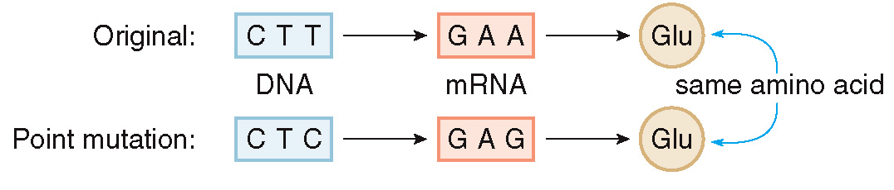
22.9 Mutations and Genetic Disease (3)
A silent mutation has a negligible effect to the organism, because the resulting amino acid is identical.
The mutation has no effect.

Slide 48
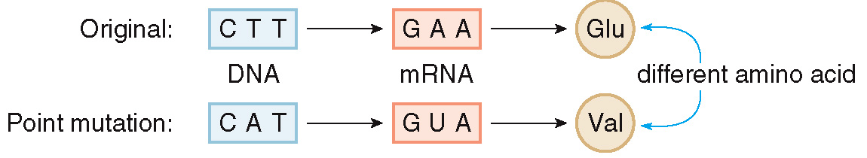
22.9 Mutations and Genetic Disease (4)
A mutation that produces a protein with one different amino acid usually has a small to moderate effect on the protein overall.
Some proteins, such as hemoglobin, substitution of just one amino acid (valine for glutamic acid) can result in the fatal disease sickle cell anemia.

Slide 49
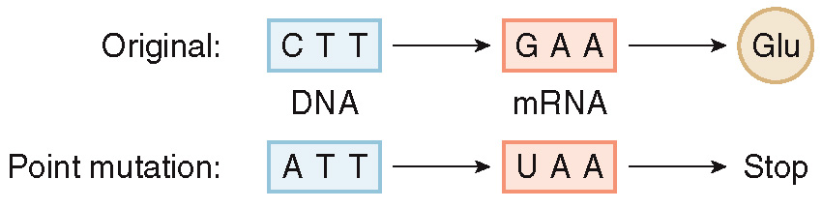
22.9 Mutations and Genetic Disease (5)
If a mutation causes a big change, like producing a stop codon, the remainder of the protein will not be synthesized, which can have catastrophic results.

Slide 50
22.9 Mutations and Genetic Disease (6)
When a mutation causes a protein deficiency or defective protein synthesis and this mutation is passed through generations, it is a genetic disease.
Table 22.5 Genetic Diseases
Disease | Characteristics
Tay-Sachs disease | Mental retardation; caused by a defective hexosaminidase A enzyme
Sickle cell anemia | Anemia; occlusion and inflammation of blood capillaries, caused by defective hemoglobin
Phenylketonuria | Mental retardation; caused by a deficiency of the enzyme phenylalanine hydroxylase needed to convert the amino acid phenylalanine to tyrosine
Galactosemia | Mental retardation; caused by a deficiency of an enzyme needed for galactose metabolism
Huntington's disease | Progressive physical disability; caused by a defect in the gene that codes for the Htt protein, resulting in degeneration in the neurons in certain areas of the brain.

Slide 51
22.10 Recombinant DNA (1)
General Principles
Recombinant DNA is synthetic DNA that contains segments from more than one source.
Three key elements are needed to form recombinant DNA:
A DNA molecule into which a new DNA segment will be inserted.
An enzyme that cleaves DNA at specific locations.
A gene from a second organism that will be inserted into the original DNA molecule.

Slide 52
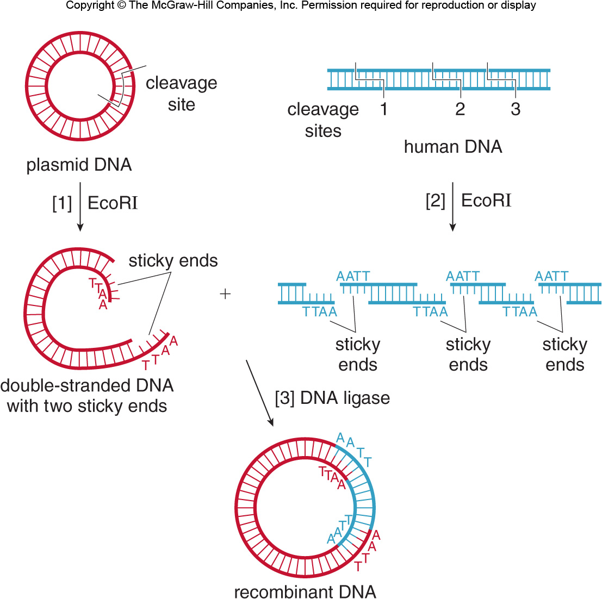
22.10 Recombinant DNA (2)
General Principles
First, bacterial plasmid DNA is cut by the restriction endonuclease EcoRI, which cuts in a specific place.
This gives a double strand of linear plasmid DNA with two ends ready to bond, called sticky ends.

Slide 53
22.10 Recombinant DNA (3)
General Principles
Then, a second sample of human DNA is cut with the same EcoRI.
This forms human DNA segments with sticky ends that are complimentary to the plasmid DNA.

Slide 54
22.10 Recombinant DNA (4)
General Principles
Combining the two pieces of DNA (with DNA ligase enzyme) forms DNA containing the new segment.
This DNA chain is slightly larger because of its additional segment.

Slide 55
22.10 Recombinant DNA (5)
Polymerase Chain Reaction
Polymerase chain reaction (PCR) amplifies a specific portion of a DNA molecule, producing millions of exact copies.

Slide 56
22.10 Recombinant DNA (6)
Polymerase Chain Reaction
Four elements are needed to amplify DNA by PCR:
The segment of DNA that must be copied.
Two primers—short polynucleotides that are complementary to the two ends of the segment to be amplified.
A DNA polymerase enzyme to catalyze the synthesis of a complementary strand.
Nucleoside triphosphates—the source of the A, T, C, and G needed to make the new DNA.

Slide 57
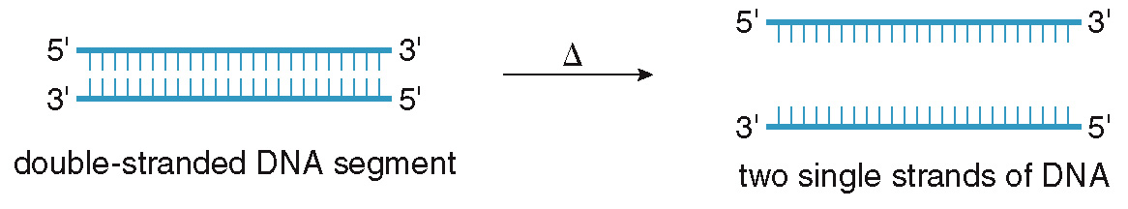
22.10 Recombinant DNA (7)
HOW TO Use the Polymerase Chain Reaction to
Amplify a Sample of DNA
Heat the DNA segment to unwind the
double helix to form single strands.
Step [1]

Slide 58
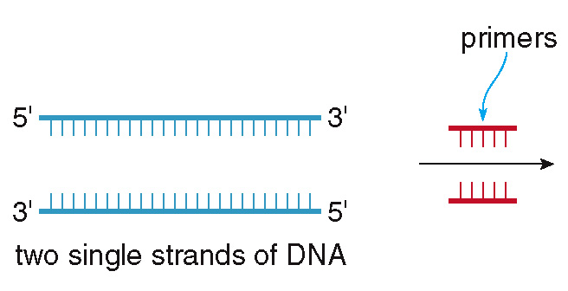
22.10 Recombinant DNA (8)
HOW TO Use the Polymerase Chain Reaction to
Amplify a Sample of DNA
Add primers that are complementary to
the DNA sequence at either end of the
DNA segment.
Step [2]

Slide 59
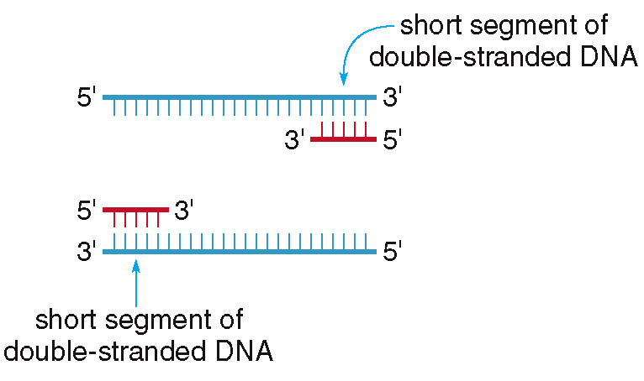
22.10 Recombinant DNA (9)
HOW TO Use the Polymerase Chain Reaction to
Amplify a Sample of DNA
Step [2]

Slide 60
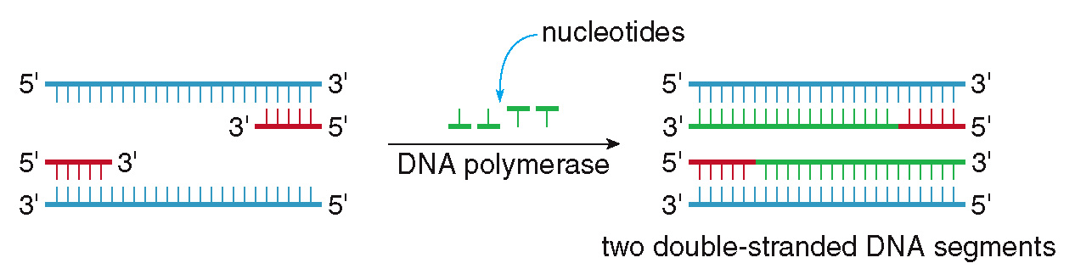
22.10 Recombinant DNA (10)
HOW TO Use the Polymerase Chain Reaction to
Amplify a Sample of DNA
Use a DNA polymerase and added
nucleotides to lengthen the DNA segment.
Step [3]
After each cycle the amount of DNA is doubled, so
after 20 cycles, 1,000,000 copies have been made.

Slide 61
22.10 Recombinant DNA (11)
Focus on the Human Body
The DNA of each individual person is unique, so DNA can be used as a method of identification.
Any type of cell (skin, saliva, semen, blood, etc.) can be used to obtain a DNA fingerprint.
The DNA is first amplified by PCR and then cut by restriction enzymes.
The DNA fragments are then separated by size by gel electrophoresis.

Slide 62
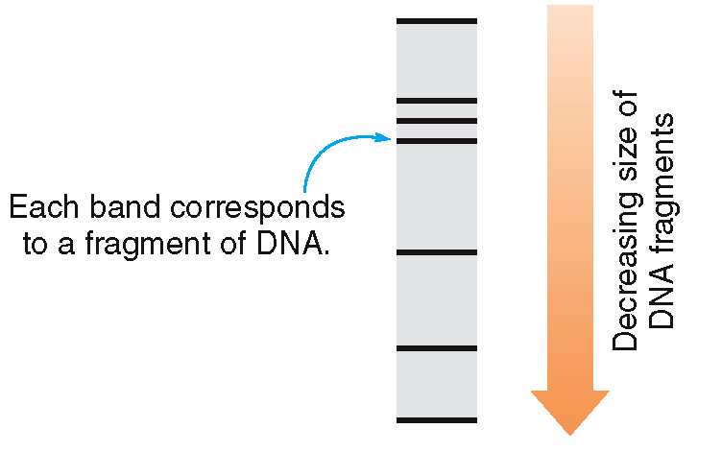
22.10 Recombinant DNA (12)
Focus on the Human Body
DNA fragments can be visualized on X-ray film after they have been separated:

Slide 63
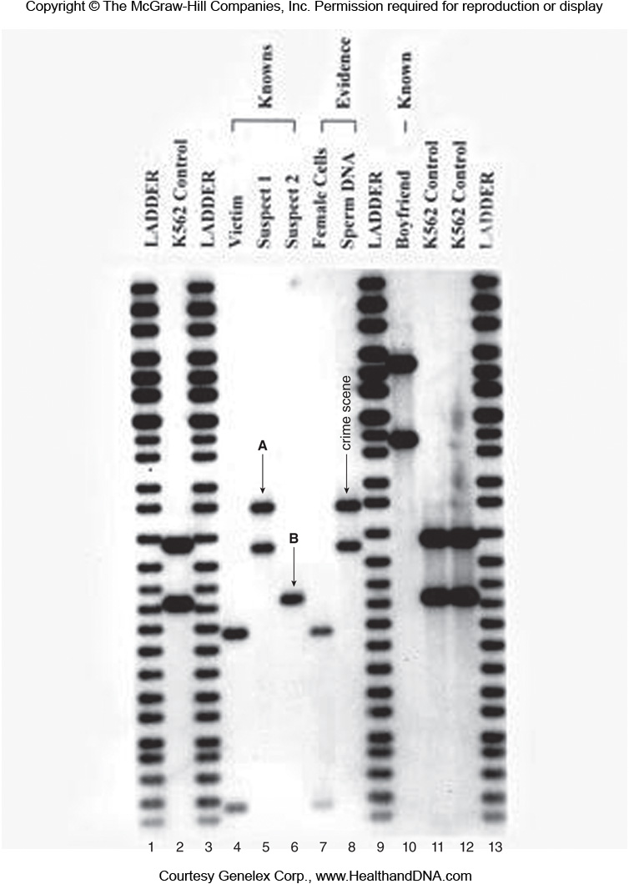
22.10 Recombinant DNA (13)
Focus on the Human Body
DNA fragments can be visualized on X-ray film after they have been separated:
Courtesy Genelex Corp., www.HealthandDNA.com

Slide 64
22.11 Focus on Health & Medicine
Viruses (1)
A virus is an infectious agent consisting of a DNA or RNA molecule that is contained within a protein coating.
It is incapable of replicating alone, so it invades a host organism and makes the host replicate the virus.
Many prevalent diseases like the common cold, influenza, and herpes are viral in origin.
A vaccine is an inactive form of a virus that causes a person’s immune system to produce antibodies to the virus to ward off infection.

Slide 65
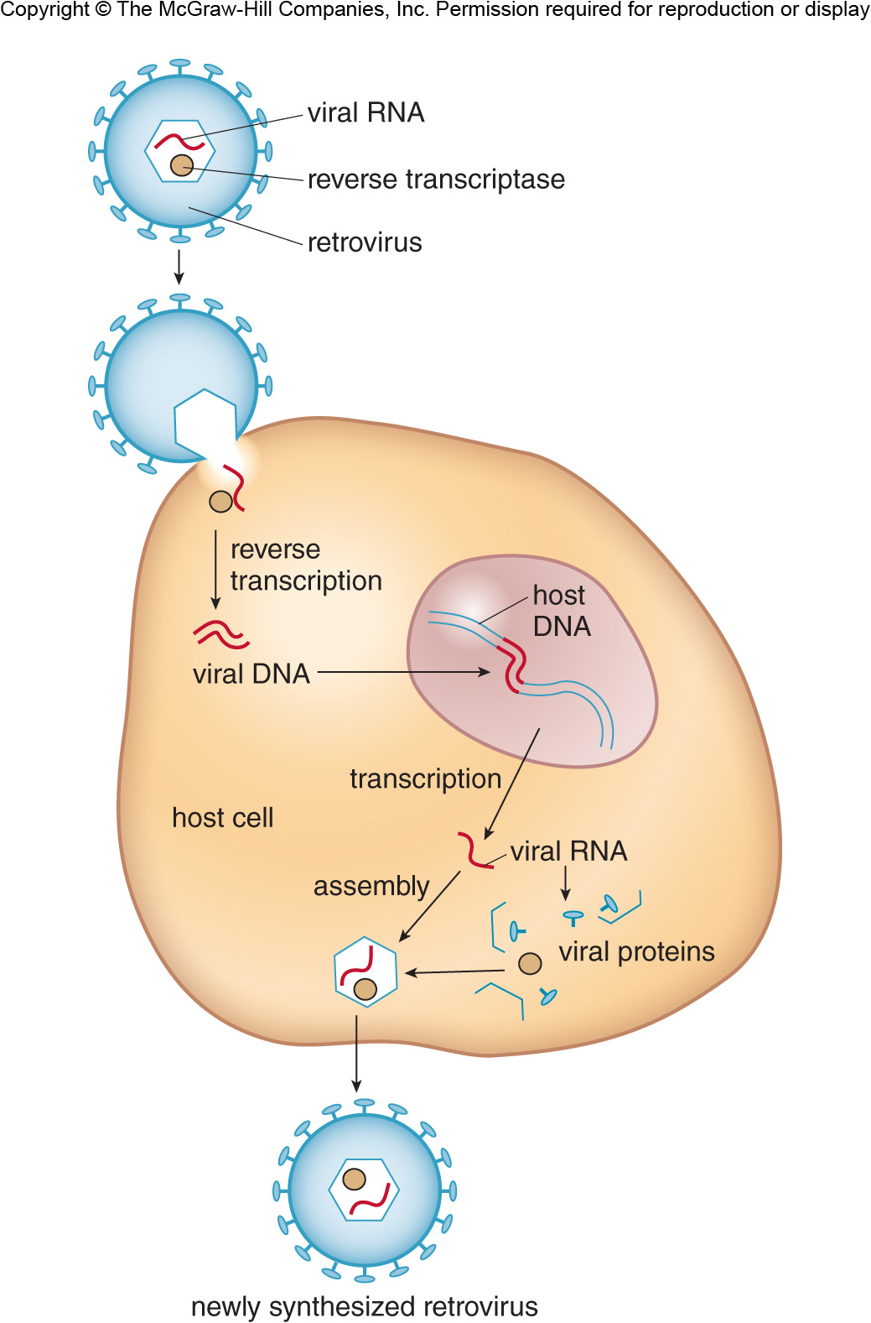
22.11 Focus on Health & Medicine
Viruses (2)
A virus with an RNA core is called a retrovirus.

Slide 66
22.11 Focus on Health & Medicine
Viruses (3)
Retroviruses invade a host and then synthesize viral DNA by reverse transcription.
The viral DNA can then transcribe RNA, which then directs protein synthesis (new retroviral particles to infect other cells).
Acquired immune deficiency syndrome (AIDS) is caused by the retrovirus human immunodeficiency virus (HIV).

