Slide 1

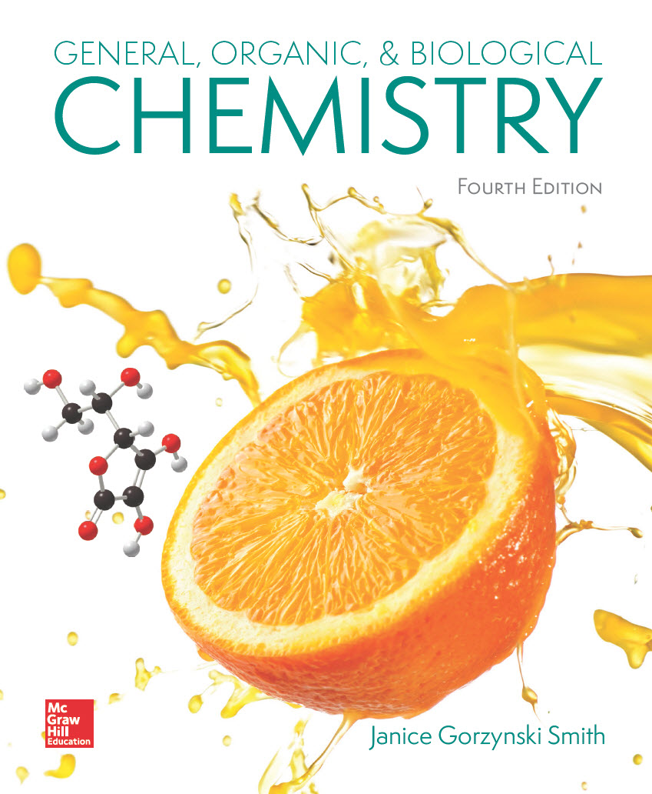
Chapter 23
Lecture Outline
Prepared by
Harpreet Malhotra
Florida State College at Jacksonville

Slide 2
23.1 Introduction (1)
Metabolism is the sum of all the chemical reactions that take place in an organism.
Catabolism is the breakdown of large molecules into smaller ones; energy is generally released during catabolism.
Anabolism is the synthesis of large molecules
from smaller ones; energy is generally absorbed during anabolism.
Often, the process is a series of consecutive reactions called a metabolic pathway, which can be linear or cyclic.

Slide 3
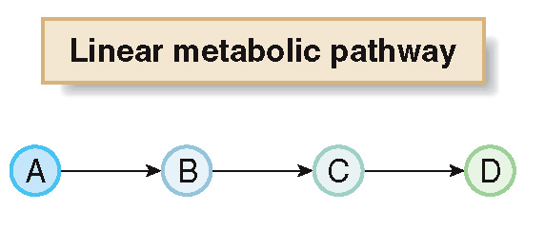
23.1 Introduction (2)
A linear pathway is the series of reactions that generates a final product different from any of the reactants.

Slide 4
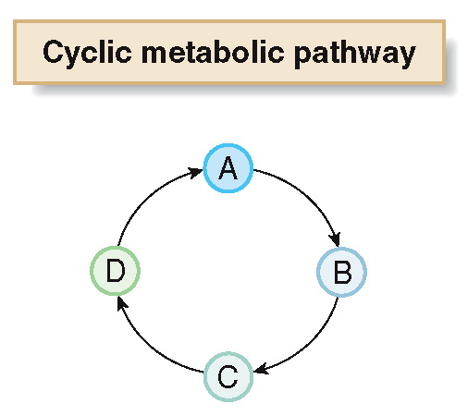
23.1 Introduction (3)
A cyclic pathway is the series of reactions that regenerates the first reaction.

Slide 5
23.1 Introduction (4)
Energy production occurs in the mitochondria.
Mitochondria are organelles within the cytoplasm of a cell.
Mitochondria contain an outer membrane and an inner membrane with many folds.
The area between the two membranes is called the intermembrane space.
The area enclosed by the inner membrane is called the matrix, where energy production occurs.

Slide 6
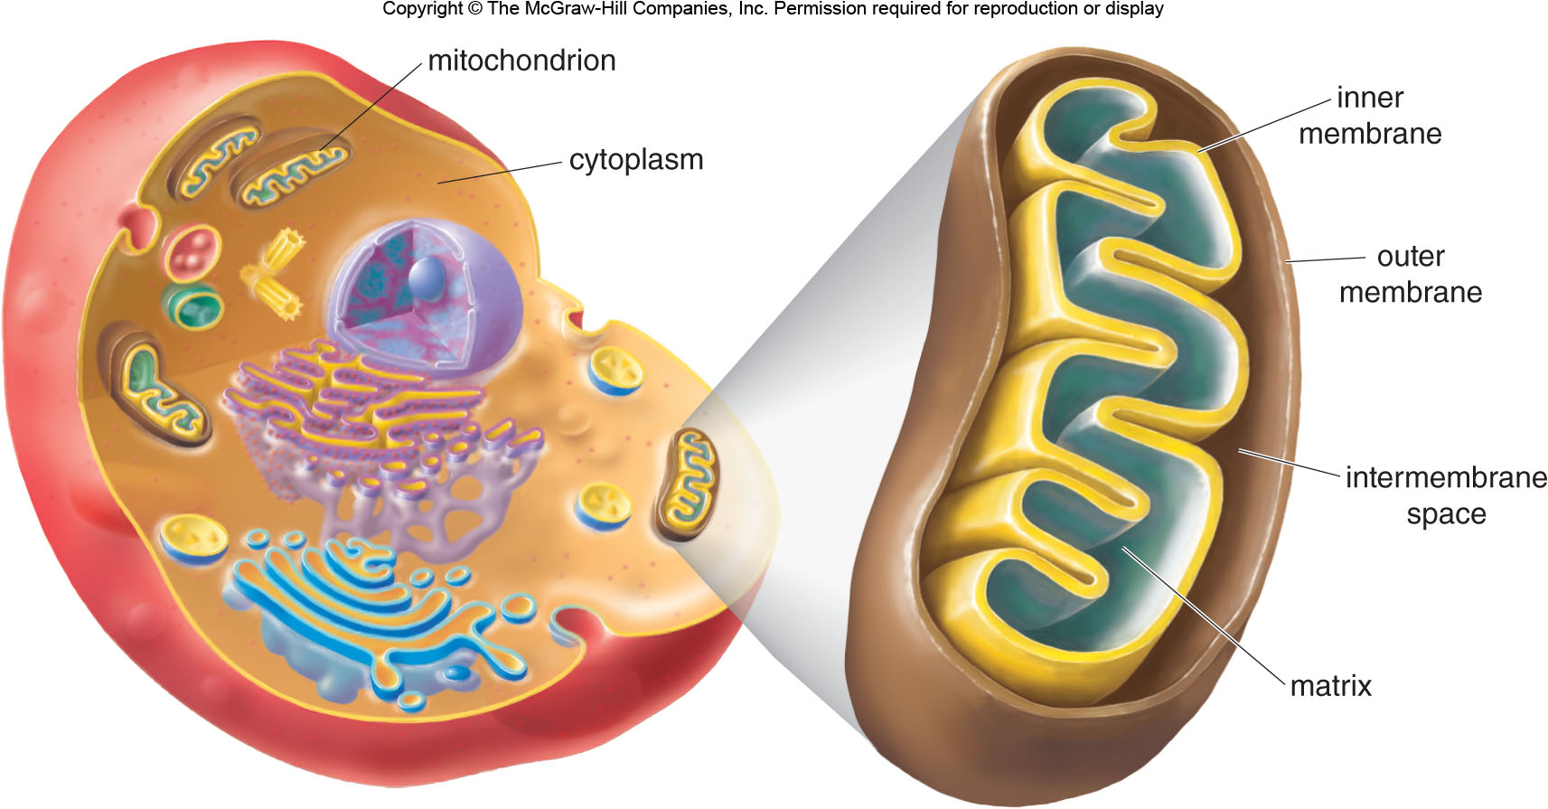
23.1 Introduction (5)

Slide 7
23.2 An Overview of Metabolism (1)
Stage [1]—Digestion
The catabolism of food begins with digestion, which is catalyzed by enzymes in the saliva, stomach, and small intestines.

Slide 8
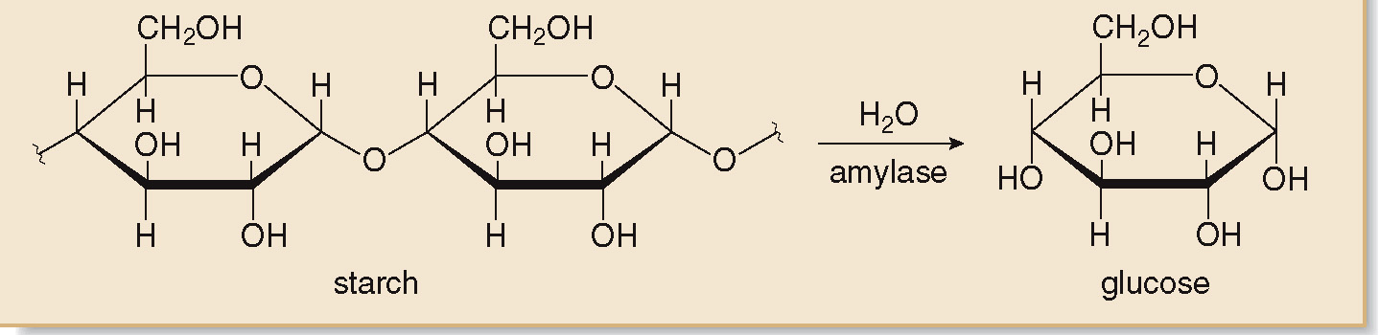
23.2 An Overview of Metabolism (2)
Stage [1]—Digestion
Carbohydrates are hydrolyzed into monosaccharides beginning with amylase enzymes in saliva and continuing in the small intestine.

Slide 9
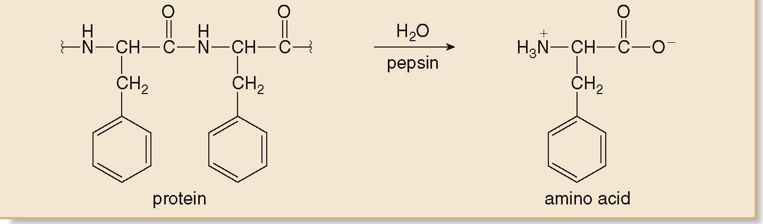
23.2 An Overview of Metabolism (3)
Stage [1]—Digestion
Protein digestion begins when stomach acid denatures the protein and pepsin begins to cleave the large protein backbone into smaller peptides.
Then, in the small intestines, trypsin and chymotrypsin cleave the peptides into amino acids.

Slide 10
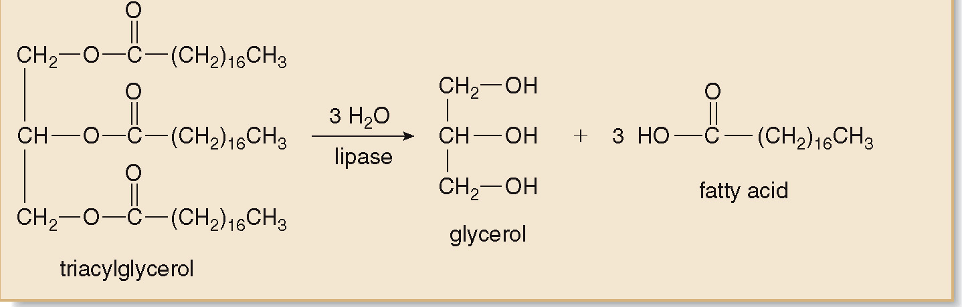
23.2 An Overview of Metabolism (4)
Stage [1]—Digestion
Triacylglycerols are emuslified by bile secreted by the liver, then hydrolyzed by lipases in the small intestines into 3 fatty acids and a glycerol backbone.

Slide 11
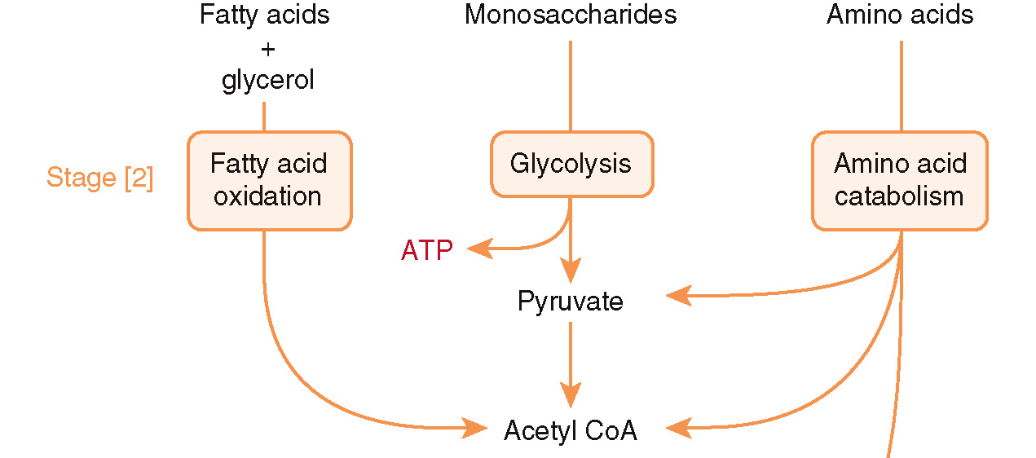
23.2 An Overview of Metabolism (5)
Stage [2]—Formation of Acetyl CoA

Slide 12
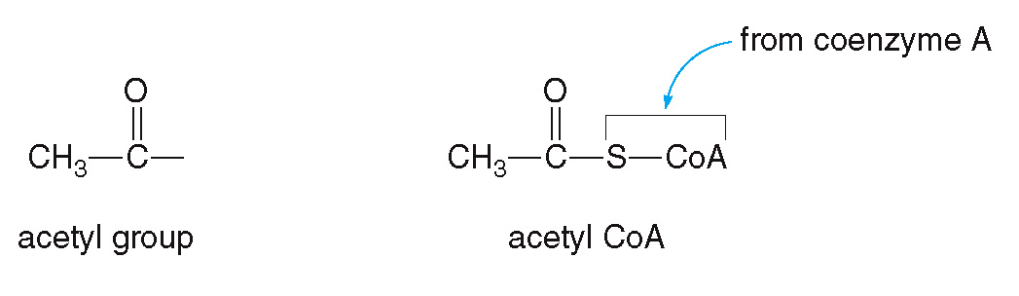
23.2 An Overview of Metabolism (6)
Stage [2]—Formation of Acetyl CoA
Monosaccharides, amino acids, and fatty acids are degraded into acetyl groups, which are then bonded to coenzyme A forming acetyl-CoA.

Slide 13
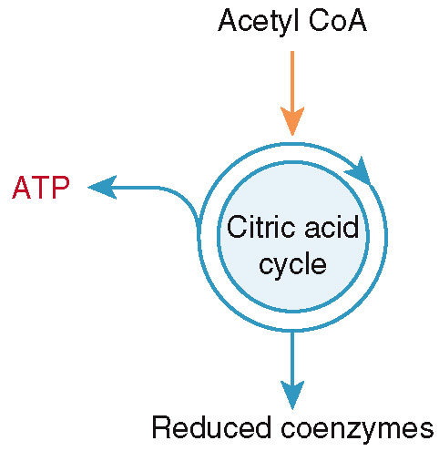
23.2 An Overview of Metabolism (7)
Stage [3]—The Citric Acid Cycle
The citric acid cycle is based in the mitochondria, where the acetyl CoA is oxidized to CO₂.
The cycle also produces energy stored as a nucleoside triphosphate (Section 22.1) and the reduced coenzymes.

Slide 14
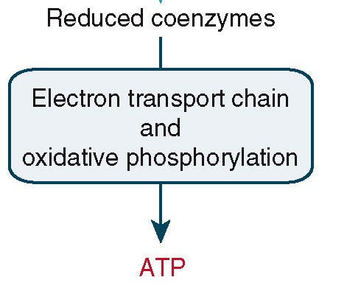
23.2 An Overview of Metabolism (8)
Stage [4]—The Electron Transport Chain and Oxidative Phosphorylation
Within the mitochondria, the electron transport chain and oxidative phosphorylation produce ATP (adenosine 5’-triphosphate).
ATP is the primary energy-carrying molecule in the body.

Slide 15
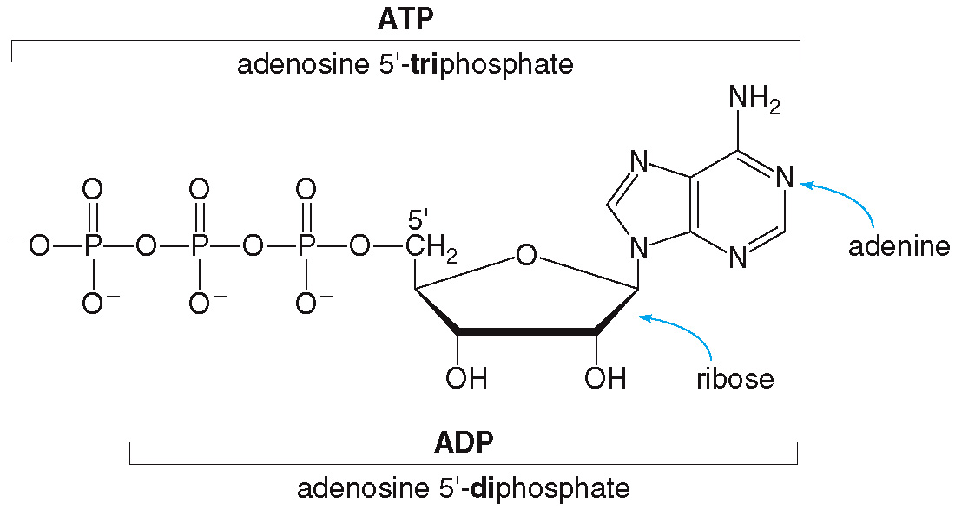
23.3 ATP and Energy Production (1)

Slide 16
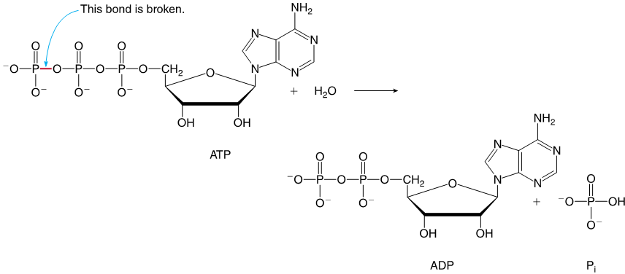
23.3 ATP and Energy Production (2)
General Features of ATP Hydrolysis
Hydrolysis of ATP cleaves 1 phosphate group.
This forms ADP and hydrogen phosphate
releasing 7.3 kcal/mol of energy.

Slide 17
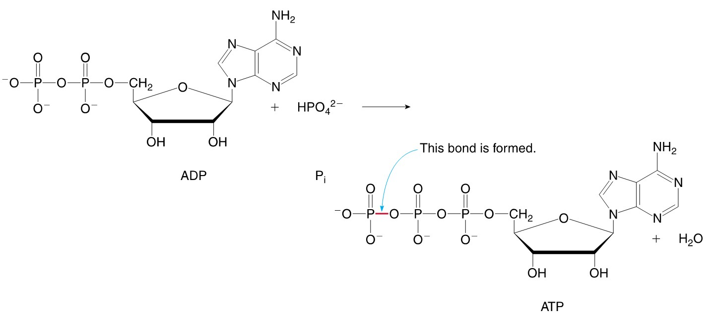
23.3 ATP and Energy Production (3)
General Features of ATP Phosphorylation
Phosphorylation is the reverse reaction, where a phosphate group is added to ADP, forming ATP requiring 7.3 kcal/mol of energy.

Slide 18
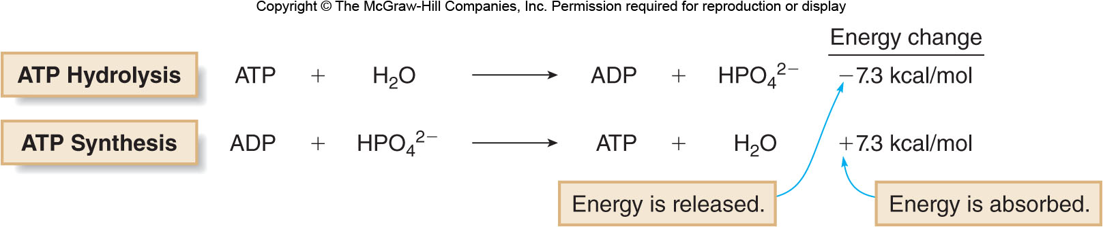
23.3 ATP and Energy Production (4)
General Features of ATP Phosphorylation
Any process (walking, running, breathing) is fueled by the release of energy when ATP is hydrolyzed to ADP.
Energy is absorbed and stored in ATP when it is synthesized from ADP.

Slide 19
23.3 ATP and Energy Production (5)
Coupled Reactions in Metabolic Pathways
Coupled reactions are pairs of reactions that occur together.
The energy released by one reaction is absorbed by the other reaction.
Coupling an energetically unfavorable reaction with a favorable one that releases more energy than the amount required is common in biological reactions.

Slide 20
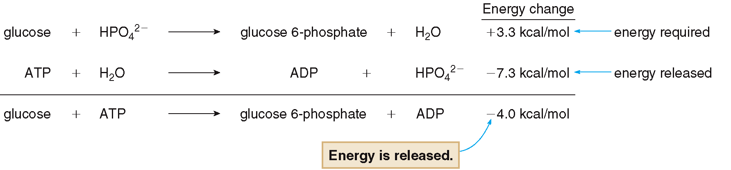
23.3 ATP and Energy Production (6)
Coupled Reactions in Metabolic Pathways
The hydrolysis of ATP provides the energy for the phosphorylation of glucose.

Slide 21
23.3 ATP and Energy Production (7)
Coupled Reactions in Metabolic Pathways
Coupled reactions that use ATP or coenzymes are often drawn as such:
This is meant to emphasize the organic substrates of the reaction, while making it clear that other materials are needed for the reaction to occur.

Slide 22
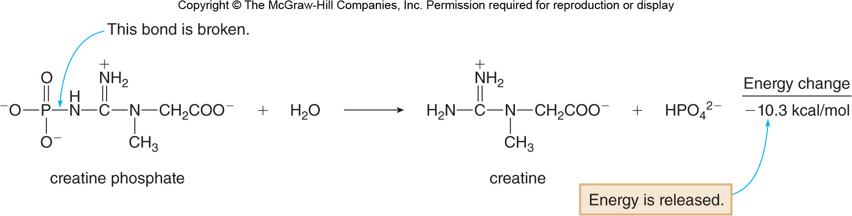
23.3 ATP and Energy Production (8)
Focus on the Human Body
Creatine, an amino acid byproduct, is taken by athletes as a supplements to boost their performance.
It is stored in muscle tissue as creatine phosphate, a high-energy molecule.

Slide 23
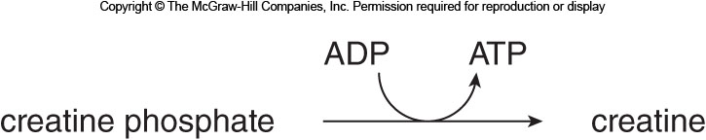
23.3 ATP and Energy Production (9)
Focus on the Human Body
The creatine phosphate hydrolysis provides energy for ADP phosphorylation to produce ATP, so the two processes are drawn as coupled reactions:
This provides high levels of energy for short bursts of intense activity.

Slide 24
23.4 Coenzymes in Metabolism (1)
Coenzymes
and NADH
Oxidation results in …
a loss of electrons, or a loss of hydrogen, or a gain of oxygen.
Reduction results in …
a gain of electrons, or a gain of hydrogen, or a loss of oxygen.

Slide 25
23.4 Coenzymes in Metabolism (2)
Coenzymes
and NADH
A coenzyme acting as an oxidizing agent causes an oxidation reaction to occur, so the coenzyme is reduced.
When a coenzyme acts as an oxidizing agent, it gains
and e⁻.
A coenzyme acting as a reducing agent causes a reduction reaction to occur, so the coenzyme is oxidized.
When a coenzyme acts as a reducing agent, it loses
and e⁻.

Slide 26
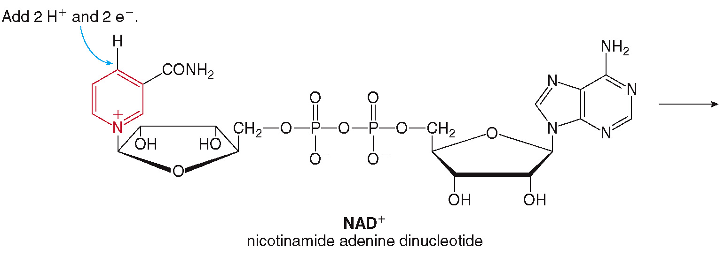
23.4 Coenzymes in Metabolism (3)
Coenzymes
and NADH
Coenzyme
(nicotinamide adenine dinucleotide)
is an oxidizing agent.

Slide 27
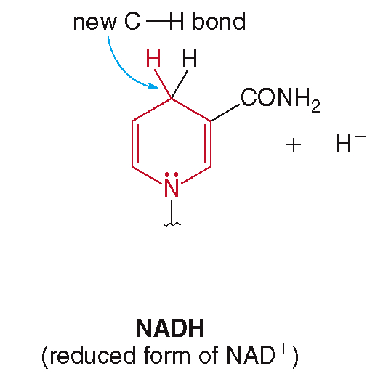
23.4 Coenzymes in Metabolism (4)
Coenzymes
and NADH
After gaining
and 2 e⁻, the reduced form of
is NADH.

Slide 28
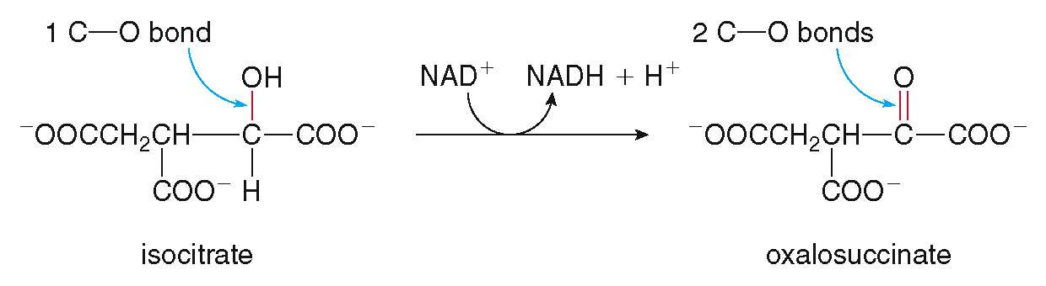
23.4 Coenzymes in Metabolism (5)
Coenzymes
and NADH
Curved arrows are often used to depict reactions that use coenzymes.
In this reaction, isocitrate is oxidized to oxalosuccinate while
is reduced to NADH.

Slide 29
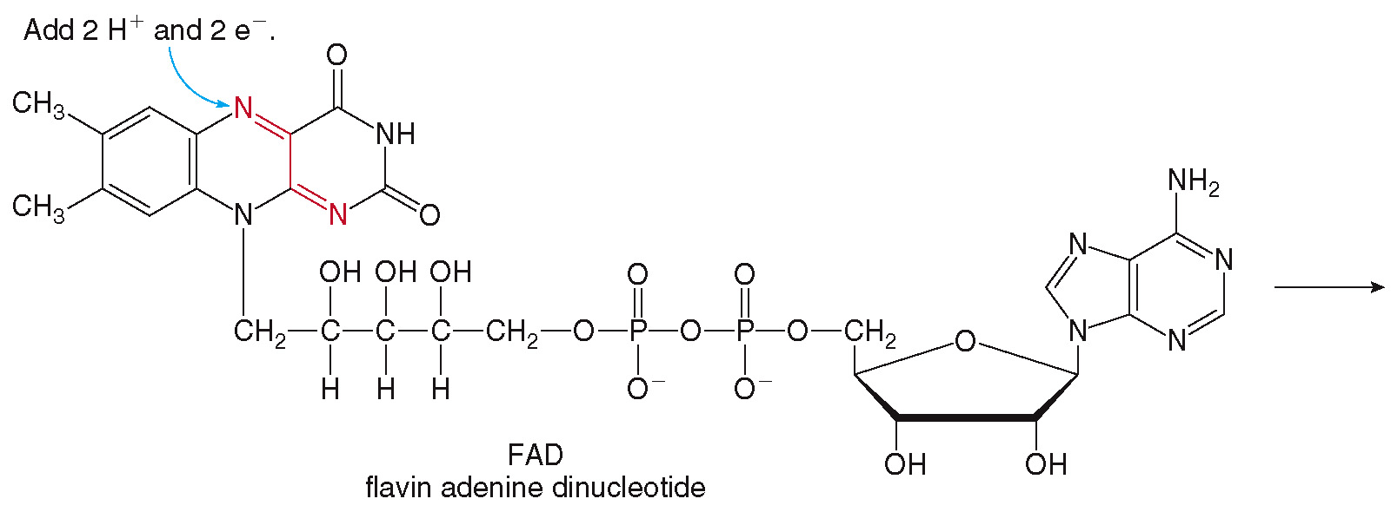
23.4 Coenzymes in Metabolism (6)
Coenzymes FAD and FADH₂
Coenzyme FAD (flavin adenine dinucleotide) is an oxidizing agent as well.

Slide 30
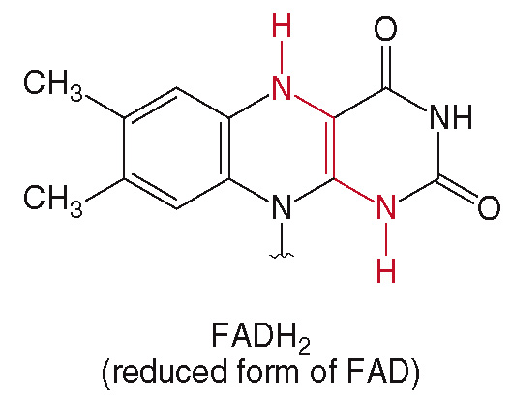
23.4 Coenzymes in Metabolism (7)
Coenzymes FAD and FADH₂
After gaining
and 2 e⁻, the reduced form of
FAD is FADH₂.

Slide 31
23.4 Coenzymes in Metabolism (8)
Coenzymes FAD and FADH₂
FAD is synthesized in cells from vitamin
riboflavin.
Riboflavin is a yellow, water-soluble vitamin obtained in the diet from leafy green vegetables, soybeans, almond and liver.
When large quantities of riboflavin are ingested, excess amounts are excreted in the urine, giving it a bright yellow appearance.

Slide 32
23.4 Coenzymes in Metabolism (9)
    Summary
Table 23.1 Coenzymes Used for Oxidation and Reduction
Coenzyme Name
Abbreviation
Role
Nicotinamide adenine dinucleotide
Oxidizing agent
Nicotinamide adenine dinucleotide (reduced form)
NADH
Reducing agent
Flavin adenine dinucleotide
FAD
Oxidizing agent
Flavin adenine dinucleotide (reduced form)
FADH₂
Reducing agent

Slide 33
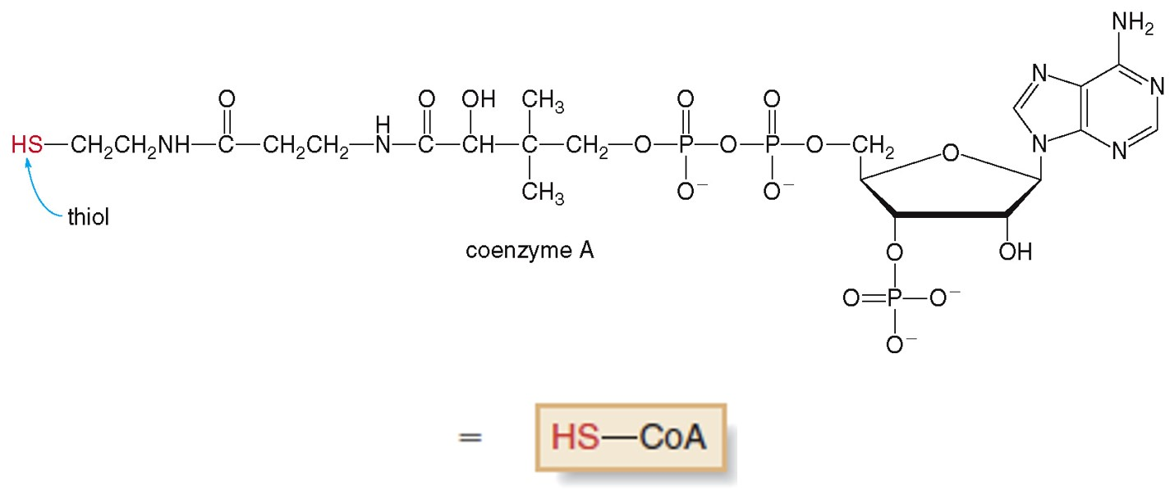
23.4 Coenzymes in Metabolism (10)
Coenzyme A
Coenzyme A (HS-CoA) is neither an oxidizing nor a reducing agent.

Slide 34
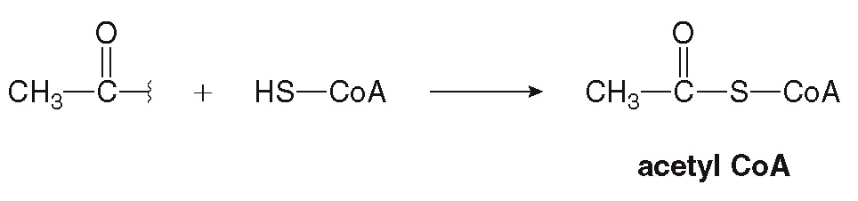

23.4 Coenzymes in Metabolism (11)
Coenzyme A
When an acetyl group reacts with the sulfhydryl end of coenzyme A, the thioester acetyl CoA is formed.
When the thioester bond is broken, 7.5 kcal/mol of energy is released.

Slide 35
23.5 The Citric Acid Cycle (1)
The citric acid cycle is a cyclic metabolic pathway that begins with the addition of acetyl CoA to a four-carbon substrate.
The cycle ends when the same four-carbon substrate is formed as a product eight steps
later.
The citric acid cycle produces high-energy compounds for ATP synthesis in stage [4] of catabolism.

Slide 36
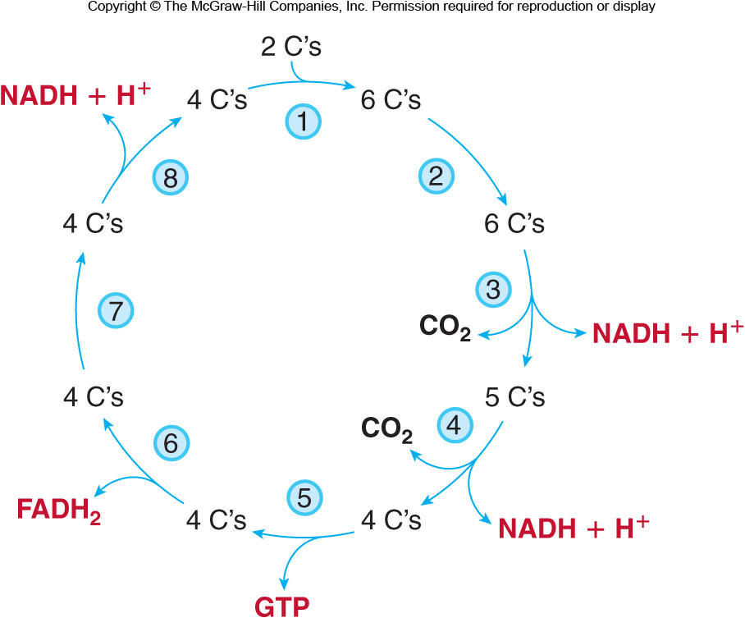
23.5 The Citric Acid Cycle (2)
Overview of the Citric Acid Cycle

Slide 37
23.5 The Citric Acid Cycle (3)
Overview of the Citric Acid Cycle
The citric acid cycle begins when 2 C’s of acetyl CoA react with a four-carbon substrate to form a six-carbon product (step [1]).
2 C atoms are sequentially removed to form 2 CO₂ molecules (steps [3] and [4]).
4 molecules of reduced coenzymes (3 NADH’s and 1 FADH₂) are formed (steps [3], [4], [6], and [8]).
1 mole of GTP is made in step [5]; GTP is similar to ATP.

Slide 38
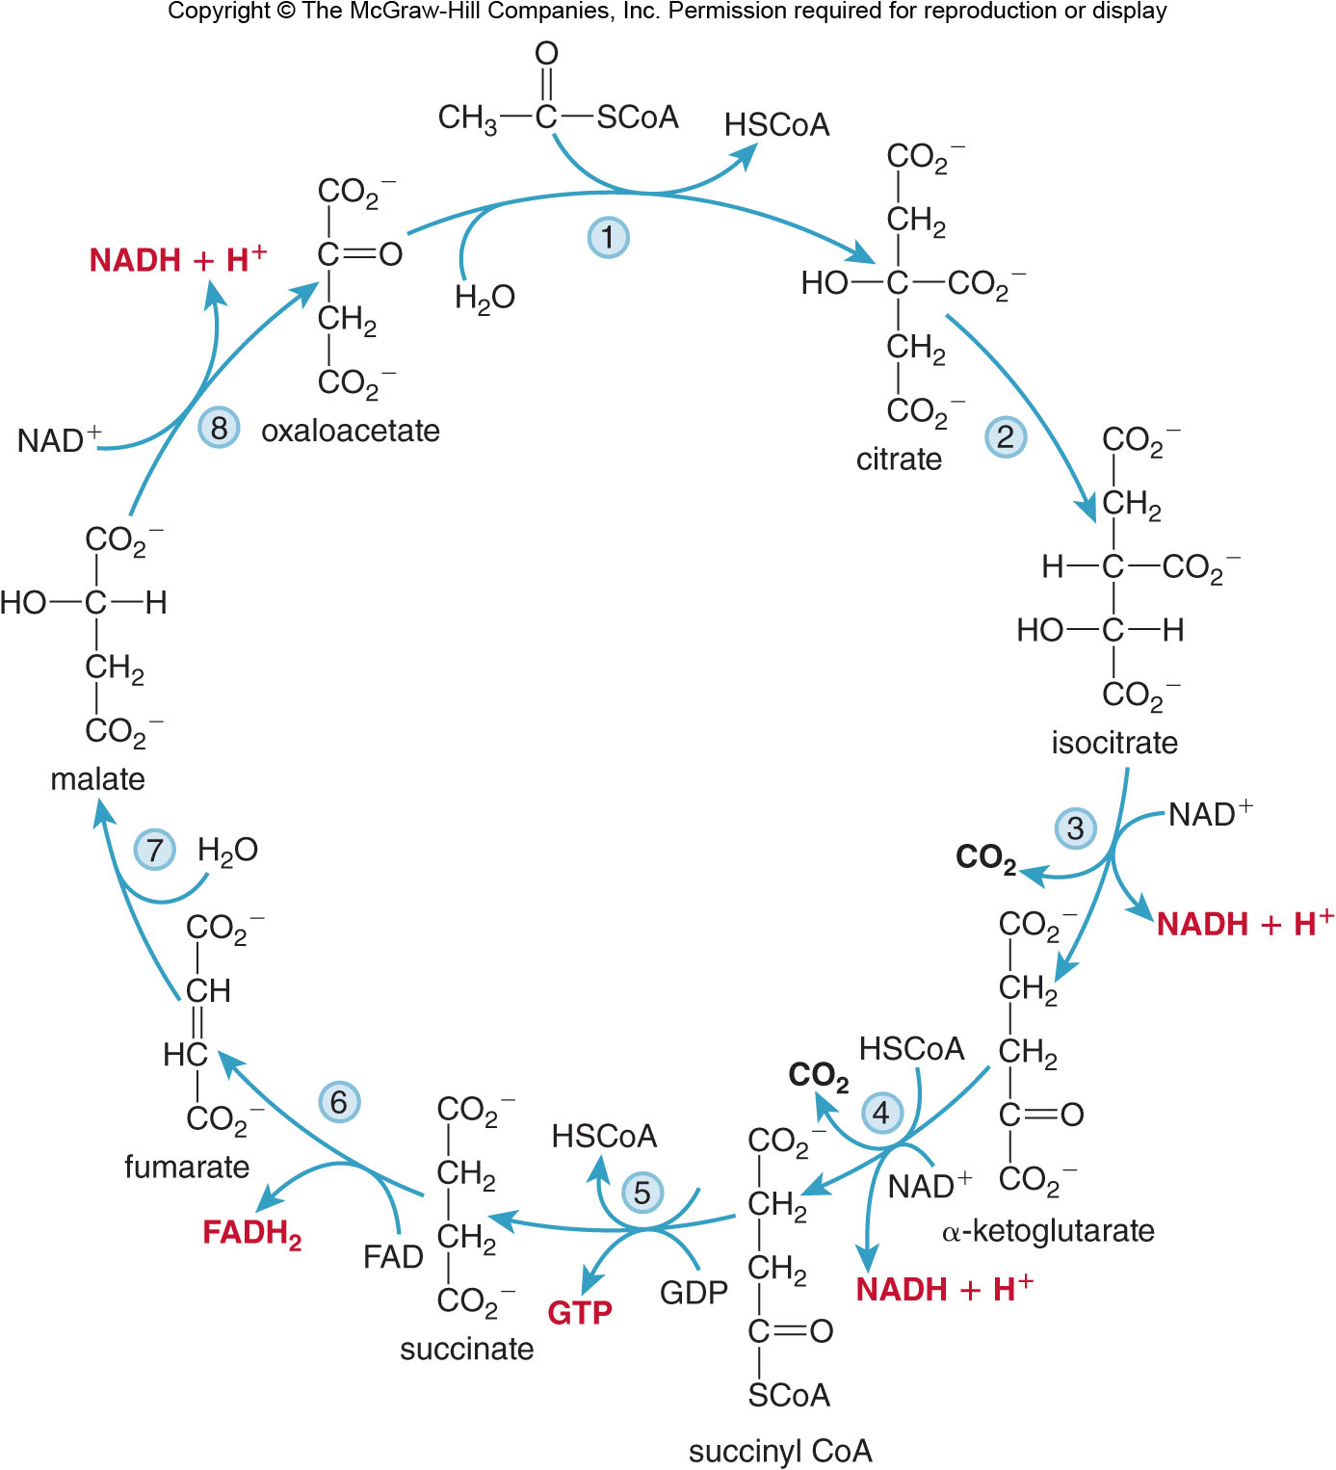
23.5 The Citric Acid Cycle (4)
Specific Steps of the Citric Acid Cycle

Slide 39
23.5 The Citric Acid Cycle (5)
Specific Steps of the Citric Acid Cycle
Step [1] reacts acetyl CoA with oxaloacetate to form citrate, and it is catalyzed by citrate synthase.

Slide 40
23.5 The Citric Acid Cycle (6)
Specific Steps of the Citric Acid Cycle
Step [2] isomerizes the
alcohol in citrate to
the
alcohol in
isocitrate; it is catalyzed by aconitase.

Slide 41
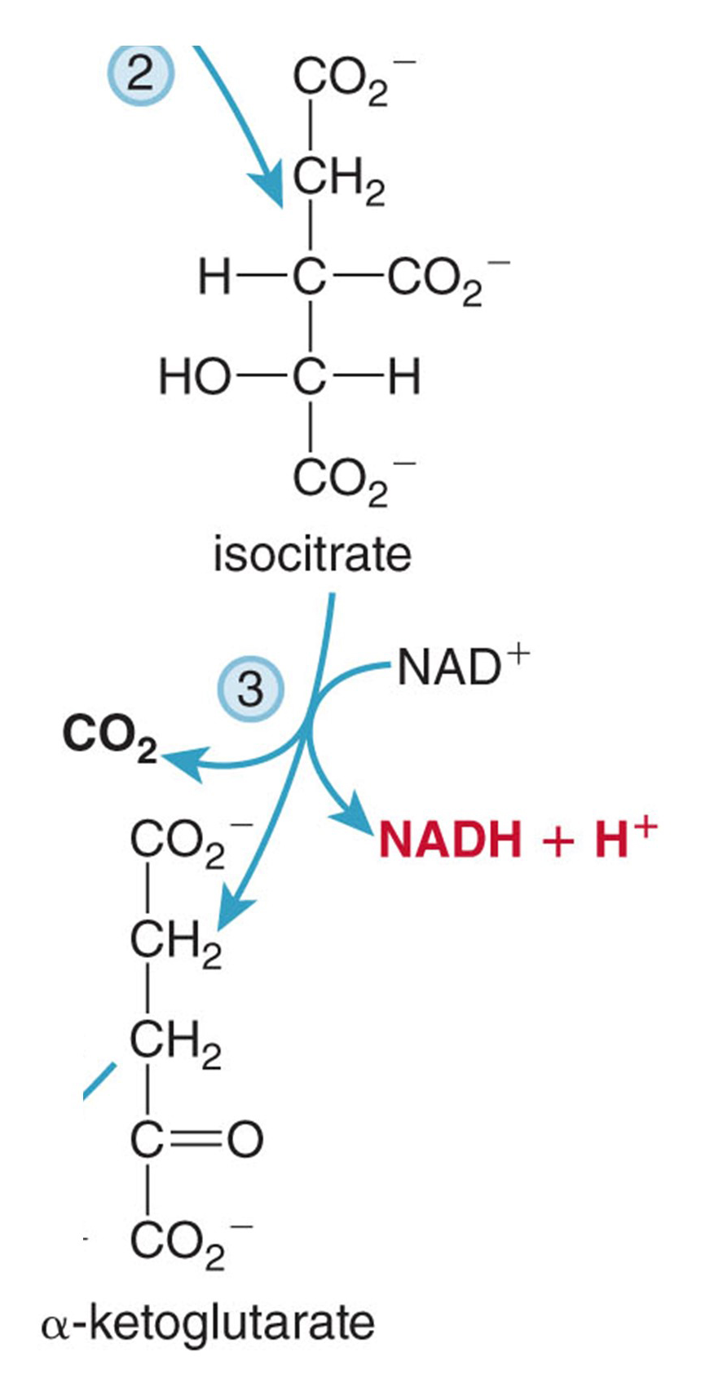
23.5 The Citric Acid Cycle (7)
Specific Steps of the Citric Acid Cycle
Step [3] isocitrate loses CO₂ in a decarboxylation reaction catalyzed by isocitrate dehydrogenase.
Also, the
alcohol of
isocitrate is oxidized by the oxidizing agent
to form the ketone
and
NADH.

Slide 42
23.5 The Citric Acid Cycle (8)
Specific Steps of the Citric Acid Cycle
Step [4] releases another CO₂ with the oxidation of
by
in the presence of
coenzyme A to form succinyl CoA and NADH.
This step is catalyzed by
dehydrogenase.

Slide 43
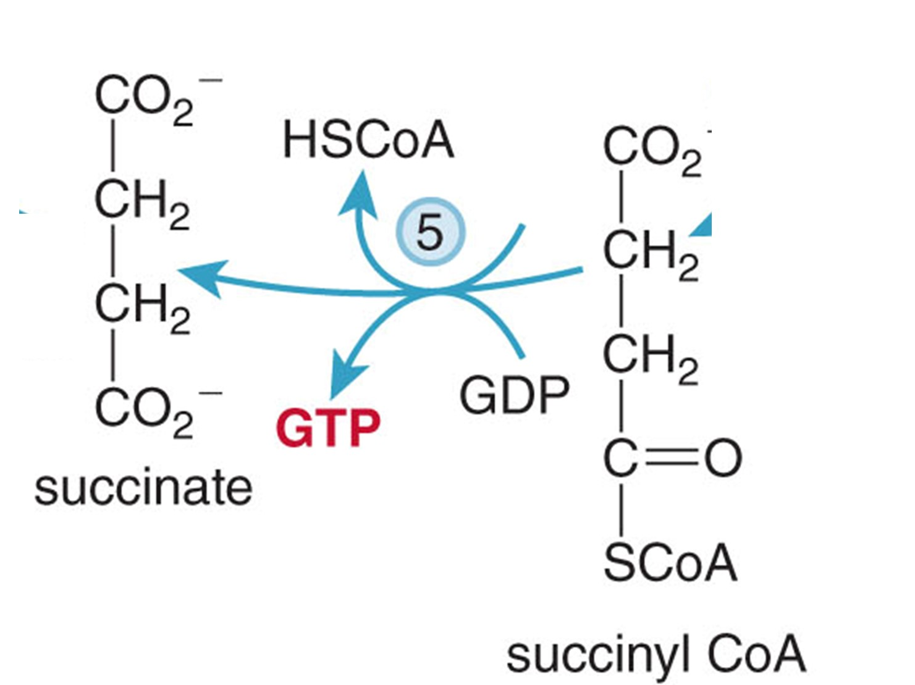
23.5 The Citric Acid Cycle (9)
Specific Steps of the Citric Acid Cycle
In step [5] the thioester bond of succinyl CoA is hydrolyzed to form succinate, releasing energy that converts GDP to GTP.

Slide 44
23.5 The Citric Acid Cycle (10)
Specific Steps of the Citric Acid Cycle
In step [6] succinate is converted to fumarate with FAD and succinate dehydrogenase; FADH₂ is formed.

Slide 45
23.5 The Citric Acid Cycle (11)
Specific Steps of the Citric Acid Cycle
In step [7], water is added across the C=C; this transforms fumarate into malate, which has a
alcohol.

Slide 46
23.5 The Citric Acid Cycle (12)
Specific Steps of the Citric Acid Cycle
In step [8], the
alcohol
of malate is oxidized by
to form the ketone
portion of oxaloacetate and NADH.
The product of step [8] is the starting material for step [1].

Slide 47
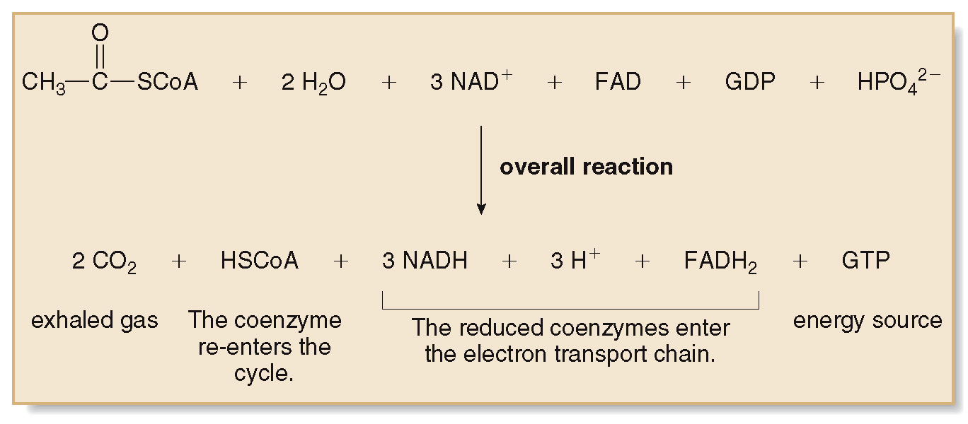
23.5 The Citric Acid Cycle (13)

Slide 48
23.5 The Citric Acid Cycle (14)
The overall citric acid cycle yields:
2 CO₂ molecules
3 NADH and 1 FADH₂ molecules
1 GTP molecule
The main function of the citric acid cycle is to produce reduced coenzymes (NADH and FADH₂).
These molecules enter the electron transport chain and ultimately produce ATP.

Slide 49
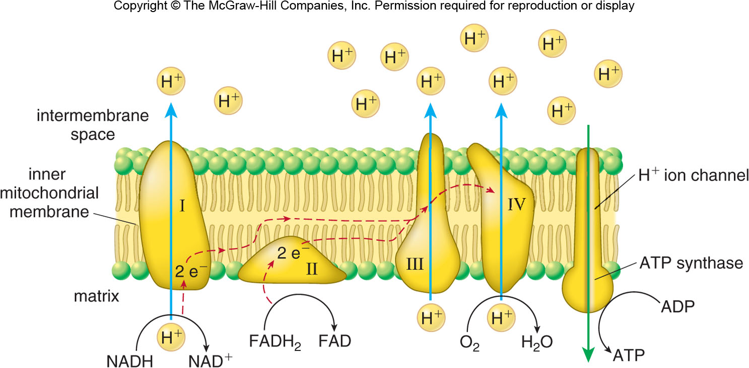
23.6 A. The Electron Transport Chain (1)
The electron transport chain is a multistep process using 4 enzyme complexes (I, II, III and IV) located along the mitochondrial inner membrane.

Slide 50
23.6 A. The Electron Transport Chain (2)
The reduced coenzymes (NADH and FADH₂) are reducing agents, and can donate e⁻ when oxidized.
NADH is oxidized to
and FADH₂ is oxidized to
FAD when they enter the electron transport chain.
The e⁻ donated by the coenzymes are passed down from complex to complex in a series of redox reactions, which produces some energy.
These e⁻ and
react with inhaled O₂ to form water.
This process is aerobic because of the use of O₂.

Slide 51
23.6 B. ATP Synthesis by Oxidative Phosphorylation (1)
The electron transport chain provides the energy to
pump
ions across the inner membrane of the
mitochondria.
The concentration of
ions in the intermembrane
space becomes higher than that inside the matrix.
This creates a potential energy gradient, much like the potential energy of water stored behind a dam.

Slide 52
23.6 B. ATP Synthesis by Oxidative Phosphorylation (2)
To return to the matrix,
ions travel through a
channel in the ATP synthase enzyme.
ATP synthase is the enzyme that catalyzes the phosphoryation of ADP into ATP.
The energy released as the
ions return to the
matrix is the energy stored in the ATP molecule.
It is called oxidative phosphorylation because the energy used to transfer the phosphate group results from the oxidation of the coenzymes.

Slide 53
23.6 C. ATP Yield from Oxidative Phosphorylation (1)
Each NADH entering the electron transport chain produces enough energy to make 2.5 ATPs.
Each FADH₂ entering the electron transport chain produces enough energy to make 1.5 ATPs.
The citric acid cycle produces overall:
3 NADH × 2.5 ATP = 7.5 ATP
1 FADH₂ × 1.5 ATP = 1.5 ATP
1 GTP = 1 ATP
10 ATP

Slide 54
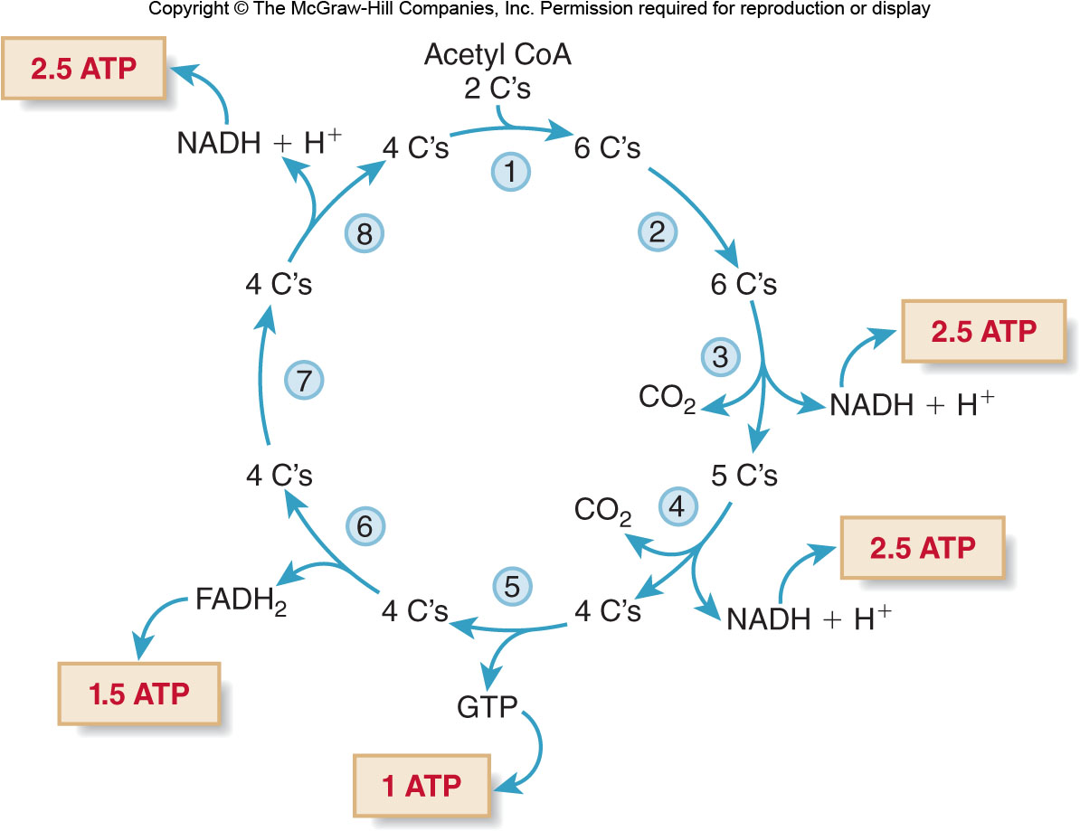
23.6 C. ATP Yield from Oxidative Phosphorylation (2)

Slide 55
23.7 Focus on Health & Medicine Hydrogen Cyanide (1)
If any one step of the electron transport chain or oxidative phosphorylation is disrupted an organism cannot survive.
Hydrogen cyanide (HCN) produces
which
irreversibly binds to the
portion of the
cytochrome oxidase.
Cytochrome oxidase is a key enzyme of complex IV of the electron transport chain.

Slide 56
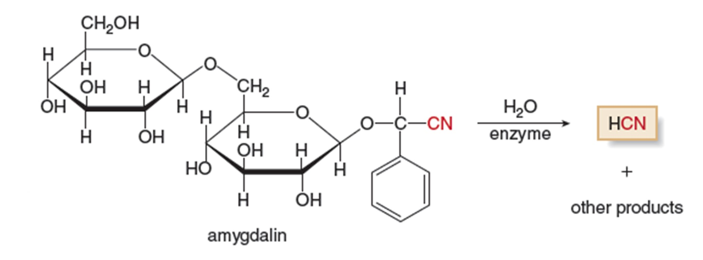
23.7 Focus on Health & Medicine Hydrogen Cyanide (2)
This prevents the
from being reduced to
halting th e electron transport chain and
energy production.
ATP is not synthesized, and cell death occurs.
Amygdalin is present in the seeds and pits of apricots, peaches, and wild cherries. HCN is produced by hydrolysis.

