Slide 1

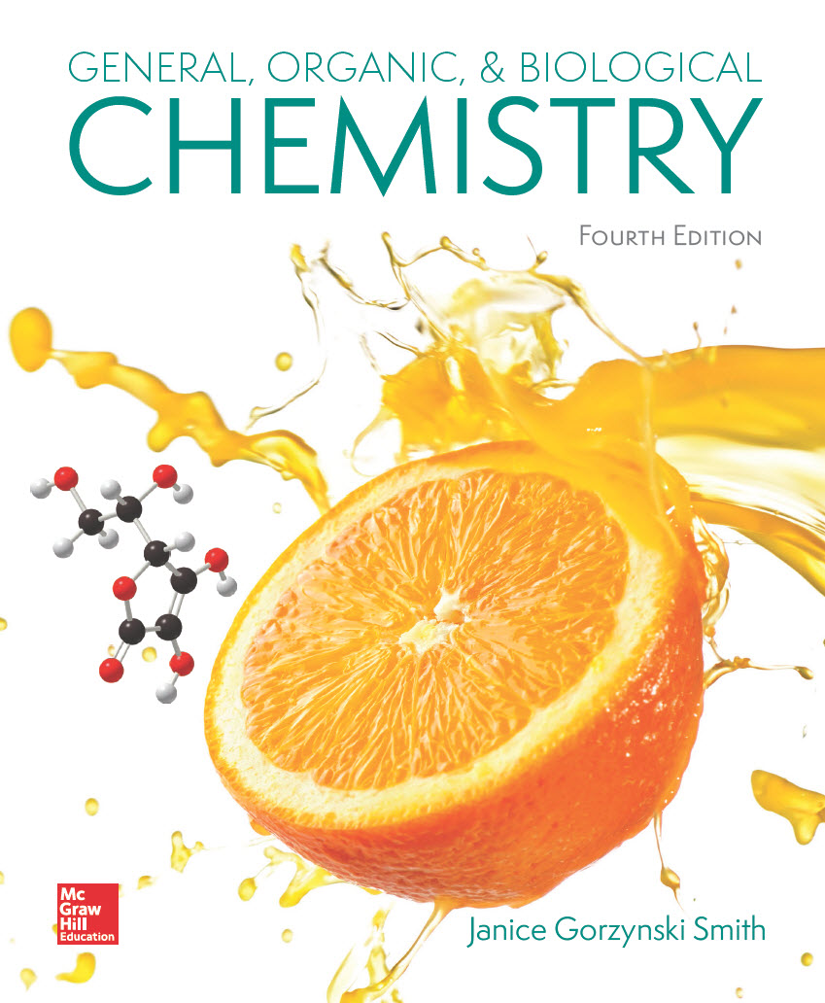
Chapter 24
Lecture
Outline
Prepared by
Harpreet Malhotra
Florida State College at Jacksonville

Slide 2
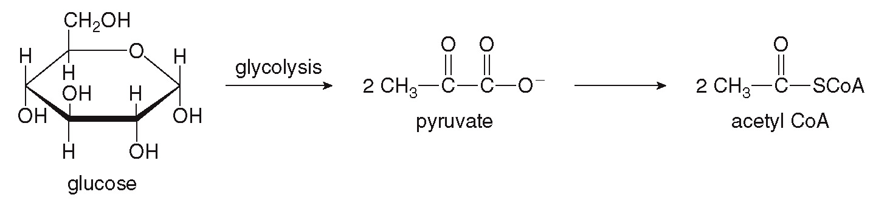
24.1 Introduction (1)
In the catabolism of carbohydrates, glycolysis converts glucose into pyruvate, which is then metabolized into acetyl CoA.

Slide 3
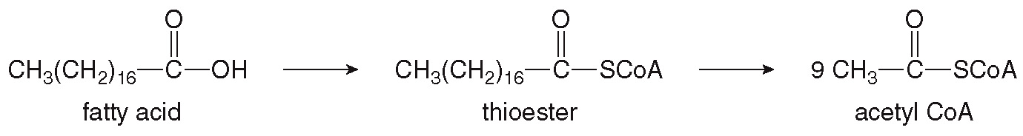
24.1 Introduction (2)
In the catabolism of lipids, fatty acids are converted into thioesters and then cleaved into many acetyl CoA units.

Slide 4
24.1 Introduction (3)
Amino acids are usually reassembled into new proteins.
Since excess amino acids are not stored in the body, they can also be catabolized for energy.
The amino groups (NH₂) are converted to urea [(NH₂)₂C=O], which is excreted in urine.

Slide 5
24.2 Understanding Biochemical Reactions (1)
The name of an enzyme is often a clue as to the type
of reaction it catalyzes:
Carboxylase catalyzes the addition of a
(carboxylate).
Decarboxylase catalyzes the removal of CO₂.
Dehydrogenase catalyzes the removal of 2 H atoms.
Isomerase catalyzes the isomerization of one isomer into another.
Kinase catalyzes the transfer of a phosphate.

Slide 6
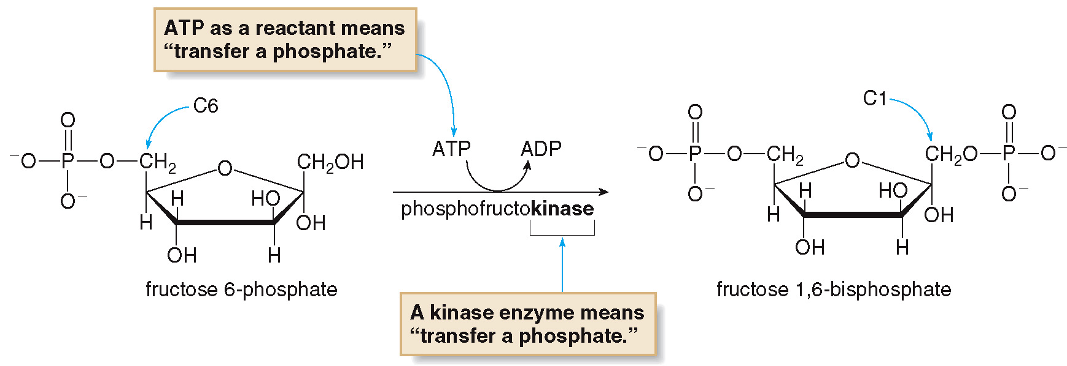
24.2 Understanding Biochemical Reactions (2)
The transfer of a phosphate unit from ATP to the fructose 6-phosphate molecule is catalyzed by a kinase enzyme.

Slide 7
24.3 Glycolysis (1)
Glycolysis is a linear, 10-step anaerobic pathway that converts glucose into two molecules of pyruvate.
Steps [1] to [5] comprise the energy investment phase, where 2 ATP molecules are hydrolyzed.
The 6-carbon glucose molecule is converted into two 3-carbon segments.
Steps [6] to [10] comprise the energy-generating phase, producing 1 NADH and 2 ATPs for each pyruvate formed.

Slide 8
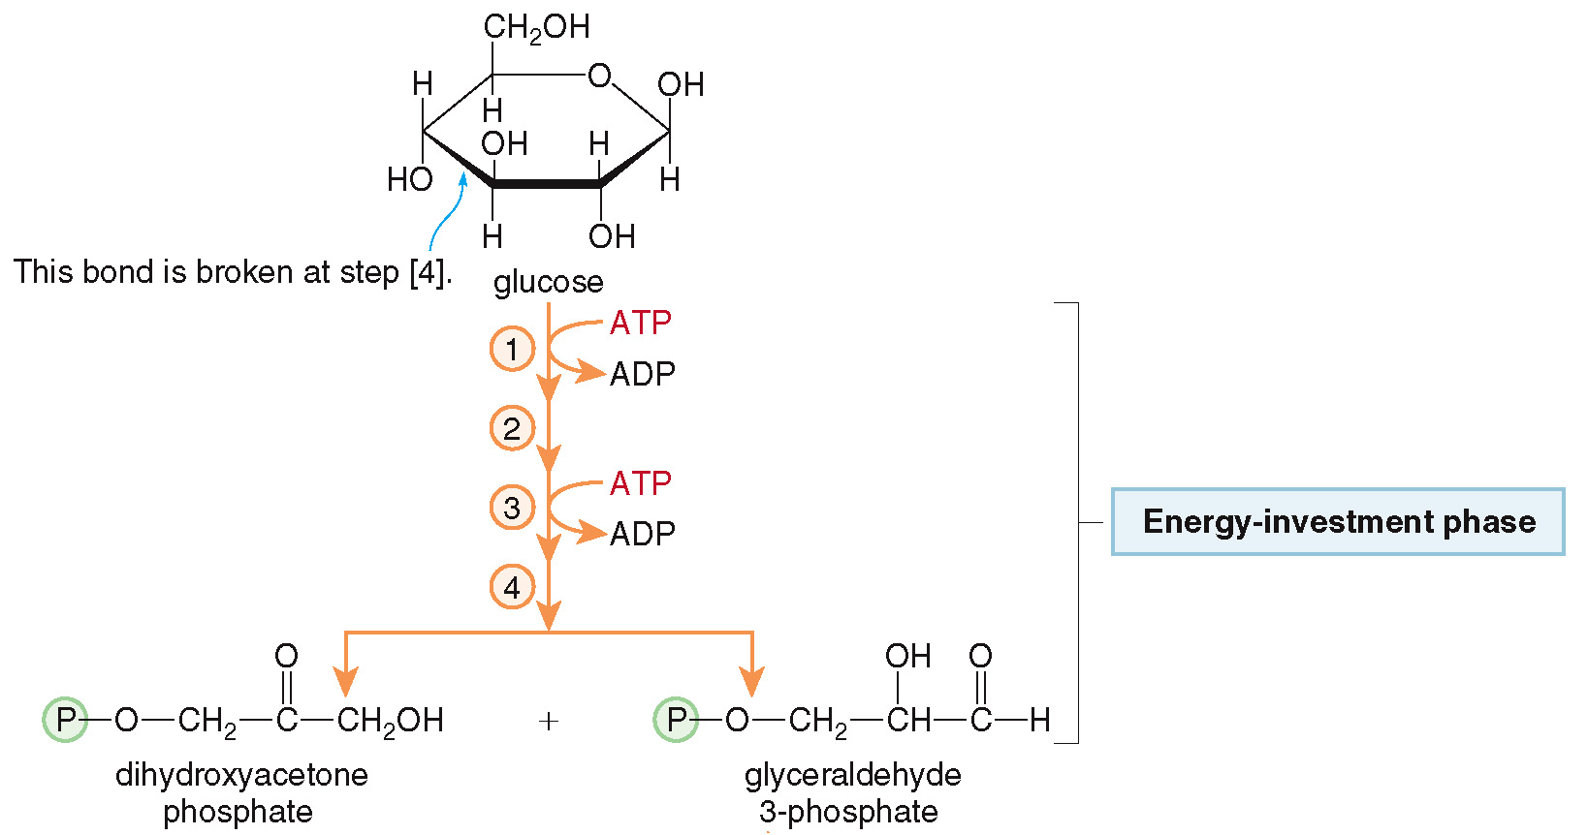
24.3 Glycolysis (2)

Slide 9
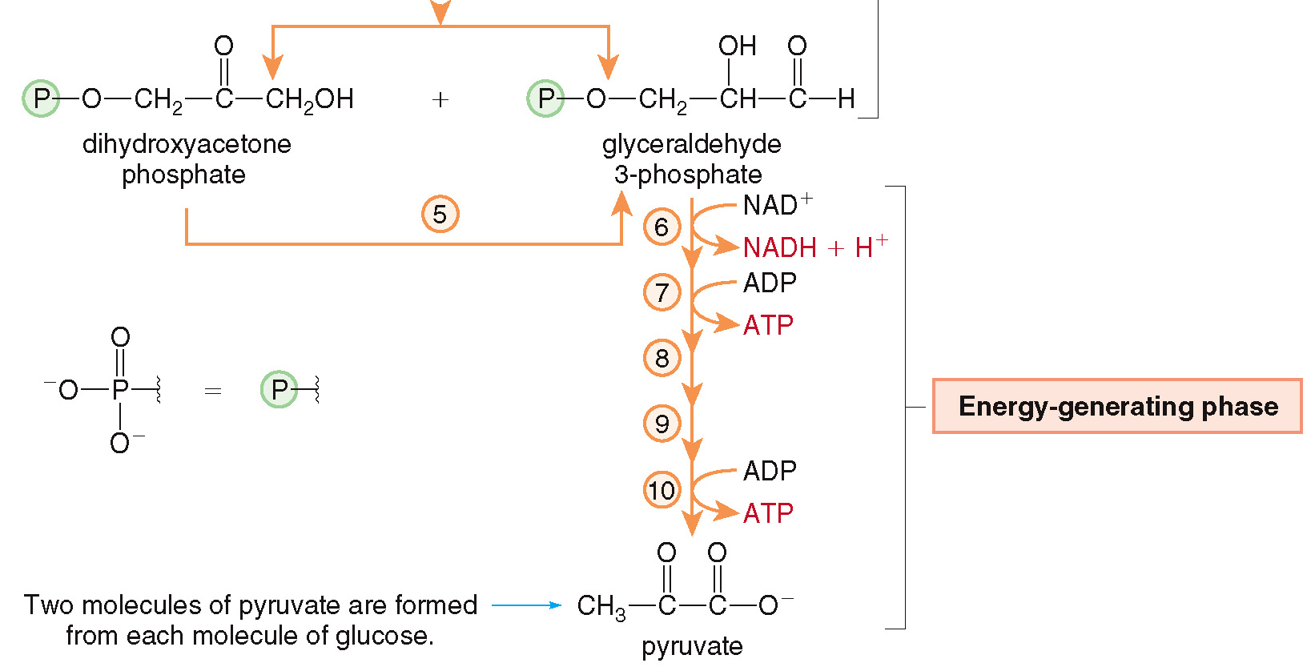
24.3 Glycolysis (3)

Slide 10
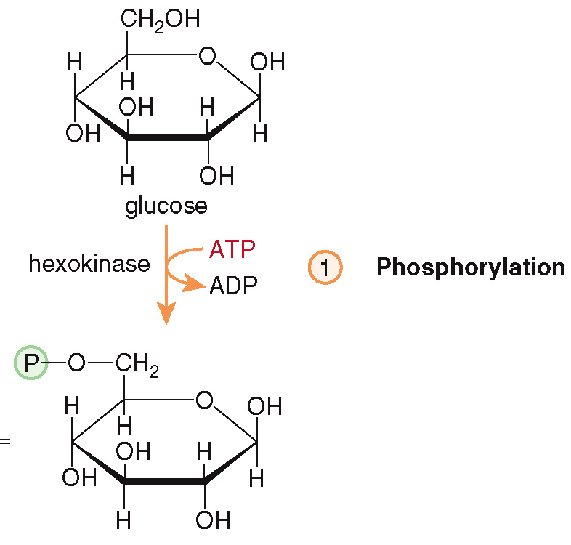
24.3 Glycolysis (4)
The Steps in Glycolysis
Step [1] begins with the phosphorylation of glucose into glucose 6-phosphate, using an ATP and a kinase enzyme.

Slide 11
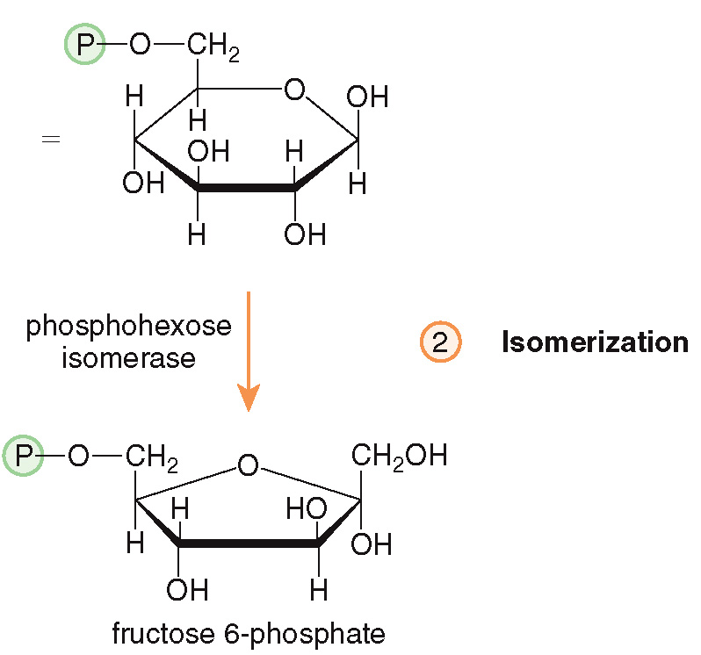
24.3 Glycolysis (5)
The Steps in Glycolysis
Step [2] isomerizes glucose 6-phosphate to fructose 6-phosphate with an isomerase enzyme.

Slide 12
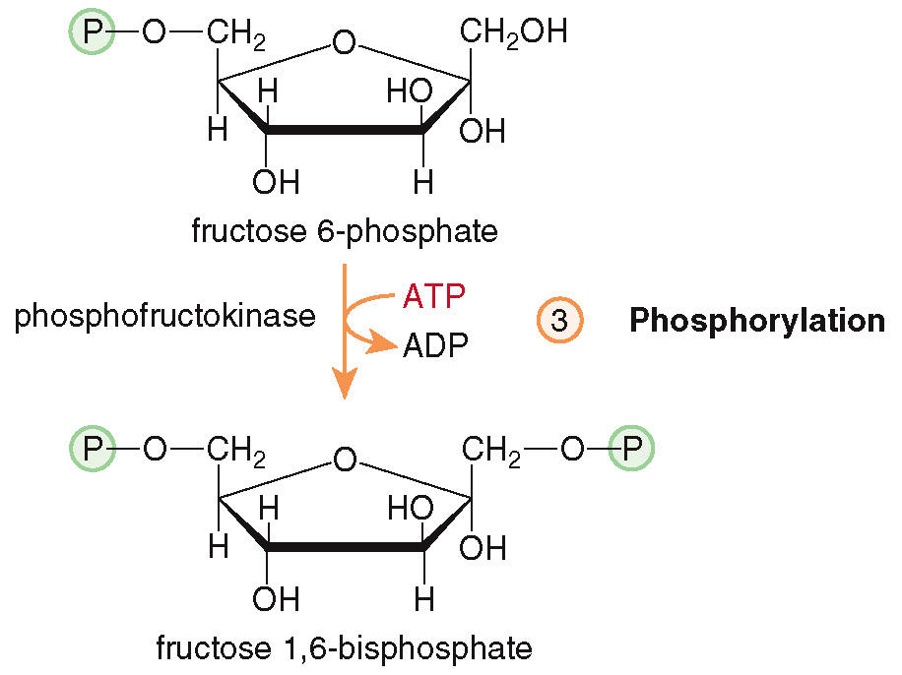
24.3 Glycolysis (6)
The Steps in Glycolysis
Step [3] is the phosphorylation of fructose 6-phosphate into fructose 1,6-bisphosphate with a kinase enzyme.

Slide 13
24.3 Glycolysis (7)
The Steps in Glycolysis
Overall, the first three steps of glycolysis add 2 phosphate groups and isomerize a 6-membered glucose ring into a 5-membered fructose ring.
The energy stored in 2 ATP molecules is utilized to modify the structure of glucose for the later steps that generate energy.

Slide 14
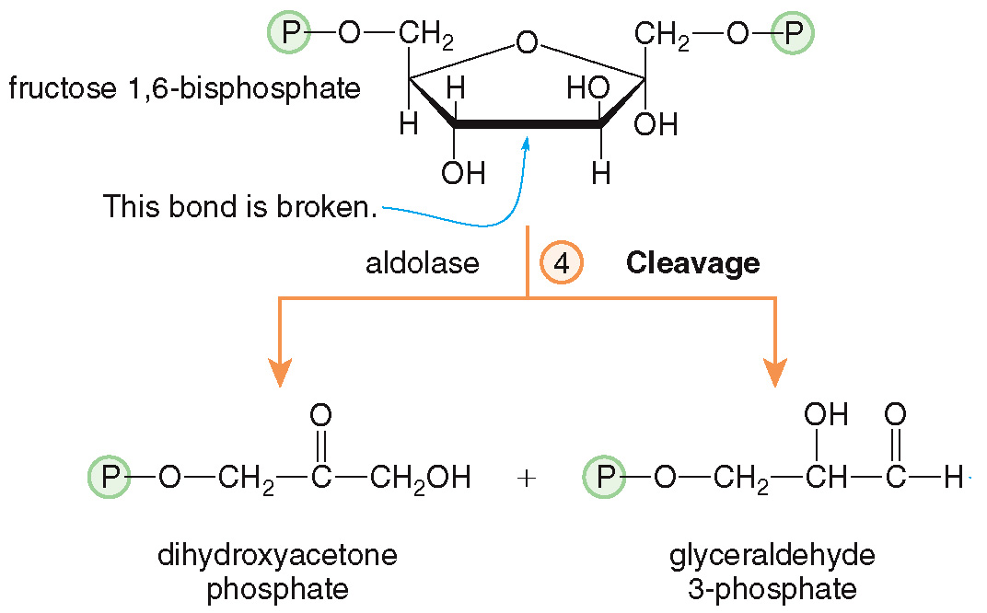
24.3 Glycolysis (8)
The Steps in Glycolysis
Step [4] cleaves the fructose ring into a dihydroxyacetone phosphate and a glyceraldehyde 3-phosphate.

Slide 15
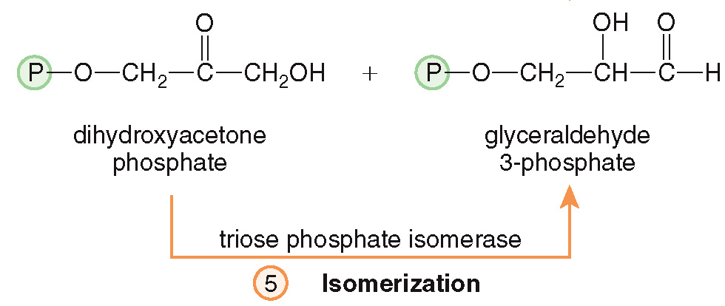
24.3 Glycolysis (9)
The Steps in Glycolysis
Step [5] isomerizes the dihydroxyacetone phosphate into another glyceraldehyde 3-phosphate.
Thus, the first phase of glycolysis converts glucose into 2 glyceraldehyde 3-phosphate units.

Slide 16
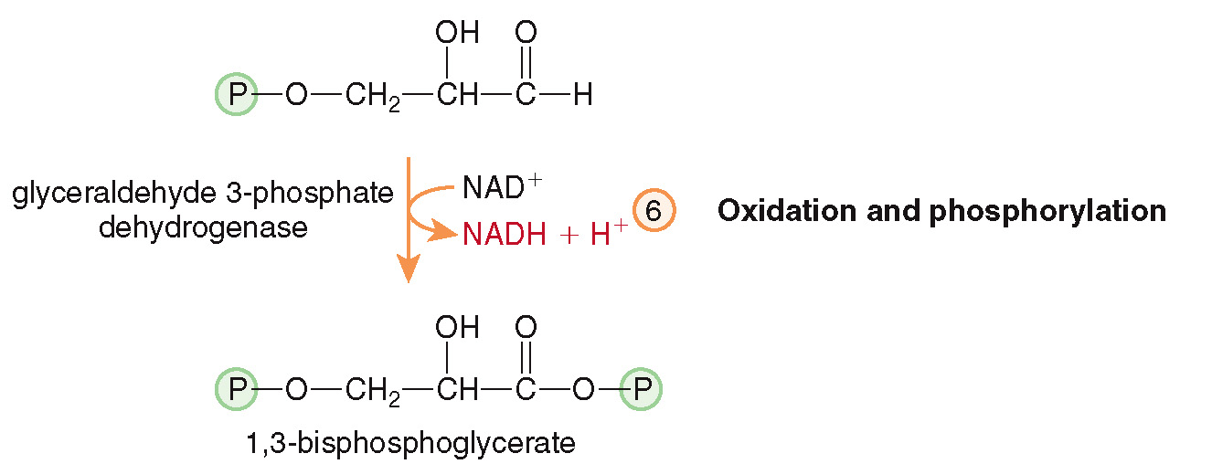
24.3 Glycolysis (10)
The Steps in Glycolysis
In step [6] the aldehyde end of the molecule is oxidized and phosphorylated by a dehydrogenase enzyme and
this produces
1,3-bisphosphoglycerate and NADH.

Slide 17
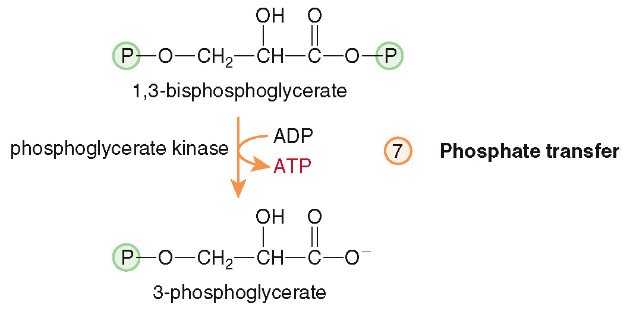
24.3 Glycolysis (11)
The Steps in Glycolysis
In step [7], the phosphate group is transferred onto an ADP with a kinase enzyme, forming
3-phosphoglycerate and ATP.

Slide 18
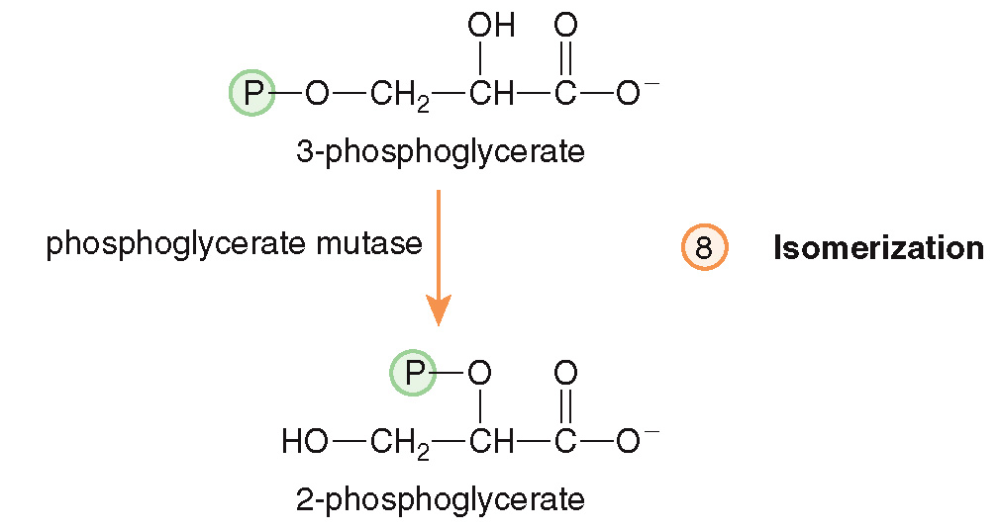
24.3 Glycolysis (12)
The Steps in Glycolysis
In step [8], the phosphate group is isomerized to a new position in 2-phosphoglycerate.

Slide 19
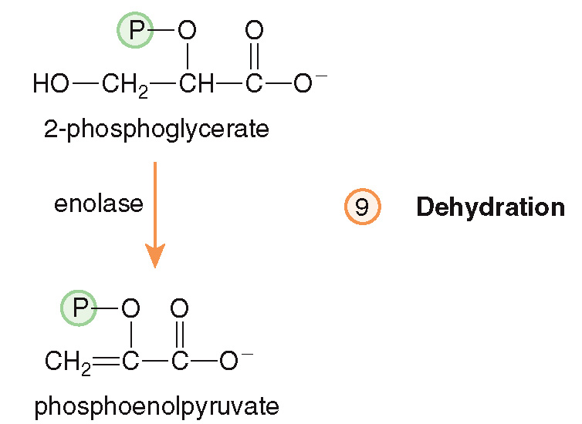
24.3 Glycolysis (13)
The Steps in Glycolysis
In step [9], water is lost to form phosphoenolpyruvate.

Slide 20
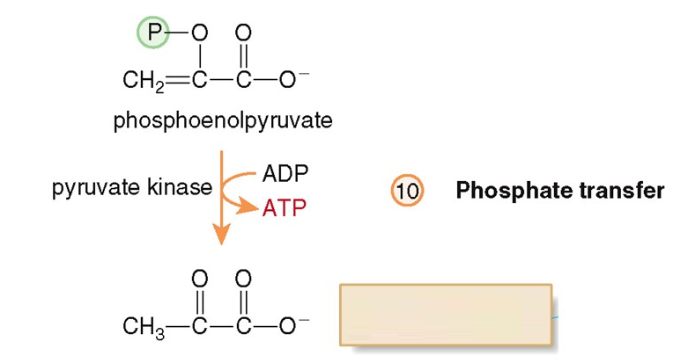
24.3 Glycolysis (14)
The Steps in Glycolysis
In step [10], the phosphate is transferred to an ADP, yielding pyruvate and ATP with a kinase enzyme.
Two molecules of pyruvate are formed.

Slide 21
24.3 Glycolysis (15)
The Steps in Glycolysis
The 2 glyceraldehyde 3-phosphate units are converted into 2 pyruvate units in Phase two of glycolysis.
Overall, the energy-generating phase forms 2 NADHs and 4 ATPs.

Slide 22
24.3 Glycolysis (16)
The Net Result of Glycolysis
2 ATPs are used in phase one of glycolysis, and 4 ATPs are made in phase two of glycolysis.
The net result is the synthesis of 2 ATPs from glycolysis.
The 2 NADHs formed are made in the cytoplasm and must be transported to the mitochondria to join the electron transport chain and make ATP.
The fate of the 2 pyruvate molecules depends on O₂ availability.

Slide 23
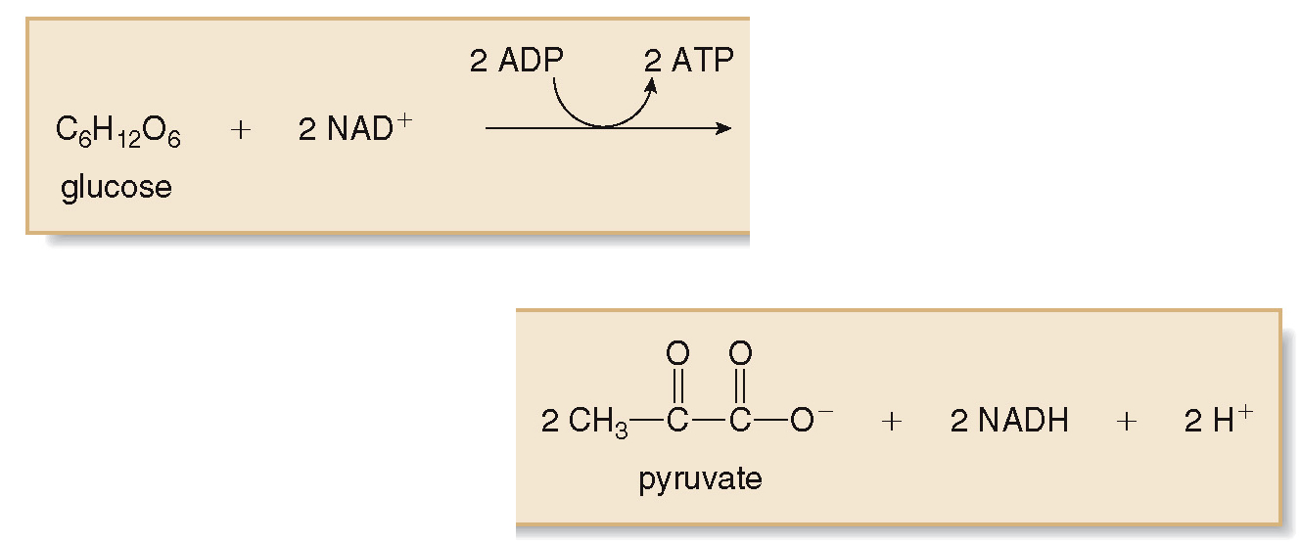
24.3 Glycolysis (17)
The Net Result of Glycolysis

Slide 24
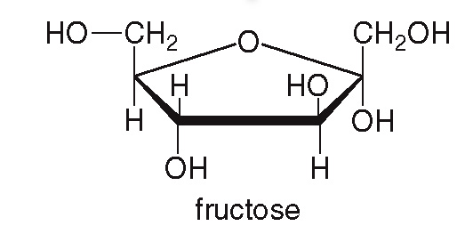
24.3 Glycolysis (18)
Glycolysis and Other Hexoses
Fructose is obtained by the hydrolysis of the disaccharide sucrose, found in sugar beets and sugarcane.
It can be converted by muscle or kidney cells into fructose 6-phosphate and enter glycolysis at step [3].
Or, it can be converted by the liver to glyceraldehyde 3-phosphate and enter glycolysis at step [6].

Slide 25
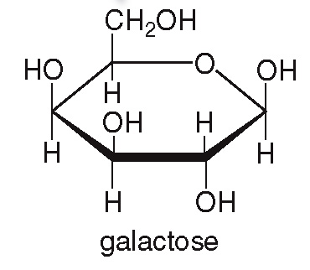
24.3 Glycolysis (19)
Glycolysis and Other Hexoses
Galactose is obtained by the hydrolysis of the disaccharide lactose in milk.
Galactose is converted into glucose 6-phosphate and then enters glycolysis in step [2].
Patients with galactosemia lack the enzyme to perform this conversion.

Slide 26
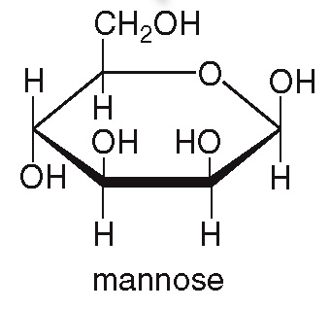
24.3 Glycolysis (20)
Glycolysis and Other Hexoses
Mannose is obtained from polysaccharides in fruits such as cranberries and currants.
Mannose is converted to fructose 6-phosphate, and it enters glycolysis at step [3].
Thus, all the common hexoses enter glycolysis and are metabolized into pyruvate.

Slide 27
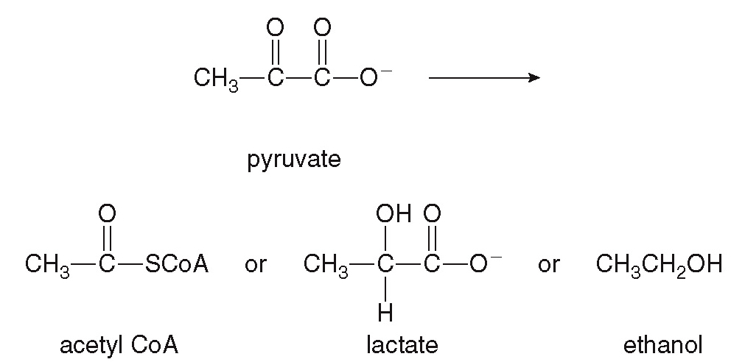
24.4 The Fate of Pyruvate (1)
Pyruvate can be converted into three possible products depending on the conditions and the organism.
under aerobic conditions
under anaerobic conditions
in fermentation by microorganisms

Slide 28
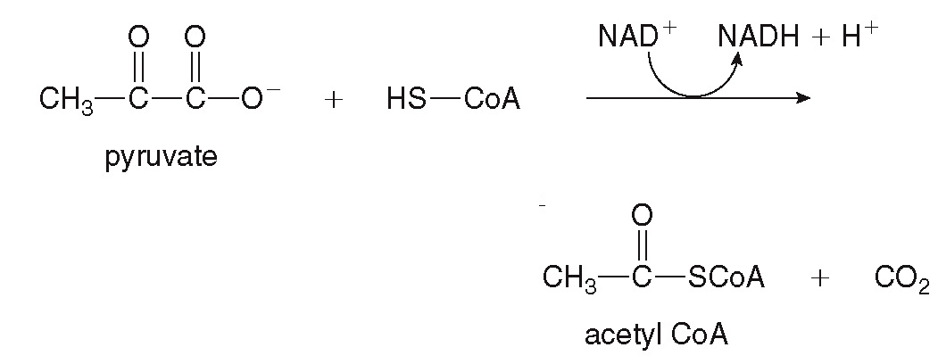
24.4 The Fate of Pyruvate (2)
Conversion to Acetyl CoA
Under aerobic conditions (when O₂ is plentiful), pyruvate is oxidized by
in the presence of
coenzyme A to form acetyl CoA.
so
The NADH formed needs O₂ to return to
without O₂ no additional pyruvate can be oxidized.

Slide 29
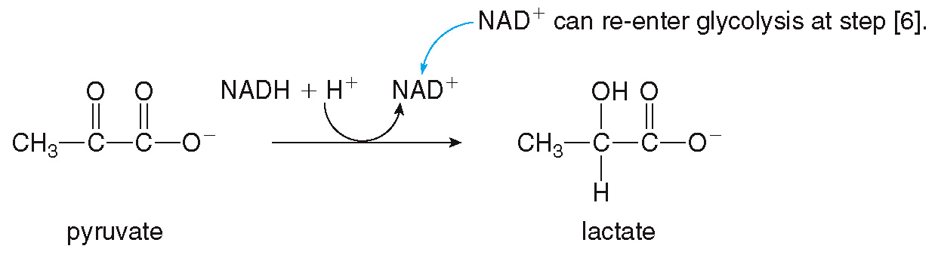
24.4 The Fate of Pyruvate (3)
Conversion to Lactate
In anaerobic conditions (when O₂ is lacking) there is an abundance of NADH.
The NADH acts as a reducing agent, reducing pyruvate to lactate.

Slide 30
24.4 The Fate of Pyruvate (4)
Conversion to Lactate
During strenuous exercise, when ATP needs are high, there is not enough O₂ being inhaled to re-oxidize NADH in the electron transport chain.
The lactate formed by anaerobic metabolism of pyruvate builds up in muscle cells, resulting in soreness and cramping.
An “oxygen debt” is created, and when the vigorous activity decreases, the person must take deep breaths of air to repay this debt.

Slide 31
24.4 The Fate of Pyruvate (5)
Conversion to Lactate
The lactate in the muscles is then re-oxidized to pyruvate, which can return to acetyl CoA and muscle soreness, fatigue, and shortness of breath resolve.
The pain felt during a heart attack is caused by an increase of lactate in the heart and areas near the heart cut off from oxygenated blood.
A higher-than-normal blood lactate level can indicate lung disease, congestive heart failure, or serious infection.

Slide 32
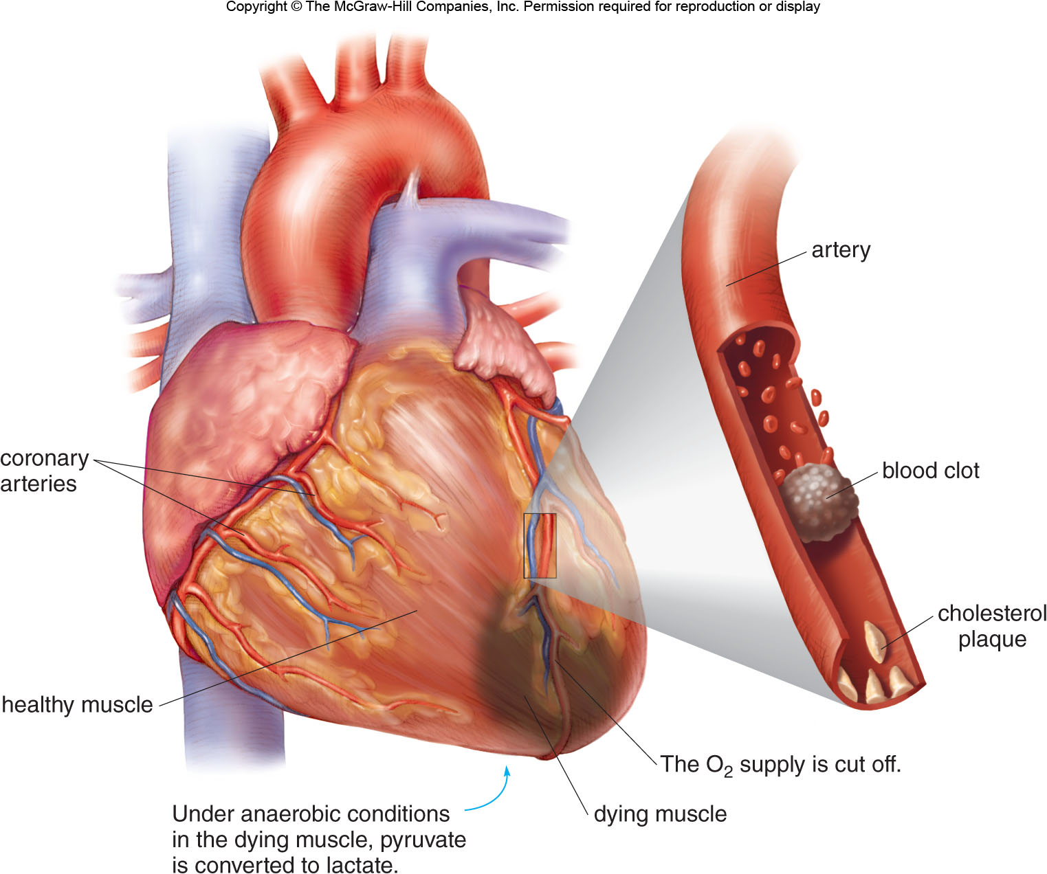
24.4 The Fate of Pyruvate (6)
Conversion to Lactate

Slide 33
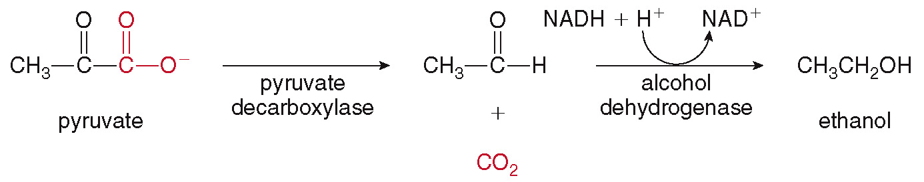
24.4 The Fate of Pyruvate (7)
Conversion to Ethanol
Fermentation is the anaerobic conversion of glucose to ethanol and CO₂ by yeast and other microorganisms.
The ethanol in alcoholic beverages is obtained by fermentation of the sugars in grapes, barley malt, corn, rye, rice, or potatoes.

Slide 34
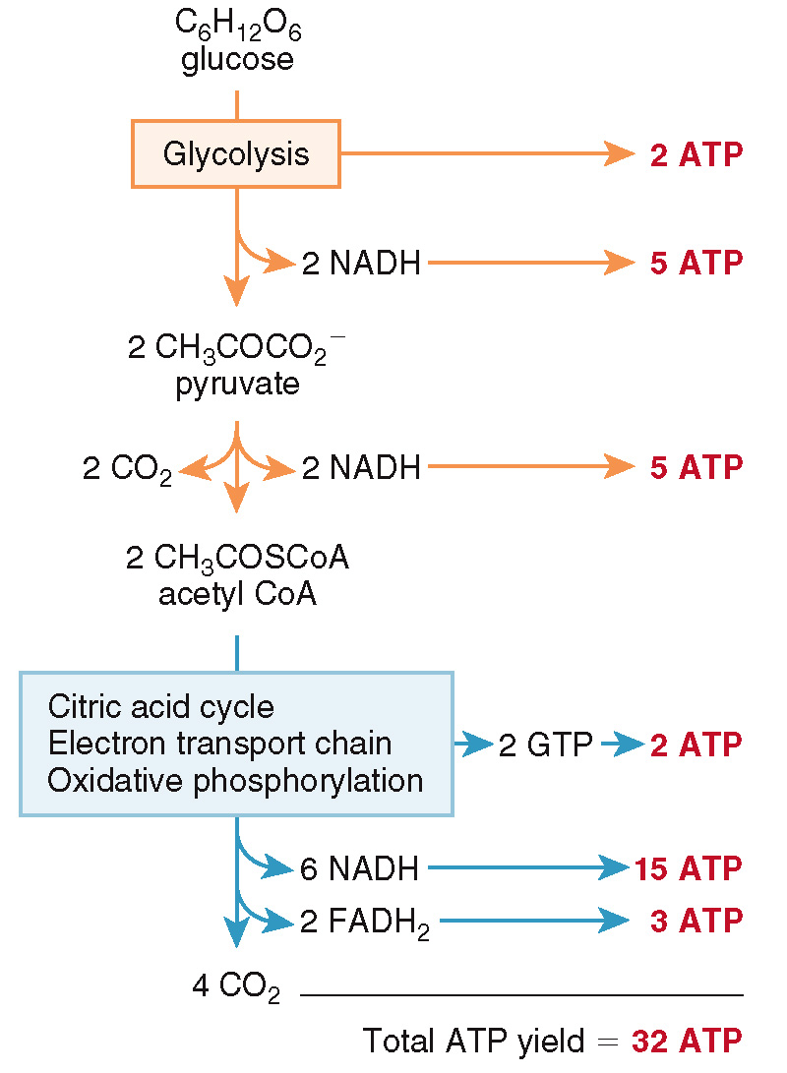
24.5 The ATP Yield from Glucose (1)

Slide 35
24.5 The ATP Yield from Glucose (2)
First, glycolysis yields a net of 2 ATPs and 2 NADHs (which will give 5 ATPs).
2 x 2.5 ATP =
5 ATP

Slide 36
24.5 The ATP Yield from Glucose (3)
Second, oxidation of the 2 pyruvates yields 2 NADHs (which will give 5 ATPs).
2 x 2.5 ATP =
5 ATP

Slide 37
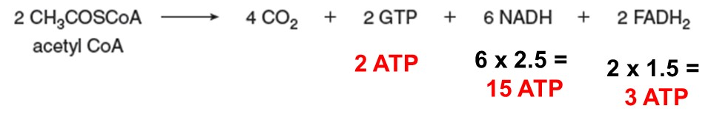
24.5 The ATP Yield from Glucose (4)
Finally, the 2 acetyl CoAs proceed through the citric acid cycle, starting the electron transport chain and oxidative phosphorylation, yielding 10 ATPs × 2 = 20 ATPs.
The final total is 1 glucose = 32 ATP.

Slide 38
24.5 The ATP Yield from Glucose (5)
Blood glucose levels are carefully regulated by two hormones.
When blood glucose levels rise after a meal, insulin stimulates the passage of glucose into cells for metabolism.
When blood glucose levels are low, the hormone glucagon stimulates the conversion of stored glycogen to glucose.

Slide 39
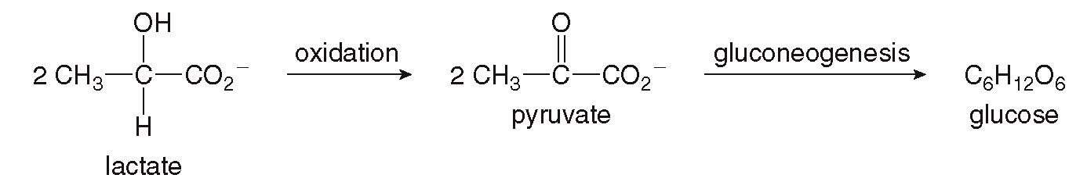
24.6 Gluconeogenesis (1)
Gluconeogenesis is the synthesis of glucose from noncarbohydrate sources—lactate, amino acids, or glycerol.
Gluconeogenesis is an anabolic pathway since it results in the synthesis of larger molecules from smaller ones.

Slide 40
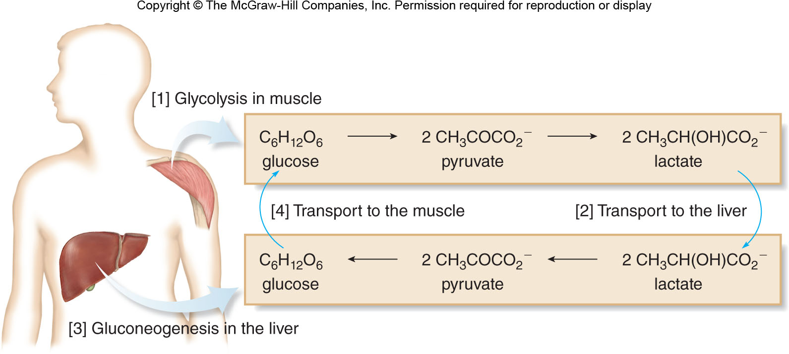
24.6 Gluconeogenesis (2)
Cycling compounds from the muscle to the liver and back again is the Cori Cycle.

Slide 41
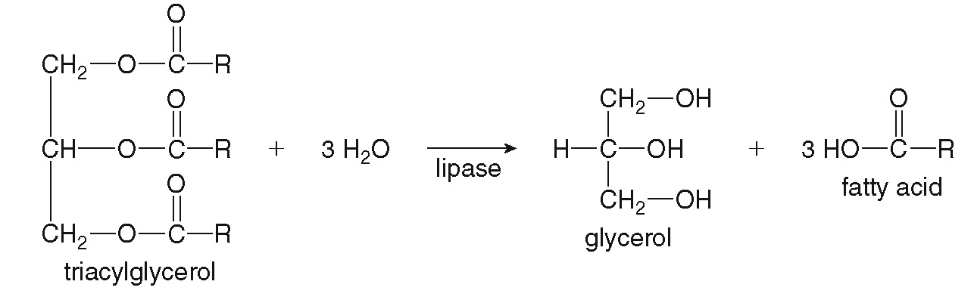
24.7 The Catabolism of Triacylglycerols (1)
The first step in the catabolism of triacylglycerols is the hydrolysis of the three ester bonds to yield glycerol and 3 fatty acids.

Slide 42
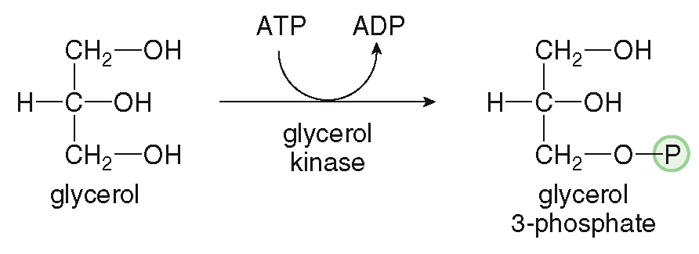
24.7 The Catabolism of Triacylglycerols (2)
Glycerol Catabolism
The glycerol backbone is converted to dihydroxyacetone phosphate, which can enter glycolysis.
The first step involves the phosphorylation of glycerol to glycerol 3-phosphate.

Slide 43
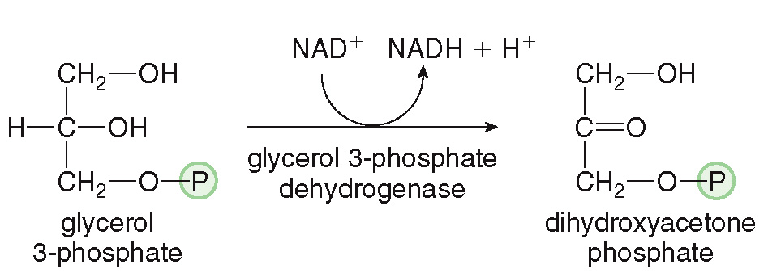
24.7 The Catabolism of Triacylglycerols (3)
Glycerol Catabolism
The second step involves oxidation with
to
yield dihydroxyacetone phosphate and NADH.
The product is an intermediate in both glycolysis and gluconeogenesis, so two pathways are available.

Slide 44
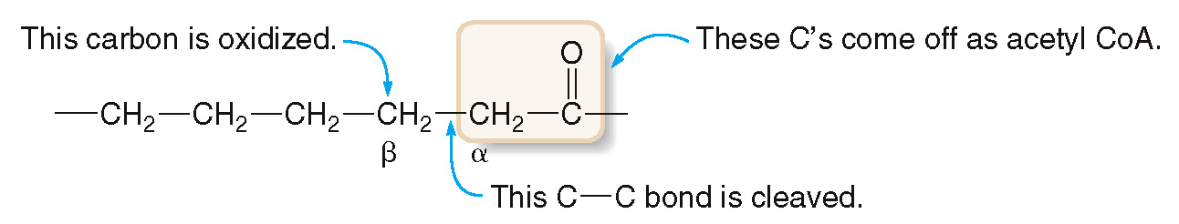
24.7 The Catabolism of Triacylglycerols (4)
Fatty Acid Catabolism by
Fatty acids are catabolized by
a
process whereby acetyl CoA units are sequentially cleaved from the fatty acid.

Slide 45
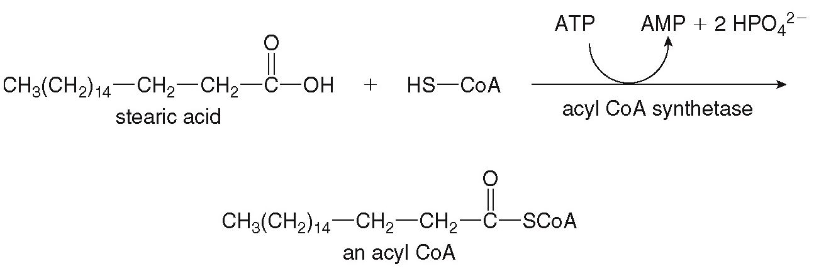
24.7 The Catabolism of Triacylglycerols (5)
Fatty Acid Catabolism by
First, the fatty acid is converted to a thioester with coenzyme A, then
begins.
This requires energy, provided by the conversion of ATP to AMP.

Slide 46
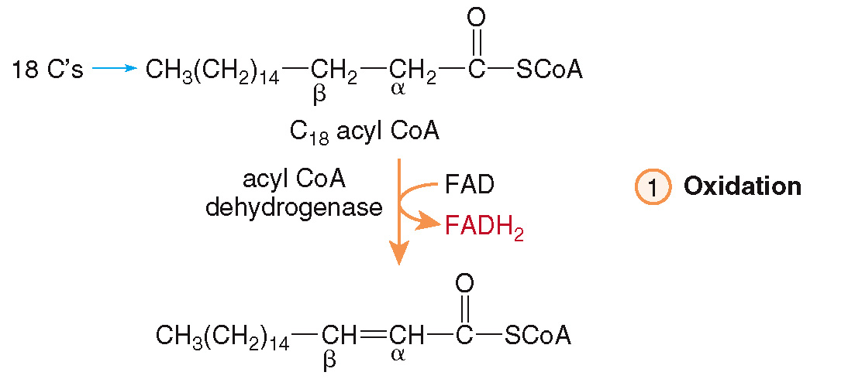
24.7 The Catabolism of Triacylglycerols (6)
Fatty Acid Catabolism by
In step [1], FAD removes 2 H’s to form FADH₂, and a double bond forms between the
and
carbons.

Slide 47
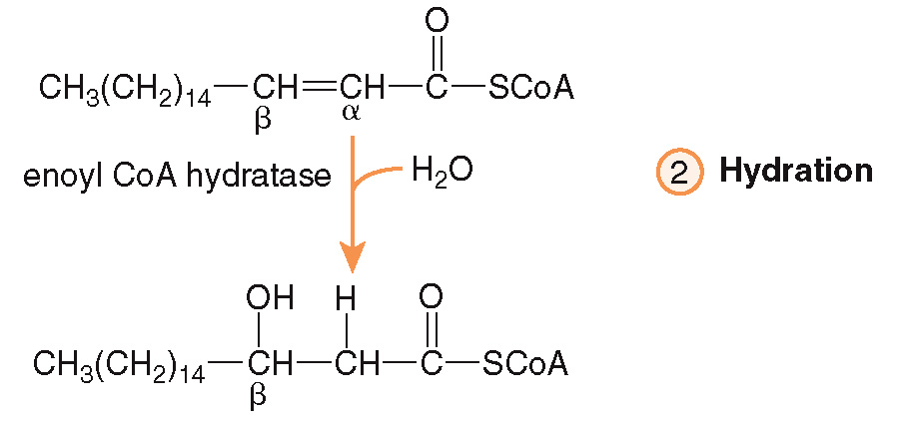
24.7 The Catabolism of Triacylglycerols (7)
Fatty Acid Catabolism by
In step [2], water is added to the double bond; this always makes a

Slide 48
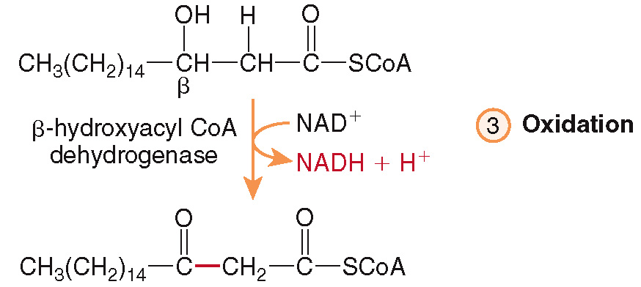
24.7 The Catabolism of Triacylglycerols (8)
Fatty Acid Catabolism by
In step [3], the
is oxidized with
forming a
and NADH.

Slide 49
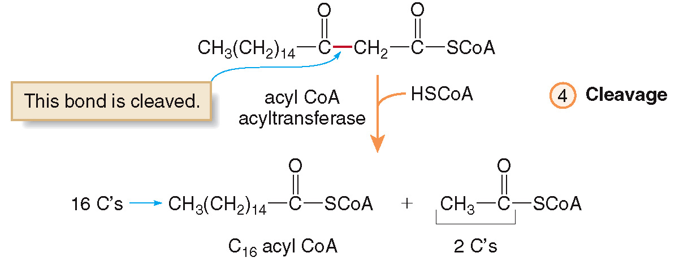
24.7 The Catabolism of Triacylglycerols (9)
Fatty Acid Catabolism by
In step [4], the bond between and
and
carbons
is cleaved with another coenzyme A.

Slide 50
24.7 The Catabolism of Triacylglycerols (10)
Fatty Acid Catabolism by
The result is a new acyl CoA having 2 fewer C’s than the original.
This new acyl CoA can then proceed through
again, cleaving off two more C’s, until
finally only acetyl CoA molecules are present.
For example, an 18-carbon acyl CoA is cleaved into 9 acetyl CoA molecules.
A total of 8 cycles of
are needed to
cleave the eight C-C bonds, such that every carbon of the original fatty acid ends up in an acetyl CoA.

Slide 51
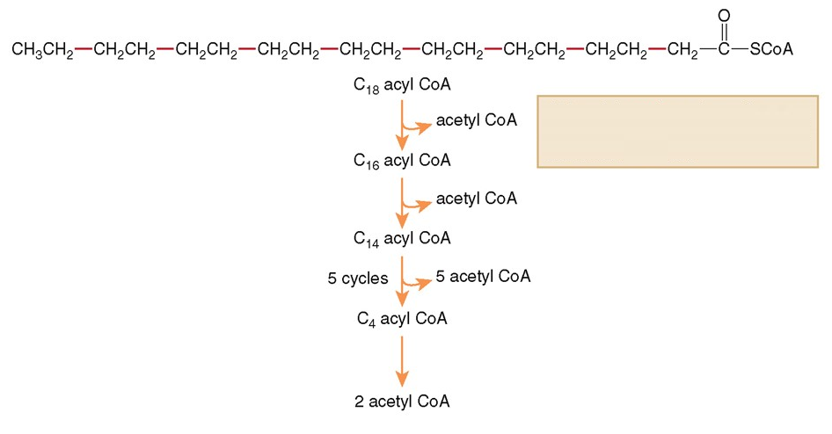
24.7 The Catabolism of Triacylglycerols (11)
Fatty Acid Catabolism by
All bonds in red are cleaved, one at a time, beginning near the carbonyl end of the acyl CoA.

Slide 52
24.7 The Catabolism of Triacylglycerols (12)
Fatty Acid Catabolism by
Complete
of the acyl CoA derived from
an 18-carbon fatty acid (steric acid) forms:
9 Acetyl CoA molecules
8 NADH molecules
8 FADH₂ molecules

Slide 53
24.7 The Catabolism of Triacylglycerols (13)
HOW TO Determine the Number of ATPs Formed from
a Fatty Acid
How much ATP is formed by the complete
catabolism of steric acid C₁₈H₃₆O₂.
Example
Converting the fatty acid into the fatty acyl
CoA uses up 2 ATP.
Step [1]
ATP Total = − 2 ATP

Slide 54
24.7 The Catabolism of Triacylglycerols (14)
HOW TO Determine the Number of ATPs Formed from
a Fatty Acid
Next, add up the ATP from the reduced coenzymes made during
Step [2]
To cleave the 8 C—C bonds, 8 cycles of
are required, producing:
8 NADH × 2.5 ATP = 20 ATP
8 FADH₂ × 1.5 ATP = 12 ATP
32 ATP
ATP Total = − 2 ATP + 32 ATP

Slide 55
24.7 The Catabolism of Triacylglycerols (15)
HOW TO Determine the Number of ATPs Formed from
a Fatty Acid
Finally, add up the ATP synthesized from
each acetyl CoA.
Step [3]
9 Acetyl CoA × 10 ATP = 90 ATP
ATP Total = − 2 ATP + 32 ATP + 90 ATP
ATP Total = 120 ATPs from steric acid

Slide 56
24.7 The Catabolism of Triacylglycerols (16)
Fatty Acid Catabolism by
We can compare the amount of ATP per gram of the carbohydrate glucose and the fatty acid stearic acid.

Slide 57
24.8 Ketone Bodies (1)
When not enough carbohydrates are present to meet the body’s energy needs, the body turns to catabolizing stored triacylglycerols.
The
of fatty acids releases a large
amount of acetyl CoA molecules.
If the citric acid cycle cannot process all of the extra acetyl CoA, they are converted into compounds called ketone bodies through ketogenesis.
The ketone bodies are acetoacetate,
and acetone.

Slide 58
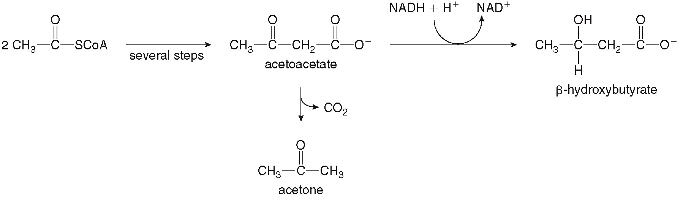
24.8 Ketone Bodies (2)

Slide 59
24.8 Ketone Bodies (3)
Ketone bodies are small molecules, which are readily soluble in blood and urine.
The buildup of ketone bodies in urine (due to starvation, vigorous dieting, and uncontrolled diabetes is called ketosis.
Ketosis can develop into ketoacidosis, where the acidic ketone bodies actually lower the pH of the bloodstream.

Slide 60
24.9 Amino Acid Metabolism (1)
The catabolism of amino acids can be divided into two parts.
The first part concerns the fate of the amino group.
The second part concerns the fate of the carbon atoms.

Slide 61
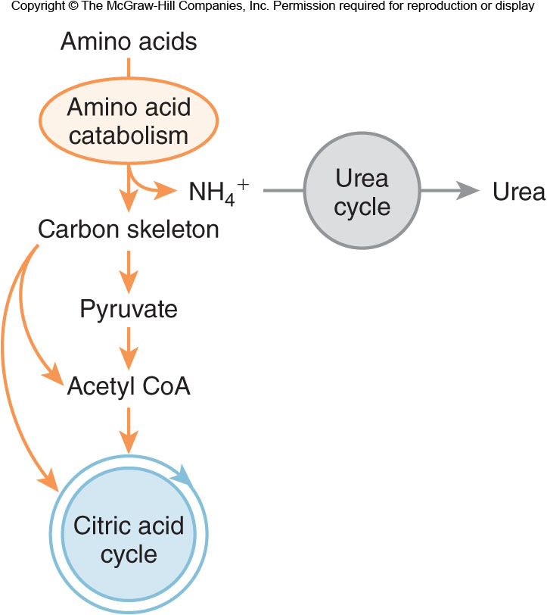
24.9 Amino Acid Metabolism (2)

Slide 62
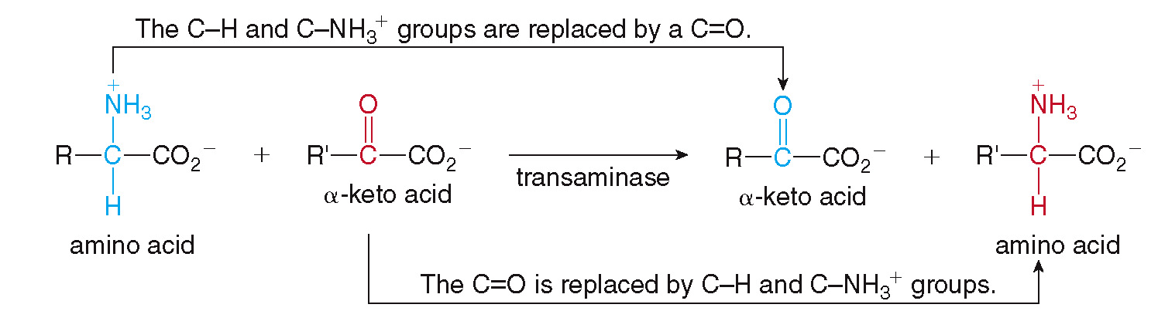
24.9 Amino Acid Metabolism (3)
The Fate of the Amino Group
The amino group of the amino acid is first removed by transamination.
Transamination is the transfer of an amino group from an amino acid to an

Slide 63
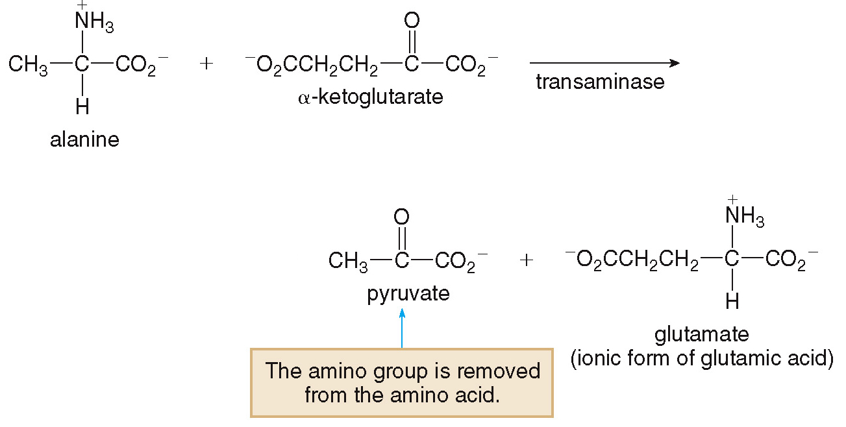
24.9 Amino Acid Metabolism (4)
The Fate of the Amino Group
Transamination often uses
as the

Slide 64
24.9 Amino Acid Metabolism (5)
The Fate of the Amino Group
After transamination, the original amino acid contains only C, O, and H atoms.
After accepting the amino group, glutamate is degraded through oxidative deamination to regenerate
and to make
The
then enters the urea cycle, where it is
converted into urea, (NH₂)₂C=O , in the liver and excreted by the kidneys in urine.

Slide 65
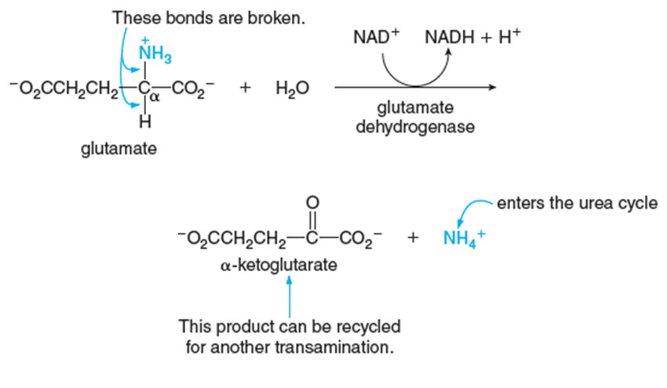
24.9 Amino Acid Metabolism (6)
The Fate of the Amino Group
Oxidative deamination of glutamate:

Slide 66
24.9 Amino Acid Metabolism (7)
The Fate of the Carbon Skeleton
There are three common fates of the carbon
skeletons of amino acids
conversion to pyruvate
conversion to acetyl CoA
conversion to an intermediate in the citric acid cycle

Slide 67
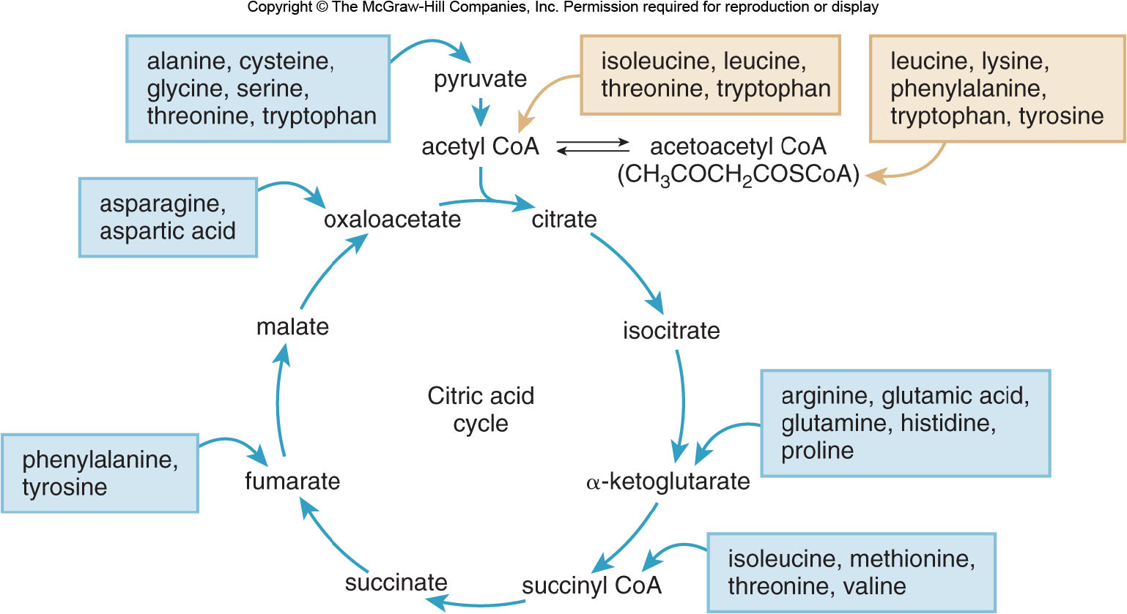
24.9 Amino Acid Metabolism (8)
The Fate of the Carbon Skeleton

Slide 68
24.9 Amino Acid Metabolism (9)
The Fate of the Carbon Skeleton
Glucogenic amino acids are catabolized to pyruvate or an intermediate of the citric acid cycle.
These products can be used for gluconeogenesis, which is synthesizing glucose.
Ketogenic amino acids are converted to acetyl CoA or a related thioester acetoacetyl CoA.
These products can be used to synthesize ketone bodies and can yield energy on that path.

