Slide 1


Chapter 4
Lecture Outline
Prepared by
Harpreet Malhotra
Florida State College at Jacksonville

Slide 2
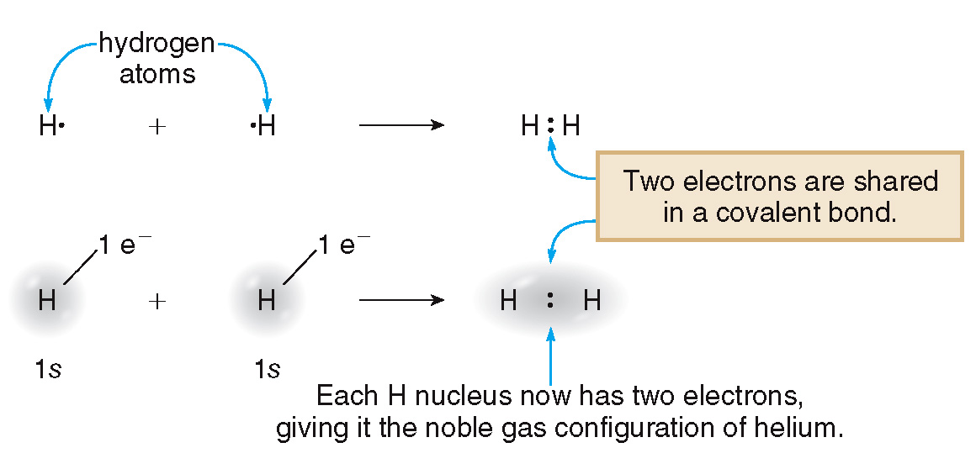
4.1 Introduction to Covalent Bonding (1)
Covalent bonds result from the sharing of electrons
between two atoms.
A covalent bond is a two-electron bond in which the bonding atoms share valence electrons.
A molecule is a discrete group of atoms held together by covalent bonds.

Slide 3
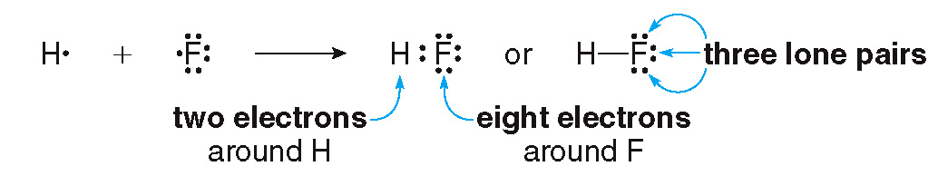
4.1 Introduction to Covalent Bonding (2)
Unshared electron pairs are called nonbonded
electron pairs or lone pairs.
Atoms share electrons to attain the electronic
configuration of the noble gas closest to them
in the periodic table.
H shares 2 e⁻.
Other main group elements share e⁻ until they reach an octet of e⁻ in their outer shell.

Slide 4
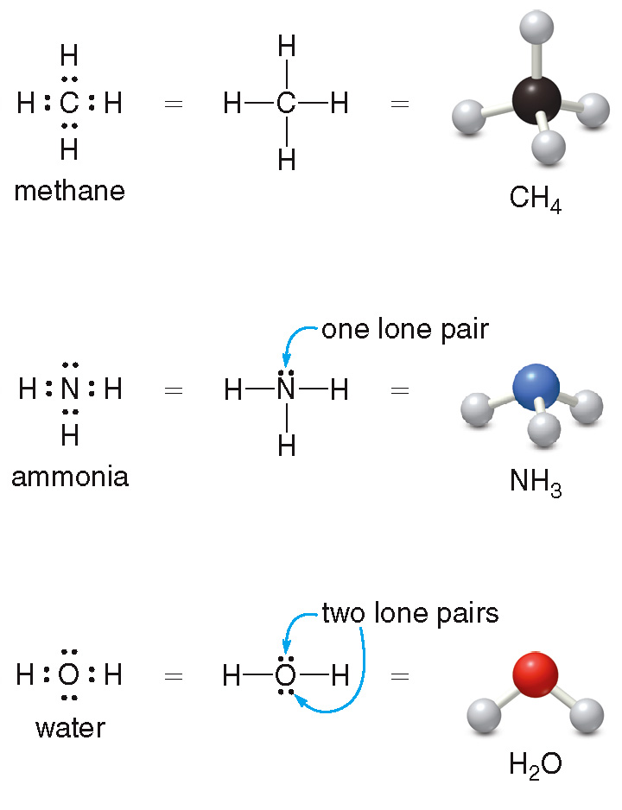
4.1 Introduction to Covalent Bonding (3)
Covalent Bonding and the Periodic Table
Lewis structures are electron-dot structures for
molecules. They show the location of all valence e⁻.

Slide 5
4.1 Introduction to Covalent Bonding (4)
Covalent Bonding and the Periodic Table
Covalent bonds are formed when two nonmetals
combine, or when a metalloid bonds to a nonmetal.
How many covalent bonds will a particular atom form?
Hydrogen forms one bond, with its one valence e⁻.
Atoms with one, two, or three valence e⁻ form one, two, or three bonds, respectively.
Atoms with four or more valence electrons form enough bonds to give an octet. For these atoms, the following formula is used:
predicted number of bonds
= 8 − number of valence e⁻

Slide 6
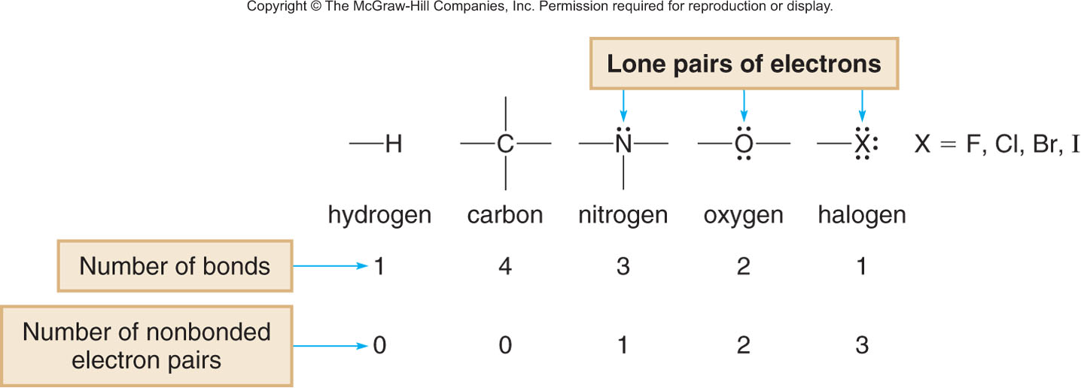
4.1 Covalent Compounds
Covalent Bonding and the Periodic Table
General rule for bonding elements (except for hydrogen, H)
Number of bonds
+
Number of lone pairs
=
4

Slide 7
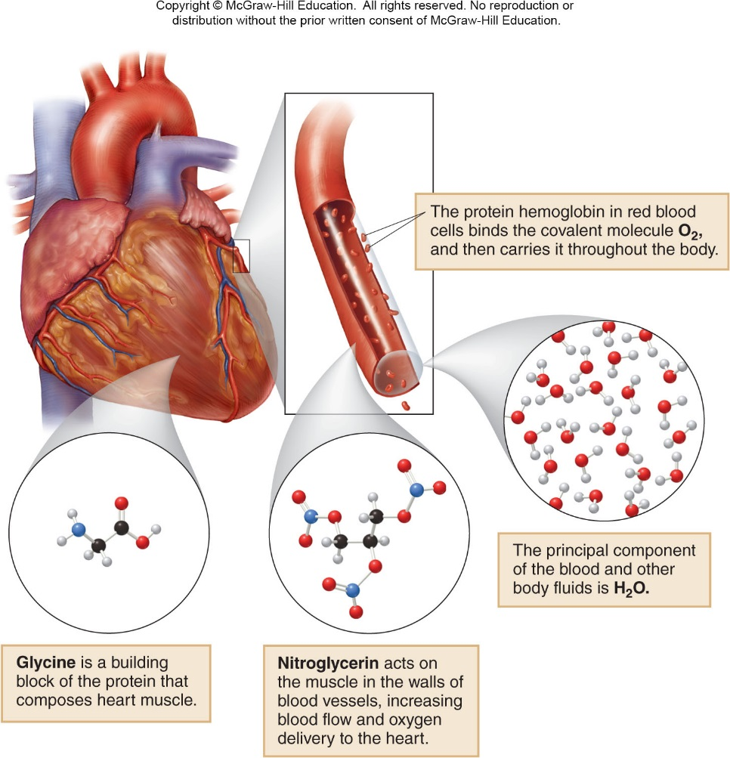
4.1 Introduction to Covalent Bonding
Focus on the Human Body
There are many covalent compounds related to the chemistry of the heart.

Slide 8
4.2 Lewis Structures (1)
A molecular formula shows the number and identity
of all of the atoms in a compound, but not which
atoms are bonded to each other.
A Lewis structure shows the connectivity between
atoms, as well as the location of all bonding and
nonbonding valence electrons.

Slide 9
4.2 Lewis Structures (2)
Drawing Lewis Structures
General rules for drawing Lewis structures:
Draw only valence electrons.
Give every main group element (except H) an octet of e⁻.
Give each hydrogen 2 e⁻.

Slide 10
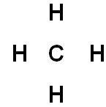

4.2 Lewis Structures (3)
HOW TO Draw a Lewis Structure
Arrange the atoms next to each other that you think are bonded together.
Step [1]
Place H and halogens on the periphery, since they can only form one bond.
For CH₄:
not
This H cannot form two bonds.

Slide 11
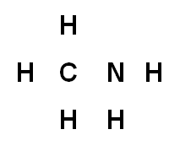
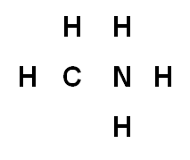
4.2 Lewis Structures (4)
HOW TO Draw a Lewis Structure
Use the common bonding patterns from Figure 4.1 to arrange the atoms (Slide 6).
For CH₅N:
not
Place four atoms around C, since C
generally forms
four bonds.
Place three atoms around N, since N generally forms three bonds.

Slide 12
4.2 Lewis Structures (5)
HOW TO Draw a Lewis Structure
Step [2]
Count the valence electrons.
For main group elements, the number of valence
e⁻ is equal to the group number.
The sum gives the total number of e⁻ that must be used in the Lewis structure.
For CH₃Cl:
1 C×4 e⁻ = 4 e⁻
3 H×1 e⁻ = 3 e⁻
3 Cl×7 e⁻ = 7 e⁻
14 total valence e⁻

Slide 13
4.2 Lewis Structures (6)
HOW TO Draw a Lewis Structure
Step [3]
Arrange the electrons around the atoms.
Place one bond (two e⁻ ) between every two atoms.
For main group elements, give no more than 8 e⁻.
For H, give no more than 2 e⁻.
Use all remaining electrons to fill octets with lone pairs, beginning with atoms on the periphery.

Slide 14
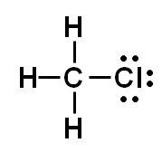
4.2 Lewis Structures (7)
HOW TO Draw a Lewis Structure
For CH₃Cl:
4 bonus×2 e⁻ = 8 e⁻
+ 3 lone pairs×2 e⁻ = 6 e⁻
2 e⁻ on
each H
8 e⁻
on Cl
14 e⁻
All valence e⁻ have
been used.
If all valence electrons are used and an atom still does not have an octet, proceed to Step [4].
Use multiple bonds to fill octets when needed.
Step [4]

Slide 15


4.2 Lewis Structures (8)
Multiple Bonds
One lone pair of e⁻ can be converted into one bonding pair of e⁻ for each 2 e⁻ needed to complete an octet on a Lewis Structure.
A double bond contains four electrons in two 2 e⁻ bonds.
A triple bond contains six electrons in three 2 e⁻ bonds.

Slide 16

4.2 Lewis Structures (9)
Multiple Bonds
Example
Draw the Lewis Structure for C₂H₄.
Step [1]
Arrange the atoms.
Step [2]
Count the valence e⁻.
2 C×4 e⁻ = 8 e⁻
4 H×1 e⁻ = 4 e⁻
12 e⁻ total

Slide 17
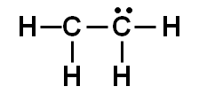
4.2 Lewis Structures (10)
Multiple Bonds
Step [3]
Add the bonds and lone pairs.
5 bonds×2 e⁻ = 10 e⁻
+ 1 lone pair×2 e⁻ = 2 e⁻
12 e⁻
C still does not have an octet.
All valence e⁻ have been used.

Slide 18
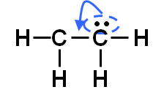
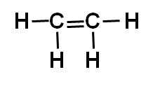
4.2 Lewis Structures (11)
Multiple Bonds
Step [4]
Change one lone pair into one bonding
pair of e⁻, forming a double bond.
Answer
Each C now has an octet.

Slide 19
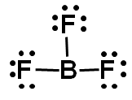
4.3 Exceptions to the Octet Rule (1)
Most of the common elements generally follow the octet rule.
H is a notable exception, because it needs only 2 e⁻ in bonding.
Elements in group 3A do not have enough valence e⁻ to form an octet in a neutral molecule.
only 6 e⁻ on B

Slide 20
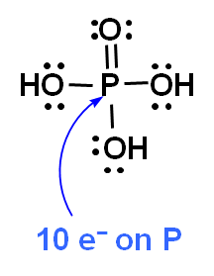
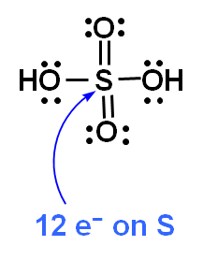
4.3 Exceptions to the Octet Rule (2)
Elements in the third row have empty d orbitals available to accept electrons.
Thus, elements such as P and S may have more than 8 e⁻ around them.

Slide 21
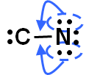


4.4 Resonance (1)
When drawing Lewis structures for polyatomic ions:
Add one e⁻ for each negative charge.
Subtract one e⁻ for each positive charge.
For CN⁻ :
Answer
1 C×4 e⁻ = 4 e⁻
1 N×5 e⁻ = 5 e⁻
−1 charge = 1 e⁻
All valence e⁻
are used, but
C lacks an octet.
Each atom
has an octet.
10 e⁻ total

Slide 22
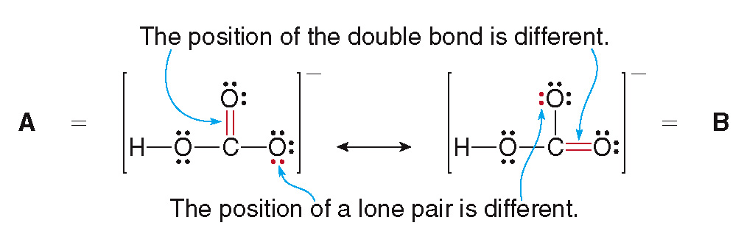
4.4 Resonance (2)
Drawing Resonance Structures
Resonance structures are two Lewis structures having the same arrangement of atoms but a different arrangement of electrons.
Two resonance structures of
:
Neither Lewis structure is the true structure of
.

Slide 23
4.4 Resonance (3)
Drawing Resonance Structures
The true structure is a hybrid of the two resonance structures.
Resonance stabilizes a molecule by spreading out lone pairs and electron pairs in multiple bonds
over a larger region of space.
A molecule or ion that has two or more resonance structures is resonance-stabilized.

Slide 24
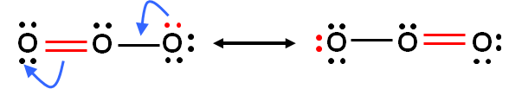
4.4 Resonance (4)
Focus on the Environment
Resonance structures can be drawn for neutral molecules.
Ozone, O₃, can be drawn as two resonance structures.
Ozone is formed in the upper atmosphere by the reaction of O₂ and oxygen atoms.
It acts as a shield which protects the earth’s surface from destructive UV radiation.

Slide 25
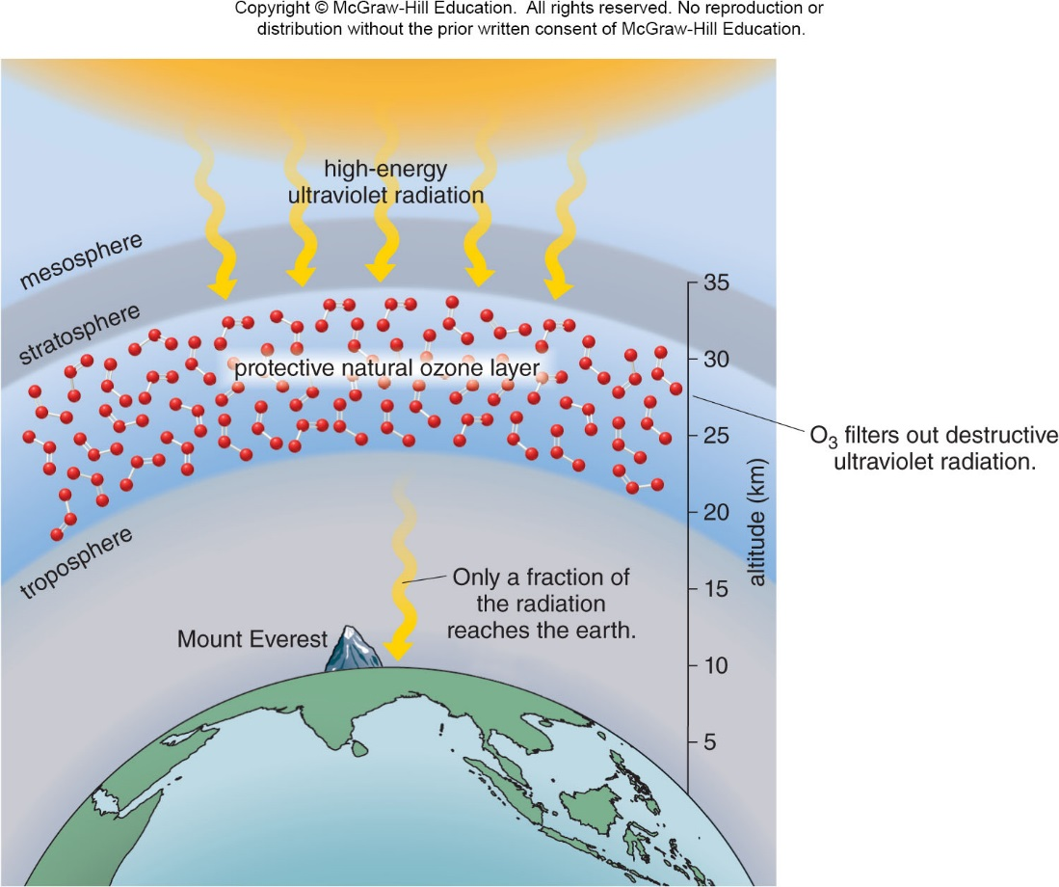
4.4 Resonance (5)
Focus on the Environment

Slide 26
4.5 Naming Covalent Compounds (1)
HOW TO Name a Covalent Molecule
Example
Name each covalent molecule:
NO₂
N₂O₄
Step [1]
Name the first nonmetal by its element
name and the second using the suffix
“-ide.”
NO₂
N₂O₄
nitrogen oxide
nitrogen oxide

Slide 27
4.5 Naming Covalent Compounds (2)
HOW TO Name a Covalent Molecule
Step [2]
Add prefixes to show the number of
atoms of each element.
Use a prefix from Table 4.1 for each element.
The prefix “mono-” is usually omitted when only one atom of the first element is present, but it is retained for the second element.
If the combination would place two vowels next to each other, omit the first vowel.
mono + oxide = monoxide (not monooxide)

Slide 28
4.5 Naming Covalent Compounds (3)
HOW TO Name a Covalent Molecule
Table 4.1 Common Prefixes in Nomenclature
Number of Atoms | Prefix
1 | Mono
2 | Di
3 | Tri
4 | Tetra
5 | Penta
6 | Hexa
7 | Hepta
8 | Octa
9 | Nona
10 | Deca
NO₂
nitrogen dioxide
N₂O₄
dinitrogen tetroxide

Slide 29
4.6 Molecular Shape (1)
The Lewis structure gives information about how the atoms are connected, but it implies nothing of the geometry or shape.
To determine the shape around a given atom, first determine how many groups surround the atom.
A group is either an atom or a lone pair of electrons.
Use the VSEPR theory to determine the shape.
The most stable arrangement keeps the groups as far away from each other as possible.

Slide 30
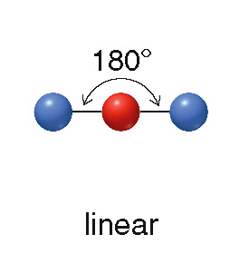
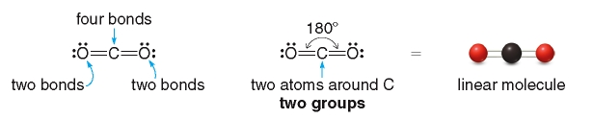
4.6 Molecular Shape (2)
Two Groups Around an Atom
Any atom surrounded by only two groups is linear and has a bond angle of
An example is CO₂:
Ignore multiple bonds in predicting geometry. Count only atoms and lone pairs.

Slide 31
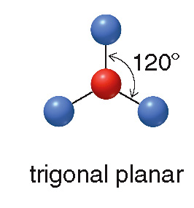
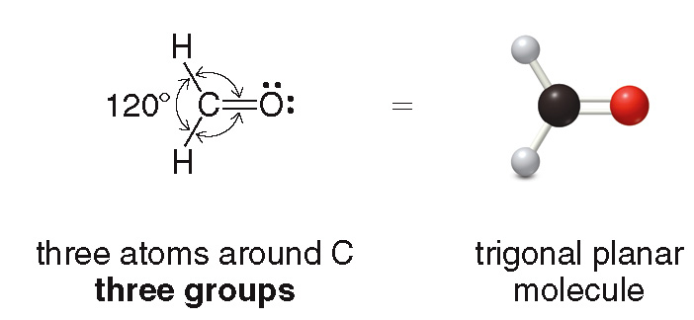
4.6 Molecular Shape (3)
Three Groups Around an Atom
Any atom surrounded by three groups is trigonal planar and has bond angles of
An example is H₂CO (formaldehyde):

Slide 32
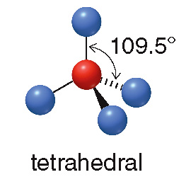
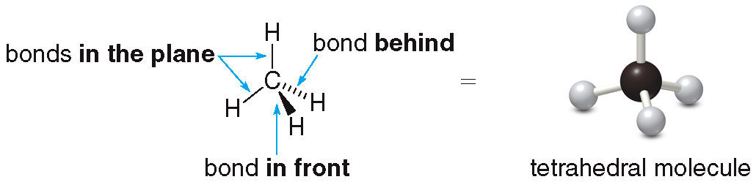
4.6 Molecular Shape (4)
Four Groups Around an Atom
Any atom surrounded by four groups is tetrahedral and has bond angles of
An example is CH₄ (methane):

Slide 33
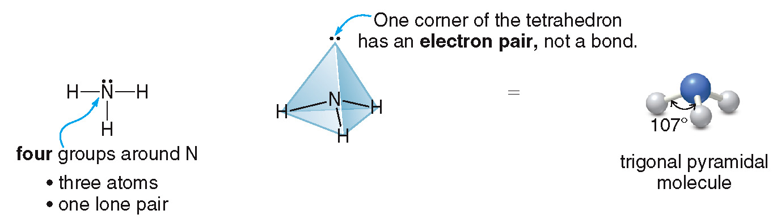
4.6 Molecular Shape (5)
Four Groups Around an Atom
If the four groups around the atom include one lone pair, the geometry is a trigonal pyramid with bond angles of
, close to
An example is NH₃ (ammonia):

Slide 34
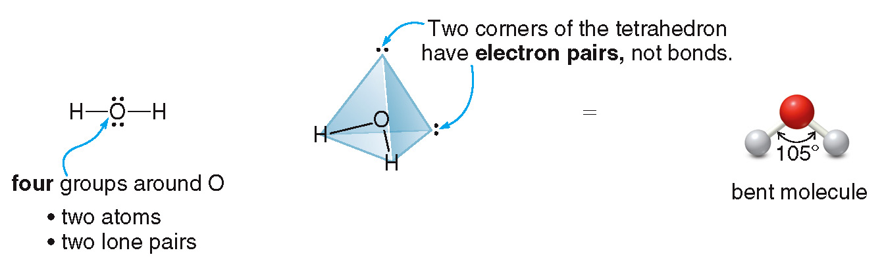
4.6 Molecular Shape (6)
Four Groups Around an Atom
If the four groups around the atom include two lone pairs, the geometry is bent and the bond angle is
(that is, close to
).
An example is H₂O:

Slide 35
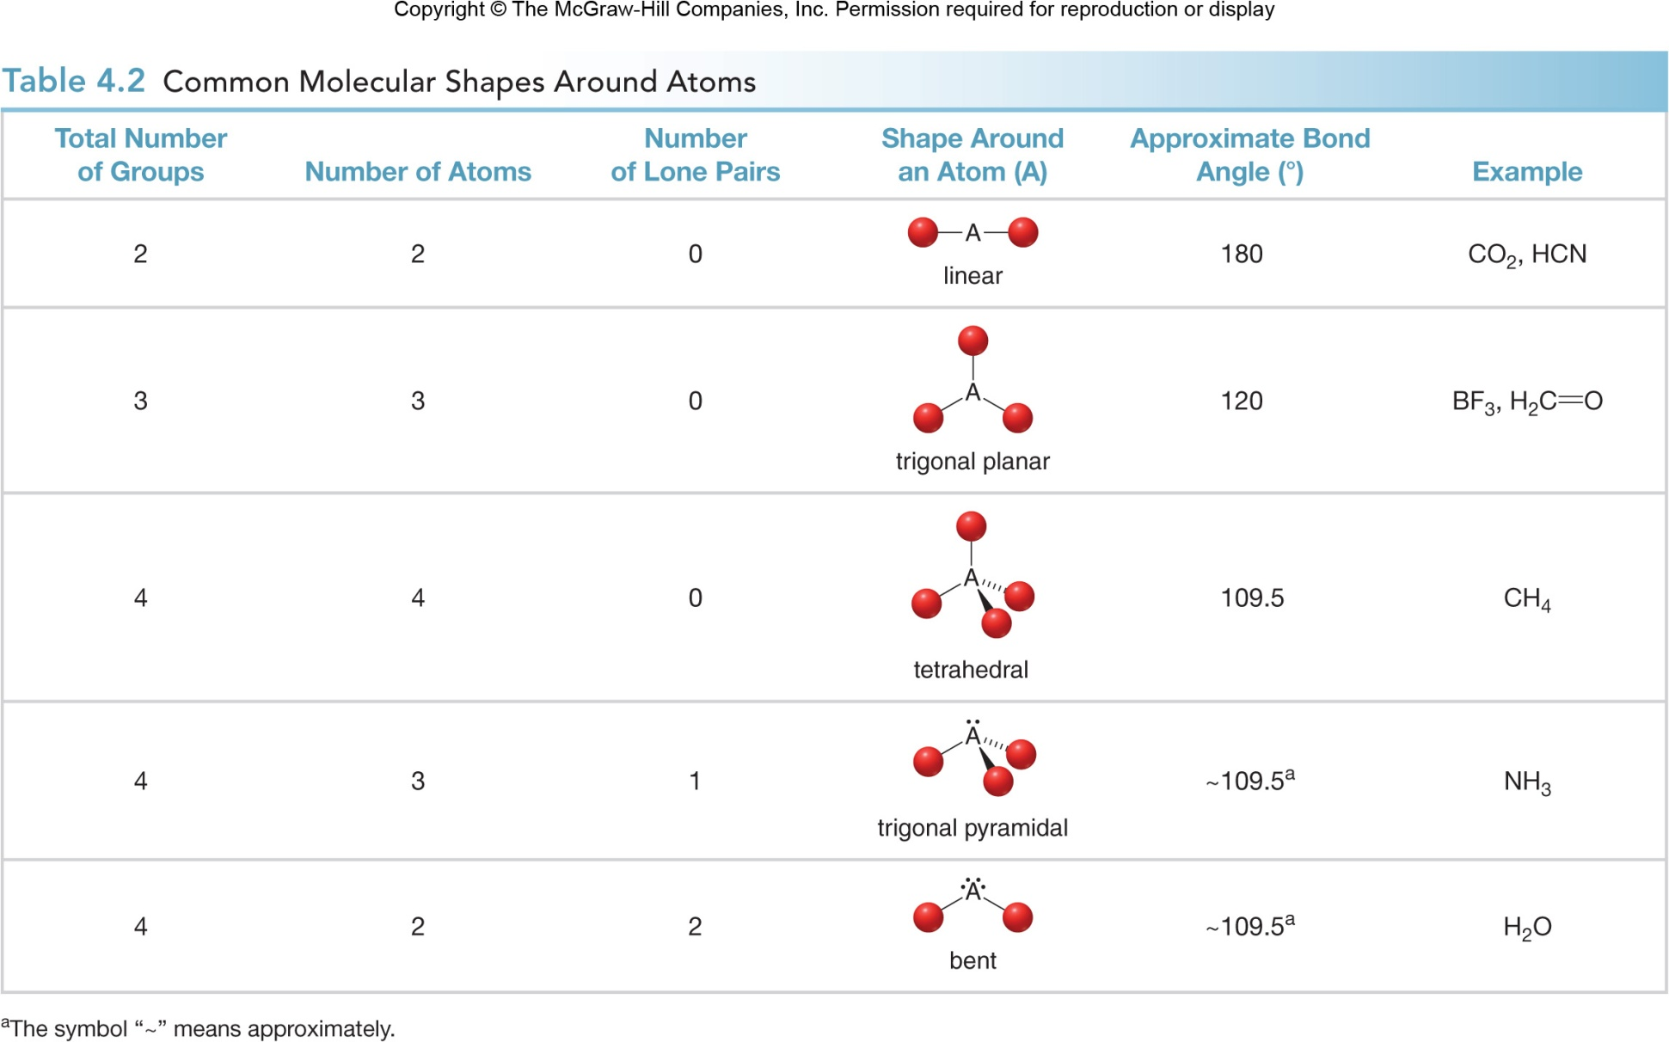
4.6 Molecular Shape (7)

Slide 36
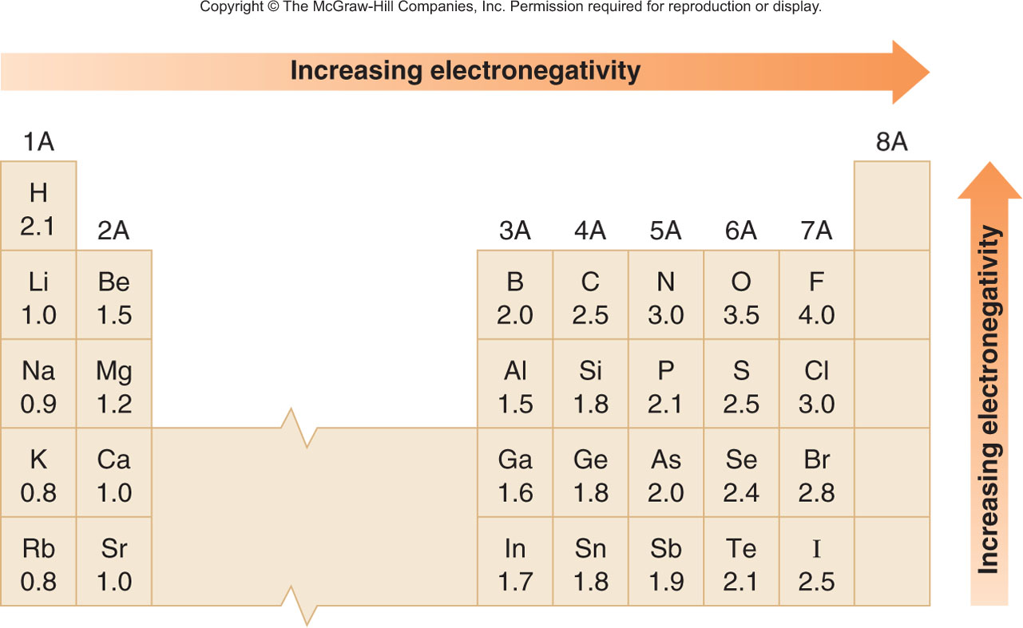
4.7 Electronegativity and Bond Polarity (1)
Electronegativity is a measure of an atom’s attraction for e⁻ in a bond.
It tells how much a particular atom “wants” e⁻.

Slide 37
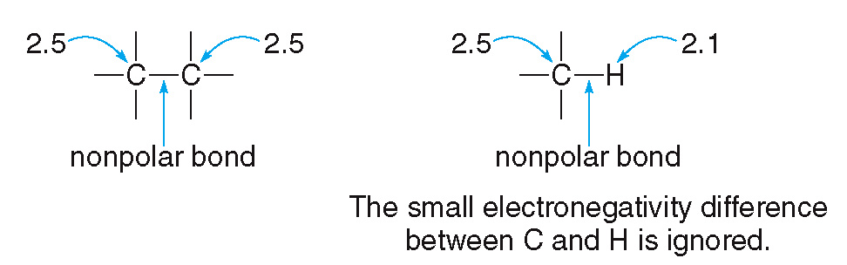
4.7 Electronegativity and Bond Polarity (2)
If the electronegativities of two bonded atoms are equal or similar, the bond is nonpolar.
The electrons in the bond are being shared equally between the two atoms.

Slide 38
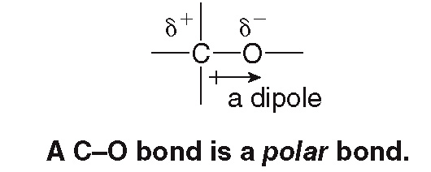
4.7 Electronegativity and Bond Polarity (3)
Bonding between atoms with different electro-negativities yields a polar covalent bond or dipole, a partial separation of charge.
The electrons in the bond are unequally shared between the C and the O.
e⁻ are pulled toward O, the more electronegative element; this is indicated by the symbol
.
e⁻ are pulled away from C, the less electronegative element; this is indicated by the symbol
.

Slide 39
4.7 Electronegativity and Bond Polarity (4)
Table 4.3 Electronegativity Difference and Bond Type
Electronegativity Difference | Bond Type | Electron Sharing
Less than 0.5 units | Nonpolar | Electrons are equally shared.
0.5 to 1.9 units | Polar covalent | Electrons are unequally shared; they are pulled towards the more electronegative element.
Greater than 1.9 units | Ionic | Electrons are transferred from the less electronegative element to the more electronegative element.

Slide 40
4.8 Polarity of Molecules (1)
The classification of a molecule as polar or nonpolar
depends on:
The polarity of the individual bonds
The overall shape of the molecule
Nonpolar molecules generally have:
No polar bonds
Individual bond dipoles that cancel
Polar molecules generally have:
One or more polar bonds
Individual bond dipoles that do not cancel

Slide 41
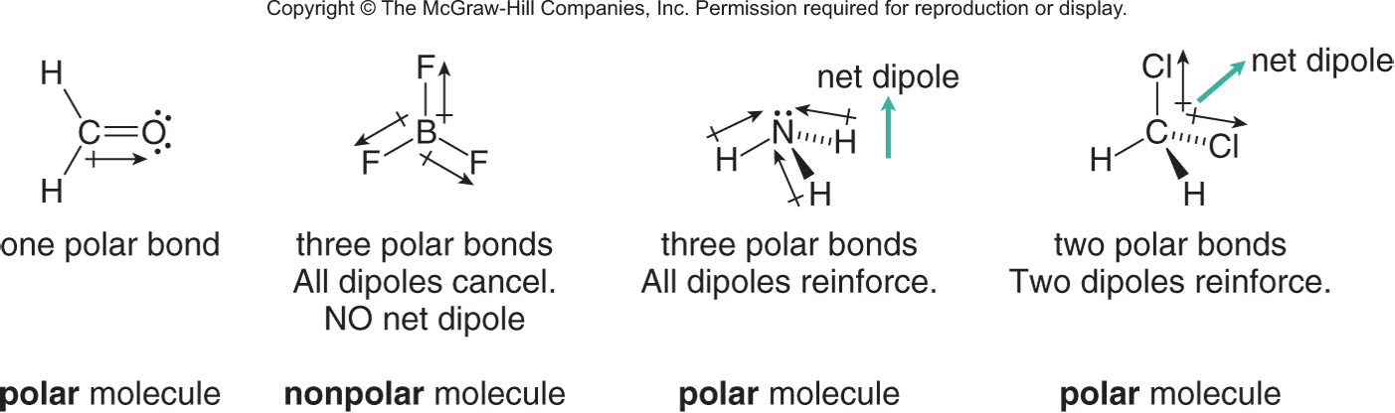
4.8 Polarity of Molecules (2)
To determine the polarity of a molecule with two or more polar bonds:
Identify all polar bonds based on electronegativity differences.
Determine the shape around individual atoms by counting groups.
Decide if individual dipoles cancel or reinforce.

