Slide 1

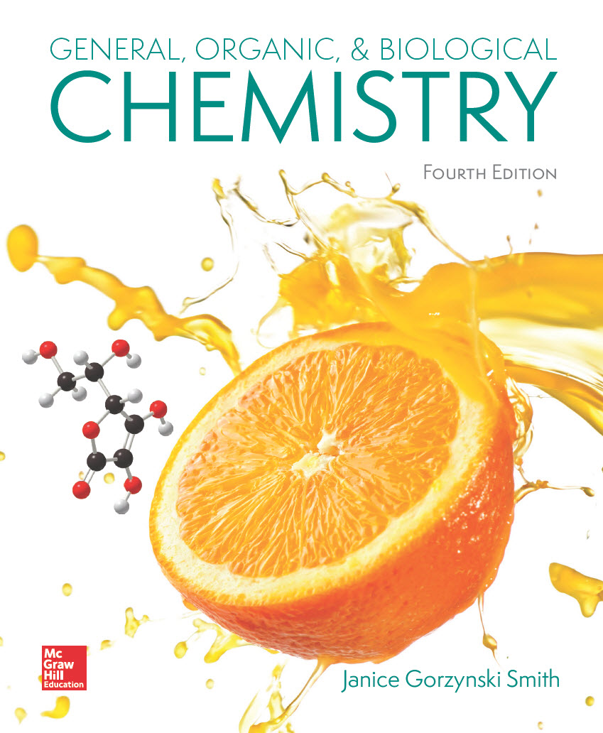
Chapter 7
Lecture Outline
Prepared by
Harpreet Malhotra
Florida State College at Jacksonville

Slide 2
7.1 The Three States of Matter (1)
Table 7.1 Properties of Gases, Liquids, and Solids
Property
Gas
Liquid
Solid
Shape and Volume
Expands to fill its container
A fixed volume that takes the shape of the container it occupies
A definite shape and volume
Arrangement of Particles
Randomly arranged, disorganized, and far apart
Randomly arranged but close
Fixed arrangement of very close particles
Density
Low (< 0.01 g/mL)
High (1 to 10 g/mL)
Particle Movement
Very fast
Moderate
Slow
Interaction Between Particles
None
Strong
Very strong

Slide 3
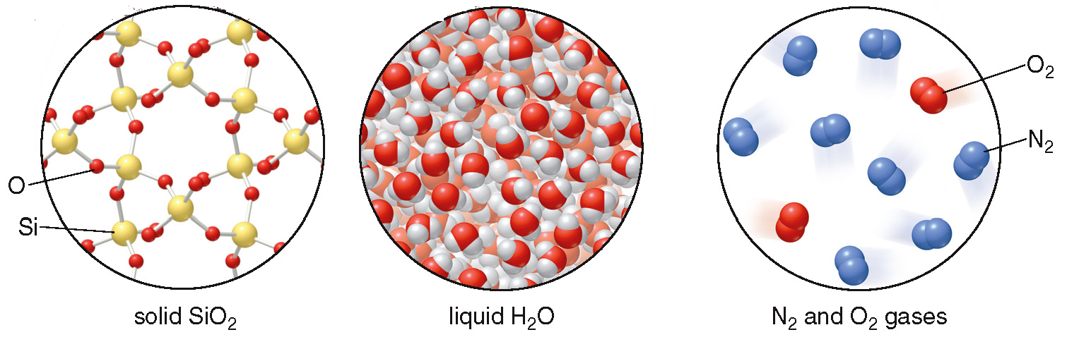
7.1 The Three States of Matter (2)
Existing as a gas, liquid, or solid depends on:
The balance between the kinetic energy of its particles.
The strength of the interactions between the particles.

Slide 4
7.2 Gases and Pressure (1)
Properties of Gases
The kinetic-molecular theory of gases:
A gas consists of particles that move randomly and rapidly.
The size of gas particles is small compared to the space between the particles.
Gas particles exert no attractive forces on each other.
The kinetic energy of gas particles increases with increasing temperature.
When gas particles collide with each other, they rebound and travel in new directions.

Slide 5
7.2 Gases and Pressure (2)
Gas Pressure
When gas particles collide with the walls of a container, they exert a pressure.
Pressure (P) is the force (F) exerted per unit area (A).
760. mm Hg
760. torr
14.7 psi
101,325 Pa
1 atmosphere (atm) =

Slide 6
7.3 Gas Laws (1)
Boyle’s Law
Boyle’s law: For a fixed amount of gas at constant
temperature, the pressure and volume of the gas
are inversely related.
If one quantity increases, the other decreases.
The product of the two quantities is a constant, k.
Pressure × Volume = constant
P × V = k

Slide 7
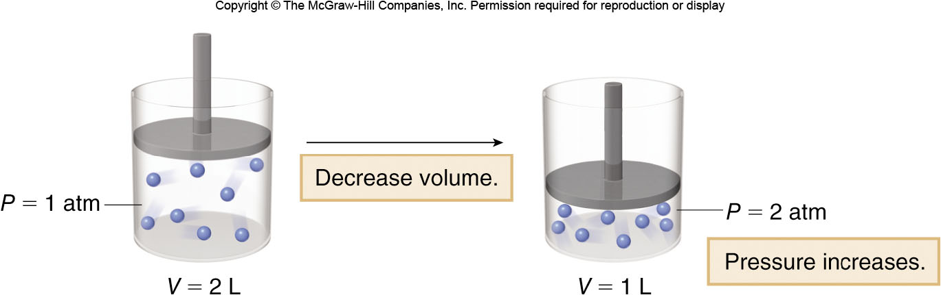
7.3 Gas Laws (2)
Boyle’s Law
If the volume of a cylinder of gas is halved, the pressure of the gas inside the cylinder doubles.
This behavior can be explained by the equation:
=
initial conditions
new conditions

Slide 8
7.3 Gas Laws (3)
  Boyle’s Law
HOW TO Use Boyle’s Law to Calculate a New Gas
Volume or Pressure
Example
If a 4.0-L container of helium gas has a
pressure of 10.0 atm, what pressure does
the gas exert if the volume is increased
to 6.0 L?
Identify the known quantities and the
desired quantity.
Step 1
known quantities
desired quantity

Slide 9
7.3 Gas Laws (4)
Boyle’s Law
HOW TO Use Boyle’s Law to Calculate a New Gas Volume or Pressure
Write the equation and rearrange it to isolate
the desired quantity on one side.
Step 2
Solve for
by dividing
both sides by

Slide 10
7.3 Gas Laws (5)
    Boyle’s Law
HOW TO Use Boyle’s Law to Calculate a New Gas
Volume or Pressure
Step 3
Solve the problem.
Liters cancel

Slide 11
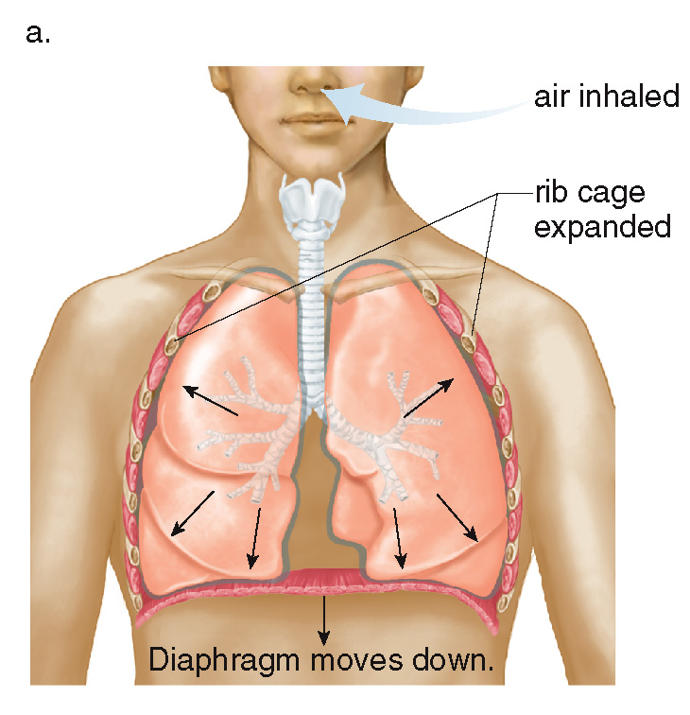
7.3 Gas Laws (6)
Boyle’s Law
To inhale:
The rib cage expands and the diaphragm lowers.
This increases the volume of the lungs.
Increasing the volume causes the pressure to decrease.
Air is drawn into the lungs to equalize the pressure.

Slide 12
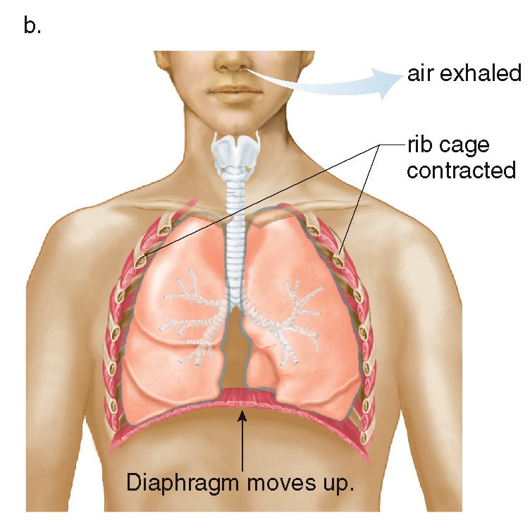
7.3 Gas Laws (7)
Boyle’s Law
To exhale:
The rib cage contracts and the diaphragm is raised.
This decreases the volume of the lungs.
Decreasing the volume causes the pressure to increase.
Air is expelled out of the lungs to equalize the pressure.

Slide 13
7.3 Gas Laws (8)
Charles’s Law
Charles’s law: For a fixed amount of gas at constant
pressure, the volume of the gas is proportional to
its Kelvin temperature.
If one quantity increases, the other increases
as well.
Dividing volume by temperature is a constant, k.

Slide 14
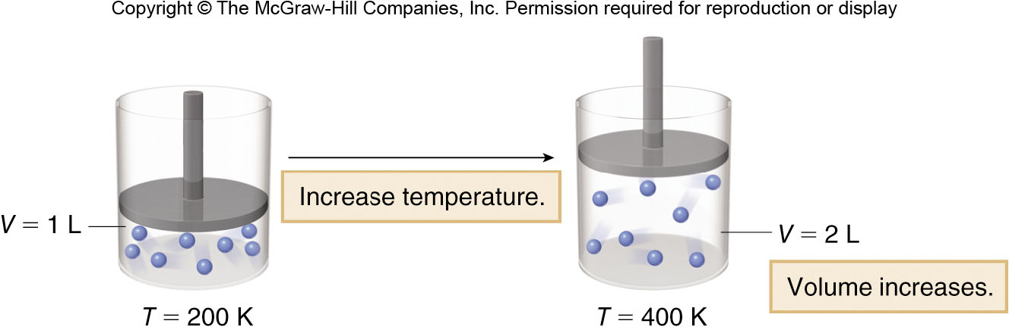
7.3 Gas Laws (9)
Charles’s Law
If the temperature of the cylinder is doubled, the volume of the gas inside the cylinder doubles.
This behavior can be explained by the equation:
=
initial conditions
new conditions

Slide 15
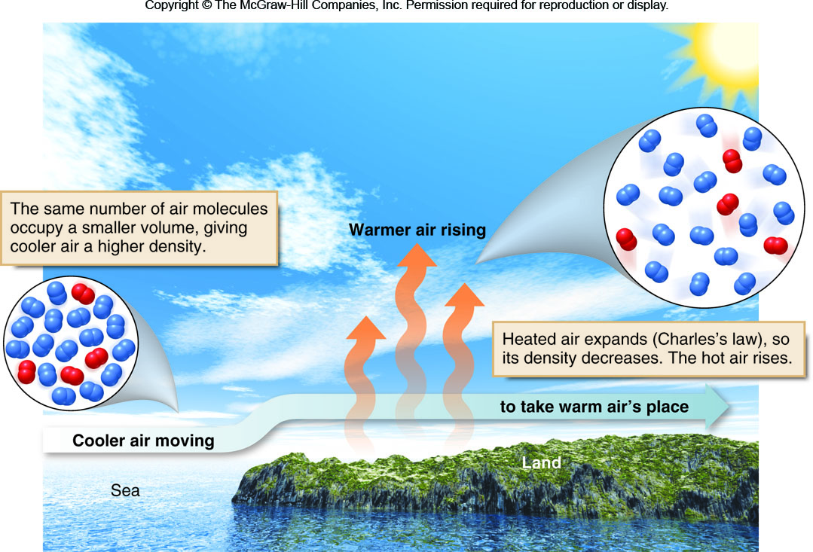
7.3 Gas Laws (10)
Charles’s Law

Slide 16
7.3 Gas Laws (11)
Gay–Lussac’s Law
Gay–Lussac’s law: For a fixed amount of gas at
constant volume, the pressure of a gas is
proportional to its Kelvin temperature.
If one quantity increases, the other increases
as well.
Dividing pressure by temperature is a constant, k.

Slide 17
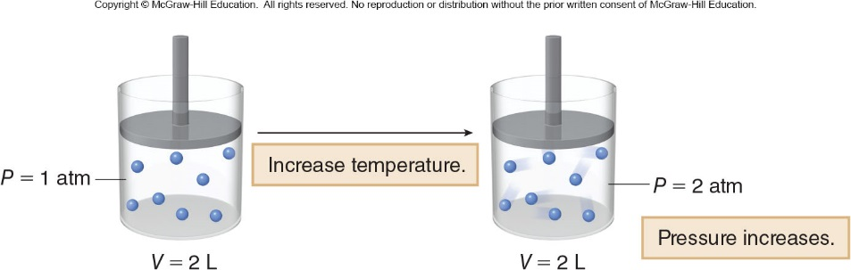
7.3 Gas Laws (12)
Gay–Lussac’s Law
Increasing the temperature increases the kinetic energy of the gas particles, causing the pressure exerted by the particles to increase.
This behavior can be explained by the equation:
=
initial conditions
new conditions

Slide 18
7.3 Gas Laws (13)
The Combined Gas Law
All three gas laws can be combined into one equation:
=
initial conditions
new conditions
This equation is used for determining the effect of changing two factors (for example, P and T) on the third factor (V).

Slide 19
7.3 Gas Laws (14)
Table 7.2 Summary of the Gas Laws That Relate Pressure, Volume, and Temperature
Law
Equation
Relationship
Boyle’s law
As P increases, V decreases for constant T and n.
Charles’s law
As T increases, V increases for constant P and n.
Gay-Lussac’s law
As T increases, P increases for constant V and n.
The combined gas law shows the relationship of P, V, and T when two quantities are changed and the number of moles (n) is constant.
Combined gas law

Slide 20
7.4 Avogadro’s Law (1)
Avogadro’s law: When the pressure and temperature
are held constant, the volume of a gas is proportional
to the number of moles present.
If one quantity increases, the other increases
as well.
Dividing the volume by the number of moles is a constant, k.

Slide 21
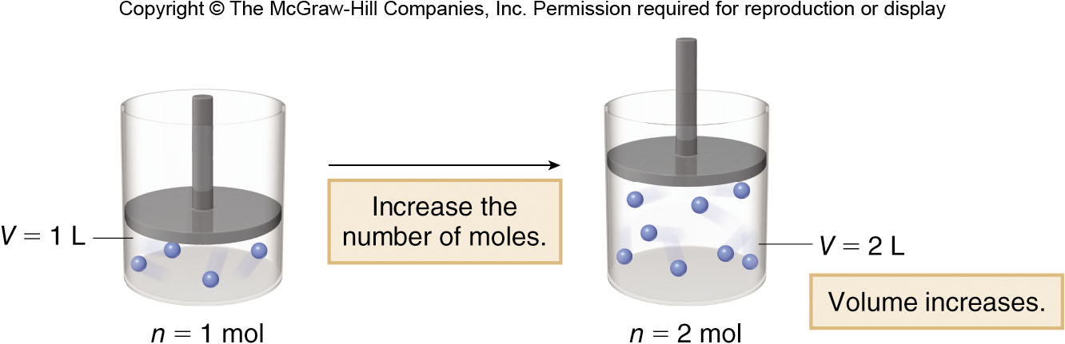
7.4 Avogadro’s Law (2)
If the number of moles of gas in a cylinder is increased, the volume of the cylinder will increase as well.
This behavior can be explained by the equation:
=
initial conditions
new conditions

Slide 22
7.4 Avogadro’s Law (3)
Often amounts of gas are compared at a set of standard conditions of temperature and pressure, abbreviated as STP.
STP conditions are:
1 atm (760 mm Hg) for pressure
for temperature
At STP, 1 mole of any gas has a volume of 22.4 L.
22.4 L is called the standard molar volume.

Slide 23
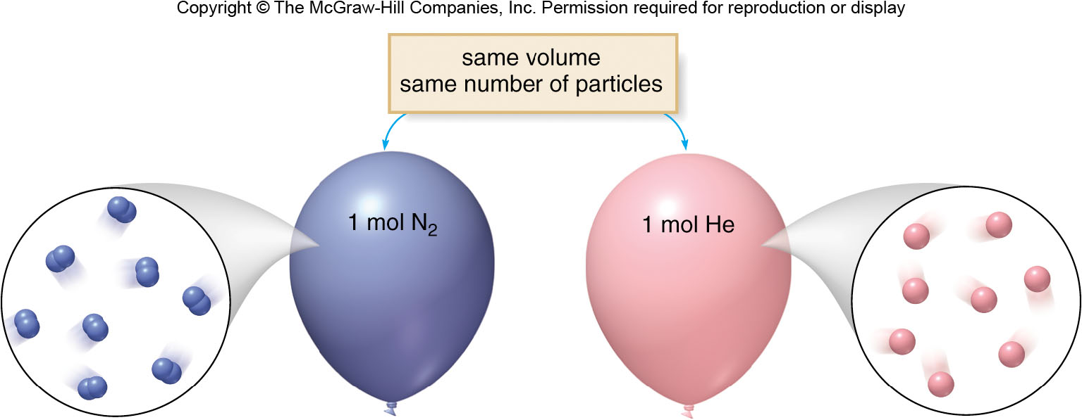
7.4 Avogadro’s Law (4)
1 mol N₂
22.4
1 mol He
22.4 L
28.0 g N₂
4.0 g H₂

Slide 24
7.4 Avogadro’s Law (5)
HOW TO Convert Moles of Gas to Volume at STP
Example
How many moles are contained in 2.0 L of
N₂ at standard temperature and pressure.
Identify the known quantities and the desired
quantity.
Step [1]
2.0 L of N₂
original quantity
? moles of N₂
desired quantity

Slide 25
7.4 Avogadro’s Law (6)
HOW TO Convert Moles of Gas to Volume at STP
Step [2]
Write out the conversion factors.
or
Choose the right side to cancel L
Step [3]
Set up and solve the problem.
Liters cancel

Slide 26
7.5 The Ideal Gas Law (1)
All four properties of gases (That is, P, V, n, and T) can
be combined into a single equation called the ideal
gas law.
PV = nRT
R is the universal gas constant:
For atm:
For mmHg:

Slide 27
7.5 The Ideal Gas Law (2)
HOW TO Carry Out Calculations with the Ideal Gas Law
How many moles of gas are contained in a
typical human breath that takes in 0.50 L
of air at 1.0 atm pressure and
Example
Step [1]
Identify the known quantities and the
desired quantity.
P = 1.0 atm
V = 0.50 L
n = ? mol
known quantities
desired quantity

Slide 28
7.5 The Ideal Gas Law (3)
HOW TO Carry Out Calculations with the Ideal Gas Law
Convert all values to proper units and choose
the value of R that contains these units.
Step [2]
Temperature is given in
, but must be in K:
K = 310 K
The pressure is given in atm, so use the following R value:

Slide 29
7.5 The Ideal Gas Law (4)
HOW TO Carry Out Calculations with the Ideal Gas Law
Step [3]
Write the equation and rearrange it to isolate
the desired quantity on one side.
PV = nRT
Solve for n by dividing both sides by RT.
Step [4]
Solve the problem.

Slide 30
7.6 Dalton’s Law and Partial Pressures (1)
Dalton’s law: The total pressure
of a gas
mixture is the sum of the partial pressures of its
component gases.
For a mixture of three gases A, B, and C:

Slide 31
7.6 Dalton’s Law and Partial Pressures (2)
Sample Problem 7.9
A sample of exhaled air contains four gases with
the following partial pressures: N₂ (563 mm Hg),
O₂ (118 mm Hg), CO₂ (30 mm Hg), and H₂O (50 mm
Hg). What is the total pressure of the sample?
Answer

Slide 32
7.7 Intermolecular Forces, Boiling Point, and Melting Point
Intermolecular forces are the attractive forces that exist between molecules.
In order of increasing strength, these are:
London dispersion forces
Dipole–dipole interactions
Hydrogen bonding
Strength of the intermolecular forces determines
  if compound has a high or low melting point and boiling point
  if it is solid, liquid, or gas at a given temperature.

Slide 33
7.7 Intermolecular Forces (1)
London Dispersion Forces
London dispersion forces are very weak interactions
due to the momentary changes in electron density
in a molecule.
The change in electron density creates a temporary dipole.
The weak interaction between these temporary dipoles constitutes London dispersion forces.
All covalent compounds exhibit London dispersion forces.
The larger the molecule, the larger the attractive force, and the stronger the intermolecular forces.

Slide 34
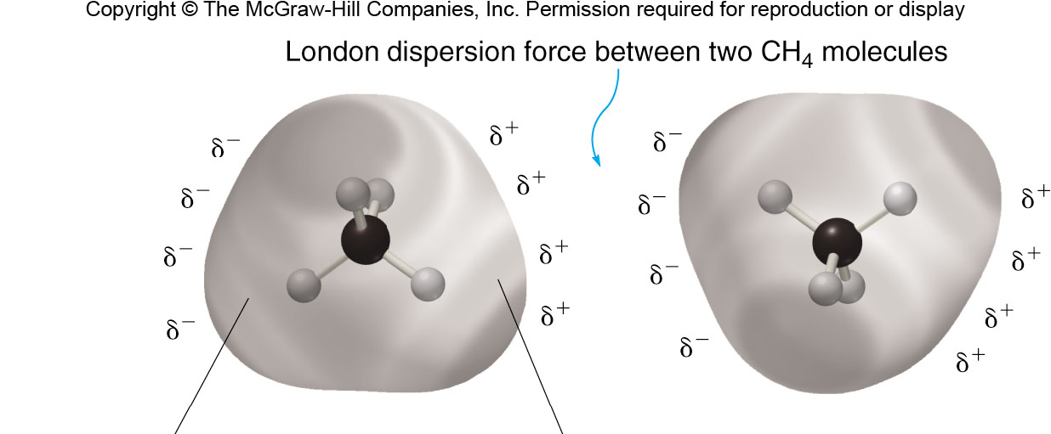
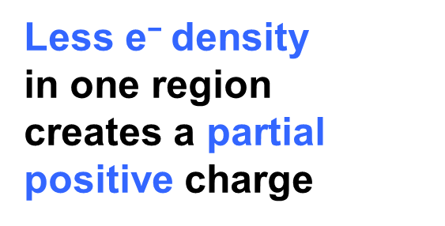
7.7 Intermolecular Forces (2)
London Dispersion Forces
More e⁻ density
in one region
creates a partial
negative charge
Less e⁻ density
in one region
creates a partial
positive charge

Slide 35
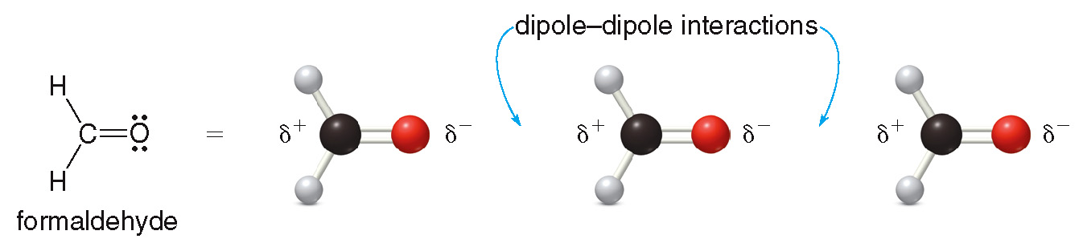
7.7 Intermolecular Forces (3)
Dipole–Dipole Interactions
Dipole–dipole interactions are the attractive forces
between the permanent dipoles of two polar
molecules.

Slide 36
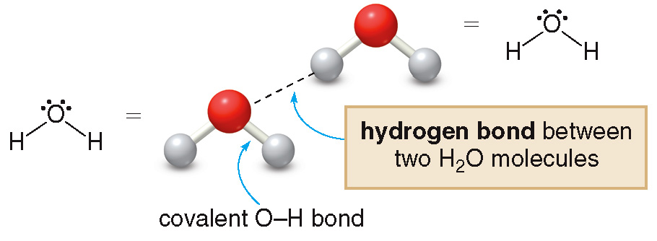
7.7 Intermolecular Forces (4)
Hydrogen Bonding
Hydrogen bonding occurs when a hydrogen atom
bonded to O, N, or F is electrostatically attracted
to an O, N, or F atom in another molecule.
Hydrogen bonds are the strongest of the three types
of intermolecular forces.

Slide 37
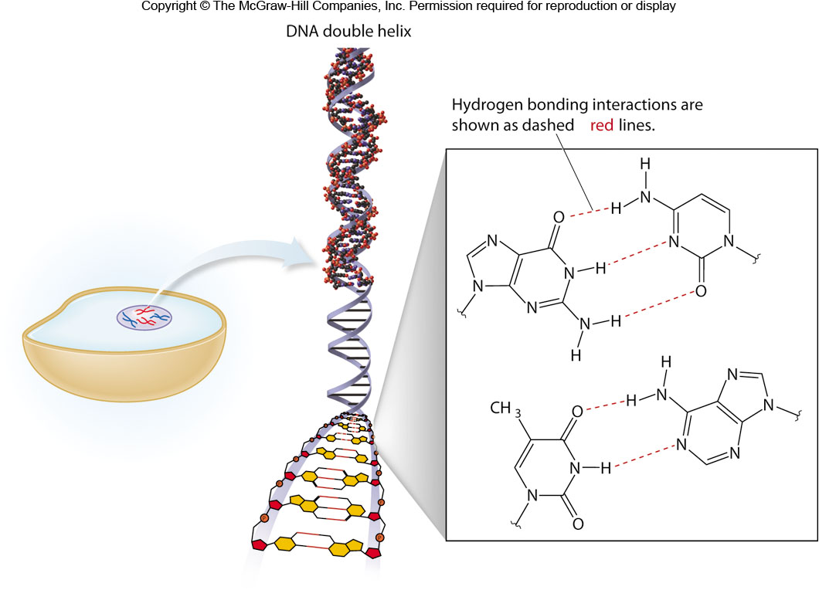
7.7 Intermolecular Forces (5)
Hydrogen Bonding

Slide 38
7.7 Intermolecular Forces
Summary
Table 7.3 Summary of the Types of Intermolecular Forces
Type of Force | Relative Strength | Exhibited by | Example
London dispersion | Weak | All molecules | CH₄, H₂CO, H₂O
Dipole-dipole | Moderate | Molecules with a net dipole | H₂CO, H₂O
Hydrogen bonding | Strong | Molecules with an O-H, N-H, or H-F bond | H₂O

Slide 39
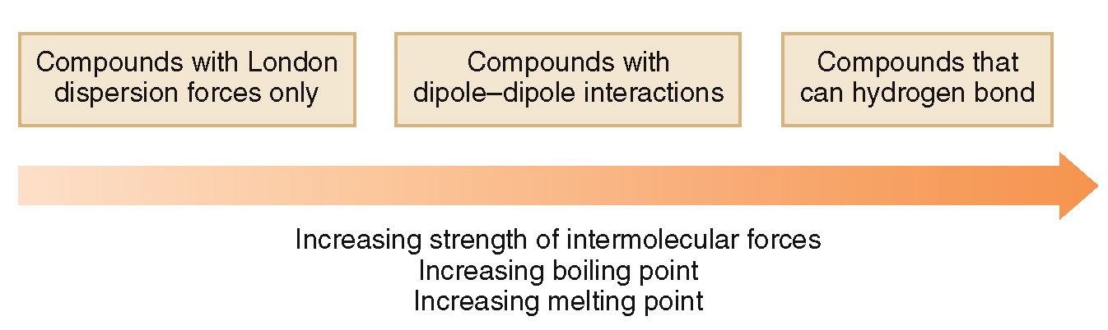
7.7 Intermolecular Forces (6)
Boiling Point and Melting Point
The boiling point is the temperature at which a liquid is converted to the gas phase.
The melting point is the temperature at which a solid is converted to the liquid phase.
The stronger the intermolecular forces, the higher the boiling point and melting point.

Slide 40
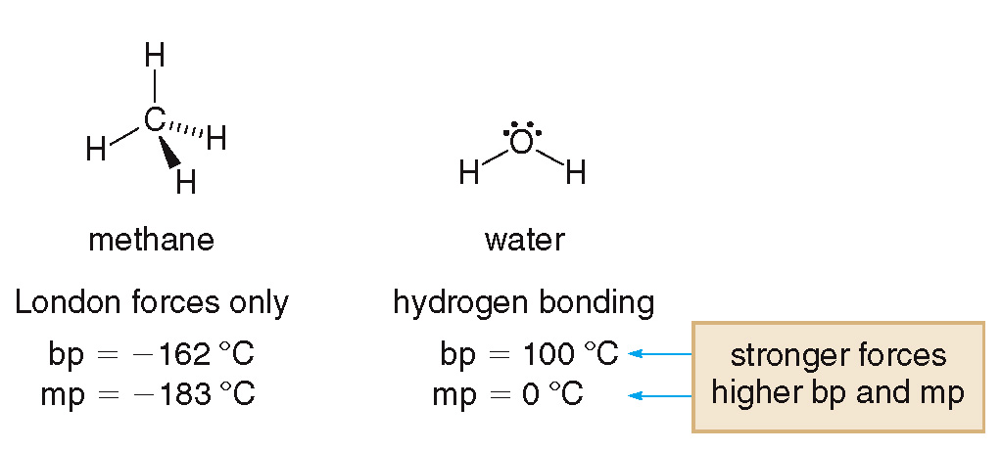
7.7 Intermolecular Forces (7)
Boiling Point and Melting Point

Slide 41
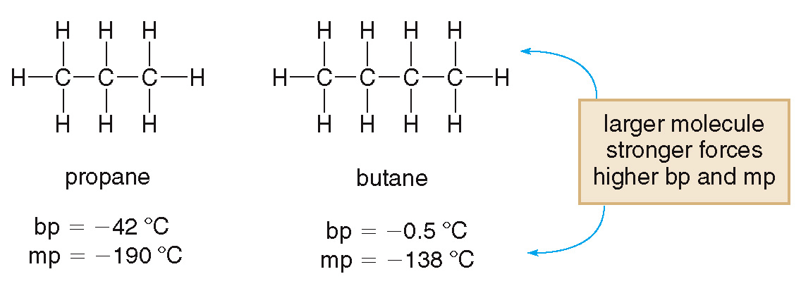
7.7 Intermolecular Forces (8)
Boiling Point and Melting Point

Slide 42
7.8 The Liquid State (1)
Vapor Pressure
Evaporation is the conversion of liquids into the gas phase.
endothermic—it absorbs heat from the surroundings.
Condensation is the conversion of gases into the liquid phase.
exothermic—it gives off heat to the surroundings.

Slide 43
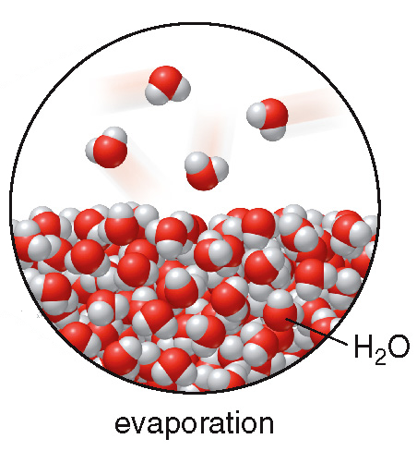
7.8 The Liquid State (2)
Vapor Pressure
Vapor pressure is the pressure exerted by gas molecules in equilibrium with the liquid phase.
Vapor pressure increases with increasing temperature.
The boiling point of a liquid is the temperature at which its vapor pressure = 760 mmHg.

Slide 44
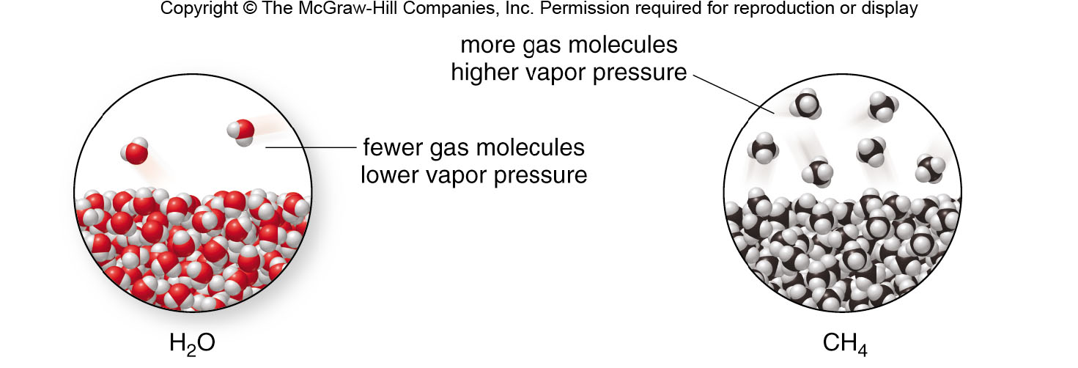
7.8 The Liquid State (3)
Vapor Pressure
The stronger the intermolecular forces, the lower the vapor pressure at a given temperature.
Stronger intermolecular forces keep the H₂O molecules as a liquid.
Weaker intermolecular forces allow more CH₄ molecules to escape to the gas phase.

Slide 45
7.8 The Liquid State (4)
Viscosity and Surface Tension
Viscosity is a measure of a fluid’s resistance to flow freely.
A viscous liquid feels “thick.”
Compounds with strong intermolecular forces tend to be more viscous.
Substances composed of large molecules tend to be more viscous.

Slide 46
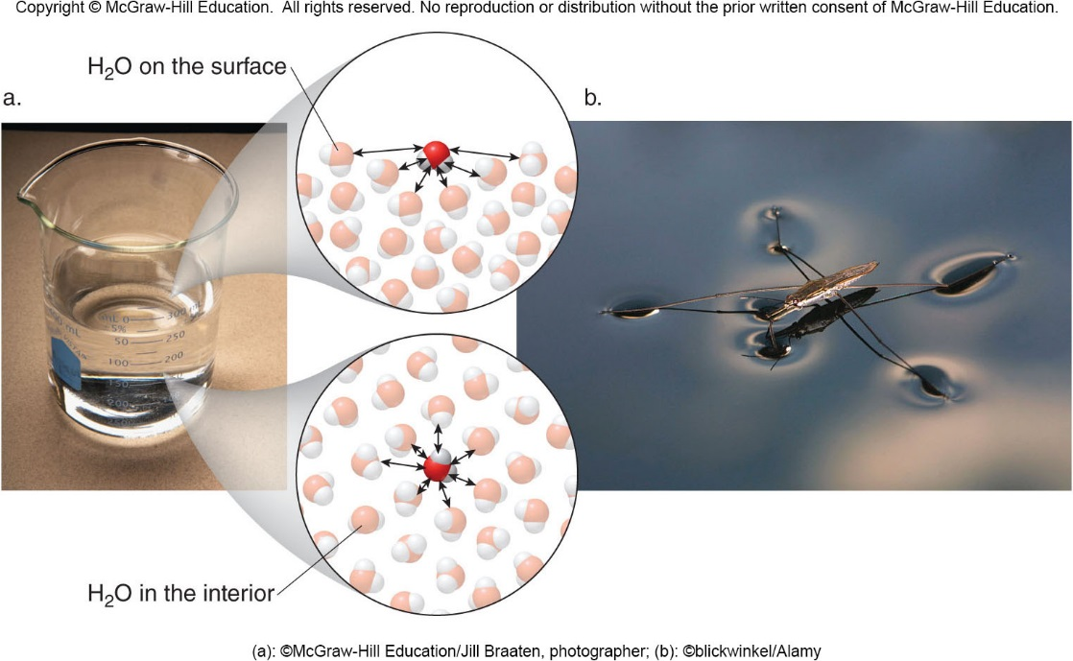
7.8 The Liquid State (5)
Viscosity and Surface Tension
Surface tension is a measure of the resistance of a
liquid to spread out.
(a): ©McGraw-Hill Education/Jill Braaten, photoghrapher; (b): ©blickwinkel/Alamy

Slide 47
7.8 The Liquid State (6)
Viscosity and Surface Tension
The stronger the intermolecular forces, the stronger the surface molecules are pulled down toward the interior of a liquid and the higher the surface tension.
Water has a very high surface tension because of its strong intermolecular hydrogen bonding.
When small objects seem to “float” on the surface of water, they are held up by the surface tension only.

Slide 48
7.9 The Solid State
Solids can be either crystalline or amorphous.
  A crystalline solid has a regular arrangement of particles—atoms, molecules, or ions—with a repeating structure.
  An amorphous solid has no regular arrangement of its closely packed particles.
There are four different types of crystalline solids—ionic, molecular, network, and metallic.

Slide 49
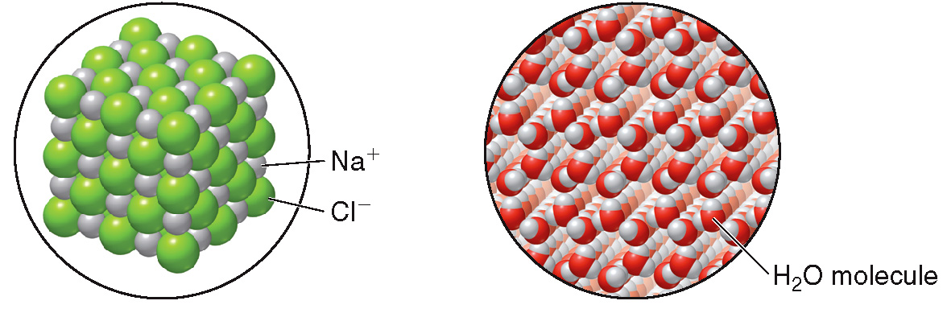
7.9 The Solid State Crystalline Solids (1)
An ionic solid is composed of oppositely charged ions (NaCl).
A molecular solid is composed of individual molecules arranged regularly (H₂O).

Slide 50
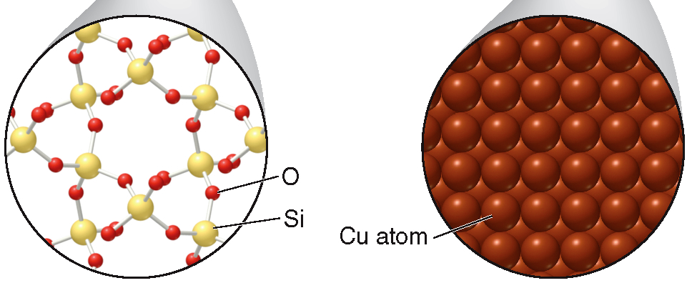
7.9 The Solid State Crystalline Solids (2)
A network solid is composed of a vast number of atoms covalently bonded together (SiO₂ ).
A metallic solid is a lattice of metal cations surrounded by a cloud of e⁻ that move freely (Cu).

Slide 51
7.9 The Solid State Amorphous Solids
Amorphous solids have no regular arrangement of their particles.
They can be formed when liquids cool too quickly for regular crystal formation.
Very large covalent molecules tend to form amorphous solids, because they can become folded and intertwined.
Examples include rubber, glass, and plastic.

Slide 52
7.10 Specific Heat (1)
The specific heat is the amount of heat energy (cal or J) needed to raise the temperature of 1 g of a substance by
The larger the specific heat , the less its temperature will change when it absorbs a particular about of heat energy.

Slide 53
7.10 Specific Heat (2)
Table 7.4 Specific Heats of Some Substances
Substance
Substance
Aluminum
0.214
0.895
2-Propanol
0.612
2.56
Carbon (graphite)
0.169
0.707
Rock
0.200
0.837
Copper
0.0900
0.377
Sand
0.200
0.837
Ethanol
0.583
2.44
Silver
0.0560
0.234
Gold
0.0310
0.130
Water(l)
1.00
4.18
Iron
0.107
0.448
Water(g)
0.481
2.01
Mercury
0.0335
0.140
Water(s)
0.486
2.03

Slide 54
7.10 Specific Heat (3)
HOW TO Calculate the Heat Absorbed, given Specific Heat
Example
How many calories are needed to heat a pot of 1600 g of water from
to
Step 1
Identify the known quantities and the desired quantity.
Mass = 1600 g
? calories
known quantities
desired quantity
The specific heat of water is

Slide 55
7.10 Specific Heat (4)
Step 2
Write the equation.
The specific heat is a conversion factor that relates the heat absorbed to the temperature change (ΔT) and mass.
heat = mass × ΔT × specific heat

Slide 56
7.10 Specific Heat (5)
Step 3
Solve the equation.
Substitute the known quantities into the equation and solve for heat in calories.

Slide 57
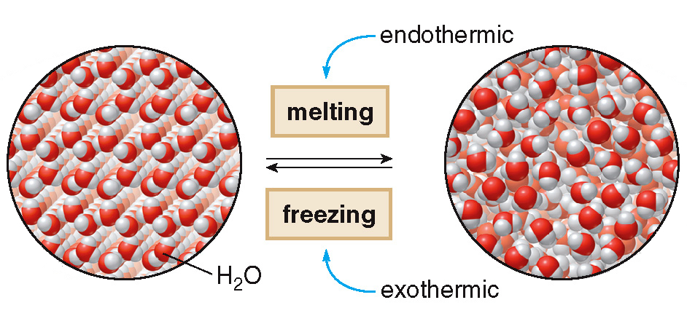
7.11 Energy and Phase Changes (1)
Converting a Solid to a Liquid
solid water
liquid water
The amount of energy needed to melt 1 gram of a
substance is called its heat of fusion.

Slide 58
7.11 Energy and Phase Changes (2)
Converting a Solid to a Liquid
Sample Problem 7.14
How much energy in calories is absorbed when 50.0 g
of ice cubes melt? The heat of fusion of H₂O is
79.7 cal/g.
Identify original quantity and desired quantity:
50.0 g
? calories
original quantity
desired quantity

Slide 59
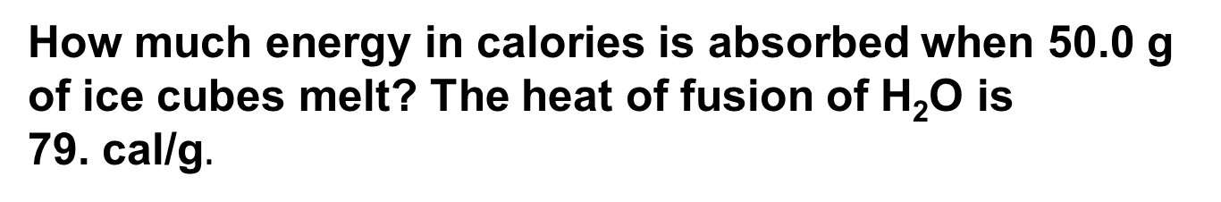
7.11 Energy and Phase Changes (3)
Converting a Solid to a Liquid
Sample Problem 7.14
How much energy in calories is absorbed when 50.0 g
of ice cubes melt? The heat of fusion of H₂O is
79. cal/g$.$
Write out the conversion factors:
The heat of fusion is the conversion factor.
or
Choose the right one to cancel the unwanted unit, mg.

Slide 60
7.11 Energy and Phase Changes (4)
Converting a Solid to a Liquid
Sample Problem 7.14
How much energy in calories is absorbed when 50.0 g
of ice cubes melt? The heat of fusion of H₂O is
79.7 cal/g.
Solve the problem:
=
3990 cal
3 sig. figures
Unwanted unit
cancels

Slide 61
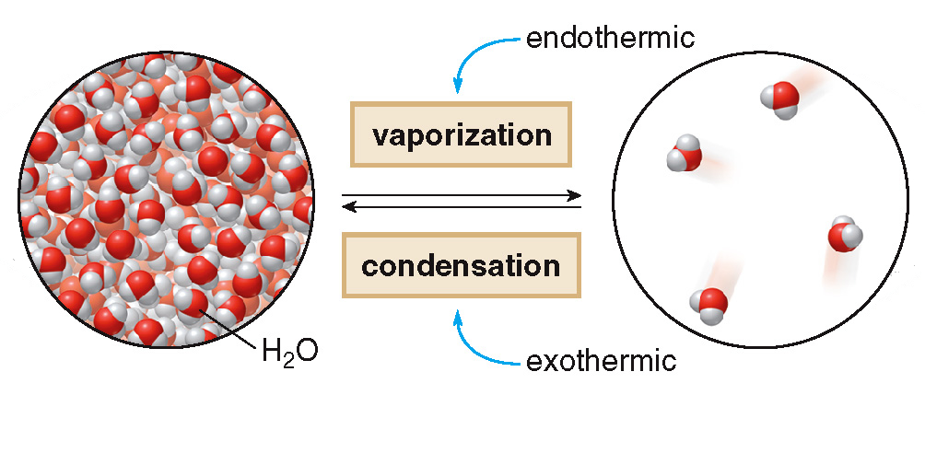
7.11 Energy and Phase Changes (5)
Converting a Liquid to a Gas
liquid water
gaseous water
The amount of energy needed to vaporize 1 gram of
a substance is called its heat of vaporization.

Slide 62
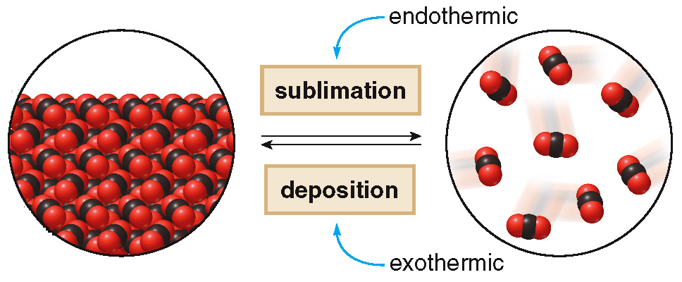
7.11 Energy and Phase Changes (6)
Converting a Solid to a Gas
solid CO₂
gaseous CO₂

Slide 63
7.11 Energy and Phase Changes (7)
Table 7.4 Summary of Energy and Phase Changes
Process | Phases | Energy Change
Melting | Solid → liquid | Endothermic process – Energy is absorbed.
Freezing | Liquid → Solid | Exothermic process – Energy is released.
Vaporization | Liquid → gas | Endothermic process – Energy is absorbed.
Condensation | Gas → liquid | Exothermic process – Energy is released.
Sublimation | Solid → gas | Endothermic process – Energy is absorbed.
Deposition | Gas → solid | Exothermic process – Energy is released.

Slide 64
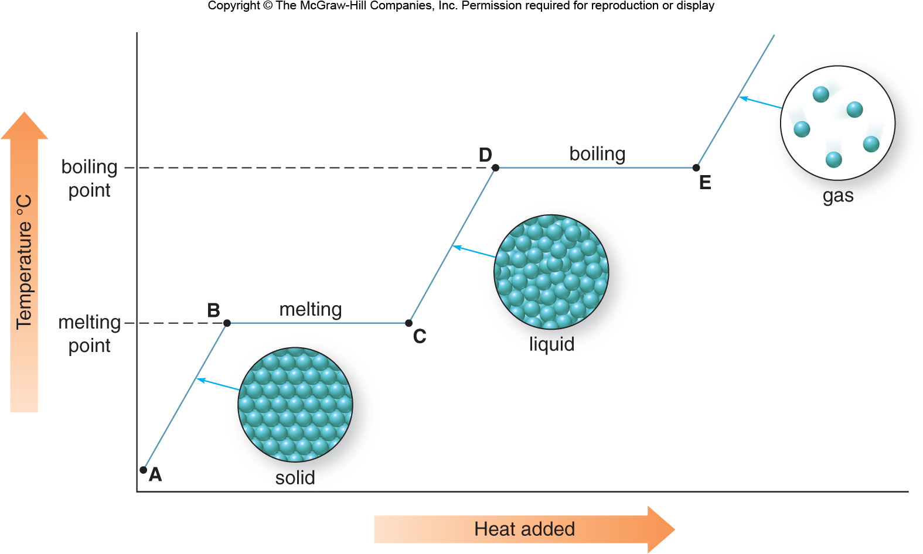
7.12 Heating and Cooling Curves (1)
A heating curve shows how a substance’s temperature
changes as heat is added.

Slide 65
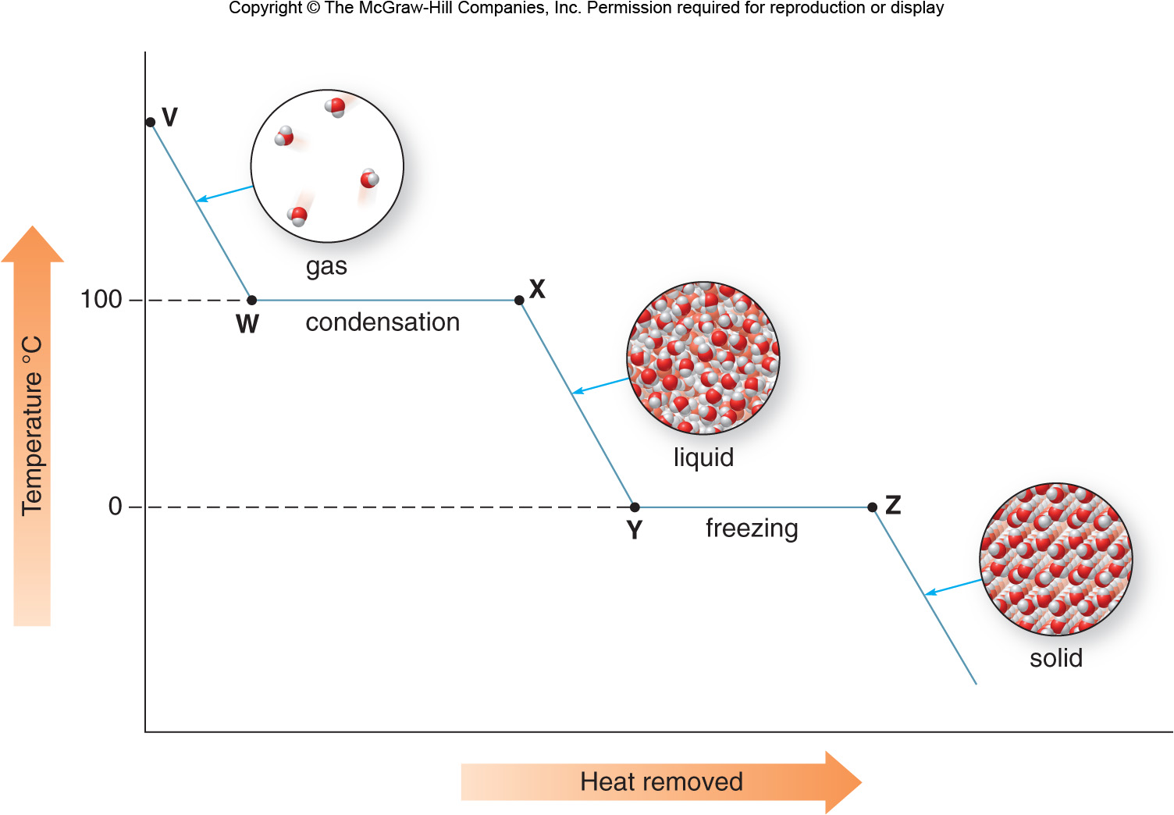
7.12 Heating and Cooling Curves (2)
A cooling curve shows how a substance’s temperature
changes as heat is removed.

