Slide 1

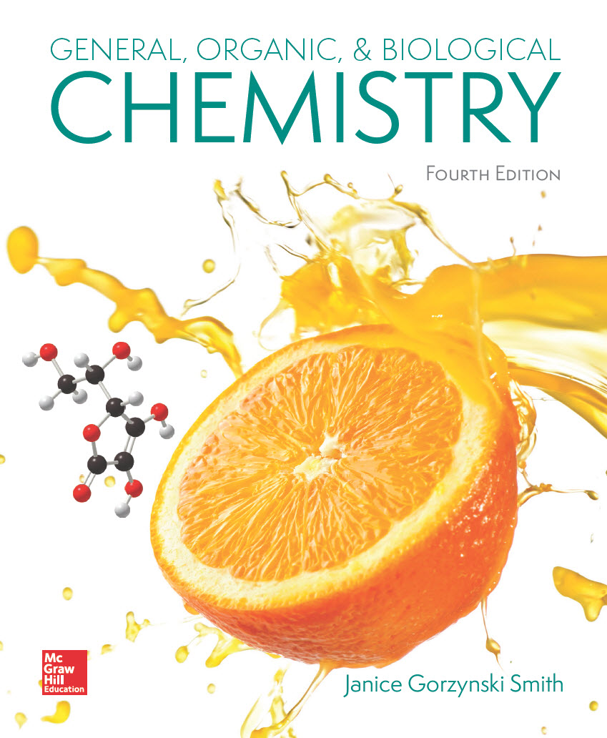
Chapter 8
Lecture Outline
Prepared by
Harpreet Malhotra
Florida State College at Jacksonville

Slide 2
8.1 Mixtures (1)
Pure substances— elements, covalent compounds, and ionic compounds.
Most matter we come into contact with is a mixture
of two or more pure substances.
A heterogeneous mixture does not have a uniform
composition throughout the sample.
A homogeneous mixture has a uniform composition
throughout the sample.

Slide 3
8.1 Mixtures (2)
Solutions
A solution is a homogeneous mixture that contains
small particles. Liquid solutions are transparent.
Solutions consist of two parts:
The solute is the substance present in a lesser
amount.
The solvent is the substance present in a larger
amount.
An aqueous solution has water as the solvent.

Slide 4
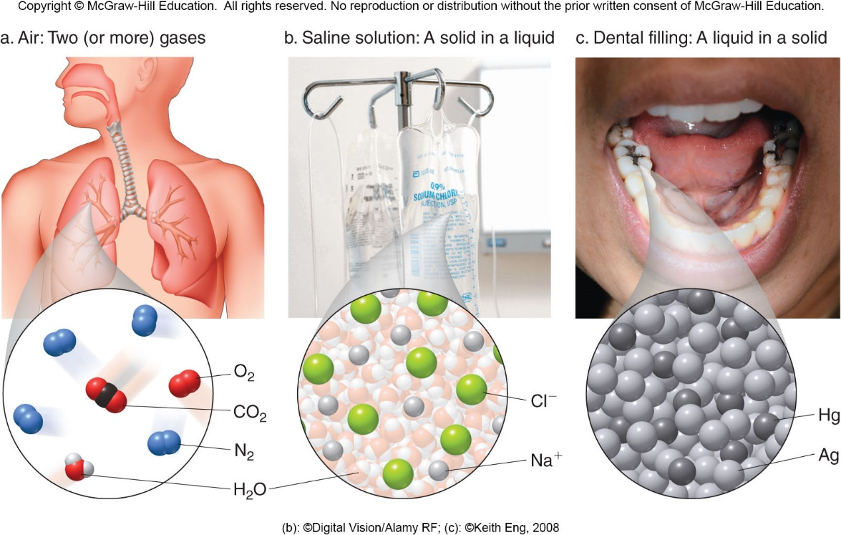
8.1 Mixtures (3)
A. Solutions
(b): ©Digital Vision/Alamy RF; (c): ©Keith Eng,2008

Slide 5
8.1 Mixtures (4)
Colloids and Suspensions
A colloid is a homogeneous mixture with larger
particles, often having an opaque appearance.
  Particles in a colloid cannot be filtered from its other components.
  They do not settle out.
A suspension is a heterogeneous mixture that contains large particles suspended in a liquid.
  Particles are so large that they do not dissolve in a liquid.
  They can be filtered away from the liquid or separated using a centrifuge.

Slide 6
8.1 Mixtures (5)
Colloids and Suspensions
Table 8.1 Solutions, Colloids, and Suspensions
Mixture | Particle Size | Settling | Separation
Solution | Small, < 1 nm | No | The components cannot be separated by filtration.
Colloid | Larger, 1 nm − 1 µm | No | The components cannot be separated by common filtration techniques.
Suspension | Large, > 1 µm | Yes | The components can be separated by filtration or centrifugation.

Slide 7
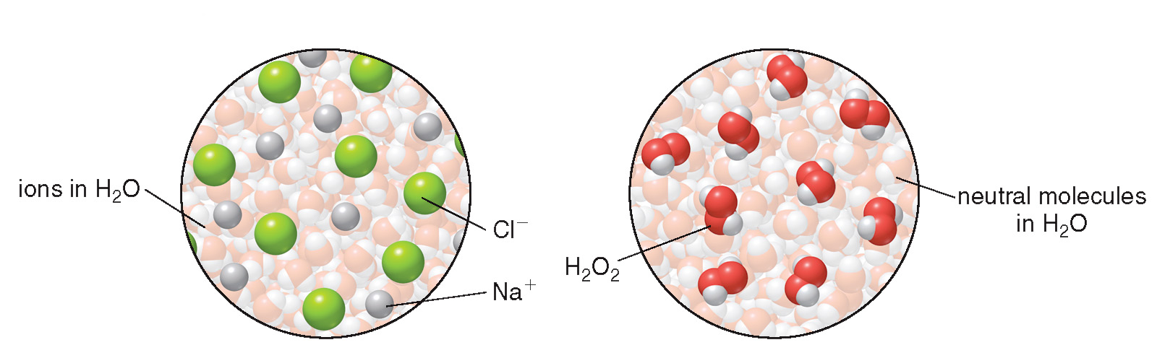
8.2 Electrolytes and Nonelectrolytes (1)
Classification
A substance that does not conduct an electric current in water is called a nonelectrolyte.
A substance that conducts an electric current in water is called an electrolyte.
NaCl(aq) dissociates into
H₂O₂ does not dissociate
and

Slide 8
8.2 Electrolytes and Nonelectrolytes (2)
Classification
A strong electrolyte dissociates completely in water to form ions.
A weak electrolyte dissociates partially in water to form some ions, leaving mostly uncharged molecules.
Table 8.2 Strong Electrolytes, Weak Electrolytes, and Nonelectrolytes
Solute | Species in Solution | Conductivity | Examples
Strong electrolyte | Ions | Conducts an electric current | NaCl, KOH, HCl, KBr
Weak electrolyte | Molecules with a few ions | Conducts an electric current | NH₃, CH₃CO₂H, HF
Nonelectrolyte | Molecules | Does not conduct an electric current | CH₃CH₂OH, H₂O₂

Slide 9
8.2 Electrolytes and Nonelectrolytes (3)
Equivalents
An equivalent (Eq) is the number of moles of charge that a mole of ions contributes to a solution.
  The number of equivalents per mole of an ion equals the charge on the ion.
In solutions that contain ions, there must be a balance between total positive and total negative charge.
Table 8.3 Moles and Equivalents
Ion
Equivalents

Slide 10
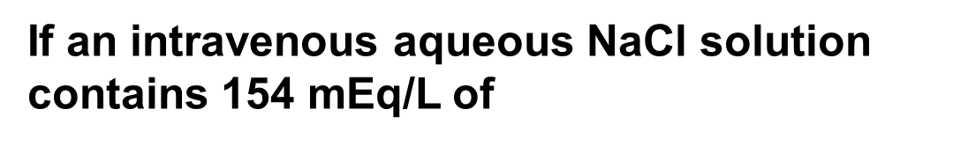
8.2 Electrolytes and Nonelectrolytes (4)
Equivalents
Example
If an intravenous aqueous NaCl solution contains 154 mEq/L of
ions, how many
mEq of
is a patient given in 800. mL of
solution?
Step [1]
Identify the known quantities and the desired quantity.
in solution
? mEq
800. mL of solution
original quantity
desired quantity

Slide 11
8.2 Electrolytes and Nonelectrolytes (5)
Equivalents
Step [2]
Write out the conversion factors.
or
or
Choose the left side ones to cancel L and mL
Step [3]
Solve the problem.
Cancel mL and L

Slide 12
8.3 Solubility—General Features
Solubility is the amount of solute that dissolves in a
given amount of solvent.
It is usually reported in grams of solute per 100 mL of solution (g/100 mL).
A saturated solution contains the maximum number of grams of solute that can dissolve.
An unsaturated solution contains less than the maximum number of grams of solute that can dissolve.

Slide 13
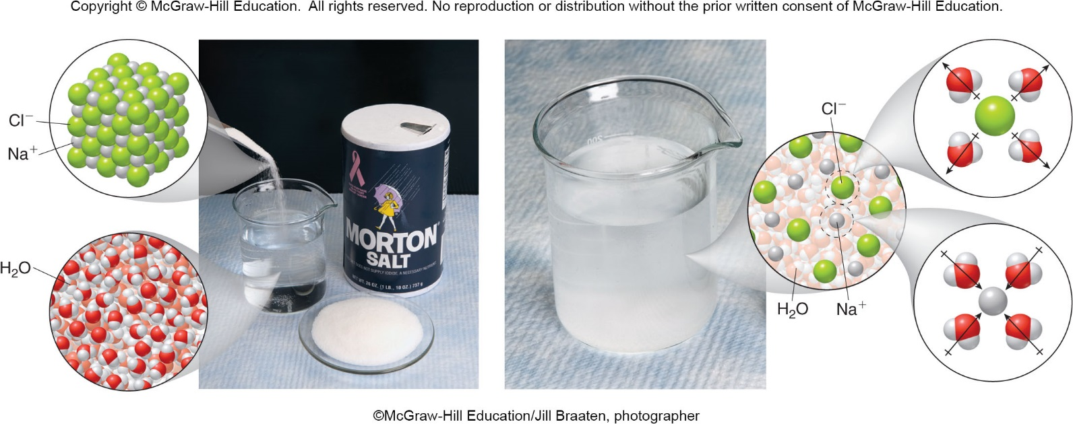
8.3 Solubility (1)
Basic Principles
Solubility can be summed up as “like dissolves like.”
Most ionic and polar covalent compounds are soluble in water, a polar solvent.
©McGraw-Hill Education/Jill Braaten, photographer

Slide 14
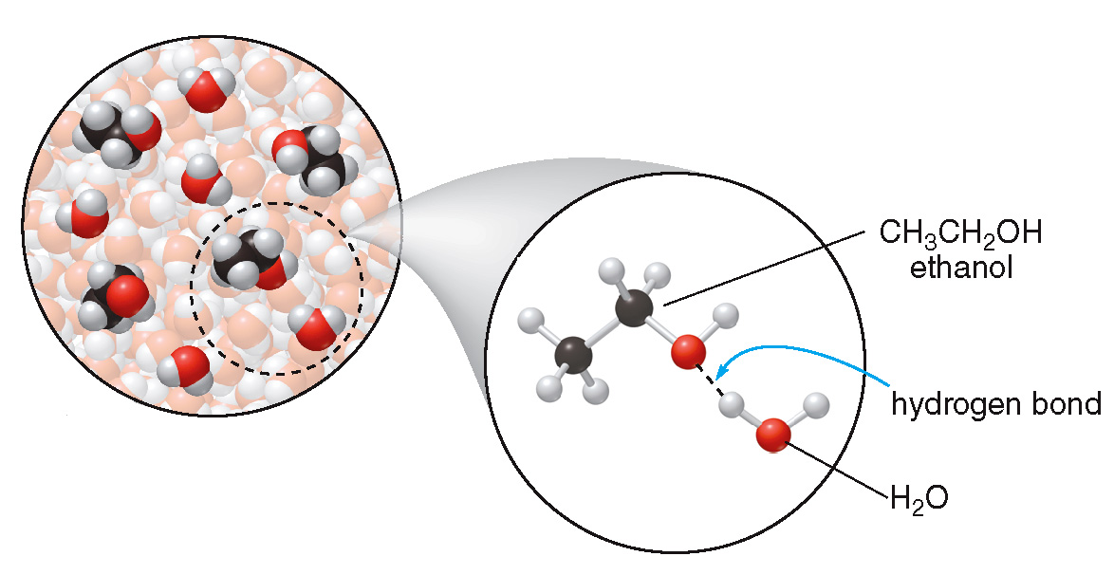
8.3 Solubility (2)
Basic Principles
Small neutral molecules with O or N atoms that can hydrogen bond to water are water soluble.

Slide 15
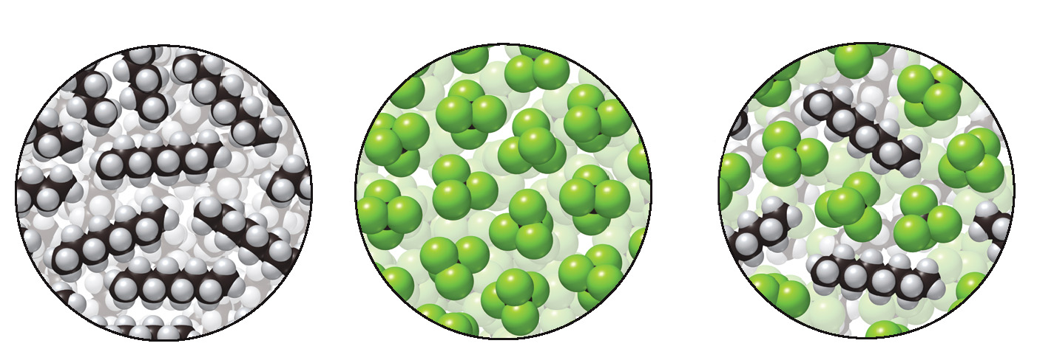
8.3 Solubility (3)
Basic Principles
Nonpolar compounds are soluble in nonpolar solvents (like dissolves like).
Octane (C₈H₁₈) dissolves in CCl₄ because both are nonpolar liquids that exhibit only London dispersion forces.
octane
CCl₄
octane + CCl₄

Slide 16
8.3 Solubility (4)
Basic Principles
When solvation releases more energy than that required to separate particles, the overall process is exothermic (heat is released).
When the separation of particles requires more energy than is released during solvation, the process is endothermic (heat is absorbed).

Slide 17
8.3 Solubility (5)
Ionic Compounds—Additional Principles
General Rules for the Solubility of Ionic Compounds
Rule [1] A compound is soluble if it contains one of the following cations:
Group 1A cations:
Ammonium,
Rule [2] A compound is soluble if it contains one of the following anions:
Halide:
except for salts with
and
Nitrate,
Acetate,
Sulfate,
except for salts with
and

Slide 18
8.4 Solubility-- Effects of T and P (1)
Temperature (T) Effects
For most ionic and molecular solids, solubility
generally increases as temperature increases.
By dissolving a solid in a solvent at high temperature and allowing it to cool slowly, a supersaturated solution can be made.
A supersaturated solution contains more than the predicted maximum amount of solute at a given temperature.
The solubility of a gas decreases with increasing temperature.

Slide 19
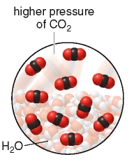
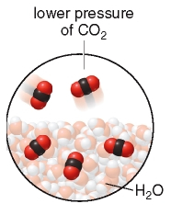
8.4 Solubility—Effects of T and P (2)
B. Pressure (P) Effects
Henry’s law: The solubility of a gas in a liquid is
proportional to the partial pressure of the gas above
the liquid.
The higher the pressure, the higher the solubility of a gas in a solvent.
closed can of soda
higher CO₂ pressure
higher CO₂ solubility
open can of soda
lower CO₂ pressure
lower CO₂ solubility

Slide 20
8.5 Concentration Units (1)
Weight/Volume Percent
The concentration of a solution tells how much
solute is dissolved in a given amount of solution.
Weight/volume percent concentration, (w/v)%, is
the number of grams of solute dissolved in 100 mL
of solution.
Weight/volume
percent concentration

Slide 21
8.5 Concentration Units (2)
Weight/Volume Percent
For example, vinegar contains 5 g of acetic acid in
100 mL of solution, so the (w/v)% concentration is:

Slide 22
8.5 Concentration Units (3)
Volume/Volume Percent
Volume/volume
Percent concentration
For example, if a bottle of rubbing alcohol contains
70 mL of 2-propanol in 100 mL of solution, then the
(v/v)% concentration is

Slide 23
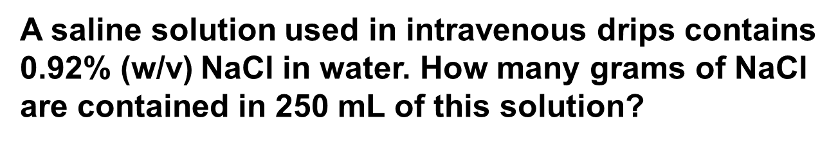
8.5 Concentration Units (4)
C. Using a Percent Concentration as a Conversion Factor
Sample Problem 8.5
A saline solution used in intravenous drips contains
0.92% (w/v) NaCl in water. How many grams of NaCl
are contained in 250 mL of this solution?
Step [1]
Identify the known quantities and the
desired quantity.
0.92% (w/v) NaCl solution
250 mL
? g NaCl
known quantities
desired quantity

Slide 24
8.5 Concentration Units (5)
Using a Percent Concentration as a Conversion Factor
Step [2]
Write out the conversion factors.
or
Choose the right side one to cancel mL
Step [3]
Solve the problem.
= 2.3 g NaCl
2 sig. fig. Answer
Milliliters cancel

Slide 25
8.5 Concentration Units (6)
Parts Per Million
When a solution contains a very small concentration
of solute, it is often expressed in parts per million.
Parts per million
or

Slide 26
8.6 Concentration Units—Molarity (1)
Molarity is the number of moles of solute per liter of
solution, abbreviated as M.

Slide 27
8.6 Concentration Units—Molarity (2)
HOW TO Calculate Molarity from a Given Number of
Grams of Solute
Example
Calculate the molarity of a solution made
from 20.0 g of NaOH in 250 mL of solution.
Step [1]
Identify the known quantities and the desired
quantity.
20.0 g NaOH
250 mL solution
? M (mol/L)
known quantities
desired quantity

Slide 28
8.6 Concentration Units—Molarity (3)
HOW TO Calculate Molarity from a Given Number of
Grams of Solute
Step [2]
Convert the number of grams of solute to
the number of moles. Convert the volume
to liters if necessary.
Use the molar mass to convert grams of NaOH to moles of NaOH (molar mass 40.0 g/mol).
Grams cancel

Slide 29
8.6 Concentration Units—Molarity (4)
HOW TO Calculate Molarity from a Given Number of
Grams of Solute
Convert milliliters of solution to liters of solution using a mL–L conversion factor.
Milliliters cancel

Slide 30
8.6 Concentration Units—Molarity (5)
HOW TO Calculate Molarity from a Given Number of
Grams of Solute
Step [3]
Divide the number of moles of solute by the
number of liters of solution to obtain the
molarity.
2 sig. fig. Answer

Slide 31
8.6 Concentration Units—Molarity (6)
Molarity is a conversion factor that relates the number of moles of solute to the volume of solution it occupies.
To calculate the moles of solute, rearrange the equation for molarity:
moles of solute (mol) = M × V (L)
To calculate the volume of the solution, rearrange the equation for molarity:

Slide 32
8.6 Concentration Units—Molarity (7)
Sample Problem 8.9
What volume in milliliters of a 0.30 M solution of
glucose contains 0.025 mol of glucose?
Step [1]
Identify the known quantities and the desired quantity.
0.30 M
0.025 mol glucose
? V(L)
known quantities
desired quantity

Slide 33
8.6 Concentration Units—Molarity (8)
Step [2]
Divide the number of moles by molarity to obtain the volume in liters.

Slide 34
8.6 Concentration Units—Molarity (9)
Step [3]
Use a mL–L conversion factor to convert liters to milliliters.
= 83 mL solution
2 sig. fig.
Answer
Liters cancel

Slide 35
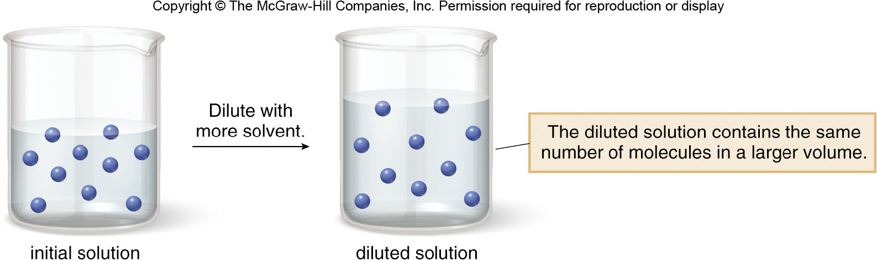
8.7 Dilution (1)
Dilution is the addition of solvent to decrease the
concentration of solute. The solution volume changes, but the amount of solute is constant.
=
initial values
final values

Slide 36
8.7 Dilution (2)
Sample Problem 8.11
What is the concentration of a solution formed by
diluting 5.0 mL of a 3.2 M glucose solution to
40,0 mL?
Step [1]
Identify the known quantities and the desired quantity.
known quantities
desired quantity

Slide 37
8.7 Dilution (3)
Step [2]
Write the equation and isolate
on one side.
Solve for
by dividing both sides by

Slide 38
8.7 Dilution (4)
Step [3]
Solve the Problem.
Substitute the three known quantities into the equation and solve for
= 0.40 M
2 sig. fig. Answer
mL unit
cancels

Slide 39
8.8 Colligative Properties (1)
Colligative properties are properties of a solution that depend on the concentration of the solute but not its identity.
The number of dissolved solute particles affects the properties of the solution, but the identity of the solute does not.
Colligative properties include the elevation of the boiling point, the lowering of the melting point, and the pressure due to osmosis.

Slide 40
8.8 Colligative Properties (2)
Boiling Point Elevation
A volatile solute readily escapes into the vapor phase.
A nonvolatile solute does not readily escape, so it
has a negligible vapor pressure at a given temperature.
The vapor pressure above a solution of a nonvolatile
solute is lower than the vapor pressure of the
pure solvent.

Slide 41
8.8 Colligative Properties (3)
Boiling Point Elevation
Boiling point elevation: A liquid solution that contains a nonvolatile solute has a higher boiling point than the solvent alone.
The amount that the boiling point increases depends only on the number of dissolved particles.
One mole of any nonvolatile solute raises the boiling point of 1 kg of H₂O the same amount,

Slide 42
8.8 Colligative Properties (4)
Freezing Point Depression
Freezing point depression: A liquid solution that contains a nonvolatile solute has a lower freezing point than the solvent alone.
The amount of freezing point depression depends only on the number of dissolved particles.
One mole of any nonvolatile solute lowers the freezing point of 1 kg of H₂O by the same amount,

Slide 43
8.9 Osmosis and Dialysis (1)
The membrane that surrounds living cells is a semipermeable membrane.
Semipermeable membranes allow water and small molecules to pass across, but ions and large molecules cannot.
Osmosis is the passage of a solvent, usually water, across a semipermeable membrane from a solution of low solute concentration to a solution of higher solute concentration.

Slide 44
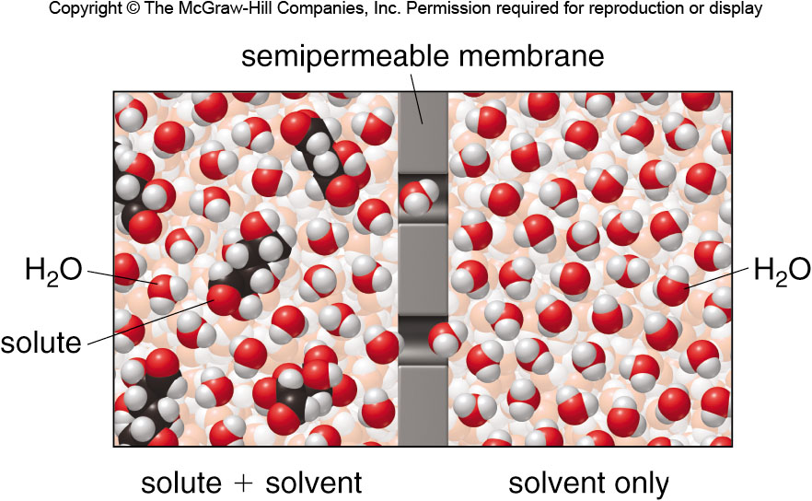
8.9 Osmosis and Dialysis (2)
Osmotic Pressure
Osmotic pressure is the pressure that prevents the flow of additional solvent into a solution on one side of a semipermeable membrane.

Slide 45
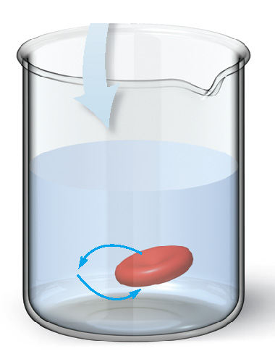
8.9 Osmosis and Dialysis (3)
Focus on the Human Body—Osmosis
Two solutions with the same osmotic pressure are
said to be isotonic.
Solutions isotonic to the body:
0.92% (w/v) NaCl solution
5.0% (w/v) glucose solution
isotonic
solution

Slide 46
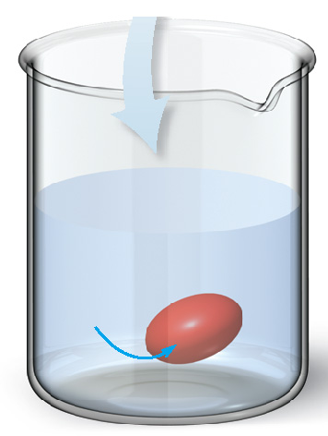
8.9 Osmosis and Dialysis (4)
Focus on the Human Body—Osmosis
A hypotonic solution has a lower osmotic pressure
than body fluids.
The concentration of particles outside the cell is lower than the concentration of particles inside the cell.
Water diffuses into the cell, so the cell swells and
eventually bursts.
For red blood cells, this swelling and rupture is called hemolysis.
Hypotonic solution

Slide 47
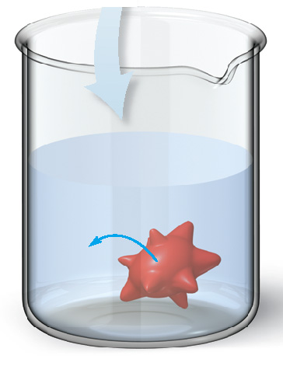
8.9 Osmosis and Dialysis (5)
Focus on the Human Body—Osmosis
A hypertonic solution has a higher osmotic pressure
than body fluids.
The concentration of particles outside the cell is higher than the concentration of particles inside the cell.
Water diffuses out of cell, so the cell shrinks.
This process is called crenation.
Hypertonic solution

Slide 48
8.9 Colligative Properties (1)
Focus on Health & Medicine: Dialysis
In the human body, blood is filtered through the kidneys by the process of dialysis.
In dialysis, water, small molecules, and ions can pass through the semipermeable (dialyzing) membrane; only large biological molecules like proteins and starch molecules cannot.
This allows waste products like urea to be removed from the bloodstream and eliminated in the urine.

Slide 49
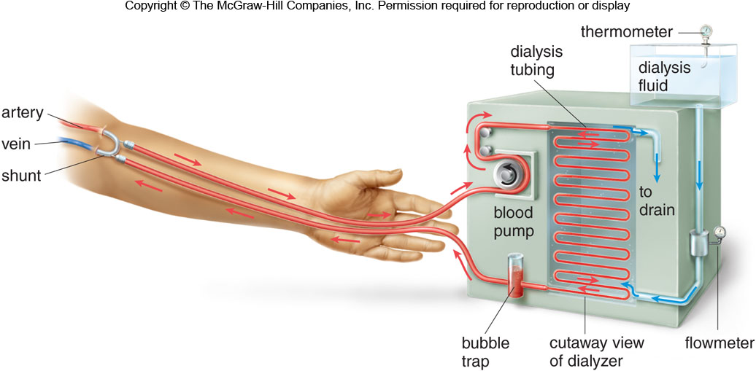
8.9 Colligative Properties (2)
Focus on Health & Medicine: Dialysis
When a person’s kidneys are incapable of removing waste products from the blood, hemodialysis is used.

